Slide 1
The Tragedy of Man and the Triumph of GOD
GOD’s story as seen in the life and death of Samson

Slide 2
Separated unto YAHWEH
The birth and calling of Samson

Slide 3
Separated unto Yahweh - Overview
Why were these stories of Samson Recorded?
What is the significance of the Philistines?
Consideration of The Woman
Consideration of The Nazarite

Slide 4
Why is Samson’s Story Recorded?

Slide 5
HISTORY
The Bible was not written to recount
But to declare the wonder and the majesty of
HIS STORY

Slide 6
The Philistines
H6429, From H6428 – Rolling, i.e., Migratory
Notes:
Judges 3:1-4

Slide 7
The Philistines
H6428 – To wallow in the dust
Notes:
Serpent – lives in the dust, feeds on the dust
Mention The transition form external temptation source to internal and external Gen 3:14, 19
The serpent would slither through the dust of man’s flesh

Slide 8
The Philistines
The ‘Uncircumcised’
Notes:
Samson’s parents, Jonathan, David, Saul (end of life)

Slide 9
SIN in the FLESH
God could have chosen any adversary to afflict Israel but he specifically choses the Philistines
Because this is HIS STORY

Slide 10
The Woman
3 And the angel of the LORD appeared unto the woman, and said unto her…
Notes:
V 2 – 3 Manoah named, woman not named, wet woman

Slide 11
THE Woman
2 …and his wife was barren, and bare not.
3 And the angel of the Lord appeared unto the woman, and said unto her, …
6 Then the woman came and told her husband, saying…
9 …and the angel of God came again unto the woman as she sat in the field: but Manoah her husband was not with her
10 And the woman made haste, and ran, and shewed her husband…
11 And Manoah arose, and went after his wife, and came to the man, and said unto him, Art thou the man that spakest unto the woman? And he said, I am.
13 And the angel of the Lord said unto Manoah, Of all that I said unto the woman let her beware.
21 But the angel of the Lord did no more appear to Manoah and to his wife. …
22 And Manoah said unto his wife, …
23 But his wife said unto him…
24 And the woman bare a son, and called his name Samson: and the child grew, and the Lord blessed him.
Notes:
Appears 14 times in chapter 13!

Slide 12
And I will put enmity between thee and the woman, and between thy seed and her seed; He shall bruise thy head, and thou shalt bruise His heel.
Genesis 3:15
Notes:
Very much a type of THE WOMAN
The stories of samson hinge around 4 women – Mother, Woman Of Timnath, Harlot of Gaza, Delilah
Man and woman story line – the story from the beginning

Slide 13
For, lo, thou shalt conceive, and bear a son; and no razor shall come on his head: for the child shall be a Nazarite unto God from the womb: and he shall begin to deliver Israel out of the hand of the Philistines
Judges 13:5

Slide 14
For, lo, thou shalt conceive, and bear a son; and no razor shall come on his head: for the child shall be a Nazarite unto God from the womb: and he shall begin to deliver Israel out of the hand of the Philistines
Judges 13:5
Notes:
You will have a son (you will be a mother)

Slide 15
For, lo, thou shalt conceive, and bear a son; and no razor shall come on his head: for the child shall be a Nazarite unto God from the womb: and he shall begin to deliver Israel out of the hand of the Philistines
Judges 13:5
Notes:
God’s son

Slide 16
For, lo, thou shalt conceive, and bear a son; and no razor shall come on his head: for the child shall be a Nazarite unto God from the womb: and he shall begin to deliver Israel out of the hand of the Philistines
Judges 13:5
Notes:
He will be a deliverer

Slide 17
The SON of GOD
Live into the meaning of
Notes:
Tension in samson between the first son and the second – called to be Christ, but fall so far short
Illustration of the wonder of Christ – his perfection, his completion
Many barren women bore special sons: Sarah, Rebekah, Rachel, Hannah, Elizabeth
But only Mary and Manoah’s wife have the angel

Slide 18
NAZARITE
Correctly understanding Samson as a

Slide 19
NAZARITE
H5139 naziyr – Separate, i.e. Consecrated, an unpruned vine
Notes:
Genesis 49:26

Slide 20
NAZARITE Numbers 6
SAMSON
Voluntarily Made a Vow
Relationship was Temporary
Abstain From The Vine
Couldn’t Touch the Dead
Couldn’t Cut Hair

Slide 21
PRINCIPLES
RULES

Slide 22
Separated Unto YAHWEH
Nazarite Vow
High Priest

Slide 23
JESUS
John The Baptist
Apostle Paul
Samuel
Samson
Joseph
Voluntary Israelites
AARON
Notes:
Galatians 1:15,16 But when it pleased God, who separated me from my mother's womb, and called me by his grace, To reveal his Son in me, that I might preach him among the heathen
Ultimately, God wants us all to become separated unto him – not just follow a list of precepts, but to be all-in
V 24, 25

Slide 24
…began to move him at times…
Judges 13:25
At times – “to and fro”
Zorah – “Hornets, to sting”, Eshtaeol – “entreaty”

Slide 25
Key Takeaways
God is the author – his Word tells HIS STORY
Samson is a type of all humanity – God wants all of us, all the time
The spirit did not always move him – he was more like Adam than Christ

Slide 27
The Battle for the Vineyard
The great contention for the heritage of Yahweh

Slide 28
The Battle for the Vineyard - Overview
The Philistine
The Vineyard
The Lion
The Battle
The Bees
The Honey

Slide 29
..and saw a woman
of the daughters of the Philistines Judges 14:1
Notes:
V 1-4

Slide 30
..and saw a woman
Eve, Judah, David, female beauty, and the lesson of Judges 14
Notes:
Taking what is forbidden
Pleasing to the eye – Forbidden Fruit
Men sin because their relationship with beauty is broken – seeing objects/images
We are natural idolators, we worship the form and not the substance/essence

Slide 31
my people
Deuteronomy 7:3, Joshua 23:12,13
Cp. v18
Notes:
Verse 3
Of the Lord doesn’t mean that God fundamentally approved of such a union, but rather, was using this sequence of temptation to create animas in Samson’s heart towards the Philistines.

Slide 32
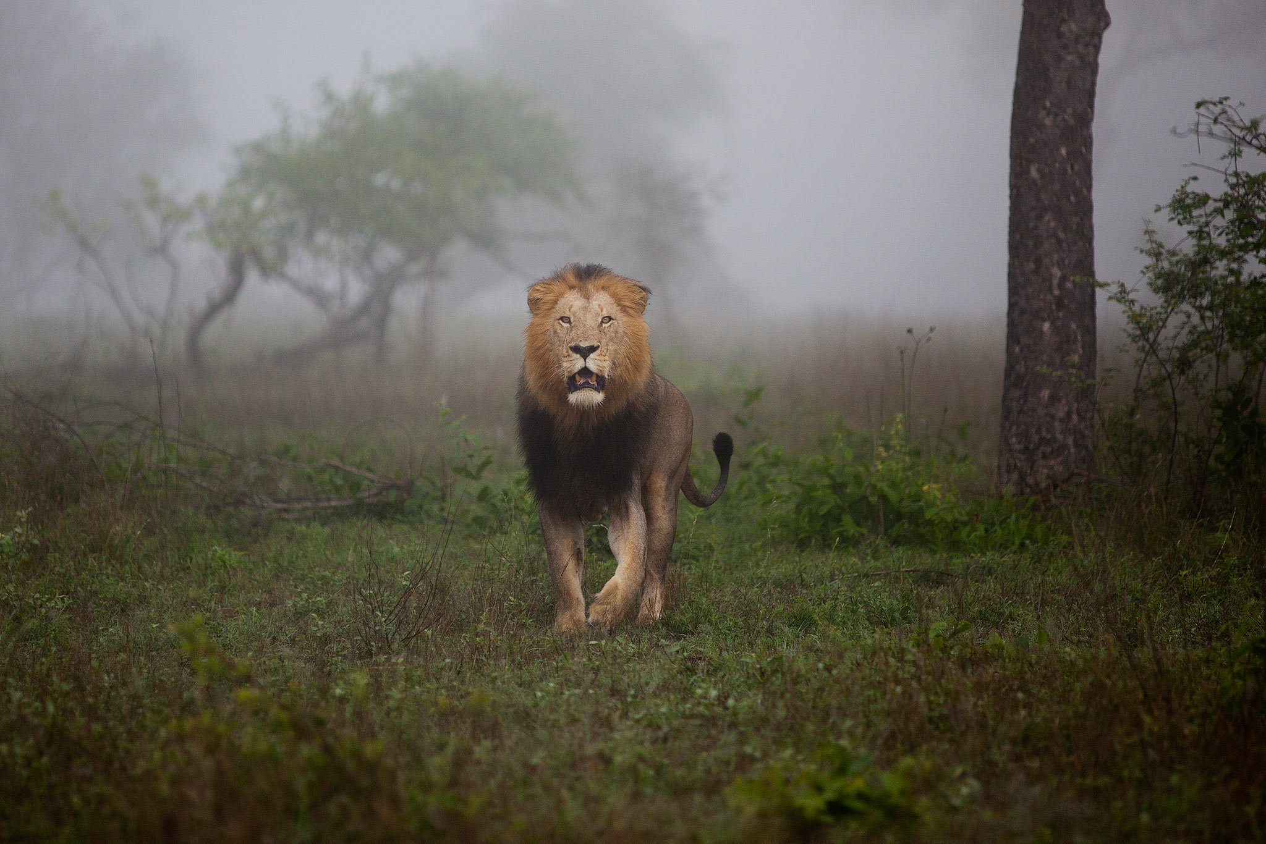
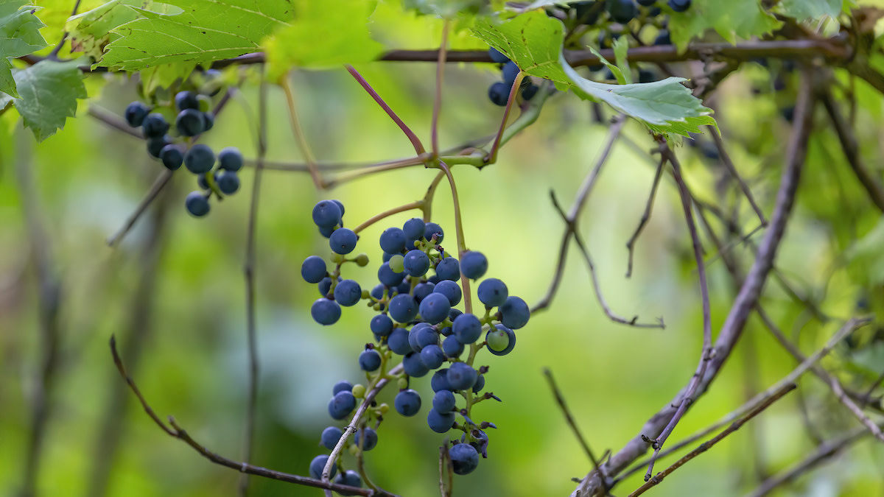
Notes:
V5 & 6
Micro and Macro application (amongst others)
Symbols who’s meaning can be found in the thing itself –or in prior scripture
Not just variable stand in’s - the things themselves contain spiritual lessons/meaning

Slide 34
The Vineyard
Promised land
Nazarite
Notes:
We’ll prove Nazarite in a second
Time requirement to grow vines – inheritance, generational (Naboth)
Micro/Macro

Slide 35
The Promised Land
And they came unto the brook of Eshcol, and cut down from thence a branch with one cluster of grapes, and they bare it between two upon a staff; and they brought of the pomegranates, and of the figs. Numbers 13:23
Notes:
Timnath means “The assigned portion”. it’s literally the inheritance of Dan.

Slide 36
The Wild Vine
That which groweth of its own accord of thy harvest thou shalt not reap, neither gather the grapes of thy vine undressed: for it is a year of rest unto the land. Leviticus 25:5
Notes:
Set apart in the seventh year to grow freely, no longer needing pruning
Maximally fruitful

Slide 37
The Wild Vine
Vine Undressed – Naw-zeer’ H5139:Separate, i.e. consecrated (as prince, a Nazirite); hence (figuratively from the latter) an unpruned vine (like an unshorn Nazirite)

Slide 38
The Wild Hair
…he shall be holy, and shall let the locks of the hair of his head grow Numbers 6:5

Slide 39
The Wild Hair
Hair – H8181: From H8175 in the sense of disheveling. Tossed or bristling hair

Slide 40
The Wild Hair
H8175: To be tempestuous

Slide 41
Undressed Vine – Unshorn Hair
Spiritual Thoughts
The Outgrowth of a Spiritual Mind

Slide 42
The Vineyard
Promised land
Nazarite
YAHWEH’s Heritage
YAHWEH’s Heritage
Notes:
Micro/Macro

Slide 43
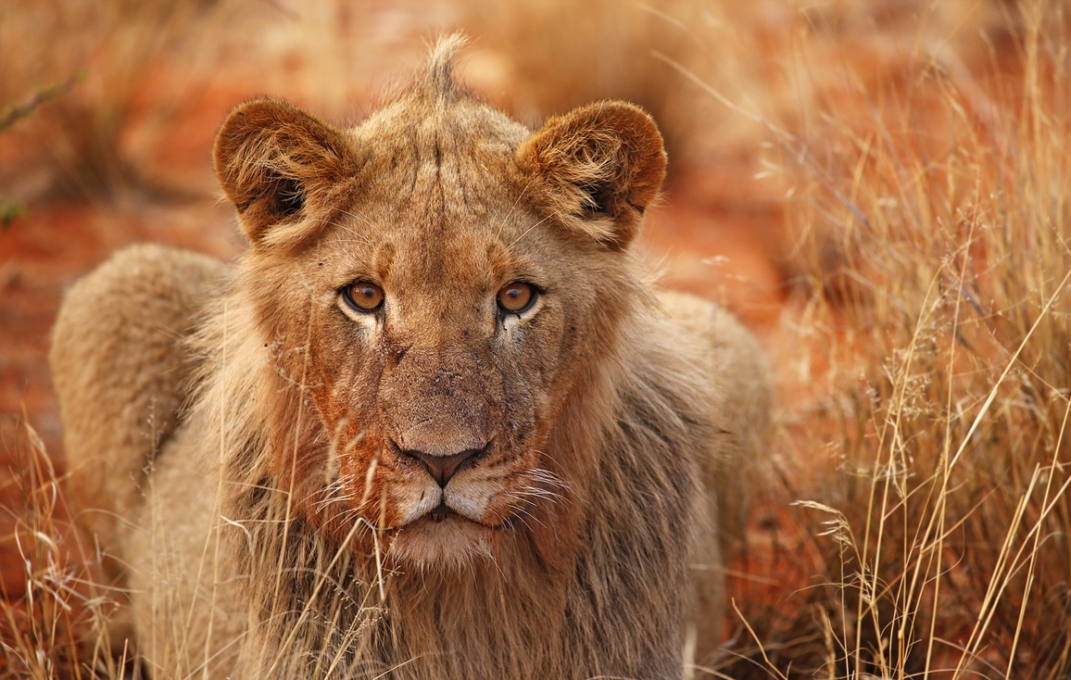

Slide 44
Notes:
Young: Means a village (as covered by walls), or a young lion (as covered by a mane)
Only translated Village one time (Nehemiah) – rest is lion
Lion: Ari – means young lion, comes from a root meaning to pluck or gather – Ari is the Violent sense of the word
Roared against him (it’s an adversary) – cp Philistines attacking in Lehi, Samson Shaking himself

Slide 45
The Young Lion
Territory
Mate
The vineyard
The woman
Notes:
Similarities between Samson and the young lion
Isa 5:29 Their roaring shall be like a lion, they shall roar like young lions: yea, they shall roar, and lay hold of the prey, and shall carry it away safe, and none shall deliver it.

Slide 46
The Young Lion
Be sober, be vigilant; because your adversary the devil, as a roaring lion, walketh about, seeking whom he may devour 1 Peter 5:8
Notes:
False accuser, liar

Slide 47
The Young Lion
The Adversary
SIN IN THE FLESH
Notes:
Bore the mark of the covenant of circumcision in his flesh – but the lesson had to be learned.

Slide 48
Adversary in the Heritage of YAHWEH
Philistines in the land of Promise
Temptation in the mind of the Nazarite
Notes:
The world
Ourself

Slide 50
Notes:
Samson is able to physically destroy the Philistines – but destroying the philistine within will plague him to the bitter end

Slide 51
That through them I may prove Israel, whether they will keep the way of the Lord to walk therein, as their fathers did keep it, or not
Judges 2:22
Notes:
CP Genesis 3 – God left the serpent in man, to see if he would keep his way
God Wants us to WANT to serve him!
Is there the same fight in our mind?

Slide 52
Battle for the Vineyard
Notes:
New experience for Samson

Slide 53
…and he rent him as he would have rent a kid…
Judges 14:6
Notes:
The physiological experience
As “HE” – could refer to the damage a lion would have done to a kid as well
Rotherham – “Tore it in pieces”…“torn in pieces a kid”
Sin offering: head, skin, legs, inwards
Flesh overcome by the spirit (mightily)

Slide 54
The Kid
Genesis 27:16 And she put the skins of the kids of the goats upon his hands, and upon the smooth of his neck:
Genesis 37:31 And they took Joseph's coat, and killed a kid of the goats, and dipped the coat in the blood;
Genesis 37:31 And they took Joseph's coat, and killed a kid of the goats, and dipped the coat in the blood;
Genesis 38:17 And he said, I will send thee a kid from the flock. And she said, Wilt thou give me a pledge, till thou send it?
Numbers 7:16, 22, 28, 34, 40, 46, 52, 58, 64, 70, 76, 82 One kid of the goats for a sin offering:
Notes:
Representative of the sinner
Atonement, sin
Kid is used by the ruler or common people for a sin offering (Leviticus 4)
Destroying sin in the flesh was the hard part

Slide 55
The Swarm of Bees
H6157 – Swarm 7x, Divers sorts of flies 2x
H5712 – Congregation 124x, Company 13x, Assembly 9x, Multitude 1x, People 1x, Swarm 1x
Notes:
The ecclesia – in the septuigent

Slide 56
Honey in a lion carcass?!

Slide 57
HONEY
Promised Land
Exodus 3:8
Eternal Life
1 Peter 1:4
Notes:
1 Peter 1:3,4 Blessed be the God and Father of our Lord Jesus Christ, which according to his abundant mercy hath begotten us again unto a lively hope by the resurrection of Jesus Christ from the dead,
To an inheritance incorruptible, and undefiled, and that fadeth not away, reserved in heaven for you,
Eternal hope which rises from the death of sin
The Word of the Lord is life giving: John 6:63, 68; 5:24; 8:51; Deut 8:3

Slide 58
National Meaning
Notes:
They had to become faithful and then by God’s deliverance, overcome the physical enemies they faced
The sweetness of the Promised Land would only be tasted if the congregation of Israel acted in faith and vanquished the enemy which occupied their inheritance.

Slide 59
Personal Meaning
Notes:
- Contest in the garden – starts at the beginning, goes to Christ
- Multitude of the saints will inherit that prize
1Cor 15:50-57
⁵⁰ Now this I say, brethren, that flesh and blood cannot inherit the kingdom of God; neither doth corruption inherit incorruption.
⁵¹ Behold, I shew you a mystery; We shall not all sleep, but we shall all be changed,
⁵² In a moment, in the twinkling of an eye, at the last trump: for the trumpet shall sound, and the dead shall be raised incorruptible, and we shall be changed.
⁵³ For this corruptible must put on incorruption, and this mortal must put on immortality.
⁵⁴ So when this corruptible shall have put on incorruption, and this mortal shall have put on immortality, then shall be brought to pass the saying that is written, Death is swallowed up in victory.
⁵⁵ O death, where is thy sting? O grave, where is thy victory?
⁵⁶ The sting of death is sin; and the strength of sin is the law.
⁵⁷ But thanks be to God, which giveth us the victory through our Lord Jesus Christ.

Slide 60
A Puzzling Riddle
Samson appears to partially understand the meaning contained in the conquest of the lion, but is not yet ready to truly appreciate the personal application

Slide 61
…the seventh day before the sun went down…
Judges 14:18
Notes:
Samson is fading – his marriage is about to be consummated, his union sealed.
Use of ARI
Sequence of the Sprirt, then the Anger
Samson becomes the ARI in the promised land… plucking the garments from the men in Ashkelon

Slide 62
Key Takeaways
Man’s relationship with goodness is broken– When God is not first, other idols take his place
We have to sacrifice the SELF– God wants all of us, all the time. He wants us to want him.
What are we planting in God’s vineyard? – What will we root out today that isn’t producing for God?
Only the Spirit can overcome the Flesh – we cannot achieve the victory of our own strength or will

Slide 64
The Ecclesia(s) that Gave Up

Slide 65
The Ecclesia(s) that gave up- Overview
Brief Background of Dan
The mindset of Samson
The mindset of Judah
Deliverance by the jawbone

Slide 66
Wherefore say unto the children of Israel, I am the Lord, and I will bring you out from under the burdens of the Egyptians, and I will rid you out of their bondage, and I will redeem you with a stretched out arm, and with great judgments:
And I will take you to me for a people, and I will be to you a God: and ye shall know that I am the Lord your God, which bringeth you out from under the burdens of the Egyptians.
And I will bring you in unto the land, concerning the which I did swear to give it to Abraham, to Isaac, and to Jacob; and I will give it you for an heritage: I am the Lord.
And Moses spake so unto the children of Israel: but they hearkened not unto Moses for anguish of spirit, and for cruel bondage.
Exodus 6:6-9

Slide 67
From Dan to Beersheba
Some Danites abandoned their inheritance and went north to Laish
Notes:
Judges 18:1 - the story of The Danites
Joshua 19:40-47

Slide 68
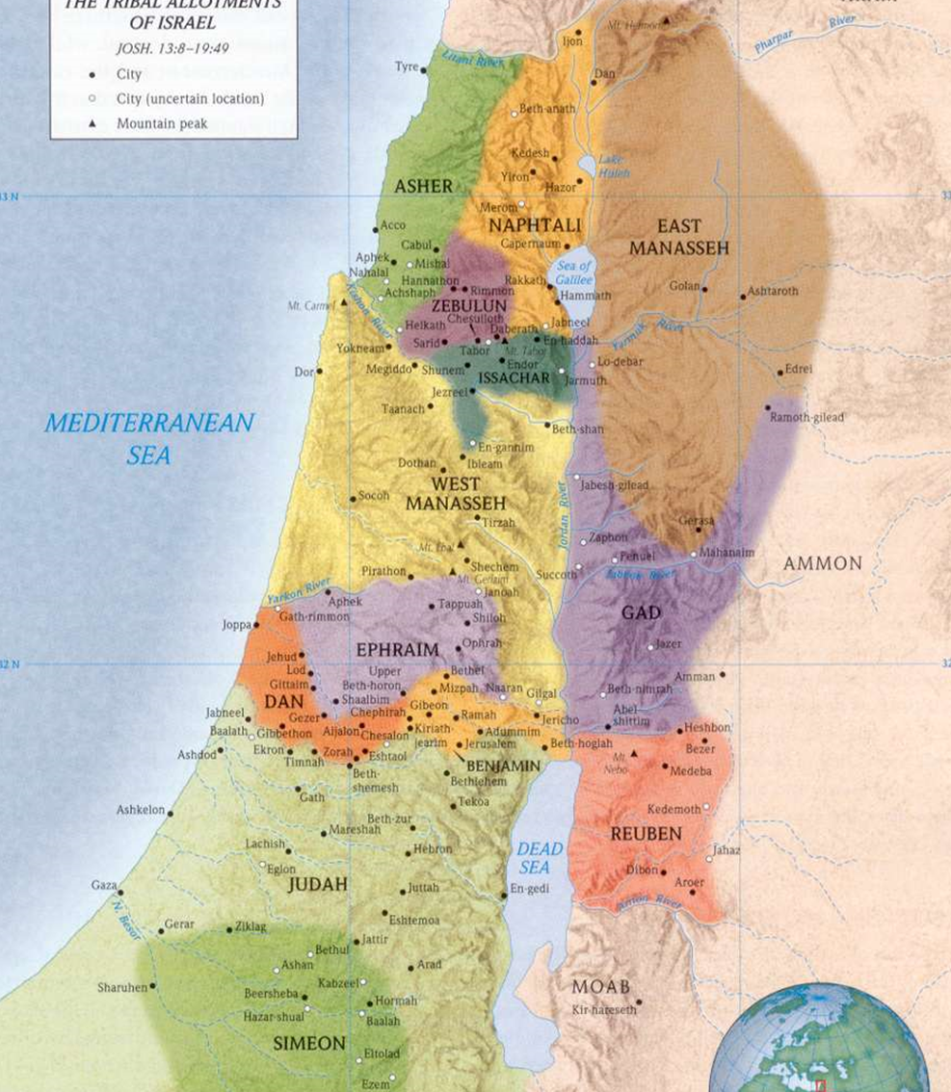

Slide 70
Now shall I be more blameless than the Philistines…
Judges 15:3
Notes:
Recap Judges 15:1-9
Felt guilty about his actions towards the Philistines – struggled to make them the enemy (like Saul)

Slide 71
It’s Personal
Samson only fights the Philistines when they attack him, or when he’s been personally slighted
Notes:
Fighting is a high investment activity

Slide 72
Knowest thou not that the Philistines are rulers over us?!
Judges 15:11
Notes:
Exodus 8:1 And the Lord spake unto Moses, Go unto Pharaoh, and say unto him, Thus saith the Lord, Let my people go, that they may serve me.

Slide 73
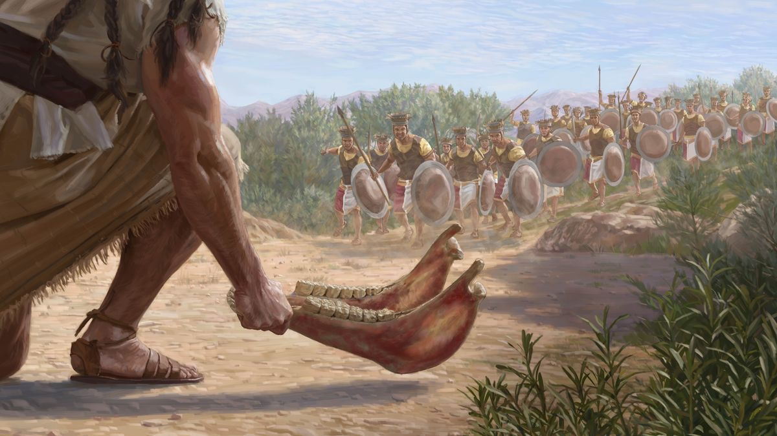
Notes:
Israel does not have the military technology that the philistines do…
Recount the episode v12-15

Slide 74
Why a Donkey’s Jawbone?

Slide 75
The Donkey
H2543 – from H2560 (Red) – A male ass (from its red coat)
Notes:
The unclean burden bearer, servant animal
Exodus 13:12,13 “¹² That thou shalt set apart unto the Lord all that openeth the matrix, and every firstling that cometh of a beast which thou hast; the males shall be the Lord's.
¹³ And every firstling of an ass thou shalt redeem with a lamb; and if thou wilt not redeem it, then thou shalt break his neck: and all the firstborn of man among thy children shalt thou redeem.
Exodus 8:1 And the Lord spake unto Moses, Go unto Pharaoh, and say unto him, Thus saith the Lord, Let my people go, that they may serve me.

Slide 76
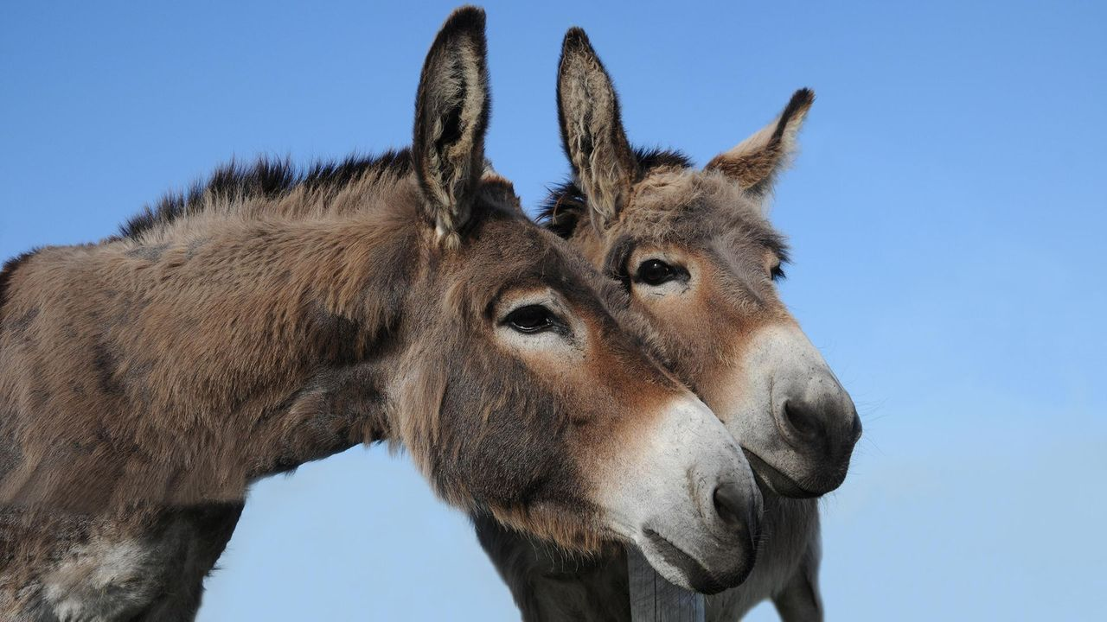
Notes:
Large ears and sturdy frame – servant animal

Slide 77
The Jawbone
A whip for the horse, a bridle for the ass, and a rod for the fool's back. Proverbs 26:3
Notes:
Jawbone’ H3895 – From an unused root meaning to be soft, The Cheek, The Jawbone
‘New’ H2961 – Moist, dripping, fresh - Rotherham says this was a jawbone of a newly slain ass
ISA 1: 2-6 (putrefying sores) only other time that word us used
Proverbs 26:3 – Bridle for the Ass
Symbolizes rulership or leadership
Judges 17:6 In those days there was no king in Israel, but every man did that which was right in his own eyes.

Slide 78
The Donkey’s corpse
Recently dead and picked over
Notes:
Minimal signs of life remain
Who has the donkey been serving? Not GOD – but the Philistines.
The Wages of Sin is Death.
Judges 2:14-19

Slide 79
Putting it all together
The Philistines – Sin/Flesh
Have dominion over Israel
Do you not know that if you present yourselves as obedient slaves, you are slaves of the one you obey, either of sin resulting in death, or obedience resulting in righteousness?
Romans 6:16 NET
The Donkey – Man/Israel
Unclean, Servant/Burden bearer,
Stubborn
Belonged to Yahweh
Required redemption by a Lamb
Notes:
Romans 6:12 Let not sin therefore reign in your mortal body, that ye should obey it in the lusts thereof.

Slide 80
but yield yourselves unto God, as those that are alive from the dead, and your members as instruments of righteousness unto God.
Let not sin therefore reign in your mortal body, that ye should obey it in the lusts thereof.
Neither yield ye your members as instruments of unrighteousness unto sin:
Romans 6:12,13

Slide 81
Putting it all together
Samson
Separated unto Yahweh
“Spirit of Yahweh came mightily upon him”
Do you not know that if you present yourselves as obedient slaves, you are slaves of the one you obey, either of sin resulting in death, or obedience resulting in righteousness?
Romans 6:16 NET
The Donkey’s Jawbone
Dying Flesh
“Take my yoke upon you”
Notes:
Samson had to identify with the jawbone…
Type of Christ (the lamb) – took on our nature (flesh and blood) and redeemed us.
Types the deliverance if the nation was ruled by Yahweh

Slide 82
And deliver them who through fear of death were all their lifetime subject to bondage.
Forasmuch then as the children are partakers of flesh and blood, he also himself likewise took part of the same; that through death he might destroy him that had the power of death, that is, the devil;;
Hebrews 2:14,15

Slide 83
I have slain 1000 men
“The whole misery of Samson arose from this, that he appropriated to himself what God had done through him” – Alfred Edersheim
Notes:
Poetry
Also relaying a very human emotion (valid feeling)!
Practical application – we take credit for much of what God gives us
V17 – cast away the Jawbone (threw it away) YUCK!
Becomes thirsty – dries out like the jawbone, because he has failed to acknowledge God

Slide 84
But God clave an hollow place that was in the jaw, and there came water thereout; and when he had drunk, his spirit came again, and he revived
Judges 15:19
Hollow – H3806 – Socket of a tooth, a mortar
Notes:
Life returns to the jawbone (fountain of life) – the battle against the internal philistine had to be sustained by living waters (the word).
The donkey (Israel) could not be discarded – had to work with it. HE was their deliverer!
John 4:14 But whosoever drinketh of the water that I shall give him shall never thirst; but the water that I shall give him shall be in him a well of water springing up into everlasting life.
The water would come from his body of flesh:
John 19:³⁴ But one of the soldiers with a spear pierced his side, and forthwith came there out blood and water.

Slide 85
And he judged Israel in the days of the Philistines twenty years
Judges 15:20

Slide 86
Key Takeaways
Choose WHO you will serve– our default settings are set to serve self
God can do the rest– He wants your all, but it all doesn’t depend on you
To God be the Glory– Be honest, you’re really not that great

Slide 88
The Strength of GOD and the Weakness of Man

Slide 89
HISTORY
The Bible was not written to recount
But to declare the wonder and the majesty of
HIS STORY

Slide 90
The strength of God and the weakness of men - Overview
Samson Goes to Gaza
Samson Loves Delilah

Slide 91
One man of you shall chase a thousand: for the Lord your God, he it is that fighteth for you, as he hath promised you.
Take good heed therefore unto yourselves, that ye love the Lord your God.
Joshua 23:10, 11

Slide 92
Samson’s Descents
Holding the Gates towards Hebron
Trip to Gaza
Love of Delilah
Betrayal
The Harlot’s Bed
The Gaza Prison

Slide 93
SEVEN Locks
H7651 – from H7650 – Seven (as the sacred full one), A week
H7650 – To be complete; to seven oneself (by repeating a declaration seven times), to take an OATH, to swear

Slide 94
The OATH which he sware to our father Abraham,
Luke 1:68-75

Slide 95
…and thy seed shall possess the gate of his enemies
Gen 22:15-18
Notes:
Abraham believed that God could raise his son – that Death couldn’t hold him.
So his own seed is promised to be the one to vanquish death’s power!

Slide 96
The last enemy that shall be destroyed is death.
1 Corinthians 15:26

Slide 97
and upon this rock I will build my ecclesia; and the gates of hell shall not prevail against it.
Matthew 16:18

Slide 98
GAZA
Meaning – The Fierce, STRONG
Capital city of the Philistines Unger’s Bible Dictionary
Military Stronghold, one of the five prominent Philistine cities - Ashkelon, Ekron, Ashdod, Gath, Gaza Unger’s Bible Dictionary
Notes:
City of the dust (Philistine)

Slide 99
The Harlot
Proverbs 7:21-27
Notes:
A hint of what will eventually bring him down…
Acts 13:36 Corruption of David

Slide 100
And they compassed him in, and laid wait for him all night in the gate of the city, and were quiet all the night, saying, In the morning, when it is day, we shall kill him.
Judges 16:2
Notes:
He’s not getting out! This is a one way trip

Slide 101
And Samson lay till midnight, and arose at midnight…
Judges 16:3
Notes:
Sleeping – horizontal – Death
Arose – resurrection
And many of them that sleep in the dust of the earth shall awake, some to everlasting life, and some to shame and everlasting contempt. Daniel 12:2
Thy dead men shall live, together with my dead body shall they arise. Awake and sing, ye that dwell in dust: for thy dew is as the dew of herbs, and the earth shall cast out the dead. Isa 26:19

Slide 102
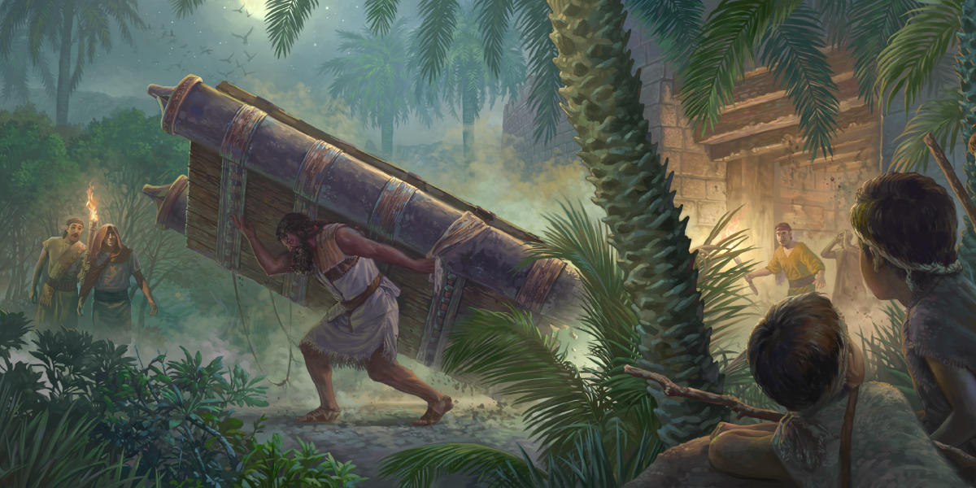

Slide 103
…and thy seed shall possess the gate of his enemies
Gen 22:15-18

Slide 104
Whereby are given unto us exceeding great and precious promises: that by these ye might be partakers of the divine nature,
2 Peter 1:4
Notes:
THESE = Godliness and knowledge of him that hath called us

Slide 105
Whereby are given unto us exceeding great and precious promises: that by these ye might be partakers of the divine nature, having escaped the corruption that is in the world through lust.
2 Peter 1:4

Slide 106
The Story Repeats
Notes:
Sorek – Noble Vine
Back in the vineyard

Slide 107
“For he fell in love with a woman that was a harlot among the Philistines”
Josephus, Antiquities of the Jews, book 5, chapter 8
Notes:
Lived close to Ekron – had a relationship with the lords of the philistines

Slide 108
GAZA HARLOT
DELILAH
FAKE LOVE - Bought for Money
Entice, Cause to sleep
TRAP
KILL
Notes:
Samson moves to join himself to a harlot
1 Corinthians 6:15-20

Slide 109
Tell me, I pray thee, wherein thy great strength lieth...
Judges 16:6
Notes:
Clearly didn’t have to be huge – true
Strength was SUPERHUMAN
Simple answer – God strengthens me
But – the answer to her question was an inditement of his own behavior. How could he give her the answer and remain in an honest relationship with this woman.
HE loved her more than he loved God
Summarize the sequence of testings

Slide 110
The MAN chooses the WOMAN over GOD
Abdicates his role as spiritual leader; chooses to die with the woman, rather than die for her
Notes:
Verses 15 - 17

Slide 111
And she made him sleep upon her knees; and she called for a man, and she caused him to shave off the seven locks of his head; and she began to afflict him, and his strength went from him.
And she said, The Philistines be upon thee, Samson.
Judges 16:19-20
Notes:
She didn’t want to be delivered from the philistines!
Shave: fig. to devastate or lay waste
Physically ended a relationship that had withered
John 15:1,2,5 I am the true vine, and my Father is the husbandman. Every branch in me that beareth not fruit he taketh away: and every branch that beareth fruit, he purgeth it, that it may bring forth more fruit.
If a man abide not in me, he is cast forth as a branch, and is withered; and men gather them, and cast them into the fire, and they are burned.
(numbers 6 Nazarite vow ending)

Slide 112
“The whole misery of Samson arose from this, that he appropriated to himself what God had done through him. God allows his strength to be destroyed, that in bitter experience he might learn, how without God's presence he was nothing at all. And so our falls always teach us best.”
Alfred Edersheim, quoting an older unnamed German commentary
Notes:
David understood God’s grace after his affair with Bathsheba

Slide 113
Samson’s Descents
Holding the Gates towards Hebron
Trip to Gaza
Love of Delilah
Betrayal
The Harlot’s Bed
The Gaza Prison
Notes:
Joshua 23:13 – Know for a certainty that the LORD your God will no more drive out any of these nations from before you; but they shall be snares and traps unto you, and scourges in your sides, and thorns in your eyes, until ye perish from off this good land which the LORD your God hath given you.

Slide 114
Key Takeaways
The heart is deceitful– choose your friends carefully and beware your heart
Highs and lows are human– Don’t throw away your relationship with God
The consequences are ours to face – Learn lessons while they are easy to learn, the pain only increases

Slide 116
IT IS FINISHED!

Slide 117
shame
Notes:
Compare Proverbs 5:1-13
- Providing for the Philistines (feeding them)
- Turned into an ass
- Weak
- No way out
Something worse than death has befallen him
Paradox of Shame
Samson outwardly becomes what he had become inwardly – Blind to sin and now slave to it!
The tragedy of MAN - sad

Slide 118
Howbeit the hair of his head began to grow again after he was shaven.
Judges 16:22
Notes:
The prodigal son – I’m a fool
No magic in his hair – these are spiritual thoughts growing out of his mind
Consequences vs. Punishment
Draw near to me and I will draw near to you.

Slide 119
Notes:
V 23-27
Psalm 22:1-11,13

Slide 120
O Lord God, remember me, I pray thee, and strengthen me, I pray thee, only this once, O God, that I may be avenged upon the Philistines for one of my two eyes.
Judges 16:28 RSV
Notes:
Calls unto – contrast calls upon (15:18) – calls out (I believe he calls out – why be silent?!, he is not ashamed of his God!)
He now intimately knows that GOD is the source of strength
One of his two eyes – he knew he deserved to lose one of them. Matthew 5:29 “And if thy right eye offend thee, pluck it out, and cast it from thee: for it is profitable for thee that one of thy members should perish, and not that thy whole body should be cast into hell.”
Prodigal son – he turn around and the father is there (I am no longer worthy to be called your son)
My Grace is sufficient for you: for My strength is made perfect in weakness (2 Cor 12:9-11)
Christ the weak (physically) – destroyed the roaring lion, broke through the gates of the enemy, and achieved his greatest victory in his own death – that in dying for others, he saved himself.

Slide 121
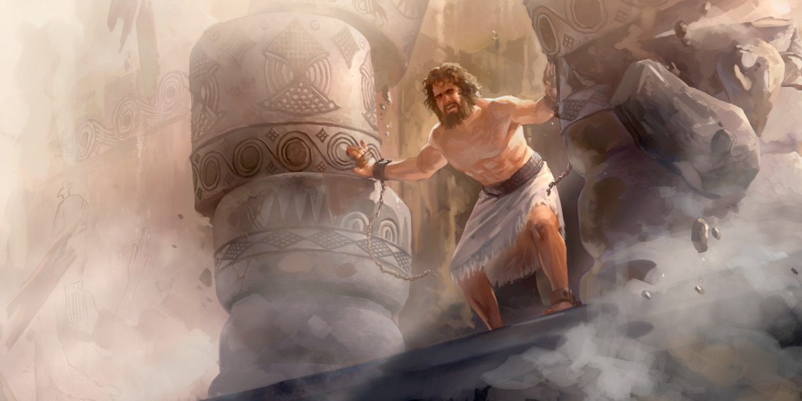
Notes:
Let me die with the Philistines – I belong here, I am no better than them, I deserve to die!
Bowed (yielded) with might – it is finished
Matthew 27:50 Jesus, when he had cried again with a loud voice, yielded up the ghost.
God finishes His Story in the life of Samson
What a privilege, what an honor – that the master story teller, write his story into the life he has given us.
Hebrews 11:32-40

Slide 122
My grace is sufficient for you (too)
Key Takeaway
Notes:
My strength is made perfect in weakness
God’s mercy as his primary characteristic – the first one we meet
He’s paid dearly for your redemption – and that grace is enough even for your sin and mine.
But you have to call out to him, you have to turn around – he’ll come the rest of the way!

Slide 123
Notes:
When he meets the Lord – and he sees him eye to eye – the Seed, who possessed the gates of Hell and opened the grave to set him free, to live and reign with the greatest man who ever lived– the man he prefigured.
Well done, thou good and faithful servant: thou hast been faithful over a few things, I will make thee ruler over many things: enter thou into the joy of thy lord.

