Slide 1
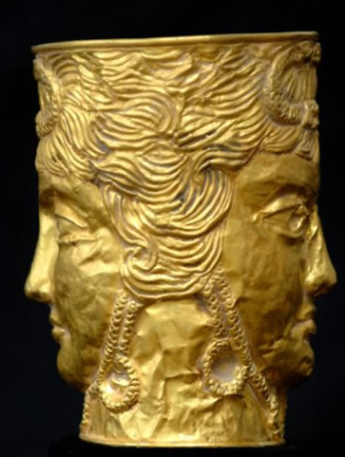
THE FEAST THE FALL OF VASHTI
Esther 1v1-22

Slide 2
The Providence of God
“And the LORD said unto Moses, Behold, thou shalt sleep with thy fathers;…and I will hide my face from them, so that they will say in that day, Are not these evils come upon us, because our God is not among us? And I will surely hide my face in that day for all the evils which they shall have wrought, in that they are turned unto other gods.”
Deuteronomy 31v16-18
“Verily thou art a God that hidest thyself, O God of Israel, the Saviour. They shall be ashamed, and also confounded, …But Israel shall be saved in the LORD with an everlasting salvation: ye shall not be ashamed nor confounded, world without end.”
Isaiah 45v15-17

Slide 3
The Name of God in Esther
Occurs 4 times acrostically – 2x forwards, 2x backwards…
1v20 “All the wives shall give” (to their husbands honour)
5v4 “Let the King and Haman come…”
5v13 “Yet all this availeth me nothing”
7v7 (Haman saw) “that there was evil determined against him” (by the King)
“God is known more by His virtues, than by open manifestation”
Companion Bible (Appendix 60)

Slide 4
The Work of God in Esther
In Israel through the Law of Moses
In his work with the Gentiles through the power of grace
In the sacrifice of Christ that brought deliverance and joy to all the world
In the subduing of the nations in the Battle of Armageddon and the conquering of Europe,
In the final elevation of Christ and the Bride…
In, as our theme for the week says : “The Triumph of the Spirit over the Flesh”…

Slide 6
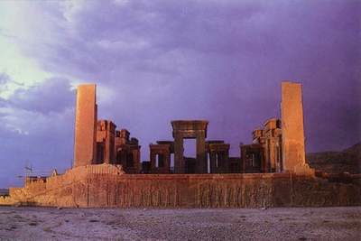

Slide 7
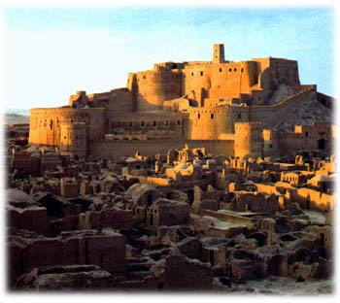

Slide 8
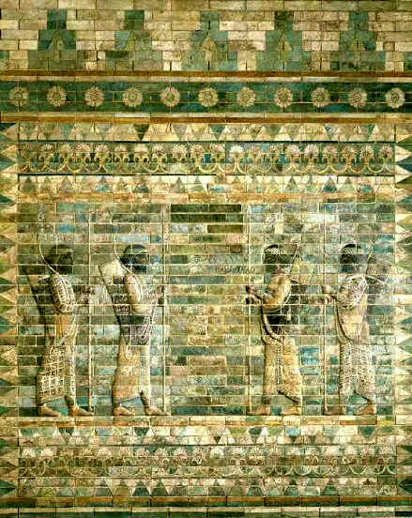

Slide 9
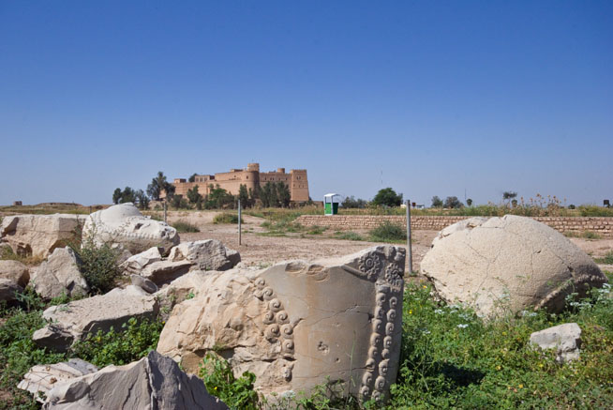

Slide 10
The Grand Feast of Esther 1

Slide 11
The Grand Feast of Esther 1
The Grand Feast of Exodus and Leviticus
(1) Ahasuerus holds a banquet to celebrate the newness of his kingdom v3
(1) God has just brought Israel out of Egypt and constituted them a kingdom! Exod 19v1-6
(2) First banquet was for all the nobility and aristocracy (“nobles and princes”) in Shushan the Palace v3
(2) First banquet was for all the aristocracy and skilled chosen men (“the elders of Israel”) in Sinai (God’s palace!) Exod 24v1,9
(3) They were “before him” (Lit – “saw his face!”) v3 Very rare event – Cp 1v14
(3) They “saw the God of Israel” Exod 24v10,11

Slide 12
The Grand Feast of Esther 1
The Grand Feast of Exodus and Leviticus
(4) First banquet lasted 180 days v4 (rotating army chiefs to keep the perimeter of the empire secure!!!)
(4) There followed a period of building the Tabernacle that lasted for 180 days (to the day?) Exod 19v1, 24v18, 34v28, 40v2
(5) During which time Ahasuerus showed them the “riches of his glorious kingdom and the honour of his excellent majesty” v4
(5) During which time God showed Israel the “honour and the majesty” that was “in his sanctuary” Psalm 96v6, 145v11-13
(6) Second banquet for all the common people for 7 days v5
(6) Second banquet for all the congregation – the 7 day consecration of the sons of Aaron Lev 8v3, 33, 9v5

Slide 13
The Grand Feast of Esther 1
The Grand Feast of Exodus and Leviticus
(7) 7 day feast held in a tent (“hangings”, Lit – “awning”) v6
(7) 7 days feast held in Tabernacle (tent)!! Exod 35v11
(8) Colors of tent were “blue”, “purple” and white “fine linen” v6
(8) Only other place in Bible where those three colors occur together is the Tabernacle!! Exod 25v4, 28v5-6, 35v6, 23, 25, 35, 38v23, 39v3
(9) The hangings are held up by pillars, cords and silver rings v6
(9) The Tabernacle possessed both pillars, cords and silver rings! Exod 35v17, 39v40 (John in Rev 3v12 quotes Lev 8v33!!)

Slide 14
The Grand Feast of Esther 1
The Grand Feast of Exodus and Leviticus
(10) There is a “pavement” of different colored stone v6
(10) There was a “paved work of sapphire stone” Exod 24v10
(11) There were many “vessels of gold” all diverse from one another v7
(11) In the God’s newly formed house, there were many diverse people II Tim 2v20-21, I Cor 15v41, but all formed by faith! Heb 11v29
(12) Drinking was “according to the law”, but “none did compel” v8 (Paradox!)
(12) The people that were joined to the Law of Moses volunteered their obedience – “All that Yahweh hath said will we do and be obedient!” Exod 24v7

Slide 15
Vashti – The perfect type of natural Israel

Slide 16
Disobedient Vashti
Disobedient Israel
(1) Vashti was the King’s first wife v9
(1) Israel was clearly God’s first wife Isa 54v5, Jer 31v32
(2) Vashti known for her beauty v11
(2) Israel was “exceeding beautiful, and thy renown went forth among the heathen for their beauty” Ezekiel 16v8-14
(3) Vashti was supposed to be the perfect reflection of her lord the king to all the nobles and princes Psalm 45v11, Isa 33v17
(3) God expected Israel to be a reflection of Him to all the nations Exod 19v5-6, Deut 7v6. Isaiah 43v7 says– “I have created him for my glory!”

Slide 17
Disobedient Vashti
Disobedient Israel
(4) Ahasuerus sent to fetch her after a feast of 187 days v10 to show off her reflected glory
(4) After 187 days, the priest-hood was to be consecrated as the crowning glory of God’s Kingdom of priests Lev 9v6 – “The glory of Yahweh shall appear unto you”
(5) Vashti refused to come v12
(5) The sons of Aaron – Nadab and Abihu (as types of the whole nation down through time) refused to accept God’s goodness and clearly rebelled against God Lev 10v1 Down through time the nation refused to obey Jer 13v11, Luke 14v15-24, Matt 22v4-8

Slide 18
Disobedient Vashti
Disobedient Israel
(6) Ahasuerus was very wroth and his anger burned within him v12
(6) God’s fiery wroth Lev 10v6 and anger flashed out and burned up Nadab and Abihu because they refused to obey God’s commands Lev 10v2-3 and down through time Israel would be punished with God’s wroth II Chron 34v25, 36v16, Deut 29v28, Jer 32v37, Isa 30v27, Matt22v7

Slide 19
Israel and Disobedience
Joshua 5v7 – “For the children of Israel walked forty years in the wilderness till all…were consumed because they obeyed not the voice of Yahweh”…
I Samuel 8v19 – “Nevertheless the people refused to obey the voice of Samuel”…
Isaiah 42v24 – “Who gave Jacob for a spoil?...Did not Yahweh?...for they would not walk in his ways, neither were they obedient unto his Law”…
Jeremiah 22v21 – “But thou saidst – ‘I will not hear’. This hath been thy manner from thy youth, that thou obeyest not my voice”…

Slide 20
“Another that is better than she”
Clearly these words are an allusion to…
I Samuel 15v28 – “And Samuel said to him, ‘Yahweh hath rent the Kingdom of israel from thee this day, and hath given it to a neighbour of thine, that is better then thou’”…
Christ picks this up when he addresses the nation...
Matthew 21v43 – “Therefore I say unto you, ‘The Kingdom of God shall be taken from you, and given to a nation bringing forth the fruits thereof”…
Compare Matthew 22v1-10 and Esther 2v3!!!

Slide 21
The Importance of OBEDIENCE
I Peter 4v17 – “For the time is come that judgment must begin at the house of God: and if it first begin at us, what shall the end be of them that obey not the gospel”…
II Thessalonians 1v8 – “…the Lord Jesus shall be revealed from heaven with his mighty angels, In flaming fire taking vengeance on them that know not God, and that obey not the gospel of our Lord Jesus Christ”…

Slide 22
The Obedience of Christ and the Bride
OBEDIENCE OF CHRIST
Hebrews 5v8 – “Though he were a Son, yet learned he obedience by the things which he suffered”…
OBEDIENCE OF HIS BRIDE
Hebrews 5v9 – “And being made perfect, he became the author of eternal salvation unto all them that obey him”…

Slide 24
THE MAIDENS THE RISE OF ESTHER
Esther 2v1-23

Slide 25
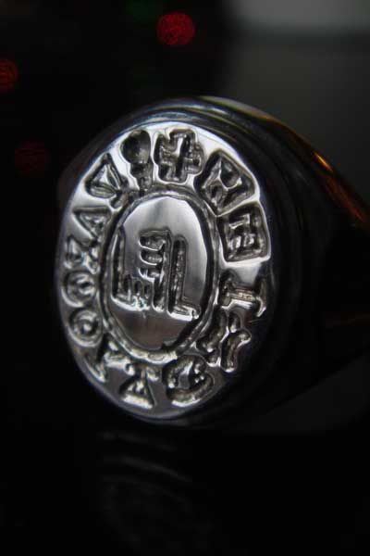
THE DECREE THE RISE OF HAMAN
Esther 3v1 - 4v17

Slide 26
THE SCEPTRE THE RISE OF AHASUERUS
Esther 5v1 – 6v11

Slide 27
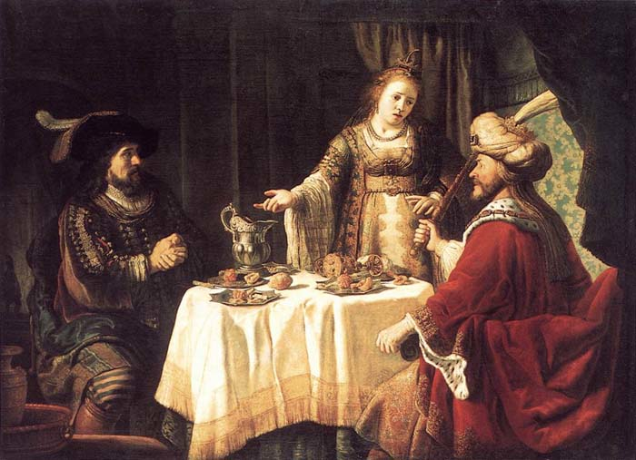
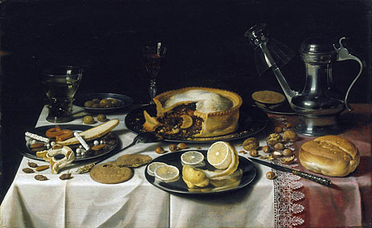
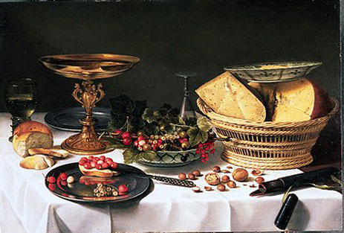
THE BANQUET THE FALL OF HAMAN
Esther 6v12 – 7v10

Slide 28
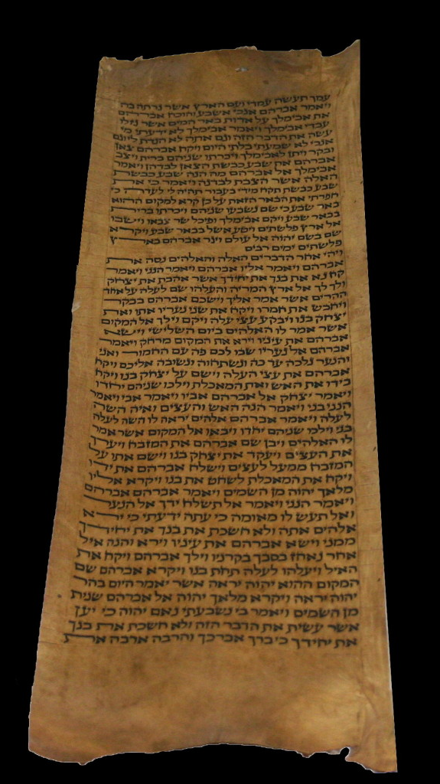
THE COMMAND THE RISE OF MORDECAI
Esther 8v1 – 10v3

Slide 29
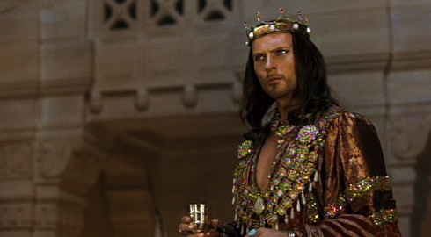
THE KING

Slide 30
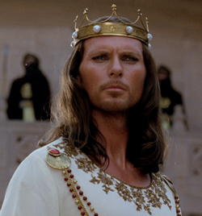
THE KING

Slide 31
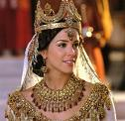
THE QUEEN

Slide 32
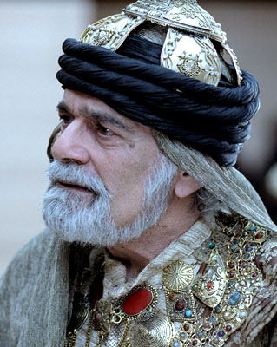
MORDECAI

Slide 33
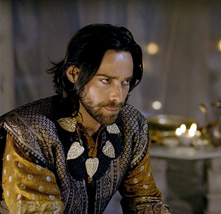
HAMAN

Slide 34
