Slide 1
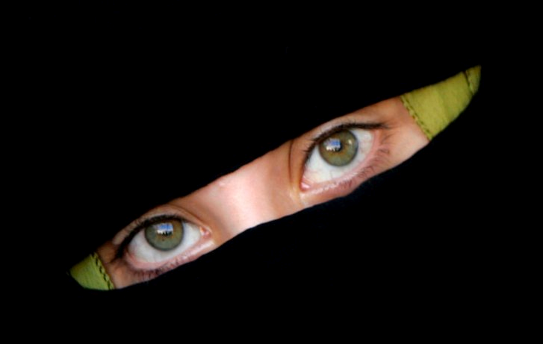
THE MAIDENS THE RISE OF ESTHER
Esther 2v1-23

Slide 2
The New Bride of Faith
Hebrews 11v6 – “For without faith it is impossible to please God”…
Romans 8v8 – “…they that are in the flesh cannot please God”…

Slide 3
“Hadassah that is Esther”
Neh 8v15 – “Go forth,…and fetch olive branches, and pine branches and myrtle branches, and palm branches,…branches of thick trees, to make booths”
Zech 1v8-12, 17 – Vision of a man among the myrtle trees who promised that all the earth would sit still and be at rest…
Isaiah 41v19, 55v13 – Mentioned as trees that will flourish in the Kingdom age with Israel at rest…
Therefore the myrtle tree is associated with the “rest” of the Kingdom Age when Israel will be at peace, and all the world will keep the Feast of Tabernacles…

Slide 4
“Hadassah that is Esther”
The name “Esther” is a little more difficult to define because it is a Persian name…Authorities differ and suggest either:
(1) A Star – In which case she clearly types the true seed of Abraham by faith – “like the stars of the heaven for multitude”, and interestingly the phrase “Hadassah that is Esther” has a numerical value of
1152
= 12x12x8!!!

Slide 5
“Hadassah that is Esther”
The name “Esther” is a little more difficult to define because it is a Persian name…Authorities differ and suggest either:
(2) Hidden – In which case she clearly types the true Bride of Christ who is hidden among the nations are will later be revealed…
I John 3v2 – “Beloved, now are we the sons of God,…it doth not yet appear what we shall be”
Colossians 3v3 – “For ye are dead, and your life is hid with Christ in God”…

Slide 6
“Neither Father or Mother”
Esther is introduced as a spiritual orphan…
Rom 8v15 – “For ye have not received the spirit of bondage again unto fear; but ye have received the spirit of adoption, whereby we cry Abba, Father”…
A member of the Melchizedek priesthood…
Heb 7v3 – “Without father, without mother, without descent, having neither beginning of days nor end of life”…

Slide 8
“The Bride by Grace”
The Hebrew word for “kindness” is “chesed” – the “covenant loving-kindness”…
It describes Esther as asking for or obtaining “favour”, and “kindness” and “grace” seven times… 2v9, 15, 17, 5v2, 8, 7v3, 8v5
Exactly the same as Joseph…another exile in a strange land, but cared for by God…
“But Yahweh was with Joseph, and shewed him mercy,… gave him favour in the sight of the keeper of the prison” Genesis 39v4,21

Slide 10
“6 months with oil of myrrh”
Myrrh is associated with the holy anointing oil of the priests Exod 30v23 and the Bride in Song of Solomon rejoices at the myrrh that “drips from the bridegrooms lips” Song 5v13, like the Law that should drop from the lips of the priest Mal 2v7
Myrrh is also associated with the birth of the King of Israel Matt 2v11, the life of the King (Psalm 45v7-8 –Only other time “oil” and “myrrh” occur together), and the death of the King of Israel John 19v39

Slide 11
“6 months with sweet odours”
Sweet odours are associated with the incense Exod 30v34-38, and as such was symbolic of prayer Rev 5v8 – the role of the priest Psalm 141v2
Sweet odours are also associated with the recognition of a King II Chron 16v14, Dan 2v46

Slide 12
“6 months with sweet odours”
The Bridegroom is strongly associated with both – “I have gathered my myrrh with my spice(odours)” Song 5v1 because he is the KING-PRIEST!
The Bride prepares herself with both – because she desires to be a perfect reflection of the King, and she is called to be the KINGS and PRIESTS of the age to come!! Rev 5v10

Slide 14
“But what Hegai appointed”
“Hegai” is closely related to the Hebrew word “Higgaion” – “to meditate”…
So Esther found favour with all who looked upon her because she got her thinking right…
Proverbs 8v35 – “For whoso findeth me (Wisdom) findeth life, and shall obtain favour of Yahweh”…

Slide 15
The Doctrine of Election
Matthew 22v14 – “For many are called but few are chosen”…
Mark 13v20 – “But for the elect’s sake , whom he hath chosen, he hath shortened the days”…
Romans 9v11 – “For the children being not yet born, neither having done any good or evil, that the purpose of God according to election might stand, not of works, but of him that calleth”…
Revelation 17v14 – “…And they that are with him are called, and chosen, and faithful”…

Slide 16
The Importance of PREPARATION
Revelation 19v7
“The marriage of the Lamb is come, and his wife hath made herself ready”
Revelation 21v2
“And I John, saw the holy city, New Jerusalem, coming down from God out of heaven, prepared as a bride adorned for her husband”

