Slide 1
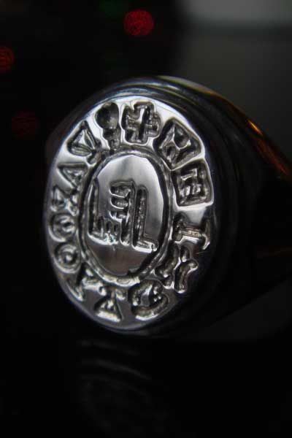
THE DECREE THE RISE OF HAMAN
Esther 3v1 - 4v17

Slide 2
“Haman the Agagite”
Descended from Esau Gen 36v12
“The first nation to war against Israel” Num24v20
Known for their lack of fear of God Duet 25v18
Picked off the stragglers –cowards!! Deut 25v18
God called them “sinners”! I Samuel 15v18
Catalogued with all the Jew haters!! Psalm 83v7
God made Amalek typical of all the Jews enemies, and declared war against Amalek from generation to generation Exod 17v16
God promised “I will blot out the remembrance of Amalek from under heaven” Duet 25v19

Slide 3
“But Mordecai bowed not…”
(1) Divine reverence to a man directly contravened the Law Exod 20v5, Psalm 95v6, Daniel 3v11-12,28. This was endorsed in the New Testament Acts 5v29, 12v21-23, 14v11-15
(2) Amalekites were cursed under the Law Exod 17v14-16, Deut 25v19, I Samuel 15v3 and so he hated Haman because he was diametrically opposed to God…

Slide 4
“Pur, that is the Lot”
“Surely there is no enchantment against Jacob, neither is there any divination against Israel…”
Numbers 23v23
“The lot is cast into the lap, but the whole disposing is of Yahweh…”
Proverbs 16v33

Slide 5
“Ten thousand talents”
I Chron 29v7 - What David was donated to the Temple and setting up of Jewish worship…
Matt 18v24 – The amount of money the unjust creditor owed his Lord…

Slide 6
“Destroy, kill, cause to perish”
I Samuel 15v3 – “Now go and smite Amalek, and utterly destroy all that they have, and spare not; but slay both man and woman, infant and suckling, ox and sheep, camel and ass…”
Esther 3v13 – “And the letters were sent by posts into all the King’s provinces, to destroy, to kill, and cause to perish all Jews, both young and old, little children and women, in one day…”

Slide 7
The Importance of CONSISTENCY
Heb 13v8 – “Jesus Christ, the same yesterday, and today, and forever”…
I Chron 28v7 – “…Moreover I will establish his kingdom for ever, if he be constant to do my commandments”…
I Cor 15v58 – “Therefore my beloved brethren, be ye stedfast, unmovable, always abounding in the work of the Lord, forasmuch as ye know that your labour is not in vain in the Lord”…

