Slide 1
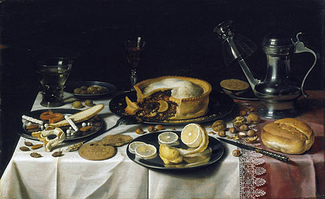
THE BANQUET THE FALL OF HAMAN
Esther 6v12 – 7v10

Slide 2
The Poetic Justice of God
Psalm 9v16 – “Yahweh is known by the judgment which He executeth: the wicked is snared in the work of his own hands…”
Psalm 10v2 – “The wicked in his pride doth persecute the poor: let them be taken in the devices which they have imagined…”
Psalm 141v10 – “Let the wicked fall into their own nets, whilst that I withal escape…”

Slide 3
The King’s Wrath
Proverbs 16v14 – “The wrath of a King is as messengers of death: but a wise man will pacify it…”
Proverbs 19v12 – “The King’s wrath is as the roaring of a lion; but his favour is as dew upon the grass…”
Proverbs 20v2 – “The fear of a King is as the roaring of a lion: whoso provoketh him to anger sinneth against his own soul…”

Slide 5
“Given the whole world”
Isaiah 61v6 – “But ye shall be named the Priests of Yahweh: … ye shall eat the riches of the Gentiles, and in their glory shall ye boast yourselves…”
Daniel 7v18 – “But the saints of the Most High shall take the Kingdom, and possess the Kingdom for ever, even for ever and ever…”
II Cor 6v10 (NEB) – “In our sorrows we have always cause for joy, poor ourselves we bring wealth to many, penniless we own the world…”

Slide 6
13th
14th
15th
16th
17th
18th
Haman’s decree 3v12 (13th of Abib)
Shushan perplexed 3v15
Mordecai mourns 4v1 (9am)
Mordecai’s 3 day fast 4v16 (3pm)
Esther comes before King 5v1
Esther’s first banquet 5v6-8
(Mordecai dead)
The King can’t sleep 6v1

Slide 7
13th
14th
15th
16th
17th
18th
Mordecai’s 3 day fast 4v16 (3pm)
Mordecai’s resurrection/parade 6v11 (5am)
Esther’s second banquet 7v1
Haman is hung 7v10
Mordecai’s ascension to meet King 8v1
“Then said I, Lo, I come (in the volume of the book it is written of me), to do thy will O God…” Hebrews 10v7

Slide 8
The Importance of LOVE
I Cor 13v6-8 – “Love… rejoiceth not in iniquity, but rejoiceth in the truth; Beareth all things, believeth all things, hopeth all things, endureth all things. Love never faileth ”…
I John 4v18-19 – “There is no fear in love; but perfect love casteth out fear: because fear hath torment. He that feareth is not made perfect in love. We love him because he first loved us”…

