Slide 1
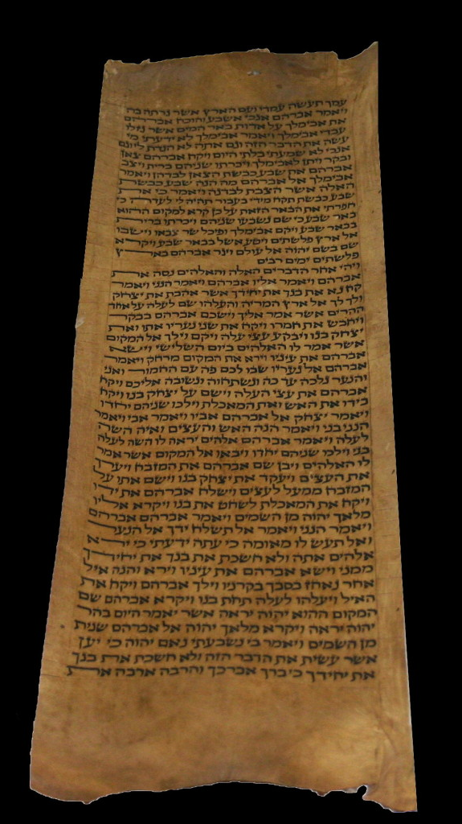
THE COMMAND THE RISE OF MORDECAI
Esther 8v1 – 10v3

Slide 2
“Blotting out the Handwriting”
“Blotting out the handwriting of ordinances that was against us, which was contrary to us, and took it out of the way, nailing it to the cross, and having spoiled principalities and powers, he made a shew of them openly, triumphing over them in it”…
Colossians 2v14-15

Slide 3
“Be Glad and Rejoice”
Isaiah 25v9 – “And it shall be said in that day, Lo, this is our God, we have waited for him, and he will save us: this is Yahweh; we have waited for him, we will be glad and rejoice in his salvation”…
Zephaniah 3v14-15 – “Sing O daughter of Zion; shout O Israel; be glad and rejoice with all thy heart... Yahweh hath taken away thy judgments, he hath cast out thine enemy: the King of Israel, even Yahweh is in the midst of thee: thou shalt not see evil any more”…

Slide 4
“They became Jews”
Micah 7v16-17– “The nations shall see thee and be confounded…They shall lick the dust like a serpent…they shall be afraid of Yahweh our God, and shall fear because of thee”…
Zechariah 8v23 – “…In those days it shall come to pass, that ten men shall take hold out of all languages of the nations, even shall take hold of the skirt of him that is a Jew, saying, We will go with you: for we have heard that God is with you”…

Slide 5
Gog and the Ghost of Haman

Slide 6
Haman the Agagite
Gog the Chief Prince
(1) Obviously we have the striking similarities in names – “Haman the Agagite” 3v1
(1) “Gog” Ezek 38v2 is the ghost of the Agagite spirit and his burying place – Hamon-Gog Ezek 39v11
(2) Haman wanted to “destroy, to kill and cause to perish all Jews” 3v13
(2) Gog will go forth… to “destroy and utterly to make away many” Dan 11v44
(3) Haman’s blatant plan was to “take a spoil of them for a prey” 3v13
(3) Gog’s blatant plan is to “take a spoil and a prey” Ezek 38v12-13
(4) Haman “sought to lay hands on” (literal Hebrew) the Jews 8v7
(4) Gog is going to “stretch forth his hand also upon the countries” Dan 11v42

Slide 7
Haman the Agagite
Gog the Chief Prince
(5) Haman wanted to take advantage of the Jews that were defenseless – “that dwelt in unwalled villages” 9v19
(5) Gog attacks “the land of unwalled villages” Ezek 38v11 (Only other time those two words occur together)
(6) Haman’s plan to massacre the Jews is described as “a wicked device” 9v25
(6) Gog’s plan to massacre the Jews is described as “an evil thought” Ezek 38v10 (Exactly the same expression in the Hebrew)
(7) Haman’s wicked device would return upon his own head (Heb-“Rosh”) 9v25
(7) Gog is the “prince of Rosh” (head) Ezek 38v2

Slide 8
Haman’s Ten Sons
Parshandatha – “Given to Persia”
Dalphon – “Dripping”
Aspatha – “Horse given”
Poratha – “Fruitfulness”
Adalia – “Honour of Ized”
Aridatha – “The lion of the decree”
Parmashta – “Superior”
Arisai – “Lion of my banners”
Aridai – “Gift of the plough or bull”
Vajezatha – “Strong as the wind”

Slide 9
Haman’s “Lucky” Number
“Haman the Agagite”
117 = 13 x 9
“Zeresh”
507 = 13 x 39
“Names of the 10 sons”
10,244 = 13 x 788
Whole Family
10, 868 = 13 x 836

Slide 10
“The Greatness of Mordecai”
Esther 2v21 – “sat in the King’s gate”…
Esther 6v11 – “Brought him on horseback”…
Esther 8v2 – “And the King took off his ring…and gave it to Mordecai”…
Esther 8v7-9 – “Write ye also for the Jews as it liketh you, in the King’s name”…
Esther 8v15 – “And Mordecai went out from the presence of the King in royal apparel”…
Esther 9v4 – “was great in the King’s house”…
Esther 9v4 – “waxed greater and greater”…
Esther 10v3 – “next unto King Ahasuerus”…

Slide 11
“Next unto the King”
“The isles of the Sea” – Isaiah 60v9, Psalm 72v10-11
“Next unto the King” – Gen 41v38-44, I Cor 15v27
“Great among the Jews” – Psalm 118v24-26, Isaiah 66v19, Matt21v42
“Accepted of the multitude of his brethren” – Zechariah 12v10, Isaiah 49v6
“Seeking the wealth of his people” – Psalm 72v2,4, 12-13, 112v2-3, Isaiah 60v11
“Speaking peace to all his seed” – Psalm 72v3, 17-19, Isaiah 52v7, Eph 2v14-17, Zech 9v10

Slide 12
“Send portions and give gifts”
II Samuel 6v18-19– “And as soon as David had made an end of offering…he dealt among all the people, even the whole multitude of Israel…to every one a cake of bread, and a good piece of flesh, and a flagon of wine”…
Nehemiah 8v10-12 – “Then he said unto them, Go your way, eat the fat, and drink the sweet, and send portions unto them for whom nothing is prepared…and all the people went their way”…

Slide 13
The Importance of GLADNESS
Revelation 19v7 – “Let us be glad and rejoice, and give honour to him: for the marriage of the Lamb is come, and his wife hath made herself ready”…
Hymn 256 – “Why should his people now be sad; none have such reason to be glad, as reconcil’d to God”…
Psalm 126v3– “Yahweh hath done great things for us; whereof we are glad”…

