Slide 1
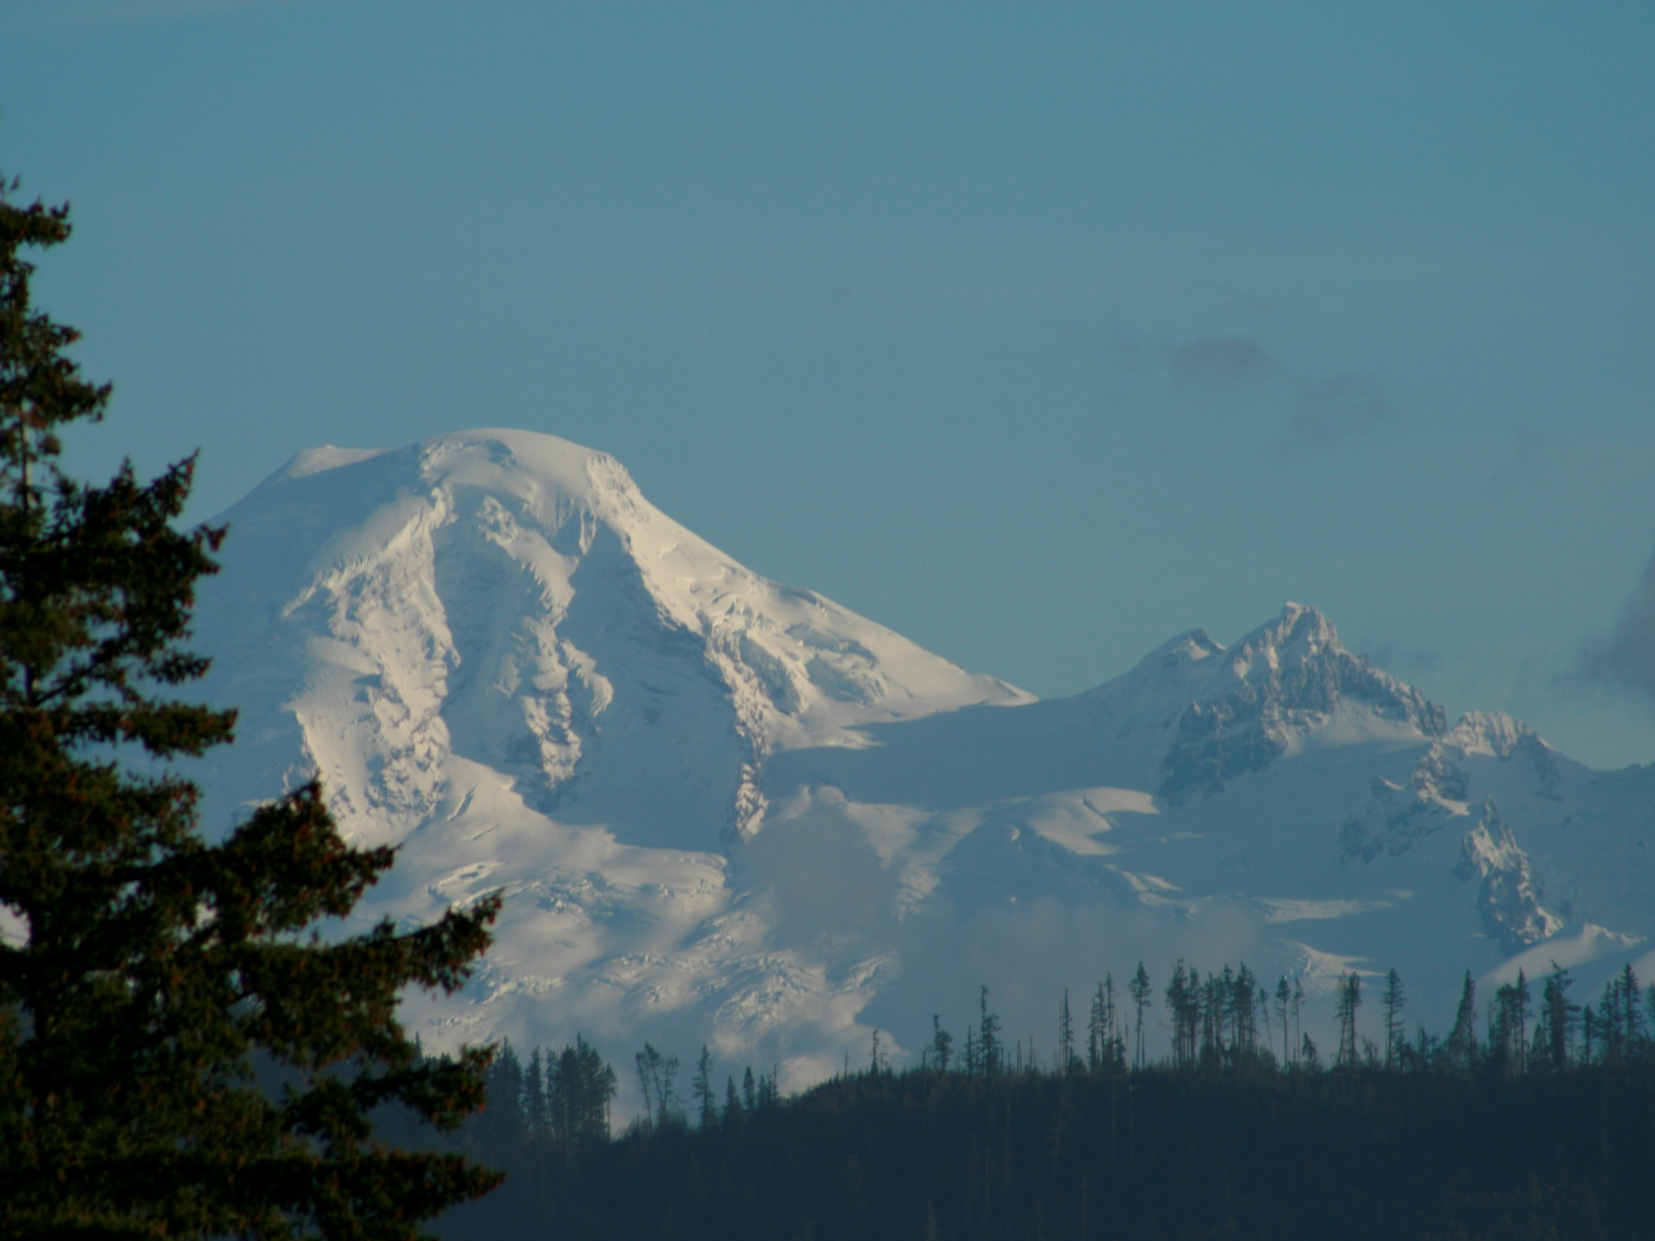
Flesh Dies on Moriah

Slide 2
Gen 22:1 And it came to pass after these things, that God did tempt Abraham, and said unto him, Abraham: and he said, Behold, here I am.
James 1:13 Let no man say when he is tempted, I am tempted of God: for God cannot be tempted with evil, neither tempteth he any man:
nacah (naw-saw'); to test
Ex 20:20 And Moses said unto the people, Fear not: for God is come to prove you, and that his fear may be before your faces, that ye sin not.

Slide 3
Gen 22:2 And he said, Take now thy son, thine only Isaac, whom thou lovest
John 1:14 only begotten of the Father
John 1:18 the only begotten Son
John 3:16 his only begotten Son
Heb 11:17 his only begotten son
Why not Ishmael?
Gen 16:11-12…call his name Ishmael; because the Lord hath heard thy affliction.
12 And he will be a wild man; his hand will be against every man, and every man's hand against him; and he shall dwell in the presence of all his brethren.

Slide 4
Gen 22:2 And he said, Take now thy son, thine only son Isaac, whom thou lovest, and get thee into the land of Moriah; and offer him there for a burnt offering upon one of the mountains which I will tell thee of.
Seen of Yah
Olah a step, to ascend
Ex 29:18,25 a sweet savour
Lev 1 :9,13,17, sweet savour
Restful, pleasant
Odor, to anticipate, enjoy

Slide 5
Gen 22:2 And he said, Take now thy son, thine only son Isaac, whom thou lovest, and get thee into the land of Moriah; and offer him there for a burnt offering upon one of the mountains which I will tell thee of.
2. Gen 22:3 Burnt offering
3. Gen 22:6 Burnt offering
4. Gen 22:7 Burnt offering
5. Gen 22:8 Burnt offering
6. Gen 22:13 Burnt offering
6 is the number of man, or FLESH this was to be consumed in service to the Father

Slide 6
Gen 22:5 And Abraham said unto his young men, Abide ye here with the ass; and I and the lad will go yonder and worship, and come again to you,
Gen 22:6 And Abraham took the wood of the burnt offering, and laid it upon Isaac his son; and he took the fire in his hand, and a knife; and they went both of them together.
Gen 22:8 And Abraham said, My son, God will provide himself a lamb for a burnt offering: so they went both of them together.

Slide 7
Gen 22:6 And Abraham took the wood of the burnt offering, and laid it upon Isaac his son; and he took the fire in his hand, and a knife; and they went both of them together.
John 19:17 And he bearing his cross went forth into a place called the place of a skull, which is called in the Hebrew Golgotha:
John 4:34 Jesus saith unto them, My meat is to do the will of him that sent me, and to finish his work.

Slide 8
Gen 22:9 And they came to the place which God had told him of; and Abraham built an altar there, and laid the wood in order, and bound Isaac his son, and laid him on the altar upon the wood.
Gen 12:8 And he removed from thence unto a mountain on the east of Bethel, and pitched his tent, having Bethel on the west, and Hai on the east: and there he builded an altar unto the Lord, and called upon the name of the Lord.
Flesh
Hai = Ruins
Built an altar
Spirit
Bethel = House of God

Slide 9
Ex 20:24-25
24 An altar of earth thou shalt make unto me, and shalt sacrifice thereon thy burnt offerings, and thy peace offerings, thy sheep, and thine oxen: in all places where I record my name I will come unto thee, and I will bless thee.
25 And if thou wilt make me an altar of stone, thou shalt not build it of hewn stone: for if thou lift up thy tool upon it, thou hast polluted it.
Memorial of individuality
to mark, to remember
“Holiness to Yahweh”

Slide 10
Isa 62:1-3
62 For Zion's sake will I not hold my peace, and for Jerusalem's sake I will not rest, until the righteousness thereof go forth as brightness, and the salvation thereof as a lamp that burneth.
2 And the Gentiles shall see thy righteousness, and all kings thy glory: and thou shalt be called by a new name, which the mouth of the Lord shall name.
3 Thou shalt also be a crown of glory in the hand of the Lord, and a royal diadem in the hand of thy God.
Rev 3:12-13
12 Him that overcometh will I make a pillar in the temple of my God, and he shall go no more out: and I will write upon him the name of my God, and the name of the city of my God, which is new Jerusalem, which cometh down out of heaven from my God: and I will write upon him my new name.
13 He that hath an ear, let him hear what the Spirit saith unto the churches.

Slide 11
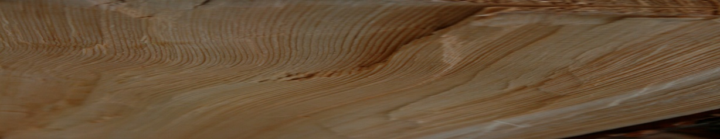

Gen 22:9 And they came to the place which God had told him of; and Abraham built an altar there, and laid the wood in order, and bound Isaac his son, and laid him on the altar upon the wood.
“the wood laid in order”
to set in a row, i.e. arrange, put in order

Slide 12
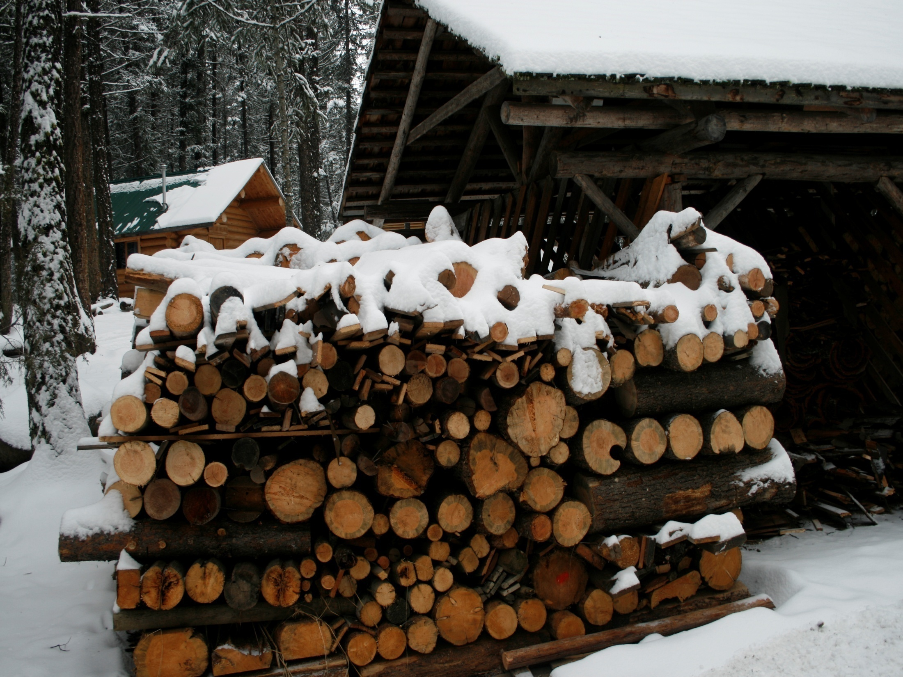

A sacrifice of our nature, not a sacrifice for our nature
Our life has to be laid out in order before our God
All our Life, all our strength, and every breath.

Slide 13
Gen 22:2 And he said, Take now thy son, thine only son Isaac, whom thou lovest, and get thee into the land of Moriah; and offer him there for a burnt offering upon one of the mountains which I will tell thee of.
Seen of Yah
Gen 22:14 And Abraham called the name of that place Yahweh-jireh: as it is said to this day, In the mount of the Lord it shall be seen.
Yahweh has seen

