Slide 1
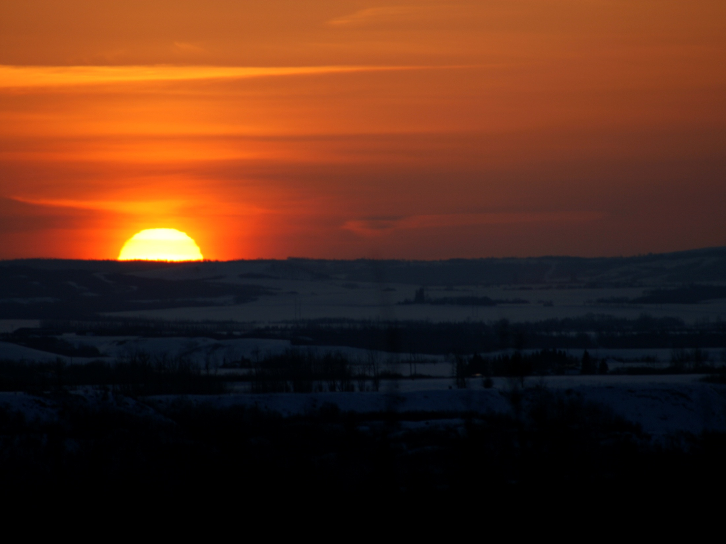
The Spirit Invitation
Covenant of the Spirit

Slide 2
“The covenant of God is to redeem for himself a race from mortality that have displayed faith in action, putting on his characteristics and manifesting his love to the laying down of their lives in the service of the vineyard.”

Slide 3
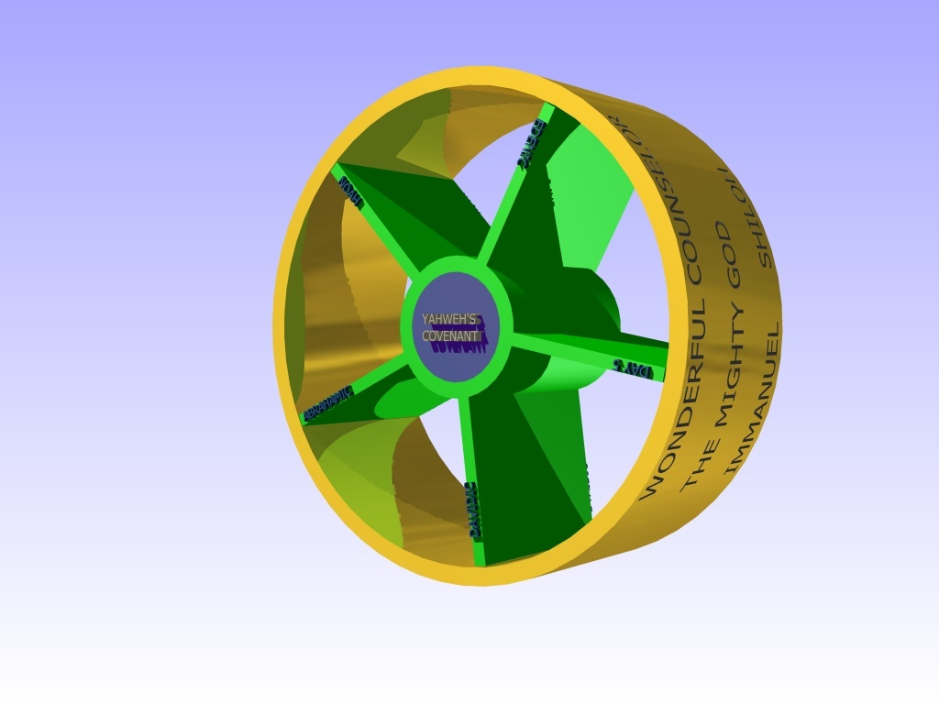
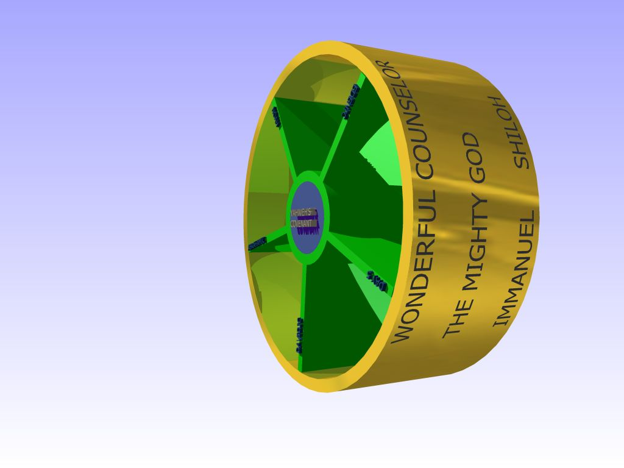
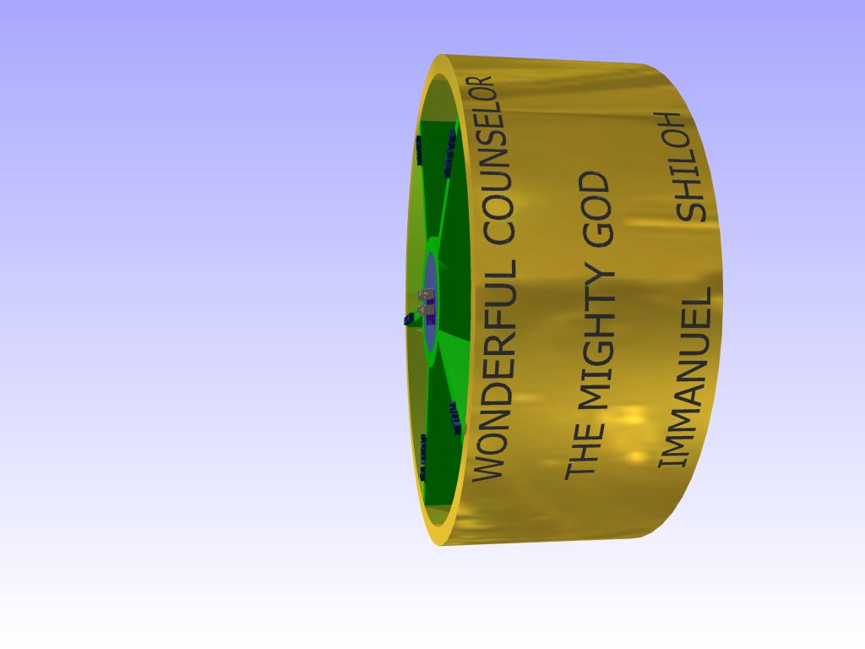
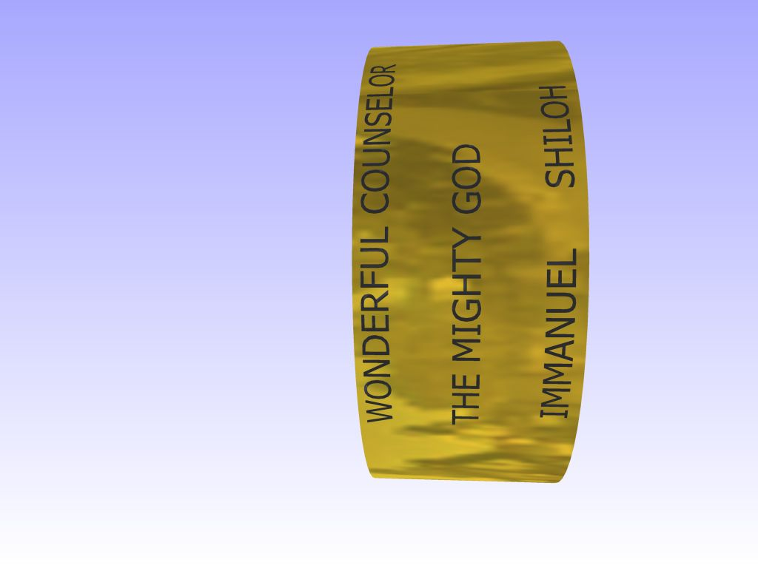
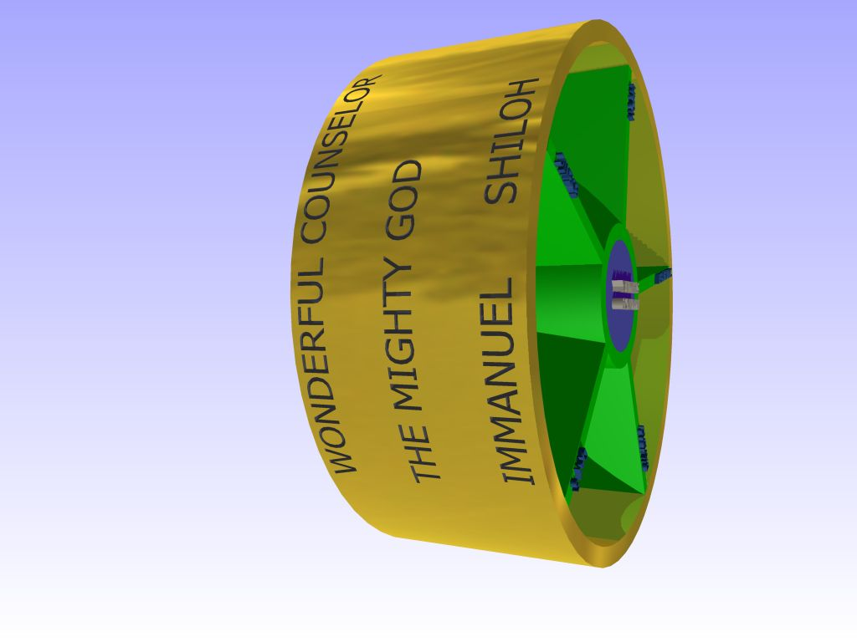
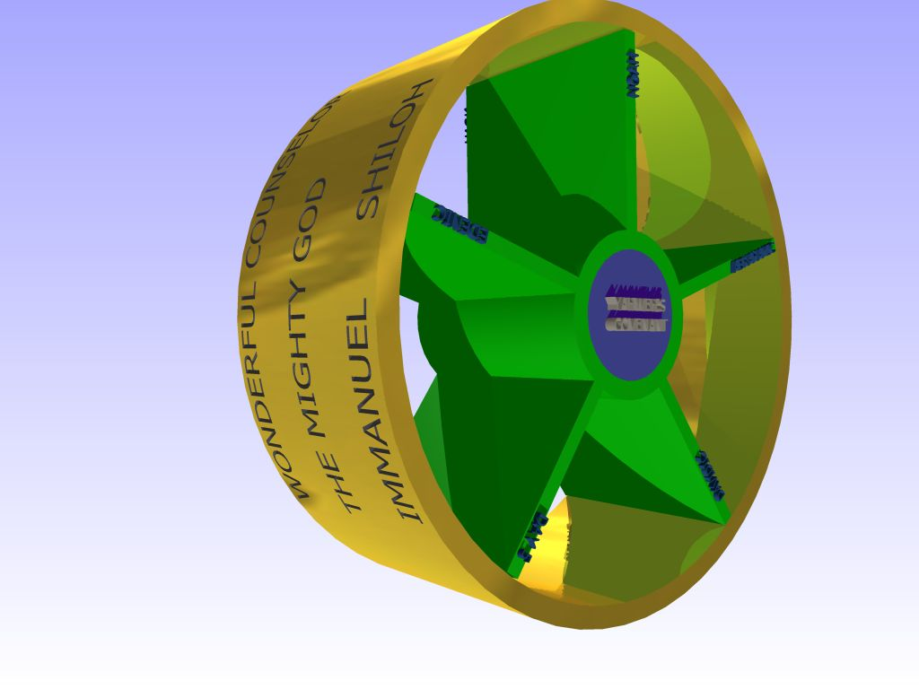
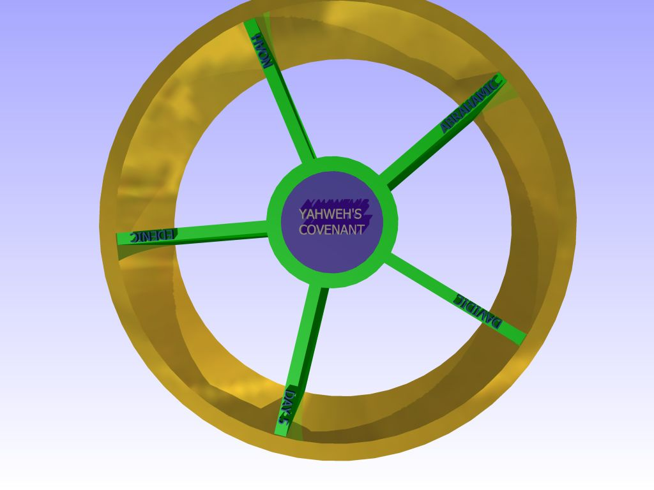
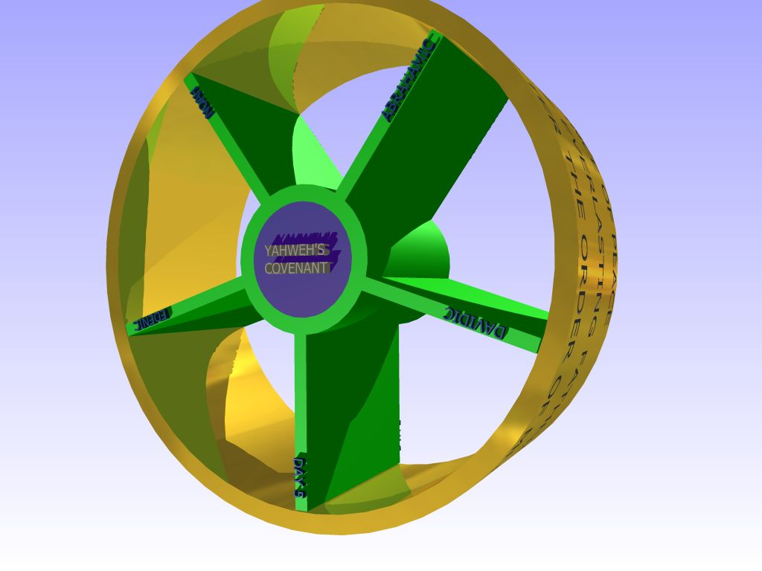
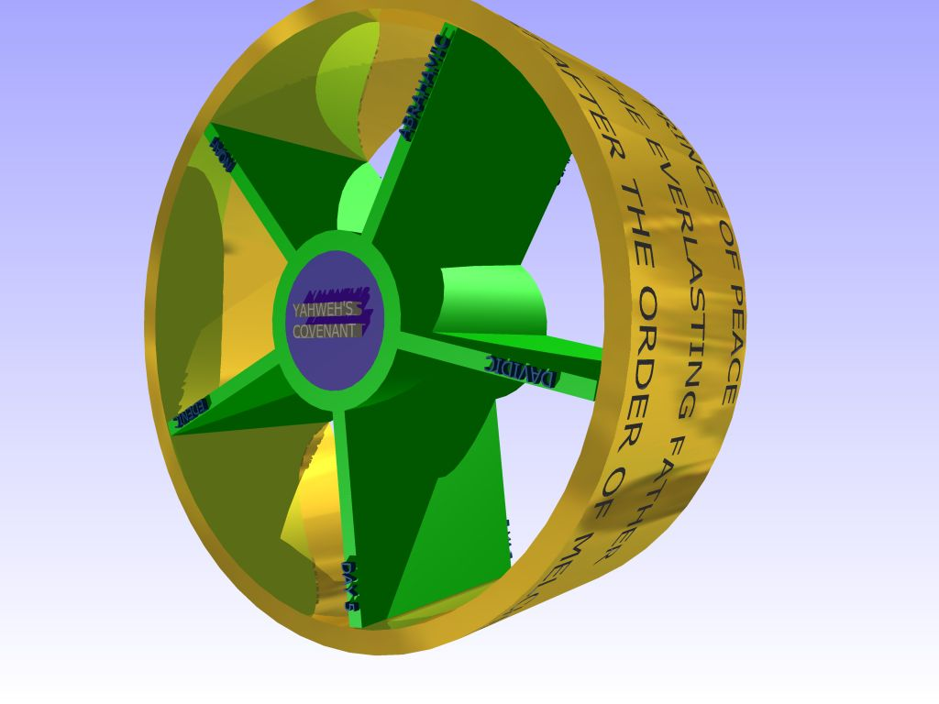
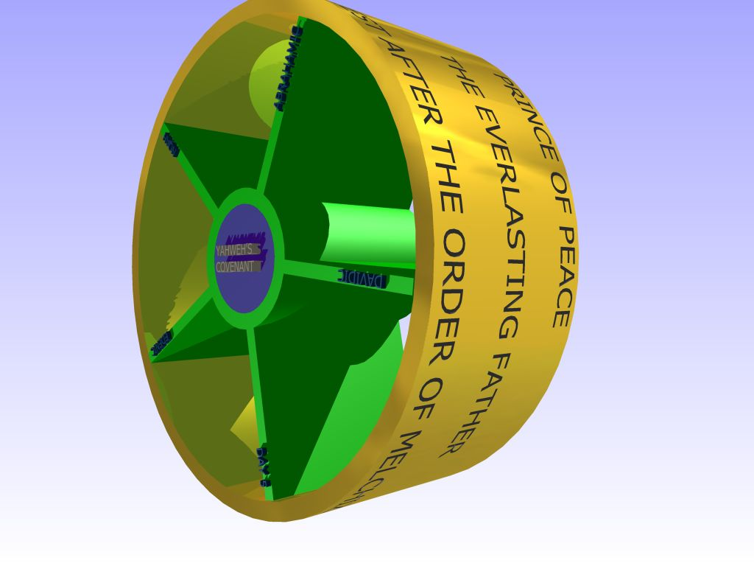

Slide 4
Rom 8:17 And if children, then heirs; heirs of God, and joint-heirs with Christ; if so be that we suffer with him, that we may be also glorified together.
Num 18:20 And the Lord spake unto Aaron, Thou shalt have no inheritance in their land, neither shalt thou have any part among them: I am thy part and thine inheritance among the children of Israel.
Num 18:23 But the Levites shall do the service of the tabernacle of the congregation, and they shall bear their iniquity: it shall be a statute for ever throughout your generations, that among the children of Israel they have no inheritance.

Slide 5
Rom 4:13-16
13 For the promise to Abraham and his offspring that he would be heir of the world did not come through the law but through the righteousness of faith.
14 For if it is the adherents of the law who are to be the heirs, faith is null and the promise is void.
15 For the law brings wrath, but where there is no law there is no transgression.
16 That is why it depends on faith, in order that the promise may rest on grace and be guaranteed to all his offspring—not only to the adherent of the law but also to the one who shares the faith of Abraham, who is the father of us all,
ESV

Slide 6
Gal 2:16 Knowing that a man is not justified by the works of the law, but by the faith of Jesus Christ, even we have believed in Jesus Christ, that we might be justified by the faith of Christ, and not by the works of the law: for by the works of the law shall no flesh be justified.
Faith
credence; moral conviction, especially reliance upon Christ for salvation; abstractly, constancy in such profession; by extension, the system of religious (Gospel) truth itself:
Strong's
Faith
primarily, "firm persuasion," a conviction based upon hearing, is used in the NT always of "faith in God or Christ, or things spiritual."
Vine's Expository Dictionary
Notes:
Faith in the unseen has nothing to do with this world
The fall of Flesh can only happen when the spirit of God rules in our life

Slide 7
HOPE
elpis (el-pece'); from a primary elpo (to anticipate, usually with pleasure); expectation (abstractly or concretely) or confidence:
PROMISE
epaggelia (ep-ang-el-ee'-ah); an announcement (for information, assent or pledge; especially a divine assurance of good):
Acts 26:6 And now I stand and am judged for the hope of the promise made of God unto our fathers:
Acts 26:6 “I stand and am now judged of the anticipation of pleasure that Yahweh has assured his children of good.”

Slide 8
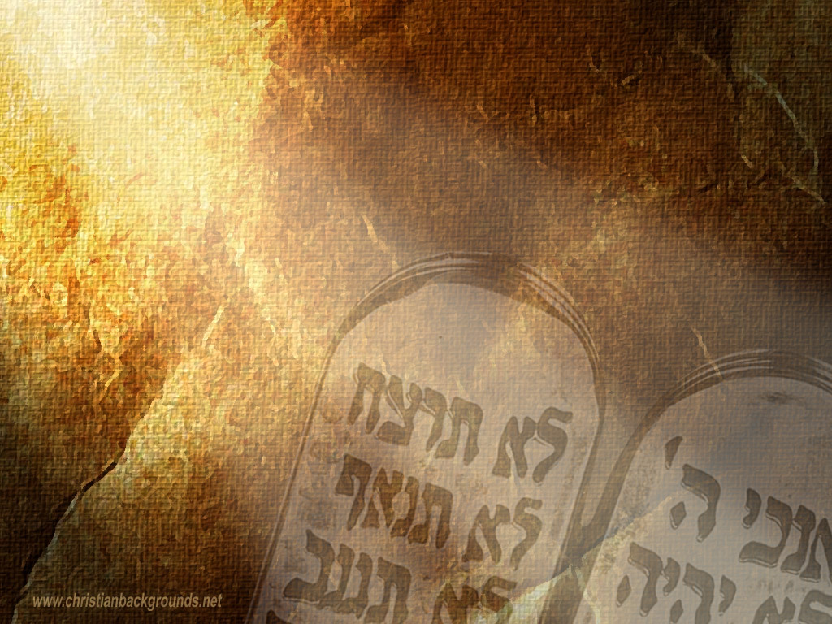
FAITH
OBEDIANCE

Slide 9
GRACE
charis (khar'-ece); graciousness (as gratifying), of manner or act (abstract or concrete; literal, figurative or spiritual; especially the divine influence upon the heart, and its reflection in the life; including gratitude):
“Not by works of righteousness which we have done, but according to his mercy he saved us, by the washing of regeneration, and renewing of the Holy Spirit; Which he shed on us abundantly through Jesus Christ our Saviour; That being justified by his grace, we should be made heirs according to the hope of eternal life.” Titus 3:5-7

Slide 10
Gal 3:16 Now to Abraham and his seed were the promises made. He saith not, And to seeds, as of many; but as of one, And to thy seed, which is Christ.

