Slide 1

Triumph in Eden

Slide 3
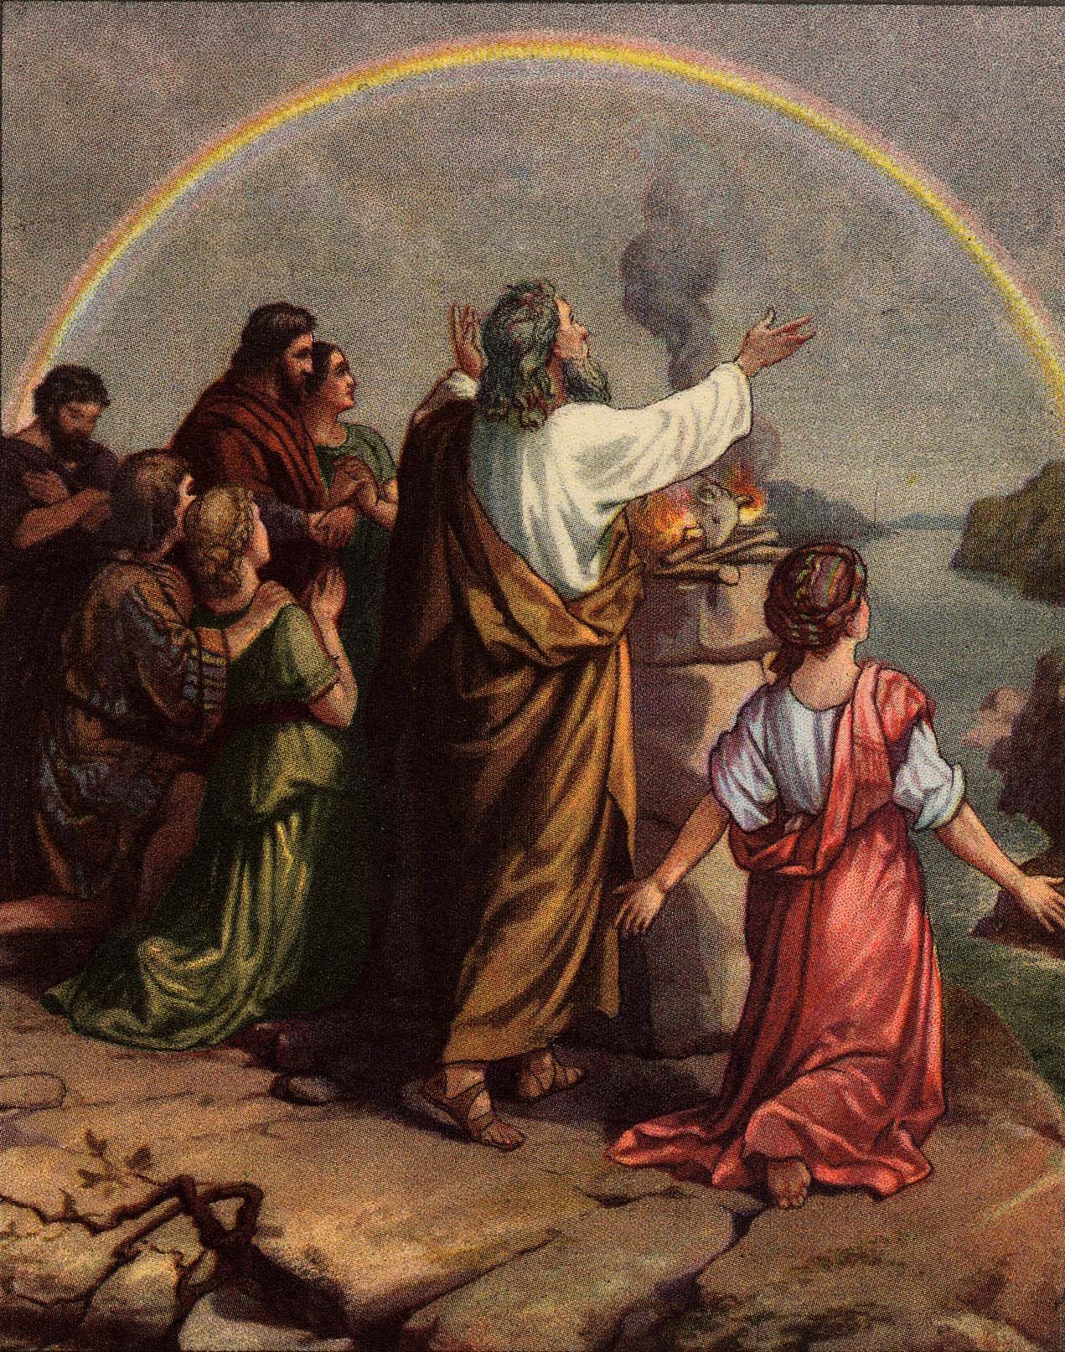
“be fruitful and multiply and replenish the earth”

Slide 4
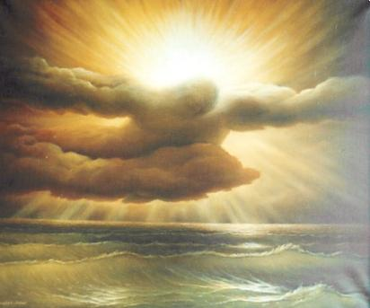
Day 5
The day of grace, when covenant language is used by the Elohim

Slide 5
Day 5
Gen 1:20-22
Waters bring forth abundantly
Great Whales & every living creature
Gen 1:22 And God blessed them, saying, Be fruitful, and multiply, and fill the waters in the seas, and let fowl multiply in the earth.

Slide 6
Day 5
Gen 48:16 The Angel which redeemed me from all evil, bless the lads; and let my name be named on them, and the name of my fathers Abraham and Isaac; and let them grow into a multitude in the midst of the earth.
Abundance, from a root to multiply by the myriad
To move rapidly to spawn, become numerous, from a root - fish

Slide 7
Gen 1:29 And God said, Behold, I have given you every herb bearing seed, which is upon the face of all the earth, and every tree, in the which is the fruit of a tree yielding seed; to you it shall be for meat.
`eseb (eh'seb); from an unused root meaning to glisten (or be green); grass (or any tender shoot):
zera` (zeh'-rah); seed; figuratively, fruit, plant, sowing-time, posterity:
a primitive root; to sow; figuratively, to disseminate, plant, fructify:

Slide 8
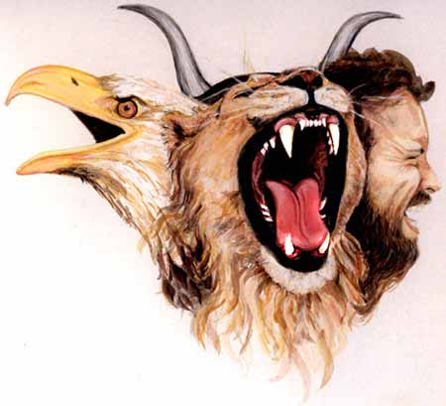

Slide 9
Foundation of Yahweh’s covenant
Many out of one
1 source of water into four rivers
1 throne four living ones
1 mercy seat four living ones
1 seed manifested in the four faces

Slide 10
The Triumph of Spirit
The Fall of Flesh
RIGHTEOUSNESS
LIGHT
CHRIST
BELIEVER
TEMPLE OF GOD
UNRIGHTEOUSNESS
DARKNESS
BELIAL
INFIDEL
IDOLS

Slide 11
Two ways of life
ENMITY
or
HOSTILITY
Seed of the woman
White
Life
Clean
Bride
Spirit
Seed of the serpent
Black
Death
Unclean
Harlot
Dust

Slide 12
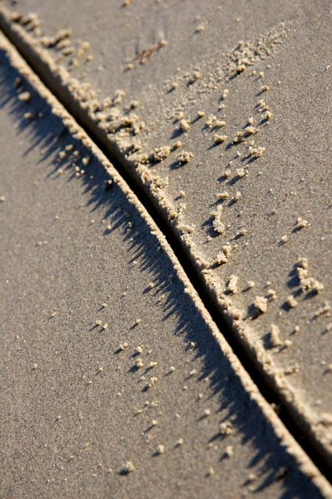
Com
promise
1 a: settlement of differences by arbitration or by consent reached by mutual concessions b: something intermediate between or blending qualities of two different things2: a concession to something derogatory or prejudicial <a compromise of principles>

Slide 13
M & W
Sinned = disobedience
Eyes were opened = moral defilement
Became dying = Physical law/defilement
Righteousness = obedience
Clean hearts = God manifestation
Immortality = Gift of God
M & W
God
M & W
M & W
God

Slide 14
“It was customary for Yahweh to answer men by fire, when any great principle, or new institution was to be established….the flaming sword in Eden was applied to a similar purpose, namely, to flash forth its fire for the consumption of the sacrifices offered by the family of Adam before Yahweh”.
“From these passages it is evident that fire which is also light, is in symbolic representation that signifies the spirit of God…such glory, or brightness, so beautifully represented by Ezekiel and John, will cloth the Saints, as well as the Lord Jesus, when they appear in the Kingdom of God”
Bro John Thomas Elpis Israel pg 152-154

