Slide 1
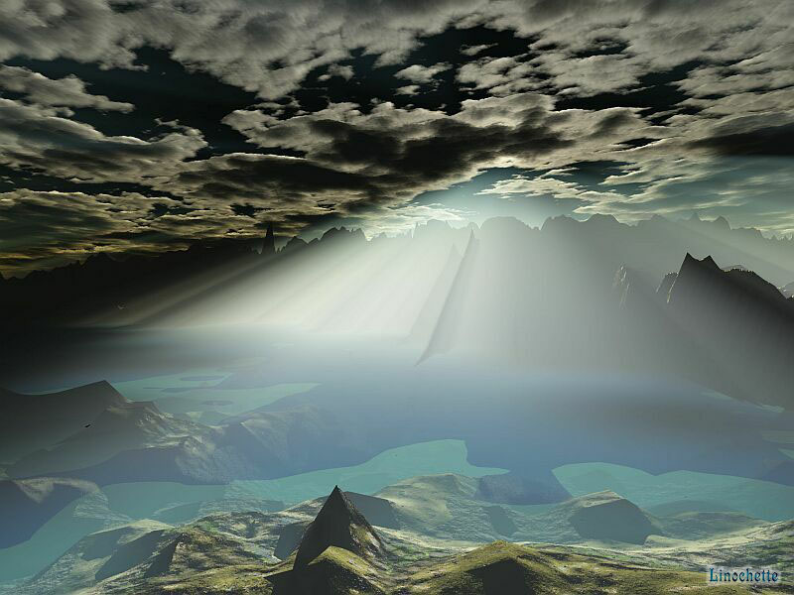
Man of Spirit, Friend of God

Slide 2
Abraham & Keturah Gen 25:2
Priest of Midian
Raguel Reuel Ex 2:18
Friend of God
Kenites
Jethro Ex 18:27
Hobab Num 10:29
Zipporah10:29
6 daughters
Hemath 1 Chron 2:55
Rechab 1 Chron 2:55
Heber Judges 4:11
Jael Judges 5:24
Jehonadab 2 Kings 10:15, 23
Kenites
Rechabites Jer 35

Slide 3
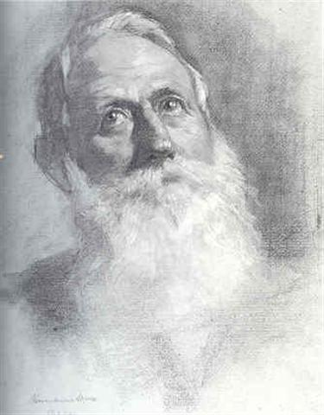
Abraham’s Obituary
The days of the years of his pilgrimage were 175, traveled throughout the middle east during his younger years, met with world leaders, fought battles, raised a family that walked in “THE WAY”, but above all was considered a close friend of Yahweh Elohim!
No distrust made him waver concerning the promise of God, but he grew strong in his faith as he gave glory to God, fully convinced that God was able to do what he had promised. That is why his faith was "counted to him as righteousness."
ESV

Slide 4
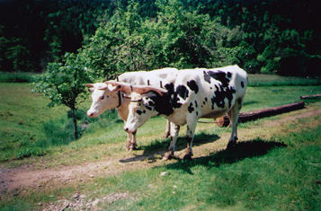
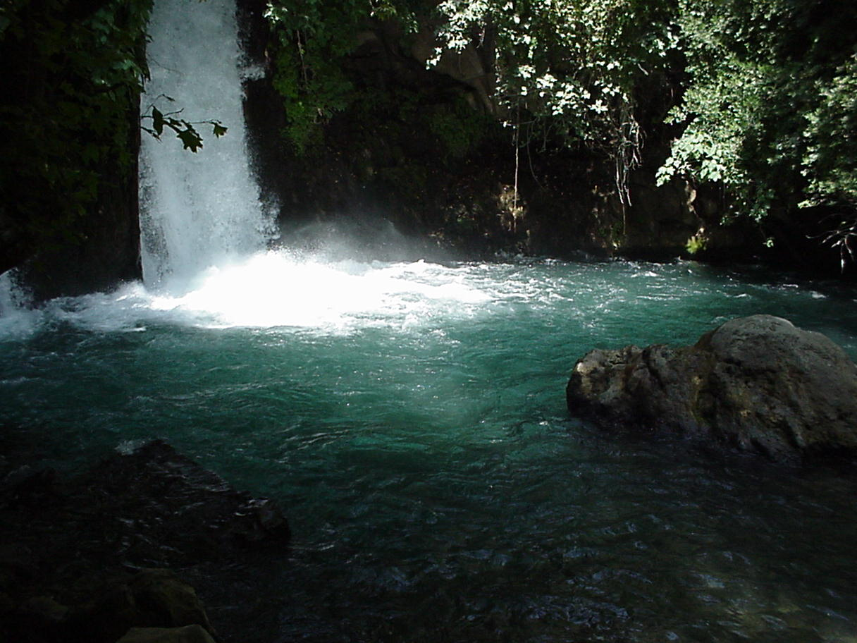
Sichem = a ridge, the neck as a place of burden
Moreh = from teacher, a root to flow as water

Slide 5
Gen 12:8 And he removed from thence unto a mountain on the east of Bethel, and pitched his tent, having Bethel on the west, and Hai on the east: and there he builded an altar unto the Lord, and called upon the name of the Lord.
Yahweh I will be
Gen 3:15 I will put
Gen 9:11 I will establish
Gen 12:2 I will make
Gen 12:3 I will bless
Gen 13:4 Unto the place of the altar, which he had made there at the first: and there Abram called on the name of the Lord.

Slide 6
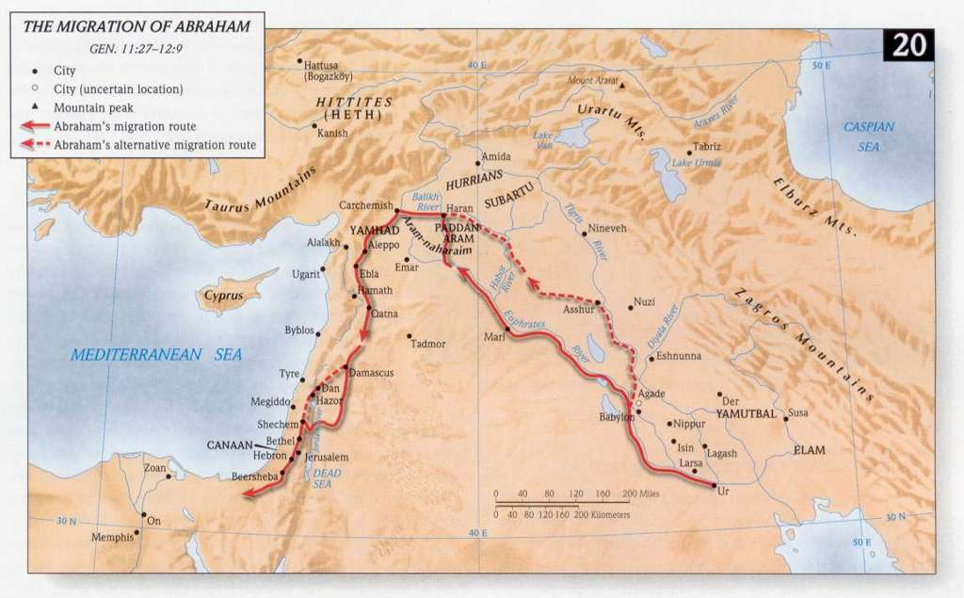
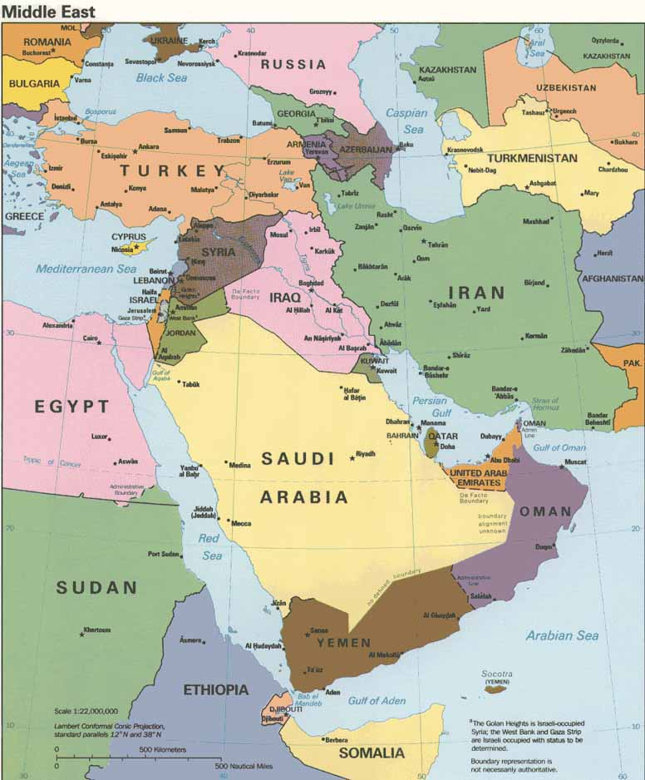

Slide 7
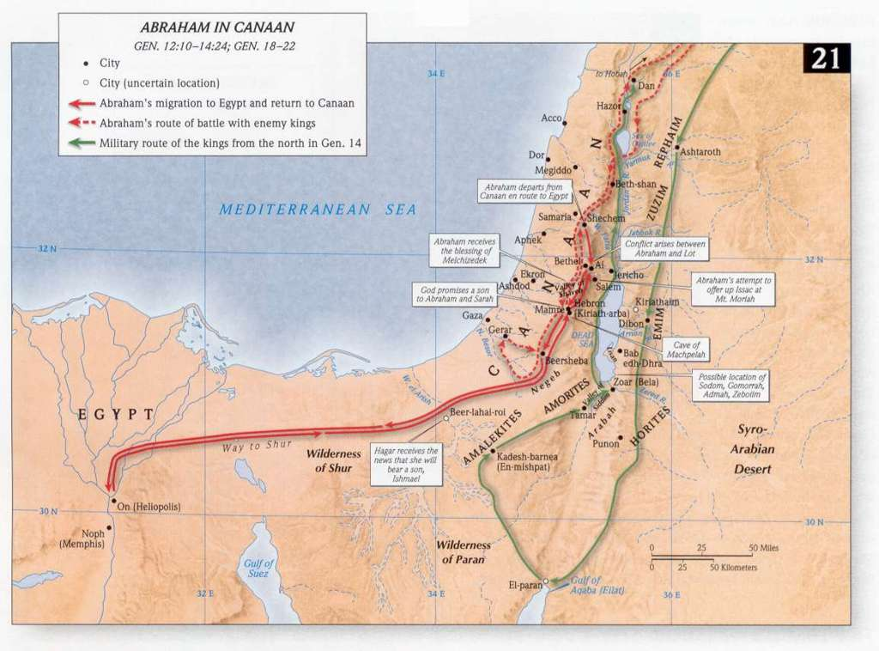

Slide 8
Gal 3:8 And the scripture, foreseeing that God would justify the heathen through faith, preached before the gospel unto Abraham, saying, In thee shall all nations be blessed.
To announce good news in advance

Slide 9
N E W S
N
ORTH
EAST
WEST
SOUTH

Slide 10
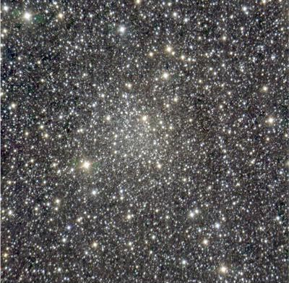
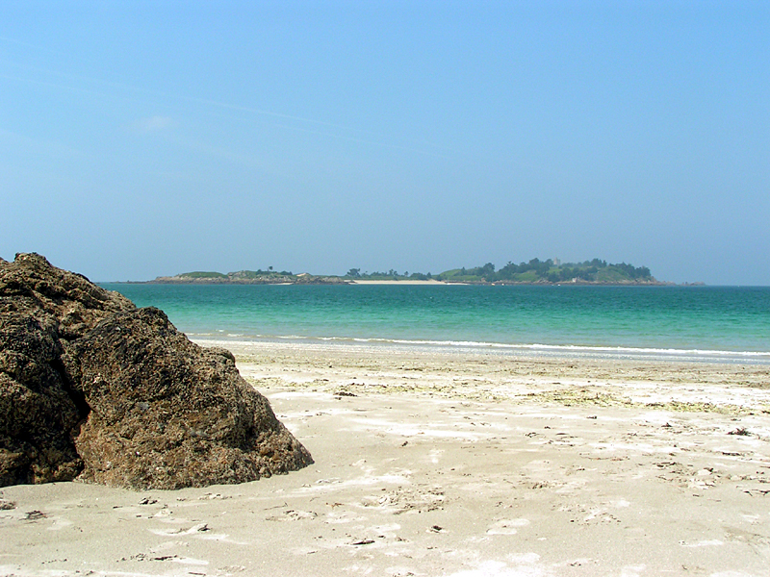
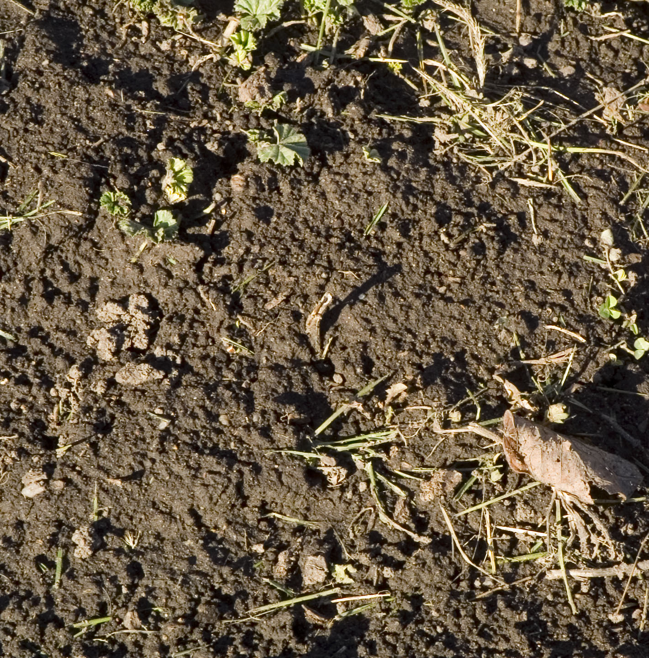
STARS OF HEAVEN
SAND ON THE SEA SHORE
`aphar (aw-far'): meaning either to be gray or perhaps rather to pulverize;
DUST OF THE EARTH

Slide 11
She Judged him Faithful Who had promised
Strength = force, or miraculous power
Faithful = trustworthy from a root, convince
Promised = to announce
Through Faith also, Sara herself got hold of a miraculous power and (was delivered of a child) (when she was) past age because she deemed him trustworthy who had given a divine assurance of good!!!
Through Faith also, Sara herself got hold of a miraculous power, past age, because she deemed him trustworthy who had given a divine assurance of good!!!

Slide 12
SEPARATE & HOLY
We DO NOT belong to this world, we have to stay at arms length from it and its ideals. Yahweh’s requirement was acted out in the life of Abraham, come out from among them and be separate. He NEVER compromised his heirship by considering the land he dwelt on as his, for the hope that was set before him he endured all Yahweh brought into his life.

Slide 13
When Christ returns will he find the Faith?
Are you to proud to accept the help of the Angels?
What are you going to do with the prosperous ease?
Are you soaring in the knowledge of this world?
Are you taking care of the young and poor in spirit?

Slide 14
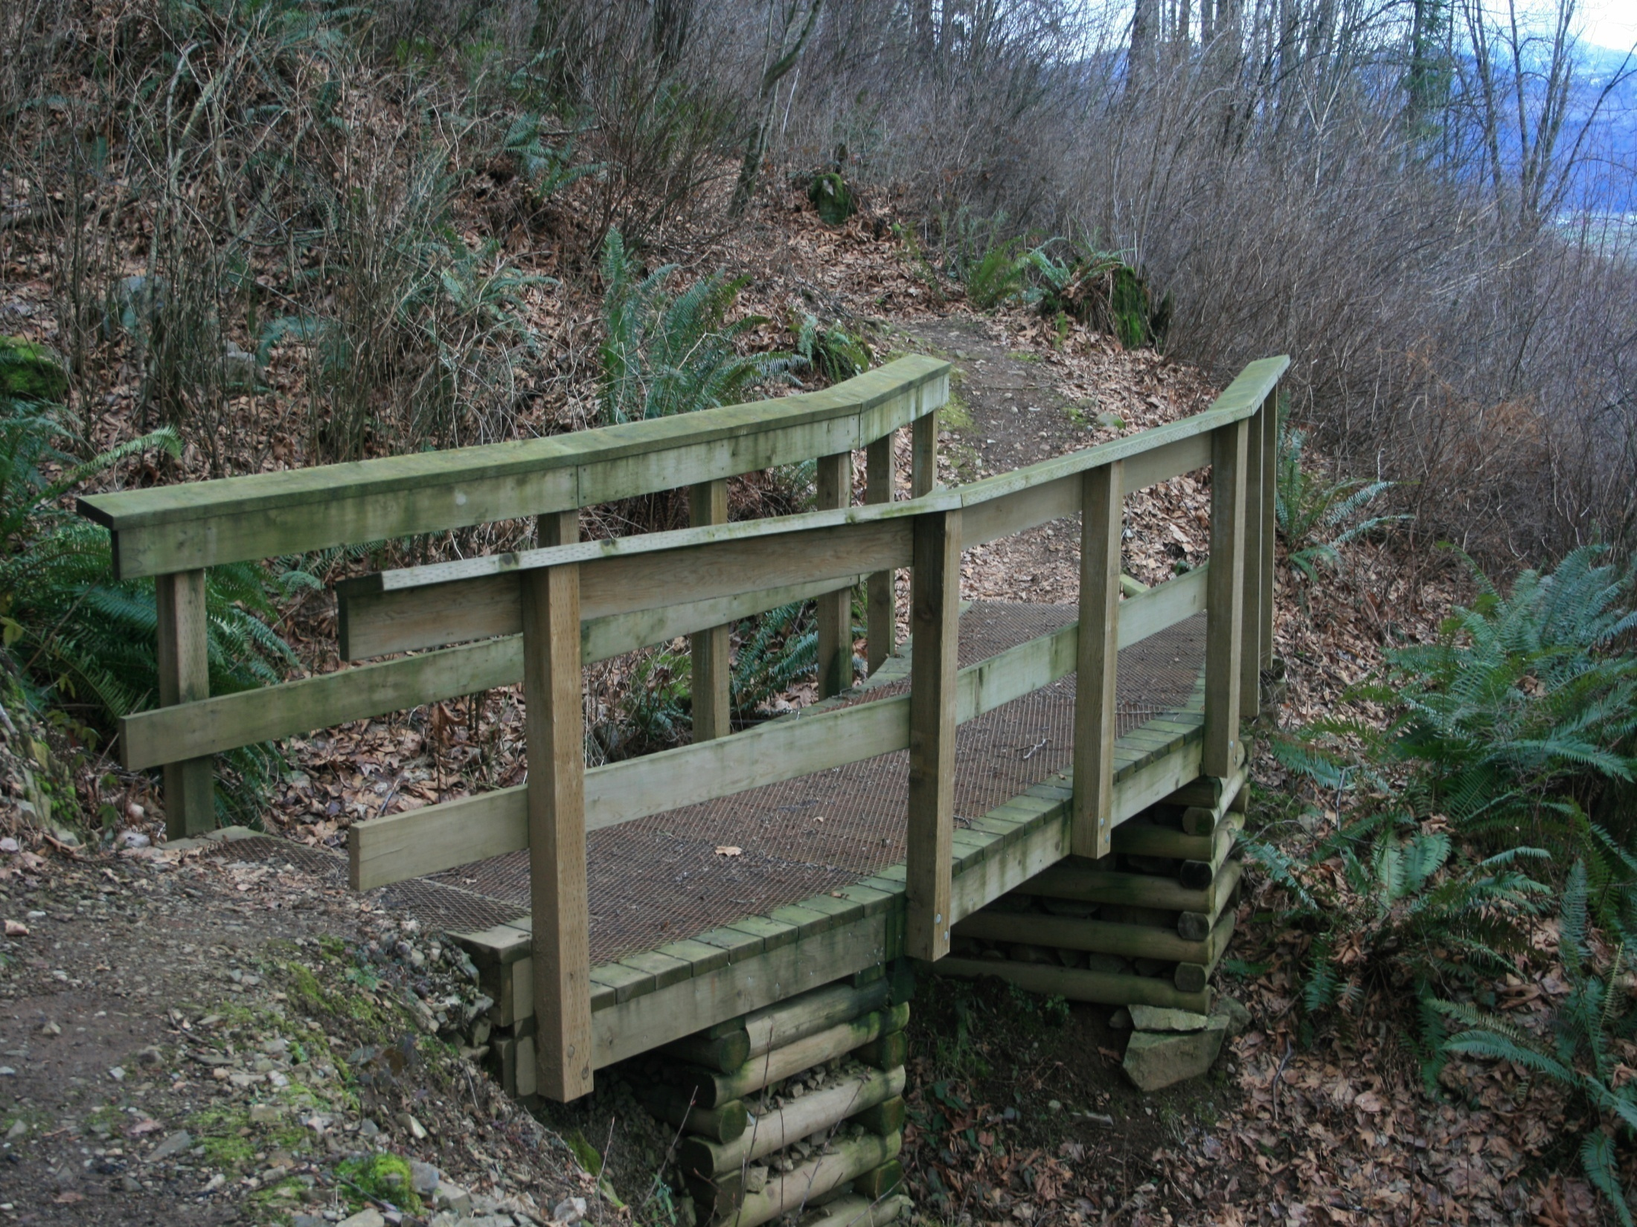
No distrust will make us waver concerning the divine assurance of good, but we will grow strong in our faith as we give glory to God, fully convinced that God is able to do what he has promised. In this way our faith will be "counted to us as righteousness."

