Slide 1
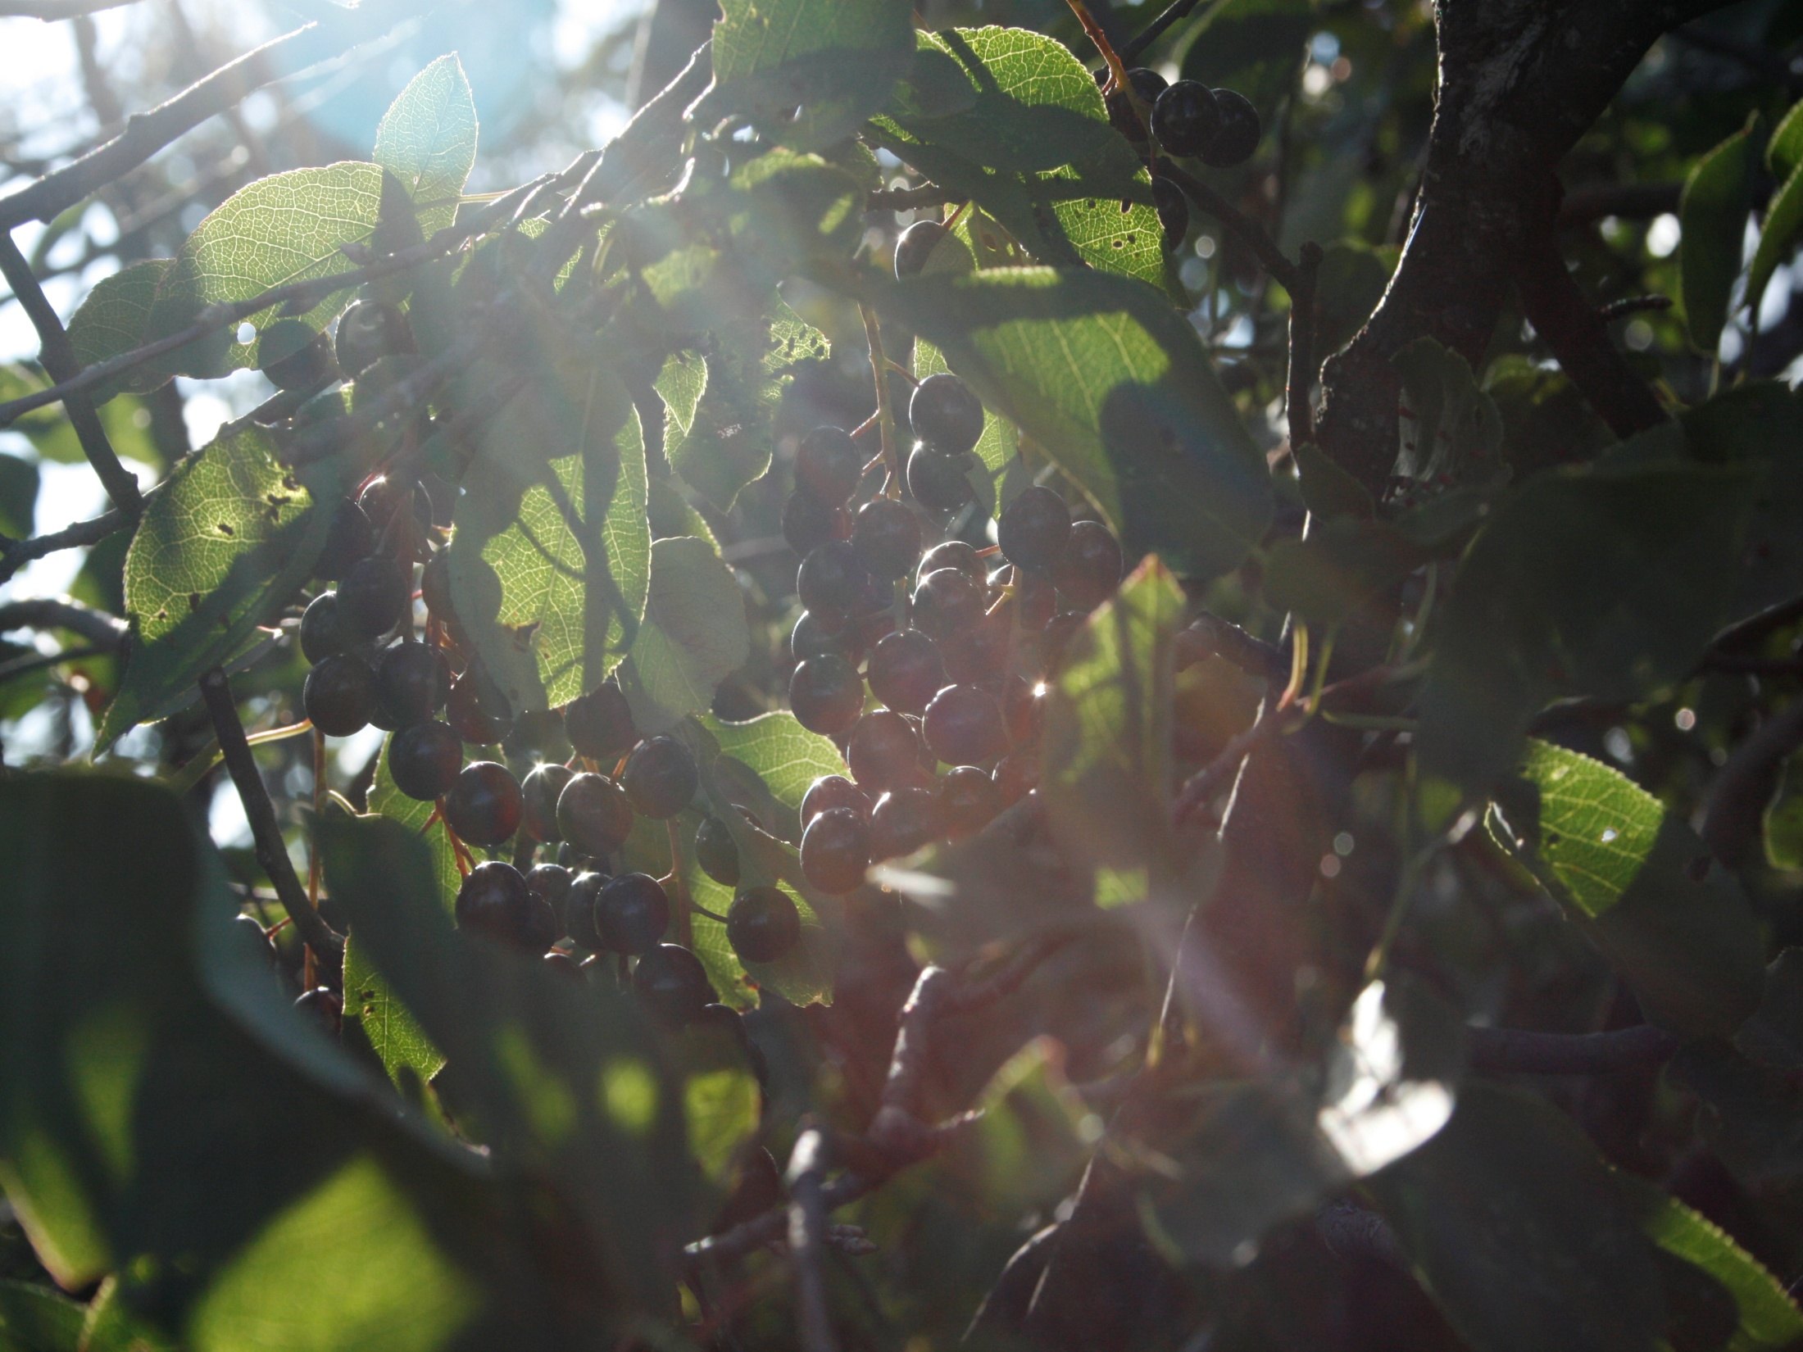
2 Sam 7:10 Moreover I will appoint a place for my people Israel, and will plant them, that they may dwell in a place of their own, and move no more; neither shall the children of wickedness afflict them any more, as beforetime,
The Planting of Yahweh

Slide 2
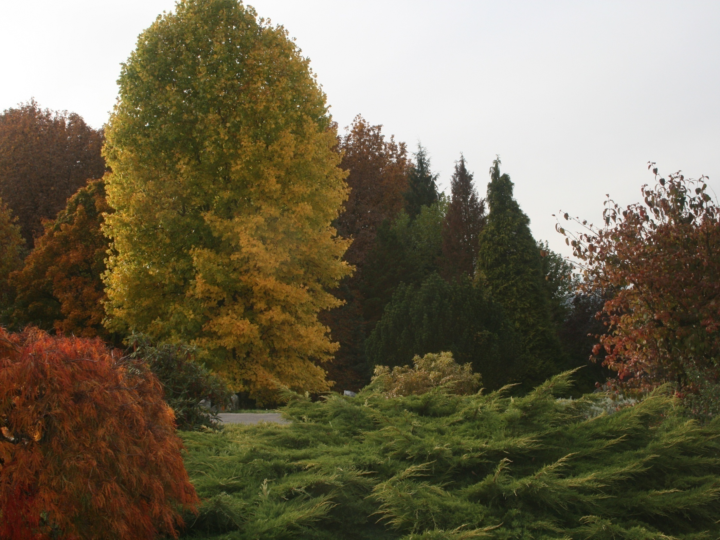
Gen 2:8
The planting of Yahweh
Amos 9: 13-15
Matt 7:17-20
Isa 61:1-3

Slide 3
The planting of Yahweh
Gen 2:8
Lord God planted a garden eastward in Eden
Amos 9:15
I will plant them upon their land
Matt 7:17
every good tree bringeth forth good fruit
2 Sam 7:10 I will appoint a place for my people Israel, and will plant them
Isa 61:3
that they might be called trees of righteousness, the planting of the Lord

Slide 4
Melchizedek
Christ
David

Slide 5
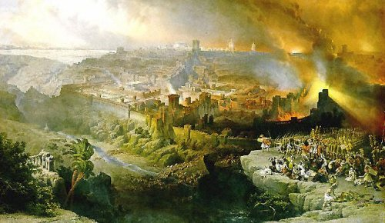
Chedorlaomer King of Elam
Tidal King of Nations
Elam = Veil
Religious
Military
Gen 14:17 And the king of Sodom went out to meet him after his return from the slaughter of Chedorlaomer, and of the kings that were with him, at the valley of Shaveh, which is the king's dale.
A Plain, from a root to level, equalize, “to resemble”

Slide 6
{
Religious
Melchizedek
Military
Heb 2:14 took part of the same
Heb 2:16 took on the seed of Abraham
Heb 2:17 to be made like his brethren
A Plain, from a root to level, equalize, “to resemble”

Slide 7
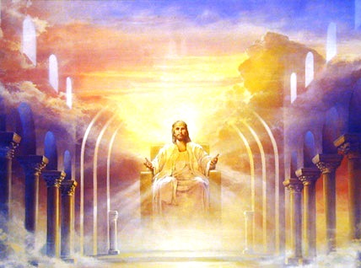
Thou art a priest for ever after the order of Melchizedek
Priest of the Most High God
First King of Righteousness
and King of Peace

Slide 8
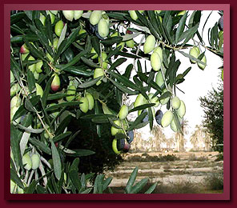

1 Kings 6:13 I will dwell among them
Ez48:35 The name of the city will be Yahweh Shammah-”Yahweh is there”
1 Kings 6:18 buds & open flowers
1 Kings 6:19 the ark of the covenant
Ez41:18,19 Cherubim & Palm trees, Palm between Cerub and Cherub, the Cherub had two faces a man and a Lion
1 Kings 6:29-35 carved figures of cherubim, palm trees, open flowers

Slide 9
1 Kings 6:23 And within the oracle he made two cherubims of olive tree, each ten cubits high.
Ps 52:8 But I am like a green olive tree in the house of God: I trust in the mercy of God for ever and ever.
Ps 1:1-2
1 Blessed is the man that walketh not in the counsel of the ungodly, nor standeth in the way of sinners, nor sitteth in the seat of the scornful.
2 But his delight is in the law of the Lord; and in his law doth he meditate day and night.
Ps 1:3 And he shall be like a tree planted by the rivers of water, that bringeth forth his fruit in his season; his leaf also shall not wither; and whatsoever he doeth shall prosper.

Slide 10
1 Kings 6:31-33
31 he made doors of olive tree
32 The two doors also were of olive tree; and he carved upon them carvings of cherubims and palm trees and open flowers, and
33 So also made he for the door of the temple posts of olive tree, a fourth part of the wall.
Ps 84:10 For a day in thy courts is better than a thousand. I had rather be a doorkeeper in the house of my God, than to dwell in the tents of wickedness.

Slide 11
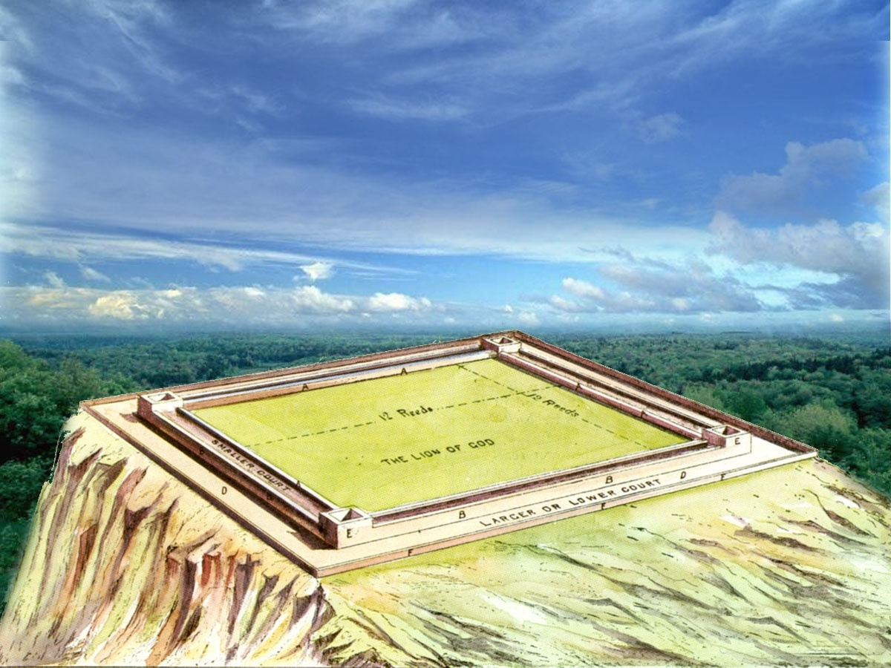
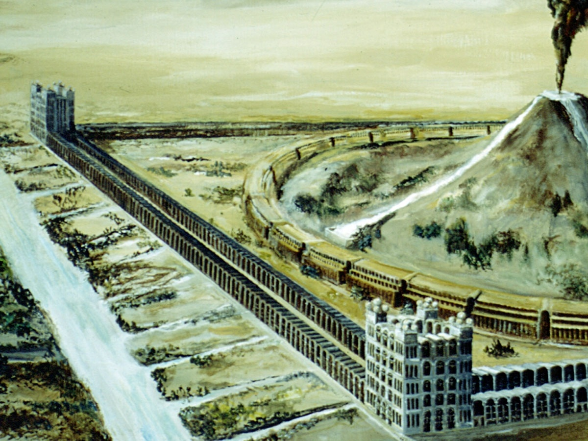
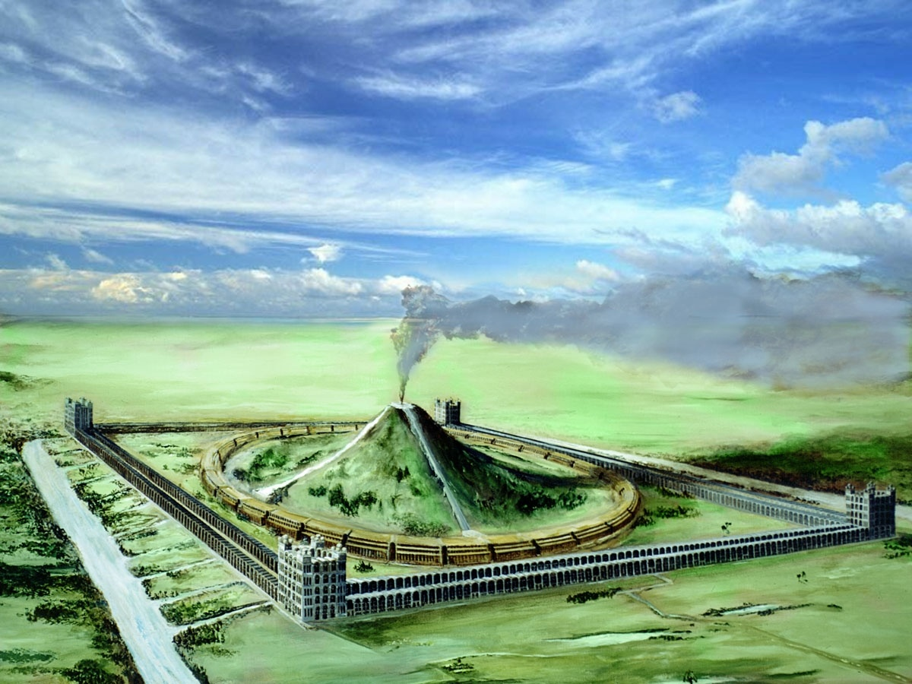
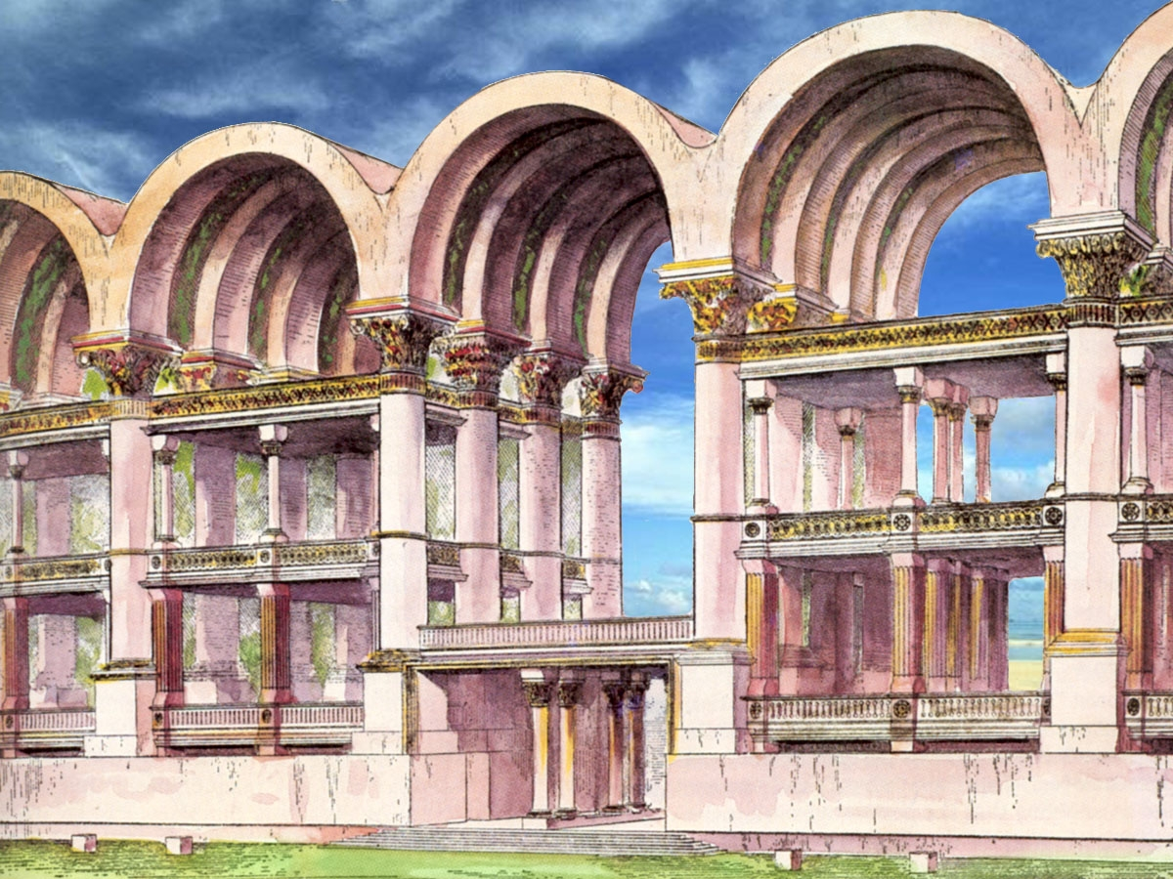
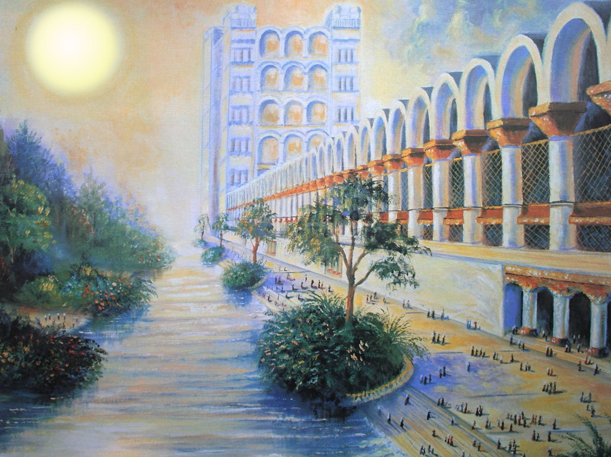
Isa 9:7 Of the increase of his government and peace there shall be no end, upon the throne of David, and upon his kingdom, to order it, and to establish it with judgment and with justice from henceforth even for ever. The zeal of the Lord of hosts will perform this.

