Slide 1
The Things Thou Hast Seen!
Detroit CYC
Attica, Michigan
Jan. 2009

Slide 2



Bible Mark, Cross Reference, Meanings etc.
Tip, Key Word/Verse etc.
Lesson For Us, Personal Application

Slide 3
But saints are separated from the world, and it becomes them not to let the mind dwell on the sins of the world. The mind insensibly is affected by the stream of thought passing through it, and it is desirable to have the stream as pure as possible. A mind familiarised by pictures of evil is not strongly fortified if sin should assail.
Vol. 69: The Christadelphian : Volume 69. 2001, c1932.

Slide 4
The Revelation of Jesus Christ, which God gave unto him, to show unto his servants things which must shortly come to pass; and he sent and signified it by his angel unto his servant John: Who bare record of the word of God, and of the testimony of Jesus Christ, and of all things that he saw.

Slide 5

Introduction
“Of Jesus Christ which God gave unto Him…”
    Teaches us that Christ was dependant upon God for his Knowledge.
    Previously certain knowledge was hidden from the Lord Cp. Mk. 13:32; Acts 1:7, but having overcome and raised to life eternal, the FULL revelation of the Fathers purpose was given to him. Cp. Rev. 5:5
    Proves that Jesus is not co-equal with His Father.

Slide 6
The Revelation of Jesus Christ, which God gave unto him, to show unto his servants things which must shortly come to pass; and he sent and signified it by his angel unto his servant John: Who bare record of the word of God, and of the testimony of Jesus Christ, and of all things that he saw.

Slide 7









Slide 8
Introduction
The book of Revelation should not be neglected. Unfortunately, it is neglected by many who believe that it is beyond their comprehension or grasp.
More than any other book of the Bible, divine “blessings” are given to those who apply themselves to a study and an understanding of the Revelation.
John in Patmos was told that the wise who come to understand the things revealed unto him will be “blessed.” Cp. Rev. 1:3

Slide 9
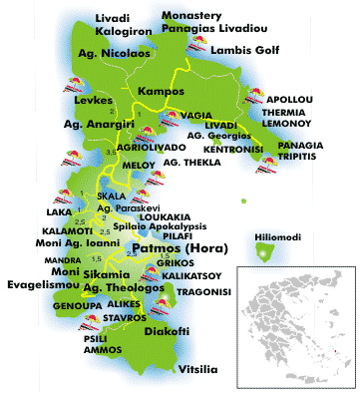
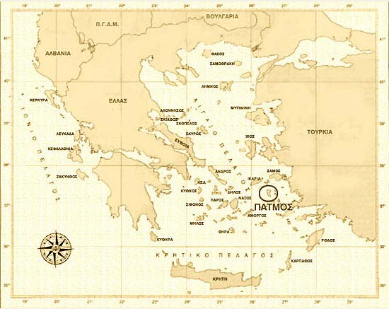
Patmos
Patmos belongs to the Dodecanese (The Dodecanese = Gk: literally
"twelve islands" and are a group of 12 larger plus 150 smaller Greek
islands in the Aegean Sea, off the southwest coast of Turkey).
The designations and legends associated with early Patmos easily
override the sparse documentation available, which is often woven
around the fortunes of dominant city-states, such as Miletus and Rhodes.

Slide 10
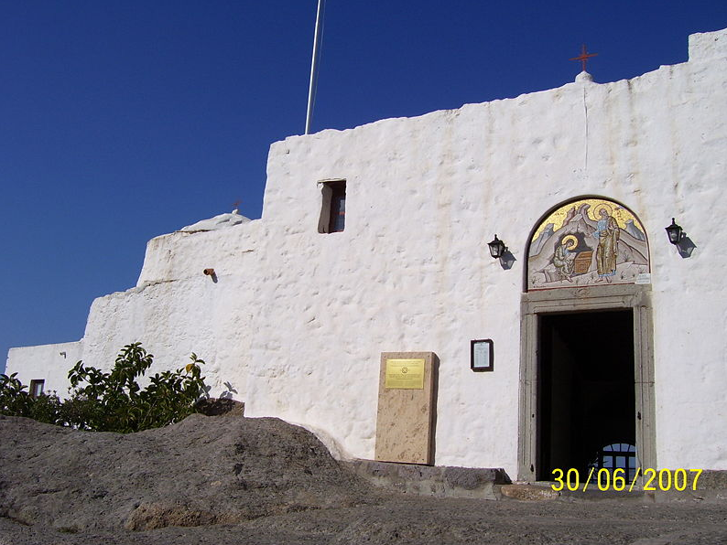
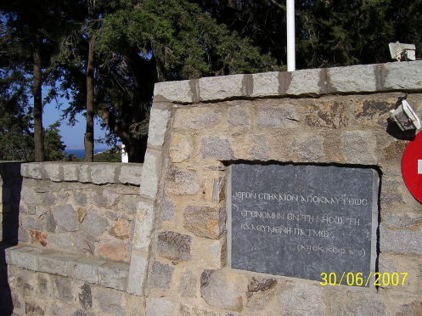
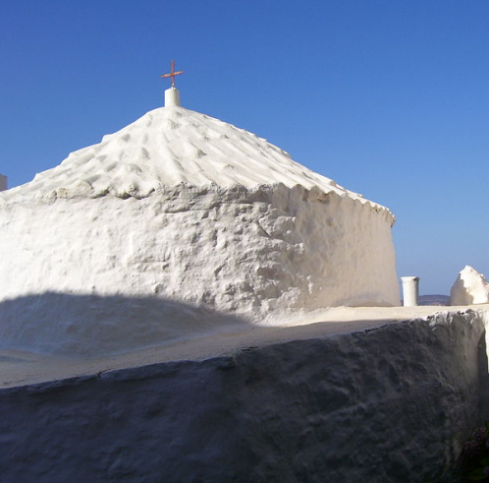
Patmos
"I was in the isle that is called Patmos", Rev. 1:9
"I was in the isle that is called Patmos", Rev. 1:9
"I was in the isle
that is called Patmos"
Rev. 1:9
The Cave of the Apocalypse is situated about halfway up the mountain,
on the Greek island of Patmos, along the road between the villages of Chora
and Skala. This grotto is believed to mark the spot where John of Patmos
received his visions that he recorded in the Book of Revelation. In 1999, UNESCO
declared the cave a joint World Heritage Site

Slide 11
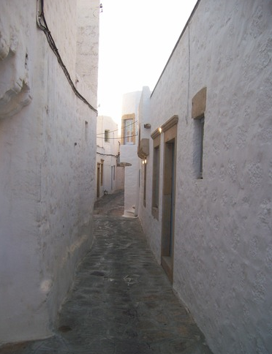
Patmos
It has a population of 2,984 and an
area of 34.05 km (13 square miles).
The highest point is Profitis Ilias,
269 meters above sea level.
The Municipality of Patmos,
includes the offshore islands of Arkoi (pop. 54), Marathi (pop. 6), and several uninhabited islets, has a total population of 3,044 and a combined land area of 45.039 km².
Patmos' main communities are
Chora (the capital city), and Skala,
the only commercial port.
The churches and communities
on Patmos are of the
Eastern Orthodox tradition.

