Slide 1
“The Alpha & Omega”
1 -3

Slide 2

John
John and his brother James, it would appear met Jesus through the preaching of John the Baptist John 1:35-37
Left his fishing nets on the Sea of Galilee to follow Jesus Matt. 4:21-22.
Travelled with Jesus during his ministry – heard the teachings, saw miracles and the transfiguration. Matt. 17:1-7
Stayed with Jesus for the final week of His life. John 19:25-27
Worked with Simon Peter as a leader of the early Jerusalem ecclesia. Acts 3-4
Not heard from in Acts after the death of his brother James. Acts 12:1-2
Banished for a time on the isle of Patmos. Rev. 1:9

Slide 3

Break-Up
Key Passage: Rev. 1:1
Scope & Plan of the Prophecy: Rev. 1:19
Era of commencement: Rev. 1:3
Jesus Christ and the Redeemed (Ch.1)
  Prologue Vv. 1-3
  Salutation Vv. 4-8
  Introduction V.9
  The Initial Vision – Multitudinous Christ
  Vv. 10-20

Slide 4
Psalm 50
A triple summons:
The “world” as a whole (v 1) is summoned to observe
what is about to happen;
“Heavens” and “earth” are summoned, as witnesses
of the covenant event (v 4), and finally
The people themselves are summoned to gather in
the divine presence (v 5)

Slide 5
Psa. 50:23
The Aim is to Overcome!
He that hath an ear, let him hear what the Spirit saith unto the churches; To him that overcometh will I give to eat of the tree of life, which is in the midst of the paradise of God. Rev. 2:7
He that hath an ear, let him hear what the Spirit saith unto the churches; He that overcometh shall not be hurt of the second death. Rev. 2:11
He that hath an ear, let him hear what the Spirit saith unto the churches; To him that overcometh will I give to eat of the hidden manna, and will give him a white stone, and in the stone a new name written, which no man knoweth saving he that receiveth it. Rev. 2:17
And he that overcometh, and keepeth my works unto the end, to him will I give power over the nations: Rev. 2:26
.

Slide 6
Psa. 50:23
The Aim is to Overcome!
He that overcometh, the same shall be clothed in white raiment; and I will not blot out his name out of the book of life, but I will confess his name before my Father, and before his angels Rev. 3:5
Him that overcometh will I make a pillar in the temple of my God, and he shall go no more out: and I will write upon him the name of my God, and the name of the city of my God, which is new Jerusalem, which cometh down out of heaven from my God: and I will write upon him my new name. Rev. 3:12
To him that overcometh will I grant to sit with me in my throne, even as I also overcame, and am set down with my Father in his throne. Rev. 3:21
He that overcometh shall inherit all things; and I will be his God, and he shall be my son. Rev. 21:7

Slide 7
Increase in Knowledge…
An increasing knowledge of the Truth is a constant need:
Col. 1:10
Acts 20:32
Because it is the means chosen by God for the sanctification of his “saints.”
John 17:17
1 Thess. 2:13

Slide 8
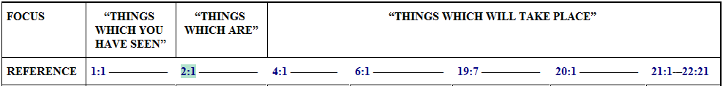
“…which is, which was and is to come”
He is manifested now in the Lord Jesus Christ. Cp John 8:42
He was proclaimed to Moses at the bush. Cp. Ex. 3:14
He is to come in that his glory will be revealed in the multitudinous company of the redeemed (you and I). Cp. 2 Pet. 1:4, Rev. 3:12, Rom. 5:2
And expressed throughout the prophecy as:

Slide 9

“…which is, which was and is to come”
In the Revelation God is set before us in the several phases of manifestation in which he has and will reveal himself:
  Firstly in the word
  Secondly, in the Lord Jesus Christ
  Thirdly, in the redeemed
Through Isaiah he declared “I am the first and with the Last.” Cp. Isa. 41:4

Slide 10

“I am Alpha & Omega…”
There are twenty-four letters of the Greek alphabet
King David divided priests and Levites into a series of 24 orders. Cp. 1 Chron. 24:4; 25:1, 31.
Their duties were to minister to the people in all forms of service, including teaching. Cp. 2 Chron. 15:3 musical arrangements. Cp. 1 Chron. 25: 1, 31 etc.
The twenty-four elders represent the Royal Priesthood in the kingdom. Cp. Rev. 5:9-10; 14:3. God manifest in a people
Jesus is the author & finisher of our faith. Cp. Heb. 12:2 and to Him we should look. God is manifested in the Lord Jesus Christ and he “will be” (Yahweh)manifested in you and I. Cp. Rom. 8:19 note Isa. 44:6 with Isa. 41:4

Slide 11
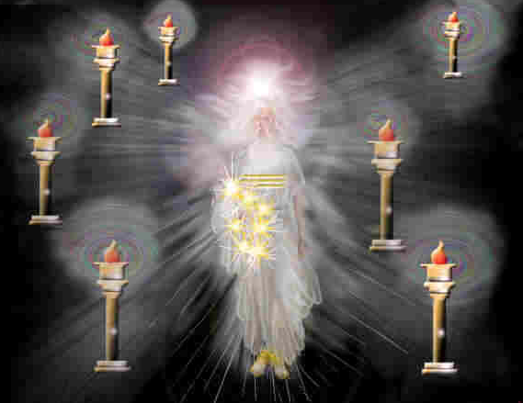
“One like unto the Son of Man”

Slide 12
The Initial Vision –
The Multitudinous Christ.
Vv 10 – 20
“A trumpet sound causes John to look behind him. He observes “one like unto” the Son of Man. The vision is similar to that seen by Daniel (Dan. 10)…The vision is so striking that it over awes John, causing him to fall down in a faint. He is restored by the voice of one like unto the Son of Man and in being raised to his feet again, he figuratively enacts his own death and ressuection. This vison therefore, symbolises the future glory of the elect, raised from the dead and made one with Christ.” The Apocalypse Epitomised, H. P. Mansfield
“One like unto the Son of Man”

Slide 13
“…one like unto…”
“…The first is that described in chap. ﻿1:13–16﻿, and styled “﻿Son of Man.﻿” This does not represent an individual man. It represents many in One. What John saw among the lightstands was a similitude or likeness—omoion huio anthropou, like to a Son of man. The voice John heard proclaimed the reality of this likeness to be “﻿the Last﻿”—the Spirit in the last manifestation; the One Yahweh in many Elohim…” Bro. John Thomas - Eureka Vol. 1, Pg. 111

Slide 14

“Clothed with a garment…”
It teaches us that we must be figuratively covered with the “garment of salvation.” Cp. Isa. 61:10
Which we put on at baptism. Cp. Gal 3:27
Our covering by which our sins are hidden or forgiven are found in Christ.
We must keep the Christ-Robe unspotted from the world. Cp. Rev. 3:4; Jude 23.
Are you Dating? If it needs to be covered
don’t touch it.

Slide 15
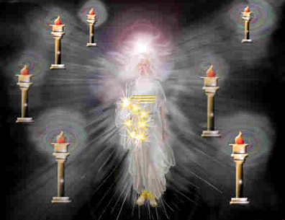
V13. “Golden Girdle” – Gold is a symbol of tried faith. Cp. 1 Pet.1:7, without which no man can please God. Cp. Heb 11:6. Faith binds and completes the robe of righteousness.
V14. “White as Snow” – The High Priest had a white mitre of linen. Cp. Ex. 28:39 pointing forward to the perfection of Christ mentality. Snow is used to describe the refreshing effect of Gods word Cp. Isa. 55:10, Purity Cp. Ps. 51:7 Divine Glory Cp. Matt 28:3. Snow rep’ flesh purified.
V14. “Head and hair, white like wool” – Christ is the Head of the Body. Cp. Eph. 5:23, every member should be motivated by his thinking. Cp. Phil. 2:5. “White as wool” Rep’s his righteousness Cp. Isa. 1:18. Ultimately every member of the Body must appear as he is and be united as one with the head. Cp. John 17:21
V14. “Eyes as a flame of fire” The eye is the Symbol of intelligence and investigation. In the past the angels have acted as the eyes of God, supervising over the developments of Gods plan. The symbol rep’s the eyes of the multitudinous Christ, flashing with fire of anger. Cp. Isa. 30:27
V15. “Feet like fine brass” – Are those saints marching forth to execute Gods judgement. The “feet” of Zech. 14:4 are those bearing the name of God. Brass is a symbol of flesh purified by fire. Flesh must be purified before judgement upon the nations to bring them into subjection with Christ. Mal. 4:1-3

