Slide 1
A Study of David
Series of Bible classes studying the life of King David

Slide 2
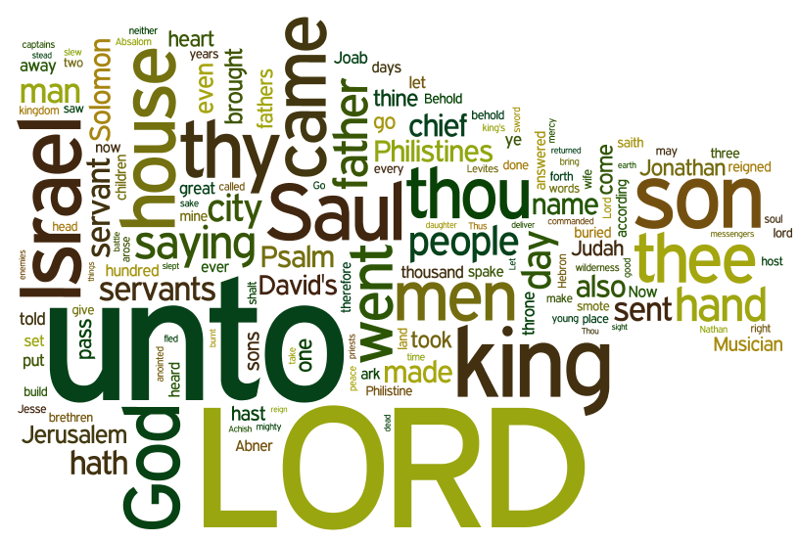

Slide 3
Different Approaches
David
Typical
Personal
Thematic

Slide 4
Structure of study
Session 1
Intro
Anointing
Session 2
David at Nob
David and the Philistines
Session 3
Return of the Ark
Rebellions
Goliath
Legacy
Fleeing

Slide 5
Themes
Leadership and Passion
Outside the Law
David showing traits of leadership
Instilling Passion for God
Inspiring them to perform extraordinary things
David breaking the “rules”
David pushing the boundaries of the letter of the law
David being misunderstood

Slide 6
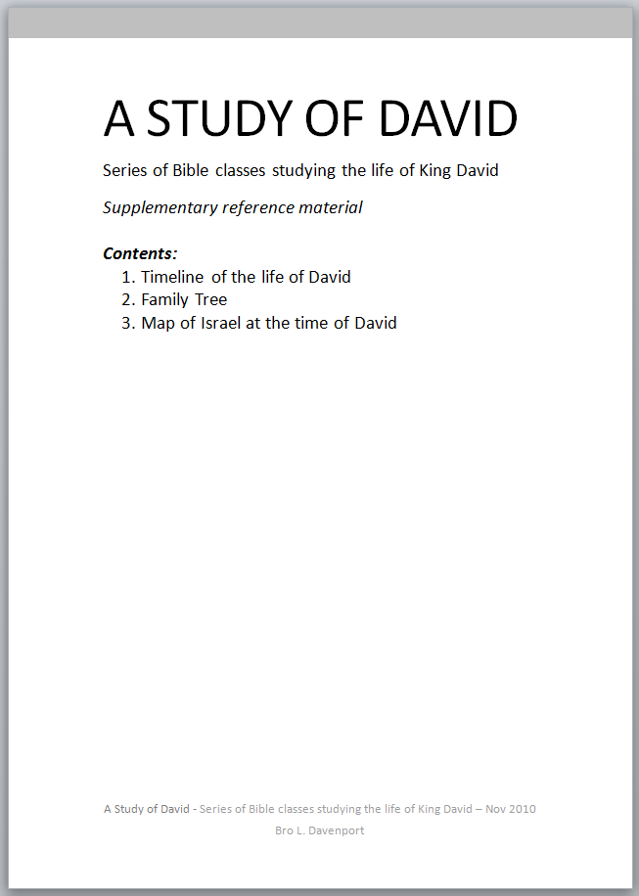
Introduction and Hand-out
Contents:
1. Timeline of the life of David
2. Family Tree
3. Map of Israel at the time of David

Slide 7
Anointing – 1 Sam 16
v1 | Samuel mourned for Saul (ch 17v35) How long – Samuel found Saul’s failure difficult Combination of his son’s failure and now the King he anointed failed “I have rejected him”, “I have provided me a king” – God in control
Saul
Stgs 5057
David
King
Stgs 4428 from 4427
Captain
Commander
Prince
Leader
King, royal
Royalty
Notes:
Comes to Jesse – Bethlehem – Hill country – outside Samuel's usual route – scares the locals
Jesse’s grandmother = Ruth a Moabitess -

Slide 8
Anointing – 1 Sam 16
v5 | Jesse and sons sanctified
V6 - 7 | HE looked on Eliab – Surely the Lord’s anointed? Look not on countenance / Lord looked on the heart All about the state of the heart and not appearance: – 1 Sam 13v14, Acts 13v22, Prov 23v26 Reflection of the Law of Moses being superseded by Law of Christ The Bride Adorned – 1 Peter 3v3-4
Notes:
V1 -

Slide 9
Anointing – 1 Sam 16
v11 | “are here all thy children?” “not sit down” – seems related to sitting round as part of the sacrifice.
V12-13 | Rushed into the proceedings Ruddy – Reddish complexion Beautiful Countenance – attractive eyes Goodly - Handsome
Notes:
V1 -

Slide 10
Anointing – 1 Sam 16
Leadership and Passion
Outside the Law
Tended the sheep
Responsible
Protecting
Led the sheep
Seed of a Moabitess (Deut 23v3)
  10 generation
  Excluded from worshipping community
Not Sanctified (ch16v5)
  Directly from wilderness to the sacrifice
  2 Chron 30v17-20
  Attitude of the heart
Notes:
V1 -

Slide 11
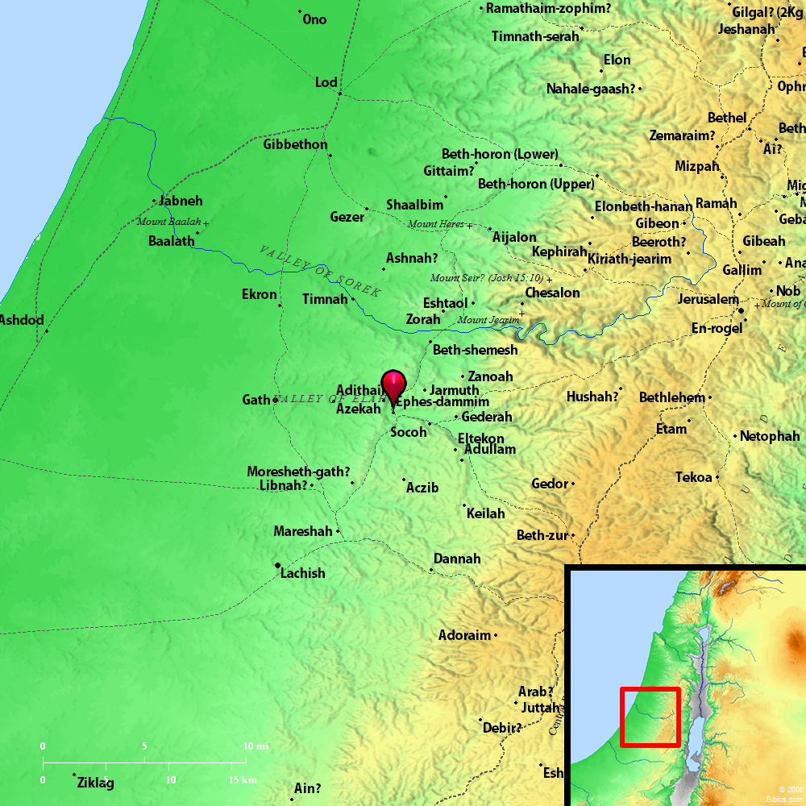
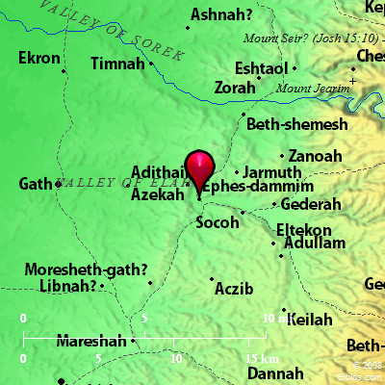
Goliath

Slide 12
Goliath – 1 Sam 17
v5-6 | Brass, Brass, Brass Head, body (mail and target), legs Operating under the drive of the flesh
v13-15 | David returned from Saul (been playing for him – ch 16v19-> )
v16 | 40 days of fear vs 40 days of tranquillity with the sheep

Slide 13
Goliath – 1 Sam 17
V20, 22 | Bright, eager, keen!
v26, 30,31 | David’s refreshing view vs the beaten view of Israel Went round spreading view Matt 4v23-25
V28 - 29 | Brothers reject his involvement – falsely accuse
Leadership and Passion
Infectious enthusiasm – from real confidence in his God. Transfers to others – 1 Chr 28v20

Slide 14
Goliath – 1 Sam 17
v40 | Saul’s Armour fitted but unproved Crossed the lines Took stones, staff, scrip (bag) and sling Prepared for the fight against flesh with only the necessary – Gal 6v5
v46-47 | Speech – to Israel as much as threat to Goliath: “I will smite thee” “Take thine head from thee” Host of Philistine given to the fowls Reason – “all the earth may know there is a God in Israel” (John 11v4 – Lazarus, 1 Kings 18v36 – Prophets of Baal , David's experience in wilderness – Ps 44v6-7)

Slide 15
Goliath – 1 Sam 17v49-51
RAN!
Slang!
Hit Goliath
Stopped, no sword
Ran (past shield bearer)
Stood on Goliath
Cut his head off!

Slide 16
Goliath – 1 Sam 17
v49 | Forehead + stone Isa 8v14 + 1 Pet 2v8 – Stone of Stumbling
v49 | “he fell upon his face to the earth” 1 Sam 5v3
Dagon Fell face to earth
In front of Ark
Goliath Fell face to earth
In front of David and Israel

Slide 17
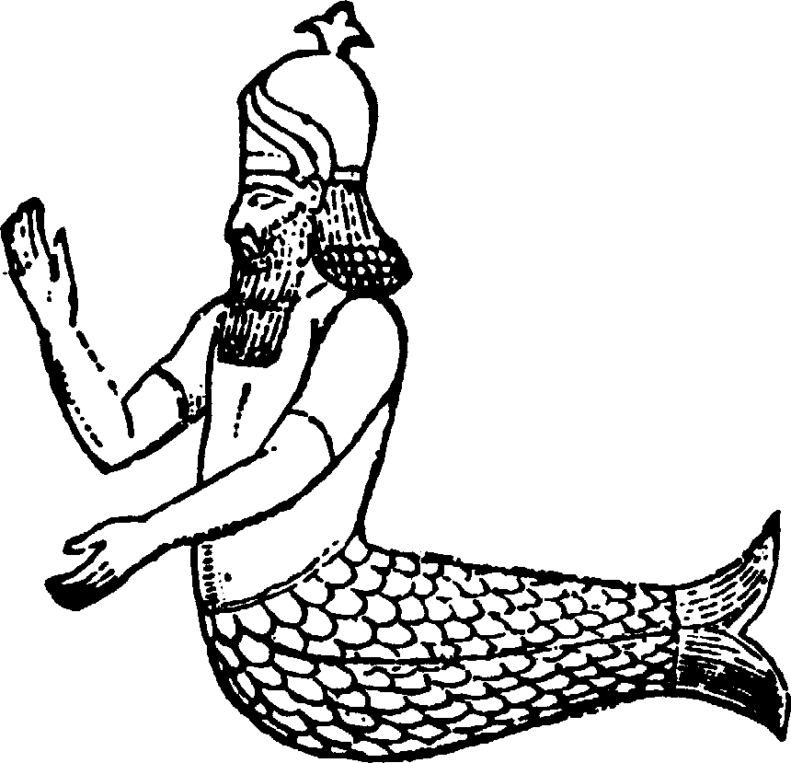
Goliath – 1 Sam 17
“Rabbinical tradition says that he (Goliath) boasted of being the Philistine warrior who had captured the Ark of Covenant, (1 Sam. 4) slaying the two sons of the sanctuary priest Eli in the same battle. He is described as being strongly devoted to the god of the Philistines, Dagon.”
“According to Rabbi Huna, Goliath had a picture of Dagon engraved upon his heart”
Source: http://www.newworldencyclopedia.org/entry/Goliath

Slide 18
Circumstance before fleeing
David and Jonathan
1 Sam 18v1
Saul removes David
1 Sam 18v12-16
Michal & the quest of the 100 foreskins
David flees
With Michal’s help
David at the school of the Prophets
1 Sam 19v18,24
Ps59v1,16

Slide 19
Next Time…
This week
David’s youth and preparation
David’s rise to prominence
Next week
Depths of despair in the wilderness
David learns of sacrifice & humility

