Slide 1
A Study of David
Series of Bible classes studying the life of King David

Slide 2
Structure of study
Session 1
Intro
Anointing
Session 2
David at Nob
David and the Philistines
Session 3
Return of the Ark
Rebellions
Goliath
Legacy
Fleeing

Slide 3
Themes
Leadership and Passion
Outside the Law
David showing traits of leadership
Instilling Passion for God
Inspiring them to perform extraordinary things
David breaking the “rules”
David pushing the boundaries of the letter of the law
David being misunderstood

Slide 4
David the Fugative - Overview
Kingdom
7 Yrs on the road
Watchful and prudent
Enemy from within and without
Separate from Family and Believers
Trials and tests at every turn
Development of Character

Slide 5
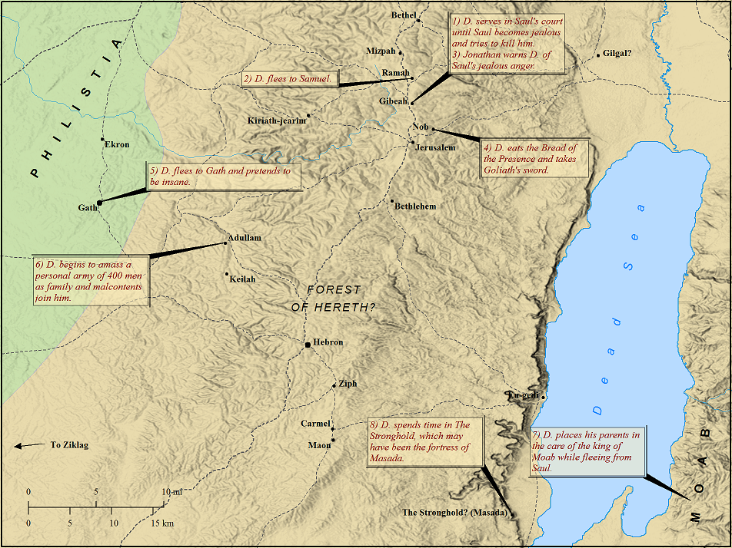

Slide 6
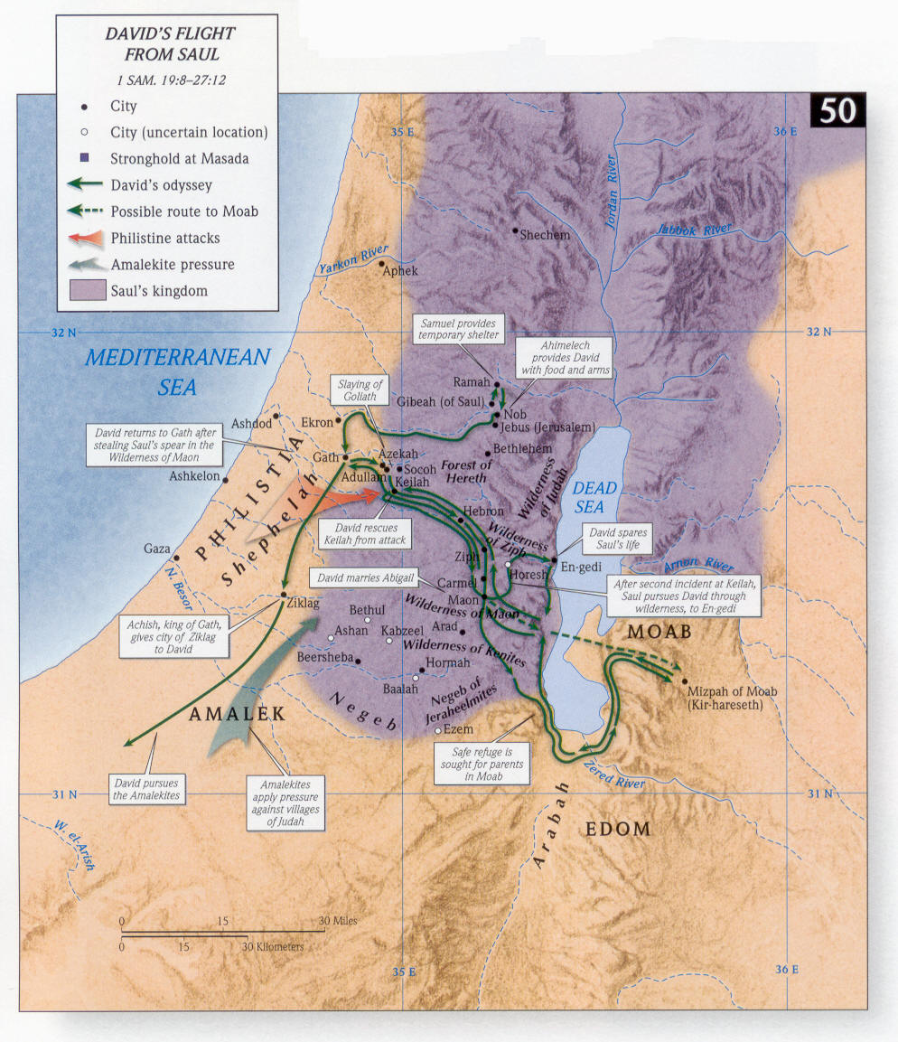

Slide 7
Circumstance before fleeing
David and Jonathan
1 Sam 18v1
Saul removes David
1 Sam 18v12-16
Michal & the quest of the 100 foreskins
David flees
With Michal’s help
David at the school of the Prophets
1 Sam 19v18,24
Ps59v1,16

Slide 8

At Nob – 1 Sam 21
v1 | Why art thou alone – David had apointed his servants to such and such a place Did he have anybody with him? Was the fact his servants were near a ruse? Were 5 loaves needed for 5 servants?
Outside the Law
David telling “white lie” to protect Ahimelech should he be asked in the future. Bore false witness.
(Proverbs 6:30 KJV) Men do not despise a thief, if he steal to satisfy his soul when he is hungry;
Notes:
V1 -

Slide 9
At Nob – 1 Sam 21
Outside the Law
v4 | Ahimelech suggested eating the shew bread Conditional! – young men kept from women
v5 | David’s reply – (1 Samuel 21:5) David said to the priest, "Certainly women have been kept away from us, just as on previous occasions when I have set out. The soldiers' equipment is holy, even on an ordinary journey. How much more so will they be holy today, along with their equipment!" Why special? Holy Mission or proximity to a new moon feast?
Outside the Law
Notes:
V1 -

Slide 10
At Nob – 1 Sam 21
v7 | Doeg assumes he is inquiring of the Lord – 1 Sam 22v9-10
v10 | David Fled! – Matt 12v15 “withdrew” Goes to Gath (with Goliaths sword) DAVID IN FULL SURVIVAL MODE.
v13 | Feigned madness and was dismissed Recognised, Humiliated, Providentially Achish dismissed Ps 34v1-6, 17 Ps 56v3,11 – emphasis on the fear of David
Notes:
V1 -

Slide 11
Cave Adullam – 1 Sam 22
v1 | Escape = BDB = to slip away (John 8:59 KJV) Then took they up stones to cast at him: but Jesus hid himself, and went out of the temple, going through the midst of them, and so passed by. David thought of fathers house
Leadership and Passion
People came to David
Distressed (trouble), in debt,
Discontented = Marah nephesh (bitter soul)
Would have been easier for David to hide with very few people around him.
He became responsible for them (a new flock)
Required work to motivate and organise
Notes:
V1 -

Slide 12
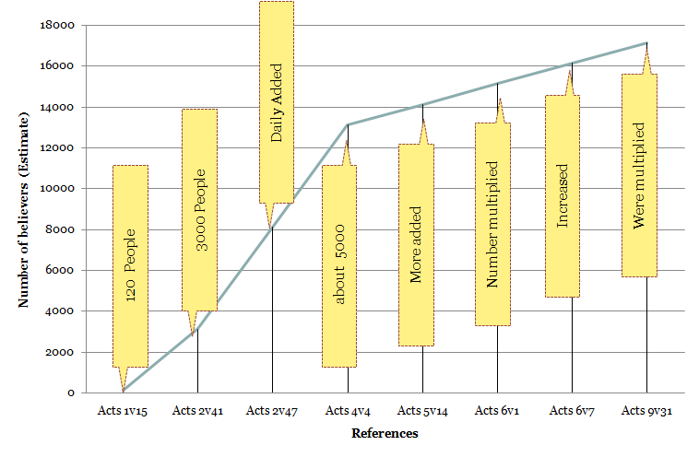
Cave Adullam – 1 Sam 22
Notes:
V1 -

Slide 13
Cave Adullam – 1 Sam 22
Leadership and Passion
Took control of the protection of Father and Mother – v3-4 (may have taken 2 journeys to Moab)
These years of hardship formed some of his most trusted relationships for when he was King
  Eliab (or Elihu) – 1 Chron 27v18
  “All his fathers house” – probably included the “Sons of Zeruiah” – 1 Sam 26v6
  Even though David was younger than most he inspired them! – 1 Chron 11v15-19
V19-20 | David and Doeg have a hand in outworking the judgements of God – 1 Sam 2v32 1 Sam 2v33 = Abiathar 1 Kings 1v25 , 1 Kings 2v26-27
Notes:
V1 -

Slide 14
Keilah & Maon – 1 Sam 23
Philistines attack Keilah. v1
Inquires twice of God (Gideon and the fleece) vs2-4
Keilah – gates and bars
v12 deliver=shut up (Ps 31v8,21)
David flees to Ziph
Strongholds
Jdg 6v2
Jonathan strengthening came just when David needed it!
Pro 15:23 … a word spoken in due season, how good is it!
1 Sam 24v18 | And thou hast shewed this day how that thou hast dealt well with me: forasmuch as when the LORD had delivered me into thine hand, thou killedst me not.
Notes:
V1 -

Slide 15
Keilah & Maon – 1 Sam 23
V24 -28 | Maon – David Caught (lapse in concentration?) Compassed = crowned (encircling) – Ps 5v12 compassed by protection of God “Haste” in action and prayer – Ps 31v22-23
Notes:
V1 -

Slide 16
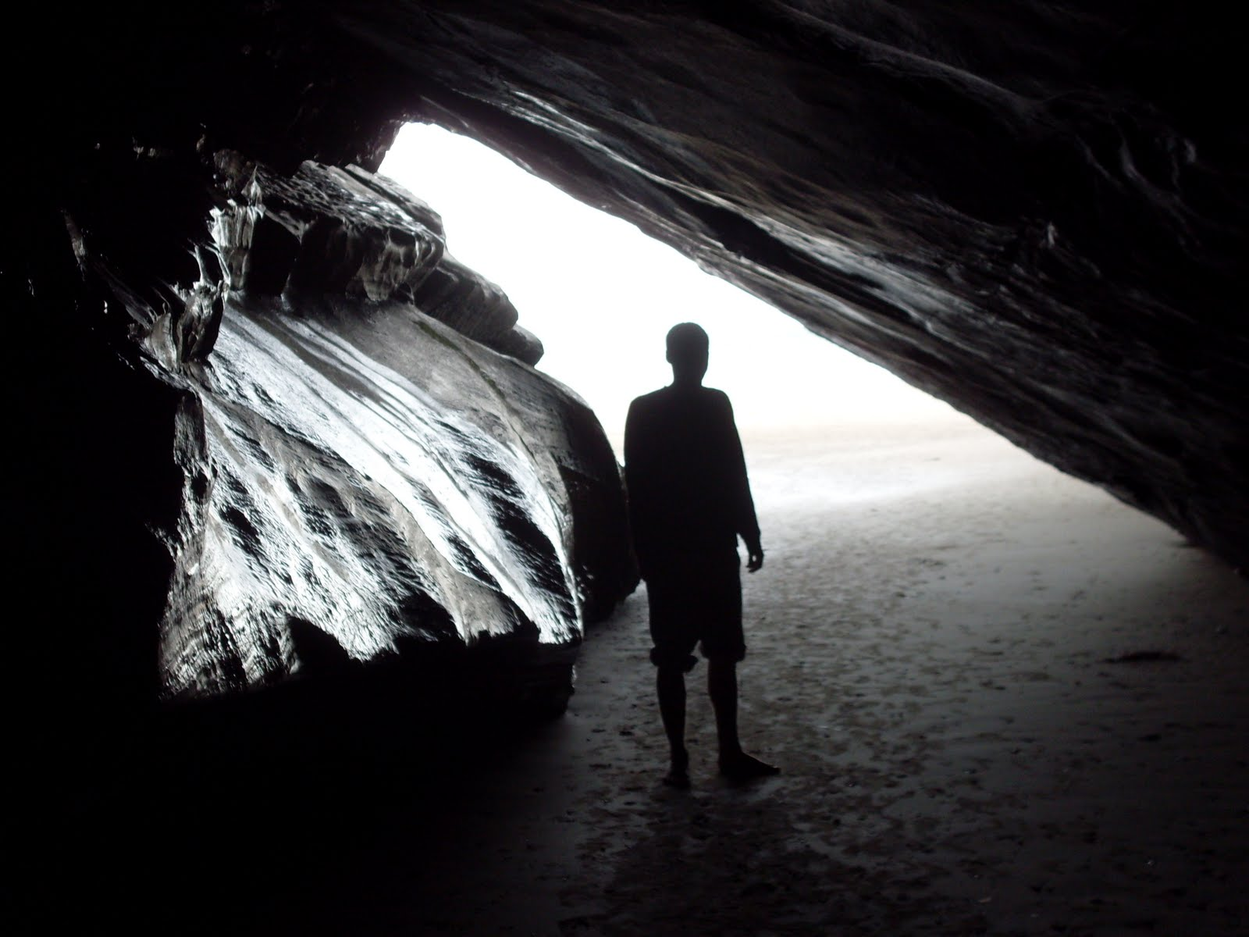
En-Gedi – 1 Sam 24
Notes:
V1 -

Slide 17
En-Gedi – 1 Sam 24
Leadership and Passion
Not all of David’s men had the same heart as him
  Ps 57v4-6
  The Sons of Zeruiah
But David was not swayed by peer pressure – Ps 57v7
David realised God makes Kings not man – Rom13v1-2
Outside the Law
David misunderstood by peers
  Those risking life to gather water from Bethlehem
  Those seeing Saul in the cave at En-Gedi as an opportunity
“Law of Man” would state “take what you can”
Notes:
V1 -

Slide 18
Abigail and Nabal – 1 Sam 25
Abigail; faith maintained while living with foolish Nabal
Interesting that David felt vengeful towards Nabal and not Saul
Humility of Abigail
“my lord” x 15
Avenging thyself = saving thyself
Against so many Psalms
Ps18v2
David rapid recognition of God’s Words .Marries Abigail and Ahinoam

Slide 19
Hachilah and Gath – 1 Sam 26
Hachilah
Saul compassed (shielded) by the flesh
v5
David had to repeat to Abishai that he would not kill Saul
v8
v19 – David put the matter into God’s hand
Saul used “God will” as excuse
Effect was to put David in a spiritually testing time (outside the LORD’s inheritance)
Saul fundamentally unchanged and David flees to Gath
1 Sam 27v1
1 Cor 5:5 ESV | you are to deliver this man to Satan for the destruction of the flesh, so that his spirit may be saved in the day of the Lord.
Notes:
V1 -

Slide 20
Final Days as a Fugitive
Leadership and Passion
Ch 27
Goes to Achish
Lives in Ziklag
Lies to Achish
Mass killing of tribes
Ch 29
Philistine Captains reject David
Ch 30
Ziklag burned
Families taken
Men upset
Amazing Chase and rescue
Ch 31
Saul and sons slain
Notes:
V1 -

Slide 21
Next Time…
This week
Depths of despair in the wilderness
David learns of sacrifice & humility
Next Time
Waxing Strong
A costly lapse

