Slide 1
A Study of David
Series of Bible classes studying the life of King David

Slide 2
Structure of study
Session 1
Intro
Anointing
Session 2
David at Nob
David and the Philistines
Session 3
Return of the Ark
Rebellions
Goliath
Legacy
Fleeing

Slide 3
Themes
Leadership and Passion
Outside the Law
David showing traits of leadership
Instilling Passion for God
Inspiring them to perform extraordinary things
David breaking the “rules”
David pushing the boundaries of the letter of the law
David being misunderstood

Slide 4
Final Days as a Fugitive
Leadership and Passion
Ch 27
Goes to Achish
Lives in Ziklag
Lies to Achish
Mass killing of tribes
Ch 29
Philistine Captains reject David
Ch 30
Ziklag burned
Families taken
Men upset
Amazing Chase and rescue
Ch 31
Saul and sons slain
Notes:
V1 -

Slide 5
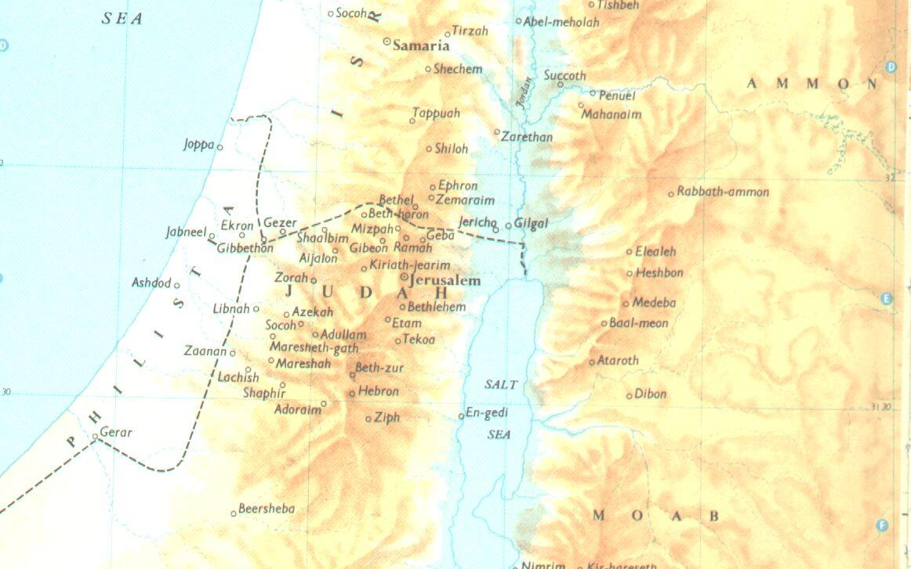
From Ziklag to Hebron
Notes:
V1 -

Slide 6
Tabernacle of David
Context | Prior to David's Tabernacle in Jerusalem the Ark was separate from the place of worship. Ark in Kirjathjearim Tabernacle in Gibeon 2 Sam 6v2 – Dwelling place of God Mechanical worship without the presence of God No enquiring of God – 1 Chron 13v3 Enquiring = Stgs 1875 = resort to , frequent, consult
Notes:
V1 -

Slide 7
Tabernacle of David
Ref | Situation
1 Samuel 23:2 | Keilah | All these instances are stgs 7592. request, ask, beg Compare to enquiring at the Ark (1 Chr 13v3- prev. slide).
1 Samuel 23:4 | Keilah
1 Samuel 30:8 | Ziklag and the Amelakites
2 Samuel 2:1 | From Ziklag to Hebron as King
2 Samuel 5:19 | Smiting Philistines
2 Samuel 5:23 | Smiting Philistines
2 Samuel 21:1 | Famine and slaying Saul's sons
Other instances of David enquiring of God | 1 Sam 23v6-7 using the ephod 1 Sam 23v26 – Haste in prayer and action (Ps 31v22)
Notes:
V1 -

Slide 8
Tabernacle of David
Enquiring at the Ark: More to do with fellowship Worship Care Seek out (salvation) Resort to … frequently
(John 18:2 KJV) And Judas also, which betrayed him, knew the place: for Jesus ofttimes resorted thither with his disciples.
Notes:
V1 -

Slide 9
Tabernacle of David – 1 Chr 13
V1 - 6 | 1st Attempt – didn’t inquire of God properly Consulted with captains Congregation of Israel David’s longing for a habitation for Ark – Ps 132v4-5, 11-13
Leadership and Passion
V7 | New cart – incorrect mode of transport – Num 4v15 (sons of Kohath)
V11 | Uzza dies – breach Outburst of God against men “doing it their own way” Cain and Abel Jer 10v23 “it is not in man that walketh to direct his steps”
Notes:
V1 -

Slide 10
Tabernacle of David – 1 Chr 13
v12 | 2nd attempt – follows David asking God (Jeremiah 10:24 KJV) O LORD, correct me, but with judgment; not in thine anger, lest thou bring me to nothing.
RESULT
ch15v26 | “God helped the Levites that bare the Ark” Vs “the oxen stumbled” – ch 13v9
Notes:
V1 -

Slide 11
Tabernacle of David
Outside the Law
Tabernacle of David in Jerusalem is a type of the Law of Jesus.
A way of worship outside the Letter of the Law and open to Gentiles
Outside Law of Moses
Acts 15v16 – Gentiles entitled to the Gospel
Amos 9v11 – Prophecy of Gentiles
Preaching Gospel to Gentiles
Salvation and Mercy
1 Chr 16v35-36
1 Chr 16v24 -29
Salvation = liberty or succour
2 Tim 1v9
Liberty in Christ – Gal 2v5, 5v1
Letter vs Spirit
According to all that is written…
as every day’s work required
Spirit saves – 2 Cor 3v6
Breaches between availability of Gospel
Notes:
V1 -

Slide 12
Context of the “Bathsheba incident”
Ch 2
Asahel Killed
Joab fights Abner
Ch 3 War – Abner and David
David waxed stronger
Abner league with David
Michal returned
Ch 4
Ishbosheth killed
Killers executed by David
Ch 5
Jebus recaptured
Jerusalem throne of David
Ch6
Ark returned
Ch 7
Promises to David
Ch 8-10 wars with Philistines
Outside the Law
Outside the Law
Leadership and Passion
Notes:
V1 -

Slide 13
Adultery!
Adultery
Proverbs 6:32-33 KJV
(32) But whoso committeth adultery with a woman lacketh understanding: he that doeth it destroyeth his own soul.
(33) A wound and dishonour shall he get; and his reproach shall not be wiped away.

Slide 14
The “Bathsheba incident” – 2 Sam 11
Situation
Vs1-2
Should David have been in Jerusalem?
Sin #1
Vs 4
Adultery
Delay
Vs 5
Weeks of keeping the sin hidden
Cover up
Vs 6
Attempts to get Uriah to sleep with Bathsheba
Escalation
Vs 15
Letter to Joab concerning Uriah’s murder
Forgiveness
ch12v13
“put away thy sin; thou shalt not die”.
Notes:
V1 -

Slide 15
Consequences!
Joab’s additional power over David
Less respect amongst family
Reduced trust from friends / Israel
Impunity to kill his opposition
Amnon, Tamar and Absalom
Ahithophel Grandfather to Bathsheba
Sons fighting
David's distress
Rebellions
Notes:
V1 -

Slide 16
Series conclusions…

Slide 17
David “a man after mine own Heart”
Acts 13:22 KJV
(22) And when he had removed him, he raised up unto them David to be their king; to whom also he gave testimony, and said, I have found David the son of Jesse, a man after mine own heart, which shall fulfil all my will.
I took thee from the sheepcote
I was with thee whithersoever thou wentest
I will appoint a place for my people Israel
[The LORD] will make thee an house.
I will set up thy seed after thee
I will stablish the throne of his kingdom for ever
I will be his father
2 Sam 7v5-16

Slide 18
David “a man after mine own Heart”
Heart was directed by God
“Eased” the outworking of his purpose
Grace, mercy, forgiveness and salvation
Lesson
Make it easy for ourselves in the truth by ridding ourselves of the unnecessary

Slide 19
David - Exercised by trials
Psalms 119:67-71 KJV
(67) Before I was afflicted I went astray: but now have I kept thy word.
…
(71) It is good for me that I have been afflicted; that I might learn thy statutes.
Incident | Development
Fugitive | Faith Friendship / Fellowship / Trust Respect for God’s anointed Leadership / Care
Abigail | Humility
Bathsheba | Combating lust
Joab | Put not your trust in princes
Lesson
Don’t be discouraged by failure
None of us are the finished article.
Important how we react to events
Our direction (heart) through all events should be towards God

Slide 20
David - Care
Psalms 78:72 KJV
(72) So he fed them according to the integrity of his heart; and guided them by the skilfulness of his hands.
1 Samuel 22:2 KJV
(2) And every one that was in distress, and every one that was in debt, and every one that was discontented, gathered themselves unto him; and he became a captain over them: and there were with him about four hundred men.
2 Corinthians 11:28 KJV
(28) Beside those things that are without, that which cometh upon me daily, the care of all the churches.
Lesson
It may be easier for us to “go it alone”. We are required to care for the members of our churches however inconvenient it will be in our own present position.
David did not use excuses in his own life to stop him helping others.

Slide 21
A Study of David
Series of Bible classes studying the life of King David
Because David did that which was right in the eyes of the LORD, and turned not aside from any thing that he commanded him all the days of his life, save only in the matter of Uriah the Hittite.
1 Kings 15:5 KJV

