Slide 1
Modern challenges
to fundamental
principles
“...because of the angels...”

Slide 2
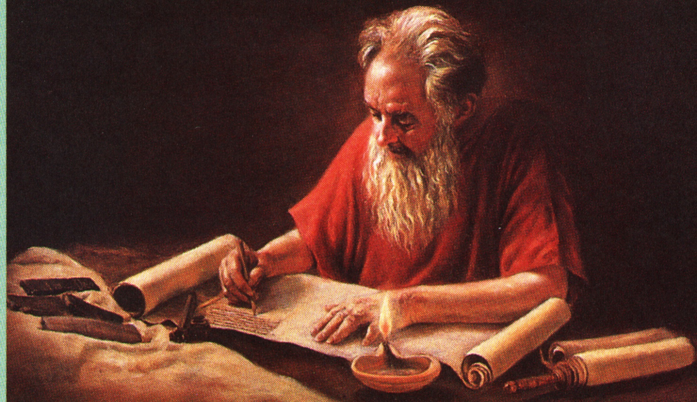
John’s writing interrupted by Christ – Rev. 16:15
“And I saw three unclean spirits like frogs….. Behold, I come as a thief….. And he gathered them together”

Slide 3
The Spirits of Devils – Rev. 16:14
A “spirit” here is an ideology or way of thinking – Luke 9:55; 2 Cor. 11:4; Eph. 2:2; 2 Thess. 2:2; 1 Tim. 4:1; 1 John 4:1, 6.
“devils” is daimon (demons) – used of the madness of Legion, of insanity and disease; but also of earthly wisdom – James 3:15 (daimoniōdēs) which produces “confusion and every evil work” (v.16).
The spirits of the French Revolution – Liberty, Equality and Fraternity – fit this description.

Slide 4
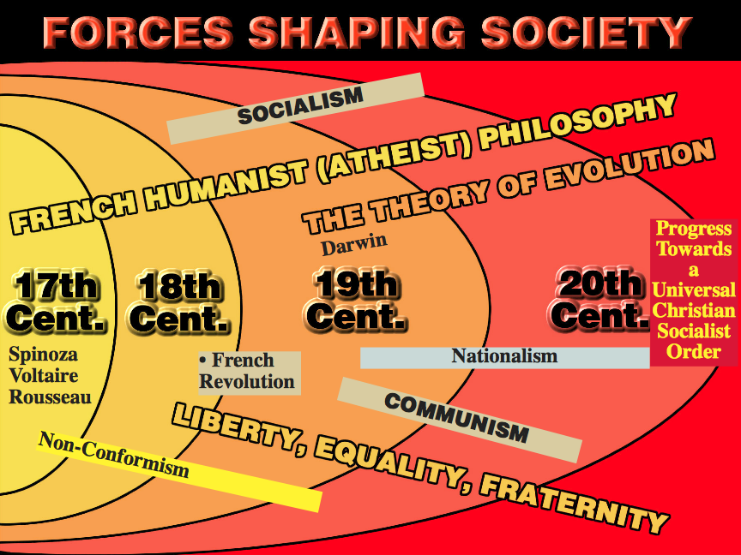

Slide 5
Women's liberation - Its impact on society
1975 - International Women's Year - a watershed. Since then women have sought and largely gained:
Government sponsored "affirmative action" programs.
the right to have their own career unhindered by family commitments.
equality with men in the workplace - EEO, equal pay and promotional opportunities.

Slide 6
Women's liberation - Its impact on society
Government and employer subsidised childcare facilities.
equality in the Church - even to the priesthood and ministry.
Some of the consequences:
disappearance of traditional family life.
rapidly increasing rate of divorce and remarriage.

Slide 7
Women's liberation - Its impact on society
growing number of defacto "marriages“.
emergence of "step-families" through remarriage.
dramatic growth of dining out for evening meals.
men forced to accept domestic duties.

Slide 8
Contemporary Society
Recently, in late 2010, an entire Anglican Parish in Britain returned to Roman Catholicism over the ordination of women bishops.
The Catholic Church has accepted married priests from other communions into its mainly celibate priesthood.
The voice of Bro. Morrie Stewart (1968) – “The Brotherhood is only 5-10 years behind the trends in the world.”

Slide 9
Contemporary Facts
There is at least one ‘ecclesia’ in Australia that has a sister as recorder.
Sisters are invited to speak at various conferences and gatherings in Christadelphia – a role once reserved entirely for brethren.
The ‘Sisters Speak’ movement has gained considerable momentum over the last decade.
Ecclesias exist solely for that purpose.

Slide 10
Contemporary Arguments
Women of the church say Paul (an unmarried man) was prejudiced against women – hence his biased teachings.
Some Christadelphians say Paul’s comments are ‘site specific’; i.e. written to one ecclesia to address a local issue.
Others say that Paul’s teachings are not matched by those of Christ on the subject of woman’s role.

Slide 11
Equality of women with men
We hear much in some parts of the world of the political rights and equality of women with men; and of their preaching and teaching in public assemblies. We need wonder at nothing which emanates from the unenlightened thinking of sinful flesh.
There is no absurdity too monstrous to be sanctified by unspiritualized animal intellect. Men do not think according to God's thinking, and therefore it is they run into the most unscriptural conceits; among which may be enumerated the political and social equality of women.

Slide 12
"because of the angels"
Trained to usefulness, of cultivated intellect, and with moral sentiments purified and ennobled by the nurture and admonition of the Lord's truth, women are "helps meet" for the Elohim; and much too good for men of ordinary stamp.
The sex is susceptible of this exaltation; though I despair of witnessing it in many instances till "the Age to come." But, even women of this excellency of mind and disposition, were it possible for such to do so, would be guilty of indiscretion, presumption, and…….

Slide 13
"species of actresses"
rebellion against God's law, in assuming equality of rank, equality of rights, and authority over man, which is implied in teaching and preaching.
It is the old ambition of the sex to be equal to the gods; but in taking steps to attain it, they involved themselves in subjection to men. Preaching, and lecturing, women, are but species of actresses, who exhibit upon the boards for the amusement of sinful and foolish men.…

Slide 14
True adornment
They aim at an equality for which they are not physically constituted; they degrade themselves by the exhibition, and in proportion as they rise in assurance, they sink in all that really adorns a woman.
Bro. John Thomas - Elpis Israel

Slide 15
The teachings of Paul
1 Cor. 14:37-38 – Paul’s teachings are those of God and Christ (see also 1 Cor. 7:10 and contrast Vv. 6, 25).
Principle – Luke 10:16.
Paul’s teachings on women are for all ecclesias and for every era – 1 Cor. 14:33-34; 7:17; 11:16.
Paul uses the Old Testament as the primary source of his authority – 1 Cor. 14:34; 1 Tim. 2:11-14.

Slide 16
The Divine Hierarchy
1 Cor. 11:1-7
But I would have you know, that the head of every man is Christ; and the head of the woman is the man; and the head of Christ is God.
Every man praying or prophesying, having his head covered, dishonour-eth his head.
But every woman that prayeth or prophesieth with her head uncovered dishonoureth her head…
Yahweh
Christ
Man
Woman
kataischuno – to shame down; disgrace

Slide 17
"…as also saith the Law"
The law, which forms a part of the foundation of the world, says to the woman, "He shall reign over thee." The nature of this subjection is well exhibited in the Mosaic law (Num. 30:3-15).
A daughter being yet in her youth in her father's house, could only make a vow subject to his will. If he held his peace, and said nothing for or against, she was bound by her word; but if when he heard it, he disallowed it, she was not bound to perform; and the Lord forgave the failure of the vow. The same law applied to a wife.

Slide 18
Commanded to be under obedience
A widow, or divorced woman, were both bound to fulfil, unless their husbands had made them void before separation. If not, being subject to God, they had no release. This throws light upon the apostle's instructions concerning women. "They are commanded to be under obedience, as also saith the law." And "let the woman learn in silence with all subjection. But I suffer not a woman to teach, nor to usurp authority over the man, but to be in silence." The reason he gives for imposing silence and subjection, is remarkable.

Slide 19
"Adam was first formed"
He adduces the priority of Adam's formation; and the unhappy consequences of Eve's talkativeness and leadership in transgression; as it is written, "Adam was first formed, then Eve. And Adam was not deceived, but the woman being deceived was in the transgression" (I Tim. 2:11-14) first.
And then, as to their public ministrations, he says, "Let women keep silence in the congregations; for it is not permitted unto them to speak; but to be under obedience, as saith the law.

Slide 20
Exercising gift of teaching
And if they will learn any thing, let them ask their husbands at home: for it is a shame for women to speak in the congregation" (1 Cor. 14:34-35). It is true, that in another place the apostle says, "let the aged women be teachers of good things;" but then this teaching is not to be in the congregation, or in the brazen attitude of a public oratrix. They are to exercise their gift of teaching privately among their own sex, "that they may teach the young women to be sober, to love their...

Slide 21
Repudiate God-aspiring Eve
…husbands, to love their children, to be discreet, chaste, keepers at home, good, obedient to their own husbands, that the word of God (which they profess) be not blasphemed" (Tit. 2:4-5).
Christian women should not copy after the god-aspiring Eve, but after Sarah, the faithful mother of Israel, who submitted herself in all things to Abraham, "calling him lord" (Gen. 18:12).

Slide 22
The example of Sarah
Nor should their obedience be restricted to Christian husbands only. They should also obey them "without the word;" that is, those who have not submitted to it, in order that they may be won over to the faith when they behold the chaste and respectful behavior of their wives, produced by a belief of the truth (I Pet. 3:1-6).
Bro. John Thomas - Elpis Israel

Slide 23
Contrasting Christadelphian Homes
Sarah | Lot's Wife
Content to dwell in tents (Gen. 24:67) | Loved the materialism of Sodom (Luke 17:31-32)
Laboured with Abraham to show hospitality (Gen. 18:6) | Invisible, though present, when Lot entertained angels unawares (Gen. 19:3)
Faithfully followed Abraham whithersoever he went (Gen. 20:1-2) | Reluctantly left Sodom even under angelic compulsion (Gen. 19:16)

Slide 24
Contrasting Christadelphian Homes
Sarah | Lot's Wife
Called Abraham "Lord" in her heart (Gen. 18:12) | Left her heart in Sodom and turned back from behind Lot
Trusted God when forsaken by husband (1 Pet. 3:5-6) | Trusted in uncertain riches when with her husband
Subject to husband even when he failed to honour the weaker vessel (1 Pet. 3:5-7) | Independent when Lot's presence vital to her survival (Gen. 19:26)

Slide 25
Contrasting Christadelphian Homes
Sarah | Lot's Wife
Prayers heard by God and delivered (Gen. 12:17; 20:18) | Prayer-less in the hour of need and forsaken (Gen. 19:26)
The "well" from whence we are digged (Isa. 51:1-2) | Became a solitary and sterile pillar of salt (Gen. 19:26)

Slide 26
Jabin King of Canaan
His name means “intelligent” or “wise” – the characteristic of the serpent – Gen. 3:1.
Jabin is a dynastic name – there were two who ruled from Hazor (“village”) – Cp. Josh. 11:1.
In both contexts – Josh. 11 and Jud. 4 Jabin is a type of the serpent in political manifestation (cp. Rev. 20).
“Canaan” = “humiliated”. Monarch of humiliation – Phil. 3:21.
Judges 4 is an enacted parable of the overthrow of the serpent power by Christ.

Slide 27
Jabin represents the Serpent
Joshua 11 | Revelation 20
V.1 – Jabin – “Intelligent”, “wise” | V.2 – The old serpent – “more subtle” Gen. 3:1
V.2-3 – from north, south, east, west | V.8 – gather from four quarters of the earth
V.4 – even as the sand on the sea shore | V.8 – as the sand of the sea
V.5 – met together, pitched together | V.9 – went upon the breadth of the earth
V.5 – Merom – “height” or “elevation” | V.9 – the beloved city – Zion (elevation - Ps.48:2)
V.6 – burned chariots with fire | V.9 – fire from God out of heaven

Slide 28
Jabin represents the Serpent – cont.
Joshua 11 | Revelation 20
V.8 – Mishrephoth-maim – “burnings of waters” | V.10 – cast into the lake of fire and brimstone
V.8 – left none remaining | V.8 – the second death – mortality abolished
V.11 – left none to breathe | V.15 – no mortals remain
V.23 – the land rested from war | The serpent destroyed – no sin and death – Gen. 3:15
Joshua 11 is the basis for Revelation 20 – it foreshadows the final conflict between Christ and the serpent in political manifestation.

Slide 29
Sisera – “Seed of the Serpent”
Name means “warlike array” or “a field of battle”.
Harosheth signifies “Mechanical work”.
As Jabin’s captain he represents the seed of the serpent in violent political. Manifestation.
Chariots of iron point in type to Rome.
Sisera’s plundering made Israel’s life unbearable – Jud. 4:3; 5:30

Slide 30
Deborah – “The Woman”
Name signifies “a bee” from root “orderly motion” (a noun of unity) = symbol for Divine wisdom in action (the mind of God)
Lapidoth – “to shine as lightning”. A divine light (truth) – shines for all to see – Luke 17:24.
Palm – tamar – to be erect or upright – see Ps.92:12; Jer. 10:5; S.S. 7:7. Evergreen – noted for striking beauty and uprightness. Fruit in head. Determined growth towards light.
Ramah – “a height” (i.e. heavenly places)
Bethel – “House of God” (the Ecclesia)

Slide 31
Barak – Type of Christ
His name signifies “glittering” or “a flashing sword” (from the sun shining on a moving blade) – symbol of the word of God in action – Heb. 4:12. Christ was the word made flesh – John 1:14.
Son of Abinoam – “Father of graciousness”
Revealed as type of Christ – Jud. 5:12 (Eph. 4:8).
Kedesh-Naphtali – “The sanctuary of my wrestling”. City of refuge (Josh. 20:7), 32 kms from Nazareth (Christ in preparation for mission).

Slide 32
God’s design - Counterparts
“Man is for strength, judgement and achievement. Woman is for grace, sympathy and ministration. Between them they form a beautiful unit: heirs together of the grace of life.”
Bro. Robert Roberts – Law of Moses pg. 220

Slide 33
…..

