Slide 1

The Mind of the Spirit
Notes:
http://blog.makezine.com/Eye%20Scapes%20-%2001.jpg

Slide 2
Class 1
Natural vs. Spiritual

Slide 3
The Mind of the Spirit
“But ye are not in the flesh, but in the Spirit, if so be that the Spirit of God dwell in you. Now if any man have not the Spirit of Christ, he is none of his.”
Romans 8:9

Slide 4
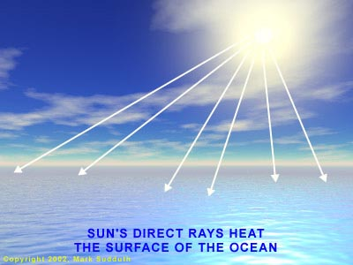
Spirit of God
Sustains life
Creative power
Divine agency
Applied personally
The mind
State of mind
Spirit of prophecy
Disposition
Understanding
Natural strength
Superhuman strength
Fruits of
Divers gifts
Inspiration

Slide 5
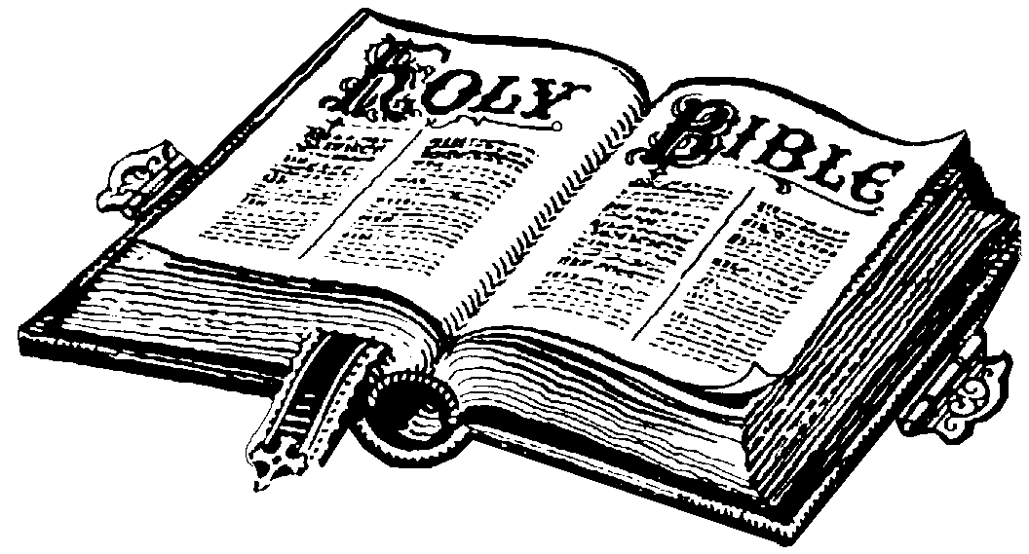


Empty Vessel

Slide 6
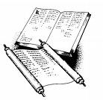
“It is the spirit that quickeneth; the flesh profiteth nothing; the words that I speak unto you, they are spirit, and they are life.”
John 6:63

Slide 7

The Mind of the Spirit
“A word is the expression of a mind and words are a channel through which power is exercised; originating in the mind of one, that power can flow forth to many who are influenced by a thought or obey a command. The grand assumption of scripture is that behind all that man can know there is an eternal mind whose spirit fills the universe, and when the mind of the eternal is expressed the power is without limit and the result instant and infallible.”
L.G.Sargent, The Teaching of the Master, pg.7

Slide 9
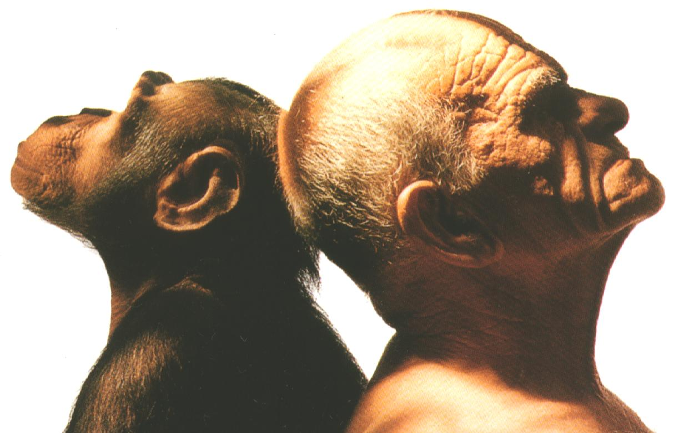
Moral Capacity
(unique to mankind)
Intellect
Propensities
eat
drink
procreate

Slide 10
“thought” -zimmah - plan, device, purpose.
RSV – “The devising of folly is sin”
It is written
Prov. 24:9 – “The thought of foolishness is sin”

Slide 11
Natural Man vs. Spiritual Man
(Foolishness) (Mind of God)
1 Corinthians 2:9,10 “…for the Spirit searcheth all things, yea, the deep things of God.”
v.11
MAN spirit of man knows him GOD
man does not know things of God
only the Spirit of God knows God

Slide 12
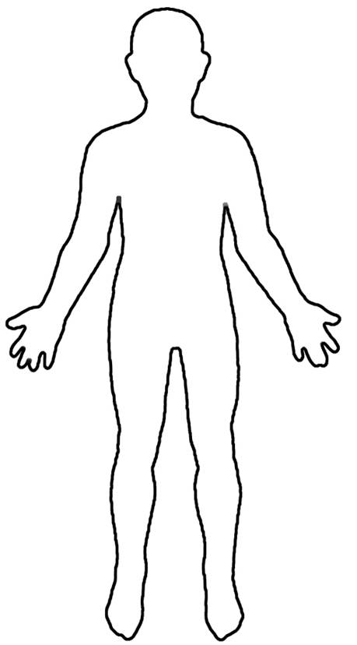
Natural Man vs. Spiritual Man
1 Corinthians 2
v.12 Spirit of the world we do not have as believers – why?
V.13 Man’s wisdom teaches
v.14 Natural man receives not the things of the Spirit of God – can’t know them, only spiritually discerned
Received the spirit of God
What Holy Spirit word teaches
Spiritual discernment receives things of the Spirit of God
v.15 “judges all things”
v.16 THE MIND OF CHRIST

Slide 13

Importance of the Word
“But whosoever drinketh of the water that I shall give him shall never thirst; but the water that I shall give him shall be in him a well of water springing up into everlasting life.”
John 4:14
“And he shall be like a tree planted by the rivers of water, that bringeth forth his fruit in his season…” Ps.1:2-3
“For he shall be as a tree planted by the waters, and that spreadeth out her roots by the river…”Jer.17:7-8

Slide 14
Bible Companion
Brother Robert Roberts
“Salvation depends upon the assimilation of the mind to divine ideas, principles and affections exhibited in the scriptures. This process commences with a belief in the gospel. But it is by no means completed thereby; it takes a lifetime for its scope and untiring diligence for its accomplishment. The mind is naturally alien from God and all His ideas (Rom.8:7; 1Cor.2:14) and cannot be brought at once to the Divine likeness…

Slide 15
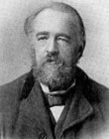
This is a work of slow development, and can only be achieved by the industrious application of the individual to the means which God has given for this purpose, viz. the expression of His mind in the scriptures of truth, spiritual mindedness or the state of mind in accordance with the mind of the Spirit as displayed in these writings can only grow within a man by daily intercourse with that mind, there unfolded.
“Bible Companion” – Bro. Robert Roberts

Slide 16
“For as many as are led by the Spirit of God, they are the sons of God.”
Romans 8:14

Slide 17

Class 2
Written in Their Hearts

Slide 18
Spirit vs. Flesh – Romans 8:5
Spirit
“having food & raiment therewith be content”
“for we have brought nothing into this world and it is certain we can take nothing out”
“seek ye first the kingdom of God”
“always abounding in the work of the Lord”
Flesh
Things of the present life (food, raiment, shelter, entertainment) all human & natural activity.
Possessing & enjoying all natural thought, reaction, emotions, desires, affections, pleasures.

Slide 19

The Magnet of the Heart
“The heart will turn as surely as the needle of a compass towards what we really value. No amount of outward religious performance will change its direction for long if the world provides its pole. But if God is our prized possession, then to Him our hearts will be drawn; and He is the only possession which can never perish, and can ensure that the possessors will never perish either.”
Bro. L.G. Sargent, The Teaching of the Master, pg.239

Slide 20
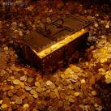

Spiritual Mind Depends on Heart’s Direction
“Lay not up for yourselves treasures upon earth, where moth and rust doth corrupt, and where thieves break through and steal.” Matthew 6:19
to treasure up (to lay up in store) James 5:3
corrupt = to cause to disappear, put out of sight, allusion to Isaiah 50:9; 51:6-8

Slide 21

But rather. . .
“But lay up for yourselves treasures in heaven, where neither moth nor rust doth corrupt, and where thieves do not break through nor steal.”
Matthew 6:20

Slide 22
One Master of the Heart
“No man can serve two masters: for either he will hate the one, and love the other; or else he will hold to the one, and despise the other. ye cannot serve God and mammon.”
Matthew 6:24
serve = to serve as a slave
love (agapao) = sacrificial love
hold to (antekomai) = to hold before one against something
despise (kataphroneo) = to think slightly of

Slide 23
“The unbeliever walks wholly in the visible world. For him there is neither secret nor invisible Being. For him the only standard of value is in the wealth of men that can be seen or the praise of men that can be heard.”
Bro. L.G. Sargent, The Teaching of the Master, pg.184

Slide 24
Mind of Spirit Crushes the Natural Mind
“For all those things hath mine hand made, and all those things have been saith the LORD: but to this man will I look, even to him that is poor and of a contrite spirit, and trembleth at my word.” Isaiah 66:2
deny self will
when self is displaced, God will be installed

Slide 25
Purity in Heart
Fight to keep the mind free of impurity and corruption. Depends on singleness of desire & purpose.
Wanting to know God (Psalm 24:6)
Building a personal relationship with God (Psalm 17:15)
Denying self

Slide 26
“For to be carnally minded is death; but to be spiritually minded is life and peace.”
Romans 8:6

Slide 27
Abstention is not Good Enough
sometimes drastic action is required to overcome sin before it takes hold
Matthew 5:29-30
Replace not Repress – Romans 12:21
Important to develop that mind of the Spirit - God wants:
      DEVOTION
      DEDICATION
      COMPLETE PUTTING AWAY OF THE PRESENT

Slide 28
Overcoming Evil with Good
“...where such an attitude of mind does not fail in one direction, it incurs a greater peril in another: it leads to the tendency to draw attention to one’s own righteousness.”
“.... concentration on prohibition strengthens the force of desire; the true method of casting out the evils is by implanting the good.”
Bro. L.G. Sargent - The Teaching of the Master, pg.182

Slide 29

The Fruit of the Spirit
Class 3

Slide 30
The Fruit of the Spirit
“…Walk in the Spirit, and ye shall not fulfil the lust of the flesh.”
Galatians 5:16

Slide 31
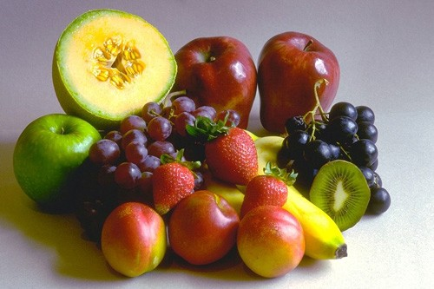
The Fruit of the Spirit – Gal. 5:22
Not the NOT list but the DO list
LOVE - agape
JOY - chara
PEACE - eirene
LONGSUFFERING - makro thumeo
GENTLENESS - chrestotes
GOODNESS - agathosune
FAITH – pistis
MEEKNESS - praotes
TEMPERANCE - egkrateia

Slide 32

LOVE
intense desire to please God and to do good to others (gives energy to faith)

Slide 33

JOY
exultation that comes from awareness of God’s mercy in forgiveness and the prospect of eternal life

Slide 34

PEACE
calm, quiet and order
contrary to fears, alarm and worry

Slide 35
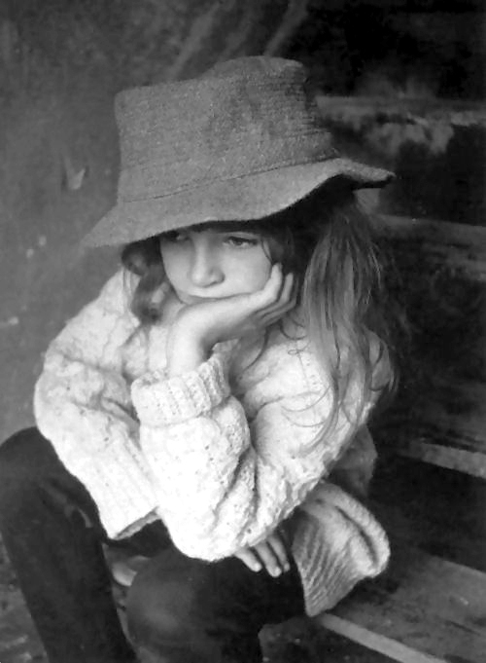
bearing with the frailties and provocation of others, bearing difficulties of life without murmuring & grumbling
knowledge that God puts up with us
LONGSUFFERING

Slide 36

GENTLENESS
treat with care and kindness

Slide 37

GOODNESS
Perpetual desire and sincere study to not only abstain from every appearance of evil, but to do good to others to the very best of our ability

Slide 38
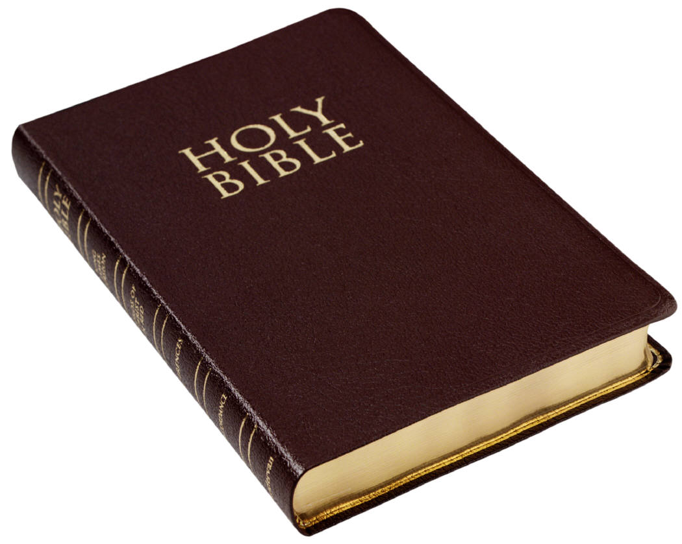
FAITH
(fidelity) punctuality in performing promises
care for that which is committed to our trust
not betraying confidences

Slide 39
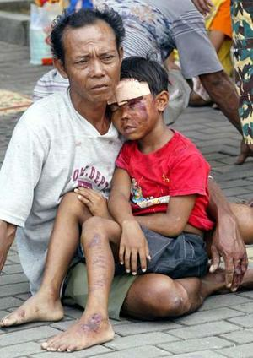
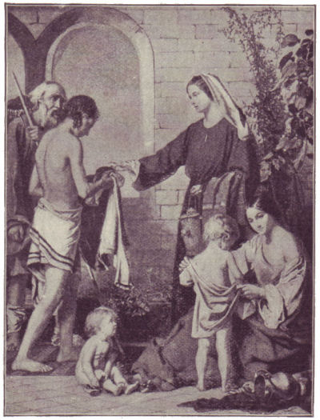
MEEKNESS
mildness, indulgence toward the weak & erring
patiently bearing injury without thought of revenge
opposite of anger

Slide 40

TEMPERANCE
moderation
principally in regard to sensual of animal appetites (eating, drinking, sleeping)

Slide 41
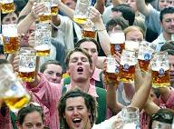
Spirit in Action
WORKS OF THE FLESH
sexuality
idolatry
strife
excess
WORKS OF THE SPIRIT
love
joy
peace
longsuffering
gentleness
goodness
faith
meekness
temperance

Slide 42
“Bring forth fruit”
“Bring forth therefore fruits meet for repentance;
…therefore every tree which bringeth not forth good fruit is hewn down, and cast into the fire.”
Matthew 3:8-10

Slide 43
Change Begins Now
“The line between deathfulness and deathlessness for the body is sharp; we shall be changed ‘in a moment, in the twinkling of an eye’. But there can be no such instantaneous change for the mind: in character we only become what we constantly and strongly desire to be, and the becoming begins now.”
Bro. L.G. Sargent - Teaching of the Master, pgs.50-51

Slide 44
Applying the Mind of the Spirit
Case 1: In Acts 15 the apostles and elders convened the Jerusalem Conference to discuss the issues certain Jewish brethren had with the Truth being preached to the Gentiles.
Quick Response
Main Issue
Group Response

Slide 45

The Spirit in Action
Class 6

Slide 46
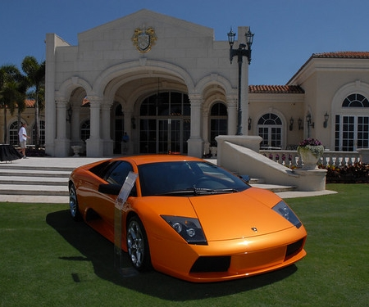

Slide 47


Slide 48
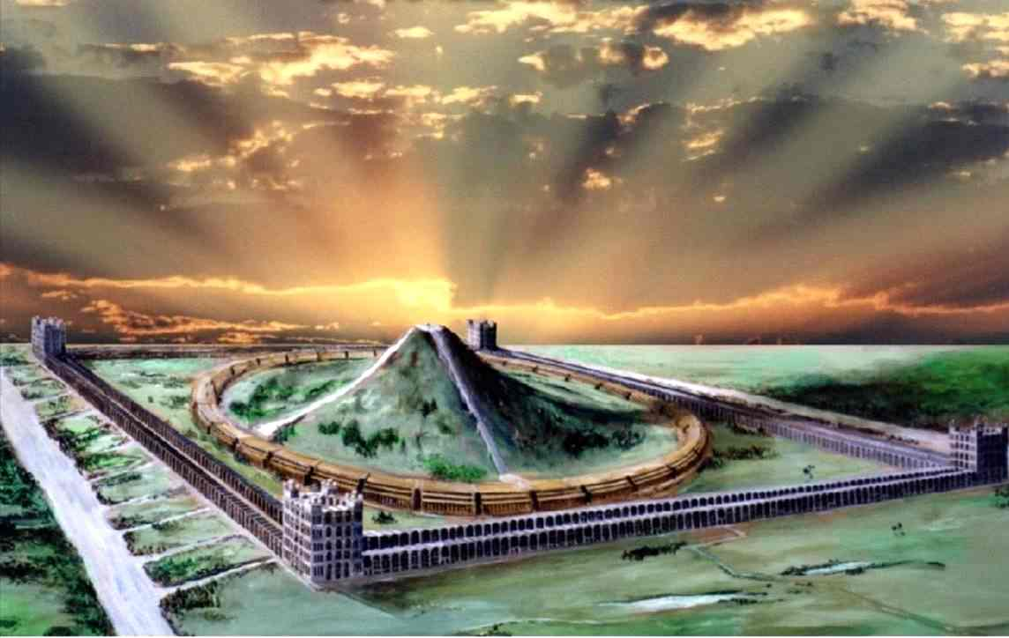
…

Slide 49
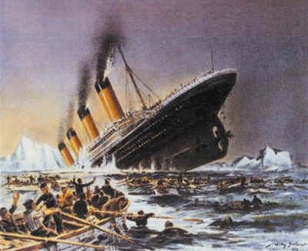
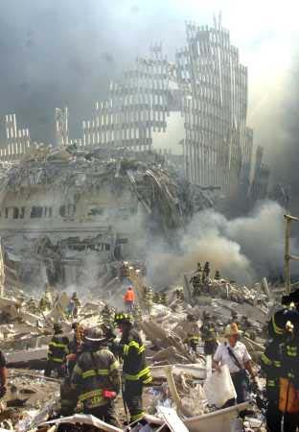
Spirit in Action
“While we look not at the things which are seen, but at the things which are not seen:
for the things which are seen are temporal; but the things which are not seen are eternal.”
2 Corinthians 4:18

Slide 50
Spirit in Action
MIND OF FLESH
Things we see are real
What we see is permanent
Trials drag us down
“GOD HATES US”
I’m poor/God doesn’t love me
MIND OF SPIRIT
Things not seen are real
What we see is not permanent
Trials for development of our character
“GOD LOVES US”
I’m rich spiritually/I’m blessed

Slide 51
Test of our Spiritual Development
SPEECH
James 1:26
James 3:8-9,13,17-18
Jesus Christ controlled the tongue:
Matthew 12:34-35
1 Peter 2:21-23

Slide 52
Test of our Spiritual Development
TRIALS
James 1:2-3 “knowing”
2 Corinthians 4:15-17 (purpose)
Matthew 5:11-12 (future benefit)
Hebrews 5:8; 12:2,11 (consider Jesus Christ)

Slide 53
Test of our Spiritual Development
VIEW OF THE WORLD
Genesis 14:17-20
Hebrews 7:1-2
James 3:17-18
Stop wars then peace
Do what’s right in God’s sight then peace

Slide 54
Test of our Spiritual Development
SELF ASSESSMENT
vs. others / vs. ourselves
Problem: we deceive ourselves
CAUTION
Joshua 5:13-15 – three sides to every point:
OUR’S - THEIR’S - GOD’S

Slide 55
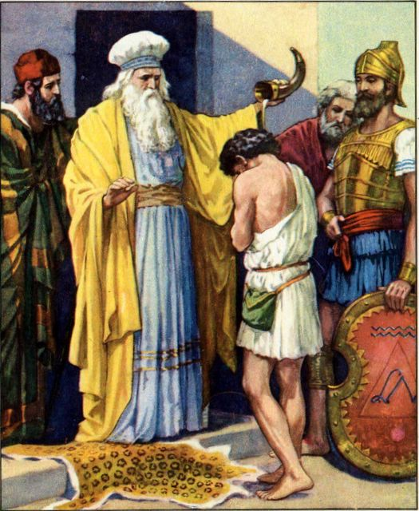
CAUTION!
MAN’S ASSESSMENT OF OTHERS
Samuel David
Abraham Ishmael
Isaac Esau

Slide 56
Developing Spiritual Minds
Key Principles:
Don’t be rooted in the here and now – Col.3:2
Recognize self cannot overcome self –
Jer. 10:23
Recognize power of self deception – Mal.1:6-8,13
Prayer
GO TO THE SPIRITUAL WELL

Slide 57
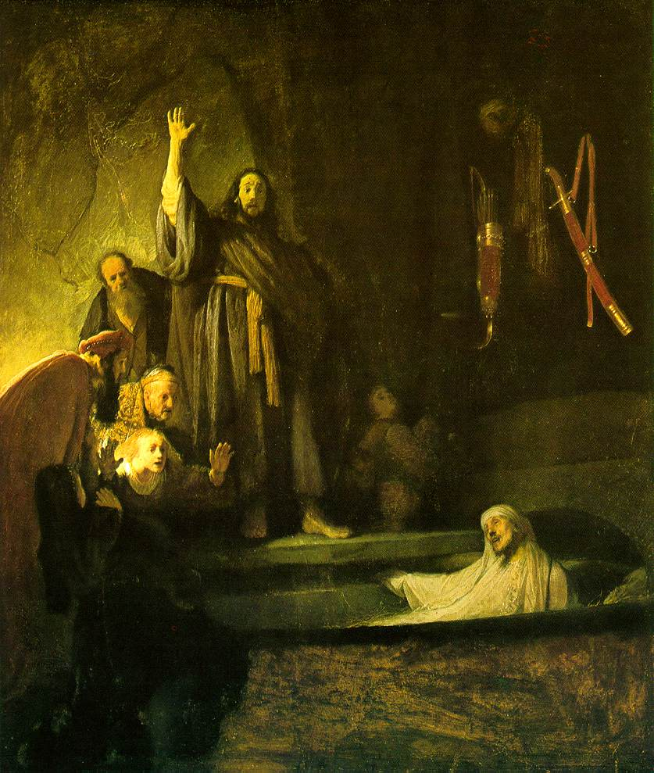
Spirit in Action
“For if ye live after the flesh, ye shall die; but if ye through the Spirit do mortify the deeds of the body, ye shall live.
For as many as are led by the Spirit of God, they are the sons of God.”
Romans 8:13-14

Slide 58

Practical Ways to Put Spirit in Action – 5 R’s
REPETITION: self talk (conscience) – God’s word called to mind, memory verses
REMEMBER: trials for good – remind us of God’s presence (find God in small things)
REMINDERS: visual reminders – ring, pictures of family at work
RIGHT: right/proper associations
RUN: run away from evil

Slide 59

“If we live in the Spirit, let us also walk in the Spirit.”
Galatians 5:25

Slide 60
…

Slide 62
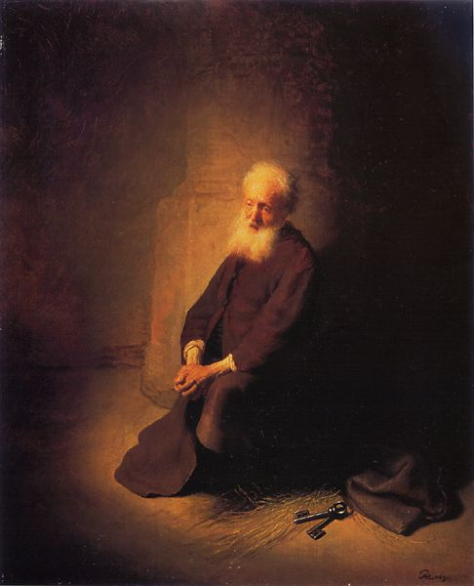
Spirit – Moral Perfection
Way of Life
Word of God:
the active ingredient in our lives.
Christ – John 6:63
Paul – Ephesians 6:17
John – 1 John 5:6

Slide 63
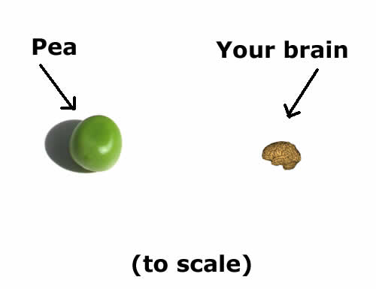

Slide 64
Applying the Mind of Christ
THINKING OF THE FLESH
Flesh deceives:
Numbers 12:1 – not the real problem
Numbers 12:2 – this is the real problem!

Slide 65
Test of our Spiritual Development
How often do we fervently pray?
What do we do in our spare time?

Slide 66
Abstention alone is deficient
“It is right to abstain - to cut off the hand or pluck out the eye rather than indulge in those things which may be a snare to others. But there are always some who seem to think that righteousness consists in finding fresh things which must not be done.”
Bro. L.G. Sargent - The Teaching of the Master, pg.182

Slide 67
Anxious Thought
“thought” - merimnao - to be full of anxiety (which divides up and distracts the mind); to be full of distracting cares, anxious.
Occurs 19 times N.T. - 6 in this discourse (Matt. 6:25,27,28,31, 34 twice).
See the use of the word in Luke 10:41 (“careful”); 1 Cor. 7:32,33,34; Phil. 4:6.
To be divided and distracted by anxious thoughts concerning the things of this life is to have an “evil eye” (V.23). It betrays also our true “treasure” (V.21).

Slide 68
Poverty of Spirit - Isa. 66:2; Ps. 51:17
A crushing of the human spirit – denial of self-will. An emptying process by which self is displaced and God’s will installed.
This crushing of the natural rebelliousness of the flesh is through the impact of the Word (“trembleth at my word” - Isa. 66:2).
The context of Isa. 57:13-21 shows this spirit may not always be possessed from the start - God intervenes to humble and crush rebellion.
This is the beginning of a breaking and softening process to produce meekness and teachable-ness.

Slide 70
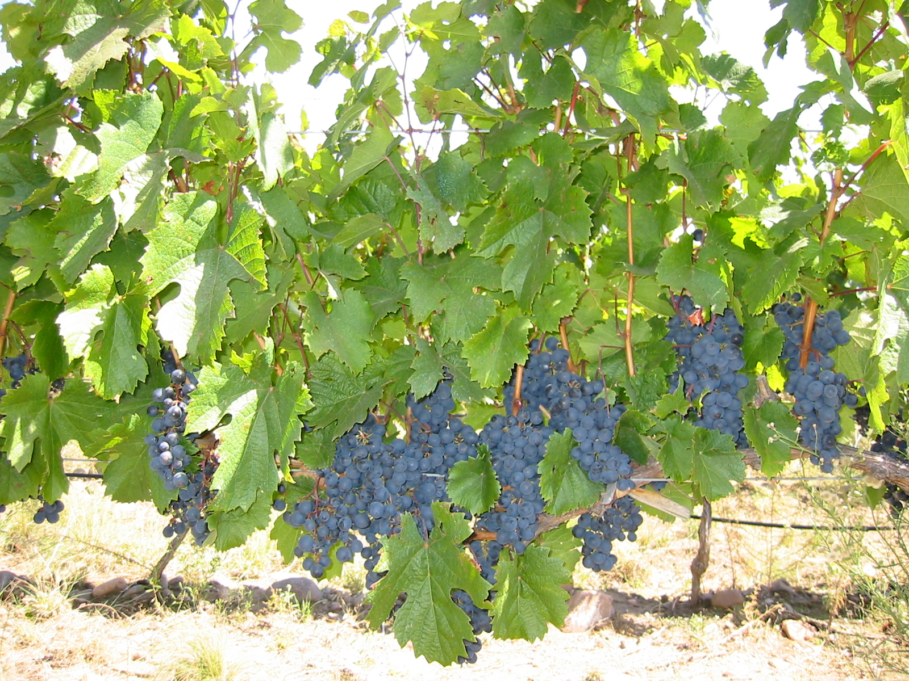
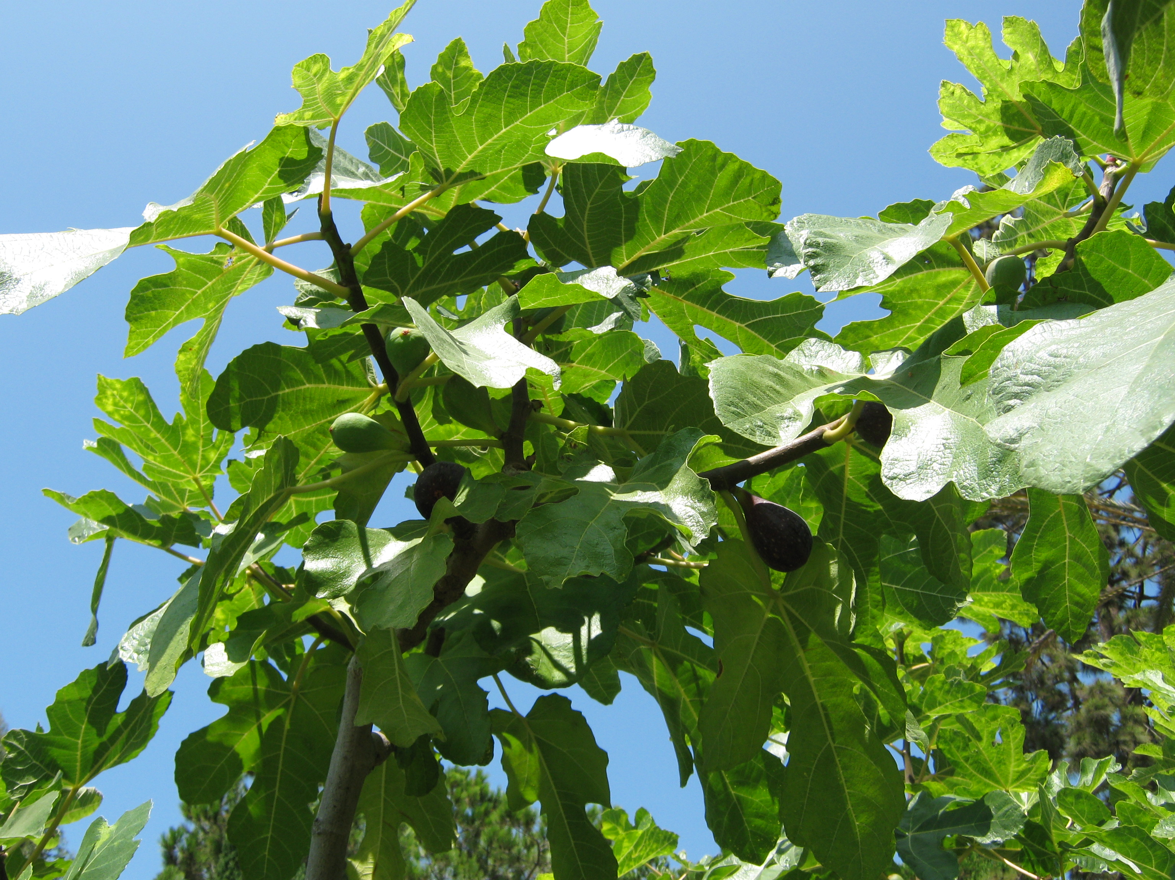
“Ye shall know them by their fruits”
Matt. 7:16-20
“Do men gather grapes of thorns, or figs of thistles?”
Gen 1:11 – “…the fruit tree yielding fruit after his kind…”

Slide 71
The Ever-Present Reality
“The man who overcomes is the man rich in faith. Because he receives the experiences of life in faith, he is humbled by them instead of being embittered. Because he sees the vision of God’s glory, he mourns over present darkness. Because he worships God alone, he is not only humbled but humble. The quality of life which he manifests is only possible because God is to him the ever-present Reality.”
Bro. L.G. Sargent - Teaching of the Master, pgs.41,44

Slide 72
Seeing Him who is Invisible
“The clue to the mind and practice of the saint is to be found in the repeated phrase, “the Father which is in secret”. He is “the King eternal, incorruptible, invisible, the only God”’ and those who love Him will live “as seeing Him who is invisible”. Withdrawing from distraction, whey will come from time to time into a realm where the measure and standards of men no longer exist.”
Bro. L.G. Sargent - Teaching of the Master, pg.183

Slide 73
The Mind of the Spirit
“That the Spirit is not a personal God distinct from the Father, but the instrumental power of the Father, radiant from His person and presence. Filling universal space as the medium of His omniscient perceptions and omnipotent behests, whether in creation or inspiration; the distinction between the Father and the Spirit being (not that they are two persons, but) that the former is Spirit in focus so intense as to be substance and light inconceivable, and the latter, spirit in diffusion continually outflowing from the divine centre, and there fore with the Father forming a unity in the stupendous scheme of creation, which is in revolution around the supreme source of all power.”
Clause XIX – “The Declaration” A.Nichols 1867

Slide 74
What we can judge!
V.19 – “hewn down” - Christ will cut the tree down – Cp. V.1
“fruit” – Occurs 7 times in Matthew 7
Key
Testing Principles not Persons
Fruits Tree

Slide 75
“For when the Gentiles, which have not the law, do by nature the things contained in the law, these, having not the law, are a law unto themselves:
Which shew the work of the law written in their hearts, their conscience also bearing witness, and their thoughts the mean while accusing or else excusing one another;
In the day when God shall judge the secrets of men by Jesus Christ according to my gospel.”
Romans 2:14-16

Slide 76
“But strong meat belongeth to them that are of full age, even those who by reason of use have their senses exercised to discern both good and evil.”
Hebrews 5:14

