Slide 1
The Angels of God
Class 1:
Who are the Angels?

Slide 2
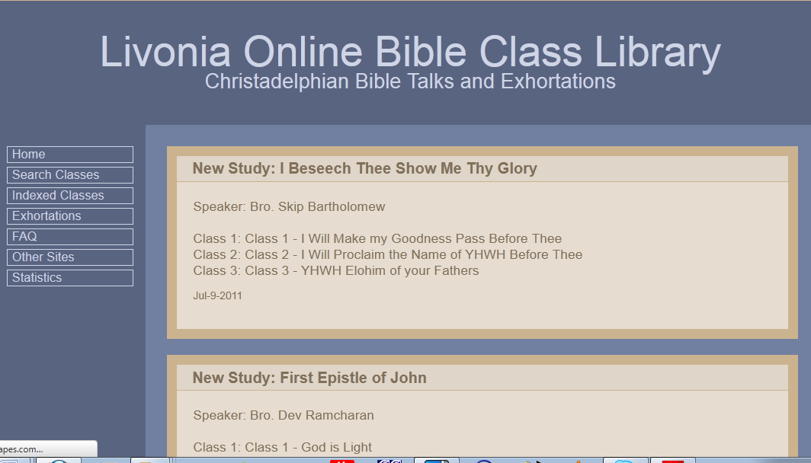
www.livoniatapes.com

Slide 3
Reasons to Study the Angels
They reveal God’s character to us
They are part of the “whole family of God”
We are training to be like them
  Morally: now Physically: in the kingdom
They are always with us and know our thoughts
They will bring us to Christ when he comes
They are God’s Spirit at work today
They are the 1st step in understanding how God manifests himself in individuals
Note: They reveal God’s character, but still maintain their individual personalities!

Slide 4
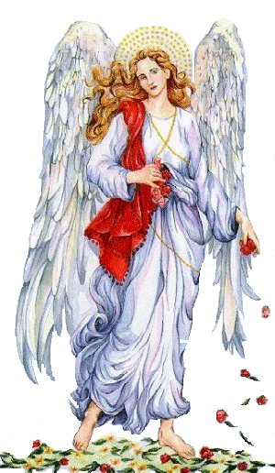
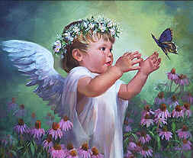
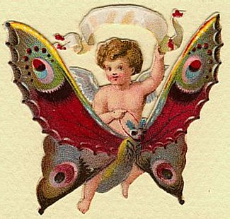
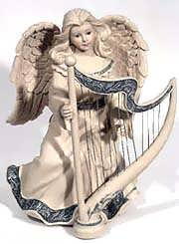
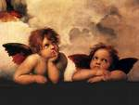
Misconceptions
These misconceptions in the churches may have influenced our community to shy away from acknowledging the daily involvement of angels in our lives

Slide 5
There are lots of angels!
Matthew 26:53
"Or do you think that I cannot now pray to My Father, and He will provide Me with more than twelve legions of angels? (at least 60,000)
Daniel 7:10
A fiery stream issued and came forth from before Him. A thousand thousands (a million!) ministered to Him; ten thousand times ten thousand (100,000,000) stood before Him. The court was seated, and the books were opened.
“innumerable company of angels” in Heb 12:22 might be “ten thousand” as in Jude 14
These are involved in saving humans on earth. There could be many more in other places!

Slide 6
Job 38:4-7
4 "Where were you when I laid the foundations of the earth? Tell Me, if you have understanding.
5 Who determined its measurements? Surely you know! Or who stretched the line upon it?
6 To what were its foundations fastened? Or who laid its cornerstone,
7 When the morning stars sang together, and all the sons of God (angels) shouted for joy? (New King James Version)
They were involved & interested in our creation.
Excited from the start! Sang & shouted for joy!

Slide 7
Psalm 103:20-22
20 Bless the LORD, you His angels, who excel in strength, who do His word, heeding the voice of His word.
21 Bless the LORD, all you His hosts, you ministers of His, who do His pleasure.
22 Bless the LORD, all His works, in all places of His dominion. Bless the LORD, O my soul!
Note vs 17-18: We must do the same to receive God’s mercy and live in His kingdom

Slide 8
Luke 20:35-36
35 "But those who are counted worthy to attain that age, and the resurrection from the dead, neither marry nor are given in marriage;
36 "nor can they die anymore, for they are equal to the angels and are sons of God, being sons of the resurrection.
Angels are immortal
They don’t have individual family relationships
They are now, what we hope to become

Slide 9
1 Timothy 6:15-16
15 which He will manifest in His own time, He who is the blessed and only Potentate, the King of kings and Lord of lords,
16 who alone has immortality, dwelling in unapproachable light, whom no man has seen or can see, to whom be honor and everlasting power. Amen
Angels were not always immortal. Only God has underived immortality.

Slide 10
Genesis 3:5, 22
5 "For God knows that in the day you eat of it your eyes will be opened, and you will be like God [“elohim” – angels], knowing good and evil."
22 Then the LORD God said, "Behold, the man has become like one of Us (angels), to know good and evil. And now, lest he put out his hand and take also of the tree of life, and eat, and live forever"--
Angels know good and evil like us. They have a conscience – must make moral decisions. They are individuals, not robots.

Slide 11
Angels are known for wisdom
2 Samuel 14:17-20
17 Your maidservant said, 'The word of my lord the king will now be comforting; for as the angel of God, so is my lord the king in discerning good and evil. And may the Lord your God be with you.'"
20 To bring about this change of affairs your servant Joab has done this thing; but my lord is wise, according to the wisdom of the angel of God, to know everything that is in the earth."
2 Samuel 19:27
27 And he (Ziba) has slandered your servant (Mephibosheth) to my lord the king, but my lord the king is like the angel of God. Therefore do what is good in your eyes.

Slide 12
Angels have emotions!
Job 38:7 When the morning stars sang together, and all the sons of God shouted for joy?
Luke 1:28 And having come in, the angel said to her, "Rejoice, highly favored one, the Lord is with you; blessed are you among women!"
Luke 2:10 Then the angel said to them, "Do not be afraid, for behold, I bring you good tidings of great joy which will be to all people.
Luke 15:7 "I say to you that likewise there will be more joy in heaven over one sinner who repents than over ninety-nine just persons who need no repentance.
10 "Likewise, I say to you, there is joy in the presence of the angels of God over one sinner who repents."
If we can bring them joy, we can also cause sadness ☹

Slide 13
Angels show compassion
Gen 21:17 And God heard the voice of the lad. Then the angel of God called to Hagar out of heaven, and said to her, "What ails you, Hagar? Fear not, for God has heard the voice of the lad where he is.
Dan 10:19 And he said, "O man greatly beloved, fear not! Peace be to you; be strong, yes, be strong!" So when he spoke to me I was strengthened, and said, "Let my lord speak, for you have strengthened me."
Matt 28:5 But the angel answered and said to the women, "Do not be afraid, for I know that you seek Jesus who was crucified.
Luke 1:13 But the angel said to him, "Do not be afraid, Zacharias, for your prayer is heard; and your wife Elizabeth will bear you a son, and you shall call his name John.
Luke 1:30 Then the angel said to her, "Do not be afraid, Mary, for you have found favor with God.
Luke 2:10 Then the angel said to them, "Do not be afraid, for behold, I bring you good tidings of great joy which will be to all people.

Slide 14
1 Timothy 5:21
21 I charge you before God and the Lord Jesus Christ and the elect (eklektos) angels that you observe these things without prejudice, doing nothing with partiality.
Eklektos is also used of the rewarded saints of our creation (Rom 8:33 – who will bring a charge against God’s elect?)
If some angels are “elect”, then some were not! Not all angels were successful during their probation. Angels probably came from another creation, experienced a period of probation, and some made it by faith!

Slide 15
The appearance of Angels
Mark 16:5
5 And entering the tomb, they (Mary, Mary and Salome) saw a young man clothed in a long white robe sitting on the right side; and they were alarmed.
Genesis 18:1-2
1 Then the LORD appeared to him by the terebinth trees of Mamre, as he was sitting in the tent door in the heat of the day.
2 So he lifted his eyes and looked, and behold, three men were standing by him; and when he saw them, he ran from the tent door to meet them, and bowed himself to the ground
Angels are restored to youth, and appear dressed in white robes
Each angel looks different

Slide 16
Matthew 28:2-3
2 And behold, there was a great earthquake; for an angel of the Lord descended from heaven, and came and rolled back the stone from the door, and sat on it.
3 His countenance was like lightning, and his clothing as white as snow.
Angels can let humans see them reflecting the glory of God – continuous brightness

Slide 17
Judges 13:3, 6
3 And the Angel of the LORD appeared to the woman and said to her, "Indeed now, you are barren and have borne no children, but you shall conceive and bear a son.
6 So the woman came and told her husband, saying, "A Man of God came to me, and His countenance was like the countenance of the Angel of God, very awesome; but I did not ask Him where He was from, and He did not tell me His name.
Angels appear to look like humans, even when reflecting God’s glory

Slide 18
Judges 13:15-16
15 Then Manoah said to the Angel of the LORD, "Please let us detain You, and we will prepare a young goat for You."
16 And the Angel of the LORD said to Manoah, "Though you detain Me, I will not eat your food. But if you offer a burnt offering, you must offer it to the LORD." (For Manoah did not know He was the Angel of the LORD.)
Angels can appear so much like humans that some humans do not know they are angels!
They don’t want us to worship them.

Slide 19
Judges 13:20-21
20 it happened as the flame went up toward heaven from the altar-- the Angel of the LORD ascended in the flame of the altar! When Manoah and his wife saw this, they fell on their faces to the ground.
21 When the Angel of the LORD appeared no more to Manoah and his wife, then Manoah knew that He was the Angel of the LORD.
Angels are not bound by our laws of physics. They are not limited by gravity and heat energy does not affect them. They easily move between heaven & earth.

Slide 20
Hebrews 13:1-2
1 Let brotherly love continue.
2 Do not forget to entertain strangers, for by so doing some have unwittingly entertained angels.
Some of the people we meet may actually be angels! Should teach us to be kind and loving to everyone we encounter, and show hospitality to strangers.
Genesis 37:15-17
15 Now a certain man found him, and there he was, wandering in the field. And the man asked him, saying, "What are you seeking?"
16 So he said, "I am seeking my brothers. Please tell me where they are feeding their flocks."
17 And the man said, "They have departed from here, for I heard them say, 'Let us go to Dothan.'" So Joseph went after his brothers and found them in Dothan.

Slide 21
Numbers 22:24-31
24 Then the Angel of the LORD stood in a narrow path between the vineyards, with a wall on this side and a wall on that side.
25 And when the donkey saw the Angel of the LORD, she pushed herself against the wall and crushed Balaam's foot against the wall; so he struck her again.
31 Then the LORD opened Balaam's eyes, and he saw the Angel of the LORD standing in the way with His drawn sword in His hand; and he bowed his head and fell flat on his face.
Angels have bodies, but they can determine who is allowed to see them. The donkey saw the angel, and Balaam didn’t – all at the same time! Jehovah Witnesses are wrong about angels materializing a body.

Slide 22
2 Kings 6:15-17
15 And when the servant of the man of God (Elisha) arose early and went out, there was an army, surrounding the city with horses and chariots. And his servant said to him, "Alas, my master! What shall we do?"
16 So he answered, "Do not fear, for those who are with us are more than those who are with them."
17 And Elisha prayed, and said, "LORD, I pray, open his eyes that he may see." Then the LORD opened the eyes of the young man, and he saw. And behold, the mountain was full of horses and chariots of fire all around Elisha.
Angels can determine the way we perceive them. In this case they chose to be seen as horses and chariots of fire – because they were there to protect Elisha. The angels have the power to affect our vision.

Slide 23
Members of God’s Family
Ephesians 1:10
10 that in the dispensation of the fullness of the times He might gather together in one all things in Christ, both which are in heaven and which are on earth-- in Him.
Ephesians 3:14-15
14 For this reason I bow my knees to the Father of our Lord Jesus Christ,
15 from whom the whole family in heaven and earth is named,

Slide 24
Angels have good memories
Luke 18:32-34
32 For He will be delivered to the Gentiles and will be mocked and insulted and spit upon. 33 They will scourge Him and kill Him. And the third day He will rise again.” 34 But they understood none of these things; this saying was hidden from them, and they did not know the things which were spoken.
Luke 24:4-7 (months later)
4 And it happened, as they were greatly perplexed about this, that behold, two men stood by them in shining garments. 5 Then, as they were afraid and bowed their faces to the earth, they (angels) said to them, "Why do you seek the living among the dead? 6 He is not here, but is risen! Remember how He spoke to you when He was still in Galilee, 7 saying, 'The Son of Man must be delivered into the hands of sinful men, and be crucified, and the third day rise again.'"

Slide 25
Lessons for Us:
We need to learn to be aware of the presence of angels all the time, even though they don’t let us see them.
The more we feel their presence, the closer we will come to walking with God.
Thank God for the work of His angels!
Now is the time to practice living like angels – to show we really want to live as members of God’s family.

