Slide 1
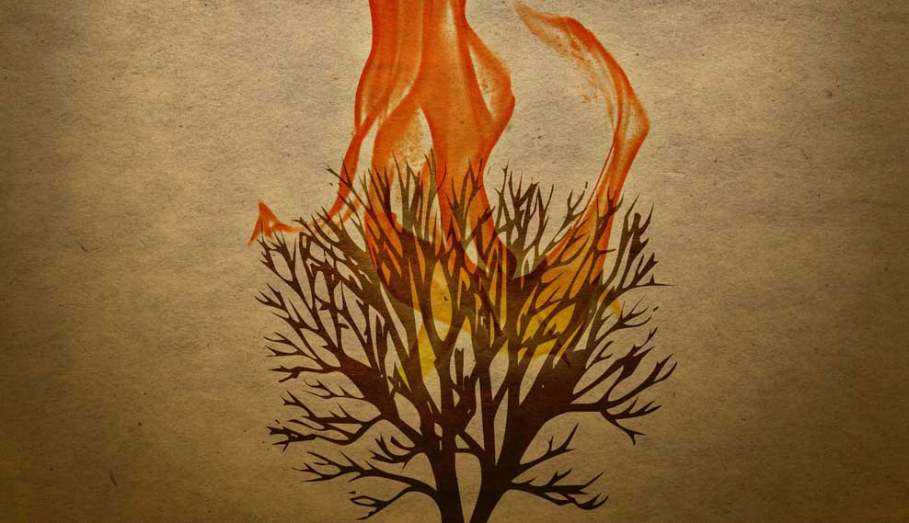
The Gospel of the Burning Bush
Exodus 3:2
Whatshan Lake Bible School 2011

Slide 2
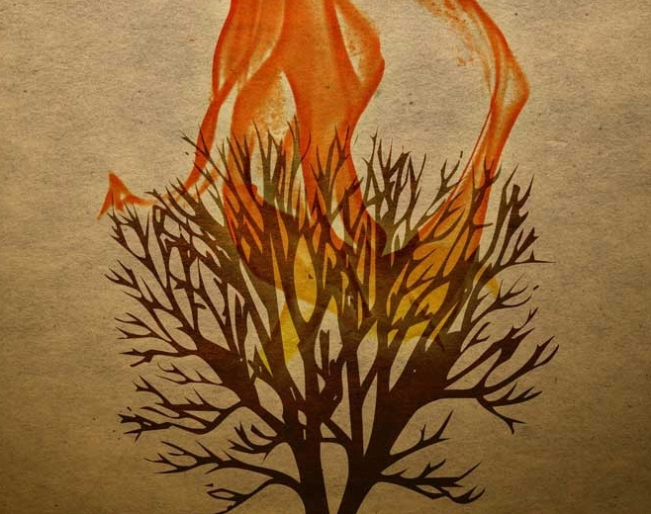
The Gospel of the Burning Bush
Class 1 Delivered from the Sword of Pharaoh
Class 2 Plucked out of the Fire
Class 3 Afflicted in all their Affliction
Class 4 Caught in a Thicket
Class 5 Revealed by Fire
Class 6 Not Ashamed to be Called their God
Exodus 3:2

Slide 3
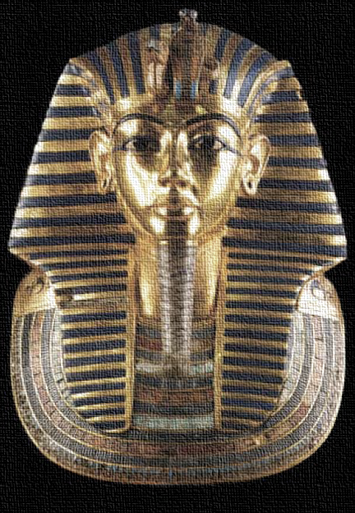
The Gospel of the Burning Bush
Class 1
Delivered from
the Sword
of Pharaoh

Slide 5
What kind of bush was it?
‘seneh’
Strong 5572 related to ‘to prick’ – a ‘bramble’
TWOT 1520 ‘the botanical identification is uncertain as is the derivation’ (acacia?)
Thayer 942 (Gk.) thorn or brier (Strong, too)
Gesenius ‘a bush, thorn bush’
BDB ‘a bush, thorny bush’
Smith some kind of thorn bush
Delivered from Pharaoh

Slide 7
Our God is a Consuming Fire
destroys by consuming
preserves by purifying
DEATH
LIFE

Slide 8
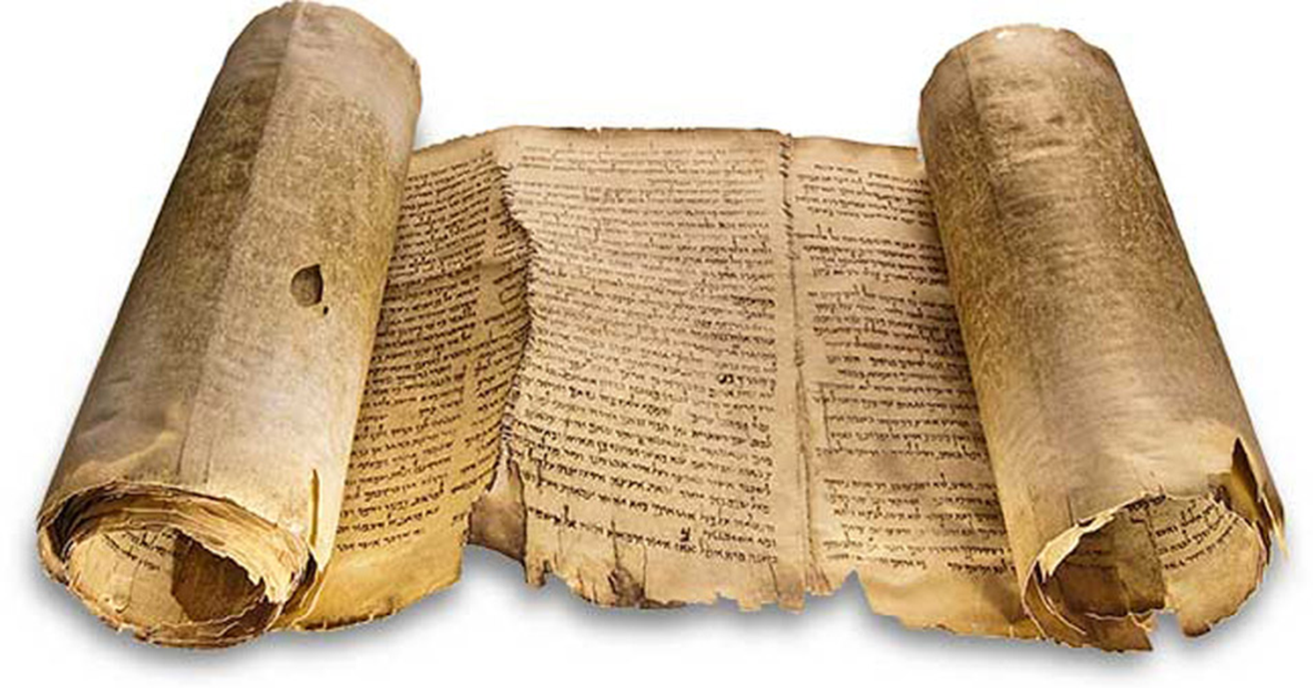
‘consumed’
Heb.
akal
Exodus
3:2
KJV
“And he looked, and behold, the bush burned with fire, and the bush was not consumed.”
Delivered from Pharaoh

Slide 9
‘devouring’
Heb.
akal
Exodus
24:17
KJV
“And the sight of the glory of Yahweh was like devouring fire on the top of the mount…”
Delivered from Pharaoh

Slide 10
see also
De. 4:24
De. 9:3
Hebrews
12:29
KJV
“For our God is a consuming fire.”
Delivered from Pharaoh

Slide 12
Moses (Unconsumed)
protected from Pharaoh’s edict Ex. 1:22-2:2
pitied by Pharaoh’s daughter Ex. 2:3-6
delivered from the sword of Pharaoh Ex. 2:15
unharmed by the serpent-rod Ex. 4:4
healed from his leprosy Ex. 4:7
spared by the angel of Yahweh Ex. 4:24
redeemed out of Egypt with Israel Ex. 12:51
rescued from his own people Ex. 17:4, etc.
relieved by able men in judgment Ex. 18:18
Delivered from Pharaoh

Slide 13
Moses (Unconsumed)
denied in offering himself as a substitute Ex. 32:32-33
preserved in God’s presence Ex. 33:20-21
sustained in his physical body De. 34:7
instructed in the Truth He. 11:23-24
Delivered from Pharaoh

Slide 15
Summary
Learning from Moses
The burning bush is a symbol of Yahweh’s preservation of Moses, through the covenants of promise made to Abraham, Isaac, and Jacob.
Delivered from Pharaoh

Slide 16
Summary
Learning from Moses
The people of God often cannot discern the ways of Providence in their lives.
Salvation comes from a belief and understanding of the Truth.
Moses had to learn that suffering affliction must precede the experience of glory.
Delivered from Pharaoh

Slide 17
Summary
Learning from Moses
Yahweh brought Moses out of Egypt unconsumed.
Our God works all things together for good for those who love Him.
The experience of Moses would become the national experience of the people that were baptized into him.
Delivered from Pharaoh

Slide 18
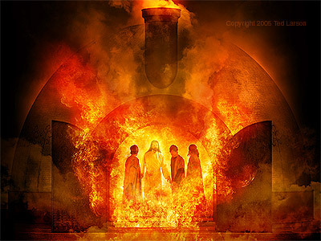
The Gospel of the Burning Bush
Class 2 Plucked out of the Fire
Ted Larsen
Notes:
Ted Larsen

Slide 20
see also
1 Ki. 8:51
Je. 11:4
Deuteronomy
4:20
KJV
“…the LORD hath taken you, and brought you forth out of the iron furnace, even out of Egypt…”
Plucked out of the Fire

Slide 22
Israel: “The Body of Moses”
Chased out of Egypt
Ex. 2:14 cp. Ex. 12:31-36
Pursued by Pharaoh and his men
Ex. 2:15 cp. Ex. 14:5-8
Delivered from Pharaoh and his men
Ex. 18:4 cp. Ex. 14:26-31
Plucked out of the Fire

Slide 23
Israel: “The Body of Moses”
Escaped to the wilderness of Sinai
Ex. 3:1 cp. Ex. 19:1
Received the word of God out of the fire at Sinai
Ex. 3:4 cp. De. 4:33,36; 5:4-5,22-26
Unconsumed at the appearing of the angel
Ex. 3:6, 33:20-23 cp.
De. 4:33; 5:24-26
Plucked out of the Fire

Slide 24
Defining “Sinai”
‘siynay’
Strong 5514 ‘of uncertain derivation’
TWOT 1488 (no suggested meaning)
ISBE probably related to ‘shine’
Gesenius ‘perhaps clayey, miry’
BDB ‘thorny’
Smith ‘thorny’
Plucked out of the Fire

Slide 25
Another connection?
‘seneh’
‘bush’ some kind of thorn bush
‘siynay’
‘Sinai’ perhaps thorny
Plucked out of the Fire

Slide 27
Israel (Unconsumed)
Egypt Exodus
Amalek Exodus
Canaan Joshua
Ammon Judges
Moab Judges
Philistia Judges
Midian Judges
Syria Ki & Ch
Assyria Ki & Ch
Babylon Ki & Ch
Edom Ki & Ch
Persia Esther
Gentiles Ezra
Greece Inter-Test.
Rome New Test.
Plucked out of the Fire

Slide 29
see also
Je. 30:11
Jeremiah
46:28
KJV
“…I am with thee; for I will make a full end of all the nations whither I have driven thee: but I will not make a full end of thee...”
Plucked out of the Fire

Slide 31
Notes:
Source: adelphosweb.com

Slide 32
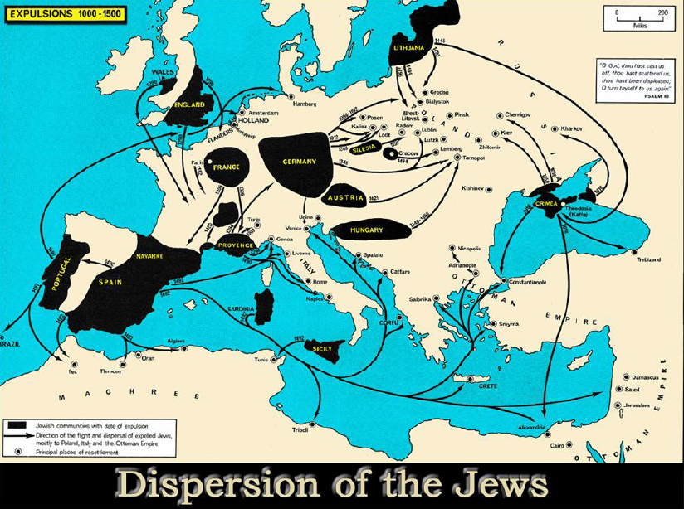
Notes:
Source: adelphosweb.com

Slide 33
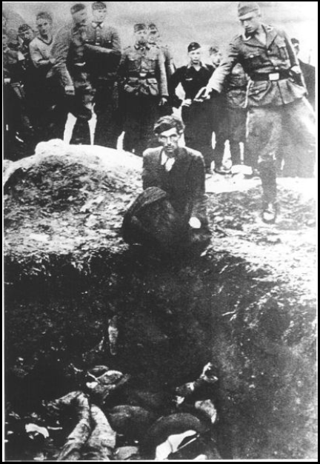
Jewish Expulsions
1012 | from Germany
1182 | from France
1192 | from Germany
1248 | from Germany
1290 | from England
1306 | from France
1348 | from Germany
1349-60 | from Hungary
1394 | from France
1420 | from France
1421 | from Austria
1492 | from Spain
1497 | from Portugal
1737 | from Germany
1871-1906 | Pogroms in Russia
Notes:
Scattered Among the Peoples: The Jewish Diaspora in Ten Portraits, Allan Levine, 2002, p. 2).

Slide 34
(under European Christendom)
Major Instances of Persecution
1096 | European Jews by crusaders
1099 | Levantine Jews by crusaders
1190 | Jews in York, England by crusaders
1298 | 146 German Jewish communities
1200s | Periodic regional massacres in Germany
1348-49 | 350 communities (blamed for Black Death)
1483-98 | Inquisition in Spain & Portugal (burnings)
1642-49 | Inquisition in Mexico (burnings)
1648 | 100,000 Polish Jews massacred
1881 | 160 communities of Russian Jews in pogroms
1903-06 | 50,000 killed in Russian pogroms
Notes:
Scattered Among the Peoples: The Jewish Diaspora in Ten Portraits, Allan Levine, 2002, p. 2).

Slide 35
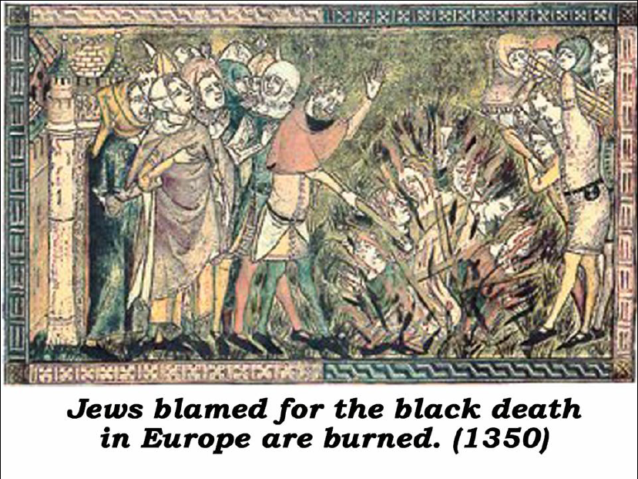
Notes:
Source: adelphosweb.com

Slide 36
Notes:
Source: adelphosweb.com

Slide 37
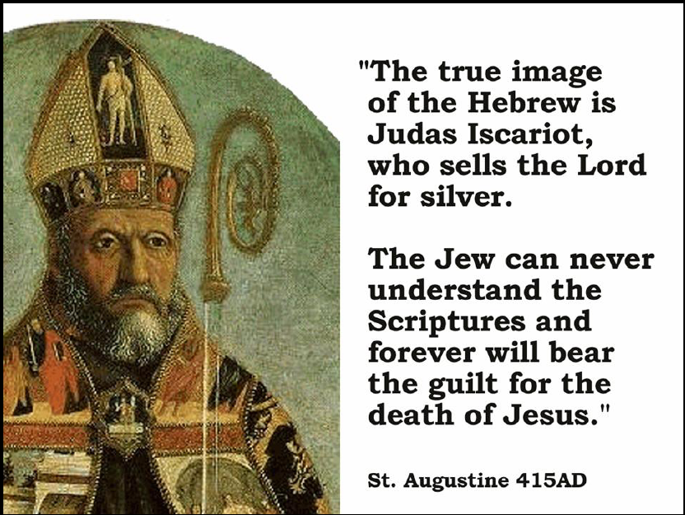
Notes:
Source: adelphosweb.com

Slide 38
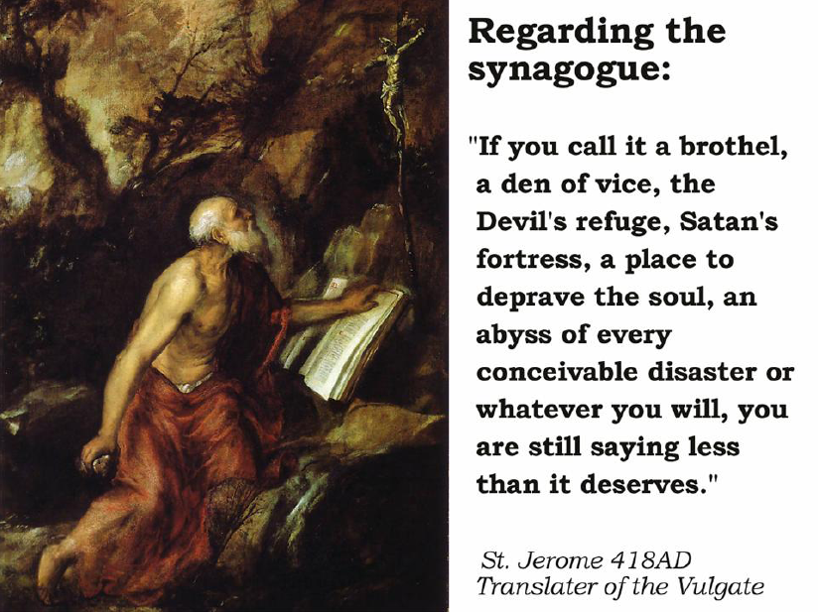
Notes:
Source: adelphosweb.com

Slide 39
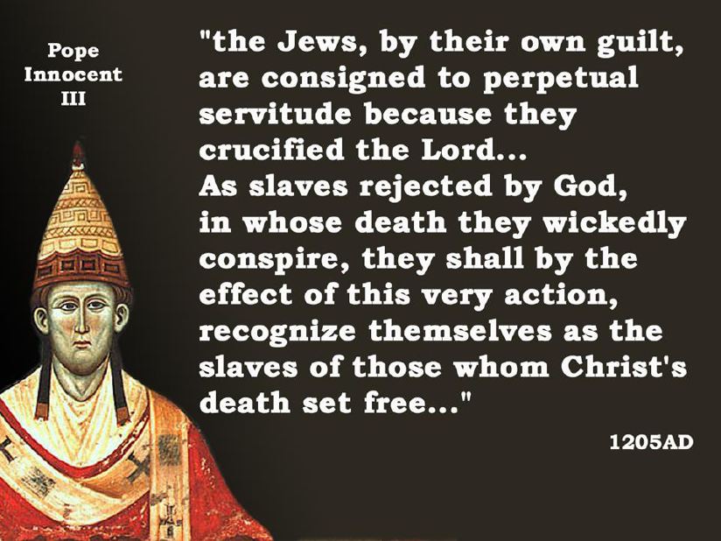
Notes:
Source: adelphosweb.com

Slide 40
Notes:
Source: adelphosweb.com

Slide 42
Isaiah
43:2
KJV
“…when thou walkest through the fire, thou shalt not be burned; neither shall the flame kindle upon thee.”
Plucked out of the Fire

Slide 44
Egypt
Exodus 15:7
KJV
“…Thou hast overthrown them that rose up against thee: thou sentest forth thy wrath, which consumed them as stubble.”
Plucked out of the Fire

Slide 45
Assyria
Isaiah
10:17
KJV
“And the light of Israel shall be for a fire, and his Holy One for a flame: and it shall burn and devour his thorns and his briers in one day.”
Plucked out of the Fire

Slide 46
Nineveh
Nahum
1:10
KJV
“For while they be folden together as thorns, and while they are drunken as drunkards, they shall be devoured as stubble fully dry.”
Plucked out of the Fire

Slide 47
Isaiah
48:9-10
KJV
“For my name’s sake will I defer mine anger, and for my praise will I refrain for thee, that I cut thee not off. Behold, I have refined thee, but not with silver; I have chosen thee in the furnace of affliction.”
Plucked out of the Fire

Slide 49
Summary
Learning from Israel
The burning bush is a symbol of Yahweh’s preservation of the nation of Israel, through the covenants of promise made to Abraham, Isaac, and Jacob.
Plucked out of the Fire

Slide 50
Summary
Learning from Israel
God’s word is heard in the wilderness, and not in the crush of the world’s concerns.
The re-establishment of the nation of Israel must never cease to sustain our faith in the covenants of promise.
Our Heavenly Father has not called us for who we are, but for who He is able to create for His glory.
Plucked out of the Fire

Slide 51
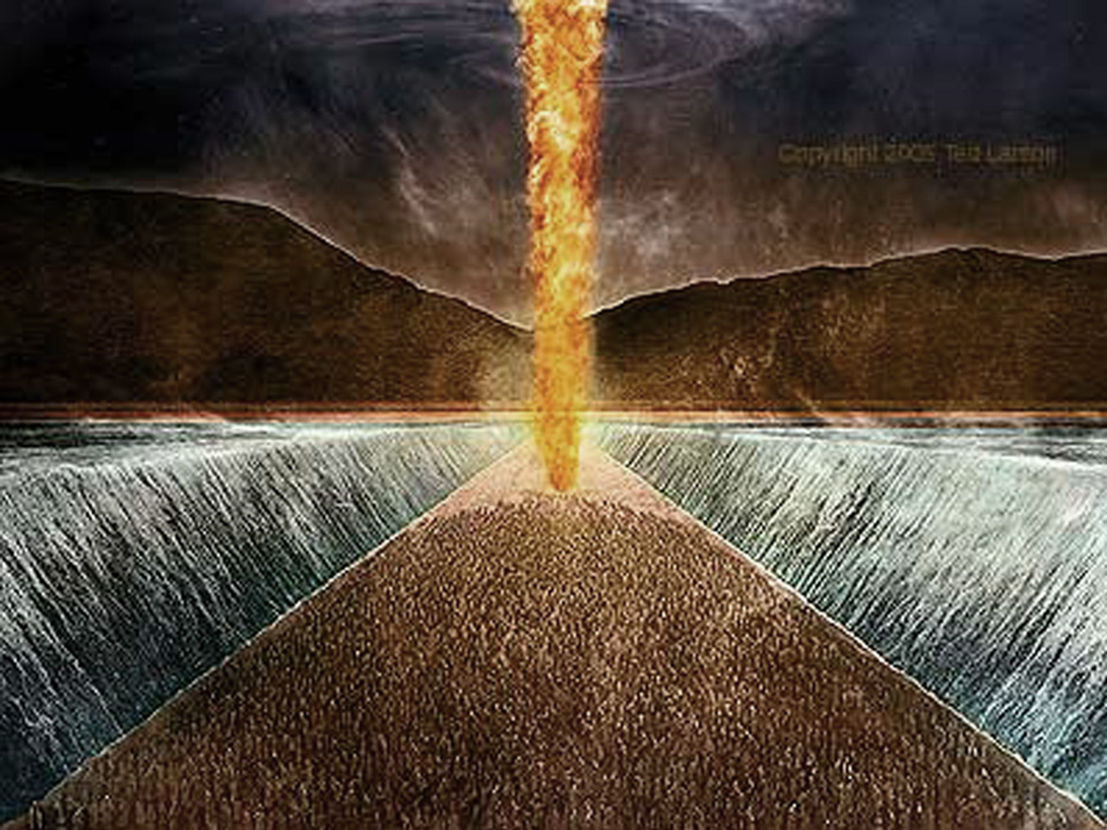
The Gospel of the Burning Bush
Ted Larsen
Class 3
Afflicted in
All their Affliction
Notes:
Ted Larsen

Slide 53
The Angel of His Presence
In the Egyptian affliction
Ex. 3:2
In the Canaanite affliction
Jg. 2:1-5
In the Babylonian affliction
Da. 3:25
In the Judean affliction
Zec. 3:1-2
Afflicted in All their Affliction

Slide 55
see also
Ps. 56:8
2 Kings
20:5
KJV
“Thus saith Yahweh, the God of David thy father, I have heard thy prayer, I have seen thy tears: behold, I will heal thee.”
Afflicted in All their Affliction

Slide 57
Summary
Learning from the Angel
The burning bush is a symbol of Yahweh’s preservation of His people, by the hand of His angels, according to the covenants of promise made to Abraham, Isaac, and Jacob.
Afflicted in All their Affliction

Slide 58
Summary
Learning from the Angel
Through His merciful forgiveness, our Heavenly Father does not mark iniquity, yet he numbers our tears.
The Father and the Son see all our afflictions.
Our works of service to each other are done to Christ; and all our good intentions left unfulfilled, are unfulfilled to him, too.
We must look to bear each other’s burdens, and so fulfill the law of Christ.
Afflicted in All their Affliction

Slide 59
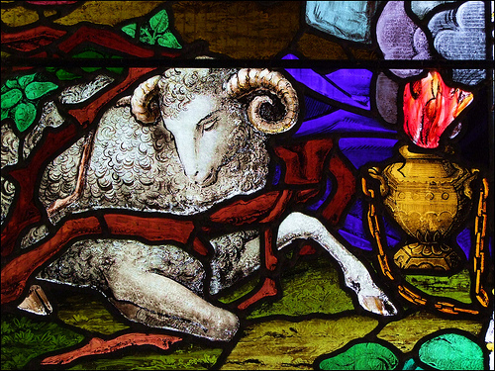
The Gospel of the Burning Bush
Class 4 Caught in a Thicket

Slide 61
What kind of bush was it?
‘seneh’
Strong 5572 related to ‘to prick’ – a ‘bramble’
TWOT 1520 ‘the botanical identification is uncertain as is the derivation’ (acacia?)
Thayer 942 (Gk.) thorn or brier (Strong, too)
Gesenius ‘a bush, thorn bush’
BDB ‘a bush, thorny bush’
Smith some kind of thorn bush
Caught in a Thicket

Slide 62
The Parable of Thorns
Associated with causes and effects of sin (deceit)
Abound from the curse on the ground
Ge. 3:17-19
Flourish in deceitfulness of sloth
Pr. 24:30-34
Choke through deceitfulness of riches
Mk. 4:18-19
Represent harmful people
2Sa. 23:6-7
Caught in a Thicket

Slide 63
Hebrews
3:13
KJV
“But exhort one another daily, while it is called To day; lest any of you be hardened through the deceitfulness of sin.”
Caught in a Thicket

Slide 65
Defining ‘Cozbi’
‘kozbiy’
Strong 3579 ‘false’
ISBE ‘deceitful’
Gesenius ‘lying’
BDB ‘my lie’
Smith ‘deceitful’
Caught in a Thicket

Slide 67
Shittim wood
“…these most striking features of the landscape. They are most picturesque trees with their gnarled trunks, sometimes 2 ft. thick, their twisted, thorny branches, which often give the whole tree an umbrella-like form, and their fine bipinnate leaves with minute leaflets. The curiously twisted pods and the masses of gum arabic which exude in many parts are also peculiar features. The trees yield a valuable, hard, close-grained timber, not readily attacked by insects.”
ISBE, e-Sword edition, ‘shittah tree; shittim wood’
Caught in a Thicket

Slide 68
Defining ‘shittim’
‘shittiym’
Strong 7848 related to ‘scourging thorns’
TWOT 2371 acacia
Gesenius a black tree with black thorns
BDB ‘acacia wood’
Smith acacia, meaning ‘the thorny’
Caught in a Thicket

Slide 69
An Ark of Shittim Wood
“…the ark of the covenant overlaid round about with gold…” (He. 9:4)
Overlaid with gold
1Pe. 1:7
Hidden manna
Re. 2:17
Aaron’s rod
Nu. 17:8
Tables of the covenant
Is. 40:8
Caught in a Thicket

Slide 70
Summary
Learning from the Son
The burning bush is a symbol of Yahweh’s preservation of His Son, (who bore our nature but never sinned) through the covenants of promise made to Abraham, Isaac, and Jacob.
Caught in a Thicket

Slide 71
Summary
Learning from the Son
Sin is deceitful, and can take over our lives if we are not diligent in forsaking it.
Because our flesh can so easily deceive us, we must fill ourselves with the Word in order to see the Truth.
Caught in a Thicket

Slide 72
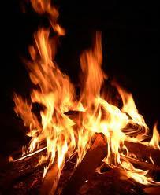
The Gospel of the Burning Bush
Class 5
Revealed
by Fire

Slide 74
see also
De. 4:24
De. 9:3
Hebrews
12:29
KJV
“For our God is a consuming fire.”
Revealed by Fire

Slide 75
Our God is a Consuming Fire
destroys by consuming
preserves by purifying
Deuteronomy 4:24
Isaiah 22:14
Deuteronomy 9:3
Isaiah 33:14-15; 6:6-7
Psalm 145:20
DEATH
LIFE

Slide 77
Leviticus
10:3
KJV
“…I will be sanctified in them that come nigh me, and before all the people I will be glorified.”

Slide 79

Shoes: symbols of walk
“He that walketh with wise men shall be wise…” (Pr. 13:20)
old shoes impoverished man (Jos. 9:5)
bloody shoes violent man (1 Ki. 2:5)
unbroken shoes unstoppable man (Is. 5:27)
removed shoes un-redeeming man (Ex. 3:5; De. 25:9-10; Jos. 5:15; Ru. 4:7-8; Ac. 7:33)
“The feet and the shoes become the symbol of a man’s standing and walk in life.”
Revealed by Fire

Slide 80
Shoes: symbols of walk
“He that walketh with wise men shall be wise…” (Pr. 13:20)
old shoes impoverished man (Jos. 9:5)
bloody shoes violent man (1 Ki. 2:5)
unbroken shoes unstoppable man (Is. 5:27)
removed shoes un-redeeming man (Ex. 3:5; De. 25:9-10; Jos. 5:15; Ru. 4:7-8; Ac. 7:33)
un-removable shoes redeemer (Mt. 3:11; Mk. 1:7; Lk. 3:15; Ac. 13:25)
Revealed by Fire

Slide 81
Moses’ sanctification
“The immediate object of Moses’ sanctification, therefore, was to fit him for the humanly impossible task that lay before him.”
The Christadelphian Magazine (Libronix), 1961 (Vol. 98, p. 98-100) “Whatsoever Toucheth the Altar is Holy”, Bro. D.D. Palmer
Revealed by Fire

Slide 83
see also
1 Pe. 1:7
Proverbs
17:3
KJV
“The fining pot is for silver, and the furnace for gold: but Yahweh trieth the hearts.”
Revealed by Fire

Slide 84
Summary
Learning from the Fire
The burning bush is a symbol of Yahweh as a consuming fire, Who preserves through purifying, or destroys through consuming, according to His wisdom.
Revealed by Fire

Slide 85
Summary
Learning from the Fire
Holiness begins with the humble recognition that we are unable to approach our Heavenly Father as we are: we must be made holy.
We must be sanctified to sanctify each other.
In family life, we must have the wisdom to know what environment will prevent our family from being consumed in the iniquity of the world.
Revealed by Fire

Slide 86
Summary
Learning from the Fire
In ecclesial life, we must be careful, especially in times of controversy, about how we interact with those we disagree with. We can injure each other’s faith.
Our Heavenly Father does not want to consume us, but if His Son is to dwell in our hearts by faith, He must try them with fire.
Revealed by Fire

Slide 87
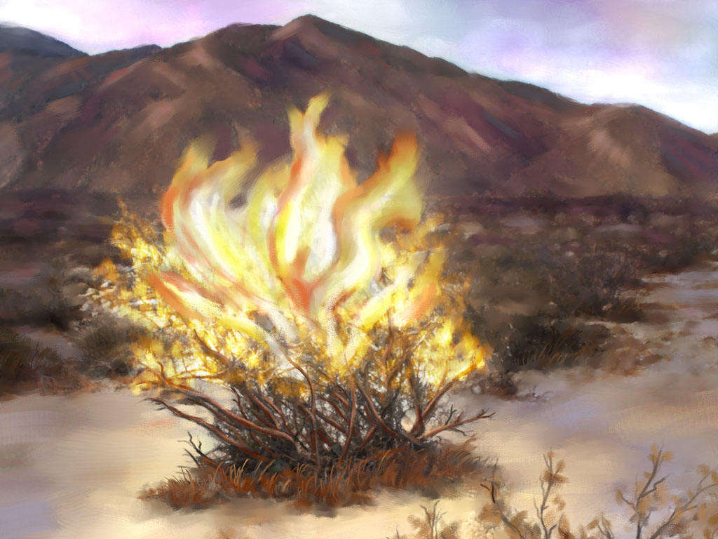
The Gospel of the Burning Bush
Class 6
Not Ashamed
to be Called their God

Slide 88
Summary
Learning from Moses
The burning bush is a symbol of Yahweh’s preservation of Moses, through the covenants of promise made to Abraham, Isaac, and Jacob.
Delivered from Pharaoh

Slide 89
Summary
Learning from Moses
The people of God often cannot discern the ways of Providence in their lives.
Salvation comes from a belief and understanding of the Truth.
Moses had to learn that suffering affliction must precede the experience of glory.
Delivered from Pharaoh

Slide 90
Summary
Learning from Moses
Yahweh brought Moses out of Egypt unconsumed.
Our God works all things together for good for those who love Him.
The experience of Moses would become the national experience of the people that was baptized into him.
Delivered from Pharaoh

Slide 91
Summary
Learning from Israel
The burning bush is a symbol of Yahweh’s preservation of the nation of Israel, through the covenants of promise made to Abraham, Isaac, and Jacob.
Plucked out of the Fire

Slide 92
Summary
Learning from Israel
God’s word is heard in the wilderness, and not in the crush of the world’s concerns.
The re-establishment of the nation of Israel must never cease to sustain our faith in the covenants of promise.
Our Heavenly Father has not called us for who we are, but for who He is able to create for His glory.
Plucked out of the Fire

Slide 93
Summary
Learning from the Angel
The burning bush is a symbol of Yahweh’s preservation of His people, by the hand of His angels, according to the covenants of promise made to Abraham, Isaac, and Jacob.
Afflicted in All their Affliction

Slide 94
Summary
Learning from the Angel
Through His merciful forgiveness, our Heavenly Father does not mark iniquity, yet he numbers our tears.
The Father and the Son see all our afflictions.
We must look to bear each other’s burdens, and so fulfill the law of Christ.
Afflicted in All their Affliction

Slide 95
Summary
Learning from the Son
The burning bush is a symbol of Yahweh’s preservation of His Son, (who bore our nature but never sinned) through the covenants of promise made to Abraham, Isaac, and Jacob.
Caught in a Thicket

Slide 96
Summary
Learning from the Son
Sin is deceitful, and can take over our lives if we are not diligent in forsaking it.
Because our flesh can so easily deceive us, we must fill ourselves with the Word in order to see the Truth.
Caught in a Thicket

Slide 97
Summary
Learning from the Fire
The burning bush is a symbol of Yahweh as a consuming fire, Who preserves through purifying, or destroys through consuming, according to His wisdom.
Revealed by Fire

Slide 98
Summary
Learning from the Fire
Holiness begins with the humble recognition that we are unable to approach our Heavenly Father as we are: we must be made holy.
We must be sanctified to sanctify each other.
In family life, we must have the wisdom to know what environment will prevent our family from being consumed in the iniquity of the world.
Revealed by Fire

Slide 99
Summary
Learning from the Fire
In ecclesial life, we must be careful, especially in times of controversy, about how we interact with those we disagree with. We can injure each other’s faith.
Our Heavenly Father does not want to consume us, but if His Son is to dwell in our hearts by faith, he must try them with fire.
Revealed by Fire

Slide 101
Abraham’s resurrections
Barrenness of Sarah’s womb
Ge. 11:30
Barrenness of Canaan’s ground
Ge. 12:10
Deadness of Sarah’s womb
Ge. 18:11 cp. Ro. 4:19
Not Ashamed

Slide 102
Abraham’s resurrections
Deadness of Abraham’s body
Ro. 4:19
Barrenness of Abimelech’s house
Ge. 20:17-18
Parable of Isaac’s sacrifice
Ge. 22 cp. He. 11:17-19
Not Ashamed

Slide 104
1 Kings 18: remember Jacob
Going separate ways in the land
1Ki. 18:6 cp. Ge. 28:9-10
Division of the faithful’s companies
1Ki. 18:4 cp. Ge. 32:7
Righteous’s fear of vengeance
1Ki. 18:9 cp. Ge. 27:41; 32:7
Foolish wives
1Ki. 16:31 cp. Ge. 26:34-35
Shameless immorality
1Ki. 16:31-33 cp. He. 12:16
Not Ashamed

Slide 105
1 Kings 18: remember Jacob
A time of trouble
1Ki. 18:7-16 cp. Ge. 32
400 wicked supporters
1Ki. 18:19 cp. Ge. 32:6
Strength of the arm of flesh
1Ki. 18:10 cp. Ge. 36:31
The faithful’s fearful lonliness
1Ki. 18:22; 19:10 cp. Ge. 32:24
Sin as scarlet
1Ki. 18:28 cp. Ge. 25:30
Not Ashamed

Slide 106
1 Kings 18: remember Jacob
The heritage of altar building
1Ki. 18:31-32 cp. Ge. 35:1
Jacob’s name changed to Israel
1Ki. 18:31 cp. Ge. 32:28
Israel’s limping strides
1Ki. 18:21,26 cp. Ge. 32:31
Sorrow without repentance
1Ki. 21:19 cp. He. 12:15
Preservation of Israel’s remnant
1Ki. 18:4; 19:18 cp. Ge. 34:30
Not Ashamed

Slide 108
Repentance for the Just
cp. Lk. 15:7
Thou, Lord, according to the abundance of thy goodness, hast proclaimed repentance and forgiveness to those that have sinned against thee, and in the multitude of thy kindnesses thou hast decreed for sinners repentance unto salvation. Surely thou, O Lord, the God of the just, hast not appointed repentance for the just, for Abraham and Isaac and Jacob who have not sinned against thee; but thou hast appointed repentance for me a sinner:
An excerpt from “The Prayer of Manasseh”
Not Ashamed
Notes:
The Septuagint with Apocrypha: Greek and English, Sir Lancelot C.L. Brenton, Hendrickson Publishers

Slide 110
Summary
Learning from the Name
The declaration of God’s Name at the burning bush proclaims the ultimate purpose of Yahweh in preserving His people by forgiving them of their sins, and resurrecting them to immortality, through the covenants of promise made to Abraham, Isaac, and Jacob.
Not Ashamed

Slide 111
Summary
Learning from the Name
The patriarchs were human, and they needed to be transformed by the word of God and faith in His promises, just as much as we do.
Our Heavenly Father has not yet given the fathers their promises, so they must be resurrected to immortality in order to receive them.
Those who are in Christ are the seed of Abraham by faith. No affliction – not even death can consume them.
Not Ashamed

Slide 113
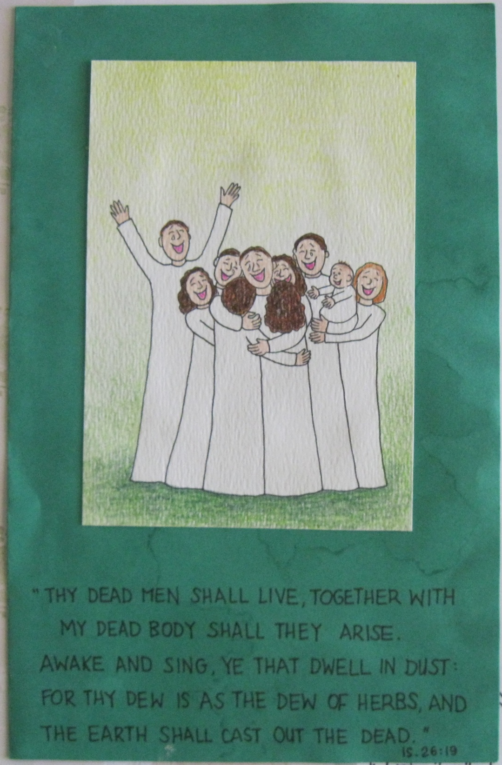
Not Ashamed

Slide 114

Not Ashamed

Slide 115
For Abraham’s God is our God,
And Isaac’s God is ours,
Ours is the God of Jacob,
With His almighty powers.
HYMN 238
Not Ashamed

