Slide 1

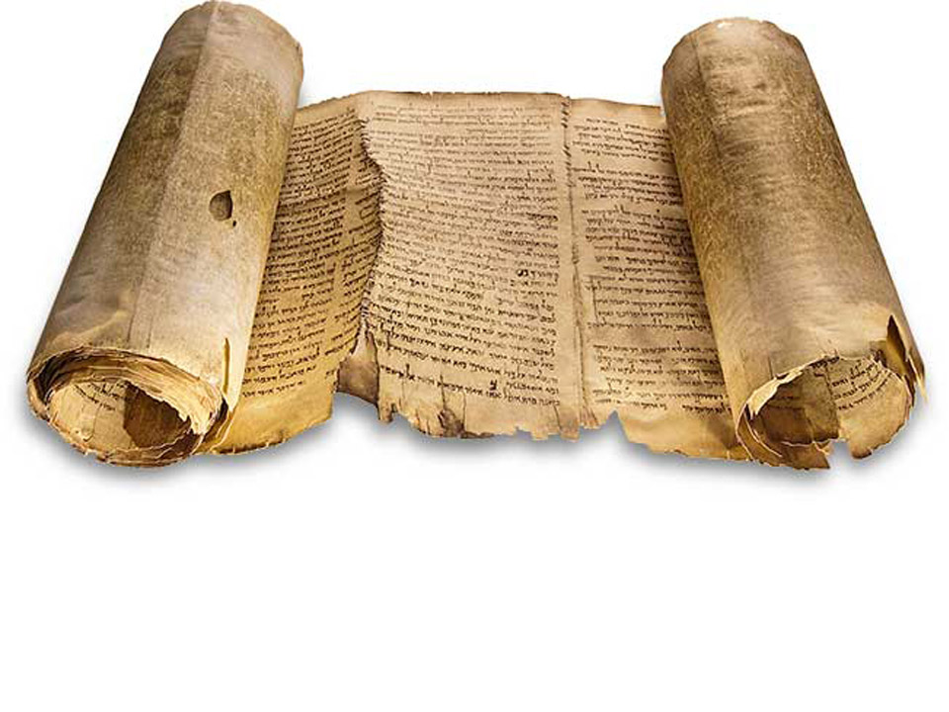
Reasons to Believe
Why we can be confident that the Bible is the Word of God
A Look at the Great Isaiah Scroll

Slide 3
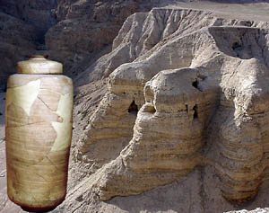
Qumran
oldest Bibles ever found
Great Isaiah Scroll
Found on northwest shore of Dead Sea
Predates MT by more than a millennium
c150-125 BC
Reasons to Believe

Slide 4
Reasons to Believe

Slide 5
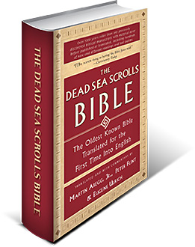
Reasons to Believe

Slide 6
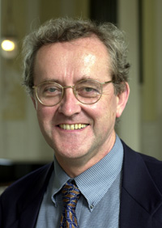
Different…?
“The Dead Sea Scrolls contain copies of biblical manuscripts that are more than a thousand years older than those previously available. Yet these texts are never included in the standard editions of the Scrolls, and have remained virtually inaccessible to the general public. Here for the first time any reader can see at a glance how the readings from Qumran differ from other biblical texts.”
The Dead Sea Scrolls Bible
John Collins
University of Chicago
Reasons to Believe

Slide 7
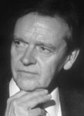
Different…?
“Here, as never before, the English reader can see personally just how fluid the Early Jewish or pre-Christian texts and canons of the First or Old Testament were, and how adaptable the biblical text was to ancient community concerns.”
The Dead Sea Scrolls Bible
James Sanders
President (ABMC)
Reasons to Believe
Notes:
ABMC (Ancient Biblical Manuscript Center)

Slide 8
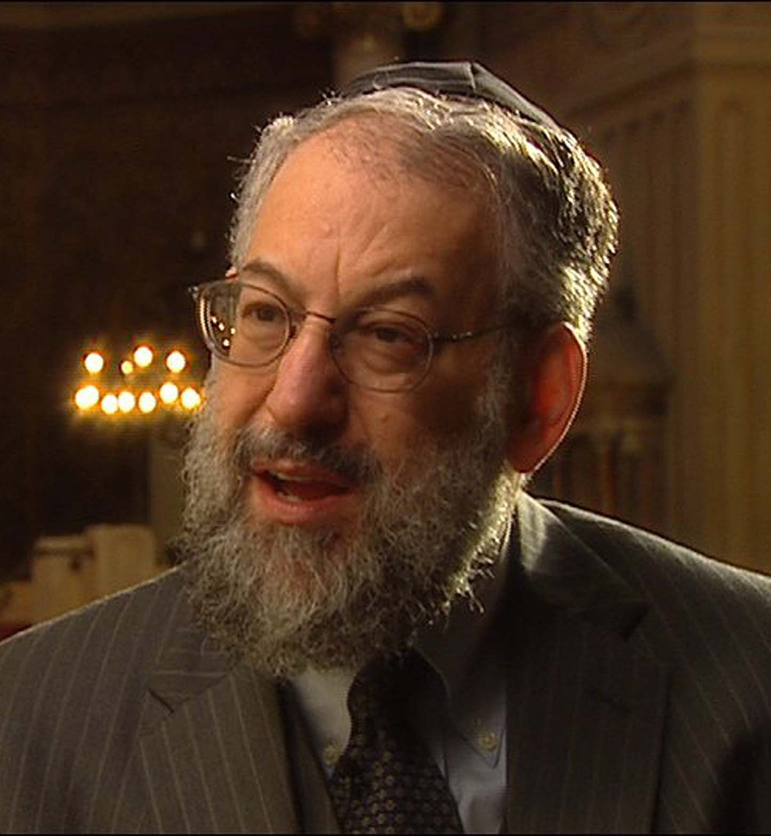
or the same…?
“It shows how Qumran manuscripts enable us to see the immense continuity of biblical tradition as well as the manner in which stabilization was accomplished by the Talmudic rabbis.”
The Dead Sea Scrolls Bible
Lawrence H. Schiffman
New York University
Reasons to Believe

Slide 9
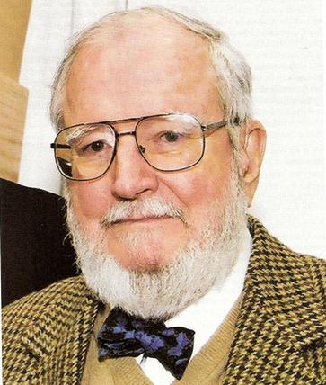
Judging for Ourselves
“Now laymen can judge for themselves whether the biblical manuscripts which predate Christian times differ radically from the received text found, for example, in the King James version.”
The Dead Sea Scrolls Bible
Frank Moore Cross
Harvard University
Reasons to Believe

Slide 10
Are the Dead Sea Scroll texts
different from
or
the same as
our current texts?
Reasons to Believe

Slide 11
…both!
…sort of
…but we will see
how we can be confident
that the Bible we have today
is the Word of God.
Reasons to Believe

Slide 12
Dead Sea Isaiah Scrolls
Reasons to Believe

Slide 13

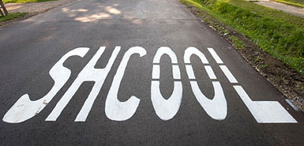
Spelling (75)
“The vision of Isaiah son of Amoz, which he saw concerning Judah and Jerusalem in the days of Uzziah, Jotham, Ahaz and Yehizqiyah.” Isaiah 1:1 QT
*In the Great Isaiah Scroll, Yehizqiyah is written with the Ye- above Hizqiyah as a correction. In the MT, it reads Yehizqiyahu.
Reasons to Believe

Slide 14
Dead Sea Isaiah Scrolls
Reasons to Believe

Slide 15
Grammar/Copying (212)
“Then the LORD will create over the whole site of Mount Zion and over her assemblies a cloud by day,
[and smoke and the shining of a flaming fire by night; for over all the glory there will be a canopy. There will be a booth for shade by day]*
from the heat, and for a refuge and a shelter from the storm and rain.” Isaiah 4:5-6 (MT ESV)
*Absent in the GIS, but another QT agrees with the MT that we have today
Reasons to Believe

Slide 16
Dead Sea Isaiah Scrolls
Reasons to Believe

Slide 17
Single Word (356)
“His delight will be in the fear of the Lord. He will not judge by appearances, nor decide by what he hears, but with righteousness he will obtain justice for the poor and decide with equity for the meek of +the land. He will strike +the land with the rod of his mouth, and with the breath of his lips the wicked will be killed [MT he shall kill the wicked]. Righteousness will be the belt around his waist and [-def. art.] faithfulness the belt around his loins.” Isaiah 11:4-5 (QT Great Isaiah Scroll)
Reasons to Believe

Slide 18
Dead Sea Isaiah Scrolls
Reasons to Believe

Slide 19
Single-Multiple Word (718)
“Be broken, you peoples, and be shattered; give ear, all you far countries; strap on your armor and be shattered; strap on your armor and be shattered*.” Isaiah 8:9 (MT ESV)
*This duplication is absent from the GIS
Reasons to Believe

Slide 20
Dead Sea Isaiah Scrolls
Reasons to Believe

Slide 21
Full Clause (4)
“Moreover I will rescue you and this city from the power of the king of Assyria. I will defend this city for my sake and my servant David`s sake*.” Isaiah 38:6 (QT GIS)
*This clause is present in the GIS, but absent in the MT
(but cp. 2 Kings 19:34!)
Reasons to Believe

Slide 22
Dead Sea Isaiah Scrolls
Reasons to Believe

Slide 23
Possibly Significant Variants
Reasons to Believe

Slide 24
Parallelism (3)
“The burden of Moab. Because in the night Ar of Moab is laid waste, and brought to silence; because in the night Kir (city QT) of Moab is laid waste and brought to silence.” (Isaiah 15:1)
Parallelism is a literary device in which the structure of a clause is repeated in another clause. A beautiful characteristic of Hebrew poetry, it is not without its practical purposes – it often clarifies difficult phrases for the reader.
“And for that the dream was doubled unto Pharaoh twice; it is because the thing is established by God, and God will shortly bring it to pass.” (Genesis 41:32)
Reasons to Believe

Slide 25
Possibly Significant Variants
Reasons to Believe

Slide 26
Immediate Context (2)
“Therefore let (let not QT) Moab wail, let everyone wail.” (Isaiah 16:7)
“…over Nebo and over Medeba Moab wails…”
Isaiah 15:2
“…on the housetops and in the squares everyone wails and melts in tears…”
Isaiah 15:3
“Heshbon and Elealah cry out; their voice is heard as far as Jahaz; therefore the armed men of Moab cry aloud…”
Isaiah 15:4
“My heart cries out for Moab…”
Isaiah 15:5
Reasons to Believe

Slide 27
Possibly Significant Variants
Reasons to Believe

Slide 28
Qumran Variants (8)
“When you spread out your hands,
I will hide my eyes from you;
even though you make many prayers, I will not listen;
your hands are full of blood.”
(Isaiah 1:15 MT ESV and another Qumran fragment)
“When you spread out your hands,
I will turn my eyes away from you.
Even multiply prayers, I will not listen.
Your hands are filled with blood,
your fingers with iniquity.”
(Isaiah 1:15 QT GIS)
Reasons to Believe

Slide 29
Possibly Significant Variants
Reasons to Believe

Slide 30
Word Plays (5)
“…that thou shalt take up this proverb
against the king of Babylon, and say,
How hath the oppressor ceased!
the golden city ceased!.”
(Isaiah 14:4 MT KJV)
“…you will take up this parable
against the king of Babylon, saying:
How the oppressor has ceased!
How his assault has ceased!”
(Isaiah 14:4 QT GIS)
Reasons to Believe

Slide 31
Possibly Significant Variants
Reasons to Believe

Slide 32
Comparative Exposition (6)
O my threshed and winnowed one…(MT)
O my threshed one and child of my stone wall…(QT)
Isaiah 21:10
And he cried as a lion…(MT)
The lookout shouted…(QT)
Isaiah 21:8
The oracle concerning the wilderness of the sea…(MT)
The oracle concerning the pasture by the sea…(QT)
Isaiah 21:1
Reasons to Believe

Slide 33
Allusions to Babylon’s Fall
Dramatic fall of Babylon
Isaiah 21:9 cp. Daniel 2:45; 5:31; Revelation 14:8; 18:2
Divine winds of judgment
Isaiah 21:1 cp. Daniel 2:35
Troubling message from God
Isaiah 21:2 cp. Daniel 2:1; 5:6,9; Revelation 10:10
Appointed destroyers of Babylon
Isaiah 21:2 cp. Daniel 2:39; 5:28,31; 7:5
Reasons to Believe

Slide 34
Allusions to Babylon’s Fall
Unremitting fear
Isaiah 21:2-4 cp. Daniel 2:1,3; 5:6,9
Visions of the night
Isaiah 21:4 cp. Daniel 2:1,19; 5:30
Careless feasts of Babylon
Isaiah 21:5 cp. Daniel 5:1-4; Revelation 18:13
Burning heat of destruction
Isaiah 21:1 cp. Daniel 2:35
Babylon’s broken images
Isaiah 21:9 cp. Daniel 2:35,44-45; 5:4
Reasons to Believe

Slide 35
Allusions to Babylon’s Fall
Lion-like figures
Isaiah 21:8 cp. Daniel 7:4; Revelation 10:3 ct. 13:2
Wilderness of the sea
Isaiah 21:1 cp. Revelation 17:1,3
Vast sea of many peoples
Isaiah 21:1 cp. Daniel 7:3; Revelation 17:15
Nation of threshing
Isaiah 21:10 cp. Daniel 2:35; Revelation 14:14-16
Reasons to Believe

Slide 36
Comparative Exposition (6)
O my threshed and winnowed one…(MT)
O my threshed one and child of my stone wall…(QT)
Isaiah 21:10
And he cried as a lion…(MT)
The lookout shouted…(QT)
Isaiah 21:8
The oracle concerning the wilderness of the sea…(MT)
The oracle concerning the pasture by the sea…(QT)
Isaiah 21:1
Reasons to Believe

Slide 37
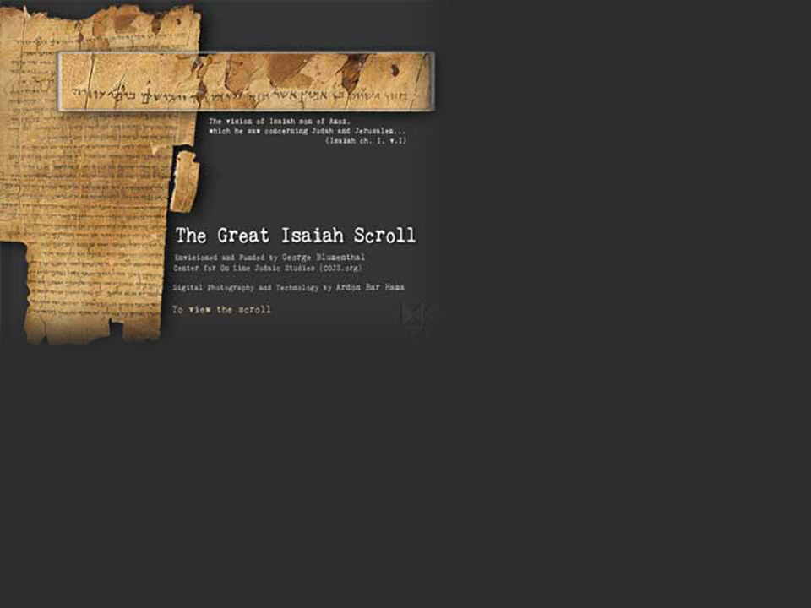
Yigael Yadin
(Israeli Archaeologist)
The Message of the Scrolls
“There is no question that the overwhelming significance of the texts lies in the fact that these scrolls, which are about a thousand years older than any Hebrew text hitherto discovered, vary only slightly from the text as it is known to us and used today. It thus proves the antiquity and authenticity of the Masoretic text.”
Reasons to Believe
Notes:
http://skinheritage.blogspot.com/2008/08/great-isaiah-scroll-of-dead-sea-scrolls.html

Slide 38
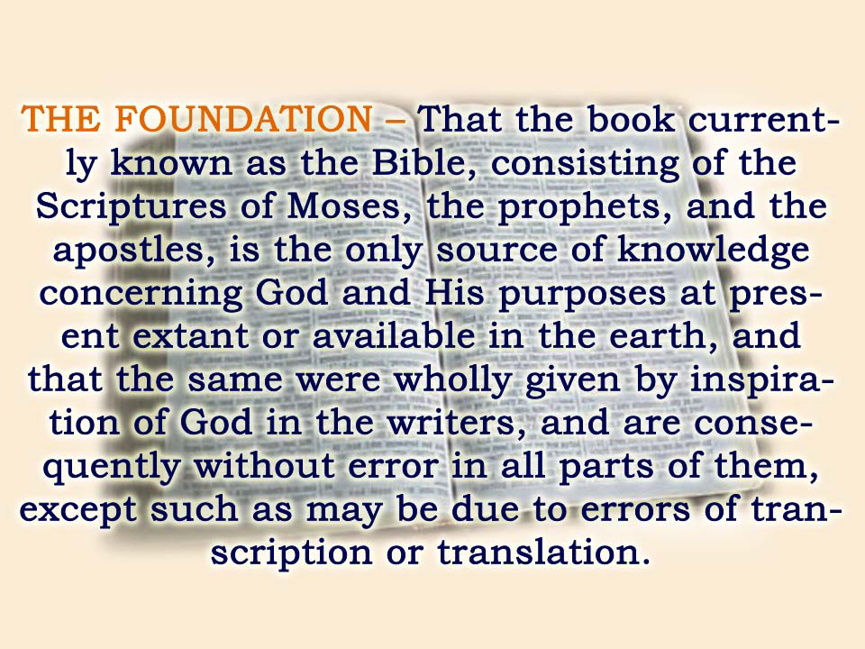

Slide 39
Reasons to Believe
Why we can be confident that the Bible is the Word of God
The differences between the QTs and MT do not interfere with our ability to understand it.
Many so-called differences can be easily reconciled with our attention to other Bible passages.
There is a remarkable identity between the QTs and the text we have today.
Reasons to Believe

Slide 40
Reasons to Believe

