Slide 1
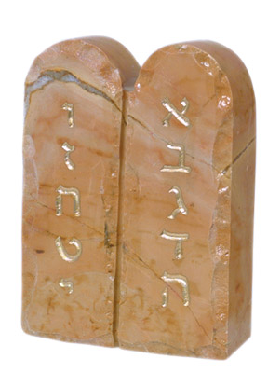
On the Edge of the Kingdom
Deuteronomy
Silver Star Bible School 2011

Slide 2
On the Edge of the Kingdom
Class 1 Out of Egypt
Class 2 Giants in the Land
Class 3 Rise Up
Class 4 National Anthem
Class 5 Shechem: A Shadow of Good Things to Come
Class 6 The Gospel of the Burning Bush
Deuteronomy

Slide 3
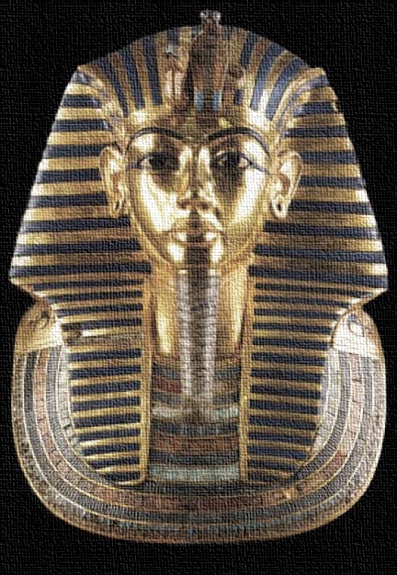
On the Edge of the Kingdom
Class 1
Out of Egypt

Slide 4
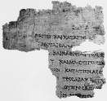
Deuteronomy:
The Second Law
Exposition of the law (1:5)
  Deuteronomy 27:8; Habakkuk 2:2
  “To expound this law clearly” (K&D cp YLT)
  Practical application
New generation (2:14)
Prophecies of the nation (28 & 32)
Out of Egypt

Slide 5
Exodus-Numbers
(103 Chapters)
Deuteronomy
(34 Chapters)
hearken (15x)
hear (16x)
observe (9x)
take heed (8x)
remember (10x)
forget not (0x)
therefore thou shalt (5x)
possess the land (3x)
heart (42x)
love (4x)
hearken (20x)
hear (32x)
observe (21x)
take heed (10x)
remember (14x)
forget not (3x)
therefore thou shalt (16x)
possess the land (42x)
heart (47x)
love (22x)
Out of Egypt

Slide 6
Overview of Deuteronomy
Moses’ 1st Speech (1:1-4:43)
Moses’ 2nd Speech (4:44-26:19)
Moses’ 3rd Speech (27:1-30:20)
Moses’ Final Words (31:1-33:29)
Conclusion (34:1-12)
Out of Egypt

Slide 7
Moses’ First
Speech
Introduction (1:1-5)
Brief history of the children of Israel (1:6-4:40)
Severing of the cities of refuge (4:41-43)
Out of Egypt

Slide 8
Moses’ First Speech:
An Outline
4:9-15
4:1-14,45
1:22-45
4:25-31
4:26
3:21-28
Memory of Sinai
Commands, statutes, judgments
Exhortation from rebellion
God’s faithfulness, Israel’s failure
Heaven and earth as witnesses
Joshua’s succession
5:1-33
6:1-8:20;
11-27
9:1-29
28:1-68
32:1-43
31:1-23
Out of Egypt

Slide 9
Moses’ Second Speech
Introduction (4:44-49)
Repetition of the Ten Commandments (5:1-33)
Laws for the children of Israel in the land of Canaan (6:1-26:19)
Out of Egypt

Slide 10
Moses’ Third Speech
Blessings and cursings of the law—
to be pronounced on Ebal and Gerizim
(27:1-30:20)
Out of Egypt

Slide 11
Moses’ Final Words
Introduction (31:1-6)
Joshua’s charge (31:7-23)
Introduction to the Song of Moses (31:24-30)
Song of Moses (32:1-47)
Moses to die in mount Nebo (32:48-52)
Moses blesses the children of Israel (33:1-29)
Out of Egypt

Slide 12
The Conclusion of the Book
Death of Moses (34:1-8)
Joshua’s succession (34:9)
Moses’ epithet (34:10-12)
“And there arose not a prophet since in Israel like unto Moses, whom the Lord knew face to face, in all the signs and the wonders, which the LORD sent him to do in the land of Egypt to Pharaoh, and to all his servants, and to all his land, and in all the great terror which Moses showed in the sight of all Israel.”
Out of Egypt

Slide 13
From Egypt to Canaan
A Suggested Chronology of the Children of Israel
Slide 1
Y | M | D | Events | Location | Num 33 | Deut | Other References
1 | 1 | 10 | Choosing of the Passover lamb | Egypt | -- | -- | Ex. 12:10
1 | 1 | 14 | Slaying and eating of the Passover lamb; Feast of unleavened bread | Egypt | -- | -- | Ex. 12:6,18
1 | 1 | 15 | The children of Israel depart from Rameses; end of the 430 years at the night of the exodus Sanctification of the firstborn Beginning of the 40 yrs | Rameses, Egypt | 33:3-4 | 11:3; 29:2-4 | Ex. 12:40-42; 13:11-16
1 | 1 | 15 | Israel journeys | Succoth to Etham | 33:5-6 | -- | Ex. 13:20
1 | 1 | 15 | Israel murmurs | Before Pi-hahiroth, between Migdol and the sea, against Baal-zephon | 33:7 | 9:7 | Ex. 14:9-12
1 | 1 | 15 | Red Sea crossing; first song of Moses; Israel murmurs at Marah; they come to Elim | Red Sea; wilderness of Etham; Marah; Elim | 33:8-9 | 11:4; 29:2-4 | Ex. 14:13-31; 15:1-22; 15:23-26; 15:27
1 | 2 | 15 | Israel murmurs in the wilderness of Sin; quail and manna provided | By the Red Sea to wilderness of Sin | 33:10-11 | 8:3 | Ex. 16:1-3; 16:4-21
1 | 2 | 15+ | No manna supplied on the Sabbath; Israel journeys | Wilderness of Sin to Dophkah to Alush | 33:12-13 | -- | Ex. 16:22-36
1 | 2 | 15+ | Israel murmurs at Rephidim (called Massah and Meribah); Amalek overcome at Rephidim Jethro’s counsel endorsed by divine decree; the leaders delegated | Rephidim (Massah and Meribah) | 33:14 | 1:9-18; 6:16 | Ex. 17:1-7; 17:8-16; 18:1-22; 18:24-27
1 | 3 | 15 | Israel comes to the wilderness of Sinai Yahweh descends on the mount; laws given; Israel brought under the covenant; specifications for the tabernacle, furniture, priestly garments and consecration | Wilderness of Sinai | 33:15 | 4:10-40; 5-8; 29:1 | Ex. 19:1-2; 19:18; 20:1-23:33; 24:1-8; 25:1-31:18

Slide 14
From Egypt to Canaan
A Suggested Chronology of the Children of Israel
Slide 2
Y | M | D | Events | Location | Num 33 | Deut | Other References
1 | 3 | 15+ | Golden calf; Moses intercedes; Levi slays the idolaters, and Israel smitten with a plague | Wilderness of Sinai | 33:15 | 9:8-21; 10:8-10 | Ex. 32:1-6; 32:7-14; 32:25-35
1 | 3 | 15+ | Moses intercedes; Yahweh provides another covenant, and shows Moses His glory Construction of the tabernacle, furniture, and priestly garments | Wilderness of Sinai | 33:15 | 9:18-21; 10:1-5 | Ex. 33:1-23; 34:1-28; 35-39
2 | 1 | 1 | Rearing up of the tabernacle | Wilderness of Sinai | 33:15 | -- | Ex. 40:17; Num. 9:15
2 | 1 | 1+ | Law of the offerings | Wilderness of Sinai | 33:15 | -- | Lev. 1-8
2 | 1 | 8 | Offerings for Aaron and the people | Wilderness of Sinai | 33:15 | -- | Lev. 9
2 | 1 | 8+ | Nadab and Abihu consumed by fire for offering strange fire | Wilderness of Sinai | 33:15 | -- | Lev. 10:1-7
2 | 1 | 8+ | Laws of diet, purifying, leprosy, uncleanness, day of atonement, sacrifices, sexual relations, sacrifices, feasts, tithes, and vows; Blessings and cursings of the law | Wilderness of Sinai | 33:15 | 11:26-32; 27-28 | Lev. 10-25, 27; Lev. 26
2 | 2 | 1 | Numbering of the children of Israel | Wilderness of Sinai | 33:15 | -- | Num. 1:1,18
2 | 2 | 1+ | Arrangement of the camp; Levitical service; law of jealousy; law of Nazarites; offering of the princes; cleansing of the Levites | Wilderness of Sinai | 33:15 | -- | Num. 2-8
2 | 1 | 14 | Israel keeps the Passover | Wilderness of Sinai | 33:15 | -- | Num. 9:1-5
2 | 2 | 14 | Special Passover Construction of the silver trumpets | Wilderness of Sinai | 33:15 | -- | Num. 9:6-14; Num. 10:1-10
2 | 2 | 20 | Israel journeys; they murmur at Taberah; and Kibroth-hattaavah | Wilderness of Sinai to Taberah to Kibroth-hattaavah | 33:16 | 9:22 | Num. 10:11; Num. 11:1-3; Num. 11:4-34

Slide 15
From Egypt to Canaan
A Suggested Chronology of the Children of Israel
Slide 3
Y | M | D | Events | Location | Num 33 | Deut | Other References
2 | 2 | 20 | Israel journeys; they murmur at Taberah; and Kibroth-hattaavah | Wilderness of Sinai to Taberah to Kibroth-hattaavah | 33:16 | 9:22 | Num. 10:11; Num. 11:1-3; Num. 11:4-34
2 | 2 | 20+ | Miriam and Aaron murmur | Hazeroth | 33:17 | -- | Num. 11:35- Num. 12:16
2 | 2 | 20+ | Spies sent out for 40 days and return with mixed reviews of the land Beginning of the 38 yrs | Kadesh (Wilderness of Paran, Wilderness of Zin, Rithmah?) | 33:18 | 1:19-25 | Num. 13
2 | 2 | 20+ | Israel murmurs; Moses intercedes; sentence of death for the unbelieving generation; the spies die in the plague; Israel smitten by the Amalekites in their presumption | Kadesh (Wilderness of Paran, Wilderness of Zin, Rithmah?) | 33:18 | 1:26-46; 9:23-29; 29:5-6 | Num. 14
2 | 2 | 20+ | Various laws for offerings; the verdict of the man gathering sticks on the Sabbath | In the wilderness | -- | -- | Num. 15
2 | 2 | 20+ | Korah, Dathan, and Abiram; Aaron’s budding rod; Levitical laws; water of separation | In the wilderness | -- | 11:6 | Num. 16-19
2 | 2 | 20+ | Israel wanders in the wilderness | In the wilderness of the Red Sea | 33:19-34 | 2:1 | --
40 | 1 | -- | Miriam dies; Israel murmurs at Meribah; Edom refuses Israel passage; Moses and Aaron excluded from the land of Canaan | Meribah at Kadesh (Wilderness of Zin) | 33:36 | 2:29; 3:25-27; 32:48-52 | Num. 20:1-21
40 | 5 | 1 | Aaron dies, buried in mount Hor; Eleazar succeeds | Mount Hor | 33:37-39 | 10:6 | Num. 20:22-29
40 | 5 | 1+ | Israel defeats king Arad the Canaanite | Hormah | 33:40 | -- | Num. 21:1-3
40 | 5 | 1+ | Israel journeys to compass Edom; they murmur and suffer a plague of serpents; Moses intercedes | By the way of the Red Sea (Zalmonah to Punon) | 33:41-42 | -- | Num. 21:4-9

Slide 16
From Egypt to Canaan
A Suggested Chronology of the Children of Israel
Slide 4
Y | M | D | Events | Location | Num 33 | Deut | Other References
40 | 5 | 1+ | Israel journeys | Oboth to Ijeabarim, Moab | 33:43-44 | -- | Num. 21:10-11
40 | 5 | 1+ | 38 years from Kadesh-barnea to crossing of brook Zered Israel overcomes Sihon king of the Amorites, and Og king of Bashan | Valley of Zared, on the other side of Arnon | -- | 2:24-3:11; 4:44-49; 29:7 | Num. 21:12-35
40 | 5 | 1+ | Israel journeys | Dibon-gad to Almon-diblathaim to the mountains of Abarim before Nebo | 33:45-47 | -- | --
40 | 5 | 1+ | Balaam and Balak; Israel sins at Baal-peor in Shittim; Phinehas slays the idolaters; the plague ceases | Shittim in the plains of Moab | 33:48-49 | 4:1-4; 23:4-5 | Num. 22-25
40 | 5 | 1+ | Second census; Joshua appointed to succeed Moses; law of offerings, feasts, and vows; Israel defeats the Midianites and Balaam, Reuben and Gad request Jazer and Gilead for themselves; borders of the land, cities of refuge, and daughters of Zelophehad request Moses’ help | Plains of Moab | 33:49-56 | 3:12-20; 4:41-43; 29:8; 31:3-8 | Num. 26:1-32; 27:18-23; 28-30; 31-32; 34-36
40 | 11 | 1 | Moses delivers Deuteronomy to the children of Israel | Land of Moab | -- | 1:1-5; 2:14 | Deut. 1:1-5; 2:14
40 | 11 | 1+ | Second song of Moses; Moses blesses Israel | Plains of Moab | -- | 31:28-33:29 | 31:28-33:29
40 | 11 | 1+ | Moses dies, buried in mount Nebo | Plains of Moab mount Nebo, at the top of Pisgah | 33:47 | 32:49; 34:1 | Deut. 32:49; 34:1

Slide 17
From Egypt to Canaan
A Suggested Chronology of the Children of Israel
Slide 5
Y | M | D | Events | Location | Num 33 | Deut | Other References
40 | 11 | 1+ | Joshua sends spies into Jericho | Shittim | -- | -- | Josh. 2
41 | 1 | 10 | Israel leaves Shittim to cross Jordan; camp at Gilgal; circumcision End of the 40 yrs | Shittim to Gilgal via the Jordan | -- | -- | Josh. 3:1; 4:19; 5:1-9
41 | 1 | 14 | Passover | Gilgal | -- | -- | Josh. 5:10-11

Slide 18
A Catalogue of Unbelief
A Suggested List of the Provocations of the Children of Israel in the Wilderness
# | Provocation | Response | Location | Deut | Other References
1 | Pharaoh approaches the children of Israel with his army, and they cry out in fear | God divides the Red Sea: the Israelites cross and the Egyptians are drowned | Beside Pi-hahiroth before Baal-zephon, between Migdol and the Red Sea | 11:3-4; 29:2-4 | Ex. 14; Num. 33:3-8
2 | Israel murmurs at the lack of drinkable water | Moses casts a tree into the waters to make them drinkable | Marah in the wilderness of Shur | -- | Ex. 15:23-26; Num. 33:9
3 | Israel murmurs at the lack of food | Moses provides quail and manna | Wilderness of Sin, between Elim & Sinai | 8:3 | Ex. 16; Num. 33:10-11
4 | Israel murmurs at the lack of water | Moses strikes the rock to provide water | Massah (Meribah) in Rephidim | 6:16 | Ex. 17:1-7; Num. 33:14
5 | Israel commits idolatry with the golden calf | Moses intercedes; Israel is plagued | Mount Sinai | 9:8-21; 10:8-10 | Ex. 32; Num. 33:15
6 | Israel continues murmuring | Moses intercedes; Israel consumed by fire | Taberah in the wilderness of Sinai | 9:22 | Num. 11:1-3; 33:16
7 | Israel murmurs at the lack of food | Moses cries out to Yahweh, who ordains 70 elders; quail are provided, Israel is plagued | Kibroth-hattaavah | 9:22 | Num. 11:4-34; 33:16-17
8 | Ten of the twelve spies discourage Israel to possess Canaan | Moses intercedes; the evil spies die in a plague; Israel sentenced to wander for forty years until the generation is consumed | Kadesh-barnea (Wilderness of Paran, Wilderness of Zin, Rithmah?) | 1:19-40; 9:23-29; 29:5 | Num. 13-14:39; 33:18
Moses casts a tree into the waters to make them drinkable
Moses strikes the rock to provide water

Slide 19
A Catalogue of Unbelief
A Suggested List of the Provocations of the Children of Israel in the Wilderness
# | Provocation | Response | Location | Deut | Other References
9 | Israel presumptuously strike against the Canaanites and the Amakekites against the word of Yahweh | Israel is smitten before their enemies | The hill top unto Hormah in Seir | 1:41-45 | Num. 14:40-45
10 | Korah, Dathan, and Abiram challenge the authority of Moses | The earth swallows the rebels; fire consumes false priests | In the wilderness | 11:6 | Num. 16:1-40
11 | Israel murmurs against Moses and Aaron for the rebels’ destruction | Moses intercedes; Israel is plagued | In the wilderness | -- | Num. 16:41-50
12 | Israel murmurs at the lack of water | Moses strikes the rock against God’s word; the people drink; Yahweh excludes Moses and Aaron from Canaan | The desert of Zin in Kadesh at Meribah | 3:25-27; 32:48-52 | Num. 20:1-13; 33:36
13 | Israel murmurs at the lack of food and water | Yahweh sends serpents to plague Israel; Moses intercedes and fashions the brazen serpent according to God’s command | Mount Hor by the Red Sea | -- | Num. 21:4-9; 33:37
14 | Israel commits idolatry and fornication with the Moabites | Israel is plagued; Moses, Phinehas, and the judges of Israel slay the idolaters; the Midianites are slain | Baal-peor in Shittim, in the plains of Moab | 4:3-4; 23:3-6 | Num. 25; 33:48-49
Moses strikes the rock against God’s word
God plagues the people with fiery serpents

Slide 20
How Do We See Our God?
“For it had been better for us to serve the Egyptians”
“Ye have brought us forth in this wilderness to kill us”
“To kill us and our children and our cattle with thirst”
“We remember the fish, which we did eat in Egypt”
“We be not able…for they are stronger than we”
“Why have ye brought up this congregation of the LORD into this wilderness, that…we should die?”
“Wherefore have ye brought us up out of Egypt to die in the wilderness?”
Ex. 14:20-21
Ex. 16:3
Ex. 17:3
Nu. 11:5
Nu. 13:31
Nu. 20:4
Nu. 21:5
Out of Egypt

Slide 21
“Help Thou Mine Unbelief”
Israel’s exclusion from the land
  Hebrews 3:19; 4:6,11
Moses’ exclusion from the land
  Numbers 20:12
Lessons for the Israel of God
  John 20:30-31; 1 Corinthians 15:2
Out of Egypt

Slide 22
The Heritage of the Truth
Teach your children
  4:9-10; 6:4-7; 11:18-19
First commandment
  Genesis 18:19
  Ephesians 4:1-6
  1 Timothy 4:16
Out of Egypt

Slide 23
Israel in the Land of Promise
“The children of Israel did evil in the sight of the LORD”
“The children of Israel did evil in the sight of the LORD”
“Israel did evil again in the sight of the LORD”
“Israel again did evil in the sight of the LORD”
“The children of Israel did evil in the sight of the LORD”
“Israel did evil again in the sight of the LORD”
“Israel did evil again in the sight of the LORD”
Judges 2:11
Judges 3:7
Judges 3:12
Judges 4:1
Judges 6:1
Judges 10:6
Judges 13:1
Out of Egypt

Slide 24
A Special
Generation
Class One
Joshua 24:31
Out of Egypt

Slide 25
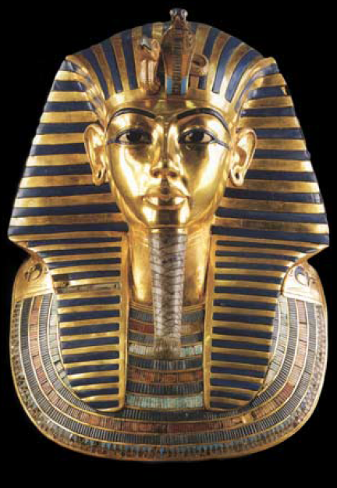

Background to the Exodus
Abraham’s 400-year prophecy
Genesis 15:13-16
Joseph’s last words
Genesis 50:24-25
The angel of Yahweh appears to Moses at the bush
Exodus 3:16
Out of Egypt

Slide 26

Deuteronomy in the
New Testament
Spiritual circumcision
  Deuteronomy 10:16-19; 30:6
  James 1:27 (drawn from Deuteronomy)
Remember Egypt
  Deuteronomy 5:12-15; 15:12-18; 16:9-12
  Hebrews 13:3
Out of Egypt

Slide 27
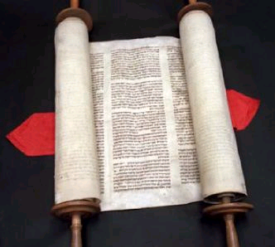
The Exodus of Jesus Christ
  ἔξοδος
  “And, behold, there talked with him two men, which were Moses and Elias: who appeared in glory, and spake of his decease which he should accomplish at Jerusalem.” Luke 9:31
CLASS 2: OUT OF EGYPT
Out of Egypt
Notes:
Jesus is ‘the way’ out of the bondage of sin and death (John 14:6)

Slide 28
Words of Encouragement
‘And be ye of good courage, and bring of the fruit of the land.’
Numbers 13:20
‘But Joshua the son of Nun, which standeth before thee, he shall go in thither: encourage him: for he shall cause Israel to inherit it.’
Deuteronomy 1:38
‘Ye shall not fear them.’
Deuteronomy 3:22
‘But charge Joshua, and encourage him, and strengthen him’
Deuteronomy 3:28
Out of Egypt

Slide 29
…just in case you missed it…
‘And Moses called unto Joshua, and said unto him in the sight of all Israel, Be strong and of a good courage.’
Deuteronomy 31:7
‘And he gave Joshua the son of Nun a charge, and said, Be strong and of a good courage.’
Deuteronomy 31:23
‘As I was with Moses, so I will be with thee: I will not fail thee, nor forsake thee. Be strong and of a good courage.’
Joshua 1:5-6
‘Only be thou strong and very courageous.’
Joshua 1:7
Out of Egypt

Slide 30
…just in case you missed it again…
‘Be strong and of a good courage; be not afraid, neither be thou dismayed.’
Joshua 1:9
‘Only be strong and of a good courage.’
Joshua 1:18
‘And the LORD said unto Joshua, Fear not, neither be thou dismayed.’
Joshua 8:1
‘And the LORD said unto Joshua, Fear them not.’
Joshua 10:8
‘And the LORD said unto Joshua, Be not afraid because of them.’
Joshua 11:6
Out of Egypt

Slide 31
Our Words of Encouragement
“Let your conduct be without covetousness; be content with such things as you have. For He Himself has said, ‘I will never leave you or forsake you.’ So we may boldly say: ‘The Lord is my helper; I will not fear. What can man do to me?’”
Hebrews 13:5-6
Out of Egypt

Slide 32
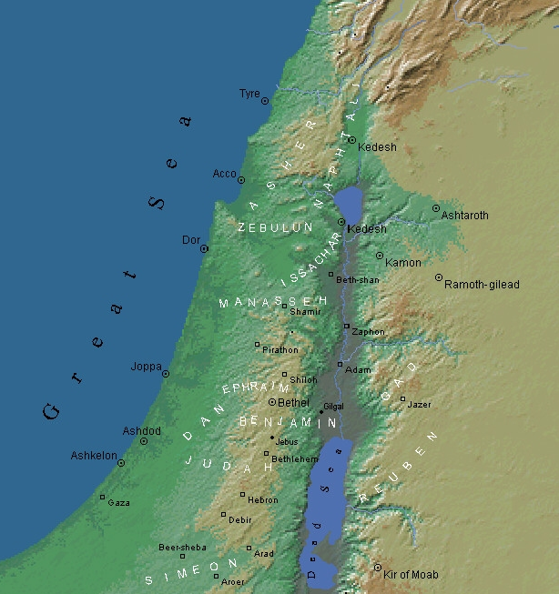
On the Edge of the Kingdom
Class 2
Giants in the Land
Notes:
Ted Larsen

Slide 33
Canaan
Deuteronomy 2
Emim (8-11)
Horim (12,22)
Zamzummim (19-21)
Avim (23)
Anakim (10-11,20-21)
Zamzummim
Avim
Anakim
Emim
Horim
Giants in the Land
Notes:
Map – from e-Sword; International Standard Version, The Biblical World

Slide 34
Emim
Deuteronomy 2:8-11
meaning ‘terrors’
giants
lived in Shaveh-kiriathaim in Moab where they were defeated by Chedorlaomer in the days of Abraham (Genesis 14:5)
displaced by the Moabites
Emim
Giants in the Land
Notes:
Map – from e-Sword; International Standard Version, The Biblical World

Slide 35
Horim
Deuteronomy 2:12,22
probably meaning ‘cave dwellers’
lived in mount Seir in the land where they were defeated by Chedorlaomer in the days of Abraham (Genesis 14:6)
displaced by the Edomites
Horim
Giants in the Land
Notes:
Map – from e-Sword; International Standard Version, The Biblical World

Slide 36
Zamzummim
Deuteronomy 2:19-21
probably meaning ‘plotters’
giants
probably the Zuzim which were defeated by Chedorlaomer in Abraham’s days (Genesis 14:5)
displaced by the Ammonites
Zamzummim
Giants in the Land
Notes:
Map – from e-Sword; International Standard Version, The Biblical World

Slide 37
Avim
Deuteronomy 2:23
probably meaning ‘overthrowers’
displaced by the Caphtorim (also called Philistines cp Amos 9:7 and Joshua 13:3)
Avim
Giants in the Land
Notes:
Map – from e-Sword; International Standard Version, The Biblical World

Slide 38
Anakim
Deuteronomy 2:10-11,20-21
probably meaning ‘long-necked’
caused the ten spies from Kadesh-barnea to fear because of their giant stature (Numbers 13:27-33)
displaced by the children of Israel when they entered Canaan
Anakim
Giants in the Land
Notes:
Map – from e-Sword; International Standard Version, The Biblical World

Slide 39
Canaan
Deuteronomy 2
Emim (8-11)
Horim (12,22)
Zamzummim (19-21)
Avim (23)
Anakim (10-11,20-21)
Ammonites
Zamzummim
Caphtorim
Avim
Israelites Anakim
Edomites Horim
Moabites Emim
Giants in the Land
Notes:
Map – from e-Sword; International Standard Version, The Biblical World

Slide 40
Powerful Lessons
Lessons for Israel are lessons for us
1 Corinthians 10:11
God warned Israel against trusting in the family they were born into
Amos 9:7-8
We must always remember that our salvation is our own personal responsibility
John 8:39
If we strive against sin, and confess our sins, we can be confident in our forgiveness
Hebrews 12:4; 1 John 1:9
Giants in the Land

Slide 41
On the Edge of the Kingdom
Class 3 Rise Up
Notes:
Ted Larsen

Slide 42
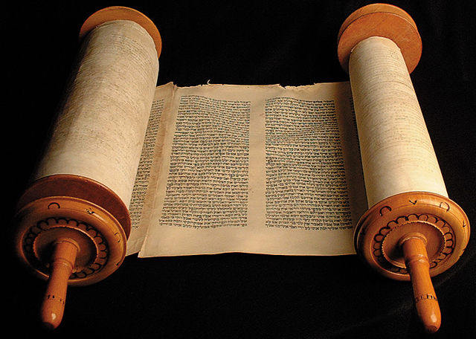
38-Year Infirmity
“And a certain man was there, which had an infirmity thirty and eight years.”
John 5:5
“Thirty and eight years; until all the men of war were wasted out from among the host.”
Deuteronomy 2:14
Rise Up

Slide 43
Y | M | D | Events | Location | Num 33 | Deut | Other References
40 | 5 | 1+ | Israel journeys | Oboth to Ijeabarim, Moab | 33:43-44 | -- | Num. 21:10-11
40 | 5 | 1+ | 38 years from Kadesh-barnea to crossing of brook Zered Israel overcomes Sihon king of the Amorites, and Og king of Bashan | Valley of Zared, on the other side of Arnon | -- | 2:24-3:11; 4:44-49; 29:7 | Num. 21:12-35
40 | 5 | 1+ | Israel journeys | Dibon-gad to Almon-diblathaim to the mountains of Abarim before Nebo | 33:45-47 | -- | --
40 | 5 | 1+ | Balaam and Balak; Israel sins at Baal-peor in Shittim; Phinehas slays the idolaters; the plague ceases | Shittim in the plains of Moab | 33:48-49 | 4:1-4; 23:4-5 | Num. 22-25
40 | 5 | 1+ | Second census; Joshua appointed to succeed Moses; law of offerings, feasts, and vows; Israel defeats the Midianites and Balaam, Reuben and Gad request Jazer and Gilead for themselves; borders of the land, cities of refuge, and daughters of Zelophehad request Moses’ help | Plains of Moab | 33:49-56 | 3:12-20; 4:41-43; 29:8; 31:3-8 | Num. 26:1-32; 27:18-23; 28-30; 31-32; 34-36
40 | 11 | 1 | Moses delivers Deuteronomy to the children of Israel | Land of Moab | -- | 1:1-5; 2:14 | Deut. 1:1-5; 2:14
40 | 11 | 1+ | Second song of Moses; Moses blesses Israel | Plains of Moab | -- | 31:28-33:29 | 31:28-33:29
40 | 11 | 1+ | Moses dies, buried in mount Nebo | Plains of Moab mount Nebo, at the top of Pisgah | 33:47 | 32:49; 34:1 | Deut. 32:49; 34:1
Israel in this section is the new generation: the children whose parents fell in the wilderness.
40 | 11 | 1+ | Joshua sends spies into Jericho | Shittim | -- | -- | Josh. 2
41 | 1 | 10 | Israel leaves Shittim to cross Jordan; camp at Gilgal; circumcision End of the 40 yrs | Shittim to Gilgal via the Jordan | -- | -- | Josh. 3:1; 4:19; 5:1-9
41 | 1 | 14 | Passover | Gilgal | -- | -- | Josh. 5:10-11

Slide 44
Textual Authenticity
“This clause is without doubt the addition of some transcriber. Five of the most ancient MSS., either reject the whole or the principal part of the clause in brackets. Bloomfield says, “the whole narrative savors of Jewish fancy.” Meyer calls it a legendary addition. It is omitted by Mill and Tischendorf, and marked as spurious by Griesbach.”
Emphatic Diaglott, p. 328, John 5:3-4
Rise Up

Slide 45
38 Yrs:
A Man &
A Generation
Jesus to the impotent man:
“Rise, take up thy bed, and walk.”
Moses to the new generation:
“Rise ye up, take your journey, and pass over the river Arnon.”
Rise Up

Slide 46
Spiritual Resurrection
Moral Resurrection
  Romans 6:3-6
  Colossians 3:1-2
  Ephesians 5:14
Rise Up

Slide 47
The Resurrection in Two Phases
“The hour is coming”
  John 5:28-29
  John 4:20-21
“The hour is coming, and now is”
  John 5:28-29
  John 4:23-24
  John 16:32
Rise Up

Slide 48
Israel’s Resurrection
Valley of dry bones
  Ezekiel 37:1-14
  Jeremiah 31:31-34
Rise Up

Slide 49
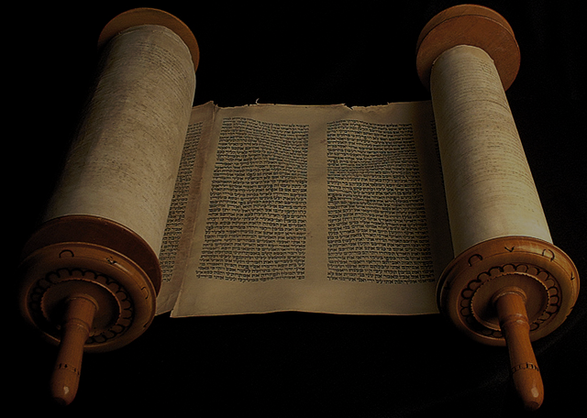
On the Edge of the Kingdom
Class 4 National Anthem

Slide 50
From Egypt to Canaan
A Suggested Chronology of the Children of Israel
Slide 1
Y | M | D | Events | Location | Num 33 | Deut | Other References
1 | 1 | 10 | Choosing of the Passover lamb | Egypt | -- | -- | Ex. 12:10
1 | 1 | 14 | Slaying and eating of the Passover lamb; Feast of unleavened bread | Egypt | -- | -- | Ex. 12:6,18
1 | 1 | 15 | The children of Israel depart from Rameses; end of the 430 years at the night of the exodus Sanctification of the firstborn Beginning of the 40 yrs | Rameses, Egypt | 33:3-4 | 11:3; 29:2-4 | Ex. 12:40-42; 13:11-16
1 | 1 | 15 | Israel journeys | Succoth to Etham | 33:5-6 | -- | Ex. 13:20
1 | 1 | 15 | Israel murmurs | Before Pi-hahiroth, between Migdol and the sea, against Baal-zephon | 33:7 | 9:7 | Ex. 14:9-12
1 | 1 | 15 | Red Sea crossing; first song of Moses; Israel murmurs at Marah; they come to Elim | Red Sea; wilderness of Etham; Marah; Elim | 33:8-9 | 11:4; 29:2-4 | Ex. 14:13-31; 15:1-22; 15:23-26; 15:27
1 | 2 | 15 | Israel murmurs in the wilderness of Sin; quail and manna provided | By the Red Sea to wilderness of Sin | 33:10-11 | 8:3 | Ex. 16:1-3; 16:4-21
1 | 2 | 15+ | No manna supplied on the Sabbath; Israel journeys | Wilderness of Sin to Dophkah to Alush | 33:12-13 | -- | Ex. 16:22-36
1 | 2 | 15+ | Israel murmurs at Rephidim (called Massah and Meribah); Amalek overcome at Rephidim Jethro’s counsel endorsed by divine decree; the leaders delegated | Rephidim (Massah and Meribah) | 33:14 | 1:9-18; 6:16 | Ex. 17:1-7; 17:8-16; 18:1-22; 18:24-27
1 | 3 | 15 | Israel comes to the wilderness of Sinai Yahweh descends on the mount; laws given; Israel brought under the covenant; specifications for the tabernacle, furniture, priestly garments and consecration | Wilderness of Sinai | 33:15 | 4:10-40; 5-8; 29:1 | Ex. 19:1-2; 19:18; 20:1-23:33; 24:1-8; 25:1-31:18

Slide 51
From Egypt to Canaan
A Suggested Chronology of the Children of Israel
Slide 4
Y | M | D | Events | Location | Num 33 | Deut | Other References
40 | 5 | 1+ | Israel journeys | Oboth to Ijeabarim, Moab | 33:43-44 | -- | Num. 21:10-11
40 | 5 | 1+ | 38 years from Kadesh-barnea to crossing of brook Zered Israel overcomes Sihon king of the Amorites, and Og king of Bashan | Valley of Zared, on the other side of Arnon | -- | 2:24-3:11; 4:44-49; 29:7 | Num. 21:12-35
40 | 5 | 1+ | Israel journeys | Dibon-gad to Almon-diblathaim to the mountains of Abarim before Nebo | 33:45-47 | -- | --
40 | 5 | 1+ | Balaam and Balak; Israel sins at Baal-peor in Shittim; Phinehas slays the idolaters; the plague ceases | Shittim in the plains of Moab | 33:48-49 | 4:1-4; 23:4-5 | Num. 22-25
40 | 5 | 1+ | Second census; Joshua appointed to succeed Moses; law of offerings, feasts, and vows; Israel defeats the Midianites and Balaam, Reuben and Gad request Jazer and Gilead for themselves; borders of the land, cities of refuge, and daughters of Zelophehad request Moses’ help | Plains of Moab | 33:49-56 | 3:12-20; 4:41-43; 29:8; 31:3-8 | Num. 26:1-32; 27:18-23; 28-30; 31-32; 34-36
40 | 11 | 1 | Moses delivers Deuteronomy to the children of Israel | Land of Moab | -- | 1:1-5; 2:14 | Deut. 1:1-5; 2:14
40 | 11 | 1+ | Second song of Moses; Moses blesses Israel | Plains of Moab | -- | 31:28-33:29 | 31:28-33:29
40 | 11 | 1+ | Moses dies, buried in mount Nebo | Plains of Moab mount Nebo, at the top of Pisgah | 33:47 | 32:49; 34:1 | Deut. 32:49; 34:1

Slide 52
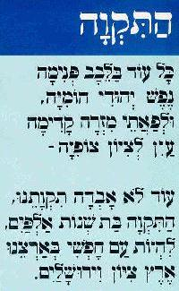
Hatikvah
In the Jewish heart
A Jewish spirit still sings,
And the eyes look east
Toward Zion
Our hope is not lost,
Our hope of two thousand years,
To be a free nation in our land,
In the land of Zion and Jerusalem
www.jewishvirtuallibrary.org
National Anthem

Slide 53
Structure of Moses’ Song
Introduction (v 1-4)
Corruption (v 5-6)
Redemption from Egypt (v 7-14)
Provocation and (v 15-35)
God’s response
Ultimate redemption of Israel (v 36-43)
and all nations blessed
National Anthem

Slide 54
The Reason for Moses’ Second Song
Deuteronomy 31:24-30
National Anthem

Slide 55
Structure of Moses’ Song
Witness against Israel’s inevitable national failure
  (31:19,21)
Exhort Israel to obey the law
to ensure a place in the land of promise
  (32:46-47)
Foretell the grafting in of the Gentiles
  (32:43)
National Anthem

Slide 56
Themes in Moses’ Song
Heavens and Earth (v 1)
Creation language (v 10-11)
Forgetting God (v 27)
Sodom and Gomorrah (v 32)
Ultimate redemption (v 36,43)
Provocation to jealousy (v 21)
All nations blessed (v 43)
National Anthem

Slide 57
Which Song?
“Then sang Moses
and the children of Israel
this song unto the LORD.”
Exodus 15:1
“And Moses spake in the ears
of all the congregation of Israel
the words of this song,
until they were ended.”
Deuteronomy 31:30
National Anthem

Slide 58
National Anthem
“Rejoice, O ye nations, with his people:
for he will avenge the blood of his servants,
and will render vengeance to his adversaries,
and will be merciful unto his land,
and to his people.”
Deuteronomy 32:43
National Anthem

Slide 59
On the Edge of the Kingdom
Class 5
Shechem:
A Shadow of Good Things to Come

Slide 60
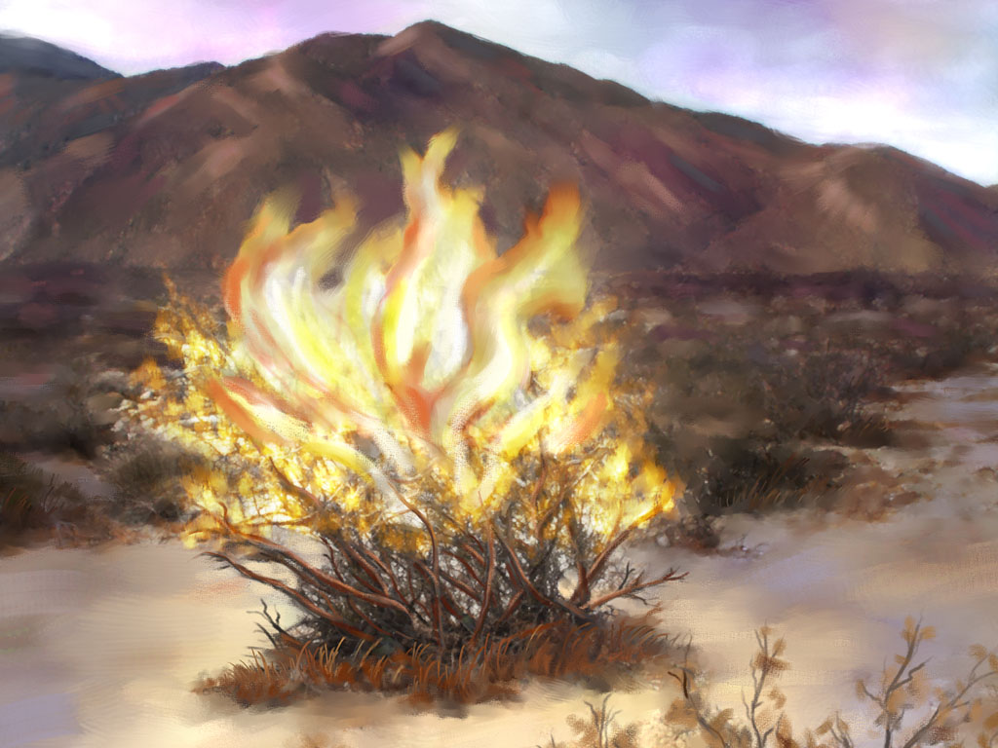
On the Edge of the Kingdom
Class 6
The Gospel of the Burning Bush

Slide 61
The Gospel of the Bush

Slide 62
Moses (Unconsumed)
protected from Pharaoh’s edict Ex. 1:22-2:2
pitied by Pharaoh’s daughter Ex. 2:3-6
delivered from the sword of Pharaoh Ex. 2:15
unharmed by the serpent-rod Ex. 4:4
healed from his leprosy Ex. 4:7
spared by the angel of Yahweh Ex. 4:24
redeemed out of Egypt with Israel Ex. 12:51
rescued from his own brethren Ex. 17:4, etc.
relieved by able men in judgment Ex. 18:18
The Gospel of the Bush

Slide 63
Moses (Unconsumed)
denied in offering himself as a substitute Ex. 32:32-33
preserved in God’s presence Ex. 33:20-21
sustained in his physical body De. 34:7
instructed in the Truth He. 11:23-24
The Gospel of the Bush

Slide 64
The Gospel of the Bush

Slide 65
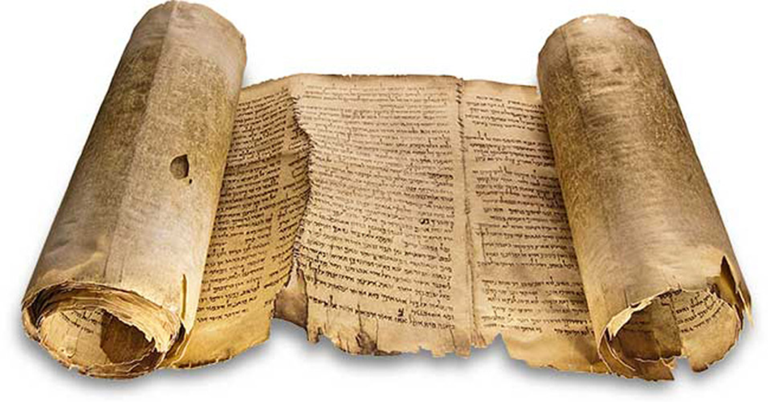
Deuteronomy
4:20
KJV
“…the LORD hath taken you, and brought you forth out of the iron furnace, even out of Egypt…”
The Gospel of the Bush

Slide 66
Deuteronomy
4:24
KJV
“For the LORD thy God is a consuming fire, even a jealous God.”
The Gospel of the Bush

Slide 67
The Gospel of the Bush

Slide 68
Notes:
Source: adelphosweb.com

Slide 69
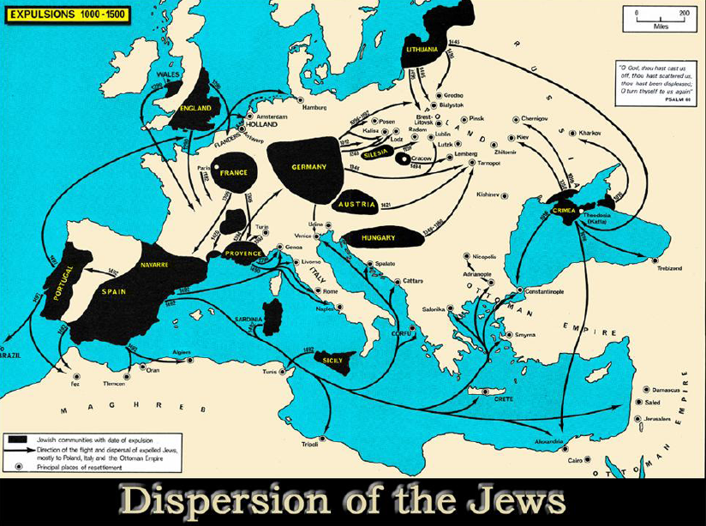
Notes:
Source: adelphosweb.com

Slide 70
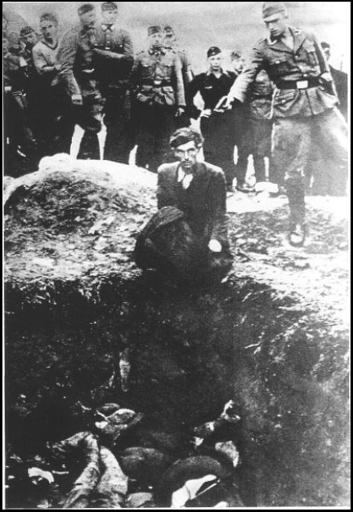
Jewish Expulsions
1012 | from Germany
1182 | from France
1192 | from Germany
1248 | from Germany
1290 | from England
1306 | from France
1348 | from Germany
1349-60 | from Hungary
1394 | from France
1420 | from France
1421 | from Austria
1492 | from Spain
1497 | from Portugal
1737 | from Germany
1871-1906 | Pogroms in Russia
The Gospel of the Bush
Notes:
Scattered Among the Peoples: The Jewish Diaspora in Ten Portraits, Allan Levine, 2002, p. 2).

Slide 71
(under European Christendom)
Major Instances of Persecution
1096 | European Jews by crusaders
1099 | Levantine Jews by crusaders
1190 | Jews in York, England by crusaders
1298 | 146 German Jewish communities
1200s | Periodic regional massacres in Germany
1348-49 | 350 communities (blamed for Black Death)
1483-98 | Inquisition in Spain & Portugal (burnings)
1642-49 | Inquisition in Mexico (burnings)
1648 | 100,000 Polish Jews massacred
1881 | 160 communities of Russian Jews in pogroms
1903-06 | 50,000 killed in Russian pogroms
Notes:
Scattered Among the Peoples: The Jewish Diaspora in Ten Portraits, Allan Levine, 2002, p. 2).

Slide 72
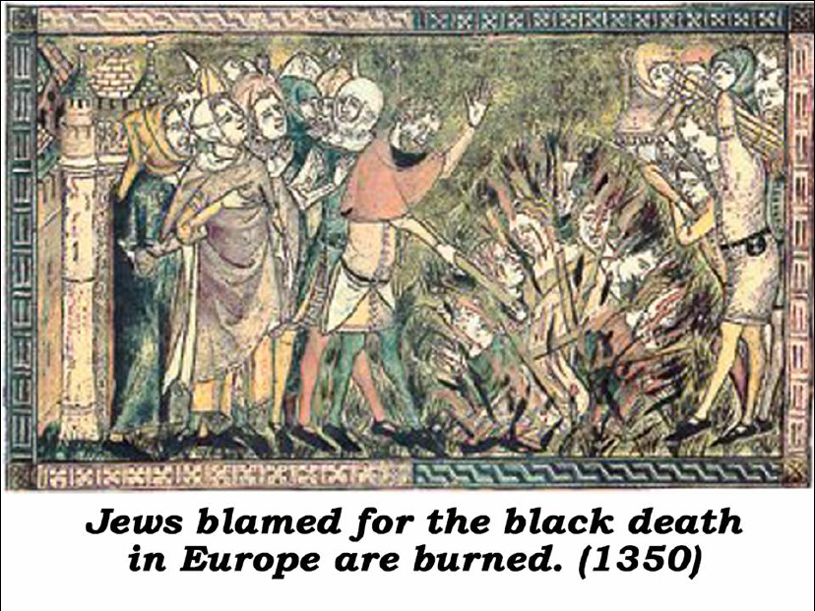
Notes:
Source: adelphosweb.com

Slide 73
Notes:
Source: adelphosweb.com

Slide 74
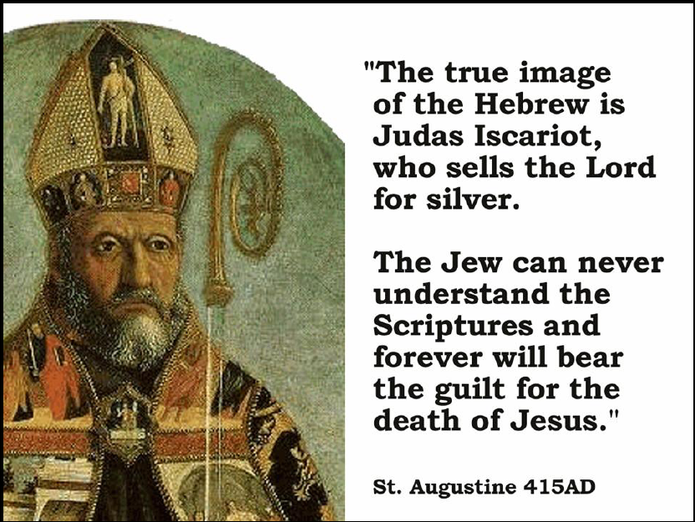
Notes:
Source: adelphosweb.com

Slide 75
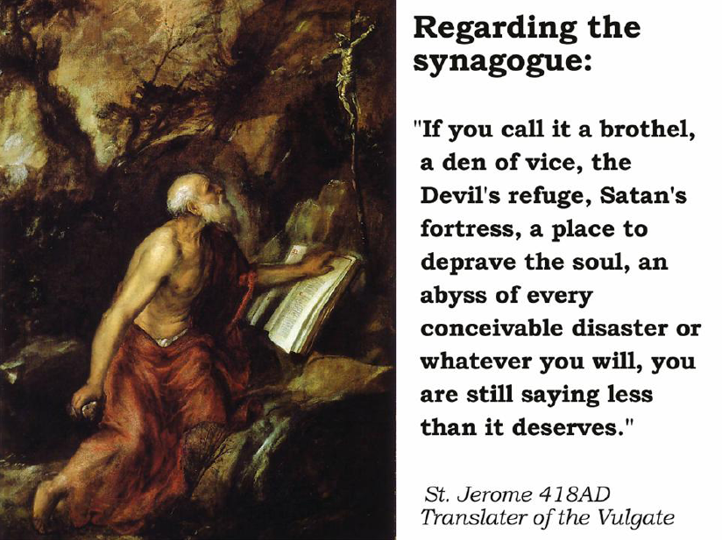
Notes:
Source: adelphosweb.com

Slide 76
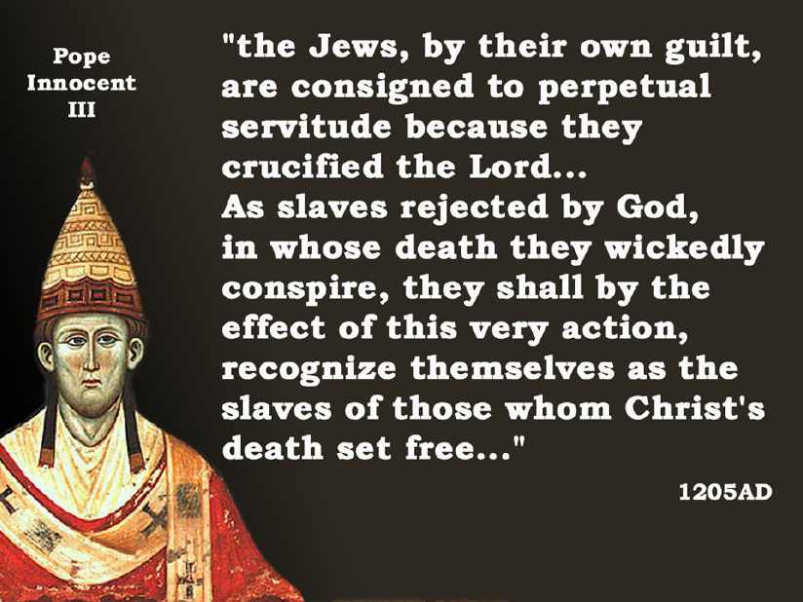
Notes:
Source: adelphosweb.com

Slide 77
Notes:
Source: adelphosweb.com

Slide 78
Isaiah
43:2
KJV
“…when thou walkest through the fire, thou shalt not be burned; neither shall the flame kindle upon thee.”
The Gospel of the Bush

Slide 79
The Gospel of the Bush

Slide 80
The Gospel of the Burning Bush
The burning bush is parable of Yahweh’s preservation in affliction, through the covenants of promise.
Moses
National Israel
The Lord Jesus Christ
Spiritual Israel
The Gospel of the Bush

Slide 81
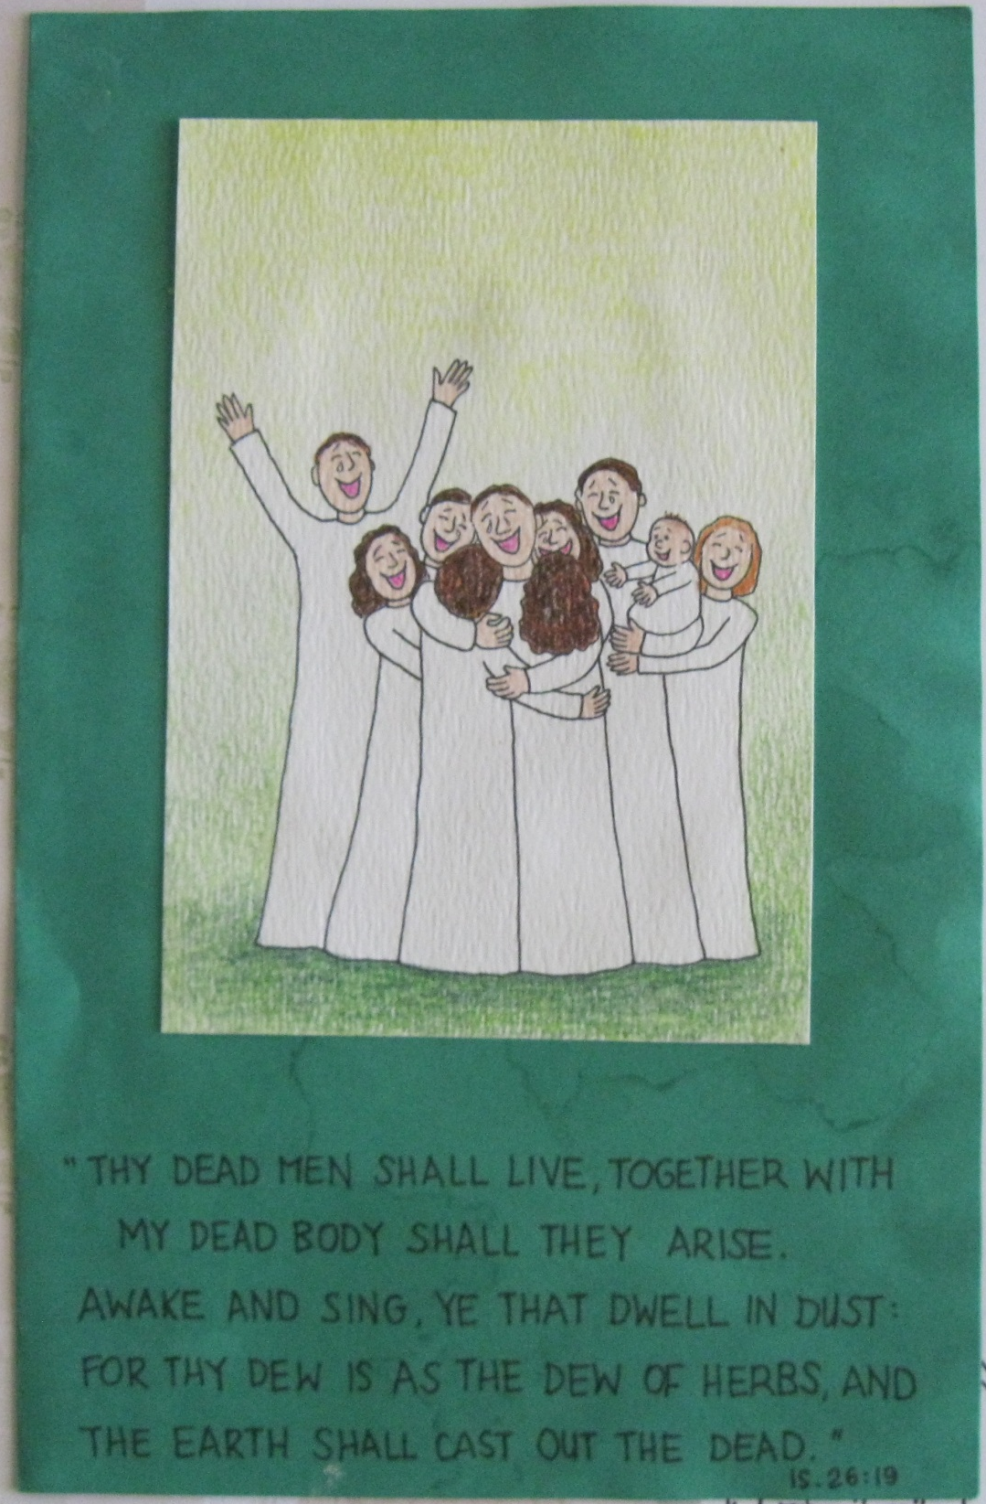
Not Ashamed

Slide 82

Not Ashamed

Slide 83
For Abraham’s God is our God,
And Isaac’s God is ours,
Ours is the God of Jacob,
With His almighty powers.
HYMN 238
Not Ashamed

