Slide 1
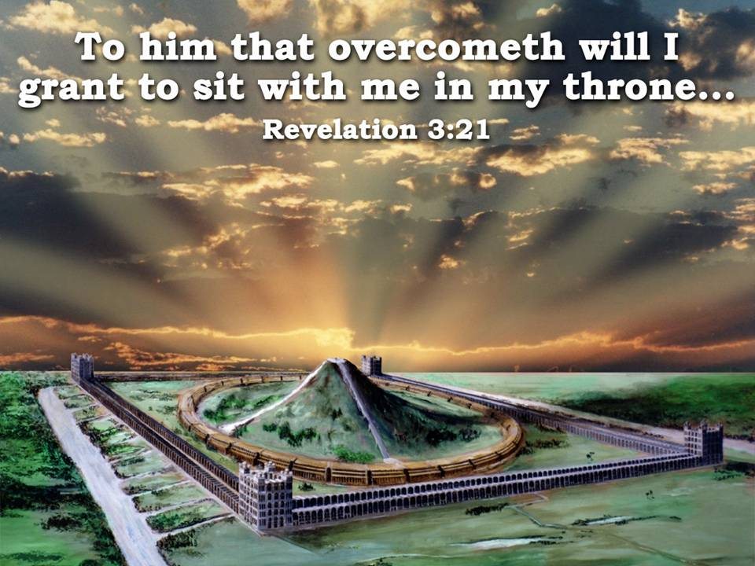
Isa 56:6 Also the sons of the stranger, that join themselves to the LORD, to serve him, and to love the name of the LORD, to be his servants, every one that keepeth the sabbath from polluting it, and taketh hold of my covenant;
Isa 56:7 Even them will I bring to my holy mountain, and make them joyful in my house of prayer: their burnt offerings and their sacrifices shall be accepted upon mine altar; for mine house shall be called…
“…an
House of Prayer
for
All People.”

Slide 2
Mar 11:17 And he taught, saying unto them, Is it not written, My house shall be called of all nations the house of prayer? but ye have made it a den of thieves.
“…an
House of Prayer
for
All People.”

Slide 3
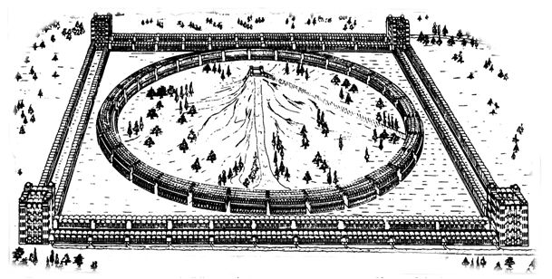
CORNER COURTS
LEVITES LIVE IN UPPER STORIES
(DURING TERM OF SERVICE). HUGE
KITCHENS BOIL SACRIFICES TO
FEED WORSHIPPERS. CHIMNEYS ON
OUTER FACE TOTAL AREA 360 SQ.FT.
42 TIMES AREA OF WASHINGTON
MONUMENT. EZK46:22-24.
PG 170, 175, 73 [82, 83, 30]
GATES.
APPARENTLY 11 ON EA. WALL
FOR ENTERING IN-GOING FORTH
EZK. 40:18 PG. 75,77 [30, 32]
PREPARATION TABLES
FURTHER PREPARATION OF SACRIFICES. 4 PER INNER GATE OF OUTER COURT. EZK. 40:39. PG. 69, 163 [27, 78-78]
THE ALTAR
SACRIFICES CONSUMED BY FIRE FROM HEAVEN. 12 REEDS SQ.(50 YDS. SQ.) EZK. 43:13, 2 CHR. 7:1, LEV. 9:24; JUD. 6:21; 2 KG. 18:23; 1CHR. 21:26; HEB. 9:8
(PG. 127) [58-59]
MOST HOLY
HERE THE GLORY OF THE OLAHM
IS HID FROM MORTAL EYES BY
TENT OF CLOUD. ISA. 4:5, ISA. 40:22; HEAVENS AS TENT OF
HOLY. PG. 185 [91-92]
SLAYING BLOCKS
ON NORTH ONLY.4 PER GATE SACRIFICE SLAIN. FIRST- FRUITS ON SOUTH -EZK. 40:40 PG. 163 [78]
SEPARATE PLACES
WORSHIPPERS PASS THROUGH-IN
TRANSIT. ASSEMBLE FOR WORSHIP
EZK.41:13.PG.111, 122 [50,56]
THRONES OF JUDGEMENT
IN INNER RECESSES OF INNER
TEMPLE. BETWEEN CHERUBIM
FROM WHENCE OFFERINGS CON-
VEYED TO ALTAR 389 THRONES
AT LEAST. PS. 122:4-6, ISA. 62:9
PG. 174 [69, 71]
ACCESS TO ALTAR
cp. TABERNACLE-NO NAKEDNESS
IN MOST HOLY TO DISCLOSE.
HENCE STEPS. EZK. 43:17
PG. 132 (60)
THE MOUNTAIN EZK. 43:12,13.PG 94, 118 [40, 52]
OUTER COURT
200’ PLAZA BETWEEN THE OUTER RANGE OF GATE BUILDINGS ON ALL SIDES (EZK. 43:4, 44:2, 46:1,2,6; SONG 5:1
DINING HALLS
UPPER GALLERIES OF OUTER
COURTS OF WEST, NORTH, SOUTH.
HALF A MILLION PER SITTING.
2,864 DINING HALLS, ~
LARGER THAN BANQUET HALLS~
ISA 25:6 -PG. 170 [82]
TABLE BEFORE YAHWEH
TIMBER ENCLOSED CONVEYOR
FOR FAT AND BLOOD ON GOLDEN
FLOATS. EZK. 41:22 PG. 134[62]
GEHENNA
OUTSIDE WEST-WALL REFUSE OF
SACRIFICES. SINNERS BURNT. OLD
GEHENNA NOW INSIDE INNER
TEMPLE ~ 65:20; 66:23,24,
EZK. 43:21, JER.31:40. PG. 168 [81]
PRINCE’S PALACE
WHOLE EASTERN OUTER COURT
SAINTS SUP ANEW WITH CHRIST
EZK. 43:4, 44:2, 46:1,2,6
SONG 5:1. PG. 173, [84,88]
CHAMBERS OF SINGERS
WHOLE CIRCLE CONTAINS THEM-
NORTHERN HALF, SONS OF ZADOK
KEEP ALTAR. SOUTHERN HALF,
LEVITES KEEP HOUSE, i.e.
IMMORTAL & MORTAL PRIESTS.
EZK. 40:44. PG. 93,151 [40, 72]
LEVITE DUTIES
OFFICIATE & DINE IN INNER
RANGE OF OUTER BUILDINGS ON
NORTH & SOUTH, EAT MOST HOLY THINGS. 444 DINING HALLS
CHANGE GARMENTS HERE.
EZK.44:17, 42:12, PG.164 [79]
STORE HOUSES
SOUTHERN OUTER COURT
WORSHIPPERS ENTER SOUTH WITH FIRSTFRUITS. EZK. 44:30;
MAL. 3:4. PG. 69, 164 [27, 70]
COVERED OPENINGS
SPACE FOR ROOTS OF FOLIAGE
WHICH COVERS INNER TEMPLE.
EZK. 41:15-17; ISA.4:6; ISA.
60:13, PS.67:6-7 PG. 140,146 [66, 69]
LIFTS
3 LIFT CHAMBERS, EA SIDE OF
EACH GATE. “THOU SHALT NOT
GO UP TO MY ALTAR BY STEPS”
EX.20:26. PG. 51, 171 [16, 82]
TWO STREAMS OE WATER
WATERS FROM ALTAR FLOW FROM
UNDER NORTHERN GATES-THEN
EAST, NORTHWEST TO MEDIT. UNDER
SOUTH GATES, THEN EAST TO HEAL
INLAND LAKE. EZK. 47:1, 9;
PS. 46:4; ZECH. 14:8. PG. 302 [152]
TREES FOR MEDICINE
ON RIVER BANKS, LEAVES SHALL
NOT FADE; FOR MEDICINE. FRUIT
FOR MEAT. EZK 47:12, REV. 22:2
PG. 168 [68, 92]
READ “THE TEMPLE OF EZEKIEL'S
PROPHECY” HENRY SULLEY.
PG. NUMBERS of the 6th ed. From the Christadelphian Office and Logos Publ.

Slide 4
Class 1 – In the Visions of God, the Land, a Mountain, the City and the Man of Brass”

Slide 5
Zechariah 14:4
Zec 14:4 And his feet shall stand in that day upon the mount of Olives, which is before Jerusalem on the east, and the mount of Olives shall cleave in the midst thereof toward the east and toward the west, and there shall be a very great valley; and half of the mountain shall remove toward the north, and half of it toward the south.

Slide 6
Psalm 48:2
Psa 48:1 (A Song and Psalm for the sons of Korah) Great is the LORD, and greatly to be praised in the city of our God, in the mountain of his holiness.
Psa 48:2 Beautiful for situation, the joy of the whole earth, is mount Zion, on the sides of the north, the city of the great King.

Slide 7
Psalm 132:13-14
Psa 132:13 For the LORD hath chosen Zion; he hath desired it for his habitation.
Psa 132:14 This is my rest for ever: here will I dwell; for I have desired it.

Slide 8
Isaiah 2:2-3
Isa 2:2 And it shall come to pass in the last days, that the mountain of the LORD'S house shall be established in the top of the mountains, and shall be exalted above the hills; and all nations shall flow unto it.
Isa 2:3 And many people shall go and say, Come ye, and let us go up to the mountain of the LORD, to the house of the God of Jacob; and he will teach us of his ways, and we will walk in his paths: for out of Zion shall go forth the law, and the word of the LORD from Jerusalem.

Slide 9
Eze 40:1 In the five and twentieth year of our captivity, in the beginning of the year, in the tenth day of the month, in the fourteenth year after that the city was smitten, in the selfsame day the hand of the LORD was upon me, and brought me thither.

Slide 10
VERSE 1
"In the five and twentieth year of our captivity" — This refers to the captivity of Jehoiachin, king of Judah, and his mighty men (2 King chs. 24-25; cp. Eze. 1:2; 33:21).
The 25 year period, dated from the fall of King Jehoiachin, comprises 11 years of Zedekiah's reign, and a further 14 years to this vision
This would be fifty years from Josiah's Passover (2Chr. 35), which, if that were a Jubilee would make this vision apply to a Jubilee year also, indicating that the temple will be opened in a Jubilee year from the return of the Great King!

Slide 11
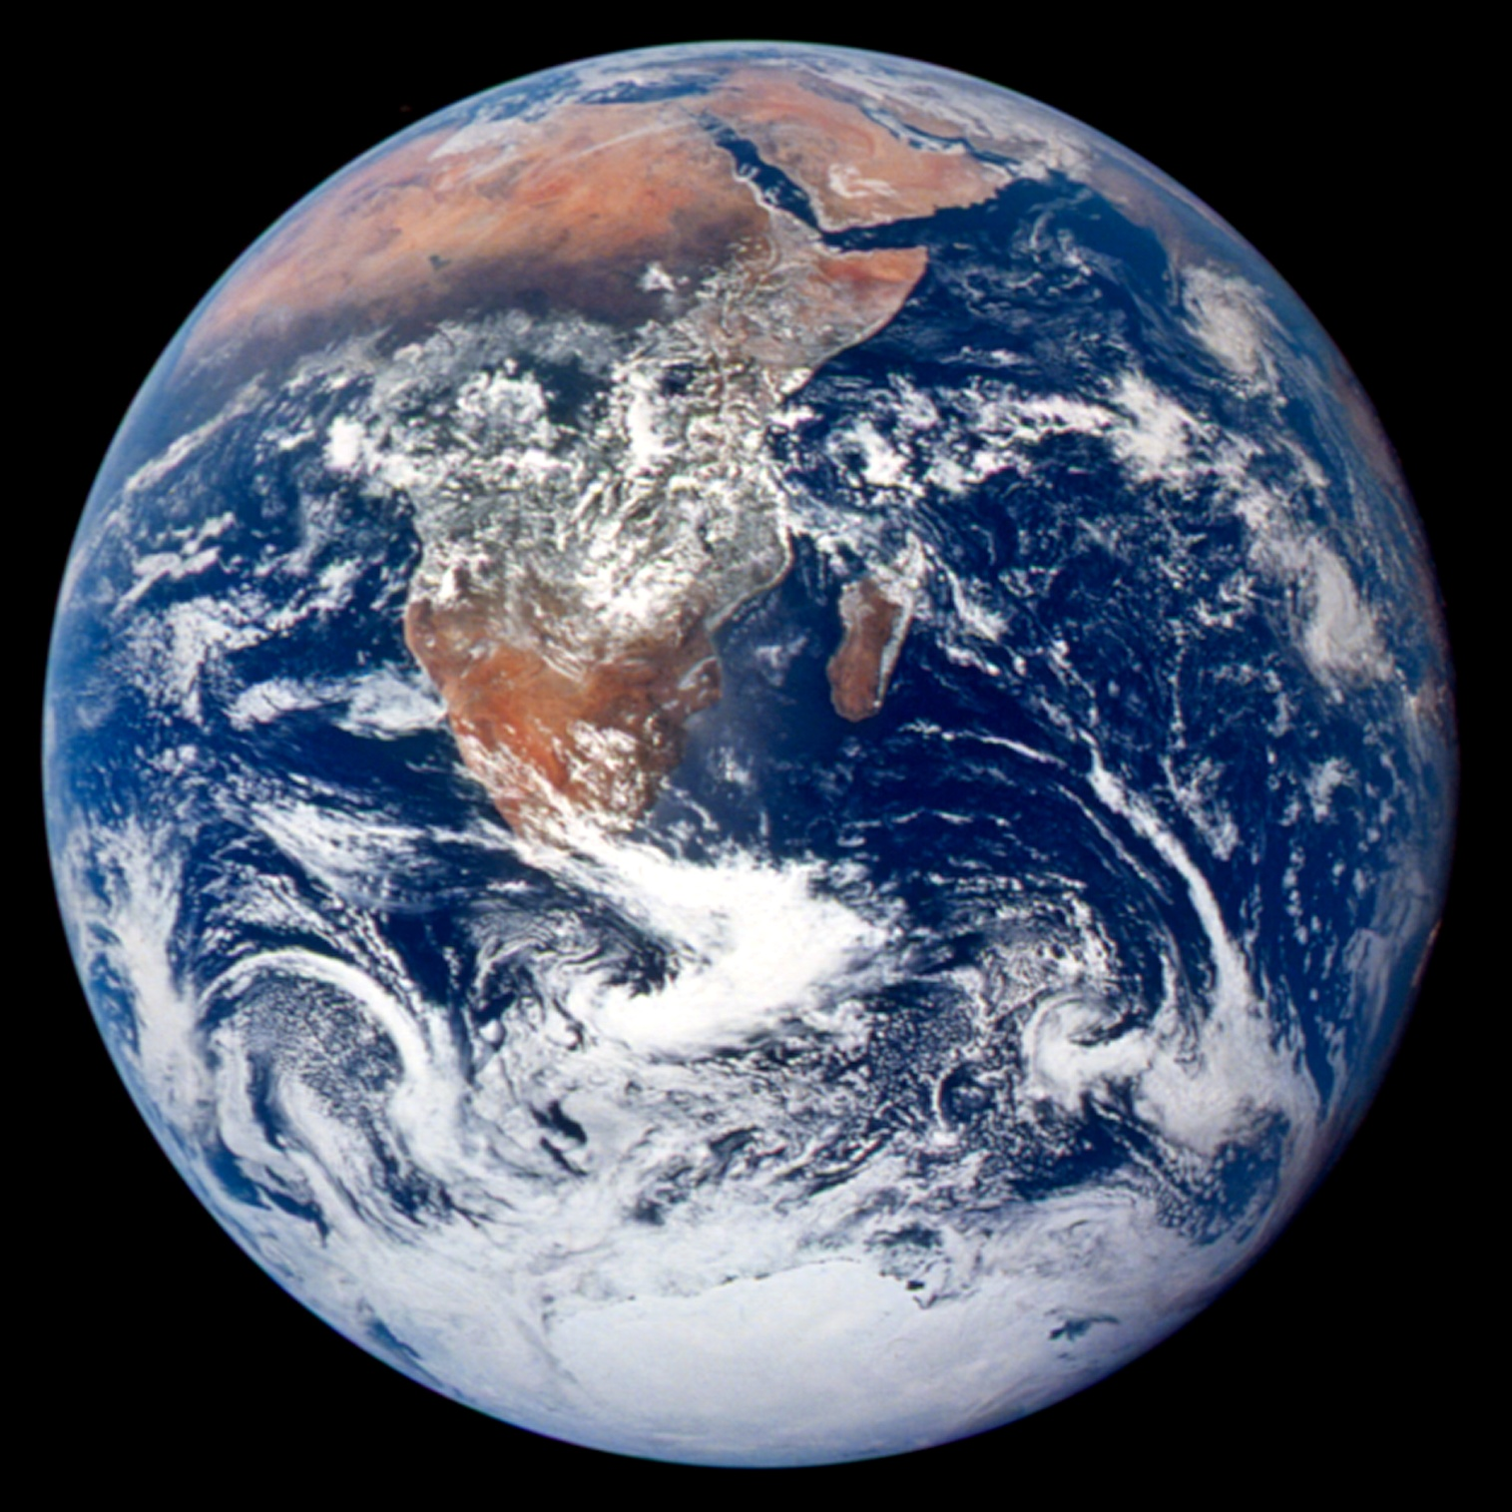
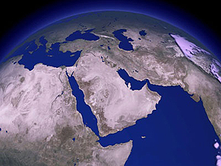
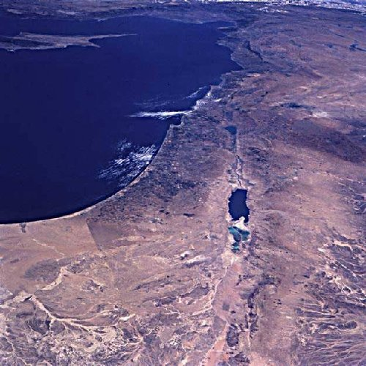
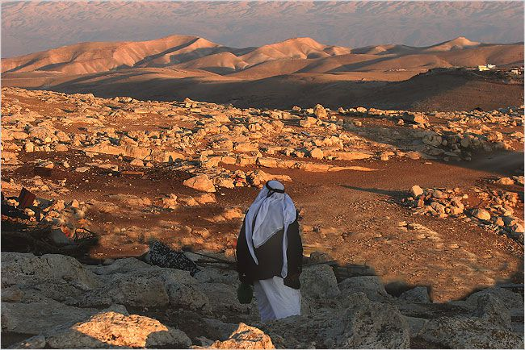
The prophet Ezekiel was transported in vision from Babylon back to his homeland of Eretz Israel

Slide 12

Eze 40:2 In the visions of God brought he me into the land of Israel, and set me upon a very high mountain, by which was as the frame of a city on the south.
Ezekiel’s initial field of vision. V 2
North
South

Slide 13
"Set me upon a very high mountain"
Ezekiel found himself sitting upon a very high mountain, upon which same mountain (see v. 2 mg.) was a literal frame of a city
From here he gained a perspective view of the glorious temple of Yahweh, prior to his conducted tour of the building.
“Mountains” have a HISTORY throughout scripture…
  Mount Moriah where Isaac was offered
  Mount Sinai/Horeb where Moses rec’vd the Law & Tabernacle
  Mountain of Daniel 2 – Sym. Of the Kingdom of God
  Mountain of Christ’s Transfiguration
  Mountain of Rev. 14 – Lamb and the 144K Stand in victory
Mountains stand between heaven & earth

Slide 14
The Vision…Substance or Symbol?
"Into the land of Israel" — This vision relates to the literal land of Israel, and in particular to the literal city of Jerusalem, the " smitten city“ (v. 1)
On the other hand, Rev. 21 relates to the symbolic "city," a symbol of the immortal saints (cp. Rev. 1:1, introducing the final prophecy as that which is "signified," i.e., to show by sign and symbol)
There is absolutely nothing about the last nine chapters of Ezekiel to suggest that it is merely a symbolic representation.
On the other hand, we are told that the book of Revelation is a book of symbols. It is incorrect to suggest that Ezekiel's prophecy is only figurative, or that the Apocalypse is only a literal account.

Slide 15
THE HOLY OBLATION
The Temple is to be built upon Mount Zion, or, in other words, on the site of ancient Jerusalem,
The HOLY OBLATION exclusive of the Prince's residue, is twenty-five thousand reeds (55 mis.) (88.53 kms) square (Chap, 48:20), and appears to be divided into three sections, viz.:
1. A piece of territory twenty-five thousand reeds long, and ten thousand reeds broad, called " The holy portion for the priests," i.e., the sons of Zadok (Chap. 45:1-4; 48:9-11.) This is the northernmost division of the holy square.
2. A piece of territory of like dimensions on the south of the last-mentioned, devoted to the use of the Levites (Chap. 45:5 ; 48:13-14.)
3. A strip of land twenty-five thousand reeds long, and five thousand wide (Plate 14) which is called " The possession of the city " (Chap. 45:6).

Slide 16
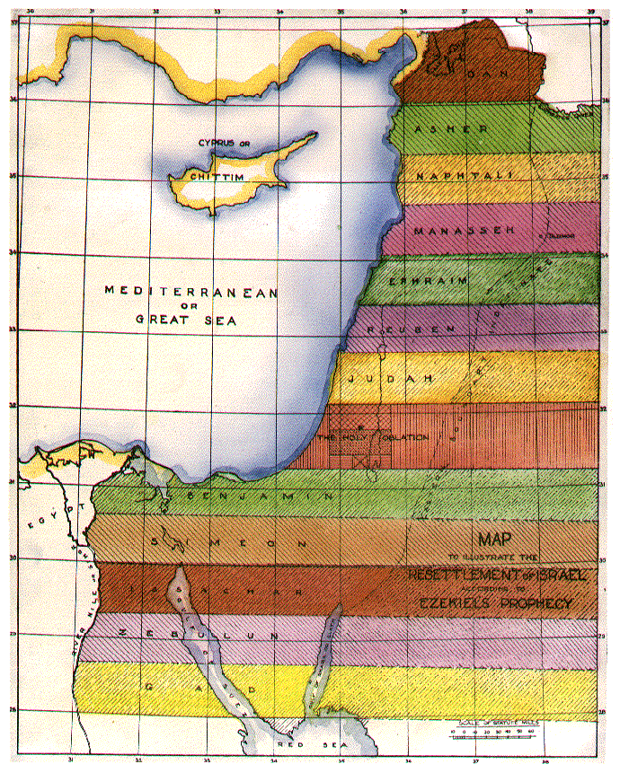
Eze 45:1 Moreover, when ye shall divide by lot the land for inheritance, ye shall offer an oblation unto the LORD, an holy portion of the land: the length shall be the length of five and twenty thousand reeds, and the breadth shall be ten thousand: it shall be holy in all the border thereof round about.
Eze 45:3 And of this measure shalt thou measure, a length of five and twenty thousand, and a breadth of ten thousand: and in it shall be the sanctuary, which is most holy.
Eze 45:4 It is an holy portion of the land; it shall be for the priests, the ministers of the sanctuary, which come near to minister unto the LORD; and it shall be a place for their houses, and an holy place for the sanctuary.
HOLY OBLATION

Slide 17
These three divisions, each twenty-five thousand reeds wide, form the Holy Oblation, thus :
Holy portion of the sons of Zadok.. 10,000 reeds.
Portion of the Levites .. …………... 10,000 reeds (22.7mi; 36.53km).
Possession of the city .. …………… 5,000 reeds.
(11.36mi; 18.28km)
25,000 reeds
(56.81mi; 91.43km)

Slide 18
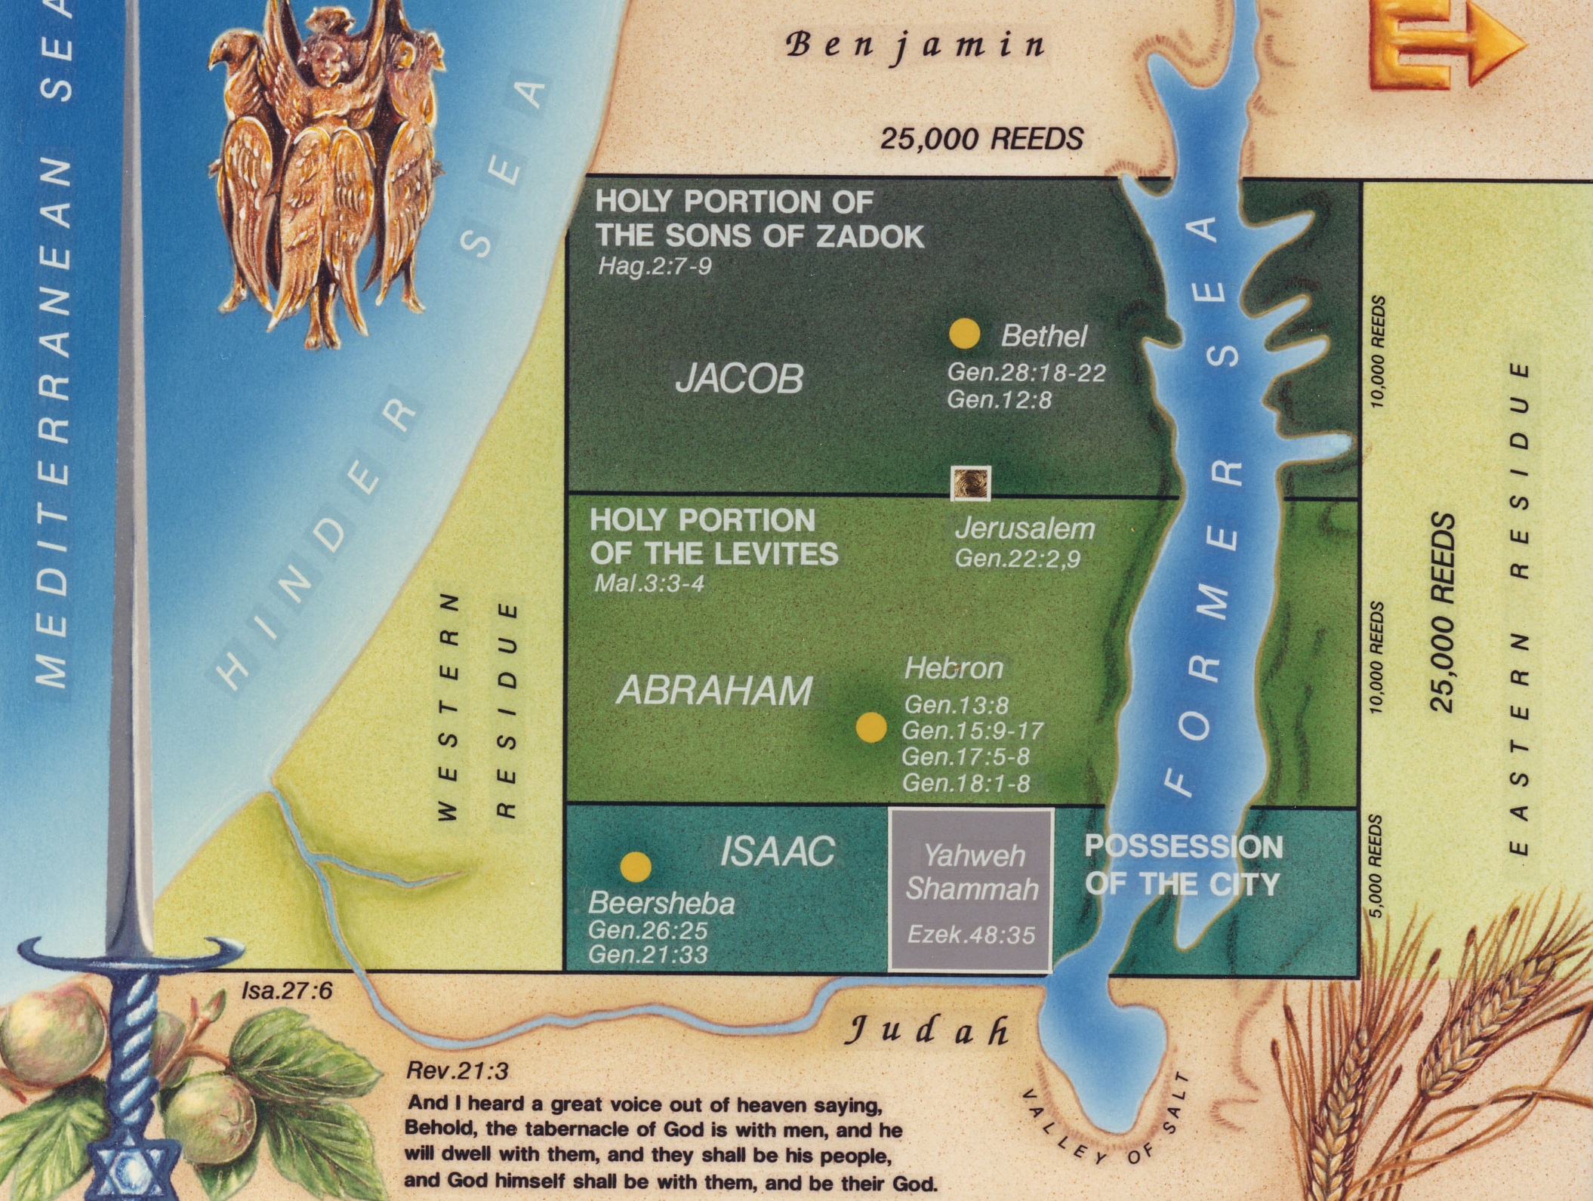

(56.81mi; 91.43km)
HOLY PORTION OF THE SONS OF ZADOK
(22.7mi;
36.53km)
THE SANCTUARY
HOLY PORTION OF THE LEVITES
(56.81mi; 91.43km)
(22.7mi;
36.53km)
POSSESSION OF THE CITY
(11.36mi;
18.28km)
THE CITY OF “YAHWEH SHAMMAH”

Slide 19
Zechariah 14:9, 10
Zec 14:9 And the LORD shall be king over all the earth: in that day shall there be one LORD, and his name one.
Zec 14:10 All the land shall be turned as a plain from Geba to Rimmon south of Jerusalem: and it shall be lifted up, and inhabited in her place, from Benjamin's gate unto the place of the first gate, unto the corner gate, and from the tower of Hananeel unto the king's winepresses.

Slide 20
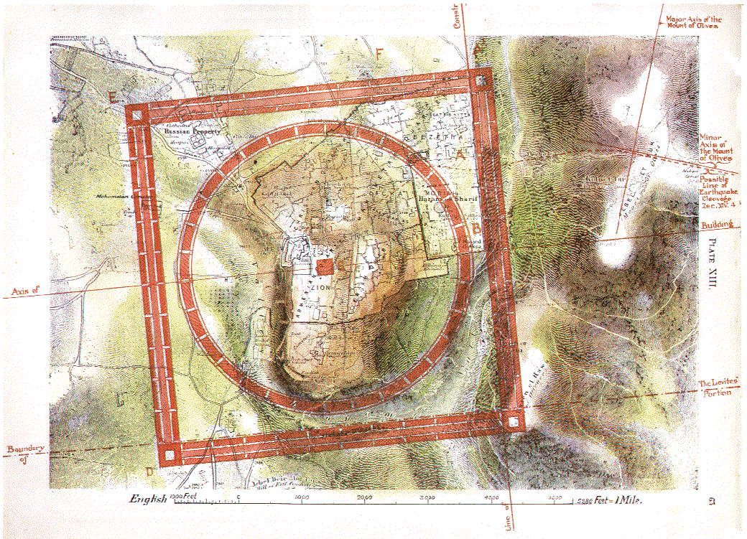
THE MOUNTAIN
EZK. 43:12,13.PG 94

Slide 21
Not “Yahweh Shammah”
This "frame of a city' is not to be confused with the residential city of Yahweh Shammah (Eze. 48:35) which is not at Zion, but some 23 miles (37 km) to the south. Note that Mt. Zion and the Temple are interchangeable terms in prophecy (Psa 132:13-14; Isa 18:7; Zech 1:16)

Slide 22
(56.81mi; 91.43km)
(56.81mi; 91.43km)
POSSESSION OF THE CITY
(11.36mi;
18.28km)
THE CITY OF “YAHWEH SHAMMAH”

Slide 23
The Frame of a City
Heb 11:10 For he looked for a city which hath foundations, whose builder and maker is God.
Heb 11:16 But now they desire a better country, that is, an heavenly: wherefore God is not ashamed to be called their God: for he hath prepared for them a city.
Heb 12:22 But ye are come unto mount Sion, and unto the city of the living God, the heavenly Jerusalem, and to an innumerable company of angels,
Heb 13:14 For here have we no continuing city, but we seek one to come.

Slide 24
Eze 40:2 In the visions of God brought he me into the land of Israel, and set me upon a very high mountain, by which was as the frame of a city on the south.
500 REEDS (6000 FT.= 1.8 KM)
North
500 REEDS (6000 FT.= 1.8 KM)
South

Slide 25
Eze 42:15 Now when he had made an end of measuring the inner house, he brought me forth toward the gate whose prospect is toward the east, and measured it round about.
Eze 42:16 He measured the east side with the measuring reed, five hundred reeds (12 X 500 = 6000’ / 1.8 km), with the measuring reed round about.
Eze 42:17 He measured the north side, five hundred reeds, with the measuring reed round about.
Eze 42:18 He measured the south side, five hundred reeds, with the measuring reed.
Eze 42:19 He turned about to the west side, and measured five hundred reeds with the measuring reed.
Eze 42:20 He measured it by the four sides: it had a wall round about, five hundred reeds long, and five hundred broad, to make a separation between the sanctuary and the profane place.
500 REEDS (6000 FT.= 1.8 KM)
North
500 REEDS (6000 FT.= 1.8 KM)
South

Slide 26
Eze 40:3 And he brought me thither, and, behold, there was a man, whose appearance was like the appearance of brass, with a line of flax in his hand, and a measuring reed; and he stood in the gate.
Eze 40:4 And the man said unto me, Son of man, behold with thine eyes, and hear with thine ears, and set thine heart upon all that I shall shew thee; for to the intent that I might shew them unto thee art thou brought hither: declare all that thou seest to the house of Israel.
Eze 40:5 And behold a wall on the outside of the house round about, and in the man's hand a measuring reed of six cubits long by the cubit and an hand breadth: so he measured the breadth of the building, one reed; and the height, one reed.

Slide 27
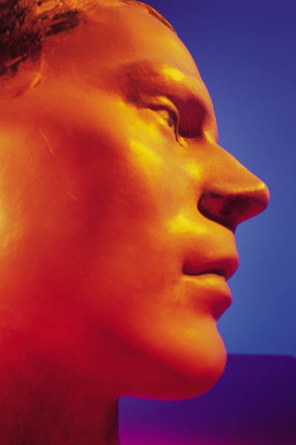
“…a man, whose appearance was like the appearance of brass…”
40:3-4
He saw a "man" (ish — a certain, individual male — usually used of a superior)
His appearance was like "brass" (bronze—Rother;Heb. "nechoshesh"—copper); representing flesh purified by fire
In type it must relate to Christ, the builder and the measurer (cp 40:14)
The man has in his hand a line of flax and a measuring reed

Slide 28
“…a man, whose appearance was like the appearance of brass…”
— This man appears like flashing brass
He speaks like the Deity (Eze. 43:2-7) yet looks like flesh (brass) in one symbolic man.
He represents the Lord Jesus Christ, whose characteristics are revealed in the "Multitudinous Christ" of Rev. 1:15, with feet of burning brass, and the Cherubim of Eze. 1:4-28, with feet of burnished (polished through trial) brass.
Numbers 16 - the brass of sinners was used to clothe the altar. Its antitype, Christ was clothed with the nature (body) of sinners at his first coming (Christ alone of Adam's race has been able to completely conquer this body, and have the victory over the flesh).
The use of brass teaches that all in the glorified "Christ-Body" have had their origin in the race of Adam.

Slide 29
A man of brass, then, holding in his hand a line of flax and a measuring reed, is an appropriate figure of Jesus and his brethren in visible, corporeal, and active manifestation during the building of the temple on Mount Zion. Here is depicted the Son and his House (Heb. 3:6)—The Bridegroom and his Bride (Rev. 19:7) — the one NEW MAN making peace (Eph. 2:15, 22 ; 4:13).
See Ezek. 22:23 – 31 – (v30) Eze 22:30 And I sought for a man among them, that should make up the hedge, and stand in the gap before me for the land, that I should not destroy it: but I found none.

Slide 30
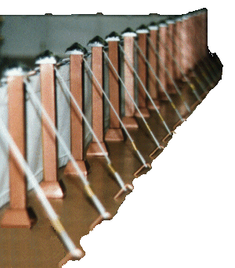
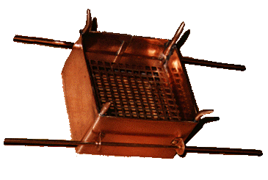
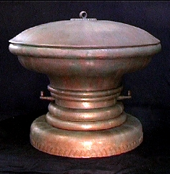
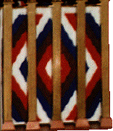
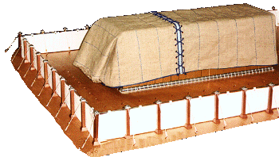
Brass, the metal of Purged Flesh
Socket bases holding up fence pillars
Brazen altar in courtyard
Laver of brass in courtyard
5 brass sockets for the door of tent
Taches binding goat-hair covers over vail

Slide 31
THE LAVER
The command to make it- Exo. 30: 17-21
Command carried out - Exo. 38:8
Cleansing of priest and sacrifices – Exo. 40:30-32
Describe the material of the laver: Brass- the element of purged flesh
The laver, made of mirrors of the women assembling at the door of the Tabernacle, became the container of that which the priesthood had to be cleansed by.
The vanity of our hearts which each of us carries within ourselves, being only flesh does reflect something- but it's not God's glory- it's our own!
Notes:
Laver
(Heb. kiyor), a "basin" for boiling in, a "pan" for cooking (1 Sam. 2:14), a "fire-pan" or hearth (Zech. 12:6), the sacred wash-bowl of the tabernacle and temple (Ex. 30:18, 28; 31:9; 35:16; 38:8; 39:39; 40:7, 11, 30, etc.), a basin for the water used by the priests in their ablutions.
That which was originally used in the tabernacle was of brass (rather copper; Heb. nihsheth), made from the metal mirrors the women brought out of Egypt (Ex. 38:8). It contained water wherewith the priests washed their hands and feet when they entered the tabernacle (40:32). It stood in the court between the altar and the door of the tabernacle (30:19, 21).
In the temple there were ten lavers used for the sacrifices, and the molten sea for the ablutions of the priests (2 Chr. 4:6). The position and uses of these are described 1 Kings 7:23-39; 2 Chr. 4:6. The "molten sea" was made of copper, taken from Tibhath and Chun, cities of Hadarezer, king of Zobah (1 Chr. 18:8; 1 Kings 7:23-26).
No lavers are mentioned in the second temple.

Slide 32
Thou Shalt Make a Laver of Brass
Exo. 30:17 And the LORD spake unto Moses, saying,
18 Thou shalt also make a laver of brass, and his foot also of brass, to wash withal: and thou shalt put it between the tabernacle of the congregation and the altar, and thou shalt put water therein.
19 For Aaron and his sons shall wash their hands and their feet thereat:
20 When they go into the tabernacle of the congregation, they shall wash with water, that they die not; or when they come near to the altar to minister, to burn offering made by fire unto the LORD:
Notes:
Laver
+ In the tabernacle, a vessel of brass containing water for the priests to wash their hands and feet before offering sacrifice. It stood in the fore offering sacrifice. It stood in the court between the altar and the door of the tabernacle. (Exodus 30:19,21) It rested on a basis, i.e. a foot, which, was well as the laver itself, was made from the mirrors of the women who assembled at the door of the tabernacle court. (Exodus 38:8) The form of the laver is not specified, but may be assumed to have been circular. Like the other vessels belonging to the tabernacle, it was, together with its "foot," consecrated with oil. (Leviticus 8:10,11)
+ In Solomon's temple, besides the great molten sea, there were ten lavers of brass, raised on bases, (1 Kings 7:27,39) five on the north and five on the south side of the court of the priests. They were used for washing the animals to be offered in burnt offerings. (2 Chronicles 4:6)
Smith’s Bible Dict.

Slide 33
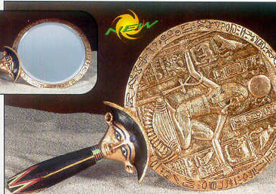
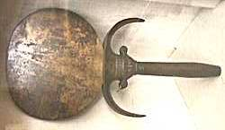
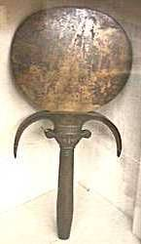
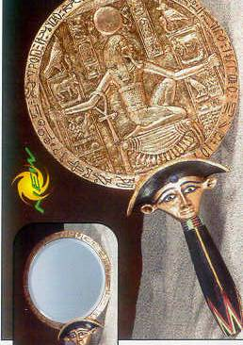
Brass Mirrors of the Women Used
Exo. 38:8 And he made the laver of brass, and the foot of it of brass, of the lookingglasses of the women assembling, which assembled at the door of the tabernacle of the congregation.

Slide 34
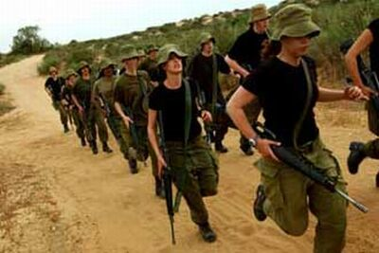
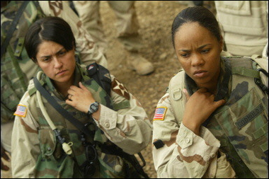
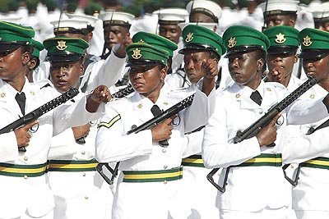
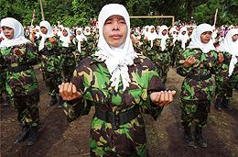
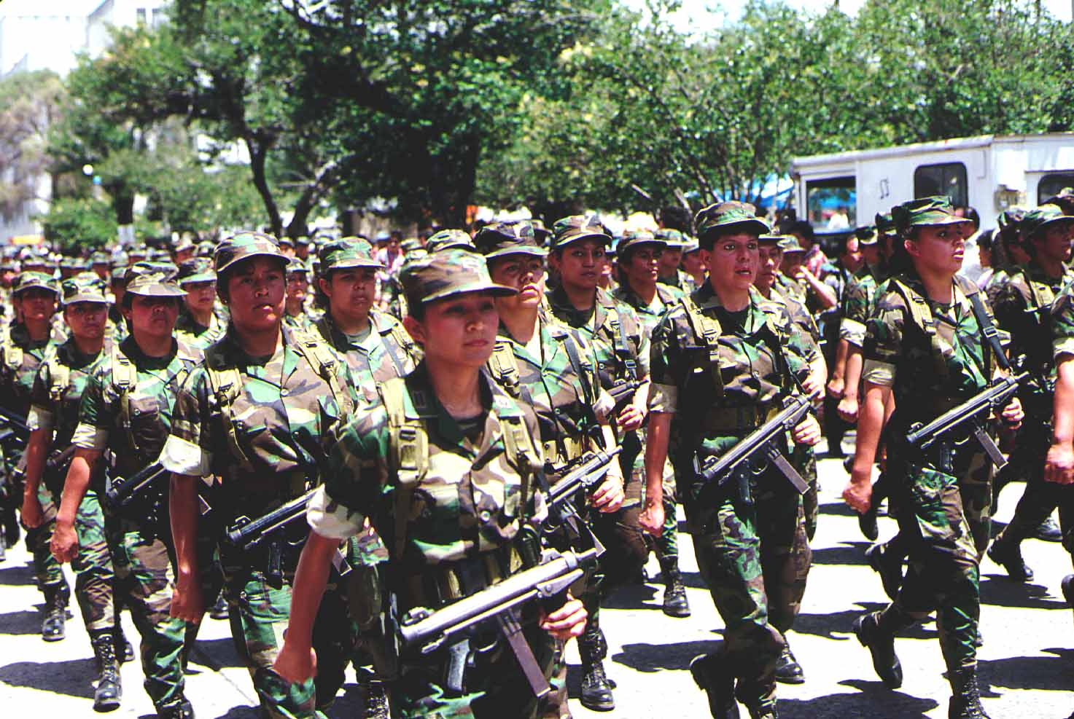
Exo. 38:8 And he made the laver of brass, and the foot of it of brass, of the lookingglasses of the women assembling, which assembled at the door of the tabernacle of the congregation. (Mg. ‘Assembling by troops’)
Troops
ISRAELIS WOMEN
U.S. WOMEN
GUATEMALAN. WOMEN
INDONESIAN. WOMEN
TRINIDAD WOMEN

Slide 35
Exo. 38:8 And he made the laver of brass, and the foot of it of brass, of the lookingglasses of the women assembling, which assembled at the door of the tabernacle of the congregation.
The “women assembling, which assembled…” likely the mothers, sisters, wives and daughters of the Levites led by Miriam to set up a guard at the gate of the Tabernacle
Offering up their brass mirrors, tokens of their past life of vanity in Egypt, where women worshipers wore them to the temples possibly as “soul mates”
They now took on the WARFARE of the saints contending for the Truth; an unattractive role in life, no longer self-glorifying, self-serving, selfish and vainly EMPTY!
Notes:
Mirror
(Exodus 38:8; Job 37:18) The Hebrew women on coming out of Egypt probably brought with them mirrors like those which were used by the Egyptians, and were made of a mixed metal, chiefly copper, wrought with admirable skill, and susceptible of a bright lustre. (1 Chronicles 13:12)
Smith’s Bible Dict.

Slide 36
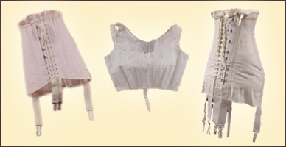
Although America did not enter the war effort officially until 1917, the impact of World War I had a paralyzing effect on fashion, and was responsible for the demise of the corset. American women entered the workforce in great numbers, providing critical labor in munitions factories and other jobs previously performed by men. Women were also recruited into the war effort to satisfy the demand for nurses, ambulance drivers and other necessary services. In the face of war, fashion became trivial and the corset was deemed an impractical and awkward device that no longer seemed appropriate. In fact, to aid the war effort at home, women were discouraged from purchasing corsets made with steel. The collected effect of the corset boycott saved 28,000 tons of steel in 1917, enough for two battleships! World War I had an emancipating affect on women.
They were freed from the bondage of corsets and since many chose employment, were freed from domestic bondage as well. With these new freedoms came an even greater one. The growing women's suffrage movement achieved a great victory in 1920 when congress passed the 19th amendment, granting women the right to vote.”

Slide 37
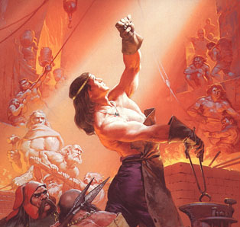
Bible History of Military Brass
Genesis 4:22
“And Zillah, she also bare Tubalcain, an instructer of every artificer in brass and iron: and the sister of Tubalcain was Naamah.”
(Rotherham) And, as for Zillah, she also, bare Tubal-Cain, a sharpener of every cutting instrument of bronze and iron,—and, the sister of Tubal-Cain, was Naamah.

Slide 38
Deuteronomy 28:23
And thy heaven that is over thy head shall be brass, and the earth that is under thee shall be iron.
1 Kings 7:14
He was a widow's son of the tribe of Naphtali, and his father was a man of Tyre, a worker in brass: and he was filled with wisdom, and understanding, and cunning to work all works in brass. And he came to king Solomon, and wrought all his work.
Judges 16:21
But the Philistines took him, and put out his eyes, and brought him down to Gaza, and bound him with fetters of brass; and he did grind in the prison house.
2 Chronicles 12:10
Instead of which king Rehoboam made shields of brass, and committed them to the hands of the chief of the guard, that kept the entrance of the king's house.
1 Samuel 17:4-6
4 And there went out a champion out of the camp of the Philistines, named Goliath, of Gath, whose height was six cubits and a span.
5 And he had an helmet of brass upon his head, and he was armed with a coat of mail; and the weight of the coat was five thousand shekels of brass.
6 And he had greaves of brass upon his legs, and a target of brass between his shoulders.
2 Kings 25:7
And they slew the sons of Zedekiah before his eyes, and put out the eyes of Zedekiah, and bound him with fetters of brass, and carried him to Babylon.
2 Kings 25:14
And the pots, and the shovels, and the snuffers, and the spoons, and all the vessels of brass wherewith they ministered, took they away.
1 Samuel 17:38
And Saul armed David with his armour, and he put an helmet of brass upon his head; also he armed him with a coat of mail.

Slide 39
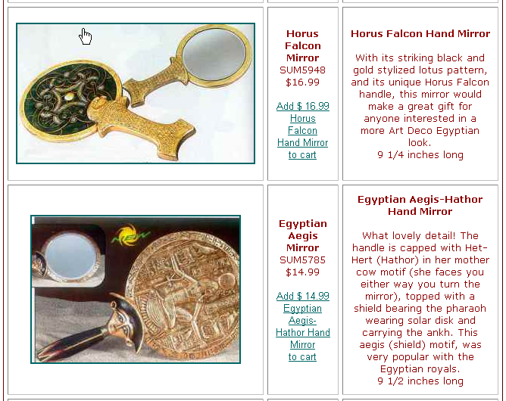
‘Lookingglasses’= Heb. ‘marah’
Hb. 'marah' (4759) the fem. form of 'mareh'(see below)and is also transl. in the following vv. As -
Gen. 46:2 - "in the visions of"
Num. 12:6 - "in a vision"
1 Sam 3:15- "the vision"
Isa. 52:14 - "visage"
Ezk. 1:1 - "visions of"
8:3 - "in the visions of"
40:2 - "in the visions of"
43:3 - "in the visions of"
Dan. 10:7 - "the vision, the vision"
10:8 - "vision"
10:16- "by the vision"
Notes:
Glass
was known to the Egyptians at a very early period of their national history, at least B.C. 1500. Various articles both useful and ornamental were made of it, as bottles, vases, etc. A glass bottle with the name of Sargon on it was found among the ruins of the north-west palace of Nimroud. The Hebrew word _zekukith_ (Job 28:17), rendered in the Authorized Version "crystal," is rightly rendered in the Revised Version "glass." This is the only allusion to glass found in the Old Testament. It is referred to in the New Testament in Rev. 4:6; 15:2; 21:18, 21. In Job 37:18, the word rendered "looking-glass" is in the Revised Version properly rendered "mirror," formed, i.e., of some metal. (Comp. Ex. 38:8: "looking-glasses" are brazen mirrors, R.V.). A mirror is referred to also in James 1:23.
Easton’s Bible Dict.

Slide 40
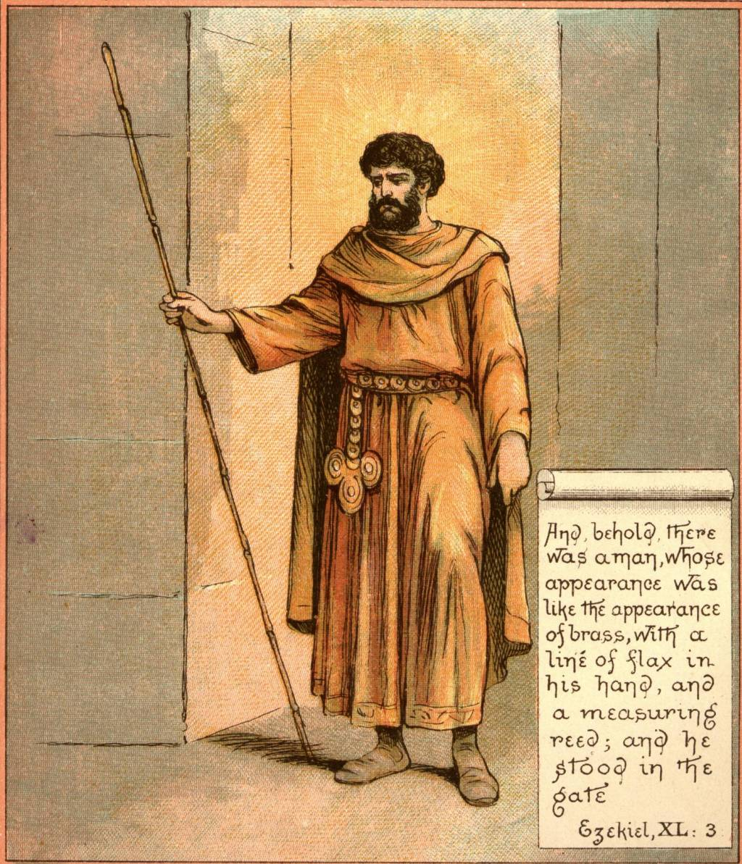
EZEKIEL 40:4 — THE OPENING INJUNCTION
VERSE 4
This is a touchstone to the interpretation of the prophecy, and is repeated and amplified in ch. 44:5, with even greater emphasis upon the need for minute observance of all that is to be observed in this vision.
Ezekiel is encouraged to see, hear, and observe "every coming in," all ordinances, and then to inform Israel of his wonderful discoveries.

Slide 41
"A line of flax in his hand" — Flax in Hebrew is pishteh, threads of linen. It signifies righteousness. The priests' garments were made of linen (Exo. 28:42)
The Apocalypse teaches that fine white linen is for the righteous actions (J.T.) of the saints (Rev. 19:8; 15:6)
Flax is quite unsuitable for accurate measurements.
Nowhere in this temple prophecy is a line used to measure, but always the measuring reed or measuring rod (e.g., Ezk. 42:15-19).
Not to be put on and taken off again, as with the Levites, but to be worn for eternity, as the sons of Zadok, who "shall come near to Me, to minister unto Me" (Ezek. 44:15-16).

Slide 42
This line of flax on the other hand, with its many threads, is a symbolic line, symbolical of the unbreakable government of Christ and the saints in the kingdom Age
The word "line" in Hebrew is pathiyl, a woven cord, from a root "to twine; to struggle." Hence it indicates the process by which the saints are wrought into one unbreakable government.
The " brass man" with a woven flax in his hand represents Christ with his omnipotent immortal host who are the governing body in the Millennial Age.

Slide 43
Eze 40:5 And behold a wall on the outside of the house round about, and in the man's hand a measuring reed of six cubits long by the cubit and an hand breadth: so he measured the breadth of the building, one reed; and the height, one reed.
"And a measuring reed" — The Heb. middah quaneh, signifies a measuring rod. This is the measuring standard used throughout the temple prophecy. The line of flax is only symbolic.
Verse 5 indicates that the reed's length is about 12 feet (3.6 metres), and this becomes the foundation for the sizes of the temple.

Slide 44
Spiritually, the REED must speak of the rulership and overall control by Christ, acknowledged mockingly by Herod’s soldiers.
Mat 27:27 Then the soldiers of the governor took Jesus into the common hall, and gathered unto him the whole band of soldiers.
28 And they stripped him, and put on him a scarlet robe.
29 And when they had platted a crown of thorns, they put it upon his head, and a reed in his right hand: and they bowed the knee before him, and mocked him, saying, Hail, King of the Jews!

Slide 45
2Co 10:12 For we dare not make ourselves of the number, or compare ourselves with some that commend themselves: but they measuring themselves by themselves, and comparing themselves among themselves, are not wise.
13 But we will not boast of things without our measure, but according to the measure of the rule which God hath distributed to us, a measure to reach even unto you.
Rev 11:1 And there was given me a reed like unto a rod: and the angel stood, saying, Rise, and measure the temple of God, and the altar, and them that worship therein.
2 But the court which is without the temple leave out, and measure it not; for it is given unto the Gentiles: and the holy city shall they tread under foot forty and two months.

Slide 46
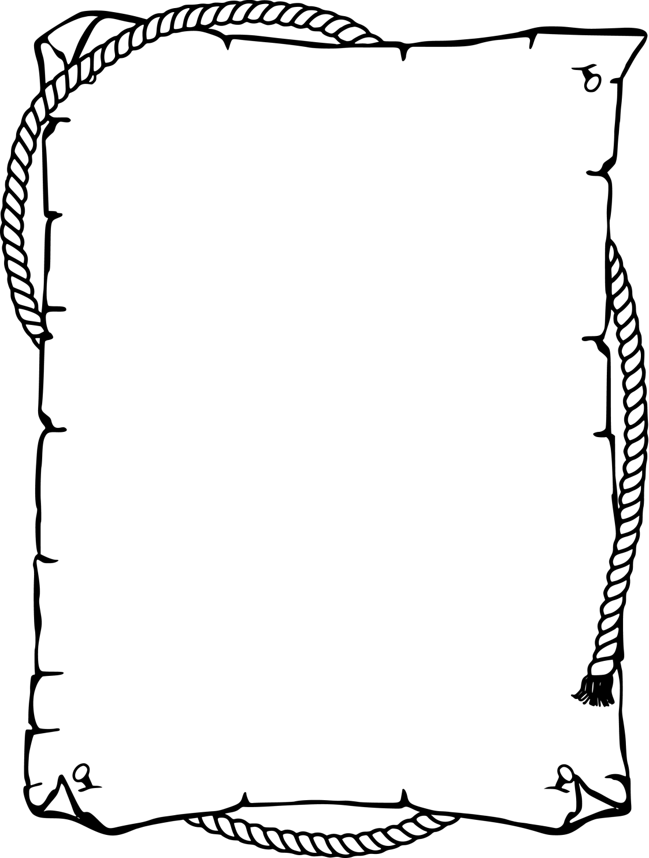

Slide 47
Heb. ‘marah’ used 4x
Gen. 46:2 And God spake unto Israel in the visions of the night, and said, Jacob, Jacob. And he said, Here am I.
Num. 12:6 And he said, Hear now my words: If there be a prophet among you, I the LORD will make myself known unto him in a vision, and will speak unto him in a dream.
1 Sam. 3:15 And Samuel lay until the morning, and opened the doors of the house of the LORD. And Samuel feared to shew Eli the vision.
Isa. 52:14 As many were astonied at thee; his visage was so marred more than any man, and his form more than the sons of men:
Notes:
Mirror
(Exodus 38:8; Job 37:18) The Hebrew women on coming out of Egypt probably brought with them mirrors like those which were used by the Egyptians, and were made of a mixed metal, chiefly copper, wrought with admirable skill, and susceptible of a bright lustre. (1 Chronicles 13:12)
Smith’s Bible Dict.

Slide 48
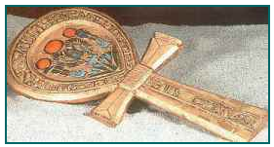
Heb. ‘marah’ used in Ezekiel
Ezk.1:1 Now it came to pass in the thirtieth year, in the fourth month, in the fifth day of the month, as I was among the captives by the river of Chebar, that the heavens were opened, and I saw visions of God.
Ezk. 8:3 And he put forth the form of an hand, and took me by a lock of mine head; and the spirit lifted me up between the earth and the heaven, and brought me in the visions of God to Jerusalem, to the door of the inner gate that looketh toward the north; where was the seat of the image of jealousy, which provoketh to jealousy.
Ezk. 40:2 - In the visions of God brought he me into the land of Israel, and set me upon a very high mountain, by which was as the frame of a city on the south.
Ezk. 43:3 And it was according to the appearance of the vision which I saw, even according to the vision that I saw when I came to destroy the city: and the visions were like the vision that I saw by the river Chebar; and I fell upon my face.

Slide 49
Heb. ‘marah’ used in Daniel 4x
Dan. 10:7 And I Daniel alone saw the vision: for the men that were with me saw not the vision; but a great quaking fell upon them, so that they fled to hide themselves.
Dan. 10:8 Therefore I was left alone, and saw this great vision, and there remained no strength in me: for my comeliness was turned in me into corruption, and I retained no strength.
Dan. 10:16 And, behold, one like the similitude of the sons of men touched my lips: then I opened my mouth, and spake, and said unto him that stood before me, O my lord, by the vision my sorrows are turned upon me, and I have retained no strength.

Slide 50
Group identity versus individual identity in Christ
As we learn the truth of that vital principle of God- manifestation we come to realize that we will only shine with the light of the love of God as we merge our identity into those who are trying to do the same. For we are being washed by the water of God's word to be presented unto Christ as a bride cleansed and adorned for her husband. (Eph. 5:25-27)

Slide 51
“Elovisions” of the Future
Creating “Super-Visionaries” (“Seers”)
“Elo-visioning” requires freeing the “right side” of the brain from pre-conceived ideas, false assmpt
Visual images of scripture are designed with an objective to help the imager recall
“A Picture worth a thousand words”

Slide 52
“Elovisions” of the Future
Build a “graphic image library” or “memory storage warehouse” within the mind from which we access images, events, symbols, etc later on
Imagination can go either way…into ‘fantasy feelings’ or into ‘futureality’
(ESV) “Where there is no prophetic vision the people cast off restraint, but blessed is he who keeps the law.” (Pro. 29:18)

Slide 53
Seeing “Reflections” of the Future that God Himself Sees and Reveals to Us
seer
Spiritually Envisioning Eternal Realities

Slide 54
Class Objectives
The purpose of a kingdom of heaven on earth
  Place – Identifying the geographical space
  Time – Identifying the chronological increment
  Government – Id the form of rule/rulers
  Power – Id the source of power of control
  Life during the kingdom for subjects
  Man in harmony with nature
  Changes in geology, topography, geography

Slide 55
God’s Purpose for the Kingdom
To transition the present earth and inhabitants from the bondage of corruption into the glorious liberty of the Sons of God
Rom 8:18 For I reckon that the sufferings of this present time are not worthy to be compared with the glory which shall be revealed in us.
19 For the earnest expectation of the creature waiteth for the manifestation of the sons of God.
20 For the creature was made subject to vanity, not willingly, but by reason of him who hath subjected the same in hope,
21 Because the creature itself also shall be delivered from the bondage of corruption into the glorious liberty of the children of God.
22 For we know that the whole creation groaneth and travaileth in pain together until now.

Slide 56
End

Slide 57
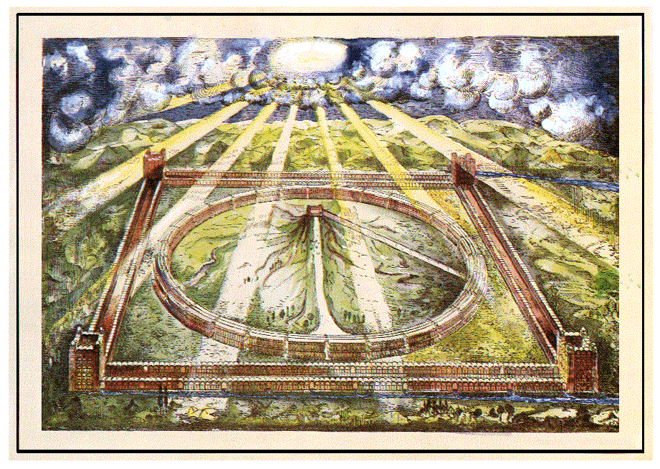

Slide 58
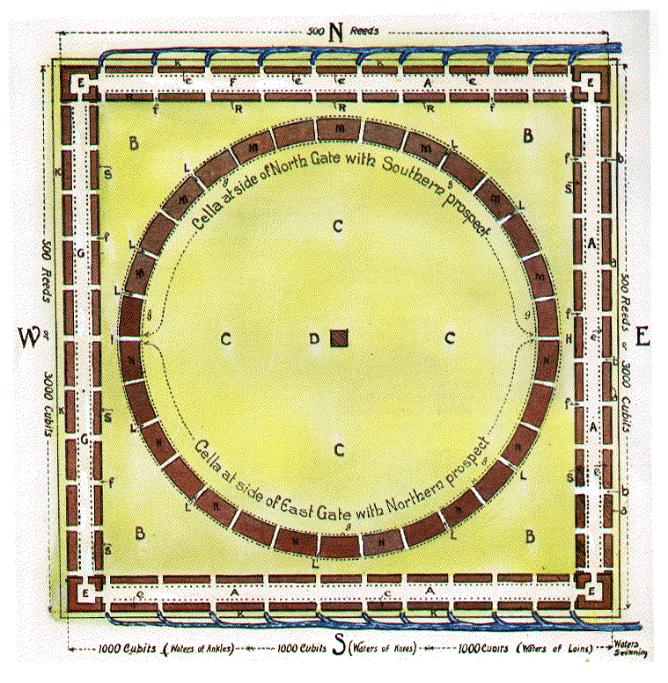
Block Plan of the Sanctuary
Plate III.
HALF PLAN SHOWING DETAILS.
A A A—Outer court 100 cubits wide.
a a a—Wall 6 cubits high and 6 cubits broad round about the Sanctuary
b b b—Outer gate towards the East. Similar gates are on the North, South and West sides.
c c c—Posts of the gates.
d d d—Posts of the court round about.
e e e—Chambers and pavement of the outer court.
f f f—Gate to inner court.
aaa
M
M
M
b
M
M
M
M
N
N
b
N
N
b
N
N
N
N

Slide 59
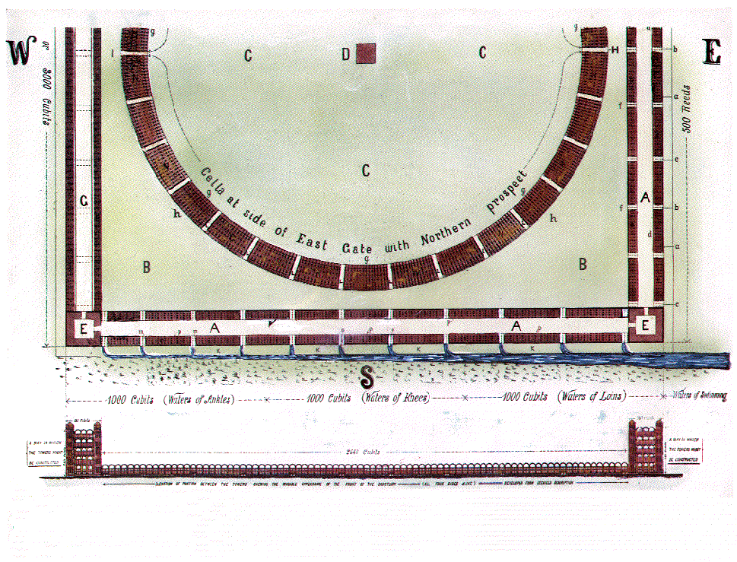
Plate III.
HALF PLAN SHOWING DETAILS.
A A A—Outer court 200 feet wide.
a a a—Wall 6 cubits high and 6 cubits broad round about the Sanctuary
b b b—Outer gate towards the East. Similar gates are on the North, South and West sides.
c c c—Posts of the gates.
d d d—Posts of the court round about.
e e e—Chambers and pavement of the outer court.
f f f—Gate to inner court.

Slide 61
Josiah reigned .. .. .. 31 years
Josiah kept a jubilee passover in his
eighteenth year .. .. 18 ,,
Josiah reigned after the jubilee .. 13 years
Jehoahaz reigned .. . . .. 3 months
Jehoiakim reigned . . .. .. 11 „
Jehoiakin reigned .. .. .. 3 „
Zedekiah reigned (to the smiting
of the city) 11 ,,
Ezekiel received the vision 14 years
later 14 „
Total period since last jubilee 49 years 6 months
Intervals ,, ,, ,, 6 “
50 „ 0 “

Slide 62
D
C
B B B—Portion of inner court “cut off” by the circular range of cellæ and therefore called the “separate place,” i.e. the cut off portion of the inner court.
C C C—Portion of the inner court called the “Most Holy,”
D—Altar and Court before “the House.”
E E E—“Corner Courts,” i.e., Cooking Courts
F—Portion of outer court showing upper cellæ.
G G G—Western side.
K K K—Profane, or void place of the Sanctuary, 50 cubits wide.
C
B
E
K
K
K

Slide 63
Block Plan of the Sanctuary
M M MTHE TEMPLE: A chamber (cella) having its prospect Southward M M M.
N N NTHE TEMPLE: A chamber (cella) having its prospect Northward N N N. See plate II for letter M.
L L L—Twenty cubits space between the cellæ of the Temple dividing it into 30 orders.
H—Separate place towards the East-100 cubits
g g g—Porch on inner side of Temple.
h h h—Porch on outer side of Temple.
L
M
M
M
M
b
L
M
M
M
M
M
L
H
N
N
b
N
N
L
N
b
N
N
N
N
N
L

Slide 65
I—Separate place towards the West—100 cubits.
R R R—Cella flanking the inner court “over against” separate place and “before” the building (e e e) towards the North, entered from the Outer Court. See plate II. for the position of this building.
S S S—Cella flanking the inner court on the cast and west, corresponding with those on the north and south.
m m m—Fence before cella, 50 cubits long.
p p p—Porches of the Court.
Psa 19:1 To the chief Musician, A Psalm of David. The heavens declare the glory of God; and the firmament sheweth his handywork.
Psa 19:2 Day unto day uttereth speech, and night unto night sheweth knowledge.
Psa 19:3 There is no speech nor language, where their voice is not heard.
Psa 19:4 Their line is gone out through all the earth, and their words to the end of the world. In them hath he set a tabernacle for the sun,
Psa 19:5 Which is as a bridegroom coming out of his chamber, and rejoiceth as a strong man to run a race.
Psa 19:6 His going forth is from the end of the heaven, and his circuit unto the ends of it: and there is nothing hid from the heat thereof.

Slide 66
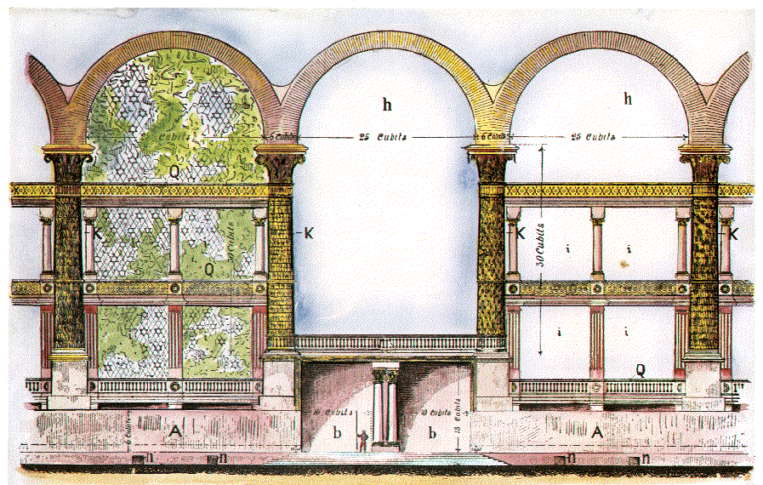

Slide 67
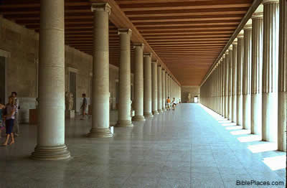
The stoa of Attalos was originally built along the Athenian Agora in 150 BCE. It functioned as a commercial center and a shelter for wealthy and influential Athenians. The photograph below is of the lower level of a modern reconstruction of this ancient structure. The stoa of Attalos consisted of two stories with a Doric colonnade on the ground floor, and an Ionic upper colonnade with a balustrade. On both levels, there exist rooms behind the colonnades. The stoas in Herod's Temple no doubt resembled the stoa of Attalos in many respects.

Slide 68
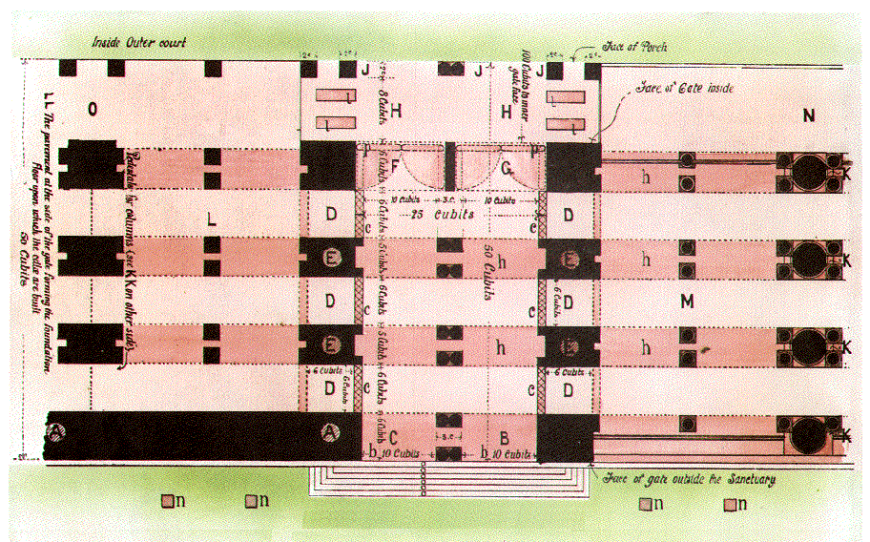
Plan of the Gate

Slide 69
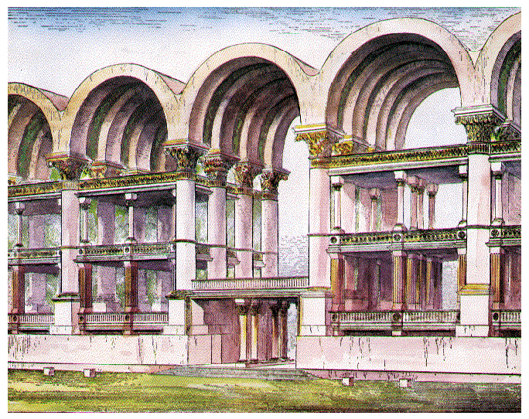
Perspective drawing of the Gate

Slide 70
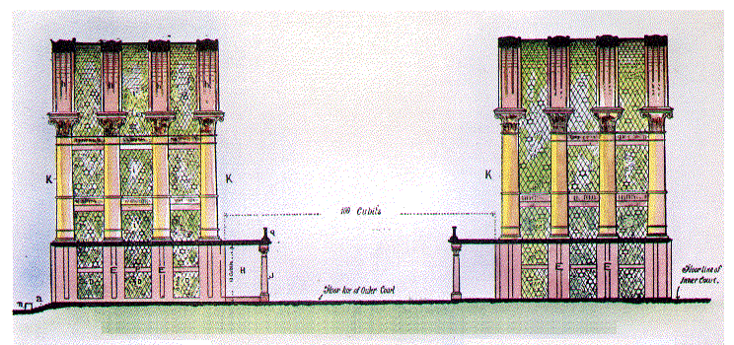
Court yard
200 feet
Floor line of Outer Court

Slide 71
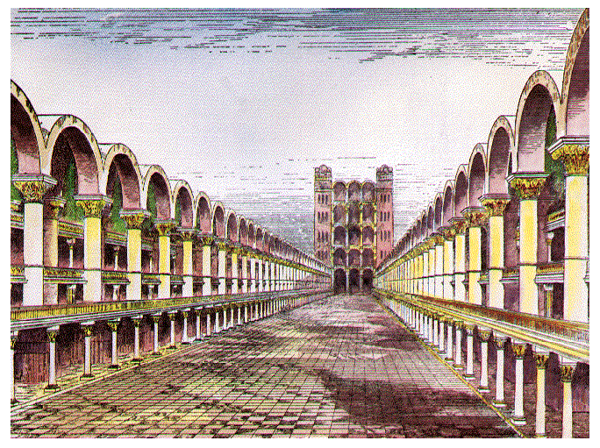
AAA-Outer court – 200 feet wide
200’ (100 cb.)

Slide 72
In The Christadelphian, June 1923, Bro. Sulley wrote: "...I may add that years ago, Dr. Thomas wrote an article showing that the Temple of Ezekiel's prophecy would be a very large building. Also one of my great privileges was to have on loan one of Dr. Thomas' old Bibles in which passages were carefully
marked. In the margin of the 40th chapter of Ezekiel he had noted the measure of the building as so many reeds, turning it into English feet: 500 reeds, not cubits."
Bro. Thomas is quoted in The Christadelphian, 1890, page 402 as stating: "The third temple which Jesus will erect on Moriah will be more magnificent than any building which has yet adorned 'the city of the Great King.' It will be renowned throughout all the earth, and will be frequented as the House of Prayer for all nations who shall flow into it."

Slide 73
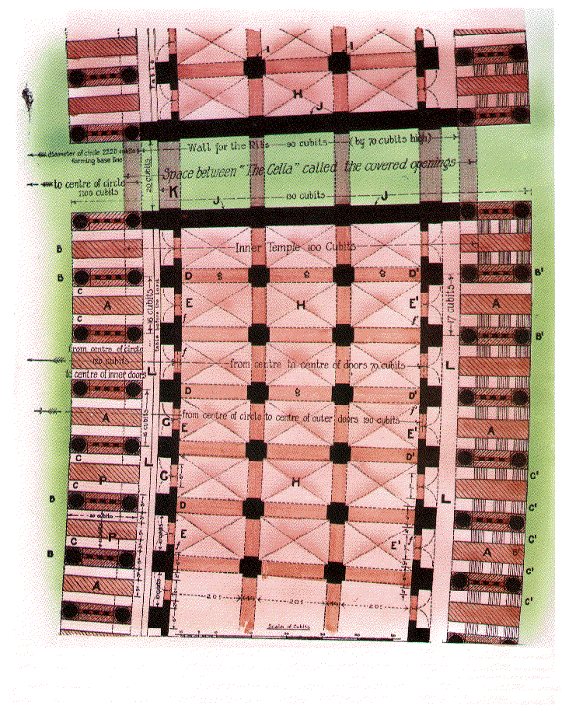

Slide 74
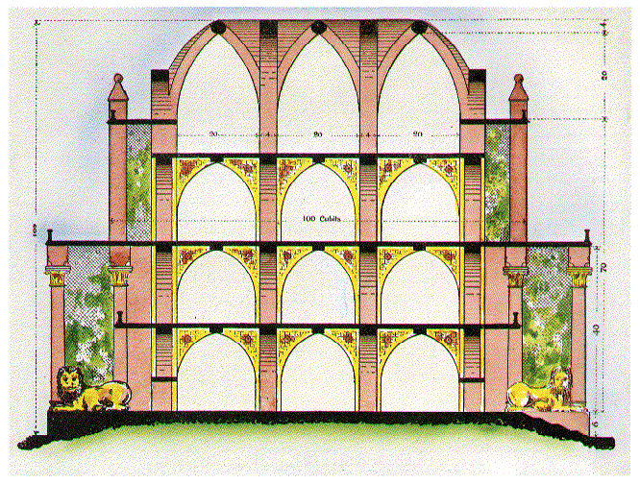

Slide 75
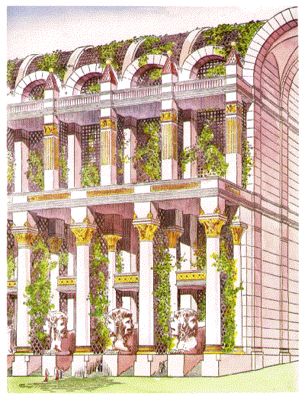

Slide 77
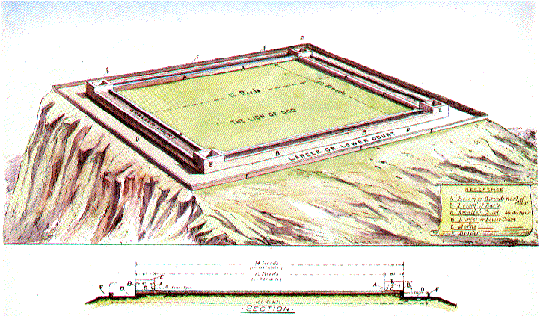

Slide 78
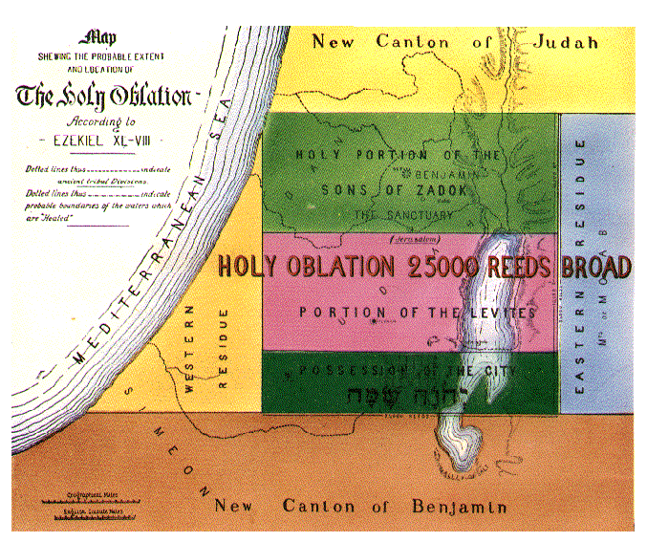

Slide 79
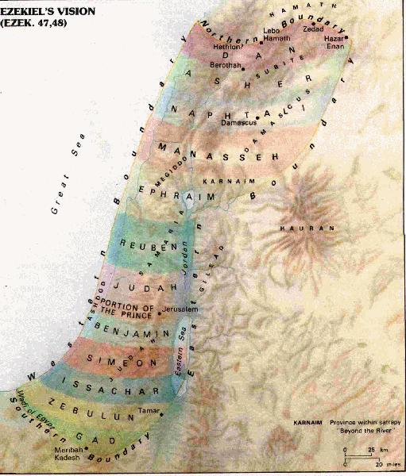

Slide 81
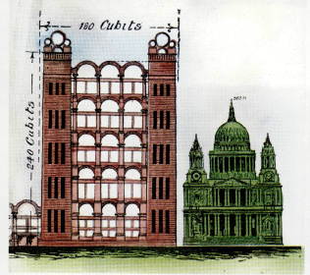
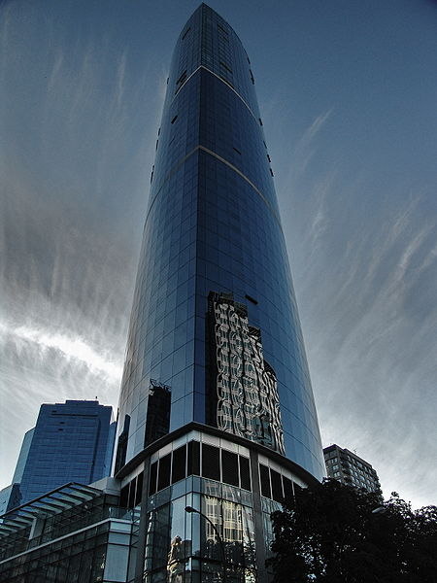
One Wall Centre- (Sheraton Wall Centre – N. Tower, the second-tallest building in Vancouver, British Columbia, Canada. 48 storeys; 491 ft., 150 m. Req’d a 75’ deep excavation; Only 11’ taller than the Corner Towers of the House of Prayer
360 ft.
480 ft.

Slide 82
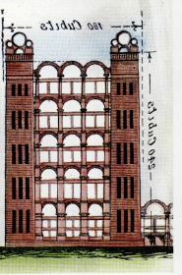
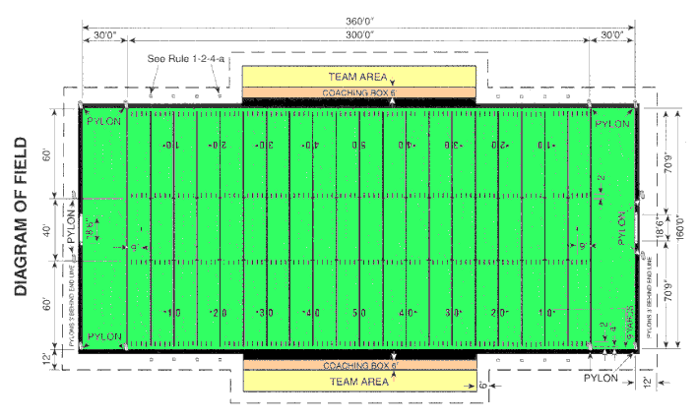
360 ft.
480 ft.
Football field Goal to Goal = 360’

