Slide 1
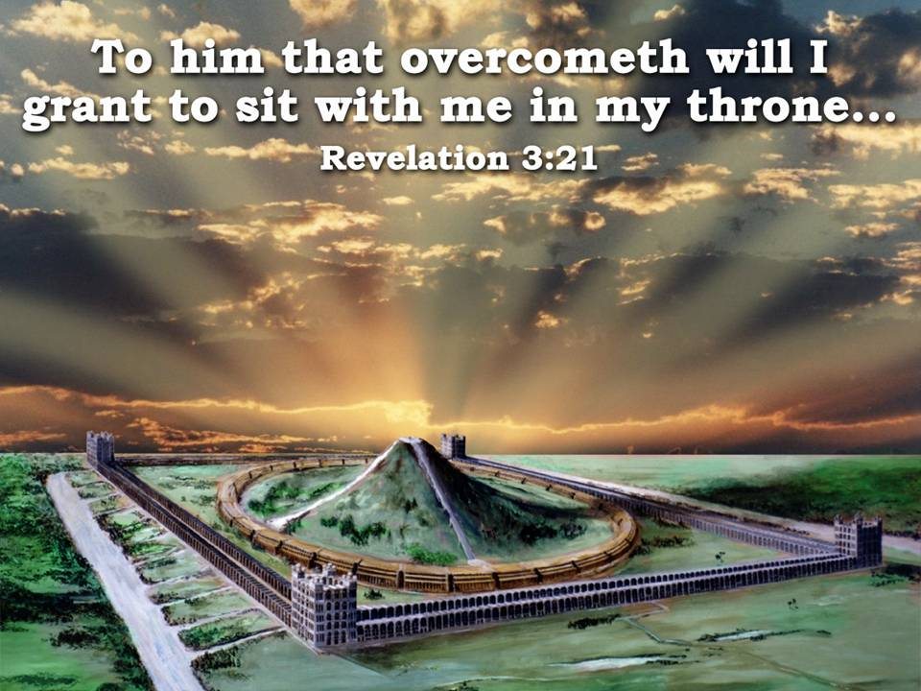
Class 2 – “Thy Gates Shall Be Open Continually”

Slide 2
We were introduced to Ezekiel’s “visions of God”; eg. Land, mountain, city & the “man of brass”
Thru significance of ‘brass’, laver and mirrors we saw the importance of keeping the vision of the Kingdom in our minds all the time
The part that a “concrete” image of the actual IHOP plays in our vision as a tangible and substantial “FRAME OF SPIRITUAL REFERENCE” to all other eternal principles of the Word (we build it in a ‘carnal’ place of our mind’s imagination through the 3D study of IHOP)
Recognizing the crucial difference in the “natural” and the “spiritual”, the literal and the symbolical or figurative
We examined the future LAND and saw the divisions of the HOLY OBLATION, Sanctuary and city of YHWH Shammah

Slide 3
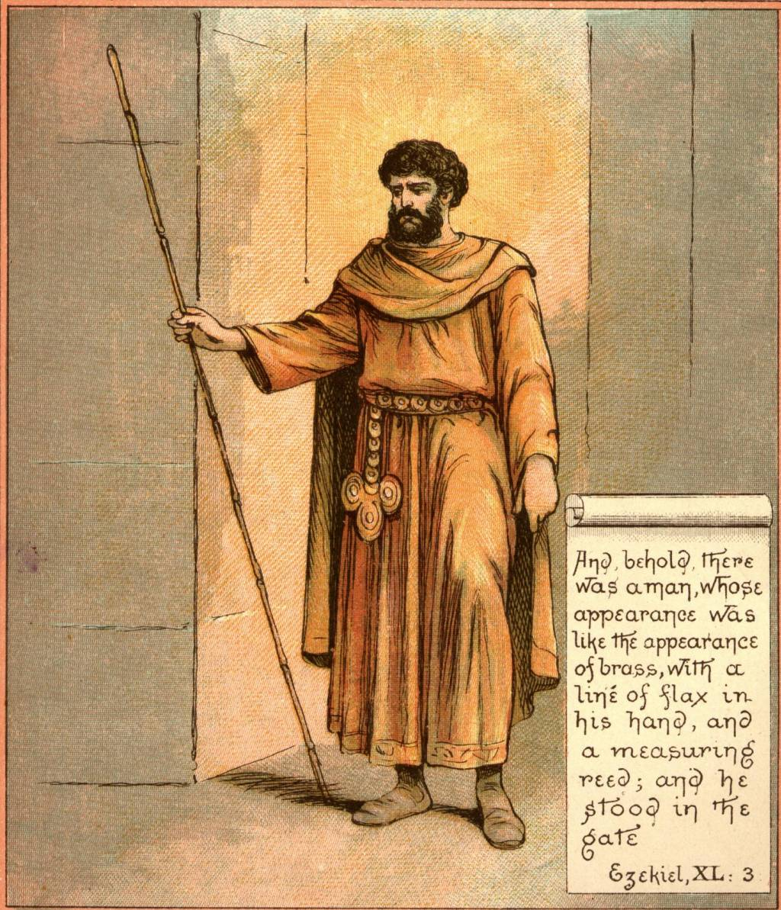
Review
Spiritually, the REED must speak of the rulership and overall control by Christ, acknowledged mockingly by Herod’s soldiers.
Mat 27:27 Then the soldiers of the governor took Jesus into the common hall, and gathered unto him the whole band of soldiers.
28 And they stripped him, and put on him a scarlet robe.
29 And when they had platted a crown of thorns, they put it upon his head, and a reed in his right hand: and they bowed the knee before him, and mocked him, saying, Hail, King of the Jews!

Slide 4
Group identity versus individual identity in Christ
As we learn the truth of that vital principle of God- manifestation we come to realize that we will only shine with the light of the love of God as we merge our identity into those who are trying to do the same. For we are being washed by the water of God's word to be presented unto Christ as a bride cleansed and adorned for her husband. (Eph. 5:25-27)

Slide 5
Eze 40:6 - “Then came he unto the gate which looketh toward the east…”
EAST

Slide 6
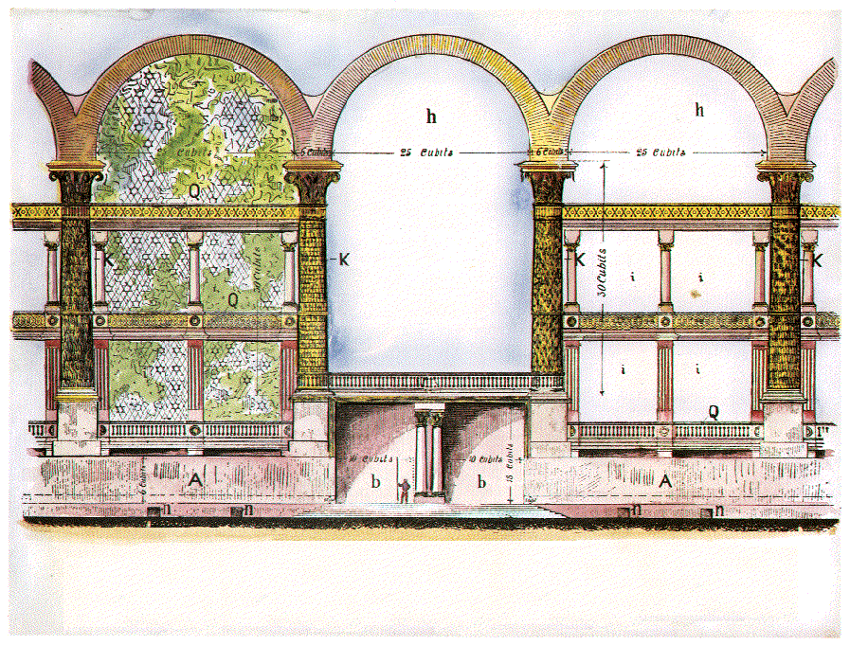
The Eastern Gate and Several “Paired” Gates of the Outer Court Buildings
The Gates of the Inner Court “Circular” Building
Why the lack of GATES leading to the MOST HOLY?
The spiritual significance of the Gates

Slide 7
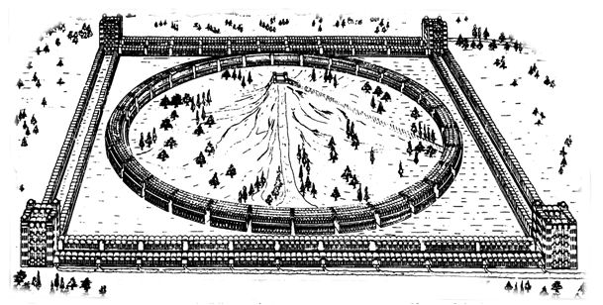
CORNER COURTS
LEVITES LIVE IN UPPER STORIES
(DURING TERM OF SERVICE). HUGE
KITCHENS BOIL SACRIFICES TO
FEED WORSHIPPERS. CHIMNEYS ON
OUTER FACE TOTAL AREA 360 SQ.FT.
42 TIMES AREA OF WASHINGTON
MONUMENT. EZK46:22-24.
PG 170, 175, 73 [82, 83, 30]
GATES.
APPARENTLY 11 ON EA. WALL
FOR ENTERING IN-GOING FORTH
EZK. 40:18 PG. 75,77 [30, 32]
PREPARATION TABLES
FURTHER PREPARATION OF SACRIFICES. 4 PER INNER GATE OF OUTER COURT. EZK. 40:39. PG. 69, 163 [27, 78-78]
THE ALTAR
SACRIFICES CONSUMED BY FIRE FROM HEAVEN. 12 REEDS SQ.(50 YDS. SQ.) EZK. 43:13, 2 CHR. 7:1, LEV. 9:24; JUD. 6:21; 2 KG. 18:23; 1CHR. 21:26; HEB. 9:8
(PG. 127) [58-59]
MOST HOLY
HERE THE GLORY OF THE OLAHM
IS HID FROM MORTAL EYES BY
TENT OF CLOUD. ISA. 4:5, ISA. 40:22; HEAVENS AS TENT OF
HOLY. PG. 185 [91-92]
SLAYING BLOCKS
ON NORTH ONLY.4 PER GATE SACRIFICE SLAIN. FIRST- FRUITS ON SOUTH -EZK. 40:40 PG. 163 [78]
SEPARATE PLACES
WORSHIPPERS PASS THROUGH-IN
TRANSIT. ASSEMBLE FOR WORSHIP
EZK.41:13.PG.111, 122 [50,56]
THRONES OF JUDGEMENT
IN INNER RECESSES OF INNER
TEMPLE. BETWEEN CHERUBIM
FROM WHENCE OFFERINGS CON-
VEYED TO ALTAR 389 THRONES
AT LEAST. PS. 122:4-6, ISA. 62:9
PG. 174 [69, 71]
ACCESS TO ALTAR
cp. TABERNACLE-NO NAKEDNESS
IN MOST HOLY TO DISCLOSE.
HENCE STEPS. EZK. 43:17
PG. 132 (60)
THE MOUNTAIN EZK. 43:12,13.PG 94, 118 [40, 52]
OUTER COURT
200’ PLAZA BETWEEN THE OUTER RANGE OF GATE BUILDINGS ON ALL SIDES (EZK. 43:4, 44:2, 46:1,2,6; SONG 5:1
DINING HALLS
UPPER GALLERIES OF OUTER
COURTS OF WEST, NORTH, SOUTH.
HALF A MILLION PER SITTING.
2,864 DINING HALLS, ~
LARGER THAN BANQUET HALLS~
ISA 25:6 -PG. 170 [82]
TABLE BEFORE YAHWEH
TIMBER ENCLOSED CONVEYOR
FOR FAT AND BLOOD ON GOLDEN
FLOATS. EZK. 41:22 PG. 134[62]
GEHENNA
OUTSIDE WEST-WALL REFUSE OF
SACRIFICES. SINNERS BURNT. OLD
GEHENNA NOW INSIDE INNER
TEMPLE ~ 65:20; 66:23,24,
EZK. 43:21, JER.31:40. PG. 168 [81]
PRINCE’S PALACE
WHOLE EASTERN OUTER COURT
SAINTS SUP ANEW WITH CHRIST
EZK. 43:4, 44:2, 46:1,2,6
SONG 5:1. PG. 173, [84,88]
CHAMBERS OF SINGERS
WHOLE CIRCLE CONTAINS THEM-
NORTHERN HALF, SONS OF ZADOK
KEEP ALTAR. SOUTHERN HALF,
LEVITES KEEP HOUSE, i.e.
IMMORTAL & MORTAL PRIESTS.
EZK. 40:44. PG. 93,151 [40, 72]
LEVITE DUTIES
OFFICIATE & DINE IN INNER
RANGE OF OUTER BUILDINGS ON
NORTH & SOUTH, EAT MOST HOLY THINGS. 444 DINING HALLS
CHANGE GARMENTS HERE.
EZK.44:17, 42:12, PG.164 [79]
STORE HOUSES
SOUTHERN OUTER COURT
WORSHIPPERS ENTER SOUTH WITH FIRSTFRUITS. EZK. 44:30;
MAL. 3:4. PG. 69, 164 [27, 70]
COVERED OPENINGS
SPACE FOR ROOTS OF FOLIAGE
WHICH COVERS INNER TEMPLE.
EZK. 41:15-17; ISA.4:6; ISA.
60:13, PS.67:6-7 PG. 140,146 [66, 69]
LIFTS
3 LIFT CHAMBERS, EA SIDE OF
EACH GATE. “THOU SHALT NOT
GO UP TO MY ALTAR BY STEPS”
EX.20:26. PG. 51, 171 [16, 82]
TWO STREAMS OE WATER
WATERS FROM ALTAR FLOW FROM
UNDER NORTHERN GATES-THEN
EAST, NORTHWEST TO MEDIT. UNDER
SOUTH GATES, THEN EAST TO HEAL
INLAND LAKE. EZK. 47:1, 9;
PS. 46:4; ZECH. 14:8. PG. 302 [152]
TREES FOR MEDICINE
ON RIVER BANKS, LEAVES SHALL
NOT FADE; FOR MEDICINE. FRUIT
FOR MEAT. EZK 47:12, REV. 22:2
PG. 168 [68, 92]
READ “THE TEMPLE OF EZEKIEL'S
PROPHECY” HENRY SULLEY.
PG. NUMBERS of the 6th ed. From the Christadelphian Office and Logos Publ.

Slide 8
Psa 24:7 Lift up your heads, O ye gates; and be ye lift up, ye everlasting doors; and the King of glory shall come in.
v8 - Who is this King of glory? The LORD strong and mighty, the LORD mighty in battle.
v9 - Lift up your heads, O ye gates; even lift them up, ye everlasting doors; and the King of glory shall come in.
V10 - Who is this King of glory? The LORD of hosts, he is the King of glory. Selah.

Slide 9
Ch. 40 -The Square Outer Temple Buildings
V. 5 ………. The Foundation Wall – (next slide)
Vv. 6-16 .. The Gates
Vv. 17-22 Outer Courts
Vv. 23-37 Inner Court Gates
Vv. 38-43 Inner Court Cellae
Vv. 44-47 Two Hemispheres
Vv. 48 to ch. 41:3...The Porches

Slide 10
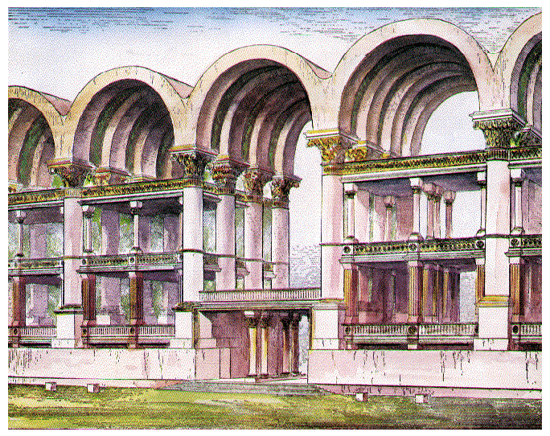
4 And the man said unto me, Son of man, behold with thine eyes, and hear with thine ears, and set thine heart upon all that I shall shew thee; for to the intent that I might shew them unto thee art thou brought hither: declare all that thou seest to the house of Israel.
5 And behold a wall on the outside of the house round about, and in the man's hand a measuring reed of six cubits long by the cubit and an hand breadth: so he measured the breadth of the building (WALL), one reed; and the height, one reed.
"WALL"... .ON the outside of the house, round" about
"REED" = six long cubits, (a cubit + a span) - about 12 feet
“So he measures the cross-section of the wall.”
It’s length is not given here.
*The length of the wall is given in Ezek. 42:20.
1 Reed
1 Reed
12’ x 12’

Slide 11
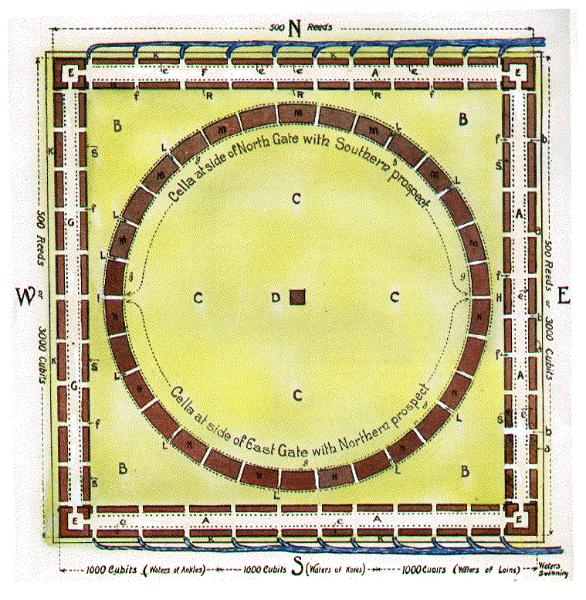
GATE PAIRS
GATES or
GATE BUILDINGS
APPARENTLY 11 ON EA. WALL
FOR ENTERING IN-GOING FORTH
EZK. 40:18
PG. 75,77

Slide 12
The word " gate " is used as a noun of multitude, a method of description frequently adopted throughout the vision where recurring features are mentioned, as already explained in the last section. "
The gate that looks toward the east' therefore, means either any or all of the gate openings on the eastern side, whatever their number, and instead of one gate only to a side, it is inferred that there are many.

Slide 13
Eze 40:6 - “…and went up the stairs thereof, and measured the threshold of the gate, which was one reed broad; and the other threshold of the gate, which was one reed broad.
Eze 40:6 Then came he unto the gate which looketh toward the east, and went up the stairs thereof, and measured the threshold of the gate, which was one reed broad; and the other threshold of the gate, which was one reed broad.
EAST

Slide 14
Eze 40:6 - “…and went up the stairs thereof, and measured the threshold of the gate, which was one reed broad; and the other threshold of the gate, which was one reed broad.

Slide 15
Isa 60:10 And the sons of strangers shall build up thy walls, and their kings shall minister unto thee: for in my wrath I smote thee, but in my favour have I had mercy on thee.
Isa 60:11 Therefore thy gates shall be open continually; they shall not be shut day nor night; that men may bring unto thee the forces of the Gentiles, and that their kings may be brought.
Isa 60:12 For the nation and kingdom that will not serve thee shall perish; yea, those nations shall be utterly wasted.

Slide 16
Gates Outer and Inner
40:6-16 – Outer East Gate sets the pattern for all others – (see vv. 21-22 “after the measure…”
40:17-19 – Describes 3 sides of outer court w/chambers (cellae)
40:20-23 – Outer North Gate
40:24-27 – Outer South Gate
40:28-31 – Inner South Gate
40:32-34 – Inner East Gate
40:35-43 – Inner North Gate
40:44- 47 – Two Hemispheres

Slide 17
40:6-16 – Outer East Gate

Slide 18
40:17-19 – Describes 3 sides of outer court

Slide 19
40:20-23 – Outer North Gate

Slide 20
40:24-27 – Outer South Gate

Slide 21
40:28-31 – Inner South Gate
The Prophet now crosses over & looks at the INNER gates across the courtyard.
(c) Ezekiel 40 - 28 to 31 : The SOUTH INNER gate.

Slide 22
40:32-34 – Inner East Gate

Slide 23
40:35-43 – Inner North Gate

Slide 24
VERSE 32
"Inner court gate toward the east" — Described in vv. 32-34, the same as the inner court gate on the south (see notes v. 28).
V 33-"Little chambers, posts, arches, windows" — These are identical to those in the outer court gates (see notes vv. 7, 14,16).
V 34 -"Arches, palm trees" — For arches, see v. 33; for palm trees, see v. 16.
V. 35 -"Inner court gate on the north" — Described in vv. 35-37. The same dimensions as the inner court gate on the south. See note v. 28, plate 2,"f'.
V. 36 -"Little chambers, posts, arches, windows" — See note v. 33.
V. 37 - "Posts, palm trees, eight steps" — For posts, see v. 14; for palm trees, see v. 16; for the eight steps, see v. 31.

Slide 25
Plate 4 – Elevation of Gate
50’/15.24m
120’/36.5m
60’/18.2m
20’/6m
26’/8m
Probable Elevation of Gate and Upper CellÆ.
A.A.—Wall, 6 cubits broad and 6 cubits high.
K.K.—Posts, or Palm Trees.
Q.—Parapet to Galleries.—[Deut. 22:8.]
h.h.—Arches 25 cubits long by 5 cubits wide.
i.i.—Arabesques.
n.n.—Slaying Blocks outside the Sanctuary.
b.b.—Entry of Gate, 10 cubits wide, 13 cubits high.

Slide 26
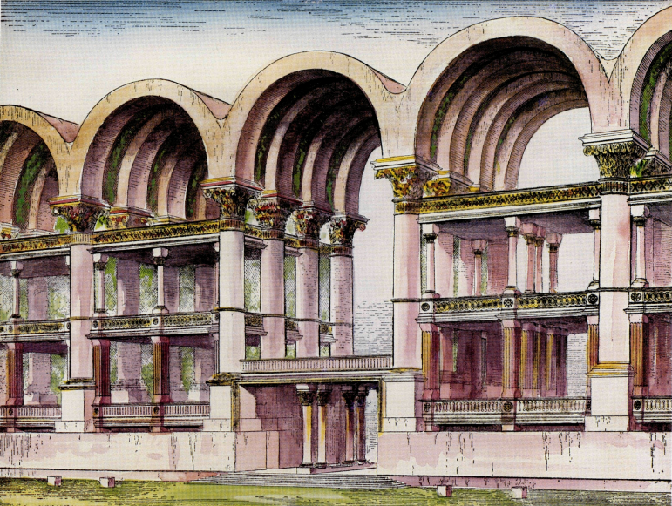
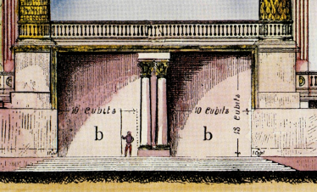
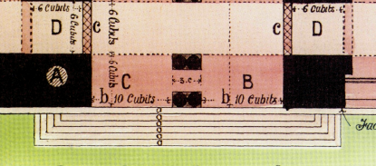
Ezek. 40:6-16 – Outer East Gate sets the pattern for all
Eze 40:6 Then came he unto the gate which looketh toward the east, and went up the stairs thereof, and measured the threshold of the gate, which was one reed broad; and the other threshold of the gate, which was one reed broad.
Eze 40:6 Then came he unto the gate which looketh toward the east, and went up the stairs thereof, and measured the threshold of the gate, which was one reed broad; and the other threshold of the gate, which was one reed broad.
60’(30c)
6cu.
6cu.
20’(10cu)
20’(10cu)
threshold of the gate, which was one reed broad (DEEP);
“…and the other threshold of the gate, which was one reed broad.(DEEP)”
26’(13c;8m)
(12’/3.6m)

Slide 27
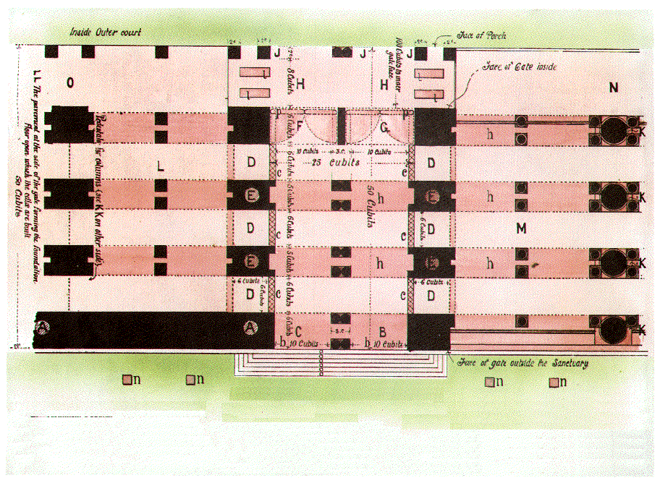
Plate 5 - Plan of Gate and Portion of CellÆ
50c/100’/30.48m
25c/50’/15.24m
7 Steps
A.A.—Wall, 6 cu (12’/3.6m) broad and 6 cu high.
B.—Threshold, 6 cu.
C.—The other Threshold, 6 cu
D.D.—“Little Chambers,” 6 cu square.
E.E.—The post between “The Little Chambers.”
F.—Threshold by Proch of Gate within, 1 rd (12’/3.6m) .
G.—Porch of Gate within, 1 reed.
H.—Porch of Gate inside the outer Court.
J.J.—Posts of this Porch, 2 cubits.
K.K.—Posts, or Palm Trees.
L.—Cellæ on lower pavement of Court.
M.—Cellæ on upper pavement.
N.—Gallery in continuation of Porch.
O.—Lower Colonnade or “Walk” in continuation of Porch.
a.a.—Seven Steps to the Gate.
b.b.—Entry of Gate, 10 cu wide, 13 cu high.
c.c.—Boundary before “The Little Chambers,” 1 cu thick.
h.h.—Arches, 25 cubits long by 5 cubits wide.
n.n.—Slaying Blocks outside the Sanctuary.
l.l.—Flaying and Washing Tables in Porch.
p.p.Folding Doors.

Slide 28
Plate 6 - Perspective View of Gate and Cellæ

Slide 29
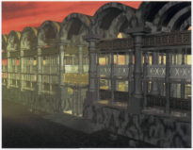
When the people of the land shall come before the Lord in the solemn feasts, he that entereth in by the way of the north gate to worship shall go out by the way of the south gate ; and he that entereth by the way of the south gate shall go forth by the way of the north gate : he shall not return by the way of the grate whereby he came in, but shall go forth over against it. (Ezek. 46:9).

Slide 30
11 gates on each side
those to the north with their sacrificial accessories
Those to the south, for the bringing in of "the offerings of the people.” (ToEP, p )

Slide 31
Eze 44:30 And the first of all the firstfruits of all things, and every oblation of all, of every sort of your oblations, shall be the priest's: ye shall also give unto the priest the first of your dough, that he may cause the blessing to rest in thine house. (Ezek. 44:30)
“He brought me to the north gate . . . . And the chambers (singular in Hebrew) and the entry thereof is by the posts of THE GATES (plural) where they washed the burnt offering.
(Ezek. 40:35, 38)

Slide 32
Christ Suffered Without The Gate
These slaughter blocks for the Burnt Offering outside the temple on the northern side speak of Christ's sacrifice "without the camp" (Heb 13:12-13), at Golgotha, outside the city of Jerusalem on the northern side. Paul alludes to this, stating " Jesus also... suffered without the gate. Let us go forth therefore unto him without the camp, bearing his reproach." The gateway outside of which Jesus was slain was the Damascus Gate nearby the hill of Golgotha.
Slaughter Blocks

Slide 33
Heb 13:12 Wherefore Jesus also, that he might sanctify the people with his own blood, suffered without the gate.
13 Let us go forth therefore unto him without the camp, bearing his reproach.
14 For here have we no continuing city, but we seek one to come.
15 By him therefore let us offer the sacrifice of praise to God continually, that is, the fruit of our lips giving thanks to his name.

Slide 34
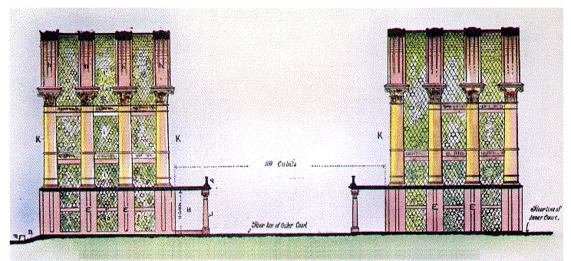
Plate 7 - Tranverse Section through the Outer Court Showing Galleries on either Side. (Pg 8)
100c
200’/30.4m
h
h
h
h
120’/36.5m
K
K
K
K
80’/24.3m
E
E
J
E
E
a
D
D
D
a.—Seven steps to Gate.
DD.—“Little chambers” of Gate.
EE.—Post “between little chambers.”
H.—Porch of gate within.
J.—Posts of Porch of gate within.
h h h.—Arches.
i i i.—Arabesques.
K K.—“Posts” or palm trees.
n.—Slaying Blocks outside the Sanctuary
Q.—Parapet to Galleries(Deut. 12:8).

Slide 35
VERSE 5: The Foundation Wall.
"behold" — Heb. Hinneh; The repetition of these words emphasizes the importance of maintaining a vision of the temple and concentrating upon the future glory of Yahweh's great work.
"A Wall" — Heb. chomah, to "surround; to join." This external wall is the "frame of a city" of verse 2. Its length is given in ch. 42:20, as 500 reeds.
It is the external foundation wall of the temple, for no other wall is described anywhere in the prophecy.

Slide 36
VERSE 5: The Foundation Wall.
"A Wall" —The wall runs right around the four mile square temple building, intersected by gates
It forms the foundation base of much higher buildings of this "frame"
Note the spiritual lessons. Chomah, "wall," is used metaphorically for a maiden as being chaste, difficult to approach, and therefore faithful (Song 8:9-10), and this characteristic of the saints is taught in the temple wall.
The "joining" represents the unity of the saints, and the "surrounding" teaches the safety and security that the saints provide.

Slide 37
Isa 26:1 In that day shall this song be sung in the land of Judah; We have a strong city; salvation will God appoint for walls and bulwarks.
Isa 26:2 Open ye the gates, that the righteous nation which keepeth the truth may enter in.
Isa 26:3 Thou wilt keep him in perfect peace, whose mind is stayed on thee: because he trusteth in thee.
“perfect peace” = shalom shalom’ ;“mind” - yêtser (Hb. 3336
From H3335; a form; figuratively conception (that is, purpose): - frame, thing framed, imagination, mind, work.
“stayed” - sâmak -A primitive root; to prop (literally or figuratively); reflexively to lean upon or take hold of (in a favorable or unfavorable sense): - bear up, establish, (up-) hold, lay, lean, lie hard, put, rest self, set self, stand fast, stay (self), sustain.

Slide 38
CHAPTER 40:44-49; CHAPTER 41; CHAPTER 42:1-14
At Ch. 40:44, Ezekiel is moved from the Outer Court Ranges, and brought to examine the Central Range—the Temple.
He seems to stand on the central "mountain", and looks first to the North (verse 45), and then to the South (verse 46).
He is told that these North quarters are for "the priests, the keepers of the charge of the house", and the South quarters are for "the priests, the keepers of the charge of the altar" — terms which are defined in more detail later (Ch. 44).
Verse 47 relates to Ch. 43:12-17 — the great Altar.

Slide 39
CHAMBERS OF LEVITE SINGERS
IMMORTALS
WHOLE CIRCLE CONTAINS THE NORTHERN HALF, SONS OF ZADOK WHO
KEEP ALTAR.
MORTALS
SOUTHERN HALF,
LEVITES KEEP HOUSE, i.e.
IMMORTAL & MORTAL PRIESTS.
Ezk. 40:44
40:44- 47 – Two Hemispheres
200’ distance in the corners

Slide 40
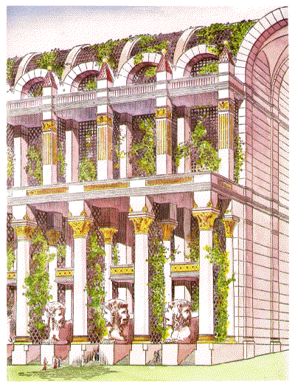
The Spiritual Lesson of the Southern Hemisphere and Eastern Gate
It is significant that Ezekiel's description should associate the southern or bottom hemisphere, with its prospect towards the north, with the eastern gate, for this hemisphere is for the immortal priests who have charge of the altar in the Most Holy (Eze. 40:46), and the eastern side of the outer temple is for Christ and the immortal saints who may be with him at any given time (Eze. 44:2-3; 46:1, 2, 8), where Christ will partake anew with them the bread and wine as he promised (Mat. 26:29; Lk. 22:6). Christ will use this eastern gate (Eze. 46:1, 2, 8), and his immortal saints will exit the eastern side to enter the southern hemisphere for their ministrations there. Hence this lower hemisphere is closely associated with the eastern side. The upper hemisphere on the other hand is for the mortal Levite priests who have charge of the House, and do not minister in the Most Holy (Eze. 40:45).

Slide 41
Temple Cellae
(Ezekiel 40:44-49 ; 41:1-26)
The major part of the specification of the " outward "
part of the sanctuary, i.e., the walls and buildings
constituting the spacious outer court and its adjacent
buildings, ends with the forty-third verse of the fortieth
chapter. Verse forty-four should be the opening verse
of chapter forty-one, of which it really forms part.
Verses 44, 45, 46 of Chapter 40 briefly refer to the
buildings that are in the inner court

Slide 42
CHAPTER 40:44-49; CHAPTER 41; CHAPTER 42:1-14
Then Ezekiel moves to the inner "porch" of the Temple itself (vv. 48-49), and watches while the Temple buildings are measured.
a circular range of 30 buildings, each about 400 hundred and 50 feet in length, 200 hundred and 60 feet in width, 200 hundred feet in height; separated the one from the other by a covered-way 40 feet wide. Thus a continuous range of porticoes is presented to his view, each 34 feet wide on the outside, and 32 feet wide on the inside with steps leading up to a corridor, or porch, 30 feet wide, running the full length of each building, both on the outer and inner sides. Thus the building proper is two hundred feet wide. (260 less 60 — 2 X 30).

Slide 43
Conducted by the angel to the gate which looketh toward the east (verse 6) Ezekiel sees its several features
v6 The entrance thresholds Plate 5. B-C
v7 The chambers of the gate “ D-D-D
v16 The pedestals of the gateway “ E-E-E
v7 The threshold " by the porch “ F
v8 The porch of the gate within the gate G
v9 The porch of the gate within the court H-H

Slide 44
7. The entry of the gate “
8. The boundary of the little chambers”
9. The length and breadth of the gate-building
10. The "palm trees” of the gate.
Plate 4. 5 and 7, K-K
11. The arches Plate 4. 5 and 7, h-h
12. The arabesques or “narrow windows“
of the gate Plates 4, 5 & 7-K-K

Slide 45
Study has convinced the present writer, and may convince the reader, that the understanding of the construction of the gates is of supreme importance to the understanding of the whole structure. This may be gathered from the fact that the bulk of the fortieth chapter is occupied in their descriptions. They are, indeed, the key of the specification. Entering the building with this key, and carefully remembering the injunction of Ezekiel's guide, we may unlock the mystery of the vision.
The gates partake more of the character of ‘gate buildings’ than the structural entrances which we conventionally understand by “gates.” ~H. Sulley,

Slide 46
The GATE - PATTERNS reveal many gates in the square buildings.
(a) Ezek: 40 - 6 to 18 : give the details of the EAST gate.
(note that verse 18 reveals "gates'' (plural) in the same row of building's. Ezekiel is only taken through ONE gate.). "Gates" here refer to any PAIR of gates at either end of any one cellae building, since he is dealing with the cellae pavement (floor) that lies between them.
(The plural "gates" is used again in verse 38 confirming many gates for the NORTH cellae.)
(b) Ezek: 40 - 20 to 23 : The gate pattern for the NORTH gate.
24 to 26 : " " " " " SOUTH "

Slide 47
(4) The GATE - PATTERNS reveal many gates in the square buildings.
The Prophet now crosses over & looks at the INNER gates across the courtyard.
(c) Ezekiel 40 - 28 to 31 : The SOUTH INNER gate.
32 to 34 : The EAST INNER gate
35 to 37 : " NORTH " " .
39 : Ezekiel LOOKS from the north INNER row of cellae and sees the inside of the outer row of buildings, and the tables at the inside porches.
40 : He goes through the out gate on the north and sees the slaughter blocks on either side of the steps as one goes up to enter the temple from the north.

Slide 48
Plate 4 – Elevation of Gate
Probable Elevation of Gate and Upper CellÆ.
A.A.—Wall, 6 cubits broad and 6 cubits high.
K.K.—Posts, or Palm Trees.
Q.—Parapet to Galleries.—[Deut. 22:8.]
h.h.—Arches 25 cubits long by 5 cubits wide.
i.i.—Arabesques.
n.n.—Slaying Blocks outside the Sanctuary.
b.b.—Entry of Gate, 10 cubits wide, 13 cubits high.

Slide 49
Plate 5 - Plan of Gate and Portion of CellÆ
a.a.—Seven Steps to the Gate.
b.b.—Entry of Gate, 10 cubits wide, 13 cubits high.
c.c.—Boundary before “The Little Chambers,” 1 cubit thick.
h.h.—Arches, 25 cubits long by 5 cubits wide.
n.n.—Slaying Blocks outside the Sanctuary.
l.l.—Flaying and Washing Tables in Porch.
p.p.Folding Doors.
A.A.—Wall, 6 cubits broad and 6 cubits high.
B.—Threshold, 6 cubits.
C.—The other Threshold, 6 cubits.
D.D.—“Little Chambers,” 6 cubits square.
E.E.—The post between “The Little Chambers.”
F.—Threshold by Proch of Gate within, 1 reed.
G.—Porch of Gate within, 1 reed.
H.—Porch of Gate inside the outer Court.
J.J.—Posts of this Porch, 2 cubits.
K.K.—Posts, or Palm Trees.
L.—Cellæ on lower pavement of Court.
M.—Cellæ on upper pavement.
N.—Gallery in continuation of Porch.
O.—Lower Colonnade or “Walk” in continuation of Porch.

Slide 50
Plate 6 - Perspective View of Gate and Cellæ

Slide 51
Plate 7 - Tranverse Section through the Outer Court Showing Galleries on either Side.
a.—Seven steps to Gate.
DD.—“Little chambers” of Gate.
EE.—Post “between little chambers.”
H.—Porch of gate within.
J.—Posts of Porch of gate within.
h h h.—Arches.
i i i.—Arabesques.
K K.—“Posts” or palm trees.
n.—Slaying Blocks outside the Sanctuary
Q.—Parapet to Galleries(Deut. 12:8).

Slide 52
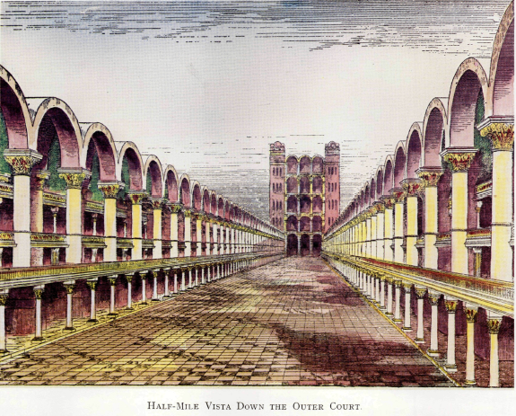
Plate 8 - Half-Mile Vista Down Outer Court

Slide 53
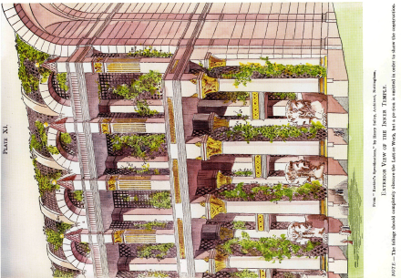
Plate 11 - Exterior View of the Inner Temple
a circular range of 30 buildings, each about 400 hundred and 50 feet in length, 200 hundred and 60 feet in width, 200 hundred feet in height; separated the one from the other by a covered-way 40 feet wide. Thus a continuous range of porticoes is presented to his view, each 34 feet wide on the outside, and 32 feet wide on the inside with steps leading up to a corridor, or porch, 30 feet wide, running the full length of each building, both on the outer and inner sides. Thus the building proper is two hundred feet wide. (260 less 60 — 2 X 30).

Slide 54
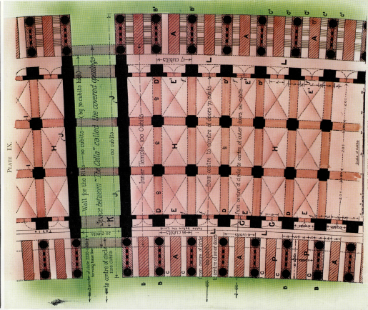
Plate 9 - Plan of "The Temple"

Slide 55
The Most Holy, therefore, is shown as an open area inside the Temple, not square in form but like a mountain with buildings "round about."
The MOST HOLY or Temple area

Slide 56
TEMPLE CELLAE
30 CELLAE IN THE CIRCULAR TEMPLE

Slide 57
Plate 2 – Block Plan of the Sanctuary (Pg 3)
Plate II.
Block Plan.
A A A.—Outer Court 100 cubits wide.
a a a.—Wall 6 cubits high and 6 cubits broad round about the Sanctuary.
b b b.—Outer gate towards the East. Similar gates are on the North, South and West sides.
c c c—Posts of the gates (Set Plate 3. for these letters.)
d d d.—Posts of the court round about. (See Plate 3. for these letters.)
e e e.—Chambers and pavement of the outer court
f f f.—Gate to inner court.
B B B.—Portion of Inner Court “cut off” by the circular range of cellæ, and therefore called the “separate place,” i.e., the cut-off portion of the inner court.
C C C.—Portion of the inner court called the “Most Holy.”
D.—Altar and Court “before the House.”
E E E.—“Corner Courts,” i.e., Cooking Courts.
F.—Portion of outer court shewing upper cellæ.(See Plate 3. for these letters.)
G G G.—Western side.
H.—Separate place towards the east—100 cubits.
I.—Separate place towards the west—100 cubits.
K K K.—Profane, or void place of the Sanctuary, 50 cubits wide.
L L L.—Twenty cubits space between the cellæ of the Temple, dividing it into 30 orders.
M M M.—THE TEMPLE: A chamber (cella) having its prospect Southward, MMM
N N N.—THE TEMPLE: A chamber (cella) having its prospect Northward, NNN.
R R R.—Cella flanking the inner court “over against” “separate place,” and “before” the building (eee) towards the North; entered from the Outer Court.
S S S.—Cella flanking the inner court on the east and west, corresponding with those on the north and south.
PAGE 3 IN YOUR HANDOUTS

Slide 58
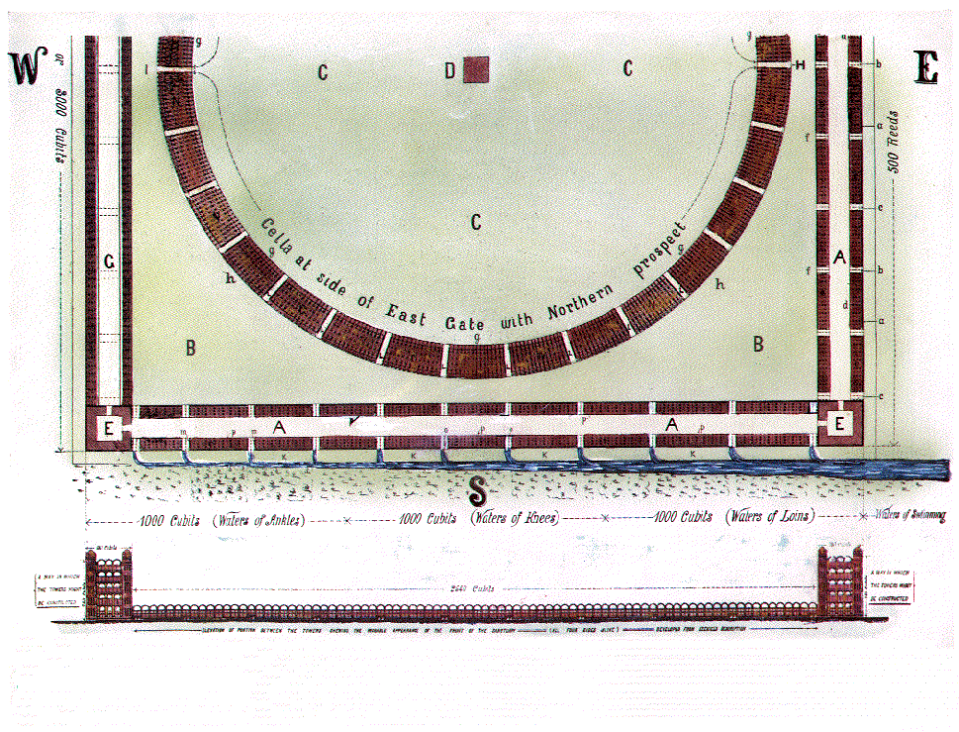
Plate 3 – Enlarged Half Plan and Elevation – (Pg 4)
Plate III.
HALF PLAN SHOWING DETAILS.
A A A—Outer court 100 cubits wide.
a a a—Wall 6 cubits high and 6 cubits broad round about the Sanctuary
b b b—Outer gate towards the East. Similar gates are on the North, South and West sides.
c c c—Posts of the gates.
d d d—Posts of the court round about.
e e e—Chambers and pavement of the outer court.
f f f—Gate to inner court.
B B B—Portion of inner court “cut off” by the circular range of cellæ and therefore called the “separate place,” i.e. the cut off portion of the inner court.
C C C—Portion of the inner court called the “Most Holy,”
D—Altar and Court before “the House.”
E E E—“Corner Courts,” i.e., Cooking Courts
F—Portion of outer court showing upper cellæ.
G G G—Western side.
K K K—Profane, or void place of the Sanctuary, 50 cubits wide.
M M M - THE TEMPLE: A chamber (cella) having its prospect Southward M M M.
N N N - THE TEMPLE: A chamber (cella) having its prospect Northward N N N. See plate 2 for letter M.
L L L—Twenty cubits space between the cellæ of the Temple dividing it into 30 orders.
H—Separate place towards the East-100 cubits
g g g—Porch on inner side of Temple.
h h h—Porch on outer side of Temple.
I—Separate place towards the West—100 cubits.
R R R—Cella flanking the inner court “over against” separate place and “before” the building (e e e) towards the North, entered from the Outer Court. See plate 2. for the position of this building.
S S S—Cella flanking the inner court on the cast and west, corresponding with those on the north and south.
m m m—Fence before cella, 50 cubits long.
p p p—Porches of the Court.
260’/ 79.24m
450’/ 137.16m

Slide 59
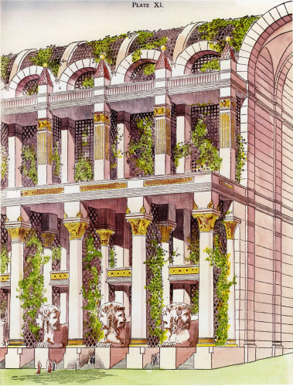
Ch. 41-The Porches of the Inner Circular Temple
VERSE 12 -"the building" —Heb. binyan, an edifice (Strong). In this instance refers to the end-walls into which the ribs are attached (plate 9, “J”) See vv. 6, 9. Ch. 41:12 gives the dimensions of the end walls, i.e., 5 cubits thick, 70 cubits high, and 90 cubits in length. These walls are therefore 140 feet (42. meters) high, quite substantial, quite grand!
140’

Slide 60
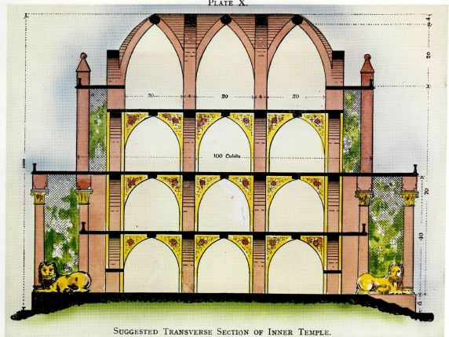
Plate 10 - Transverse Section of Inner Temple

Slide 61
Eze 40:6 - “…and went up the stairs thereof, and measured the threshold of the gate, which was one reed broad; and the other threshold of the gate, which was one reed broad.

Slide 62
Block Plan of the Sanctuary
BLOCK PLAN OF SANCTUARY
A A A—Outer court 100 cubits wide.
a a a—Wall 6 cubits high and 6 cubits broad round about the Sanctuary
b b b—Outer gate towards the East. Similar gates are on the North, South and West sides.
c c c—Posts of the gates.
d d d—Posts of the court round about.
e e e—Chambers and pavement of the outer court.
f f f—Gate to inner court.
aaa
M
M
M
b
M
M
M
M
N
N
b
N
N
b
N
N
N
N

Slide 63
QUARTER PLAN SHOWING DETAILS.
A A A—Outer court 200 feet wide.
a a a—Wall 6 cubits high and 6 cubits broad round about the Sanctuary
b b b—Outer gate towards the East. Similar gates are on the North, South and West sides.
c c c—Posts of the gates.
d d d—Posts of the court round about.
e e e—Chambers and pavement of the outer court.
f f f—Gate to inner court.
A
A

Slide 64
VERSE 45
"The chamber whose prospect is toward the south"
VERSE 46
"Chamber whose prospect is toward the north"

Slide 65
Gates of the Most Holy
The law which defines the position of the Most Holy has already been noticed, page 40 ante. The emphatic definition of this law may now again be quoted thus :
“This is the law of the house ; Upon the top of the mountain the whole limit thereof round about shall be most holy. Behold, this is the law of the house.” (Ezek. 43:12)
Ezekiel conveyed in vision to a very high mountain saw thereon as it were the frame of a city. Chap. 40:2.
From the above verse we now know that within this "frame" is THE MOST HOLY, because the top of the mountain is "Most Holy”

Slide 66
VERSES 44 το 41:26 — THE CIRCULAR TEMPLE IN THE INNER COURT
Notice that the description of the inner temple gives no side, or wall as lying in a specific direction, as is done with the outer buildings, because the inner building is circular (eg., contrast the walls of the outer building, ch. 42:16-19).
Two Hemispheres are defined in vv. 44-47 (i.e., their position and aspect, but the dimensions must be sought elsewhere in the prophecy).

Slide 67
CHAMBERS OF LEVITE SINGERS
IMMORTALS
WHOLE CIRCLE CONTAINS THE NORTHERN HALF, SONS OF ZADOK WHO
KEEP ALTAR.
MORTALS
SOUTHERN HALF,
LEVITES KEEP HOUSE, i.e.
IMMORTAL & MORTAL PRIESTS.
Ezk. 40:44

Slide 68
“These words…in thine heart…upon the posts…on thy gates”
Deu 6:4 Hear, O Israel: The LORD our God is one LORD:
Deu 6:5 And thou shalt love the LORD thy God with all thine heart, and with all thy soul, and with all thy might.
Deu 6:6 And these words, which I command thee this day, shall be in thine heart:
Deu 6:7 And thou shalt teach them diligently unto thy children, and shalt talk of them when thou sittest in thine house, and when thou walkest by the way, and when thou liest down, and when thou risest up.
Deu 6:8 And thou shalt bind them for a sign upon thine hand, and they shall be as frontlets between thine eyes.
Deu 6:9 And thou shalt write them upon the posts of thy house, and on thy gates.

Slide 69
Deu 11:18 - 28 (v20) Therefore shall ye lay up these my words in your heart and in your soul, and bind them for a sign upon your hand, that they may be as frontlets between your eyes.
Deu 11:19 And ye shall teach them your children, speaking of them when thou sittest in thine house, and when thou walkest by the way, when thou liest down, and when thou risest up.
Deu 11:20 And thou shalt write them upon the door posts of thine house, and upon thy gates:
Deu 11:21 That your days may be multiplied, and the days of your children, in the land which the LORD sware unto your fathers to give them, as the days of heaven upon the earth.
Deu 11:22 For if ye shall diligently keep all these commandments which I command you, to do them, to love the LORD your God, to walk in all his ways, and to cleave unto him;

Slide 70
“Gates of the Most Holy”- Ezk. 43:7,8
Son of man, the place of my throne, and the place of the soles of my feet, where I will dwell in the midst of the children of Israel for ever, and my holy name shall the house of Israel no more defile, they nor their kings by their whoredoms, nor by the carcasses of their kings in their high places. In the setting of their threshold by my threshold, and their doorpost near to my doorpost (and there is a wall (qir) between me and them), they have even defiled my holy name by their abominations that they have committed: wherefore I have consumed them in my anger. (Ezek. 43:7, 8)
The wall mentioned here must be the wall which we have seen forms an important part of the Inner Temple, because no other wall is provided to form the separation mentioned in the verses quoted. This decree is equal to saying :
“I have planted this wall between you Israel and me, and beyond it you shall not pass.”

Slide 71
Ch. 41-The Porches of the Inner Circular Temple
VERSE 12 -"the building" —Heb. binyan, an edifice (Strong). In this instance refers to the end-walls into which the ribs are attached (plate 9, “J”) See vv. 6, 9. Ch. 41:12 gives the dimensions of the end walls, i.e., 5 cubits thick, 70 cubits high, and 90 cubits in length. These walls are therefore 140 feet (42. meters) high, quite substantial, quite grand!
140’

Slide 73
Gates of the Most Holy
None but a certain class of priests are allowed to approach near to Yahweh. Approaching near to Yahweh must be synonymous with going into the Most Holy, which is described as a place where the God of Israel will dwell in the midst of the children of Israel. Chap, 43:2, 7
One class of priests minister in the inner court and within, i.e., within the Inner Temple buildings, but they are not permitted to go near unto Yahweh, into the Most Holy beyond the inside wall of the Inner Temple.
Chap. 44:17-19. Only the sons of Zadok are permitted this privilege.

Slide 74
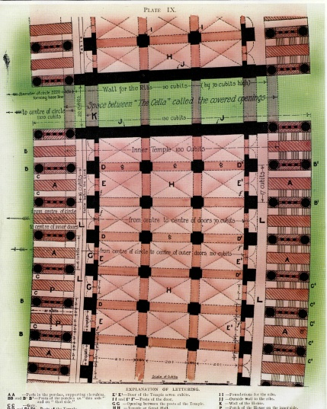
Gates of the Most Holy
41:2
VERSE 2
"The breadth of the door" — See mg. "entrance." "Door" is the Heb. pethach, an opening, which is formed between the posts of v 1. This entrance is 10 cu. wide, as deduced from v 3.
"Sides of the door" — The side of 5 cubits refers to the thickness of the sides of the porches, which are divided into two by the cherubim (plate 9, “A”)

Slide 75
Gates of the Most Holy
41:3
"Went he inward" — Ezekiel went inward from the porch, measuring the opening. Firstly the posts of the door, of 2 cubits, which are like door jambs on either side of the entrance

Slide 76
Gates of the Most Holy
41:3
“The door six cubits“ -- The entrance at the INNER GATE is 6 cu. wide. + 2 cu for each door post = 20’ (10 cu)
20’(10c)
22’(11c)
-- The entrance at the OUTER GATE is 7 cu. wide. + 2 cu for each door post = 22’ (11 cu)
20’(10c)
22’(11c)

Slide 77
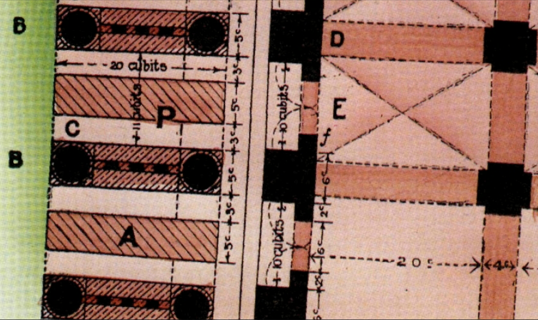
"Length 20 cubits, breadth 20 cubits" — The measurements here relate to the length and height of the circular temple rooms. The length is 20 cubits (plate 9), and the breadth is 16 cubits, the full entrance width (17 on the outer side, plate 9), hence the other 20-cubit measure of v. 4 must be the height of the rooms. The 16 cubit breadth is obtained thus: doorway 10 (v .2), plus two halves of the 6 cubit posts (v. 1), hence 10+3+3 =16 (see plate 9).
3c
10c
3c
20c

Slide 78
Gates of the Most Holy
VERSE 3
"Breadth of the door seven cubits”
— The doorway entrance on the inner side being 6 cubits (plate 9, "Ε Ε"), the doorway entrance on the outer side across the floor is a little wider, namely 7 cubits (plate 9, T E "), being in the correct proportion in harmony with the circular shape.
The outer entrance width will be slightly larger due to the increased circumference as one moves out from the centre of the circle. For any given angle, the arc increases in proportion as the radius increases.
Plate 9 of the temple book shows the full width of the inner porch to be 16 cubits from centre of pillar to centre of pillar widening to a porch of 17 cubits across the floor on the outer side.

Slide 79
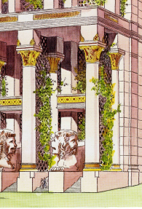

Slide 81
VERSE 15 - "the length of the building" — The word "length“ is from the Heb. orek "to stretch out" (Gesenius), i.e., to measure. This is the height of the circular building, which is 100 cubits, or 200 feet (60.9 meters), which suggests a three-storey building (see plate 10)
"the galleries" — Heb. attiyq, "decreasing," from root "to tear off." Ezekiel is viewing and describing the galleries of both the outer and inner temple buildings here, from position “R” on plate 2. Looking northwards, the outer court galleries face him, i.e., "over against" is the Heb. paniym, "faces.” Behind him, looking southwards, also "over against," are the three-storied galleries of the circular temple. But the circular temple galleries have no pillars like the square outer temple, but are constructed of rib work, as seen in ch. 42:6.

Slide 83
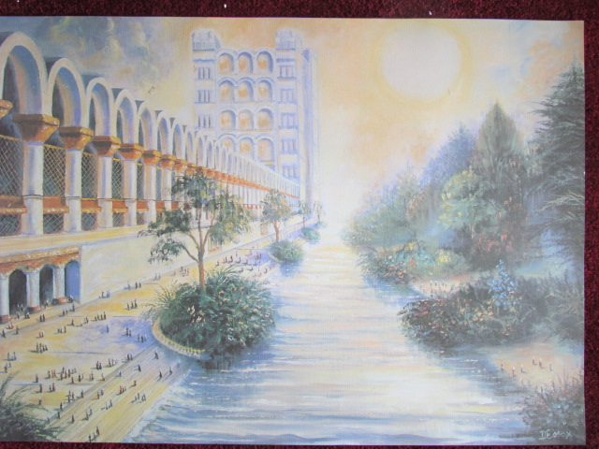

Slide 84
“Within Thy Gates…”
Deu 16:5 Thou mayest not sacrifice the passover within any of thy gates, which the LORD thy God giveth thee:
Deu 16:6 But at the place which the LORD thy God shall choose to place his name in, there thou shalt sacrifice the passover at even, at the going down of the sun, at the season that thou camest forth out of Egypt.
(Emphasizing our COMMON – UNITY in Christ, our SINGLENESS of heart and concern for each other’s welfare)

