Slide 1
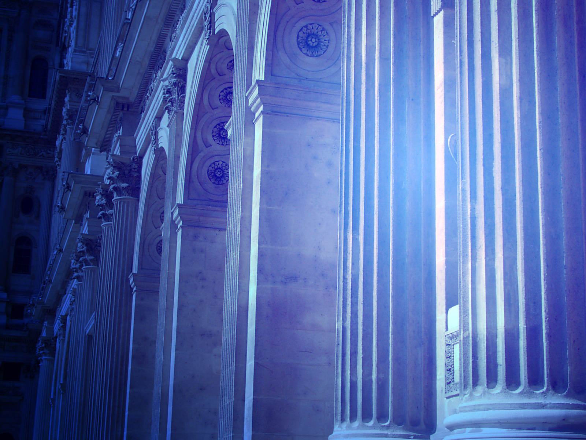
Class 3
“Porches, Posts, Pillars
and Palms”

Slide 2
Class Three Objectives
To identify the architectural and spatial location of what the KJV describes as…
  “the porch of the gate”
  “the posts”
  “the pillars”
  “the palm trees…”
in Ezk. Chapter 40 and 41 with regard to the Gate Buildings
To recognize how these features will be utilized in the House of Prayer during the worship and praise services for the nations
To apply spiritual exhortation to these features for our edification

Slide 3
The Temple Porches
There are powerful spiritual lessons arising from a consideration of the history of the temple porches. Ezekiel ch. 8 describes a monumental apostasy of Israel which occurred between the porch of the temple and the altar in Jerusalem.
The area between the porch and the altar was the place of the priest's ministration. The Hebrew for "porch" is elam and occurs only twice in Ezekiel's prophecy: chs. 8:16; 40:8.

Slide 4
Eze. 8 is a vision of idolatry among the elders of Israel. But all this will be a thing of the past in the bright millennial Age (Zech. 13:2), when the porches of Yahweh will be frequented by men and women of a "circumcised heart" (Eze. 44:9).
The purity of worship in Ezekiel's Temple is thrown into strong relief by a deliberate reference to the apostasy of the past, as we shall see when we come to look at Ezekiel chapter 44.

Slide 5
(9) and he measureth the porch of the gate eight cubits, and its posts two cubits, and the porch of the gates from within
This porch is stated to be inward, that is to say, it stands clear of the gate building and is inside the court. From the order in which the measurements are given, the two porches appear to adjoin each other, as shown in Plate 5.
The two form a sort of inner and outer porch, one six cubits wide within the main structure of the gate building on the one side of the doors, and the other with posts, projecting ten cubits into the outer court. This porch is figured Η on Plates V. and VII.

Slide 6
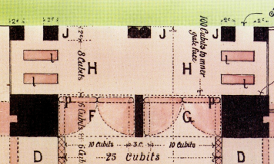
“the porch of the gate” (Ezk. 40:7-9,15)
(9) and he measureth the porch of the gate eight cubits, and its posts two cubits, and the porch of the gates from within
Face of porch

Slide 7
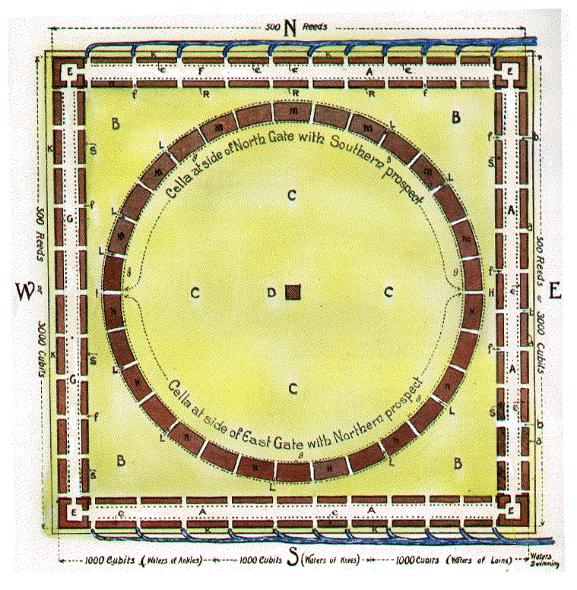
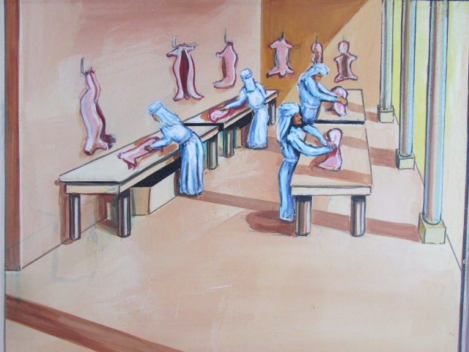
The cella between the inner court gates on the north side is first mentioned in the description of the north gate of the inner court, Chapter 40:38
“The chambers (cella) and the entries thereof are by the posts of the gates, where they washed the burnt offering.”

Slide 8
These chambers or cellae are related to the gates in the same way as are those of the outer court.
They occupy the area between the gates, and with the inner court gates form an integral part of the inner court, but their entrances face the outer court.
The outer face of these cellae and the outer face of these gates are flush, and form the south boundary of the northern outer court, because the distance from the inner face of the outer court gates to the inner court is the same as the distance from the corresponding gates, i.e., a hundred cubits (Chap. 40:18-27).

Slide 9
This cella is again mentioned in Chapter 42:1-2
He brought me forth into the utter (outer) court, the way toward the north; and he brought me into the chamber (cella) that is over against the separate place, and which is before the building toward the north. Before the length of a hundred cubits is the north door (or opening) and the breadth fifty cubits.

Slide 10
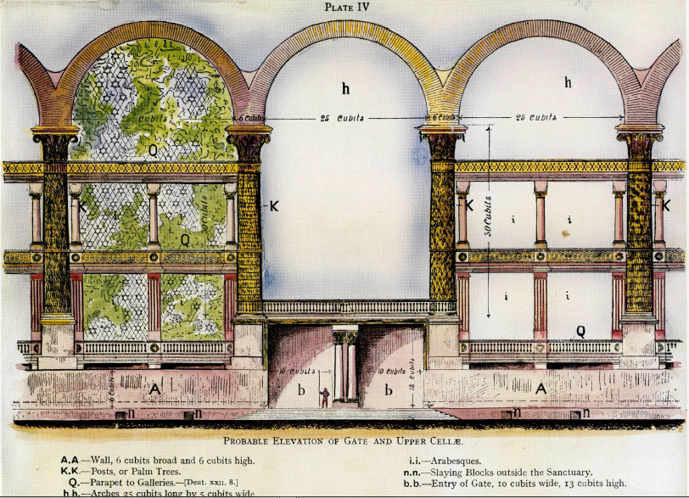

Slide 11
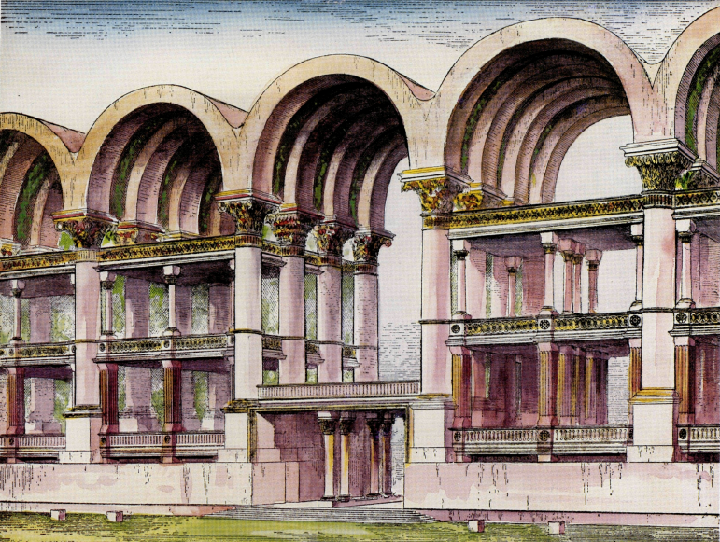
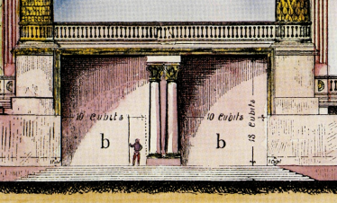
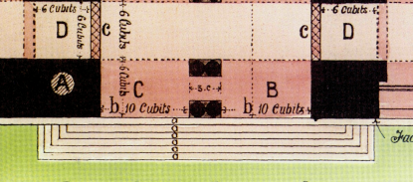
Ezek. 40:6-16 – Outer East Gate sets the pattern for all
Eze 40:6 Then came he unto the gate which looketh toward the east, and went up the stairs thereof, and measured the threshold of the gate, which was one reed broad; and the other threshold of the gate, which was one reed broad.
Eze 40:6 Then came he unto the gate which looketh toward the east, and went up the stairs thereof, and measured the threshold of the gate, which was one reed broad; and the other threshold of the gate, which was one reed broad.
60’(30c)
6cu.
6cu.
20’(10cu)
20’(10cu)
threshold of the gate, which was one reed broad (DEEP);
“…and the other threshold of the gate, which was one reed broad.”
26’(13c;8m)

Slide 12
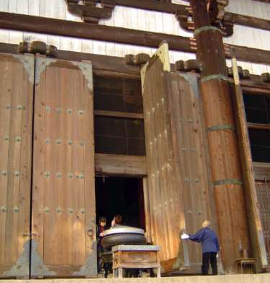
MASSIVE WOODEN DOORS OVER 20’ TALL IN THE GREAT HALL OF BUDDHA

Slide 13
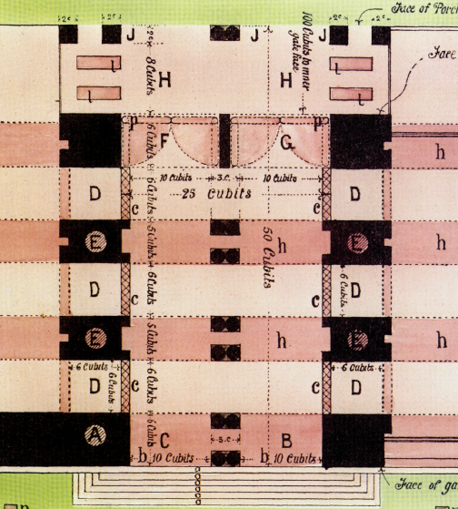
Eze 40:
7 And every little chamber (D) was one reed long, and one reed broad; and between the little chambers were five cubits; and the threshold of the gate by the porch of the gate within was one reed.
8 He measured also the porch of the gate within, one reed.
9 Then measured he the porch of the gate, eight cubits; and the posts thereof, two cubits; and the porch of the gate was inward.
E
5 Cubits
6 Cubits
“3 on this side”
“3 on that side”
Eze 40:6 Then came he unto the gate which looketh toward the east, and went up the stairs thereof, and measured the threshold of the gate, which was one reed broad (deep); and the other threshold of the gate, which was one reed broad (deep).
6 Cubits
1 Reed
Deep
1 Reed
Deep
V7-*”little chambers” … floor space = 1 reed square.
(v 10 states that there are three on each side of the gate). “spaces” between the little chambers: 5 cu.(10’)

Slide 14
v10-
Three “ little chambers” on each side of the Gate. *”i.e. “runner-chambers”
see 1 Kgs. 14:28.
*The “posts” have a common measure, given in verse 14. (Pedestals + palm-like pillars) v16. open).
”6 cu.” (12’) = the HEIGHT of the runner chambers.
Eze 40:10 And the little chambers of the gate eastward were three on this side, and three on that side; they three were of one measure: and the posts had one measure on this side and on that side.
40:11 And he measured the breadth of the entry of the gate, ten cubits; and the length of the gate, thirteen cubits.
40:12 The space also before the little chambers was one cubit on this side, and the space was one cubit on that side: and the little chambers were six cubits on this side, and six cubits on that side.
40:13 He measured then the gate from the roof of one little chamber to the roof of another: the breadth was five and twenty cubits, door against door.
50 cubits
“3 on this side”
“3 on that side”
10 c.
10 c.

Slide 15
Eze 40:
7 And every little chamber was one reed long, and one reed broad; and between the little chambers were five cubits; and the threshold of the gate by the porch of the gate within (F) was one reed.
8 He measured also the porch of the gate within, (G) one reed.
Eze 40:
9 Then measured he the porch of the gate, (H) eight cubits; and the posts thereof, two cubits; and the porch of the gate was inward.
1 Reed
Deep
1 Reed
Deep

Slide 16
v10-
Three “ little chambers” on each side of the Gate. *”i.e. “runner-chambers”
see 1 Kgs. 14:28.
*The “posts” have a common measure, given in verse 14. (Pedestals + palm-like pillars) v16. open).
”6 cu.” (12’) = the HEIGHT of the runner chambers.
Eze 40:10 And the little chambers of the gate eastward were three on this side, and three on that side; they three were of one measure: and the posts had one measure on this side and on that side.
40:11 And he measured the breadth of the entry of the gate, ten cubits; and the length of the gate, thirteen cubits.
40:12 The space also before the little chambers was one cubit on this side, and the space was one cubit on that side: and the little chambers were six cubits on this side, and six cubits on that side. (this is the HEIGHT)
40:13 He measured then the gate from the roof of one little chamber to the roof of another: the breadth was five and twenty cubits, door against door.
50 cubits
“3 on this side”
“3 on that side”

Slide 17
1Ki 14:27 And king Rehoboam made in their stead brasen shields, and committed them unto the hands of the chief of the guard, which kept the door of the king's house.
1Ki 14:28 And it was so, when the king went into the house of the LORD, that the guard bare them, and brought them back into the guard chamber. (Hb. tâ' tâ'âh)

Slide 18
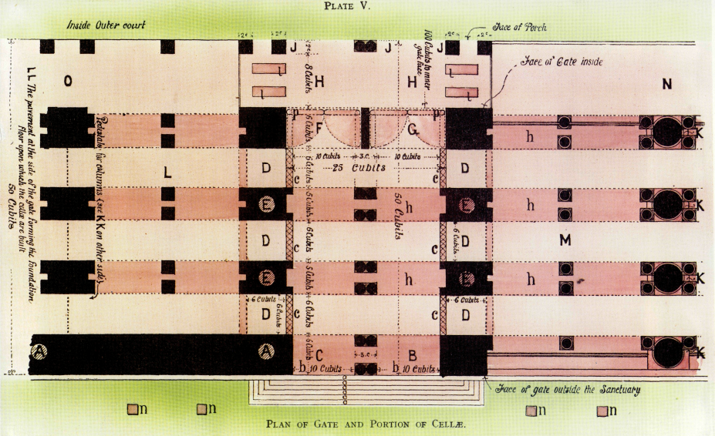
Access to the ‘ta’ (‘little chambers’)

Slide 19
Within The Porches
Mat 26:69 Now Peter sat without in the palace: and a damsel came unto him, saying, Thou also wast with Jesus of Galilee.
Mat 26:70 But he denied before them all, saying, I know not what thou sayest.
Mat 26:71 And when he was gone out into the porch, another maid saw him, and said unto them that were there, This fellow was also with Jesus of Nazareth.
Mat 26:72 And again he denied with an oath, I do not know the man.

Slide 20
Joh 10:23 And Jesus walked in the temple in Solomon's porch.

Slide 21
V14-Columns which flank either side of the gate, and
on either side of the court
Eze 40:14 He made also posts of threescore cubits, even unto the post of the court round about the gate.
Eze 40:15 And from the face of the gate of the entrance unto the face of the porch of the inner gate were fifty cubits.
V14-*Palm-like pillars (posts)...60 cu/pair, were made for the posts (surbases) at the side of the gate, as well as for those about the court.
50 cubits
V15 - LENGTH of the gate: 50 cubits

Slide 22
V. 14 – “…unto the post of the court” is a multitudinous ‘ONE’
It strikingly illustrates also that remarkable feature in the specification which helps so largely to the understanding of the vision, namely, the use of a noun of singular number in a collective or plural sense. In the latter part of the verse, we have the word "post" so used. "Unto the post of the court" cannot have reference to one post only. There are many posts in the court. Supposing they are all alike, then post, a singular noun of number, is just as expressive of the fact as our use of the word man when we mean a number of men; only we require to understand this use of the word in order to see the meaning of the specification. " The post of the court," then, means each or every post of the court.

Slide 23
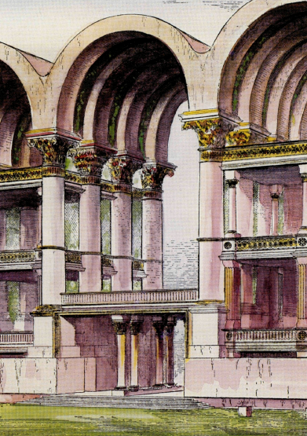
"60 cubits"..(end of v10) are for pairs of posts on either side of the gate: each pair are linked by arches.
This view of 60’ (30 cubits) for each great pillar "upon, a surbase of 10’ x 12’ x 26’ (5 x 6 x 13 cu.) provides a better proportion for the height of the building with its galleries overhead, and for the width of the gate and arches.

Slide 24
The Spiritual Lesson of the Sixty Cubit Pillars
There is special significance in the Palm pillars, in that the "man" made the pillars, whereas he simply measured elsewhere. Pillars are a key feature in the physical temple; they are everywhere. The saints are described as "pillars", and are a key feature in the spiritual temple (Rev 3:12). Pillars stand for righteous men and women, supporters of the ecclesia.
Eze 40:14 - “He made also posts of threescore cubits, even unto the post of the court round about the gate.”

Slide 25
The Spiritual Lesson of the Sixty Cubit Pillars
The number 60 is significant. In Song. 3:6, the marriage procession of Christ and his Bride from Sinai to Jerusalem is described with the expression "like pillars of smoke." The Hebrew timmeroth describes "pillars like palm trees." This is a manifestation of Yahweh's glory and power.
In v. 7 this is linked with "60 valiant men," and the whole vision seems to be based upon David's bodyguard, composed of two groups of 30 valiant men each (I Chr. 11, 12), giving a total of 60. The number 60 stands for supporters of the tabernacle of David.

Slide 26
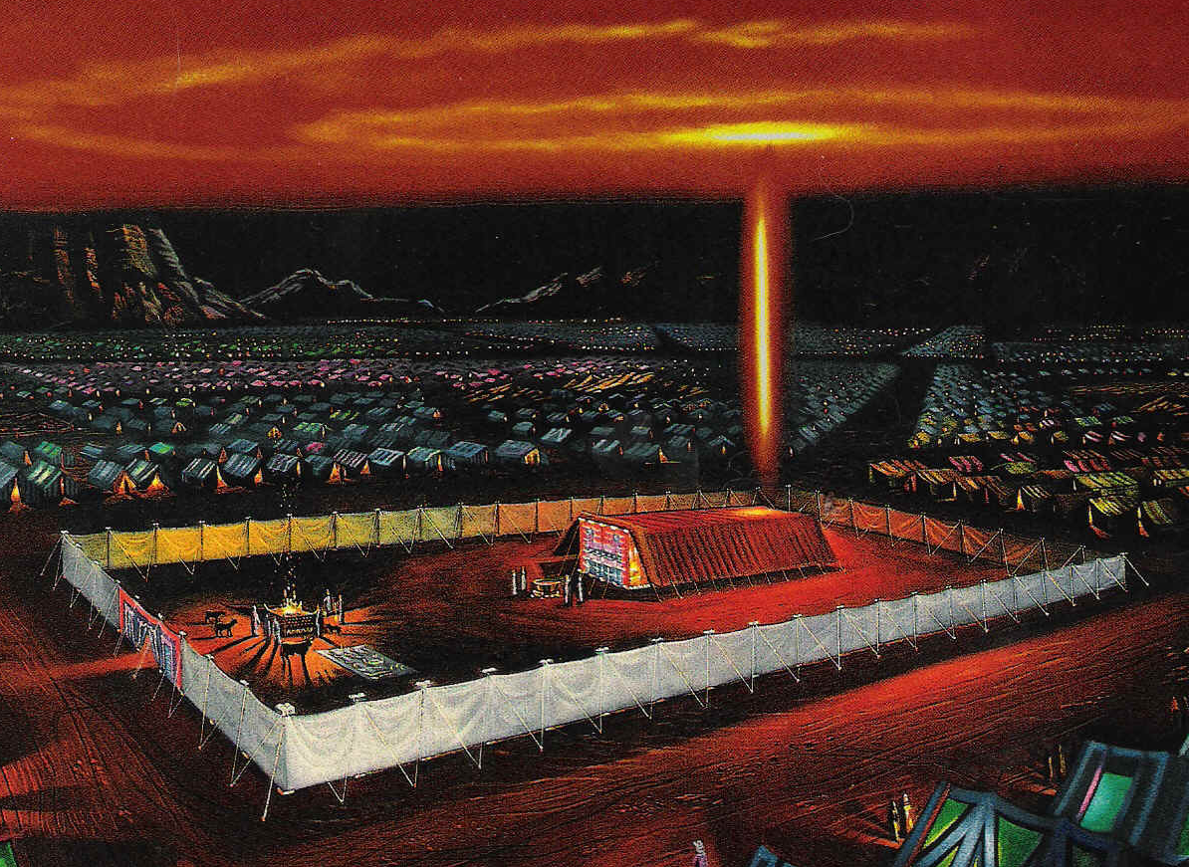
Consider also the 60 pillars of the tabernacle, which enclosed and supported the dwelling place of Yahweh with men. By describing the pillars of Ezekiel's temple in this way, attention is focused upon the number 60, directing the Bible student to find the answer
in the lessons of the tabernacle, and the beautiful Song of Solomon. (S. Snow – Logos article, )

Slide 27
*These are applied to
the little chambers
their posts
the arches
Eze 40:16 And there were narrow windows to the little chambers, and to their posts within the gate round about, and likewise to the arches: and windows were round about inward: and upon each post were palm trees.
V16-"narrow windows" = Margin gives 1 Kings 6:4
The words are rendered, "windows of fixed latticework" (RV).Gesenius states: "windows closed with bars, or lattice.” Bro, Sulley suggests that these may be arabesque architecture: fretted tracery of beautiful design of perforated work

Slide 28
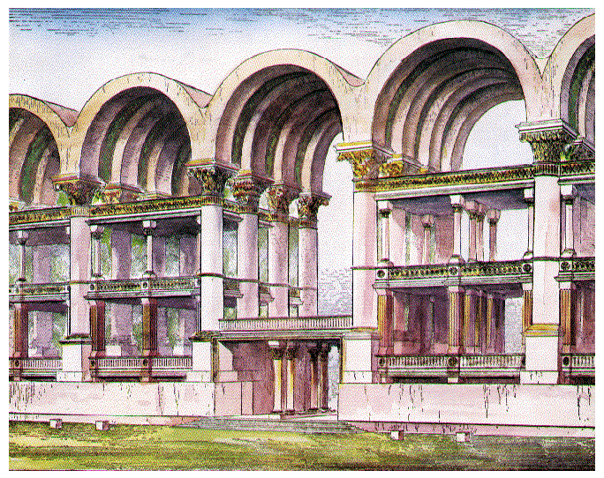
"narrow windows" indicates some sort of open screen-work one cubit thick on each side of the gate-building, in front of, or before, the ta, and probably six cubits high.
“The space also before the little chambers, one cubit on this side, and a space one cubit on that side.”
“And there were narrow windows to the little chambers, and to their posts within the gate round about.” (Verses 12 and 16.)

Slide 29
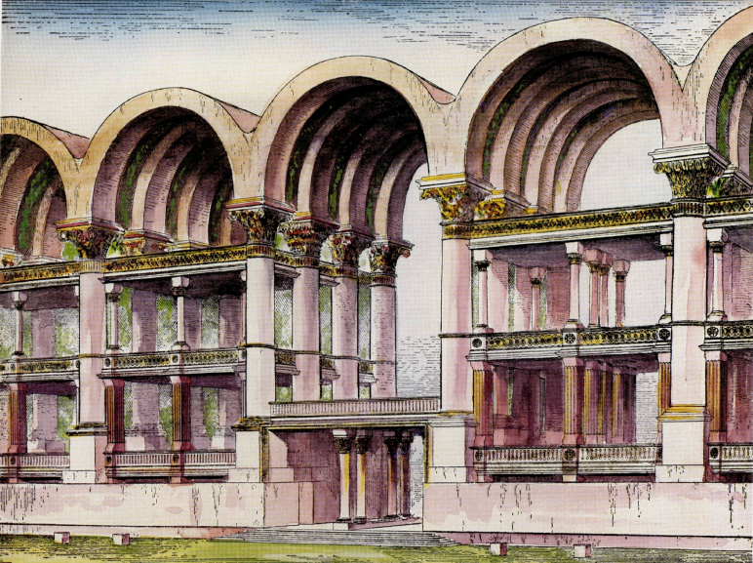
The Arches
That there are arches to the gateway, and very magnificent arches too, no one can doubt who considers all the elements of the specification.
They are mentioned in the specification of the first gate,
i.e., the eastern gate (see verses 6-16).
of the northern gate (verses 20-22).
of the southern gate (verse 24), and
of each of the inner court gates (verses 29, 33 and 36.)
These arches are "twenty-five cubits (50’) long and five (10’) broad” (see verse 30) ; that is to say, they are of the same measure as the distance separating the ta on either side of the gateway, and the same width as the posts, or surbases, between the little chambers.
Moreover, we learn from verse 22, that the arches are before the steps of the gateway. Any person, therefore, ascending these steps, would see overhead a series of arches, under which he would pass on entering the house. The arches then spring from one column to another across the gateway.

Slide 30
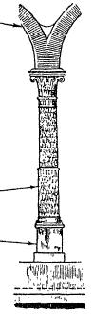
The Arches & “Palm Trees”
Mentioned in vv. 16, 22, 26, 31, 34, 36
"arches" = this from "ool" & "eel" root not used as a verb, but of wide extent in the derivatives. The primary notion is "to ROLL"., whence "ay'l" a RAM from its twisted & curled horns.
Also,"ool" belly or abdomen, so called from its roundness.
Young's literal retains "arches", so does RV,
The arch is in the shape of
(1) a rib
(2) a rainbow
(3) a horn
thus forming a curved lintel with great spiritual lessons behind them
"Palm-Trees" upon the POSTS: Artificial palm-trees"(Bagster)
In architecture, a palm-like pillaster (Strong).
*These in turn demand great arches to span across the top,
curved for great strength rather than a FLAT 50-foot stone lintel.

Slide 31
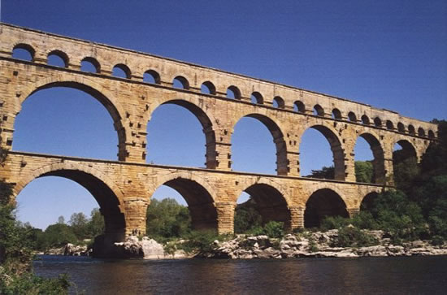
Strength of Arches
The Encyclopaedia Britannica, 2001, states, "In masonry construction, arches have several great advantages over horizontal beams, or lintels. They can span much wider openings, and this can be achieved using small, easily carried blocks of brick or stone rather than by a massive monolithic lintel. An arch can also carry a much greater load than an horizontal beam can. This carrying capacity stems from the fact that pressure downward on an arch has the effect of forcing the voussoirs [wedge shaped blocks—S.S.J together instead of apart... Arches may rest upon light supports [i.e., relatively light — S.S.]. However, where they occur in a row, because the thrust of one arch counteracts the thrust of its neighbours, the system remains stable as long as the arches at either end of the row are buttressed. This system is put to use in such structures as arched stone bridges and ancient Roman aqueducts".

Slide 32

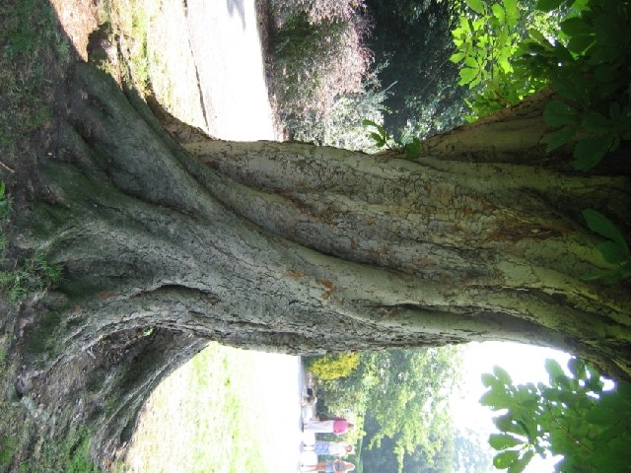
“Arches”
H361 -'êylâm 'êlâm 'êlammâh
Prob from H352;
a pillar space (or colonnade), that is, a pale (or portico): - arch.
H352 - 'ayil - ah'-yil
Fr the same as H193; properly strength; hence anything strong; specifically a chief (politically); also a ram (from his strength); a pilaster (as a strong support); an oak or other strong tree: - mighty (man), lintel, oak, post, ram, tree.
H193 - 'ûl - ool
From an unused root meaning to twist, that is, (by implication) be strong; the body (as being rolled together) also powerful: - mighty, strength.
“God”
H430 - 'ĕlôhı̂ym
el-o-heem'
Plural of H433; gods in the ordinary sense; but specifically used (in the plural thus, especially with the article) of the supreme God;
H433
אלהּ אלוהּ
'ĕlôahh 'ĕlôahh
el-o'-ah, el-o'-ah
(The second form is rare); probably prolonged (emphatically) from H410; a deity or the deity: - God, god.
H410 - 'êl - ale
Shortened from H352; strength; as adjective mighty; especially the Almighty (but used also of any deity): - God (god)

Slide 33

“Palm Trees Upon the Posts”
"Palm trees upon the posts " is an expression alike convenient and graphic for describing a series of slender, ornamental columns, standing upon pedestals and surbases, than which a more fitting figure could scarcely be selected.
A post (ayil) would in modern technical language be called a pedestal or sub-base, and upon it another post (ayil) could be placed, called in modern technical language a column, pillar, of shaft.
Upon these premises, then, verse 10 and verse 14 explain each other. The meaning of the two may be expressed thus : There are pedestals round the gateway, and these pedestals round the gateway are also pedestals to the court. They have upon them posts of threescore cubit

Slide 34
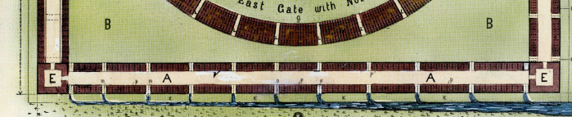
”The outer court” = the area of ground between the" two rows of buildings that make up the square.
"chambers" = any large building open at side or ends & subdivided by pillars,
"cellae" = sections of a cella - i.e. a large structure comprising many smaller subdivisions,
"thirty cellae" = because Ezekiel has only traversed THREE sides of the outer
court.
30 / 3 = 10 there must be TEN cellae for each side
*The cellae are UPON the pavement which is at the SIDE of each gate. (,v18).
Eze 40:17 Then brought he me into the outward court, and, lo, there were chambers, and a pavement made for the court round about: thirty chambers were upon the pavement.
Eze 40:18 And the pavement by the side of the gates over against the length of the gates was the lower pavement.
Eze 40:19 Then he measured the breadth from the forefront of the lower gate unto the forefront of the inner court without, an hundred cubits eastward and northward.
GATES
INNER COURT
OUTER COURT
GATES

Slide 35
1Ti 3:15 But if I tarry long, that thou mayest know how thou oughtest to behave thyself in the house of God, which is the church of the living God, the pillar and ground of the truth.

Slide 36
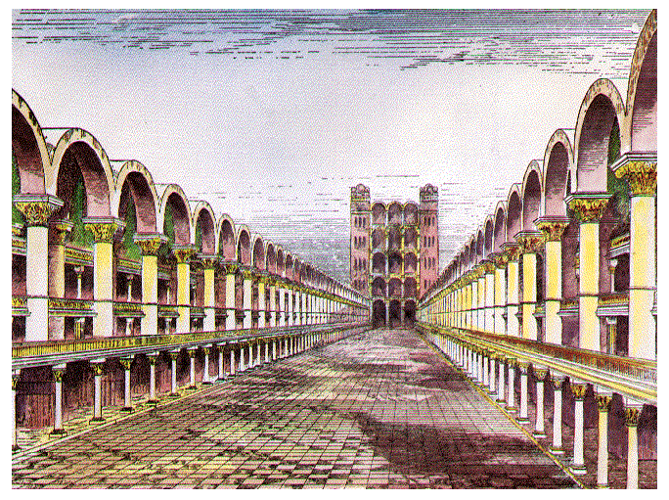
AAA-Outer court – 200 feet wide
200’ (100 cb.)

Slide 37
CHAPTER 40 VS 17-22: THE OUTER COURTS
VERSE 17
"The outward court" — The area of ground between the two rows of buildings
that form the outer square temple (plate 3, "A").
"Chambers" — Hebrew lishkah, a "room, chamber, cell," different from the "chamber" in verse 7. Here it is a room for storage, eating, or lodging, and these chambers appear to be many pillared halls, forming cellae (plural), with each subdivision being a cella. Each cella therefore is a large structure, comprising many smaller subdivisions (see Temple book, page 71, also plate 5, 'L').
"Thirty chambers [cellae]“- The three sides of the outer court range with their respective cellae = 30. These chambers, cellae, are upon the pavement at the side of each gate (Plate 5, ‘L’)

Slide 38
VERSE 18 -"The pavement"
— This is described as the lower pavement implying another pavement or pavements above. "Pavement" is the Hebrew ritspah, a tessellated pavement in a mosaic/pattern. Brother Sulley suggests it will be raised at least one cubit above the gate floor.
The pavement is beside the court (plate 5, 'L'), with a similar tessellated structure. No doubt the colors of these tiles will be significant illustrating the principles of the atonement, as was the case with the colors of the tabernacle materials in the days of Moses

Slide 39
40:31
"The eighth step" — There are seven steps to the entrance to the outer gates (v. 22). Going through the building, and crossing the floor of the outer court, worshippers ascend a further step to enter the porch of the inner range of buildings (look closely at plate 7). In this sense, the inner court gate has eight steps. There is a spiritual lesson in this eighth step, for when the mortals take it, they gain entrance to the gateway leading to the inner court and circular temple (the circle is a symbol of immortality, being an unending line). "Eight“ is the translation of the Hebrew shammeyn, meaning to "super abound."
"Eight" is the number of immortality in Scripture, Christ being raised to immortality on the first, or eighth day of the week. It is appropriate that, as we now look to the seventh millennium for immortality, the mortals in the Kingdom Age will wait for the eighth millennium to attain everlasting life. This is why the Sabbath observance will be held on the eighth day of the week (i.e., the first) in the Kingdom, as the mortals then look forward to the eighth millennium for their "rest" or "Sabbath" (Eze. 43:27; 46:1).

Slide 40
CHAPTER 40:44-49; CHAPTER 41; CHAPTER 42:1-14
At Ch. 40:44, Ezekiel is moved from a consideration of the Outer Court Ranges, and now is caused to examine the Central Range—the Temple. It seems that he stands on the central "mountain", and looks first to the North (verse 45), and then to the South (verse 46). If the "prospect" (panim — face) is toward the South, the building must be North of the point where Ezekiel is standing. He is told that these North quarters are for "the priests, the keepers of the charge of the house", and the South quarters are for "the priests, the keepers of the charge of the altar" — terms which are defined in more detail later (Ch. 44).

Slide 42
“Him that overcometh…
Rev 3:12 “…will I make a pillar in the temple of my God, and he shall go no more out: and I will write upon him the name of my God, and the name of the city of my God, which is new Jerusalem, which cometh down out of heaven from my God: and I will write upon him my new name.”

Slide 43
THE PORCH (40:48, 49 ; 41:2)
1. The porch, or porches, of the Temple differ much from those of the outer court, but in one particular they are alike, viz., there are two openings or " gates" in each porch. Thus we read (omitting the interpolated words) :

Slide 44
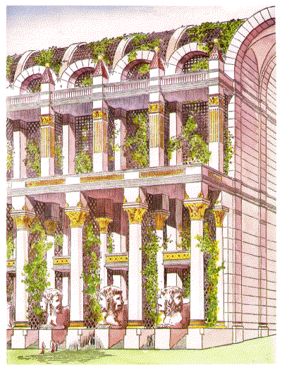
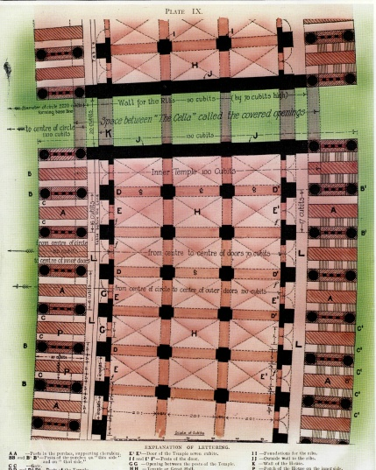
The Porches of the inner (circular)
Temple: Vv. 48-41:3
VERSE 48
"He brought me to the porch of the house" — Ezekiel descends from the altar and enters the inner porch of the circular temple (plate 2,‘
"The porch" — The inner porches have one similarity with the outer square building porches: two gates, for ingoing and outgoing traffic. Ezekiel measures the breadth of the posts on each side of the porches: "on this side and on that side," i.e., on the inside porch and outside porch of the circular temple.
He also measured the breadth of the gate i.e., the gap between/the posts on the inside, and again on the outside of the circle. These gates are 3 cubits wide with 5 cubit side posts on either side

Slide 45
The Porches of the inner (circular)
Temple: Vv. 40:48-41:3
He also measured the breadth of the gate i.e., the gap between/the posts on the inside, and again on the outside of the circle. These gates are 3 cubits wide with 5 cubit side posts on either side
5c
3c
5c
3c
5c
5c
3c
5c
3c
5c

Slide 46
The area separating the Outer (Square) Ranges, and the Central (Circular) Temple is the "Separate Place" of the Inner Court. At each corner the distance between the two is 200 feet (Ch. 41:13-14).
1. The "frame of a city" — the Outer Ranges, visible to Ezekiel as his first impression (Ch. 40:2).
2. The "Temple" — the Central Range — the circular buildings surrounding the Most Holy (Ch. 41:1).
3. The "Most Holy" — the area inside the Temple, containing the "Mountain" on the top of which is the Altar (Ch. 43:12).

Slide 47
4. The "Separate Place" — that area between the Outer Ranges and the Temple, which will be used for the passage of worshippers from North to South or from South to North—see Ch. 46:9 (Ch. 41:12-15).
5. The "Sanctuary" — the translation of two Hebrew words — qodesh (e.g. Ch. 41:21); and miqdash (e.g. Ch. 44:1).
The term "Most Holy" which is found in the AV seven times between Chs. 40 and 48 also comes from the word qodesh. Both words are said by Strong to be derived from qadash meaning to be clean, ceremonially or morally.

Slide 48
The word " porch " is to be understood in its plural sense, specifying a continuous series of porches in juxtaposition and surrounding the house on every side, i.e., on both sides of the Temple all round the circle.

Slide 49
Ezk. 41:1 – “He brought me to the temple” – ‘heykel’ – trans. ‘temple’ 68 times. Ezk arrives at the INNER PORCH (P) crossing the “place left” (L) to temple posts.
“Measured the posts” – Width of the posts = 6 cu. (D & D’)v. 21 – the posts are square; length=6c.
“breadth of the tabernacle” – Hb. ‘ohel’=to be clear, to shine, glitter, to give light…to be round, ring-shaped; tent of nomads; always ext. of tent, the round roof…”[Hb.&Chld. Lex. To OT. Pp32-33]

Slide 50
Ezk. 41:1 – “He brought me to the temple”
“breadth of the tabernacle” Bro Sulley points out that these particular posts all the way around the circle form a boundary for the Most Holy, and for the cloud, which at times covers the temple, forming a tent over the temple.

Slide 51
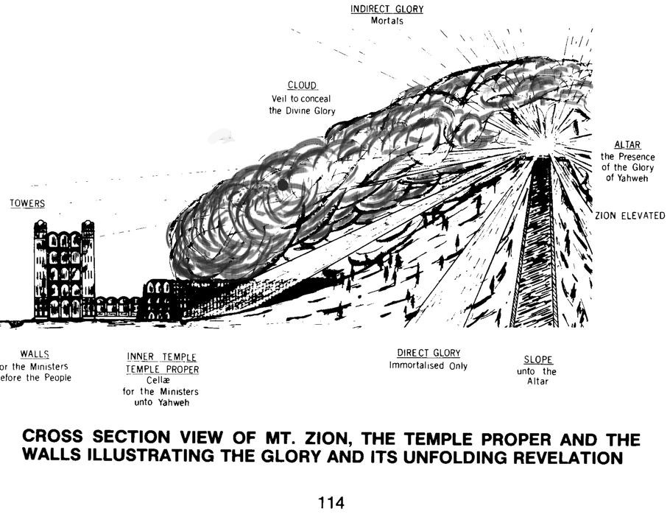
INDIRECT GLORY
Mortals
CLOUD
Veil to conceal the Divine Glory
ALTAR
The Presence of the Gory of Yahweh
TOWERS
WALLS
For the Ministers before the people
INNER TEMPLE
TEMPLE PROPER
Cellae for the Ministers unto YHWH
DIRECT GLORY
Immortalized Only
SLOPE
Unto the Altar

Slide 52
“Gates of the Most Holy”- Ezk. 43:7,8
Son of man, the place of my throne, and the place of the soles of my feet, where I will dwell in the midst of the children of Israel for ever, and my holy name shall the house of Israel no more defile, they nor their kings by their whoredoms, nor by the carcasses of their kings in their high places. In the setting of their threshold by my threshold, and their doorpost near to my doorpost (and there is a wall (qir) between me and them), they have even defiled my holy name by their abominations that they have committed: wherefore I have consumed them in my anger. (Ezek. 43:7, 8)
The wall mentioned here must be the wall which we have seen forms an important part of the Inner Temple, because no other wall is provided to form the separation mentioned in the verses quoted. This decree is equal to saying :
“I have planted this wall between you Israel and me, and beyond it you shall not pass.”

Slide 54
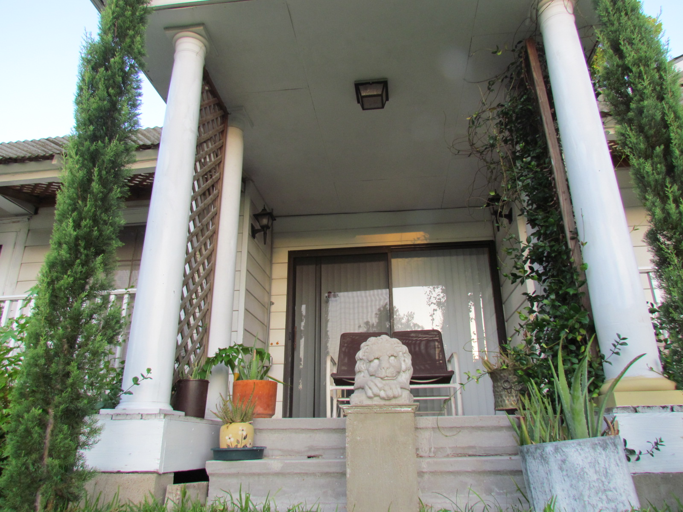

Slide 55
Gates of the Most Holy
None but a certain class of priests are allowed to approach near to Yahweh. Approaching near to Yahweh must be synonymous with going into the Most Holy, which is described as a place where the God of Israel will dwell in the midst of the children of Israel. Chap, 43:2, 7
One class of priests minister in the inner court and within, i.e., within the Inner Temple buildings, but they are not permitted to go near unto Yahweh, into the Most Holy beyond the inside wall of the Inner Temple.
Chap. 44:17-19. Only the sons of Zadok are permitted this privilege.

Slide 56
Gates of the Most Holy
41:2
VERSE 2
"The breadth of the door" — See mg. "entrance." "Door" is the Heb. pethach, an opening, which is formed between the posts of v 1. This entrance is 10 cu. wide, as deduced from v 3.
"Sides of the door" — The side of 5 cubits refers to the thickness of the sides of the porches, which are divided into two by the cherubim (plate 9, “A”)

Slide 57
Thrones of the Most Holy
Then the avenues on either
side of the house (the place left) form a necessary and
convenient means of communication between all parts of the house. There will be at least 389 positions where the judges may sit upon the
" Thrones of the House of David " within the porches, between the cherubim, before the Most Holy, which we shall see later is the most likely place for the judge to be seated.

Slide 58
Gates of the Most Holy
41:3
"Went he inward" — Ezekiel went inward from the porch, measuring the opening. Firstly the posts of the door, of 2 cubits, which are like door jambs on either side of the entrance

Slide 59
Gates of the Most Holy
41:3
“The door six cubits“ -- The entrance at the INNER GATE is 6 cu. wide. + 2 cu for each door post = 20’ (10 cu)
20’(10c)
22’(11c)
-- The entrance at the OUTER GATE is 7 cu. wide. + 2 cu for each door post = 22’ (11 cu)
20’(10c)
22’(11c)

Slide 60
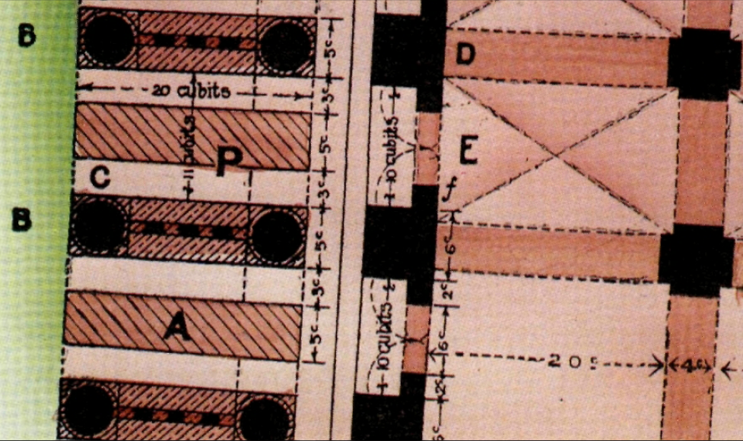
"Length 20 cubits, breadth 20 cubits" — The measurements here relate to the length and height of the circular temple rooms. The length is 20 cubits (plate 9), and the breadth is 16 cubits, the full entrance width (17 on the outer side, plate 9), hence the other 20-cubit measure of v. 4 must be the height of the rooms. The 16 cubit breadth is obtained thus: doorway 10 (v .2), plus two halves of the 6 cubit posts (v. 1), hence 10+3+3 =16 (see plate 9).
3c
10c
3c
20c

Slide 61
Gates of the Most Holy
VERSE 3
"Breadth of the door seven cubits”
— The doorway entrance on the inner side being 6 cubits (plate 9, "Ε Ε"), the doorway entrance on the outer side across the floor is a little wider, namely 7 cubits (plate 9, T E "), being in the correct proportion in harmony with the circular shape.
The outer entrance width will be slightly larger due to the increased circumference as one moves out from the centre of the circle. For any given angle, the arc increases in proportion as the radius increases.
Plate 9 of the temple book shows the full width of the inner porch to be 16 cubits from center of pillar to center of pillar widening to a porch of 17 cubits across the floor on the outer side.

Slide 62
VERSE 15 - "the length of the building" — The word "length“ is from the Heb. orek "to stretch out" (Gesenius), i.e., to measure. This is the height of the circular building, which is 100 cubits, or 200 feet (60.9 meters), which suggests a three-storey building (see plate 10)
"the galleries" — Heb. attiyq, "decreasing," from root "to tear off." Ezekiel is viewing and describing the galleries of both the outer and inner temple buildings here, from position “R” on plate 2. Looking northwards, the outer court galleries face him, i.e., "over against" is the Heb. paniym, "faces.” Behind him, looking southwards, also "over against," are the three-storied galleries of the circular temple. But the circular temple galleries have no pillars like the square outer temple, but are constructed of rib work, as seen in ch. 42:6.

Slide 63
Eze 40:20 And the gate of the outward court that looked toward the north, he measured the length thereof, and the breadth thereof.
Eze 40:21 And the little chambers thereof were three on this side and three on that side; and the posts thereof and the arches thereof were after the measure of the first gate: the length thereof was fifty cubits, and the breadth five and twenty cubits.
Eze 40:22 And their windows, and their arches, and their palm trees, were after the measure of the gate that looketh toward the east; and they went up unto it by seven steps; and the arches thereof were before them.
Eze 40:23 And the gate of the inner court was over against the gate toward the north, and toward the east; and he measured from gate to gate an hundred cubits.

Slide 64
Eze 40:24 After that he brought me toward the south, and behold a gate toward the south: and he measured the posts thereof and the arches thereof according to these measures.
Eze 40:25 And there were windows in it and in the arches thereof round about, like those windows: the length was fifty cubits, and the breadth five and twenty cubits.
Eze 40:26 And there were seven steps to go up to it, and the arches thereof were before them: and it had palm trees, one on this side, and another on that side, upon the posts thereof. Eze 40:27 And there was a gate in the inner court toward the south: and he measured from gate to gate toward the south an hundred cubits.

Slide 65
Eze 40:28 And he brought me to the inner court by the south gate: and he measured the south gate according to these measures;
Eze 40:29 And the little chambers thereof, and the posts thereof, and the arches thereof, according to these measures: and there were windows in it and in the arches thereof round about: it was fifty cubits long, and five and twenty cubits broad.
Eze 40:30 And the arches round about were five and twenty cubits long, and five cubits broad.
Eze 40:31 And the arches thereof were toward the utter court; and palm trees were upon the posts thereof: and the going up to it had eight steps.

Slide 66
Eze 40:32 And he brought me into the inner court toward the east: and he measured the gate according to these measures.
33 And the little chambers thereof, and the posts thereof, and the arches thereof, were according to these measures: and there were windows therein and in the arches thereof round about: it was fifty cubits long, and five and twenty cubits broad.
34 And the arches thereof were toward the outward court; and palm trees were upon the posts thereof, on this side, and on that side: and the going up to it had eight steps.
35 And he brought me to the north gate, and measured it according to these measures;

Slide 67
Eze 40:36 The little chambers thereof, the posts thereof, and the arches thereof, and the windows to it round about: the length was fifty cubits, and the breadth five and twenty cubits.
:37 And the posts thereof were toward the utter court; and palm trees were upon the posts thereof, on this side, and on that side: and the going up to it had eight steps.
38 And the chambers and the entries thereof were by the posts of the gates, where they washed the burnt offering.
:39 And in the porch of the gate were two tables on this side, and two tables on that side, to slay thereon the burnt offering and the sin offering and the trespass offering.

Slide 68
40 And at the side without, as one goeth up to the entry of the north gate, were two tables; and on the other side, which was at the porch of the gate, were two tables.
41 Four tables were on this side, and four tables on that side, by the side of the gate; eight tables, whereupon they slew their sacrifices.
42 And the four tables were of hewn stone for the burnt offering, of a cubit and an half long, and a cubit and an half broad, and one cubit high: whereupon also they laid the instruments wherewith they slew the burnt offering and the sacrifice.
:43 And within were hooks, an hand broad, fastened round about: and upon the tables was the flesh of the offering.

Slide 69
Eze 40:44 And without the inner gate were the chambers of the singers in the inner court, which was at the side of the north gate; and their prospect was toward the south: one at the side of the east gate having the prospect toward the north.
45 And he said unto me, This chamber, whose prospect is toward the south, is for the priests, the keepers of the charge of the house.
46 And the chamber whose prospect is toward the north is for the priests, the keepers of the charge of the altar: these are the sons of Zadok among the sons of Levi, which come near to the LORD to minister unto him.

Slide 70
Eze 40:47 So he measured the court, an hundred cubits long, and an hundred cubits broad, foursquare; and the altar that was before the house.
48 And he brought me to the porch of the house, and measured each post of the porch, five cubits on this side, and five cubits on that side: and the breadth of the gate was three cubits on this side, and three cubits on that side.
49 The length of the porch was twenty cubits, and the breadth eleven cubits; and he brought me by the steps whereby they went up to it: and there were pillars by the posts, one on this side, and another on that side.

Slide 71
Eze 40:6-49
(6) And he cometh in unto the gate whose front is eastward, and he goeth up by its steps, and he measureth the threshold of the gate one reed broad, even the one threshold one reed broad,
(7) and the little chamber one reed long and one reed broad, and between the little chambers five cubits, and the threshold of the gate, from the side of the porch of the gate from within, one reed.
(8) And he measureth the porch of the gate from within one reed,
(9) and he measureth the porch of the gate eight cubits, and its posts two cubits, and the porch of the gates from within,
(10) and the little chambers of the gate eastward, three on this side, and three on that side; one measure is to them three, and one measure is to the posts, on this side and on that side.
(11) And he measureth the breadth of the opening of the gate ten cubits, the length of the gate thirteen cubits;
(12) and a border before the little chambers, one cubit, and one cubit is the border on this side, and the little chamber is six cubits on this side, and six cubits on that side.
(13) And he measureth the gate from the roof of the one little chamber to the roof of another; the breadth twenty and five cubits, opening over-against opening.
(14) And he maketh the posts of sixty cubits, even unto the post of the court, the gate all round about;
(15) and by the front of the gate of the entrance, by the front of the porch of the inner gate, fifty cubits;
(16) and narrow windows are unto the little chambers, and unto their posts at the inside of the gate all round about--and so to the arches--and windows all round about are at the inside, and at the post are palm-trees.
(17) And he bringeth me in unto the outer court, and lo, chambers and a pavement made for the court all round about--thirty chambers on the pavement--
(18) and the pavement unto the side of the gates over-against the length of the gates is the lower pavement;
(19) and he measureth the breadth from before the lower gate, to the front of the inner court, on the outside, a hundred cubits, eastward and northward.
(20) As to the gate of the outer court whose front is northward, he hath measured its length and its breadth;
(21) and its little chambers, three on this side, and three on that side, and its posts and its arches have been according to the measure of the first gate, fifty cubits its length, and the breadth five and twenty by the cubit;
(22) and its windows, and its arches, and its palm-trees are according to the measure of the gate whose face is eastward, and by seven steps they go up on it, and its arches are before them.
(23) And the gate of the inner court is over-against the gate at the north and at the east; and he measureth from gate unto gate, a hundred cubits.
(24) And he causeth me to go southward, and lo, a gate southward, and he hath measured its posts and its arches according to these measures;
(25) and windows are to it and to its arches all round about, like these windows, fifty cubits the length, and the breadth five and twenty cubits;
(26) and seven steps are its ascent, and its arches are before them, and palm-trees are to it, one on this side, and one on that side, at its posts;

Slide 72
Eze 40:
(27) and the gate of the inner court is southward, and he measureth from gate unto gate southward, a hundred cubits.
(28) And he bringeth me in unto the inner court by the south gate, and he measureth the south gate according to these measures;
(29) and its little chambers, and its posts, and its arches are according to these measures, and windows are to it and to its arches all round about; fifty cubits the length, and the breadth twenty and five cubits.
(30) As to the arches all round about, the length is five and twenty cubits, and the breadth five cubits;
(31) and its arches are unto the outer court, and palm-trees are unto its posts, and eight steps are its ascent.
(32) And he bringeth me in unto the inner court eastward, and he measureth the gate according to these measures;
(33) and its little chambers, and its posts, and its arches are according to these measures: and windows are to it and to its arches all round about, the length fifty cubits, and the breadth five and twenty cubits;
(34) and its arches are toward the outer court, and palm-trees are toward its posts, on this side and on that side, and eight steps are its ascent.
(35) And he bringeth me in unto the north gate, and hath measured according to these measures;
(36) its little chambers, its posts, and its arches; and windows are to it all round about: the length fifty cubits, and the breadth five and twenty cubits;
(37) and its posts are to the outer court, and palm-trees are unto its posts, on this side and on that side, and eight steps are its ascent.
(38) And the chamber and its opening is by the posts of the gates, there they purge the burnt-offering.
(39) And in the porch of the gate are two tables on this side, and two tables on that side, to slaughter on them the burnt-offering, and the sin-offering, and the guilt-offering;
(40) and at the side without, at the going up to the opening of the north gate, are two tables; and at the other side that is at the porch of the gate, are two tables;
(41) four tables are on this side, and four tables on that side, at the side of the gate, eight tables on which they slaughter.
(42) And the four tables for burnt-offering are of hewn stone: the length one cubit and a half, and the breadth one cubit and a half, and the height one cubit: on them they place the instruments with which they slaughter the burnt-offering and the sacrifice.
(43) And the boundaries are one handbreadth, prepared within all round about: and on the tables is the flesh of the offering.
(44) And on the outside of the inner gate are chambers of the singers, in the inner court, that are at the side of the north gate, and their fronts are southward, one at the side of the east gate hath the front northward.
(45) And he speaketh unto me: `This chamber, whose front is southward, is for priests keeping charge of the house;
(46) and the chamber, whose front is northward, is for priests keeping charge of the altar: they are sons of Zadok, who are drawing near of the sons of Levi unto Jehovah, to serve Him.'
(47) And he measureth the court: the length a hundred cubits, and the breadth a hundred cubits, square, and the altar is before the house.
(48) And he bringeth me in unto the porch of the house, and he measureth the post of the porch, five cubits on this side, and five cubits on that side, and the breadth of the gate, three cubits on this side, and three cubits on that side;
(49) the length of the porch twenty cubits, and the breadth eleven cubits; and by the steps whereby they go up unto it: and pillars are at the posts, one on this side, and one on that side.

Slide 73
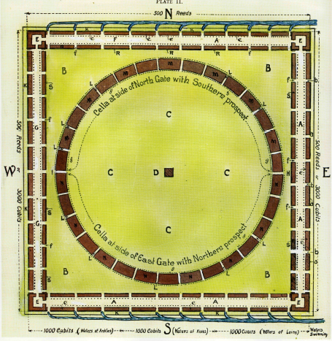
1
Eze 40:2 In the visions of God brought he me into the land of Israel, and set me upon a very high mountain, by which was as the frame of a city on the south.
2
Eze 40:3 And he brought me thither, …; and he stood in the gate.
3
1
3
Eze 40:6 “Then came he unto the gate which looketh toward the east…”
2

Slide 74
E

Slide 75
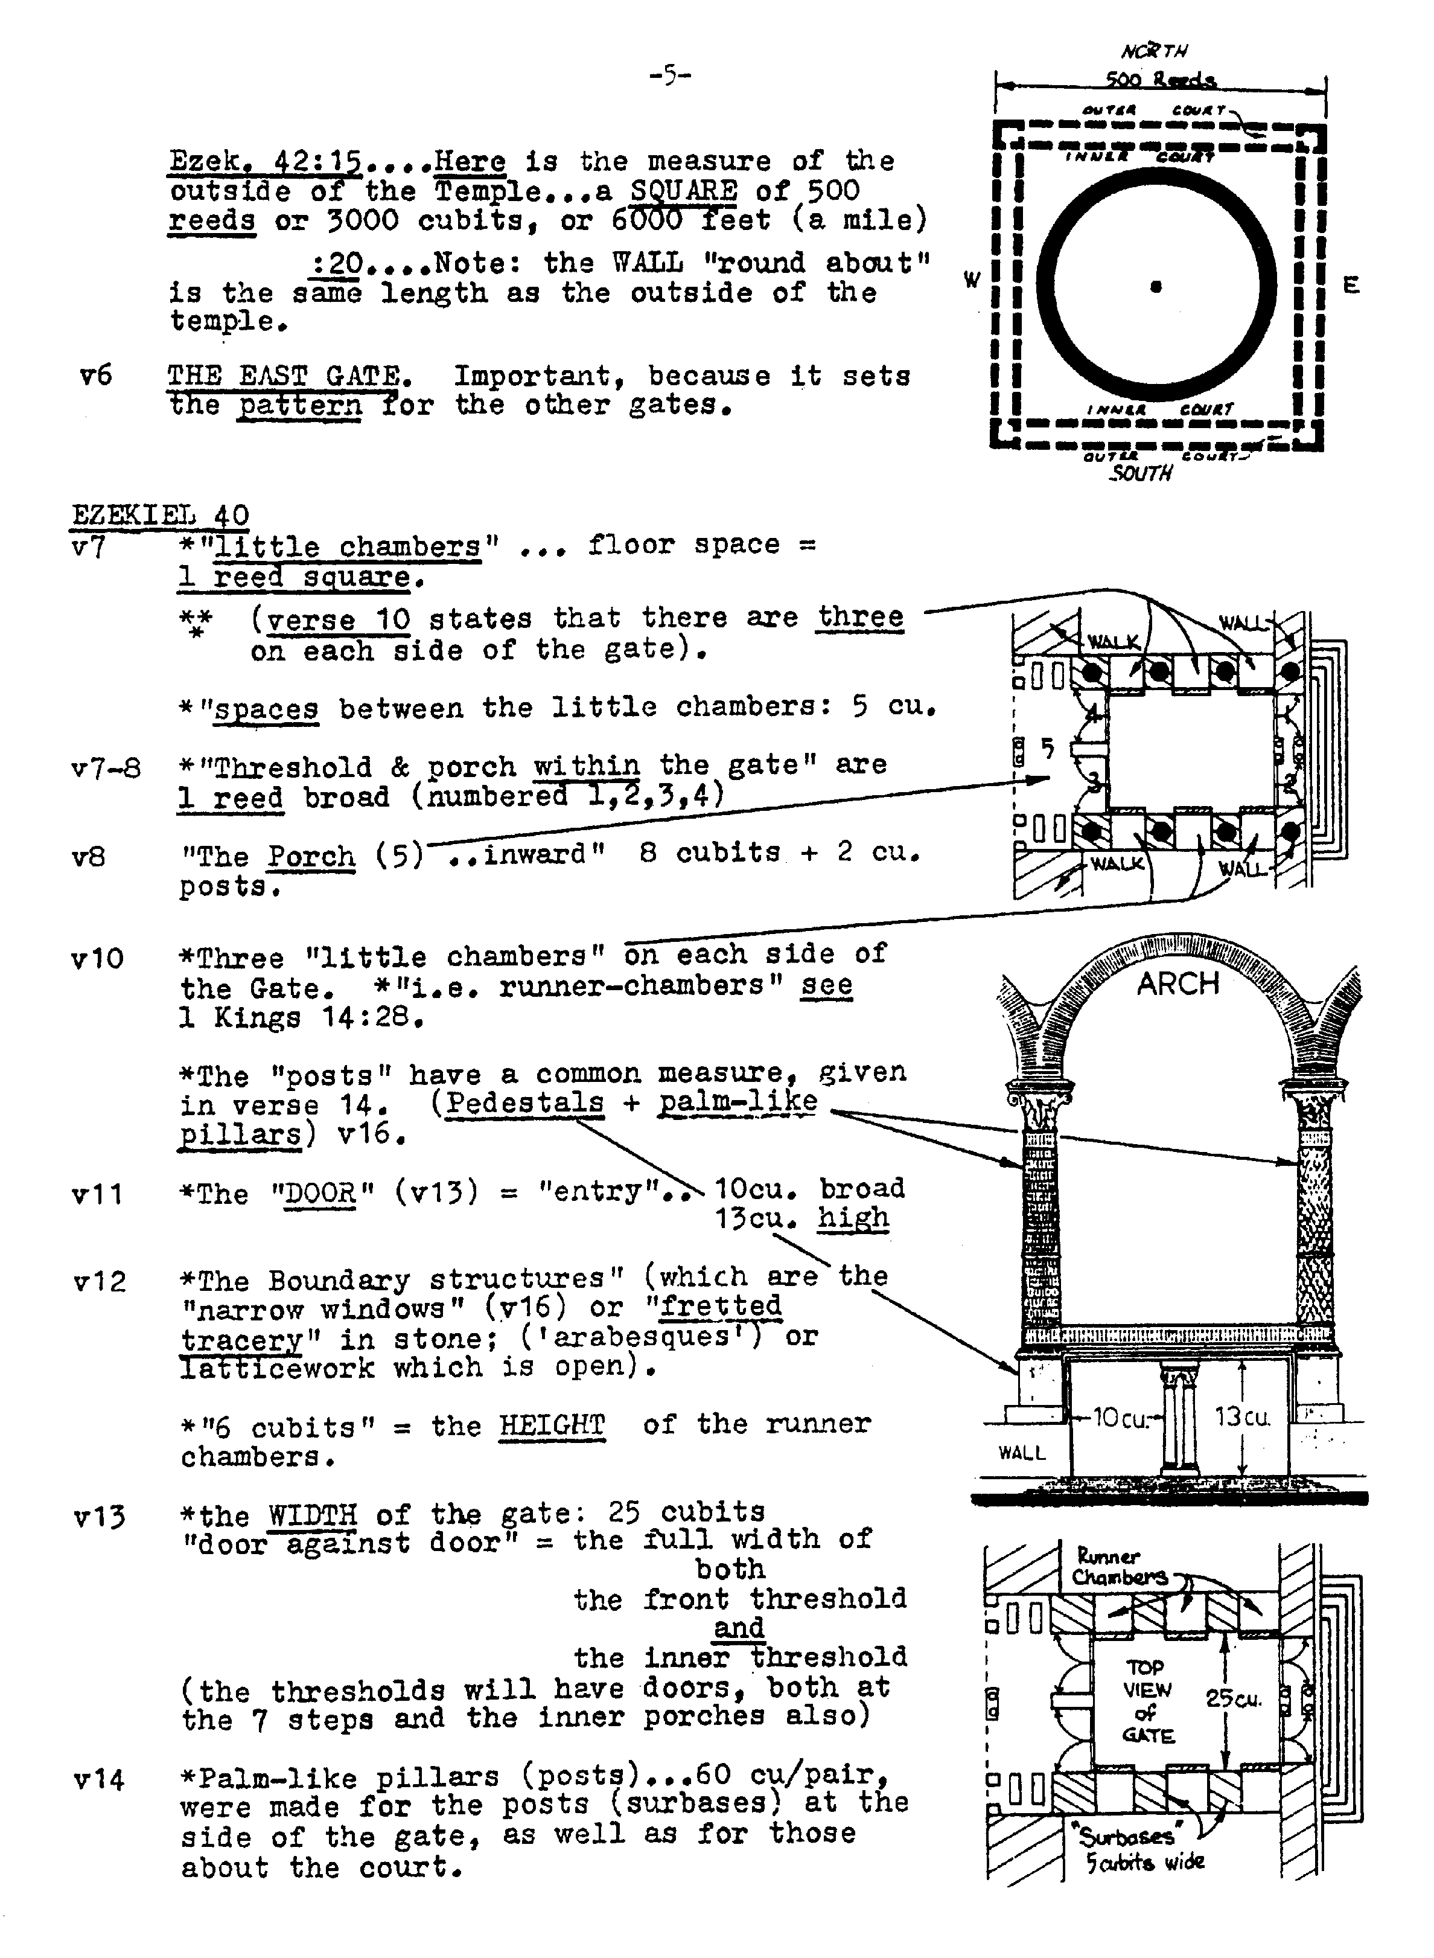
V7-*”little chambers” … floor space = 1 reed square.
(v10 states that there are three on each side of the gate).
“spaces” between the little chambers: 5 cu.
v7-8-*Threshold & porch within the gate” are 1 reed broad (numbered 1,2,3,4)
v8 -“The Porch (5) ..inward” 8 cubits + 2 cu. Posts.
v10-*Three “ little chambers” on each side of the Gate. *”i.e. “runner-chambers”
see 1 Kgs. 14:28.
*The “posts” have a common measure, given in verse 14. (Pedestals + palm-like pillars) v16.
open).
*”6 cubits” = the HEIGHT of the runner chambers.
4
1
3
2
Notes:
V7 *”little chambers” … floor space = 1 reed square.
(v10 states that there are three on each side of the gate).
“spaces” between the little chambers: 5 cu.
V7-8 *Threshold & porch within the gate” are 1 reed broad (numbered 1,2,3,4)
V8 “The Porch (5) ..inward” 8 cubits + 2 cu. Posts.
V10 *Three “ little chambers” on each side of the Gate. *”i.e. runner-changers” see 1 Kgs. 14:28.
*The “posts” have a common measure, given in verse 14. (Pedestals + palm-like pillars) v16.
V11 *The “DOOR” (v13) = “entry” .. 10cu. Broad
13cu. High
V12 *The Boundary structures” (which are the “narrow windows” (v16) or “fretted tracery” in stone; (arabesques’) or latticework which is open).
*”6 cubits” = the HEIGHT of the runner chambers.
V13 *the WIDTH of the gate: 25 cubits “door against door” = the full width of both the front threshold and the inner threshold (the thresholds will have doors, both at the 7 steps and the inner porches also)
V14 *Palm-like pillars (posts)…60 cu/pair, were made for the posts (surbases) at the side of the gate, as well as for those about the court.
“60 cubits”..(end of v10) are for pairs of posts on either side of the gate: each pair are linked by arches. This view of 30 cubits for each great pillar upon a surbase of 5 x 6 x 13 cu. Provides a better proportion for the height of the building with its galleries overhead, and for the width of the gate and arches.
V15 *The LENGTH of the gate: 50 cubits
V16 *”narrow windows” = Margin gives 1 Kings 6:4
The words are rendered, “windows of fixed latticework” (RV).
Gesenius states: “windows closed with bars, or lattice.”
Bro. Sulley suggests that these may be arabesque architecture: fretted tracery of beautiful design…of perforated work.
*These are applied to (a) the little chambers, (b) their posts, (c) the arches

Slide 76
v10-*Three “ little chambers” on each side of the Gate. *”i.e. “runner-chambers”
see 1 Kgs. 14:28.
*The “posts” have a common measure, given in verse 14. (Pedestals + palm-like pillars) v16.
open).
*”6 cubits” = the HEIGHT of the runner chambers.
4
1
3
2
Notes:
V7 *”little chambers” … floor space = 1 reed square.
(v10 states that there are three on each side of the gate).
“spaces” between the little chambers: 5 cu.
V7-8 *Threshold & porch within the gate” are 1 reed broad (numbered 1,2,3,4)
V8 “The Porch (5) ..inward” 8 cubits + 2 cu. Posts.
V10 *Three “ little chambers” on each side of the Gate. *”i.e. runner-changers” see 1 Kgs. 14:28.
*The “posts” have a common measure, given in verse 14. (Pedestals + palm-like pillars) v16.
V11 *The “DOOR” (v13) = “entry” .. 10cu. Broad
13cu. High
V12 *The Boundary structures” (which are the “narrow windows” (v16) or “fretted tracery” in stone; (arabesques’) or latticework which is open).
*”6 cubits” = the HEIGHT of the runner chambers.
V13 *the WIDTH of the gate: 25 cubits “door against door” = the full width of both the front threshold and the inner threshold (the thresholds will have doors, both at the 7 steps and the inner porches also)
V14 *Palm-like pillars (posts)…60 cu/pair, were made for the posts (surbases) at the side of the gate, as well as for those about the court.
“60 cubits”..(end of v10) are for pairs of posts on either side of the gate: each pair are linked by arches. This view of 30 cubits for each great pillar upon a surbase of 5 x 6 x 13 cu. Provides a better proportion for the height of the building with its galleries overhead, and for the width of the gate and arches.
V15 *The LENGTH of the gate: 50 cubits
V16 *”narrow windows” = Margin gives 1 Kings 6:4
The words are rendered, “windows of fixed latticework” (RV).
Gesenius states: “windows closed with bars, or lattice.”
Bro. Sulley suggests that these may be arabesque architecture: fretted tracery of beautiful design…of perforated work.
*These are applied to (a) the little chambers, (b) their posts, (c) the arches

Slide 77
V7 *”little chambers” … floor space = 1 reed square.
(v10 states that there are three on each side of the gate).
“spaces” between the little chambers: 5 cu.
V7-8 *Threshold & porch within the gate” are 1 reed broad (numbered 1,2,3,4)
V8 “The Porch (5) ..inward” 8 cubits + 2 cu. Posts.
V10 *Three “ little chambers” on each side of the Gate. *”i.e. runner-changers” see 1 Kgs. 14:28.
*The “posts” have a common measure, given in verse 14. (Pedestals + palm-like pillars) v16.
V11 *The “DOOR” (v13) = “entry” .. 10cu. Broad
13cu. High
V12 *The Boundary structures” (which are the “narrow windows” (v16) or “fretted tracery” in stone; (arabesques’) or latticework which is open).
*”6 cubits” = the HEIGHT of the runner chambers.
V13 *the WIDTH of the gate: 25 cubits “door against door” = the full width of both the front threshold and the inner threshold (the thresholds will have doors, both at the 7 steps and the inner porches also)
V14 *Palm-like pillars (posts)…60 cu/pair, were made for the posts (surbases) at the side of the gate, as well as for those about the court.
“60 cubits”..(end of v10) are for pairs of posts on either side of the gate: each pair are linked by arches. This view of 30 cubits for each great pillar upon a surbase of 5 x 6 x 13 cu. Provides a better proportion for the height of the building with its galleries overhead, and for the width of the gate and arches.
V15 *The LENGTH of the gate: 50 cubits
V16 *”narrow windows” = Margin gives 1 Kings 6:4
The words are rendered, “windows of fixed latticework” (RV).
Gesenius states: “windows closed with bars, or lattice.”
Bro. Sulley suggests that these may be arabesque architecture: fretted tracery of beautiful design…of perforated work.
*These are applied to (a) the little chambers, (b) their posts, (c) the arches
Notes:
V7 *”little chambers” … floor space = 1 reed square.
(v10 states that there are three on each side of the gate).
“spaces” between the little chambers: 5 cu.
V7-8 *Threshold & porch within the gate” are 1 reed broad (numbered 1,2,3,4)
V8 “The Porch (5) ..inward” 8 cubits + 2 cu. Posts.
V10 *Three “ little chambers” on each side of the Gate. *”i.e. runner-changers” see 1 Kgs. 14:28.
*The “posts” have a common measure, given in verse 14. (Pedestals + palm-like pillars) v16.
V11 *The “DOOR” (v13) = “entry” .. 10cu. Broad
13cu. High
V12 *The Boundary structures” (which are the “narrow windows” (v16) or “fretted tracery” in stone; (arabesques’) or latticework which is open).
*”6 cubits” = the HEIGHT of the runner chambers.
V13 *the WIDTH of the gate: 25 cubits “door against door” = the full width of both the front threshold and the inner threshold (the thresholds will have doors, both at the 7 steps and the inner porches also)
V14 *Palm-like pillars (posts)…60 cu/pair, were made for the posts (surbases) at the side of the gate, as well as for those about the court.
“60 cubits”..(end of v10) are for pairs of posts on either side of the gate: each pair are linked by arches. This view of 30 cubits for each great pillar upon a surbase of 5 x 6 x 13 cu. Provides a better proportion for the height of the building with its galleries overhead, and for the width of the gate and arches.
V15 *The LENGTH of the gate: 50 cubits
V16 *”narrow windows” = Margin gives 1 Kings 6:4
The words are rendered, “windows of fixed latticework” (RV).
Gesenius states: “windows closed with bars, or lattice.”
Bro. Sulley suggests that these may be arabesque architecture: fretted tracery of beautiful design…of perforated work.
*These are applied to (a) the little chambers, (b) their posts, (c) the arches

Slide 78
V12 *The Boundary structures” (which are the “narrow windows” (v16) or “fretted tracery” in stone; (arabesques’) or latticework which is open).
*”6 cubits” = the HEIGHT of the runner chambers.
E

Slide 80
THE ENTRY OF THE GATE (40:11).
Immediately after describing the thresholds and the porches at the inner end of the gateway, Ezekiel is given the measure of the door openings which must be related to the thresholds either at the outer or inner end of the gate-building, and which are to be furnished with folding doors. Thus we read :
  He measured the breadth of the entry of the gate, ten cubits(20’); and the length of the gate, thirteen cubits(26’). (Verse 11 )
The Temple and the Sanctuary had two doors.
The doors had two leaves, two turning leaves ; two for the one door and two leaves for the other door. (Chap. 41:23, 24.)

Slide 81
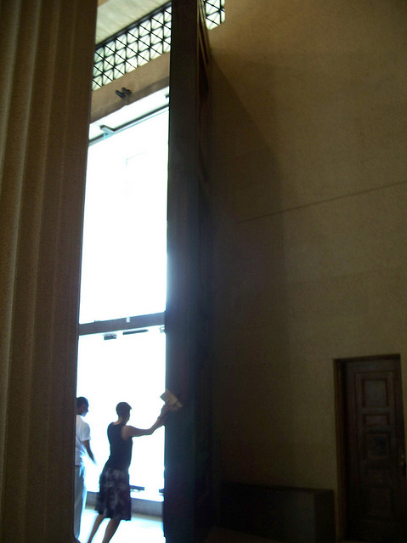
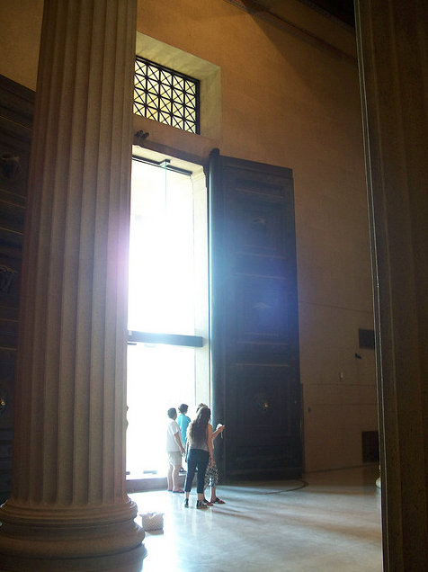
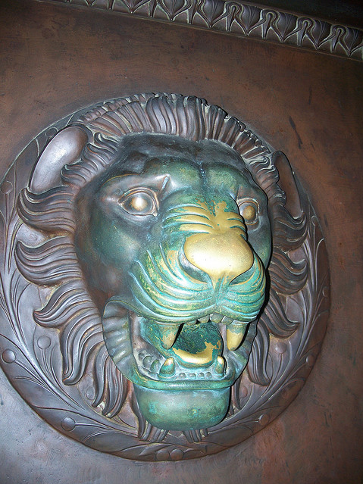
MASSIVE DOORS WEIGHING 3 TONS EACH!!

Slide 82
V7 *”little chambers” … floor space = 1 reed square.
(v10 states that there are three on each side of the gate).
“spaces” between the little chambers: 5 cu.
V7-8 *Threshold & porch within the gate” are 1 reed broad (numbered 1,2,3,4)
V8 “The Porch (5) ..inward” 8 cubits + 2 cu. Posts.
V10 *Three “ little chambers” on each side of the Gate. *”i.e. runner-changers” see 1 Kgs. 14:28.
*The “posts” have a common measure, given in verse 14. (Pedestals + palm-like pillars) v16.
V11 *The “DOOR” (v13) = “entry” .. 10cu. Broad; 13cu. High
V12 *The Boundary structures” (which are the “narrow windows” (v16) or “fretted tracery” in stone; (arabesques’) or latticework which is open).
*”6 cubits” = the HEIGHT of the runner chambers.
V13 *the WIDTH of the gate: 25 cubits “door against door” = the full width of both the front threshold and the inner threshold (the thresholds will have doors, both at the 7 steps and the inner porches also)
V14 *Palm-like pillars (posts)…60 cu/pair, were made for the posts (surbases) at the side of the gate, as well as for those about the court.
“60 cubits”..(end of v10) are for pairs of posts on either side of the gate: each pair are linked by arches. This view of 30 cubits for each great pillar upon a surbase of 5 x 6 x 13 cu. Provides a better proportion for the height of the building with its galleries overhead, and for the width of the gate and arches.
V15 *The LENGTH of the gate: 50 cubits
V16 *”narrow windows” = Margin gives 1 Kings 6:4
The words are rendered, “windows of fixed latticework” (RV).
Gesenius states: “windows closed with bars, or lattice.”
Bro. Sulley suggests that these may be arabesque architecture: fretted tracery of beautiful design…of perforated work.
*These are applied to (a) the little chambers, (b) their posts, (c) the arches
Notes:
V7 *”little chambers” … floor space = 1 reed square.
(v10 states that there are three on each side of the gate).
“spaces” between the little chambers: 5 cu.
V7-8 *Threshold & porch within the gate” are 1 reed broad (numbered 1,2,3,4)
V8 “The Porch (5) ..inward” 8 cubits + 2 cu. Posts.
V10 *Three “ little chambers” on each side of the Gate. *”i.e. runner-changers” see 1 Kgs. 14:28.
*The “posts” have a common measure, given in verse 14. (Pedestals + palm-like pillars) v16.
V11 *The “DOOR” (v13) = “entry” .. 10cu. Broad
13cu. High
V12 *The Boundary structures” (which are the “narrow windows” (v16) or “fretted tracery” in stone; (arabesques’) or latticework which is open).
*”6 cubits” = the HEIGHT of the runner chambers.
V13 *the WIDTH of the gate: 25 cubits “door against door” = the full width of both the front threshold and the inner threshold (the thresholds will have doors, both at the 7 steps and the inner porches also)
V14 *Palm-like pillars (posts)…60 cu/pair, were made for the posts (surbases) at the side of the gate, as well as for those about the court.
“60 cubits”..(end of v10) are for pairs of posts on either side of the gate: each pair are linked by arches. This view of 30 cubits for each great pillar upon a surbase of 5 x 6 x 13 cu. Provides a better proportion for the height of the building with its galleries overhead, and for the width of the gate and arches.
V15 *The LENGTH of the gate: 50 cubits
V16 *”narrow windows” = Margin gives 1 Kings 6:4
The words are rendered, “windows of fixed latticework” (RV).
Gesenius states: “windows closed with bars, or lattice.”
Bro. Sulley suggests that these may be arabesque architecture: fretted tracery of beautiful design…of perforated work.
*These are applied to (a) the little chambers, (b) their posts, (c) the arches

Slide 83
Solomon’s Porch
1Ki 7:6 And he made a porch of pillars; the length thereof was fifty cubits, and the breadth thereof thirty cubits: and the porch was before them: and the other pillars and the thick beam were before them.
1Ki 7:7 Then he made a porch for the throne where he might judge, even the porch of judgment: and it was covered with cedar from one side of the floor to the other.
1Ki 7:8 And his house where he dwelt had another court within the porch, which was of the like work. Solomon made also an house for Pharaoh's daughter, whom he had taken to wife, like unto this porch.
Cp. Vv. 19-21

Slide 84
Are We Half-way Between…?
Eze 8:15 Then said he unto me, Hast thou seen this, O son of man? turn thee yet again, and thou shalt see greater abominations than these.
Eze 8:16 And he brought me into the inner court of the LORD'S house, and, behold, at the door of the temple of the LORD, between the porch and the altar, were about five and twenty men, with their backs toward the temple of the LORD, and their faces toward the east; and they worshipped the sun toward the east.

Slide 85
Mat 26:69 Now Peter sat without in the palace: and a damsel came unto him, saying, Thou also wast with Jesus of Galilee.
70 But he denied before them all, saying, I know not what thou sayest.
71 And when he was gone out into the porch, another maid saw him, and said unto them that were there, This fellow was also with Jesus of Nazareth.
72 And again he denied with an oath, I do not know the man.
73 And after a while came unto him they that stood by, and said to Peter, Surely thou also art one of them; for thy speech bewrayeth thee.
74 Then began he to curse and to swear, saying, I know not the man. And immediately the cock crew.
75 And Peter remembered the word of Jesus, which said unto him, Before the cock crow, thou shalt deny me thrice. And he went out, and wept bitterly.

Slide 86
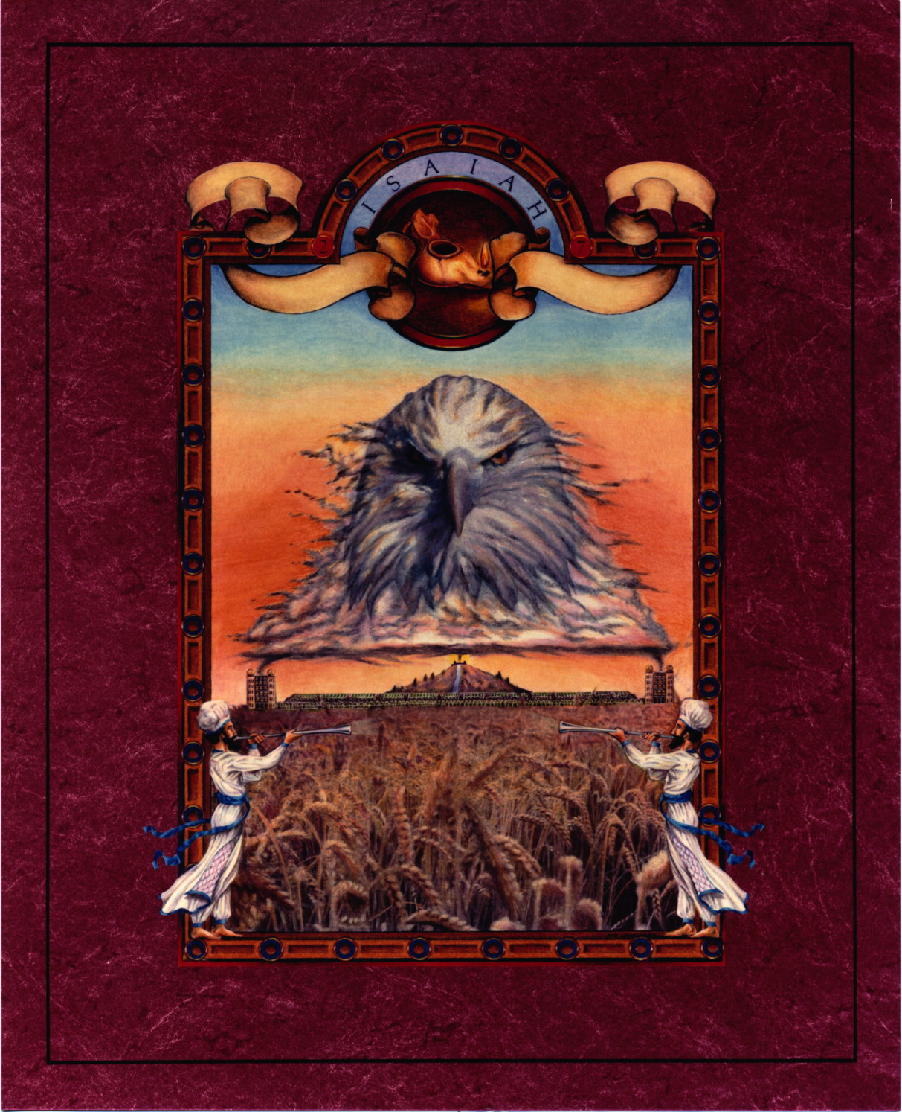

Slide 87
Jehoida’s Appointment of Porters
2Ch 23:18 Also Jehoiada appointed the offices of the house of the LORD by the hand of the priests the Levites, whom David had distributed in the house of the LORD, to offer the burnt offerings of the LORD, as it is written in the law of Moses, with rejoicing and with singing, as it was ordained by David.
2Ch 23:19 And he set the porters at the gates of the house of the LORD, that none which was unclean in any thing should enter in.
2Ch 23:20 And he took the captains of hundreds, and the nobles, and the governors of the people, and all the people of the land, and brought down the king from the house of the LORD: and they came through the high gate into the king's house, and set the king upon the throne of the kingdom.
2Ch 23:21 And all the people of the land rejoiced: and the city was quiet, after that they had slain Athaliah with the sword.

