Slide 1
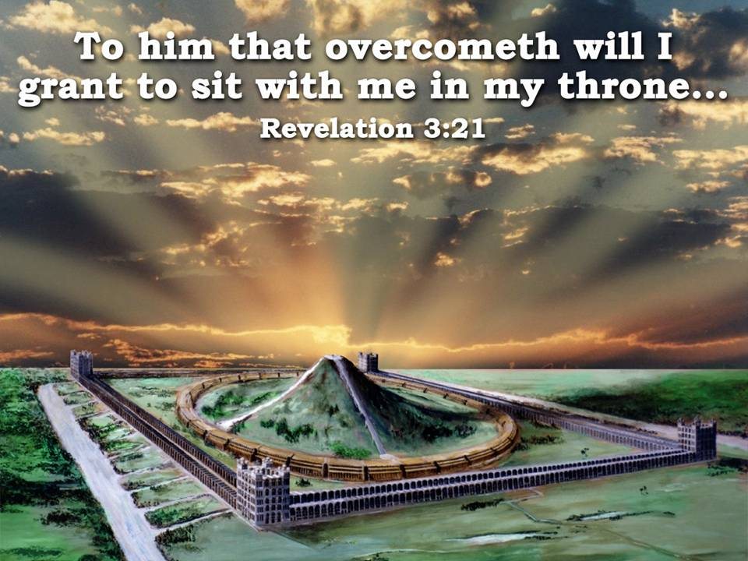
Class 4 – “The Priesthood, God’s Glory and the Altar”

Slide 2
TRIBES OF ISRAEL ENCAMPED ON THE NORTH
NORTH
MERARITES
TRIBES OF ISRAEL ON THE WEST
TABERNACLE
MOSES, AARON & SONS
GERSHONITES
TRIBES OF ISRAEL ON THE EAST
KOHATHITES
TRIBES OF ISRAEL ENCAMPED ON THE SOUTH

Slide 3
THE CHAMBERS OF THE SINGERS.
Ezekiel 40:44
The buildings forming the inner circle in the inner court are said to be the cellae of the "singers."
This designation is significant and of deep interest. The term indicates a renewal of a similar service of song which formed such an important feature in the Tabernacle and Temple of old.
1Ch 25:1 - “Moreover David and the captains of the host separated to the service of the sons of Asaph, and of Heman, and of Jeduthun, who should prophesy with harps, with psalteries, and with cymbals: and the number of the workmen according to their service was:
1Ch 25:2 Of the sons of Asaph; Zaccur, and Joseph, and Nethaniah, and Asarelah, the sons of Asaph under the hands of Asaph, which prophesied according to the order of the king.

Slide 4
Ezekiel 40:44-46
Eze 40:44 And without the inner gate were the chambers of the singers in the inner court, which was at the side of the north gate; and their prospect was toward the south: one at the side of the east gate having the prospect toward the north.
Eze 40:45 And he said unto me, This chamber, whose prospect is toward the south, is for the priests, the keepers of the charge of the house.
Eze 40:46 And the chamber whose prospect is toward the north is for the priests, the keepers of the charge of the altar: these are the sons of Zadok among the sons of Levi, which come near to the LORD to minister unto him.

Slide 5
The Most Holy, therefore, is shown as an open area inside the Temple, not square in form but like a mountain with buildings "round about."
The MOST HOLY or Temple area

Slide 6
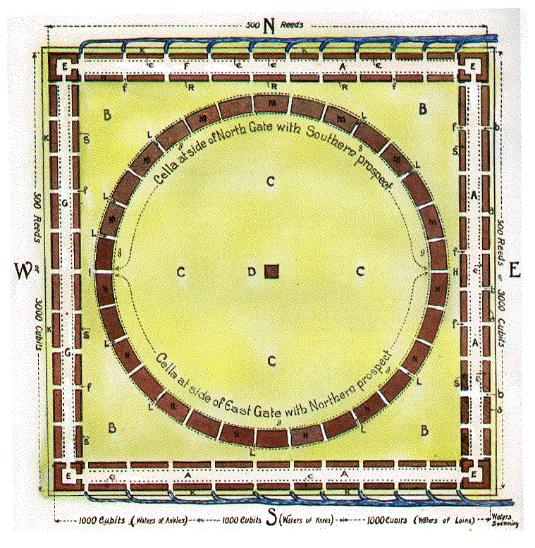
CHAMBERS OF LEVITE SINGERS
IMMORTALS
WHOLE CIRCLE CONTAINS THE NORTHERN HALF, SONS OF ZADOK WHO
KEEP ALTAR.
MORTALS
SOUTHERN HALF,
LEVITES KEEP HOUSE, i.e.
IMMORTAL & MORTAL PRIESTS.
Ezk. 40:44
40:44- 47 – Two Hemispheres
200’ distance in the corners

Slide 7
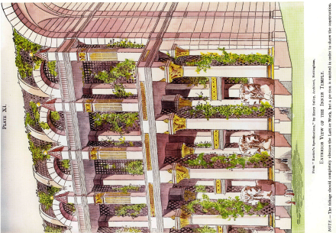
Plate 11 - Exterior View of the Inner Temple
a circular range of 30 buildings, each about 400 hundred and 50 feet in length, 200 hundred and 60 feet in width, 200 hundred feet in height; separated the one from the other by a covered-way 40 feet wide. Thus a continuous range of porticoes is presented to his view, each 34 feet wide on the outside, and 32 feet wide on the inside with steps leading up to a corridor, or porch, 30 feet wide, running the full length of each building, both on the outer and inner sides. Thus the building proper is two hundred feet wide. (260 less 60 — 2 X 30).

Slide 8
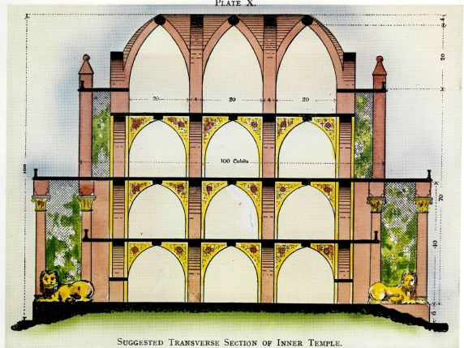
Plate 10 - Transverse Section of Inner Temple

Slide 9
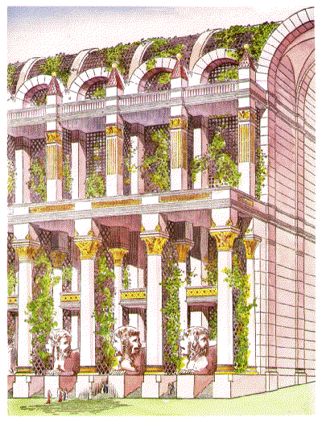

Slide 10
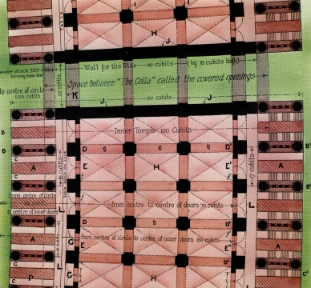
Gates of the Most Holy
41:2
VERSE 2
"The breadth of the door" — See mg. "entrance." "Door" is the Heb. pethach, an opening, which is formed between the posts of v 1. This entrance is 10 cu. wide, as deduced from v 3.
"Sides of the door" — The side of 5 cubits refers to the thickness of the sides of the porches, which are divided into two by the cherubim (plate 9, “A”)

Slide 11
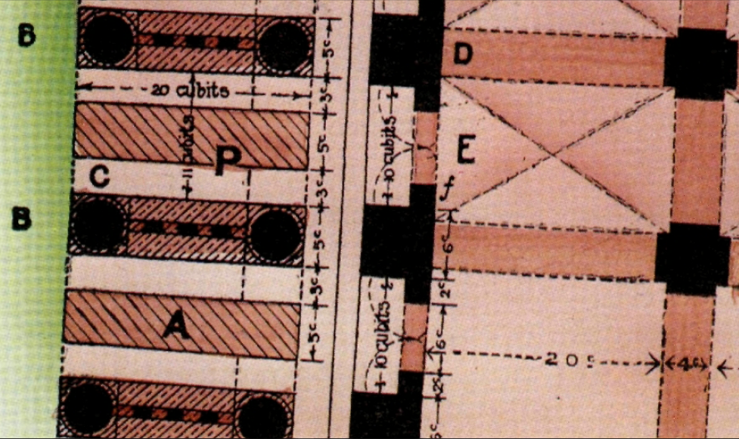
"Length 20 cubits, breadth 20 cubits" — The measurements here relate to the length and height of the circular temple rooms. The length is 20 cubits (plate 9), and the breadth is 16 cubits, the full entrance width (17 on the outer side, plate 9), hence the other 20-cubit measure of v. 4 must be the height of the rooms. The 16 cubit breadth is obtained thus: doorway 10 (v .2), plus two halves of the 6 cubit posts (v. 1), hence 10+3+3 =16 (see plate 9).
3c
10c
3c
20c

Slide 12
Plate 2 – Block Plan of the Sanctuary (Pg 3)
From these verses we learn that two sets and two orders of priests serve in these buildings—one section of the circular range, having its prospect southward, is said to be for " the use of the priests, the keepers of the charge of the house"(Chapter 40:45), and the other section for " the use of the priests the keepers of the charge of the altar"(Chap. 40:45-46), i.e., one set of mortal and immortal priests are provided for each section.
M-M-M
N-N-N

Slide 13
"Among the sons of Levi"
— Two classes of priests operate in the circular temple One is mortal, and the other immortal, each with their respective duties.
The mortal Levites' duty is to teach the people divine principles (ch. 44:23; Mal. 2:4-8), when the Law goes forth from Zion, and to instruct those visiting the great temple as to the various features of its beauty
(Isa. 2:3). The immortal class, the "sons of Zadok“ officiate in preparing the people for worship, and drawing them to appreciate the majesty of the King.

Slide 14
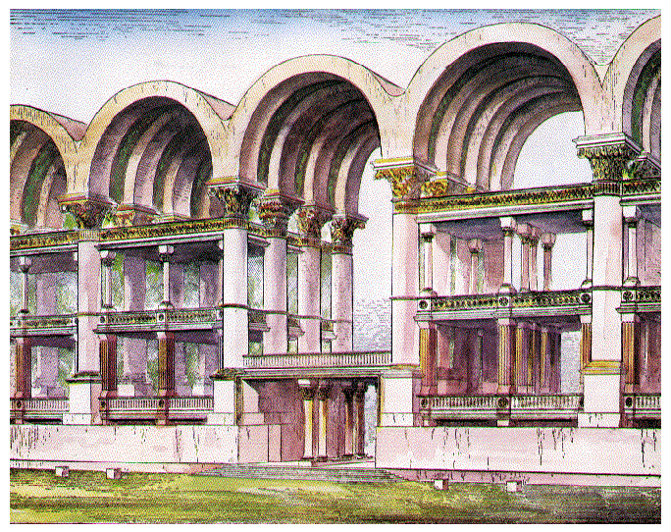
CHAPTER 44:4-9; CHAPTER 44:10-31
Ezekiel is taken to the North Gate (the place of the killing of the sacrificial animals) and there made to understand that never again will Israel be permitted to defile Yahweh's Holy House.
They had offered to Him polluted "bread, the fat and the blood", literally and in their hearts, both people and priests.

Slide 15
CHAPTER 44:4-9; CHAPTER 44:10-31
There was, and will be, a distinction between the unfaithful and the faithful priestly orders
This distinction is drawn on the basis of the dual priests of David's time, and their subsequent actions
Under David "Zadok and Abiathar were the priests" (2 Sam. 20:25). But when
Adonijah made his move to claim the throne, Abiathar allied himself to him, while Zadok remained faithful to Yahweh's choice (1 Kings 1:7-8)
Zadok subsequently anointing Solomon as king (vv. 37-38).
Solomon later "thrust out Abiathar from being priest unto the Lord" (Ch. 2:37), "and Zadok the priest did the king put in the room of Abiathar" (v. 35). Fittingly, Zadok means "righteous, justified, upright".

Slide 16
CHAPTER 44:4-9; CHAPTER 44:10-31
There was, and will be, a distinction between the unfaithful and the faithful priestly orders
This distinction is drawn on the basis of the dual priests of David's time, and their subsequent actions
Under David "Zadok and Abiathar were the priests" (2 Sam. 20:25). But when
Adonijah made his move to claim the throne, Abiathar allied himself to him, while Zadok remained faithful to Yahweh's choice (1 Kings 1:7-8)
Zadok subsequently anointing Solomon as king (vv. 37-38).
Solomon later "thrust out Abiathar from being priest unto the Lord" (Ch. 2:37), "and Zadok the priest did the king put in the room of Abiathar" (v. 35). Fittingly, Zadok means "righteous, justified, upright".
Of the Levites it is said that they will be "the keepers of the charge of the house" (Ch. 40:45); "ministers in My Sanctuary, having charge at the gates of the house, and ministering to the house; they shall slay the burnt offering and the sacrifice for the people, and they shall stand before them to minister unto them" (Ch. 44:11). But "they shall not come near unto Me, to do the office of a priest unto Me, nor to come near to any of My holy things in the Most Holy" (Ch. 44:13).

Slide 17
THE CHAMBERS OF THE SINGERS.
Ezekiel 40:44
Service of song may be one of the methods by which the people will be taught the judgments of the Lord. What can be more impressive than an innumerable company of messengers chanting divine precepts, or hymning words of praise ?
The angels sang at the birth of Jesus (Luke 11.13,14) in anticipation of " glory to God in the highest, and on earth peace and goodwill towards men “ —a prophecy which yet awaits fulfilment, when the rule of David's son is established for all the earth. (Isa. 9:6-7; Psalm 2:6-8.)
What hymns of praise will ascend from the buildings in the inner court which then become an everlasting monumental memorial of angelic song and are therefore called the " chambers," cellae, of the SINGERS ! (Psa. 27:4-6; 149:5-6.)

Slide 18
Ezekiel 40:47
"He measured the court"
At this point Ezekiel in vision ascends the mountain to the altar in the center of the circle, and measures the altar court, which is 100 cubits square (plate 12, Temple book). The details of the altar are kept until ch. 43.
"Before the house" — The word "before" is the Heb. paniym, meaning, "turning the face towards." The altar faces the house in every direction.

Slide 19
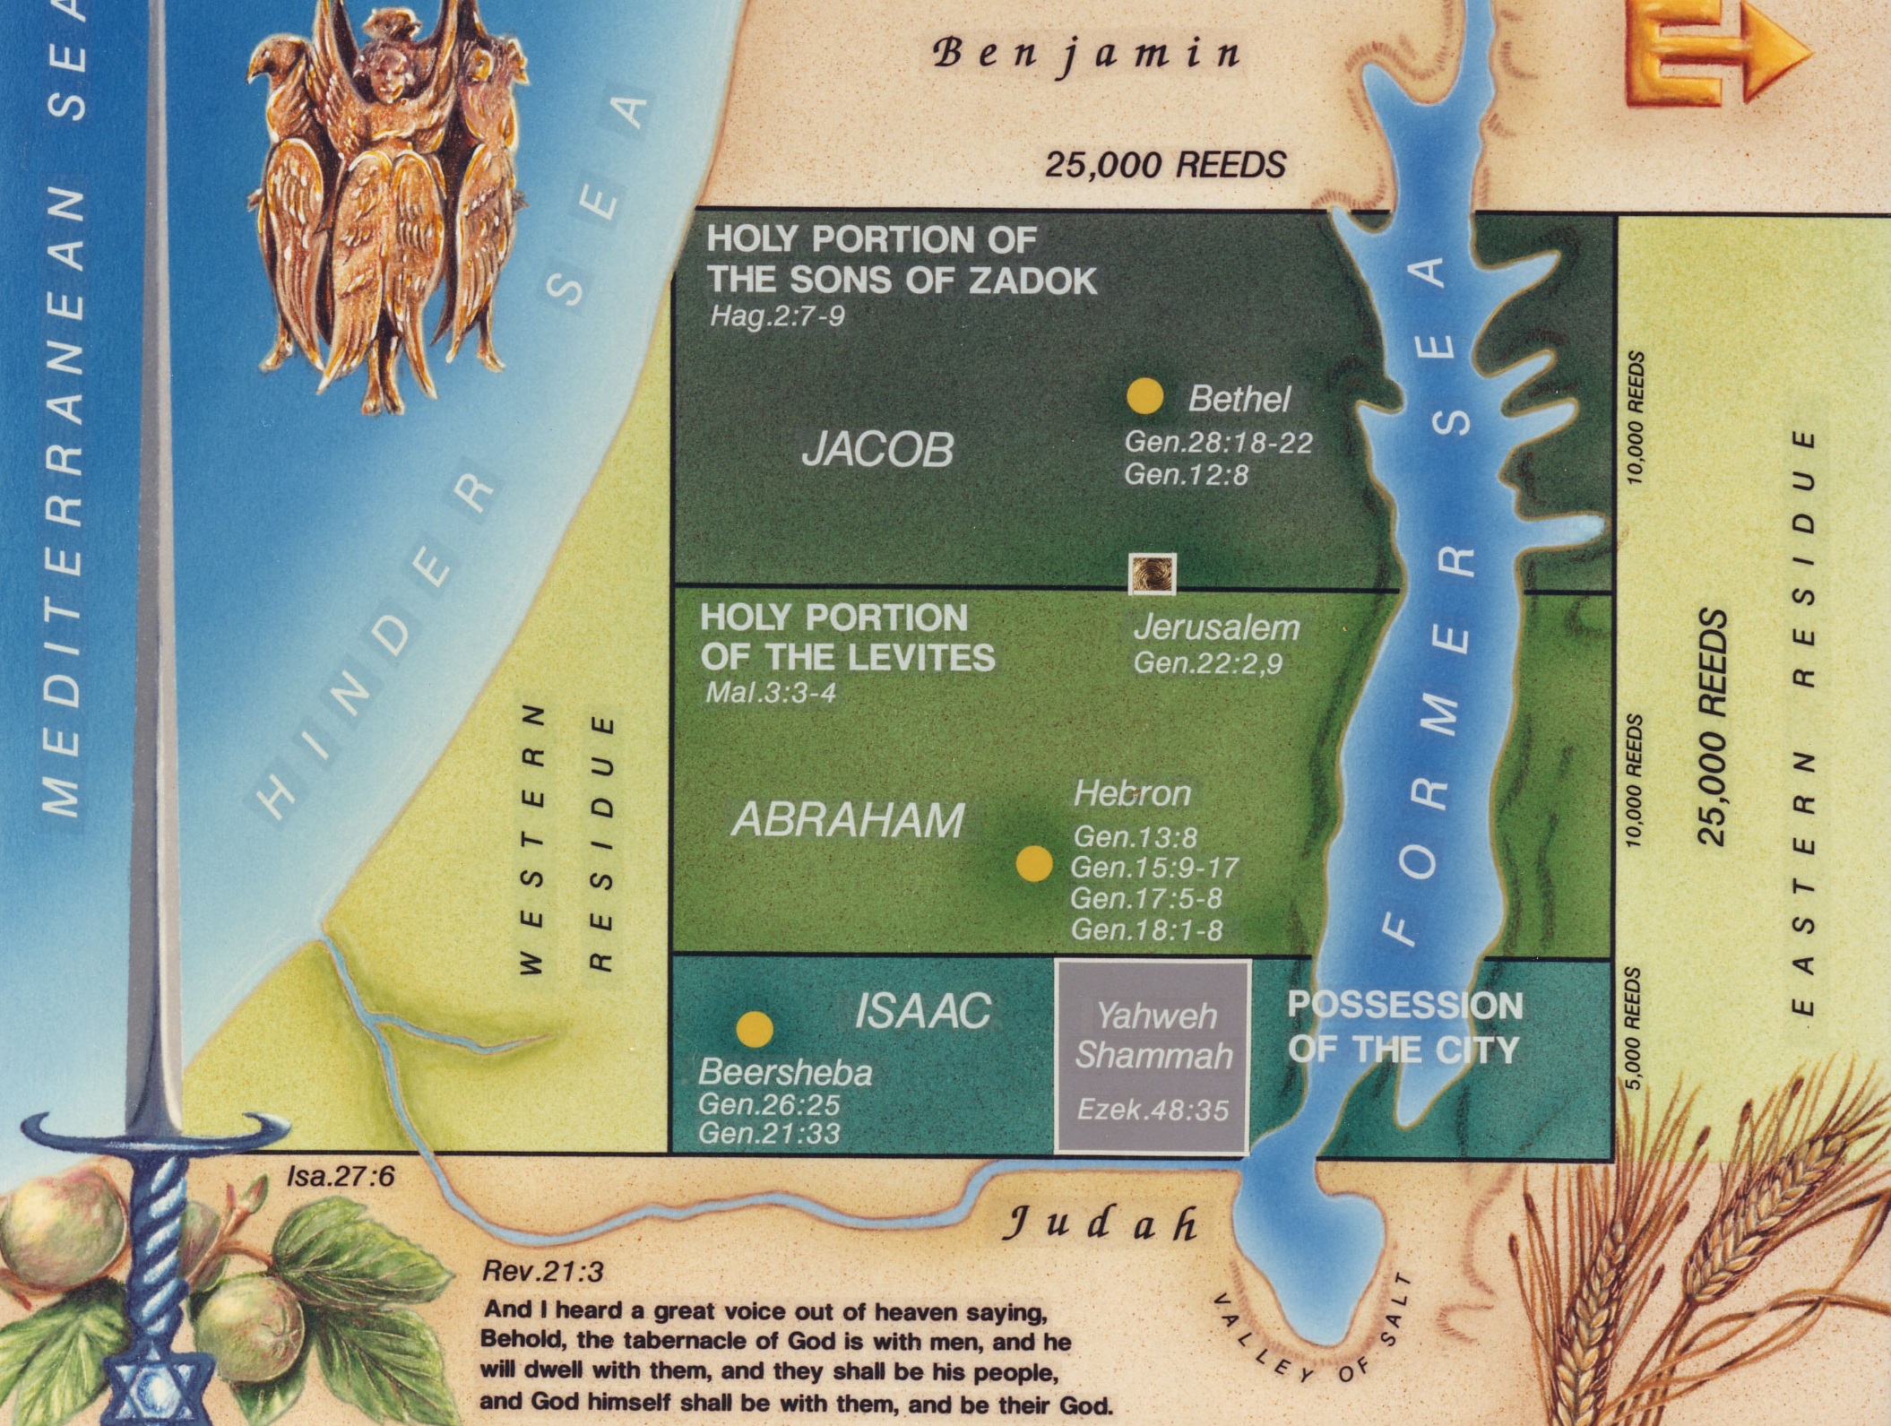

(56.81mi; 91.43km)
HOLY PORTION OF THE SONS OF ZADOK
(22.7mi;
36.53km)
THE SANCTUARY
HOLY PORTION OF THE LEVITES
(56.81mi; 91.43km)
(22.7mi;
36.53km)
POSSESSION OF THE CITY
(11.36mi;
18.28km)
THE CITY OF “YAHWEH SHAMMAH”

Slide 20
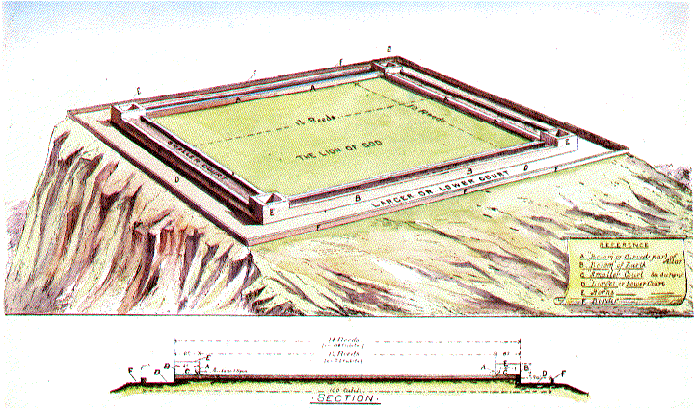
THE ALTAR
SACRIFICES CONSUMED BY FIRE FROM HEAVEN. 12 REEDS SQ.(50 YDS. SQ.) EZK43:13, 2 CHR. 7:1, LEV. 9:24; JUD. 6:21; 2 KG. 18:23; 1 CHR. 21:26; HEB. 9:8
(PG. 127) [58-59]

Slide 21
Isa 61:4 And they shall build the old wastes, they shall raise up the former desolations, and they shall repair the waste cities, the desolations of many generations.
Isa 61:5 And strangers shall stand and feed your flocks, and the sons of the alien shall be your plowmen and your vinedressers.
Isa 61:6 But ye shall be named the Priests of the LORD: men shall call you the Ministers of our God: ye shall eat the riches of the Gentiles, and in their glory shall ye boast yourselves.

Slide 22
Isa 61:7 For your shame ye shall have double; and for confusion they shall rejoice in their portion: therefore in their land they shall possess the double: everlasting joy shall be unto them.
Isa 61:8 For I the LORD love judgment, I hate robbery for burnt offering; and I will direct their work in truth, and I will make an everlasting covenant with them.

Slide 23
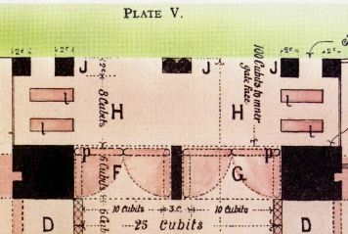
The structural arrangements for the inner porches are admirably suited to their purpose, for the immortal priests will use them and such need no doors or entrances on their own account, except where they officiate on behalf of the mortals and are observed by them. They will probably come and go to the inner porches unobserved by the mortals, and certainly will not have need of conventional doors (Cf John 20:19), being equal unto the angels (Luke 20:36).
INNER PORCH OF NORTHERN OUTER COURT GATE

Slide 24
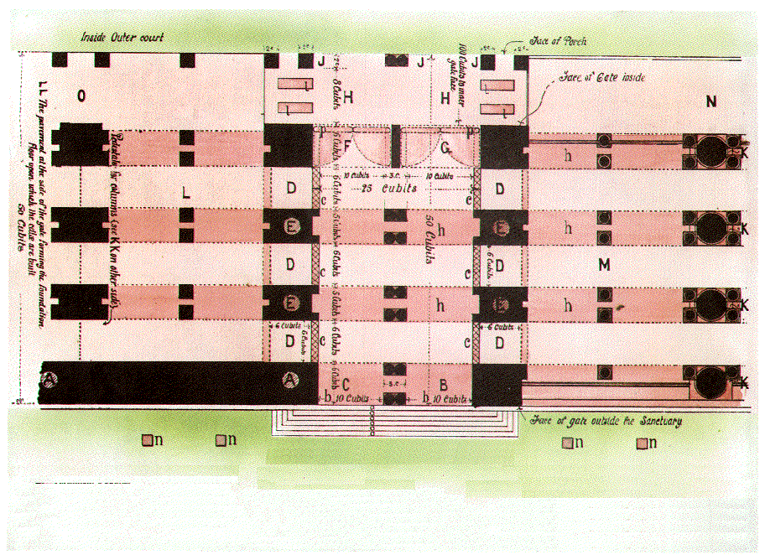

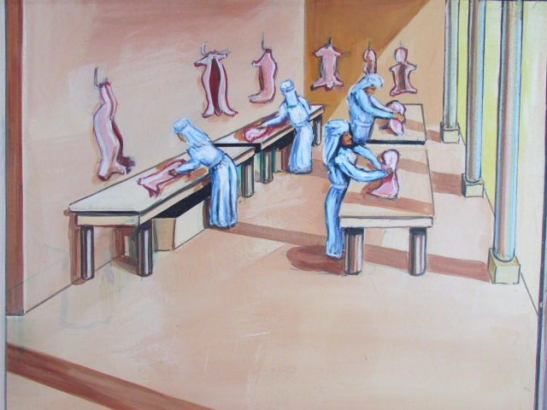
AREAS OF MORTAL PRIESTLY ACTIVITIES REGARDING THE SACRIFICIAL ARRANGEMENTS (40:38-43)

Slide 25
Priesthood and Jerusalem Coincide
First mention of Jerusalem in Scripture – Gen. 14:18 – as the city of “Salem”
The predominant idea of the city is expounded in Heb. 7:1-2 about Melchizedek
King of Salem, that is “King of Peace”
Peace is the dominating but elusive characteristic of that troubled city
Christ wept as he spoke of her blindness to what he could do for her in that regard Luke 19:42
John 14:27 – Jesus offers us that peace today

Slide 26
“Peace Within Thy Walls & Prosperity Within Thy Palaces”
The Psalmist tells us to pray for “the peace of Jerusalem” (Psa. 122:6)
Isaiah speaks of her peace flowing like a river Isa 48:18 “O that thou hadst hearkened to my commandments! then had thy peace been as a river, and thy righteousness as the waves of the sea”
Hag 2:9 The glory of this latter house shall be greater than of the former, saith the LORD of hosts: and in this place will I give peace, saith the LORD of hosts.

Slide 27
Ezekiel Proclaims Her Peaceful Future
Eze 37:26 Moreover I will make a covenant of peace with them; it shall be an everlasting covenant with them: and I will place them, and multiply them, and will set my sanctuary in the midst of them for evermore.
27 My tabernacle also shall be with them: yea, I will be their God, and they shall be my people.
28 And the heathen shall know that I the LORD do sanctify Israel, when my sanctuary shall be in the midst of them for evermore.

Slide 28
Haggai Speaks of the Peace That YHWH Will Give Jerusalem

Slide 29
Zechariah’s Prophecy of Peace
Zec 6:12 And speak unto him, saying, Thus speaketh the LORD of hosts, saying, Behold the man whose name is The BRANCH; and he shall grow up out of his place, and he shall build the temple of the LORD:
Zec 6:13 Even he shall build the temple of the LORD; and he shall bear the glory, and shall sit and rule upon his throne; and he shall be a priest upon his throne: and the counsel of peace shall be between them both.

Slide 30
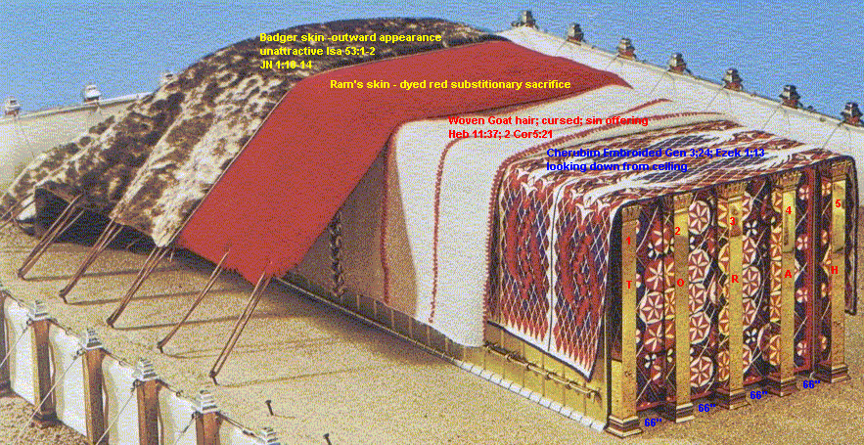
Tabernacle Coverings

Slide 31
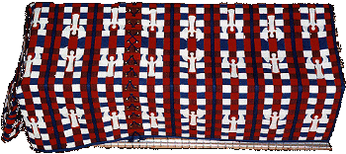
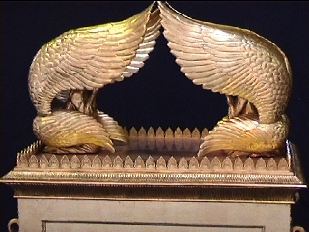
Cherubim Woven into Linen Curtains of Tabernacle

Slide 32
Cherubim Over Mercy Seat

Slide 33
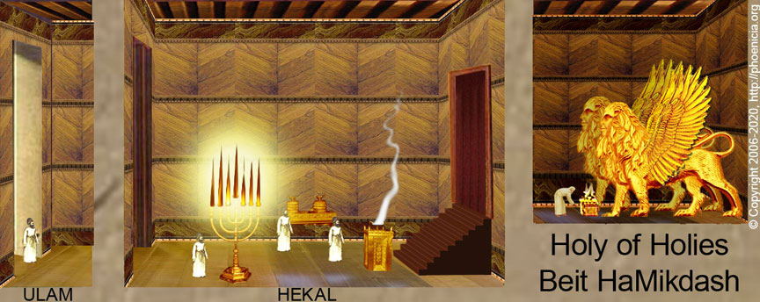
Cherubim in Solomon’s Temple

Slide 34
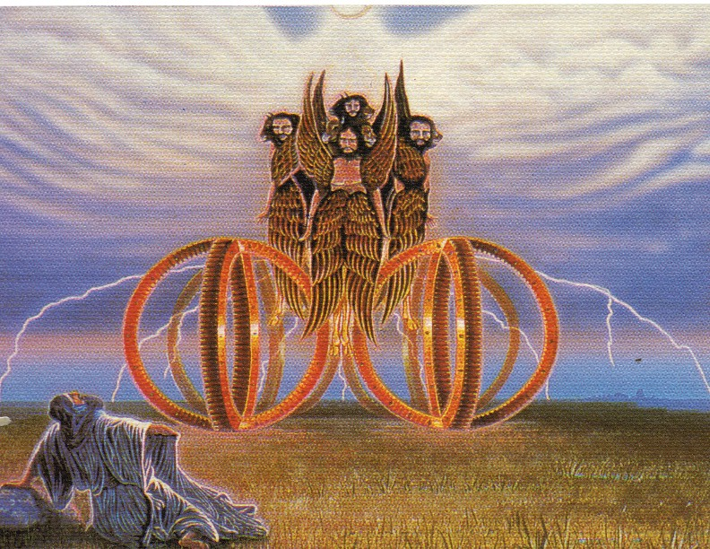
Cherubim of Ezekiel’s Vision

Slide 35
“The counsel of peace shall be between them both"
A complete fusion of kingly authority and priestly dignity without the antagonism that often disgraced these offices in the past.
The word “peace” is the Hebrew word “Shalom”, and comes from a root signifying "to be at one," "complete,” "entire.”
The union of offices in Christ will bring all mankind both into subjection to God and into fellowship with Him.
Thus men will enjoy true peace — not merely the cessation of war, but a state of union with Yahweh through Christ (Eph. 2:14, Ps. 85:8-10. Lk. 2:i4).

Slide 36
An Internationally Ransomed Kingdom of Priests
Rev 5:9 And they sang a new song, saying, "Worthy art thou to take the scroll and to open its seals, for thou wast slain and by thy blood didst ransom men for God from every tribe and tongue and people and nation,
10 and hast made them a kingdom and priests to our God, and they shall reign on earth."

Slide 37
God Created Israel to be a Kingdom of Priests Above All People
Exo 19:5 Now therefore, if ye will obey my voice indeed, and keep my covenant, then ye shall be a peculiar treasure unto me from among all peoples: for all the earth is mine:
Exo 19:6 and ye shall be unto me a kingdom of priests, and an holy nation. These are the words which thou shalt speak unto the children of Israel. (RV)

Slide 38
Rev. 5:9
(RSV) and hast made them a kingdom and priests to our God, and they shall reign on earth."
(Rotherham) And didst make them, unto our God, a kingdom and priests,—and they reign on the earth.
(RV) and madest them to be unto our God a kingdom and priests; and they reign upon the earth.

Slide 39
The Priesthood Orders
We have seen that the Most Holy is a central hypaethral (hī-ˈpē-thrəl), or the portion of the inner Temple open to the sky and, therefore, a suitable place for an altar.
Its position there may seem incongruous, nevertheless the altar in the Most Holy will be in harmony with the Mosaic pattern of the heavenly things.
Speaking of the service of the Tabernacle for the time then present the Apostle said that the way into the holy place had not then been made manifest, while the first tabernacle stood, which is a parable of future things. (Heb. 9: 8 - 9 R.V.).
“Now, the way into the Holiest was opened by Jesus entering therein. That is, He entered into the eternal state, for of Him it was written : “He asked life of thee, and thou gavest it him, even length of days for ever and ever. (Psalm 21:4.)
Of Him it is also testified : “After the power of an endless life.”

Slide 40
The Glory in Solomon’s Temple
1Ki 8:10 And it came to pass, when the priests were come out of the holy place, that the cloud filled the house of the LORD,
1Ki 8:11 So that the priests could not stand to minister because of the cloud: for the glory of the LORD had filled the house of the LORD.

Slide 41
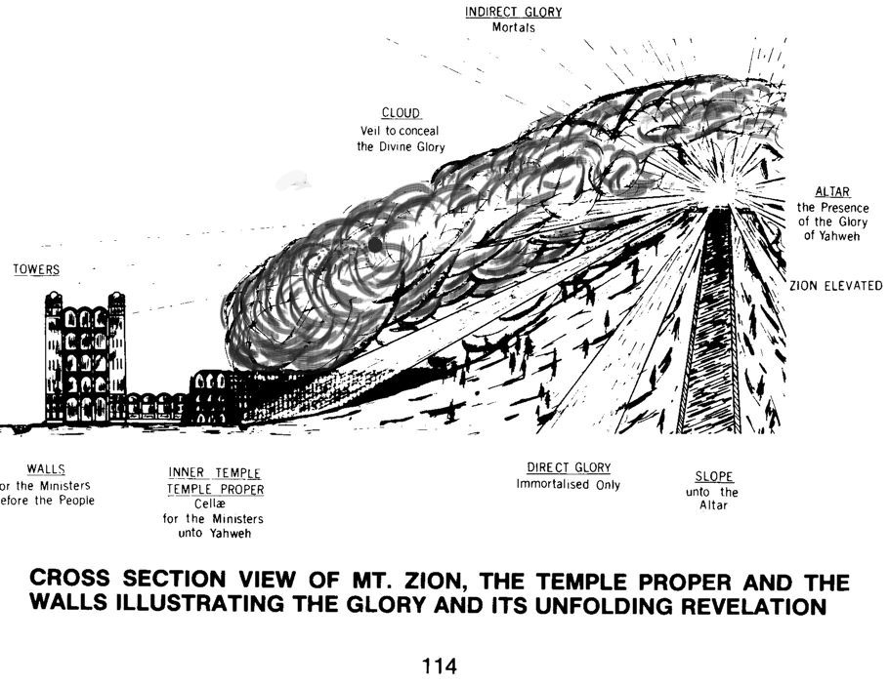
INDIRECT GLORY
Mortals
CLOUD
Veil to conceal the Divine Glory
ALTAR
The Presence of the Gory of Yahweh
TOWERS
WALLS
For the Ministers before the people
INNER TEMPLE
TEMPLE PROPER
Cellae for the Ministers unto YHWH
DIRECT GLORY
Immortalized Only
SLOPE
Unto the Altar

Slide 42
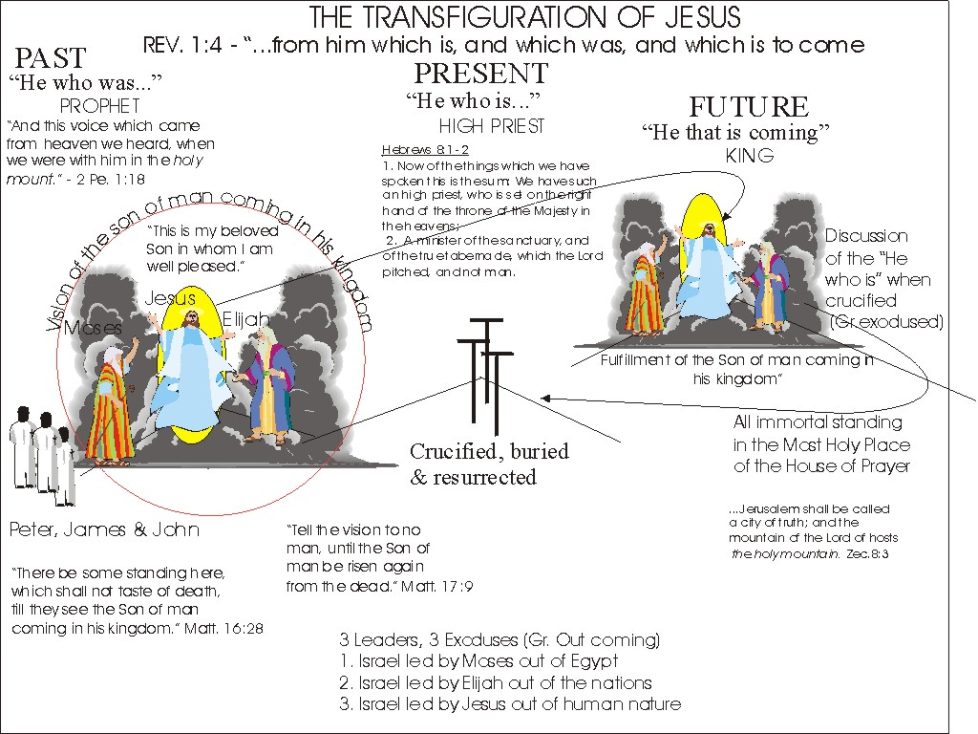

Slide 44
The Duties of the Levites
Functions of the Levitical MORTAL priesthood
Their duties
Their arrangements, buildings, clothing, etc

Slide 45
Jer. 33
15 In those days, and at that time, will I cause the Branch of righteousness to grow up unto David; and he shall execute judgment and righteousness in the land.
16 In those days shall Judah be saved, and Jerusalem shall dwell safely: and this is the name wherewith she shall be called, The LORD our righteousness.
17 For thus saith the LORD; David shall never want a man to sit upon the throne of the house of Israel;
18 Neither shall the priests the Levites want a man before me to offer burnt offerings, and to kindle meat offerings, and to do sacrifice continually.

Slide 46
Jer. 33
19 And the word of the LORD came unto Jeremiah, saying,
20 Thus saith the LORD; If ye can break my covenant of the day, and my covenant of the night, and that there should not be day and night in their season;
21 Then may also my covenant be broken with David my servant, that he should not have a son to reign upon his throne; and with the Levites the priests, my ministers.
22 As the host of heaven cannot be numbered, neither the sand of the sea measured: so will I multiply the seed of David my servant, and the Levites that minister unto me.

Slide 47
Convergence
The Convergence of the Two Ruling Offices of the Nation of Israel-High Priest and King
The convergence of the Glory of God with the Temple’s Most Holy place covered by the Shekinah glory and its disclosure to immortal eyes
The Altar’s prominent position in the collective consciousness of the earth’s populous and its lessons of “convergence”

Slide 48
Jesus afterwards spoke of this : " When the Son of Man shall come in his glory, and all the holy angels with him, then shall he sit upon the throne of his glory" (Matt. xxv. 31).
Before his death he comforted his disciples with the memory of the "Father's house," and the many abiding places which he would prepare for those who loved and obeyed him.
The apostles and the whole company of the redeemed will in that day constitute " the glory of his Father's house" which " they shall hang upon him."
There will be a Father's house in the shape of the temple of the age to come, but architectural glory, even of so exalted a kind, falls far short of the mental, moral, and deathless glory of Christ personal and multitudinous.
" The glory which thou gavest me I have given them; that they may be one even as we are one." So he spoke in prayer to the Father. In lesser degree the same thing is illustrated in the generations of Christ's friends.

Slide 49
Isa 32:15 Until the spirit be poured upon us from on high, and the wilderness be a fruitful field, and the fruitful field be counted for a forest.
Isa 32:16 Then judgment shall dwell in the wilderness, and righteousness remain in the fruitful field.
Isa 32:17 And the work of righteousness shall be peace; and the effect of righteousness quietness and assurance for ever.
Isa 32:18 And my people shall dwell in a peaceable habitation, and in sure dwellings, and in quiet resting places;

Slide 50
Rev. 21:18
" And the building of the wall of it was of jasper"—"Building" is endomesis from en, in and domad, to build, thus "that which is built in, "or the material ofwhich the wall is constructed. In v. 11, Jasper is likened to divine light, exceedingly luminous.
Speaking of the literal Temple city yet to be built at Jerusalem, Yahweh, through Zechariah, declared: "I will be unto her a wall of fire round about, and will be the glory in the midst of her" (Zech. 2:5). That wall of fire will separate the holy from the profane. The jasper stone is also likened to the "glory of God" (Rev. 21:11), and this also is appropriate, for God manifestation will comprise the basic material of this spiritual city. It will be "the glory in the midst of her."

Slide 51
START
Cp. Ezk. 42:14 with Lev. 6:11 where the priests put off their garments
Lev. 7-10-The “consecration” of the Aaronic priesthood

Slide 52
SACRIFICIAL ARRANGEMENTS.
Ezekiel 40:47; 43:13-17
I. THE POSITION OF THE ALTAR AND ITS COURT.
THE ALTAR is first mentioned in 40:47
Its position is there described, but particulars are not given of its construction. These are found in chapter The first-mentioned testimony reads :
  “He measured the court, an hundred cubits long, and an hundred cubits broad, foursquare, and the altai before the house.”
Here we see that measurement of the altar court is made while Ezekiel and his guide are in the inner court, and the altar is said to be before the house.

Slide 53
The Altar Within the Most Holy
One of the keys to the understanding of the temple prophecy is the fact that the inner sanctuary or Most Holy must surround a hill or mountain.
Any interpretation failing to provide such a hill as the Most Holy, fails to fulfil the special features stressed by the prophet, Psa.24:3,7.
When we refer to Ezek.43:12-13, we note the altar is obviously in the centre of the sanctuary circle or Most Holy, for v 13 mentions the dimensions of the altar, directly following v 12 which describes its location, i.e, the Most Holy.
That this Most Holy is a hill is seen in Psa.43:3,4; Psa. 15:1; Psa.2:6; Psa.48:1,2,9
The waters descend from the altar in Ezek.47:1
(From “The Handbook on The Temple of Ezekiel’s Prophecy”)

Slide 54
Ezek.43:17 describes the Altar. Lit. the verse reads: "And the court (i.e. altar court) fourteen long and fourteen broad ..."
To determine what these 14 "measures" are, Henry Sulley uses the consistent rule that all unspecified measures must be the original measuring staff held by the measuring angel - Ezek.40:3,5.
This we are told was one reed long. When it is intended that some smaller division of the reed measure is being applied, the Hebrew text invariably specifies some other measure, for example a cubit, span, or handbreadth (Cf 43:13).
Any attempt to expound this prophecy with a disregard for this rule, is destined to confusion. One cannot insert or omit measures at will. It is entirely inappropriate to apply cubits to the altar of the temple of the age to come, for a 14 cubit altar would be smaller than Solomon's altar, which was 20 cubits, and yet this future altar is intended for “all nations”, not just Israel!
(From “The Handbook on The Temple of Ezekiel’s Prophecy”)

Slide 56
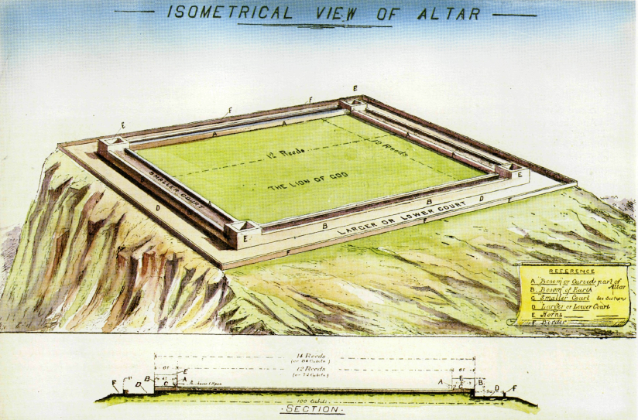
Eze 40:47 So he measured the altar (court) , an hundred cubits long, and an hundred cubits broad, foursquare; and the altar that was before the house.

Slide 57
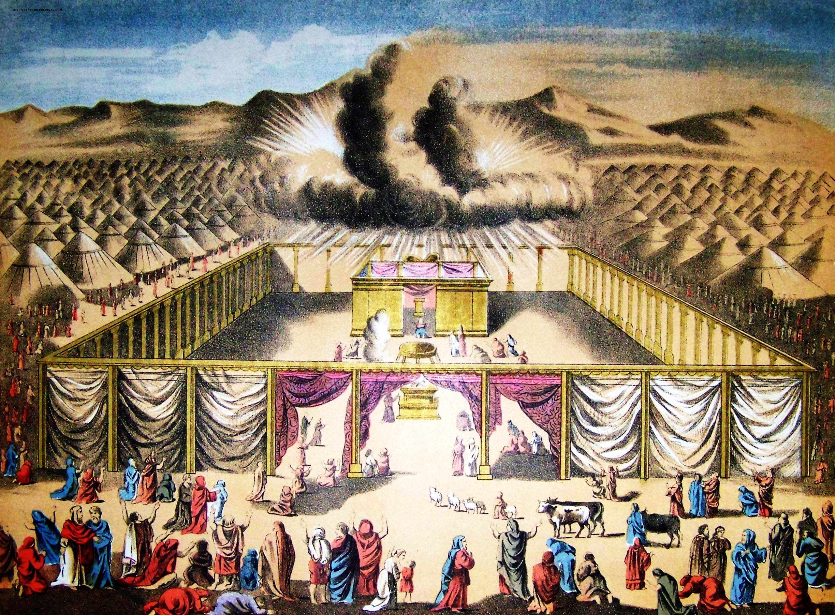
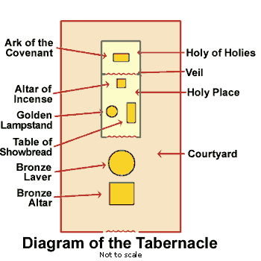
The Altar of the Tabernacle
PHYSICAL GLORIFICATION
MORAL APPLICATION
MENTAL PREPARATION
A LINEAR PROCESS FROM START TO FINISH

Slide 58
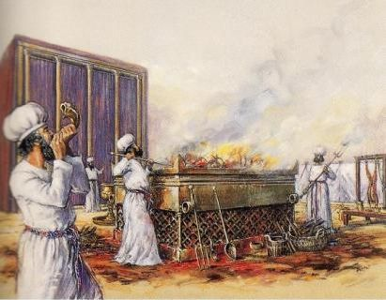
The Altar of the Tabernacle
Exo 27:1 And thou shalt make an altar of shittim wood, five cubits long, and five cubits broad; the altar shall be foursquare: and the height thereof shall be three cubits.
Exo 27:2 And thou shalt make the horns of it upon the four corners thereof: his horns shall be of the same: and thou shalt overlay it with brass.

Slide 59
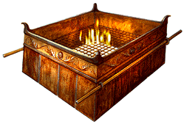
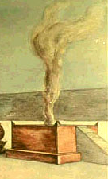
Altar of Tabernacle
Altar of Solomon’s Temple
Altar of House of Prayer
The FOURSQUARE geometric shape, four horns at the corners and brass material of the Altar are consistent features of all three altars.

Slide 60
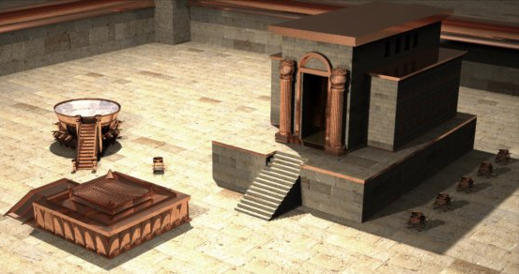
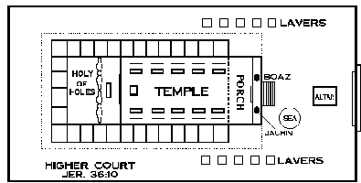
2Ch 3:8 And he made the MOST HOLY house, the length whereof was according to the breadth of the house, twenty cubits, and the breadth thereof twenty cubits:
ALTAR
2Ch 4:1 Moreover he made an ALTAR of brass, twenty cubits the length thereof, and twenty cubits the breadth thereof, and ten cubits the height thereof.

Slide 62
Matt. 16:28 Verily I say unto you, There be some standing here, which shall not taste of death, till they see the Son of man coming in his kingdom.
Matt. 17
1 And after six days Jesus taketh Peter, James, and John his brother, and bringeth them up into an high mountain apart,
2 And was transfigured before them: and his face did shine as the sun, and his raiment was white as the light.
3 And, behold, there appeared unto them Moses and Elias talking with him.
4 Then answered Peter, and said unto Jesus, Lord, it is good for us to be here: if thou wilt, let us make here three tabernacles; one for thee, and one for Moses, and one for Elias.
5 While he yet spake, behold, a bright cloud overshadowed them: and behold a voice out of the cloud, which said, This is my beloved Son, in whom I am well pleased; hear ye him.
6 And when the disciples heard it, they fell on their face, and were sore afraid.
7 And Jesus came and touched them, and said, Arise, and be not afraid.
8 And when they had lifted up their eyes, they saw no man, save Jesus only.
9 And as they came down from the mountain, Jesus charged them, saying, Tell the vision to no man, until the Son of man be risen again from the dead.

Slide 63
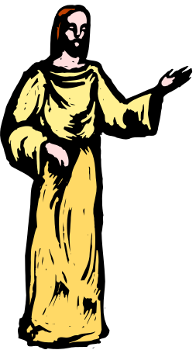
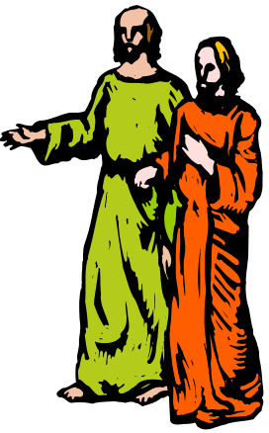
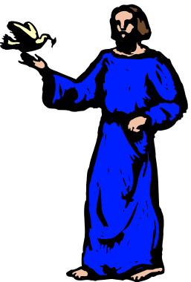
2Pe 1:16 For we have not followed cunningly devised fables, when we made known unto you the power and coming of our Lord Jesus Christ, but were eyewitnesses of his majesty.
2Pe 1:17 For he received from God the Father honour and glory, when there came such a voice to him from the excellent glory, This is my beloved Son, in whom I am well pleased.
2Pe 1:18 And this voice which came from heaven we heard, when we were with him in the holy mount.
The gospel writers had to write of a historical event that was testified to them by three men who were taken in vision to the distant future to witness two other men from their distant past, eg., Moses and Elijah, who were, in the vision, now in their “immortal glory”. And discussing with Jesus who APPEARED with them in his own “immortal glory” as King, the event of his crucifixion which in Peter, James and John’s day of their probation had not yet occurred.

Slide 64
Luk 9:27 But I tell you of a truth, there be some standing here, which shall not taste of death, till they see the kingdom of God.
Luk 9:28 And it came to pass about an eight days after these sayings, he took Peter and John and James, and went up into a mountain to pray.
Luk 9:29 And as he prayed, the fashion of his countenance was altered, and his raiment was white and glistering.
Luk 9:30 And, behold, there talked with him two men, which were Moses and Elias:
Luk 9:31 Who appeared in glory, and spake of his decease (exodos) which he should accomplish at Jerusalem.
Luk 9:32 But Peter and they that were with him were heavy with sleep: and when they were awake, they saw his glory, and the two men that stood with him.
Luk 9:33 And it came to pass, as they departed from him, Peter said unto Jesus, Master, it is good for us to be here: and let us make three tabernacles; one for thee, and one for Moses, and one for Elias: not knowing what he said.
Luk 9:34 While he thus spake, there came a cloud, and overshadowed them: and they feared as they entered into the cloud.
Luk 9:35 And there came a voice out of the cloud, saying, This is my beloved Son: hear him.
Luk 9:36 And when the voice was past, Jesus was found alone. And they kept it close, and told no man in those days any of those things which they had seen.

Slide 65
Heb 8:1 Now of the things which we have spoken this is the sum: We have such an high priest, who is set on the right hand of the throne of the Majesty in the heavens;
Heb 8:2 A minister of the sanctuary, and of the true tabernacle, which the Lord pitched, and not man.
Heb 8:3 For every high priest is ordained to offer gifts and sacrifices: wherefore it is of necessity that this man have somewhat also to offer.
Heb 8:4 For if he were on earth, he should not be a priest, seeing that there are priests that offer gifts according to the law:
Heb 8:5 Who serve unto the example and shadow of heavenly things, as Moses was admonished of God when he was about to make the tabernacle: for, See, saith he, that thou make all things according to the pattern shewed to thee in the mount.

Slide 67
1Ki 8:4 And they brought up the ark of the LORD, and the tabernacle of the congregation, and all the holy vessels that were in the tabernacle, even those did the priests and the Levites bring up.
1Ki 8:5 And king Solomon, and all the congregation of Israel, that were assembled unto him, were with him before the ark, sacrificing sheep and oxen, that could not be told nor numbered for multitude.
1Ki 8:6 And the priests brought in the ark of the covenant of the LORD unto his place, into the oracle of the house, to the most holy place, even under the wings of the cherubims.

Slide 68





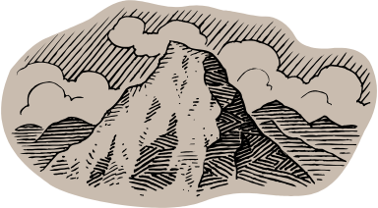
A Song of degrees of David

Slide 69
A Song of degrees of David
Psa 122:1. I was glad when they said unto me, Let us go into the house of the LORD.
2 Our feet shall stand within thy gates, O Jerusalem.
3 Jerusalem is builded as a city that is compact together:
4 Whither the tribes go up, the tribes of the LORD, unto the testimony of Israel, to give thanks unto the name of the LORD.
5 For there are set thrones of judgment, the thrones of the house of David.
6 Pray for the peace of Jerusalem: they shall prosper that love thee.
7 Peace be within thy walls, and prosperity within thy palaces.
8 For my brethren and companions' sakes, I will now say, Peace be within thee.
9 Because of the house of the LORD our God I will seek thy good.

