Slide 1
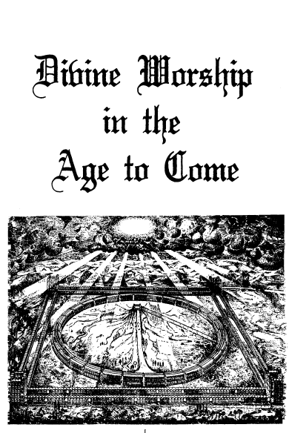
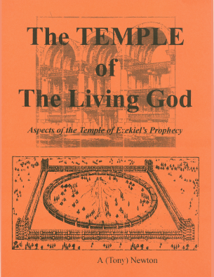
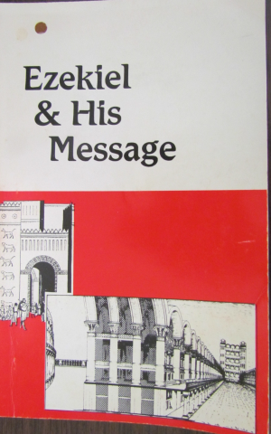
Christadelphian Resources on the House of Prayer for All Nations
"The Temple of Ezekiel's Prophecy,“ by Henry Sulley
“Divine Worship in the Age to Come” by H.P. Mansfield
“The Temple Prophecy” – series of Logos articles by S. Snow
“The Temple of the Living God” by Tony Newton
“Handbook of Answers to Objections to Ezekiel’s Temple”
“Ezekiel and His Message” by Ern Wilson

Slide 2
Class 4 Wrap-up

Slide 3
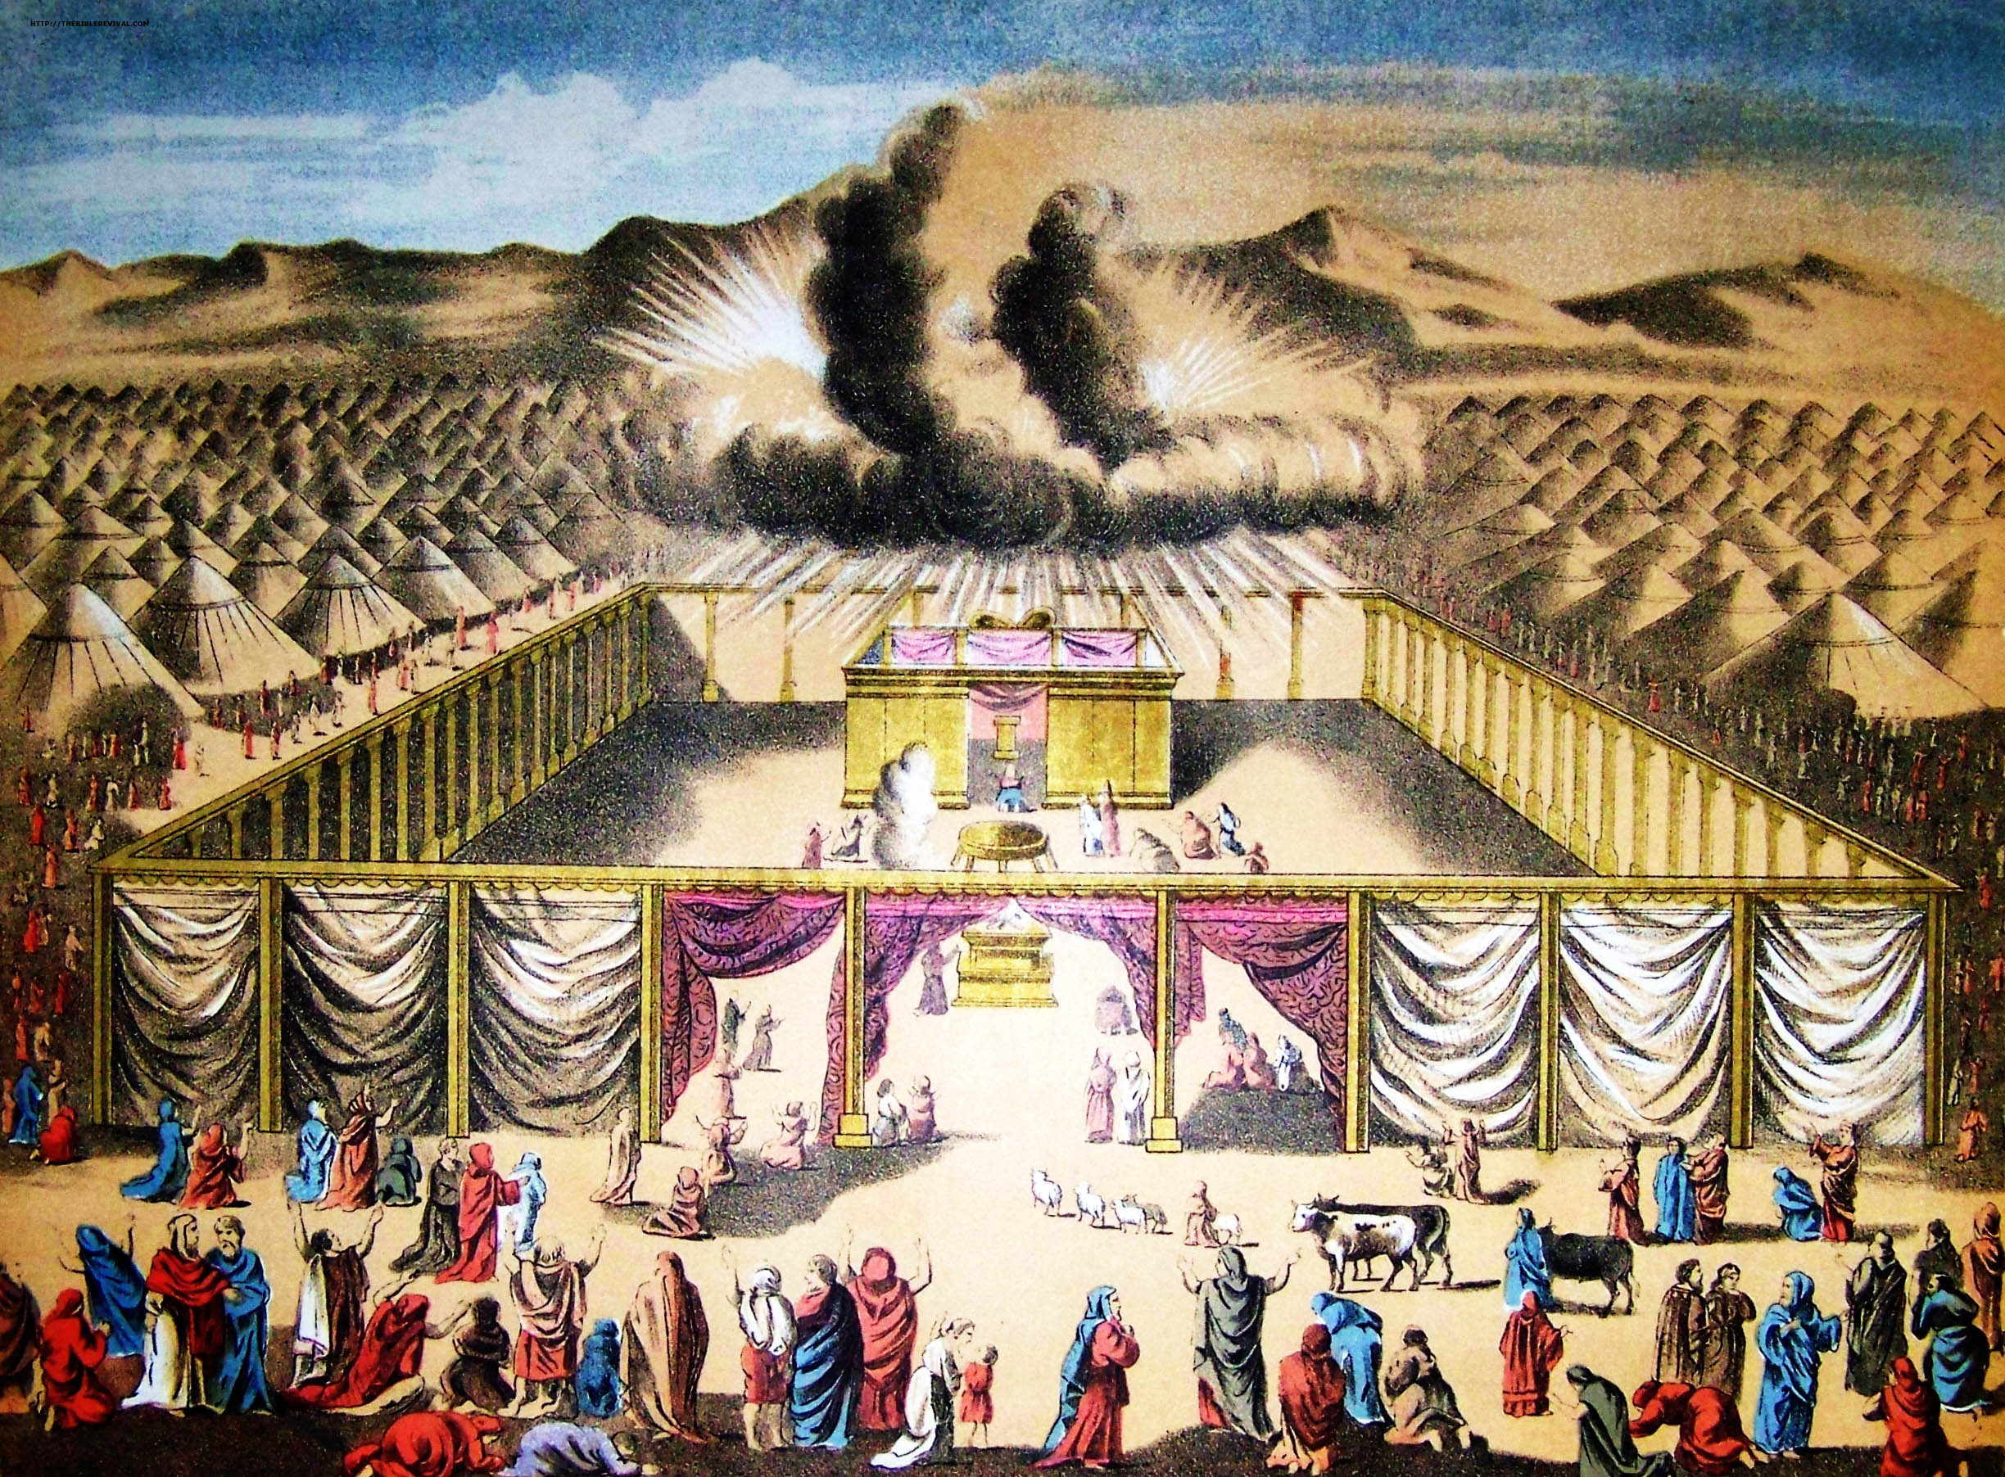
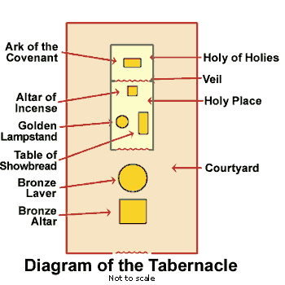
The Altar of the Tabernacle
PHYSICAL GLORIFICATION
MORAL APPLICATION
MENTAL PREPARATION
A LINEAR PROCESS FROM START TO FINISH

Slide 4
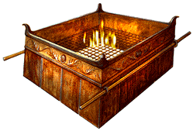
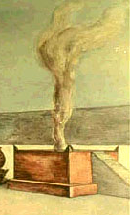
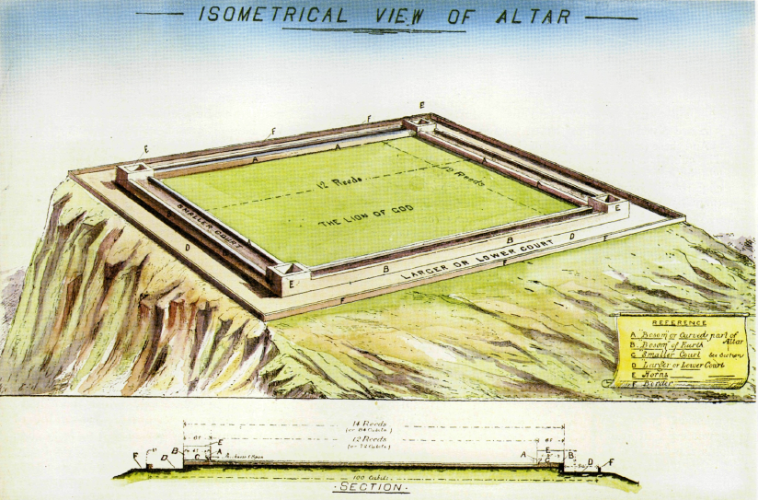
Altar of Tabernacle
Altar of Solomon’s Temple
Altar of House of Prayer
The FOURSQUARE geometric shape, four horns at the corners and brass material of the Altar are consistent features of all three altars.

Slide 5
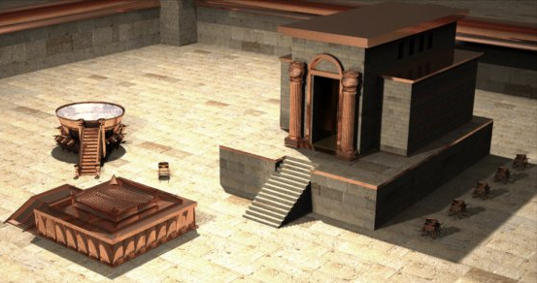
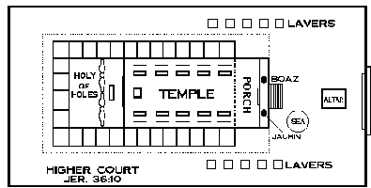
2Ch 3:8 And he made the MOST HOLY house, the length whereof was according to the breadth of the house, twenty cubits, and the breadth thereof twenty cubits:
ALTAR
2Ch 4:1 Moreover he made an ALTAR of brass, twenty cubits the length thereof, and twenty cubits the breadth thereof, and ten cubits the height thereof.

Slide 6
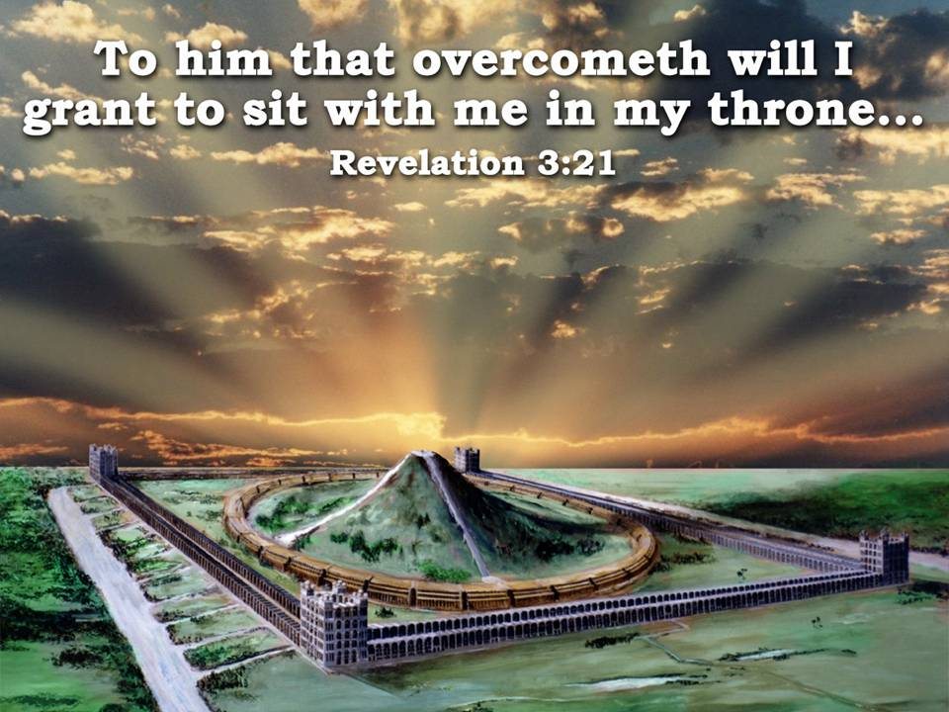

Slide 7
Matt. 16:28 Verily I say unto you, There be some standing here, which shall not taste of death, till they see the Son of man coming in his kingdom.
Matt. 17
1 And after six days Jesus taketh Peter, James, and John his brother, and bringeth them up into an high mountain apart,
2 And was transfigured before them: and his face did shine as the sun, and his raiment was white as the light.
3 And, behold, there appeared unto them Moses and Elias talking with him.
4 Then answered Peter, and said unto Jesus, Lord, it is good for us to be here: if thou wilt, let us make here three tabernacles; one for thee, and one for Moses, and one for Elias.
5 While he yet spake, behold, a bright cloud overshadowed them: and behold a voice out of the cloud, which said, This is my beloved Son, in whom I am well pleased; hear ye him.
6 And when the disciples heard it, they fell on their face, and were sore afraid.
7 And Jesus came and touched them, and said, Arise, and be not afraid.
8 And when they had lifted up their eyes, they saw no man, save Jesus only.
9 And as they came down from the mountain, Jesus charged them, saying, Tell the vision to no man, until the Son of man be risen again from the dead.

Slide 8
Luk 9:27 But I tell you of a truth, there be some standing here, which shall not taste of death, till they see the kingdom of God.
Luk 9:28 And it came to pass about an eight days after these sayings, he took Peter and John and James, and went up into a mountain to pray.
Luk 9:29 And as he prayed, the fashion of his countenance was altered, and his raiment was white and glistering.
Luk 9:30 And, behold, there talked with him two men, which were Moses and Elias:
Luk 9:31 Who appeared in glory, and spake of his decease (exodos) which he should accomplish at Jerusalem.
Luk 9:32 But Peter and they that were with him were heavy with sleep: and when they were awake, they saw his glory, and the two men that stood with him.
Luk 9:33 And it came to pass, as they departed from him, Peter said unto Jesus, Master, it is good for us to be here: and let us make three tabernacles; one for thee, and one for Moses, and one for Elias: not knowing what he said.
Luk 9:34 While he thus spake, there came a cloud, and overshadowed them: and they feared as they entered into the cloud.
Luk 9:35 And there came a voice out of the cloud, saying, This is my beloved Son: hear him.
Luk 9:36 And when the voice was past, Jesus was found alone. And they kept it close, and told no man in those days any of those things which they had seen.

Slide 9
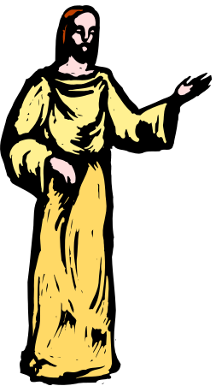
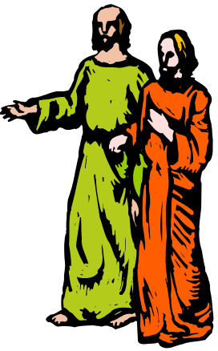
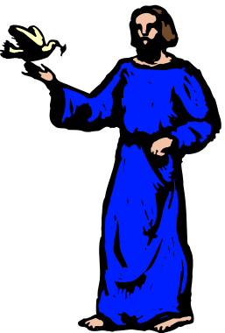
2Pe 1:16 For we have not followed cunningly devised fables, when we made known unto you the power and coming of our Lord Jesus Christ, but were eyewitnesses of his majesty.
2Pe 1:17 For he received from God the Father honour and glory, when there came such a voice to him from the excellent glory, This is my beloved Son, in whom I am well pleased.
2Pe 1:18 And this voice which came from heaven we heard, when we were with him in the holy mount.
The gospel writers had to write of a historical event that was testified to them by three men who were taken in vision to the distant future to witness two other men from their distant past, eg., Moses and Elijah, who were, in the vision, now in their “immortal glory”. And discussing with Jesus who APPEARED with them in his own “immortal glory” as King, the event of his crucifixion which in Peter, James and John’s day of their probation had not yet occurred.

Slide 10



The Altar of Wood
Eze 41:22 The altar of wood was three cubits high, and the length thereof two cubits; and the corners thereof, and the length thereof, and the walls thereof, were of wood: and he said unto me, This is the table that is before the LORD.

Slide 11
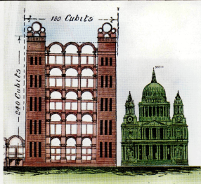
Class 5
“Corner Towers and Rivers of Healing”
Walk about Zion, and go round about her: tell the towers thereof.
Mark ye well her bulwarks, consider her palaces; that ye may tell it to the generation following.
Psalm 48:12-13

Slide 12
Class Objectives
Examine Ezek. 46:21-24 to better grasp the meaning
We will come to see why these Corner Towers are so large
We will recognize their practical usefulness
Identify the source and effects of The Rivers of Life

Slide 13
Heb 8:1 Now of the things which we have spoken this is the sum: We have such an high priest, who is set on the right hand of the throne of the Majesty in the heavens;
Heb 8:2 A minister of the sanctuary, and of the true tabernacle, which the Lord pitched, and not man.
Heb 8:3 For every high priest is ordained to offer gifts and sacrifices: wherefore it is of necessity that this man have somewhat also to offer.
Heb 8:4 For if he were on earth, he should not be a priest, seeing that there are priests that offer gifts according to the law:
Heb 8:5 Who serve unto the example and shadow of heavenly things, as Moses was admonished of God when he was about to make the tabernacle: for, See, saith he, that thou make all things according to the pattern shewed to thee in the mount.

Slide 14
Sing and rejoice, Ο daughter of Zion : for, lo, I come,
and I will dwell in the midst of thee, saith the Lord.
AND MANY NATIONS SHALL BE JOINED UNTO THE LORD
IN THAT DAY, AND SHALL PE MY PEOPLE : and I Will dwell
in the midst of thee.
And the Lord shall inherit Judah, his portion, in the
Holy Land and shall choose Jerusalem again.
At that time they shall call Jerusalem THE THRONE OF
THE LORD : and all the nations shall be gathered unto it,
to the name of the Lord το JERUSALEM : neither shall they
walk any more after the imagination of their evil heart.
(Zee. 11. 10-12 ; Jer. in. 17).

Slide 15
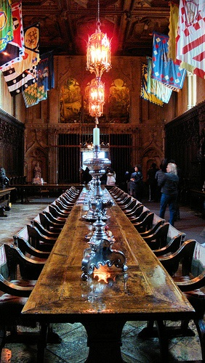
David shall never want a man to sit upon the throne of the house of Israel: Neither shall the priests the Levites want a man before me to offer burnt offerings, and to burn oblations, and to do sacrifice continually. (Jer. 33:17-18.)
In the Temple service, therefore, some provision must be found for the Levitical priesthood.

Slide 16
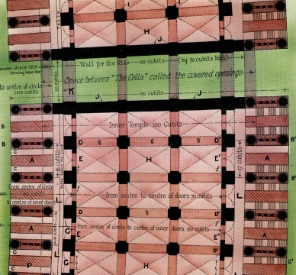
Thrones of the Most Holy
Then the avenues on either
side of the house (the place left) form a necessary and
convenient means of communication between all parts of the house. There will be at least 389 positions where the judges may sit upon the
" Thrones of the House of David " within the porches, between the cherubim, before the Most Holy, which we shall see later is the most likely place for the judge to be seated.

Slide 17
Isa 25:6 And in this mountain shall the LORD of hosts make unto all people a feast of fat things, a feast of wines on the lees, of fat things full of marrow, of wines on the lees well refined.
Isa 25:7 And he will destroy in this mountain the face of the covering cast over all people, and the vail that is spread over all nations.
Isa 25:8 He will swallow up death in victory; and the Lord GOD will wipe away tears from off all faces; and the rebuke of his people shall he take away from off all the earth: for the LORD hath spoken it.

Slide 18
Mat 22:4 Again, he sent forth other servants, saying, Tell them which are bidden, Behold, I have prepared my dinner: my oxen and my fatlings are killed, and all things are ready: come unto the marriage.

Slide 19
Since we have already seen that the range of cellae extending between the outer and the inner court on the north and south sides thereof are holy chambers, where "priests eat the most holy things'', the inference is that these buildings must also be the buildings which are reserved for the restored tribe of Levi.
Duties assigned to the Levites appear to be…
“When the priests enter therein, then shall they not go out of the holy place into the outer court, but there they shall lay their garments wherein they minister ; for they are holy ; and they shall put on other garments, and shall approach to that which pertaineth to the people.” (Chap. 42:14.)

Slide 20
46:19 (RV)- Then he brought me through the entry, which is at the side of the gate, into the holy cellae for the priests, which look towards the north ; and, behold, there (is) a place on the hinder part westward. (Verse 19, R.V.).
20 - Then he said unto me, This (is) the place where the priests boil the trespass offering and the sin offering ; where they shall bake the meal offering ; that they bear them not out into the outer court to sanctify the people. (Verse 20.)
21 - Then he brought me forth into the outer court, and caused me to pass by the four corners of the court ; and, behold, a court in every corner of the court.
22 - In the four corners of the court are courts {smoking) forty reeds long and thirty broad, one measure to their four corners. (Verse 22.)
23 - And a row round about to the four of them ; and made with boiling places under the rows round about.
24 - Then said he unto me, These are the places of them that boil, where the ministers of the house shall boil the sacrifice of the people.

Slide 21
Chapter 46:19-24 describe a very important feature in the building, viz., four corner courts in the four angles of the outer wall of the sanctuary (Plates 2. and 3. E-E-E-E).
They are distinct and self-contained, although they join up to and are connected with the outer courts at each corner.

Slide 22
Ezekiel 46:19-24 (RV)
Eze 46:19 Then he brought me through the entry, which was at the side of the gate, into the holy chambers for the priests, which looked toward the north: and behold, there was a place on the hinder part westward.
Eze 46:20 And he said unto me, This is the place where the priests shall boil the guilt offering and the sin offering, where they shall bake the meal offering; that they bring them not forth into the outer court, to sanctify the people.

Slide 23
Ezekiel 46:21-24
Eze 46:21 Then he brought me forth into the utter court, and caused me to pass by the four corners of the court; and, behold, in every corner of the court there was a court.
Eze 46:22 In the four corners of the court there were courts joined of forty cubits long and thirty broad: these four corners were of one measure.
Eze 46:23 And there was a row of building round about in them, round about them four, and it was made with boiling places under the rows round about.
Eze 46:24 Then said he unto me, These are the places of them that boil, where the ministers of the house shall boil the sacrifice of the people.

Slide 24
Probably reference is here made to the whole of the western side, with its corner courts to be used for the storage, preparation, and disposal of a vast quantity of food required for the worshippers.

Slide 25
In verse 22 reeds are substituted for cubits, because the word " cubit " is not in the original and has been inserted by the translators for no apparent reason. The measure of the house is the reed, and the courts are said to be of one measure, and therefore each side of the square is thirty measures or 30 reeds broad, and 40 measures or 40 reeds high, thus forming a court 30 reeds (360’) (180 cubits) square, whose superstructure rises 40 reeds (480’) (240 cubits) high.

Slide 26
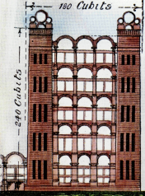
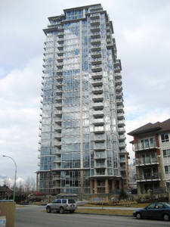
" Smoking " corners to the corner courts (verse 22). The word rendered " joined“ in the A.V. is variously translated by scholars.
360 ft.
109.7m
The expression is more correctly translated “smoking” or “steaming with fragrance,” a rendering supported by many other oc-currences of the word in the O.T., and by the marginal reading of the A.V., “made with chimneys”
480 ft.
146 m
Skye Tower Residential Bldg. downtown Kelowna = 256’ (78m)
78m

Slide 27
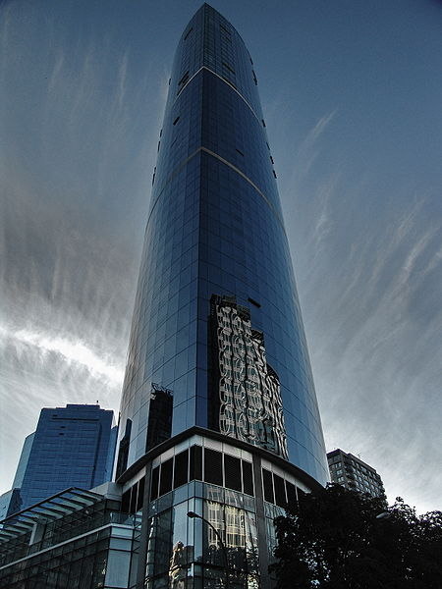
One Wall Centre- (Sheraton Wall Centre – N. Tower, the second-tallest building in Vancouver, British Columbia, Canada. 48 storeys; 491 ft., 150 m. Req’d a 75’ deep excavation; Only 11’ taller than the Corner Towers of the House of Prayer
360 ft.
109.7m
360 ft.
480 ft.
146 m
491 ft., 150 m
480 ft.

Slide 28
They form a terminal to the outer court buildings at the end of each face of the sanctuary.
These massive towers, 360 feet square and at least 480 feet high1 form the necessary abutment to counteract the thrust of the arches of the outer court.

Slide 29
Looking westward from the holy cella of the priests, Ezekiel is led to exclaim, “Behold, there is a place on the hinder part westward.”
Ezekiel sees the "place“ afar off, but he did not then become acquainted with its construction. He is told : “This is the place where the priests shall boil the trespass offerings; . . where they shall bake the meal offering; that they bring them not out into the outer court to sanctify the people.

Slide 30
Parenthetically, he gives expression to the fact thus : " In the four corners of the court I saw courts “smoking " or “steaming with fragrance.”
All four corner courts are alike and of one measure, thirty reeds each way, or one hundred and eighty cubits square.
Round about the four of them under the rows, i.e., in the lower portion of the buildings surrounding the courts, are contrivances for cooking, where the priests of the house boil the sacrifices of the people.
Ezekiel describes the house, as in full preparation for the inaugural ceremony, the flesh of the offering being upon the tables. (Chapter XL·., verse 43.)
In passing each corner court he probably also sees food in preparation, and observes the smoke or steam ascending there from.

Slide 31
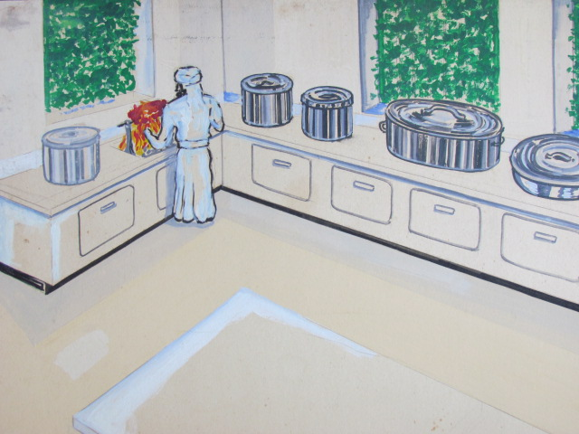
Zec 14:20 In that day shall there be upon the bells of the horses, HOLINESS UNTO THE LORD; and the pots in the LORD'S house shall be like the bowls before the altar.
Zec 14:21 Yea, every pot in Jerusalem and in Judah shall be holiness unto the LORD of hosts: and all they that sacrifice shall come and take of them, and seethe therein: and in that day there shall be no more the Canaanite in the house of the LORD of hosts.

Slide 32
HOUSES FOR THE LEVITES.
Concerning the corner courts, Ezekiel is told that they are " the places, i.e., the house (baith) of them that boil" (Chap. 46:24)
Indicates that the upper part of the towers will be utilized for residences
Here the Levites, when serving in the Temple by courses, would be close at hand during the period of service ; when they are “off duty” they would retire to their "houses" in the portion set apart for their use, viz., in the Levites' portion in the Holy Oblation
But the towers are also said to be "made with chimneys”, or furnished with suitable arrangements for conveying discharges from the kitchens underneath.
These chimneys will probably be at the corners of each tower, forming four blocks at each corner, as shown on the illustrations.

Slide 33

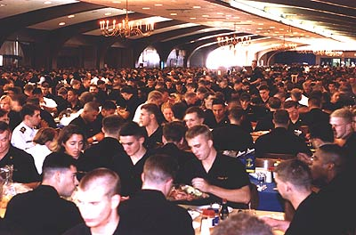

Slide 34
Optimum efficiency is the only thing that can prevent utter chaos when more than 4,000 people sit down at one time for dinner at 372 tables spread over a 55,000- square-foot area. Hot meals are served to all within five minutes, reflecting the efficiency that exists in King Hall, the midshipman dining hall at the United States Naval Academy. Statistics of the operation are impressive, from the capacity of automated food preparation equipment in the galley to the washing room which handles more than 40,000 pieces of silver, dishes and glassware for an average meal.

Slide 35
The staff in the academy's Midshipmen Food Service Division plan, prepare and serve more than 12,000 meals per day. To accomplish their tasks, they use automated food preparation equipment that handles large quantities of food.
Food preparation equipment includes
Two-hundred conveyor belt-fed, deep-fat fryers, that, together, can cook a 100 tons of fried shrimp in an hour;
Two-hundred gas-flame broilers, also operated by a conveyor belt, that churn out 300,000 hamburgers per hour;
Two-hundred rotary ovens that can hold 8000 roasting pans and cook 32,000 12- to 16-pound turkeys at a time;
and six-hundred steam-jacketed kettles that can heat 75000 gallons of soup.
Two-thousand mobile serving carts, one for every 2000 tables, maintain the trays of prepared food at 140 degrees until serving time.
The academy's food service program may be operated on a large scale, but it does so with remarkable efficiency and high standards. There is a concerted effort to keep the food from becoming "institutional." Nutrition, the attractiveness of presentation, the variety of menu items and the quality of food preparation and service are paramount concerns.
1 meal a day = 4000 x 100 = 400,000

Slide 36
The object to be served by setting apart these buildings which stand between the inner and outer courts for the use of the Levites appears to be that the Levites may not eat with the people who assemble in the Temple, and that they may have a place where they can deposit and eat the most holy things.
The extent of the buildings reserved for the Levites is very remarkable. If 444 dining halls are provided for the servants who wait upon the guests, how vast must be the multitude who sit down to feast in other parts of the Temple !

Slide 37
“Speaking from an architectural point of view, the temple towers seem but a necessary adjunct to the building of which they form a part. It has been stated that ancient architects strove to obtain effect by the length of their fa9ade or frontage, while the moderns endeavour to impress the observer by the height of their buildings. In the Temple of the age to come, when the Son of God builds the temple of universal worship, all previous structures will dwindle into insignificance by comparison.”

Slide 38
A building whose facade is over one mile long, whose towers are 360 feet square and 480 feet high ; whose outermost buildings are a double range of magnificent rooms, each 100 feet long by 50 feet wide, and perhaps 120 feet high in their several storeys is, far, far greater in magnificence than anything the world has ever seen either in ancient or modern times. A building such as that specified in Ezekiel cannot be adequately described. Words fail to convey a due sense of its magnitude, but the spirit of God in the prophets has indicated the wonder of its immensity thus :

Slide 39
The Psalmist further apostrophises thus :
GREAT is the Lord and greatly to be praised,
IN the city of our God (or Elohim).
BEAUTIFUL for situation, the joy of the whole earth
Is Mount Zion,
THE city of the Great King.
LET Mount Zion rejoice,
LET the daughter of Judah be glad
BECAUSE of thy judgments.
Then he solemnly summons attention, observation,
admiration and rejoicing:
WALK about Zion and go round about her,
TELL the towers thereof.
MARK ye well her bulwarks,
CONSIDER her palaces.
See the Towers ! Look at the bulwarks ! ! Consider
the palaces ! ! ! These words seem to stand out in
letters of gold, themselves answering the question they
raise, Whose Handiwork is this ?
YAHWEH !
THIS God is our God for ever and ever.
HE will be our Guide for evermore.

Slide 40
Rivers of Healing
“Afterwards he brought me again into the door of the house; and behold, waters issued out from under the threshold of the house eastward ; for the forefront of the house stood towards the east, and the waters came down from under, from the right side of the house at the south side of the altar.” (Chap. 47:1)

Slide 41
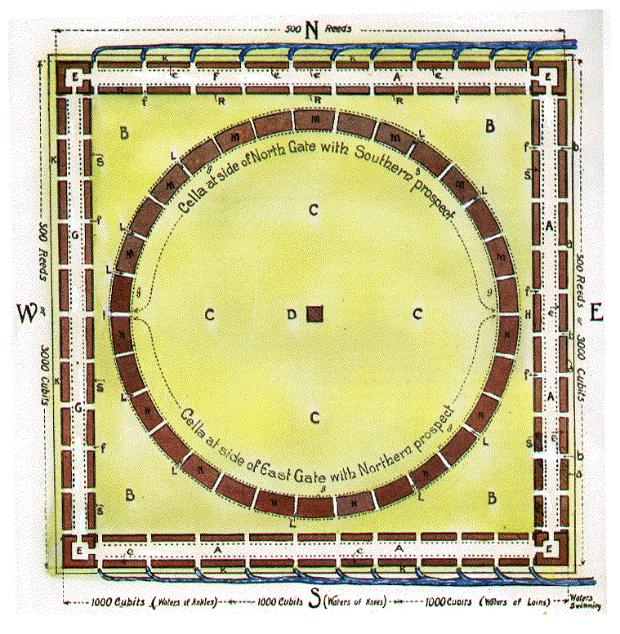
the east side is the " front " of house,
the west would be the " back,"
the south the "right “ side.
Waters issuing from under the threshold of the house on the right side, therefore, must mean that waters issued from under all the gate thresholds on the south side.
This conclusion is consistent with the other statement that the waters issued eastward.
They would first flow southward from the altar, from thence pass out under each threshold and, at their exit, turn eastward.
“front”
“back”
“right side”
Since there are many thresholds (because many gates), there would be many streams ; these all joining into one stream on the outside, would provide a large volume of water as each quota fell into the channel flowing eastward.

Slide 42
Living Waters
Zec 14:8 And it shall be in that day, that living waters shall go out from Jerusalem; half of them toward the former sea, and half of them toward the hinder sea: in summer and in winter shall it be.
Zec 14:9 And the LORD shall be king over all the earth: in that day shall there be one LORD, and his name one.

Slide 43
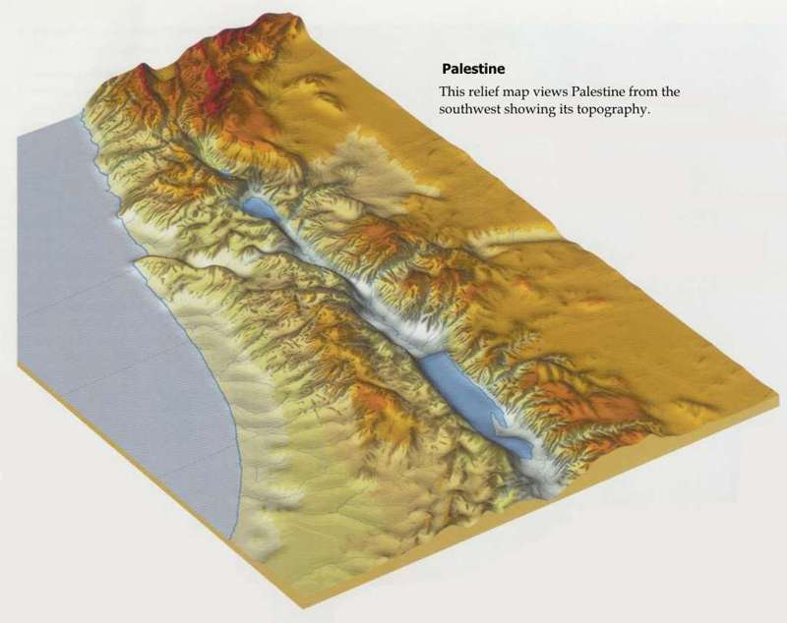

Slide 44
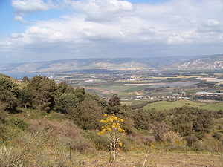
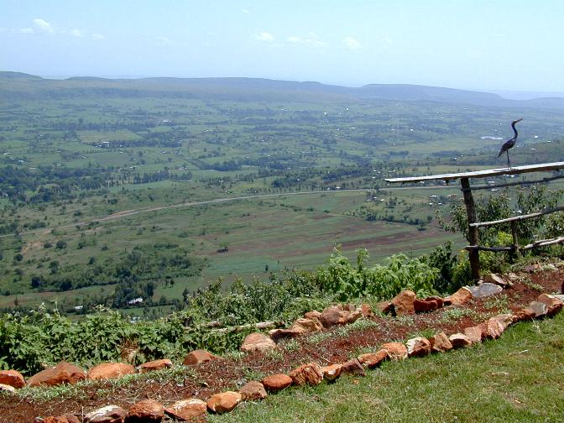

Slide 50
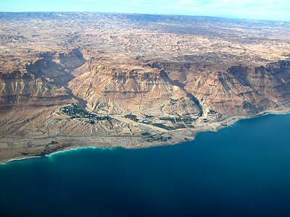
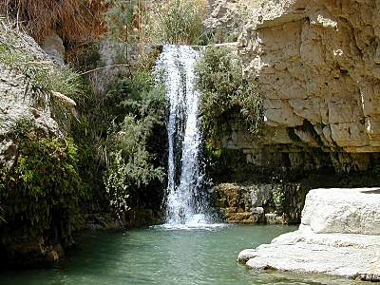

Slide 51
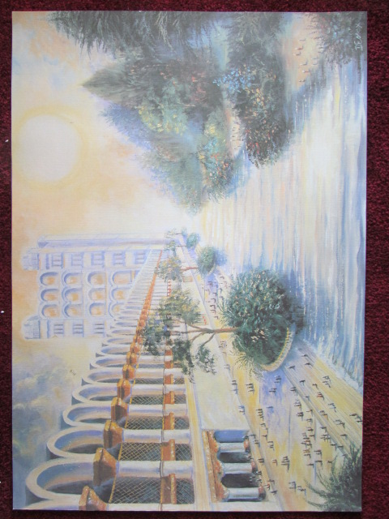
Paradeisos- par-ad'-i-sos
Of Oriental origin (compare [H6508]); a park, that is, (specifically) an Eden (place of future happiness, “paradise”): - paradise.
And he said unto him— “Verily, I say unto thee this day: With me, shalt thou be in Paradise.” (Rotherham)

Slide 52
EZEKIEL 41:15-17
The Inner Temple, the porches of the court, the
thresholds (or entrance spaces) and the " narrow windows
" (closed, R.v.) and the galleries all round to the
three of them, and before the doors (or entrance space)
ceiled with wood (creepers, or a thin growth of trees) all round about, and from the ground to the openings(marg. A.V.)—even the covered
openings—above (that which is) above the entrance, and
to the inner house and without, and to all the wall, all
round about within and without by measures (verses
15-17).

Slide 53
Eze 47:12 And by the river upon the bank thereof, on this side and on that side, shall grow all trees for meat, whose leaf shall not fade, neither shall the fruit thereof be consumed: it shall bring forth new fruit according to his months, because their waters they issued out of the sanctuary: and the fruit thereof shall be for meat, and the leaf thereof for medicine.

Slide 54
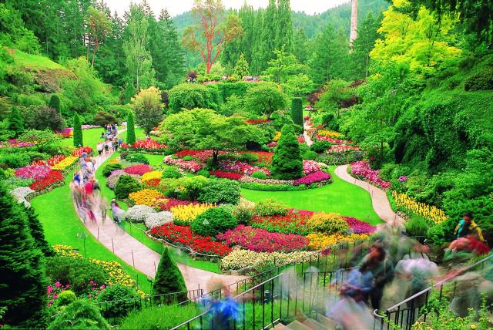
Neh 2:7 Moreover I said unto the king, If it please the king, let letters be given me to the governors beyond the river, that they may convey me over till I come into Judah;
Neh 2:8 And a letter unto Asaph the keeper of the king's forest (Hb. ‘pardes’=Gr. ‘paradise’), that he may give me timber to make beams for the gates of the palace (Hb ‘biyrah’=fortress) which appertained to the house (bayith=family), and for the wall of the city, and for the house (bayith=family), that I shall enter into. And the king granted me, according to the good hand of my God upon me.
Nehemiah may have referred to reconstructing the “Gardens of King Solomon” in Eccl. 2:5

Slide 55
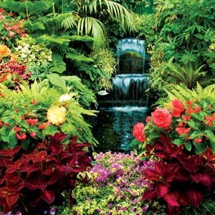
Ecc 2:4 - I enlarged my works,—I built me houses, I planted me vineyards;
5- I made me gardens, and parks (Hb.- ‘pardes’,
—I planted in them trees of every kind of fruit;
6- I made me pools of water,—to irrigate therefrom the thick-set saplings growing up into trees: (Roth.)

Slide 56
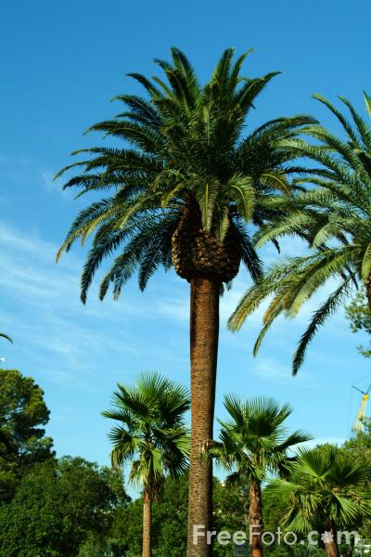
Rev 2:7 He that hath an ear, let him hear what the Spirit saith unto the churches; To him that overcometh will I give to eat of the tree of life, which is in the midst of the paradise of God.

Slide 57
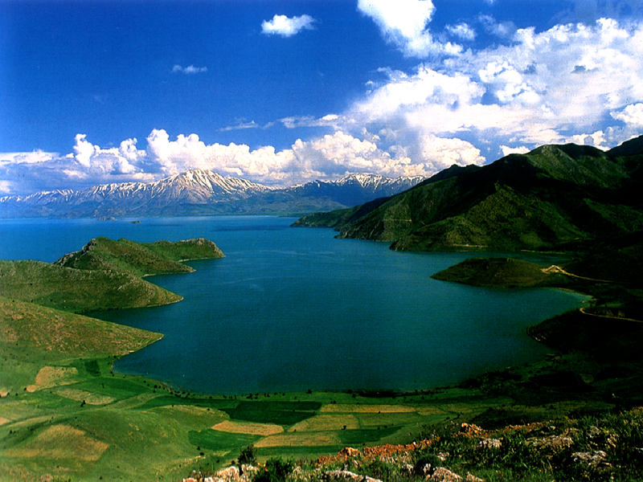

Slide 58
The Psalmist further apostrophises thus :
GREAT is the Lord and greatly to be praised,
IN the city of our God (or Elohim).
BEAUTIFUL for situation, the joy of the whole earth
Is Mount Zion,
THE city of the Great King.
LET Mount Zion rejoice,
LET the daughter of Judah be glad
BECAUSE of thy judgments.
Then he solemnly summons attention, observation,
admiration and rejoicing:
WALK about Zion and go round about her,
TELL the towers thereof.
MARK ye well her bulwarks,
CONSIDER her palaces.
See the Towers ! Look at the bulwarks ! ! Consider
the palaces ! ! ! These words seem to stand out in
letters of gold, themselves answering the question they
raise, Whose Handiwork is this ?
YAHWEH !
THIS God is our God for ever and ever.
HE will be our Guide for evermore.

