Slide 1
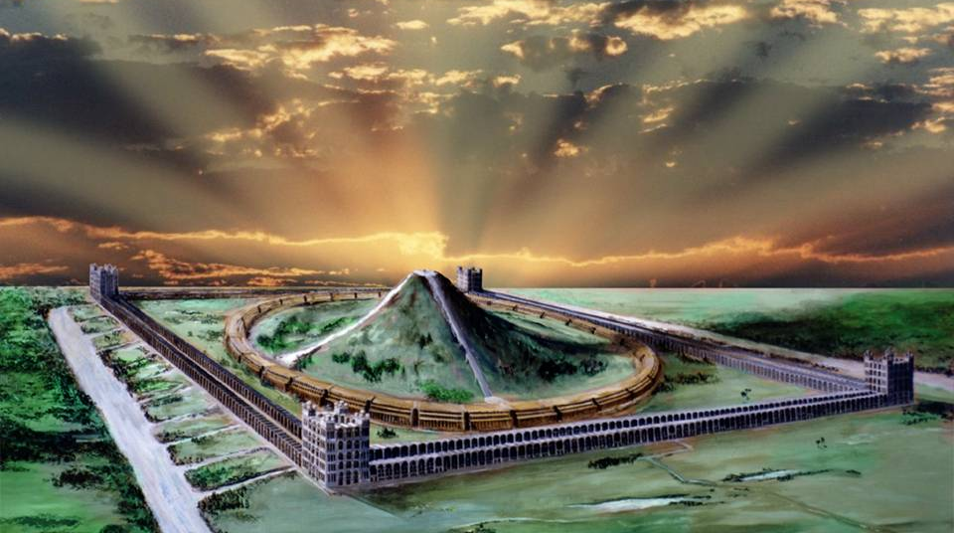
Class 6 – Type of the Third Heaven – God All In All
Psa 24:3 Who shall ascend into the hill of the LORD? or who shall stand in his holy place?
Psa 24:4 He that hath clean hands, and a pure heart; who hath not lifted up his soul unto vanity, nor sworn deceitfully.

Slide 2
Class Objectives
To better understand why our hopes should be “pegged” upon the FULL GLORIFICATION of God on earth
To recognize the “typical” aspect of the Temple of Ezekiel’s prophecy
To identify some of the eternal characteristics of the “third heaven”
To come away with a “clearer” and more comprehensive understanding of our purpose today
To recommit ourselves to God in a way that brings Him greater glory in our lives, generates a stronger love for the return of Jesus and builds a more genuine desire to serve in our ecclesial family

Slide 3
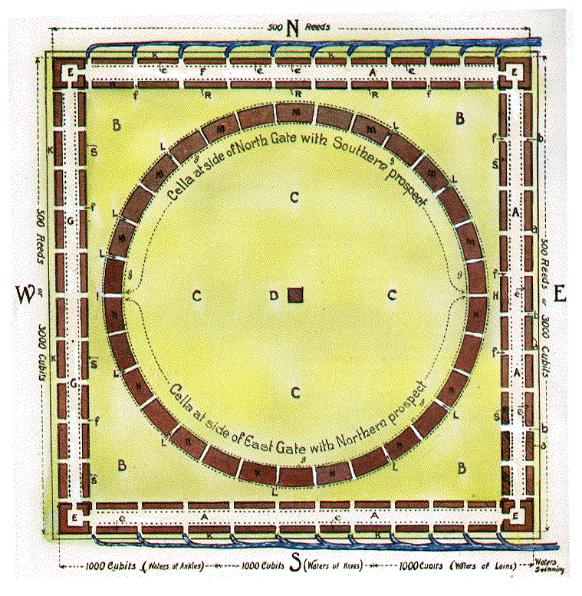
The Words of Jesus
" With desire I have desired to eat this passover with you before I suffer, for I say unto you, I will not any more eat thereof, until it be fulfilled in the kingdom of God'' (Luke 22 : 15,16)
" I will not drink henceforth of this fruit of the vine, until that day when I drink it new with you in my Father's kingdom " (Matt. 26 : 29)
Ezekiel’s description gives the whole eastern side of the OUTER COURT for the fulfillment of these words of our Lord

Slide 4
Visitor enters from north or south thru waters of BAPTISM that originate fr under the central ALTAR
Offerings of blood at North, grains, etc. at South made
Met by mortal, Levite priests & enters into the House by way of GATE BUILDINGS
Journeys down/across OUTER COURT PLAZA
Into the SEPARATE PLACE for fellowship
Up the Judgment Steps of the INNER CIRCULAR bldg
To the vast DINING HALLS in the Western OUTER COURT cellae
PATHWAY OF A VISITOR
8. His “portion” of blood offering conveyed by the table of wood to EASTERN side
9. It ascends to Great ALTAR at top of mountain

Slide 5
10. Hears hymns of praise from mortal/immortal voices within the INNER CELLAE
11. Observes in solemn reverence as “The Prince” officiates over the sacrificial ceremony
12. The fire of Yahweh will descend to consume the offerings from off of the ALTAR
13. The worshiper will continue their visit by exiting out of the opposite side of the House of Prayer from where they entered.
PATHWAY OF A VISITOR
Speaking of the future age, the Psalmist also testifies :" All the earth shall worship thee, and shall sing unto thee ; they shall sing unto thy name. . . . I will go into thy house with burnt offerings : I will pay thee my vows " (66 : 4, 13

Slide 6
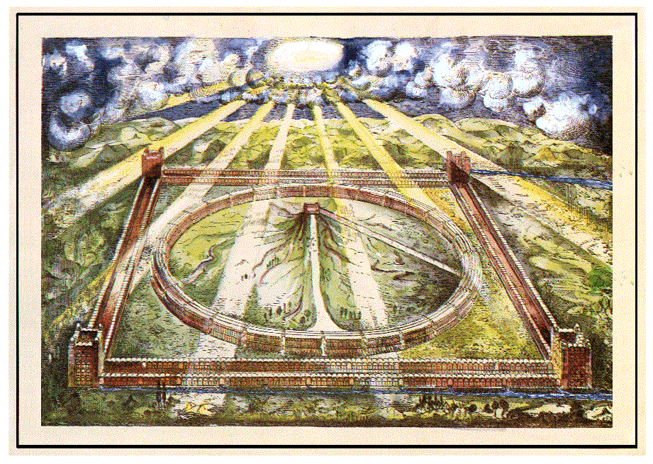
View of the Sanctuary. Ezekiel 40-47
Plate 1-Bird’s-eye View of the Sanctuary
Saints

Slide 7
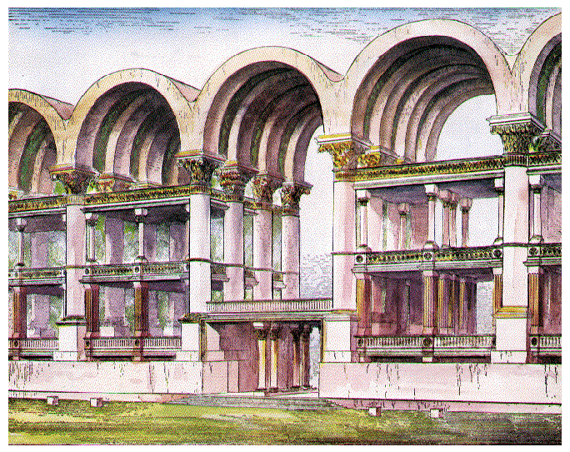

Slide 8
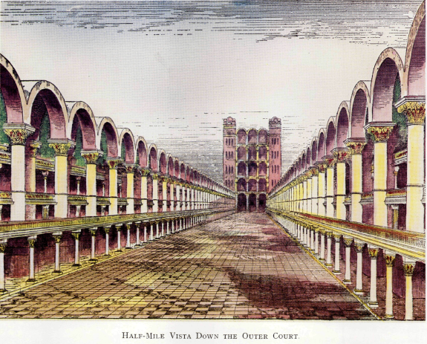
Plate 8 - Half-Mile Vista Down Outer Court

Slide 9
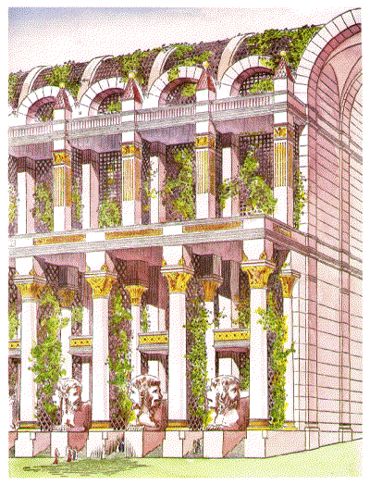

Slide 10
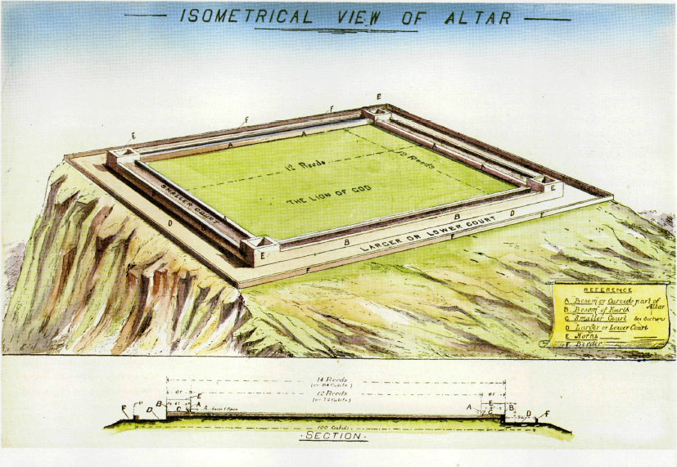
Visitor enters from north or south thru waters of BAPTISM that originate fr under the central ALTAR
Offerings of blood at North, grains, etc. at South made
Met by mortal, Levite priests & enters into the House by way of GATE BUILDINGS
Journeys down/across OUTER COURT PLAZA
Into the SEPARATE PLACE for fellowship
Up the Judgment Steps of the INNER CIRCULAR bldg
To the vast DINING HALLS in the Western OUTER COURT cellae
PATHWAY OF A VISITOR
8. His “portion” of blood offering conveyed by the table of wood to EASTERN side
9. It ascends to Great ALTAR at top of mountain

Slide 11
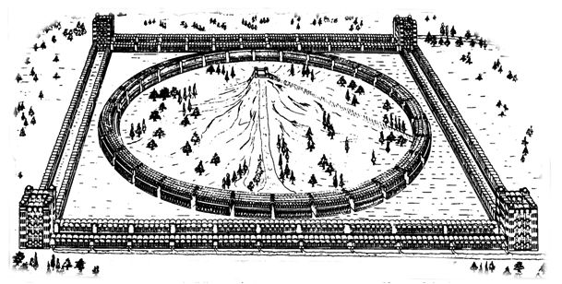
CORNER COURTS
LEVITES LIVE IN UPPER STORIES
(DURING TERM OF SERVICE). HUGE
KITCHENS BOIL SACRIFICES TO
FEED WORSHIPPERS. CHIMNEYS ON
OUTER FACE TOTAL AREA 360 SQ.FT.
42 TIMES AREA OF WASHINGTON
MONUMENT. EZK46:22-24.
PG 170, 175, 73 [82, 83, 30]
THE ALTAR
SACRIFICES CONSUMED BY FIRE FROM HEAVEN. 12 REEDS SQ.(50 YDS. SQ.) EZK. 43:13, 2 CHR. 7:1, LEV. 9:24; JUD. 6:21; 2 KG. 18:23; 1CHR. 21:26; HEB. 9:8
(PG. 127) [58-59]
MOST HOLY
HERE THE GLORY OF THE OLAHM
IS HID FROM MORTAL EYES BY
TENT OF CLOUD. ISA. 4:5, ISA. 40:22; HEAVENS AS TENT OF
HOLY. PG. 185 [91-92]
GATES.
APPARENTLY 11 ON EA. WALL
FOR ENTERING IN-GOING FORTH
EZK. 40:18 PG. 75,77 [30, 32]
PREPARATION TABLES
FURTHER PREPARATION OF SACRIFICES. 4 PER INNER GATE OF OUTER COURT. EZK. 40:39. PG. 69, 163 [27, 78-78]
SLAYING BLOCKS
ON NORTH ONLY.4 PER GATE SACRIFICE SLAIN. FIRST- FRUITS ON SOUTH -EZK. 40:40 PG. 163 [78]
SEPARATE PLACES
WORSHIPPERS PASS THROUGH-IN
TRANSIT. ASSEMBLE FOR WORSHIP
EZK.41:13.PG.111, 122 [50,56]
THRONES OF JUDGEMENT
IN INNER RECESSES OF INNER
TEMPLE. BETWEEN CHERUBIM
FROM WHENCE OFFERINGS CON-
VEYED TO ALTAR 389 THRONES
AT LEAST. PS. 122:4-6, ISA. 62:9
PG. 174 [69, 71]
ACCESS TO ALTAR
cp. TABERNACLE-NO NAKEDNESS
IN MOST HOLY TO DISCLOSE.
HENCE STEPS. EZK. 43:17
PG. 132 (60)
OUTER COURT
200’ PLAZA BETWEEN THE OUTER RANGE OF GATE BUILDINGS ON ALL SIDES (EZK. 43:4, 44:2, 46:1,2,6; SONG 5:1
THE MOUNTAIN EZK. 43:12,13.PG 94, 118 [40, 52]
DINING HALLS
UPPER GALLERIES OF OUTER
COURTS OF WEST, NORTH, SOUTH.
HALF A MILLION PER SITTING.
2,864 DINING HALLS, ~
LARGER THAN BANQUET HALLS~
ISA 25:6 -PG. 170 [82]
TABLE BEFORE YAHWEH
TIMBER ENCLOSED CONVEYOR
FOR FAT AND BLOOD ON GOLDEN
FLOATS. EZK. 41:22 PG. 134[62]
GEHENNA
OUTSIDE WEST-WALL REFUSE OF
SACRIFICES. SINNERS BURNT. OLD
GEHENNA NOW INSIDE INNER
TEMPLE ~ 65:20; 66:23,24,
EZK. 43:21, JER.31:40. PG. 168 [81]
PRINCE’S PALACE
WHOLE EASTERN OUTER COURT
SAINTS SUP ANEW WITH CHRIST
EZK. 43:4, 44:2, 46:1,2,6
SONG 5:1. PG. 173, [84,88]
CHAMBERS OF SINGERS
WHOLE CIRCLE CONTAINS THEM-
NORTHERN HALF, SONS OF ZADOK
KEEP ALTAR. SOUTHERN HALF,
LEVITES KEEP HOUSE, i.e.
IMMORTAL & MORTAL PRIESTS.
EZK. 40:44. PG. 93,151 [40, 72]
LEVITE DUTIES
OFFICIATE & DINE IN INNER
RANGE OF OUTER BUILDINGS ON
NORTH & SOUTH, EAT MOST HOLY THINGS. 444 DINING HALLS
CHANGE GARMENTS HERE.
EZK.44:17, 42:12, PG.164 [79]
STORE HOUSES
SOUTHERN OUTER COURT
WORSHIPPERS ENTER SOUTH WITH FIRSTFRUITS. EZK. 44:30;
MAL. 3:4. PG. 69, 164 [27, 70]
COVERED OPENINGS
SPACE FOR ROOTS OF FOLIAGE
WHICH COVERS INNER TEMPLE.
EZK. 41:15-17; ISA.4:6; ISA.
60:13, PS.67:6-7 PG. 140,146 [66, 69]
LIFTS
3 LIFT CHAMBERS, EA SIDE OF
EACH GATE. “THOU SHALT NOT
GO UP TO MY ALTAR BY STEPS”
EX.20:26. PG. 51, 171 [16, 82]
TWO STREAMS OE WATER
WATERS FROM ALTAR FLOW FROM
UNDER NORTHERN GATES-THEN
EAST, NORTHWEST TO MEDIT. UNDER
SOUTH GATES, THEN EAST TO HEAL
INLAND LAKE. EZK. 47:1, 9;
PS. 46:4; ZECH. 14:8. PG. 302 [152]
TREES FOR MEDICINE
ON RIVER BANKS, LEAVES SHALL
NOT FADE; FOR MEDICINE. FRUIT
FOR MEAT. EZK 47:12, REV. 22:2
PG. 168 [68, 92]
READ “THE TEMPLE OF EZEKIEL'S
PROPHECY” HENRY SULLEY.
PG. NUMBERS of the 6th ed. From the Christadelphian Office and Logos Publ.

Slide 12
2Co 12:1 It is not expedient for me doubtless to glory. I will come to visions and revelations of the Lord.
2Co 12:2 I knew a man in Christ above fourteen years ago, (whether in the body, I cannot tell; or whether out of the body, I cannot tell: God knoweth;) such an one caught up to the third heaven.
2Co 12:3 And I knew such a man, (whether in the body, or out of the body, I cannot tell: God knoweth;)
2Co 12:4 How that he was caught up into paradise, and heard unspeakable words, which it is not lawful for a man to utter.
2Co 12:5 Of such an one will I glory: yet of myself I will not glory, but in mine infirmities.

Slide 13
1Ch 21:16 And David lifted up his eyes, and saw the angel of the LORD stand between the earth and the heaven, having a drawn sword in his hand stretched out over Jerusalem.
Luke 20 :35, 36
" They which shall be accounted worthy to obtain that
world, and the resurrection from the dead, neither marry,
nor are given in marriage : neither can they die any more ;
for they are equal unto the angels : and are the children
of God, being the children of the resurrection."
Mat 18:10 Take heed that ye despise not one of these little ones; for I say unto you, That in heaven their angels do always behold the face of my Father which is in heaven.

Slide 14
Joh 6:51 - 58 I am the living bread which came down from heaven: if any man eat of this bread, he shall live for ever: and the bread that I will give is my flesh, which I will give for the life of the world.
Joh 6:52 The Jews therefore strove among themselves, saying, How can this man give us his flesh to eat?
Joh 6:53 Then Jesus said unto them, Verily, verily, I say unto you, Except ye eat the flesh of the Son of man, and drink his blood, ye have no life in you.
Joh 6:54 Whoso eateth my flesh, and drinketh my blood, hath eternal life; and I will raise him up at the last day.
Joh 6:55 For my flesh is meat indeed, and my blood is drink indeed.
Joh 6:56 He that eateth my flesh, and drinketh my blood, dwelleth in me, and I in him.
Joh 6:57 As the living Father hath sent me, and I live by the Father: so he that eateth me, even he shall live by me.
Joh 6:58 This is that bread which came down from heaven: not as your fathers did eat manna, and are dead: he that eateth of this bread shall live for ever.

Slide 15
Types of Divine Architecture
The Tabernacle in the Wilderness
Solomon’s Temple
Ezekiel’s House of Prayer
The Present-day ecclesia
The Multitudinous Christ Body
The Third Heaven-Paradise of God’s Glory

Slide 16
 | PHASE 1 | PHASE 2 | PHASE 3
Passage: | Genesis 2 | Isaiah 66 | Revelation 21
Time Frame: | Now | Millennium | After Millennium
Curse: |  |  | x
Sin & Death: |  |  | x
Suffering: |  |  | x
Kingdom: | Kingdom of Men | Kingdom of God | God All in All
Nations: | Roaring Sea | Smooth Sea | No Sea
Resurrection: | First Death | Second Death | No Death
Priesthood |  |  | x
Temple: |  |  | x
 | First Heaven | Second Heaven | Third Heaven

Slide 17
 |  | HEAVEN | EARTH | SEAS
1st H&E | Israelitish | Mosaic Priesthood & Princes of Israel | Children of Israel (as dust of earth -Gen.28:14) | Gentile nations roaring (Troubled; Flood state - Isa. 57:20)
2nd H&E | Former | Christ & Saints Ruling as Kings/Priests (as Sun, moon & stars) | National Israel Restored (as sand of seashore - Gen. 22:17) | Gentile nations subdued (Peacetime; Glassy ice - Rev. 4:6)
Paul's 3rd Heaven 2 Cor 12:1-4 | New | Paradise (8th Millennium) God All in All | All nations in Christ subject to Father | No more sea (Vaporous firmament - Rev. 21:1)

Slide 18
Yahweh's house, the Temple, is yet to be restored as a "house of prayer for all nations“ (Mark 11:15-17; Isa, 56:7)
Like the Temple of Solomon that fore-shadowed it, it will be built according to Divine plans, and with the aid of foreign labor (Isa. 60:10)
The work will be supervised by Christ (Zech. 6:12)
He shall officiate as King-priest (Ps.110; Zech. 6:13)
His immortalized followers will be associate king-priests(Rev 5:9).

Slide 19
All nations, and people will assemble there for worship (Zech. 14:16; 8:22-23; Isa, 2:2-4).
The Divine glory, once revealed by the Shekinah Light shining in the Most Holy (Ps. 80:1) will in the future be manifested through the immortalized saints (Ezek. 43:1-5; Dan. 12:3; Matt.
13:43)
“A line shall be stretched forth upon Jerusalem”- Extending its size (Jer. 31:39), this enlarged Jerusalem of the future will be a Temple-city, for it shall be “built to Yahweh” (Jer. 31:38)

Slide 20
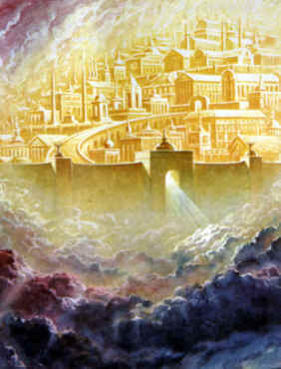
Rev 21:2 And I John saw the holy city, new Jerusalem, coming down from God out of heaven, prepared as a bride adorned for her husband.
Rev 21:3 And I heard a great voice out of heaven saying, Behold, the tabernacle of God is with men, and he will dwell with them, and they shall be his people, and God himself shall be with them, and be their God.

Slide 21
New Jerusalem
VERSE 18
" And the building of the wall of it was of jasper"—"Building" is endomesis from en, in and domad, to build, thus "that which is built in, "or the material of which the wall is constructed. In v. 11, jasper is likened to divine light, exceedingly luminous. Speaking of the literal Temple city yet to be built at Jerusalem, Yahweh, through Zechariah, declared: "I will be unto her a wall of fire round about, and will be the glory in the midst of her" (Zech. 2:5). That wall of fire will separate the holy from the profane. The jasper stone is also likened to the "glory of God" (Rev. 21:11), and this also is appropriate, for God manifestation will comprise the basic material of this spiritual city. It will be "the glory in the midst of her."

Slide 22
ToEP, p. 94
22. Doctrinal significances are shown to be associated with the construction of the house. This argument might be carried further. It might be pointed out that the circle called the " Most Holy " is a symbol of eternity, and therefore a suitable figure for architectural incorporation in the building which is to form the centre of God's worship in the age to come. The circle fittingly represents : First, the eternal Creator; and secondly, eternal life as the realized privilege of those who have been made immortal up to the time of its construction ; and thirdly, of the everlasting life which will be given to the approved at the end of Christ's reign upon the earth.

Slide 23
“In the coming years, we may need a form of externalized cybernetic memory to compensate for the overwhelming influx of data. The ability to take digital files and put that content within direct, immediate access of the mind would at least give the average person a fighting chance. The possible benefits are almost unimaginable. Instead of the current information crisis, where the wealth of the world’s knowledge is available at a mouse click but there is literally not enough time to absorb it all, we would be faced with a world of ultra-informed individuals. What would that world look like?”
KYLE MUNKITTRICK, SCIENCE NOT FICTION

Slide 24
The “first day” of the week when God created also became the “eighth day” of the week pointing to the future “8th Millennium” when God will be all in all.
Circumcision was to be performed on the “8th day” of the child’s life.
The consecration of Aaron, Israel’s high priest and the Levitical priesthood of his sons on the “8th Day”
Jesus was raised and given immortality on the “first” day of the week. Or “eighth” day.

Slide 25
The Consecration of Aaron & Sons
Exo. 28:40-43 – The garments of the Levitical priesthood are made for Aaron’s sons
Lev. 6:10 – Priest puts on linen garments
8:13 – Aaron’s sons dressed in linen garments
Lev. 9 –The Eighth Day – Inauguration of the Priesthood
10:1-11 – Fire consumes disobedient flesh; spirit permeates obedient

Slide 26
Leviticus 9 – The 8th Day – Inauguration of the Priesthood
THE OFFERINGS FOR THE PRIEST – v1-2
v1- “The eighth day” – A new beginning! Aaron & sons begin their ministry as the appointed reps of the people
THE OFFERINGS FOR THE PEOPLE – v3-4
v3- “a kid of the goats”-a nat’l remembrance of human weakness
“calf and a lamb”-

Slide 27
Leviticus 9 – The 8th Day – Inauguration of the Priesthood
A manifestation on the 8th day, the day of cutting off the flesh, a new beginning and a graphic reminder that oneness with the Creator will only come when all His appointments are recognised and His righteousness acknowledged. The manifestation under the law was to take the form of a “a consuming fire” (v24). Under grace, god was manifested in the flesh (John 1:14; 1 Tim. 3:16).

Slide 28
The Feast of Tabernacles
Leviticus 23:26-32
Lev. 23:34 – After the trauma of Armageddon, God will pour out the spirit of grace (five) upon the inhabitants of Jerusalem (Zech. 12:9-10)
“Feast of Tabernacles” – Zech. 14:
Zec 14:16 And it shall come to pass, that every one that is left of all the nations which came against Jerusalem shall even go up from year to year to worship the King, the LORD of hosts, and to keep the feast of tabernacles.

Slide 29
Leviticus 23:36
Lev 23:36 Seven days ye shall offer an offering made by fire unto the LORD: on the eighth day shall be an holy convocation unto you; and ye shall offer an offering made by fire unto the LORD: it is a solemn assembly; and ye shall do no servile work therein.
The 8th Day of the feast of Tabernacles was called “the great day of the feast” (John 7:37).
It was typical of the close of the Millennium, when God shall be all in all.

Slide 30
Leviticus 23:36
The final day is a separate day, as they would have dwelt seven days in booths, but now must gather in “solemn assembly” (a closing ceremony).
The great closing day will be when all flesh will be cut off and God shall be all and in all

Slide 31
PARABLE OF THE FEASTS
The Sabbath | Typical of the Millennial rest | Heb.4:9
The Passover | The sacrifice of Christ – deliverance | 1 Cor. 5:7
Unleavened bread | Christ’s example of incorruptness | 1 Cor.5:8
Sheaf of the first fruits | Resurrection of Christ the firstfruits | 1Cor. 15:20
Feast of weeks | Call of Jews on basis of Christ’s sacrifice | Acts 2
Gleanings of strangers | Call of Gentiles into hope of Israel | Acts 13:46
Feast of trumpets | Seventh trumpet period – resurrection | 1 Cor. 15:51-52
Day of Atonement | Day of national sacrifice | Ezek. 39:17
Feast of Tabernacles | Completion of ingathering | Zech. 14:16-19
The 8th Day | End of Millennium, God all in all | 1 Cor. 15:28

Slide 32

Interaction between animal organism and its environment occurs across one interface – that of the epidermis.
But civilization introduces two artificial membranes to modify this relationship – clothing and architecture.
INTERFACE #2-ARCHITECTURE
INTERFACE #1-CLOTHING
INTERFACE #1-CLOTHING
2
2
1
1
3
1. MICRO (Animal)
ENVIRONMENTS
1. MICRO (Animal)
ENVIRONMENTS
2. MACRO (Terrestrial)
2. MACRO (Terrestrial)
3. MESO (Architectural)

Slide 33
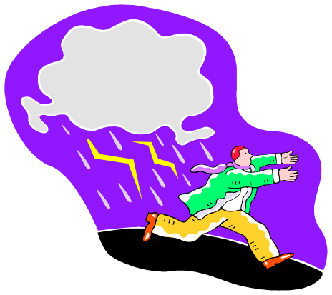
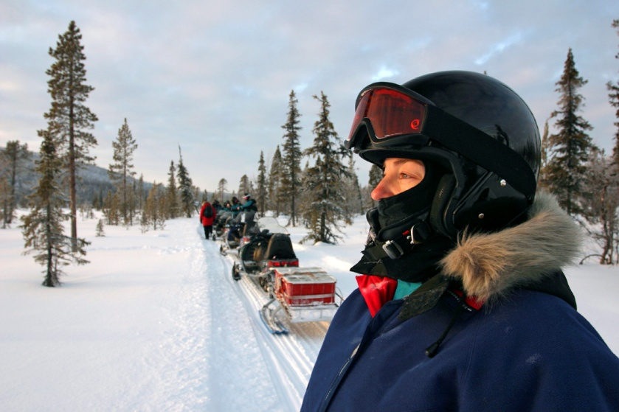

“Clothing lifts the environmental load off the individual.”
“Architecture, by creating a third “bulk” environment, takes the environmental load off both man and his institutions and processes, freeing a greater portion of human energies for socially productive activity.” [American Building, J.M. Fitch]

Slide 34
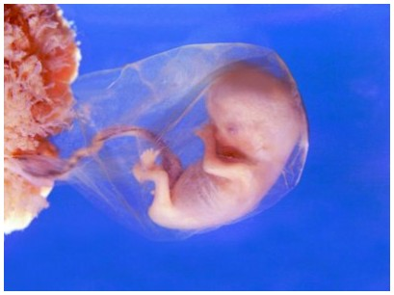
The external physical environment into which the human organism is projected at birth differs profoundly from that in which its fetal development occurred.
Instead of a habitat designed specifically for its optimal development, it now finds itself in one many of whose properties are hostile to survival, and all of whose properties, friendly and hostile alike, are in continuous and often violent fluctuation across time and space.
The moral world today is outside of the principles and spirit of God. It can only be conducive to spiritual development by the internal spiritual equilibrium being maintained by the individual herself.
The Garden of Eden was created especially for the optimal development of their spiritual being. Its properties were such as offered the exercise of man’s freewill to serve God or to serve himself. The resulting friendly, “at-one-with-God” state OR the hostile, often violent fluctuation across time and space state was to be dependent upon their choice.

Slide 35
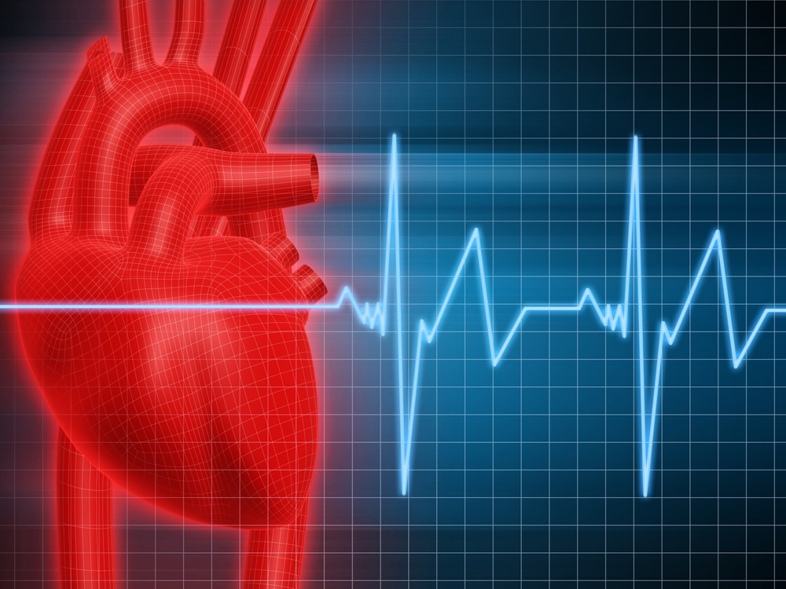

The metabolic requirements of the individual organism are constant.
Its capacity for adaptation to external change, though fairly broad, is strictly limited.
Thus arises the fundamental paradox of human existence.

Slide 36



Immersed in its physical environment, the animal body is never for a moment free of paradox
Its existence depends upon the maintenance of an internal equilibrium which external nature does not afford.
The higher the form of life, the more complex will be the function and the more intricate the structure of the body: hence the more important its internal equilibrium.

Slide 37


The body’s dependence upon external nature is absolute – in the fullest sense of the word, uterine.
Unlike the womb, this external environment never affords optimum conditions for the development of the individual.
The contradictions between internal requirements and external conditions are normally stressful.

Slide 38
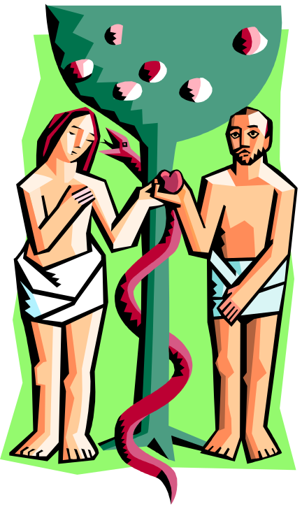
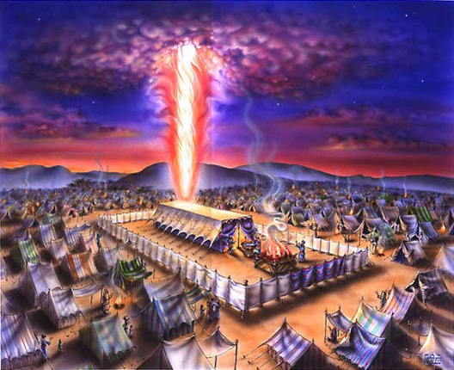
Man has perfected two ameliorating devices:
  Clothing (metaphor for individual atonement rep. by baptism into Christ)
  Building (metaphor for collective worship in fellowship with God as Israel & fraternity in Christ)
Both act as interfaces between the…
  Internal micro-environment of the body (sin in my members warring against the law of my mind)
  The macro-environment of external nature – (Lust of eyes, flesh & pride of life; things of the world)
Both modulate the play of raw environmental stresses on the body’s surfaces and orifices
  Creating a third, meso-environment whose characteristics can be tailored to meet human requirements (Fig. 6) (Providential care and guidance of believers in Christ)

Slide 39

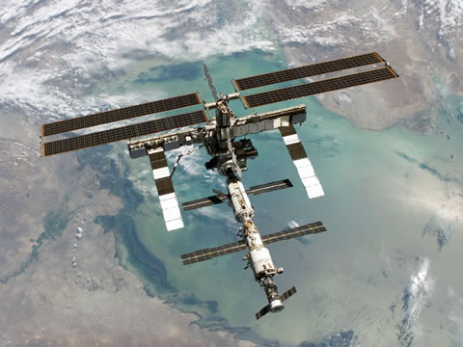
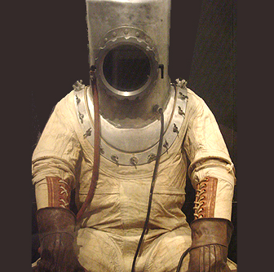
The principal difference between clothing and building
  Clothing protects the individual only (sins recognized, forgiven, overcome)
  Building shelters social processes (Aid in God manifestation , lights shining in a dark world, saving others & ourselves)
Traditionally, the function of clothing has been to manipulate the thermal environment
As man enters new environments (submarine, outer space) their clothing starts to resemble buildings
  Life-support systems for manipulating…
    Temperature
    Air pressure
    Chemical composition
    Body-waste disposal

Slide 40
Because of the continuous fluctuation of all environmental factors across time, however, the building wall must be visualized not as a simple barrier but rather as a selective, permeable membrane with the capacity to admit, reject and/or filter any of these environmental factors
Are our “individual walls” built up for OUR defense or the defense of the Gospel and God’s Glory?
It is so much easier to allow these natural barriers to form than to construct a “divinely designed” wall in our minds that depends upon the development of our mental and spiritual faculties. This requires education at the highest level. Reading, writing, studying ideas that are generated for the individual who knows how vital these “specially selected walls” are on both a personal and an ecclesial level.

Slide 41
Architecture – The “Third Environment”
By it he surrounds himself with a new environment, tailored to his (God’s) specs, interposed between himself and the world (of sin)
The building invests man, surrounds and encapsulates him at every level of his existence
It’s a “special container” whose central function is to intervene in man’s favor
Jesus tailored the ecclesia as his body according to HIS specs. Thus in effect surrounding himself with a “new environment.” This “interposition” of men and women who form his “body” make up the “linen wall of righteousness” around the Tabernacle in the wilderness. Anyone seeking the Father in spirit and truth will at some point interface through this “building” of his Body.
Apply this same principle to the “wall” and “gate bldgs.” of the IHOP.
As the ante-typical “sons of Aaron” in a higher, Melchizedek priesthood, we intervene in mankind’s favor. At least those of the race who desire to draw close to God in a true form of worship based upon an accurate doctrinal foundation.

Slide 42

The Building – By Extension, The City Invests Man
(Embraces, Empowers, Entitles, Embodies, Embattles)
MedievalLatin investire, from Latin, to clothe]
a : to array in the symbols of office or honor
b : to furnish with power or authority
c : to grant someone control or authority over : vest
2: to cover completely : envelop
3: clothe, adorn
4: [Mid French investir, from Old Italian investire, from Latin, to surround] : to surround with troops or ships so as to prevent escape or entry
5: to endow with a quality : infuse

Slide 43
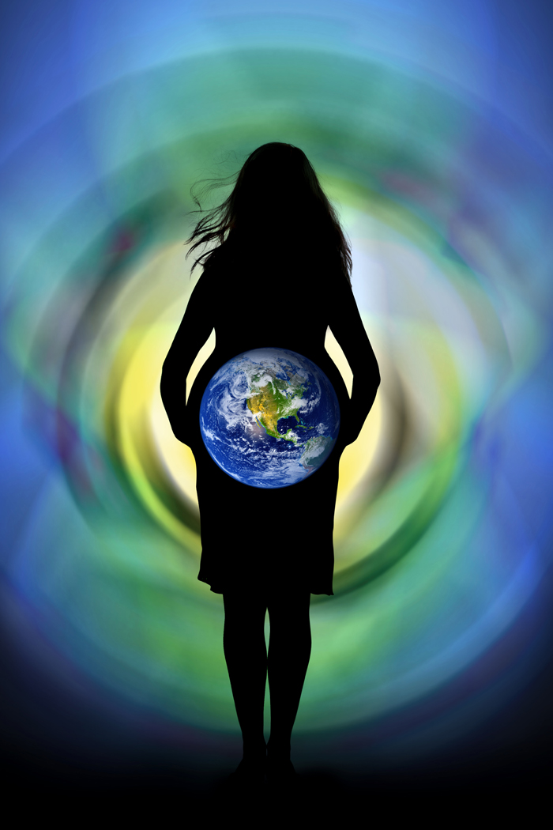
The Building – By Extension, The City
(Earth Filled With God’s Glory)
It lightens the stress of life
Shields man from the raw environment stresses
Permits him to focus his energies upon productive work
As a “uterine” analogy, building permits man to modulate the play of environmental forces upon himself and his processes
To guarantee their uninterrupted development, in very much the same way as the mother’s womb protects the embryo.

Slide 44
" Yahweh's foundation is in the mountain of holiness. He loveth the gates of Zion more than all the dwelling-places of Jacob. Glorious things are spoken of thee, O city of Elohim. Selah. This man (the foundation stone laid in ZION) was developed there : even to Zion it shall be said, The man, even THE MAN, was brought forth in her ; and HE, the Most High, will establish her In enrolling the peoples, YAHWEH will reckon (that) this man was born there. Also singers as well as musicians (Rev. v. 8 9; xiv. 2 ; xv. 2-3) there: all My springs are in Thee.“ Ps. LXXXVII. *

Slide 45
The Garden of Eden before the Fall
The Family obedient to God led by father
The Tribe, community following God’s word
The nation of Israel in covenant with YHWH
The Body of Christ today, his prospective Bride, the Ecclesia
The Kingdom of God for 1000 Years
The Kingdom delivered up unto the Father and God’s glory fills the earth

Slide 46
“He Who Built All Things Is God…”
The architect does not build for individual man, man alone and at rest
Typically he builds for social man, man at “work”
Work is not a “natural” activity; only LABOR is “natural”
That is, those activities we share with the entire animal world where the whole body is used to meet its biological needs, to feed it, bathe it, dress it, protect it from attack.
Elohim, God, built man’s natural environment for his RACE. Jesus built man’s spiritual environment, the Ecclesia for THE RACE!
Matt. 11:28-30
“Come unto me, all ye that labour and are heavy laden, and I will give you rest.
29 Take my yoke upon you, and learn of me; for I am meek and lowly in heart: and ye shall find rest unto your souls.
30 For my yoke is easy, and my burden is light.”

Slide 47


“Work” Vs. “Labor”
Work is “unnatural” – i.e., the uniquely human use of the hand and the brain to produce the artificial, non-biological world of human artifice (skyscrapers, textbooks, paintings, space ships, highways, symphonies and pharmaceuticals)
Both levels of human activity are fundamental to civilization: the world of WORK can only exist as a superstructure on the world of LABOR.

Slide 48
Insofar as we share the world of LABOR with the beasts, it can fairly be described as at once natural and subhuman.
Only the world of WORK, of human thought and artifice, is uniquely human.

Slide 49
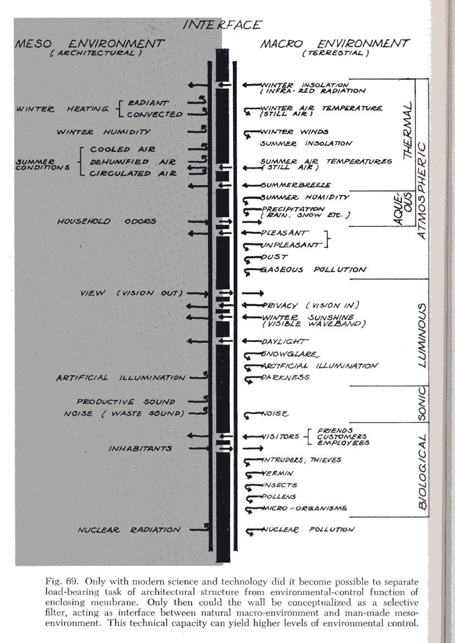

Slide 50
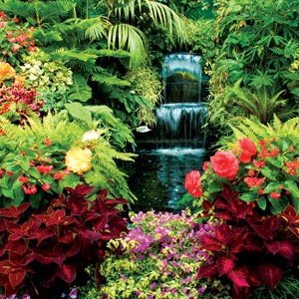
Christ and the Saints in the Eastern Court
Song Sol. 11:9.—" My beloved is like a roe, or a young hart: behold, he standeth behind our wall, he looketh forth at the windows, shewing himself through the lattice."
(Spoken of the sons of Zadok in their exalted position in the Temple of the age to come.)
Song Sol. v. 1.·—" I (Christ) am come into My garden, My sister (Matt. 12:50). My spouse (2 Cor. 11:2) ; (Matt. 25:1-13).
Eat, Ο friends (John 15:14) ; drink, yea, drink abundantly, Ο beloved."
(Spoken of Christ and His multitudinous spouse breaking bread and drinking wine in the "inclosed garden" in the Kingdom of God.)

Slide 51
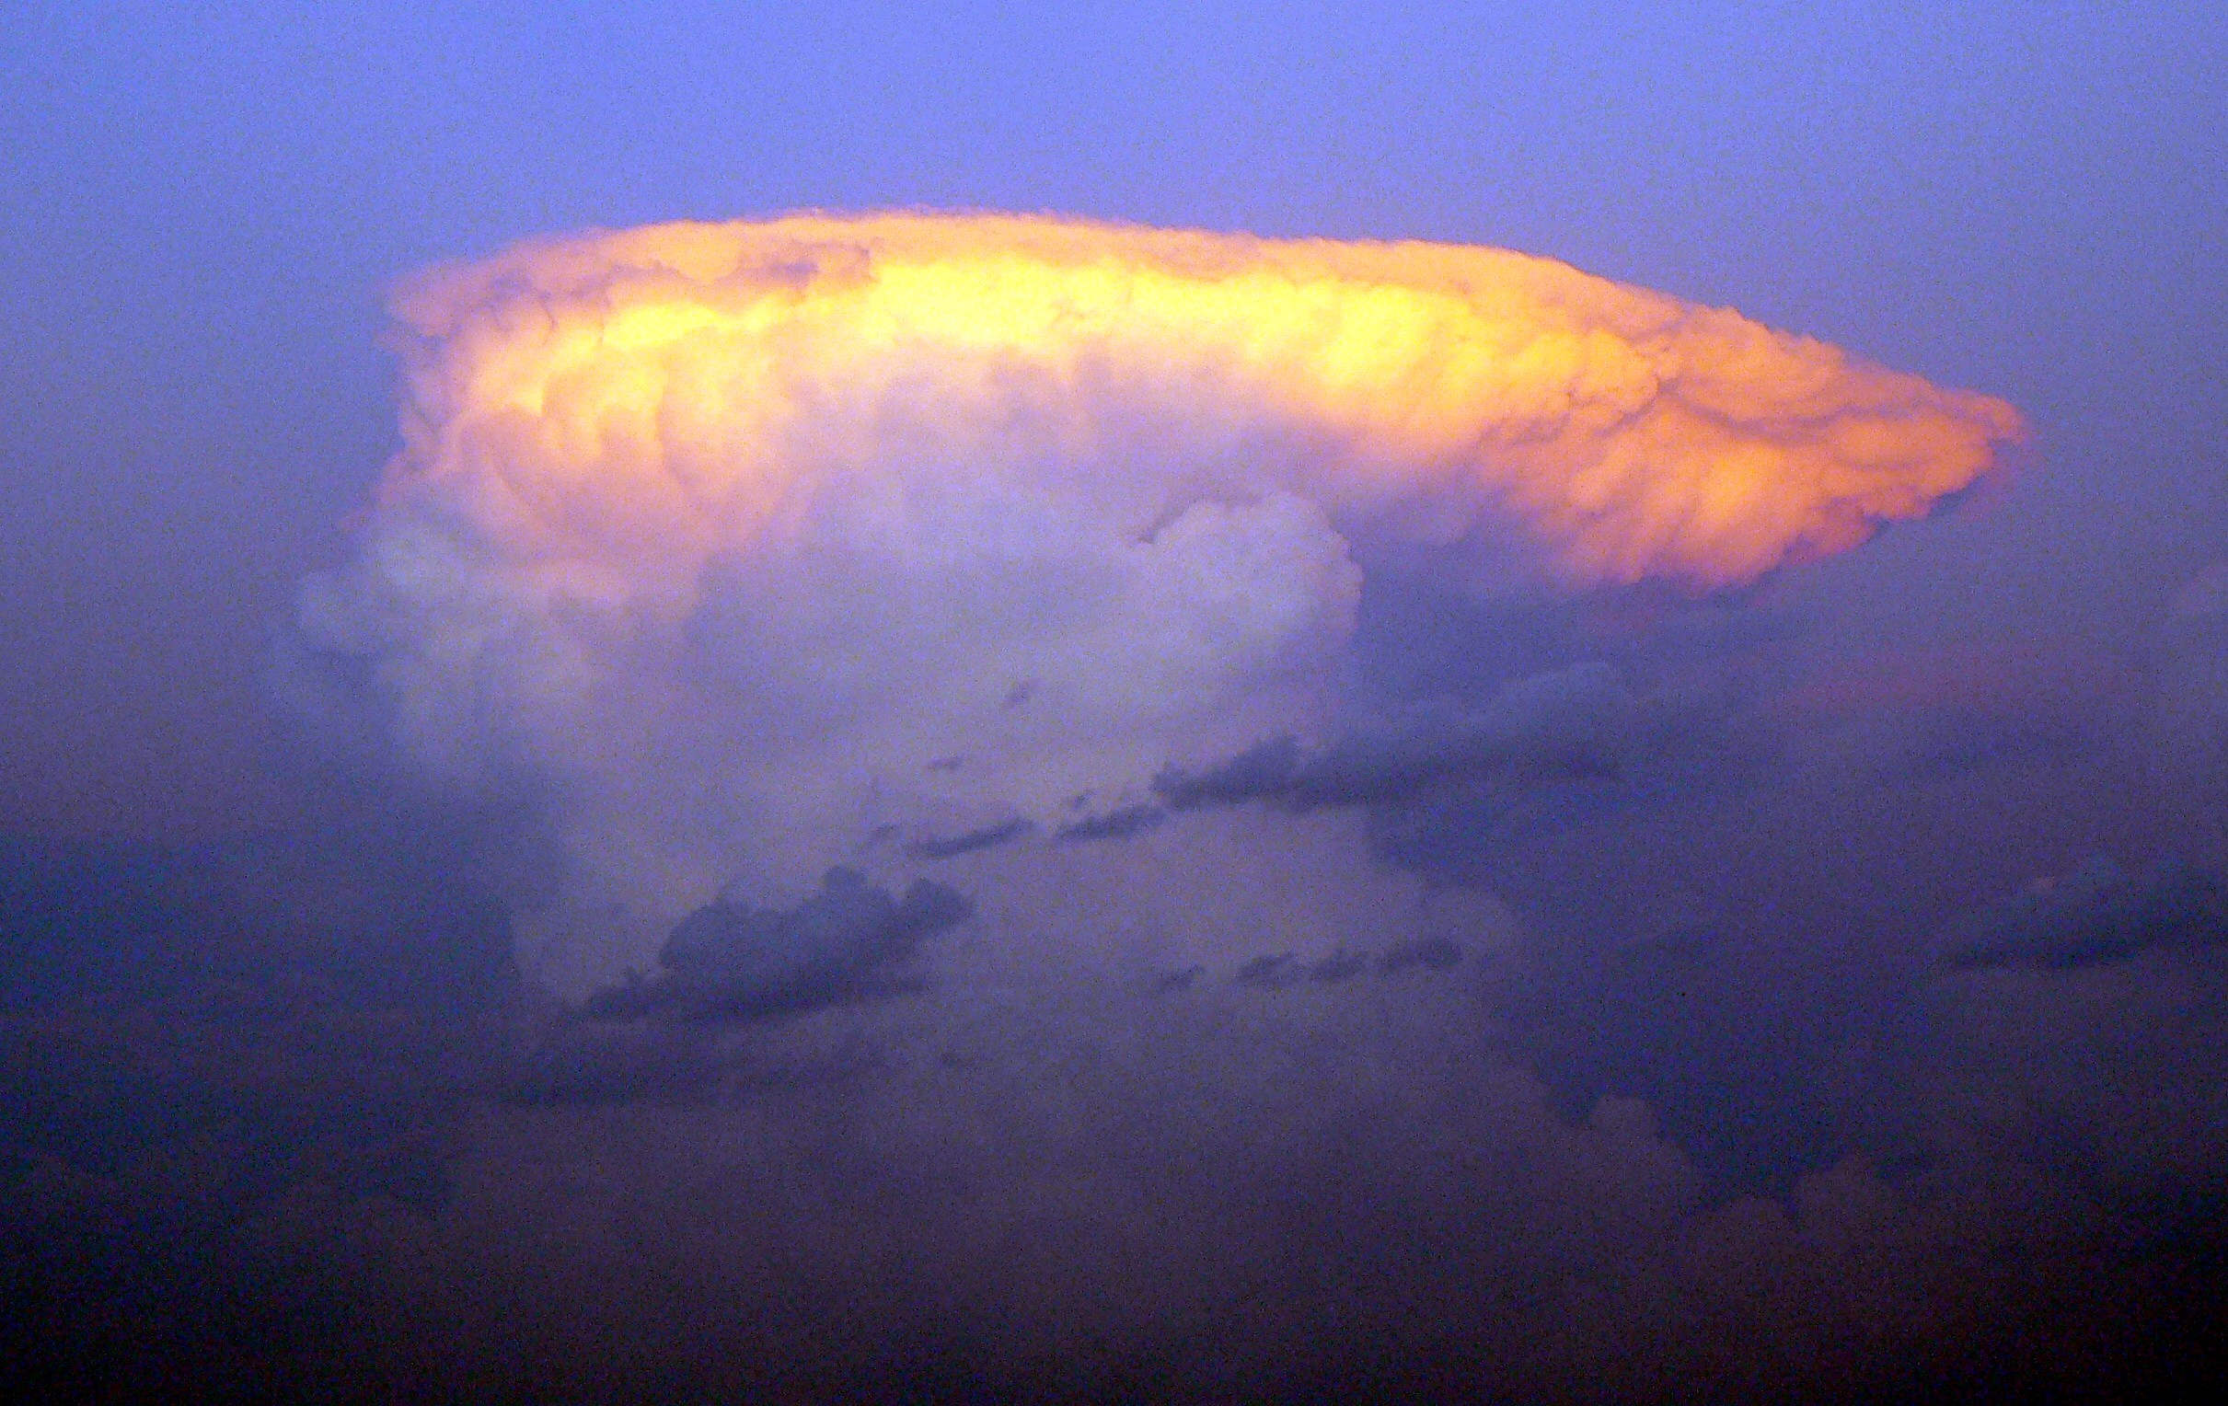
The Fire and Cloud over Jerusalem when Israel is restored.
Isa. 4: 2-6, R.V.—" In that day shall the branch of the Lord be beautiful and glorious, and the fruit of the land shall be excellent and comely for them that are escaped of Israel. And it shall come to pass that he that is left in Zion, and he that remaineth in Jerusalem, shall be called holy, even everyone that is written among the living in Jerusalem. When the Lord shall have washed away the filth of the daughters of Zion, and shall have purged the blood of Jerusalem from the midst thereof, by the spirit of judgment, and by the spirit of burning. . . . The Lord will create over the whole habitation of Mount Zion, and over her assemblies, a cloud and smoke by day, and the shining of a flaming fire by night: for over all the glory shall be spread a canopy. And there shall be a pavilion for a shadow in the daytime from the heat, and for a refuge and for a covert from storm and from rain."

Slide 52
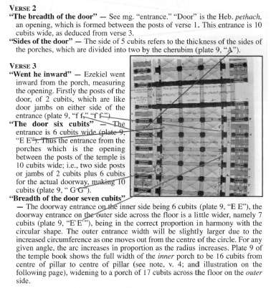
Ezek. 41:1
41:1

Slide 53
