Slide 1
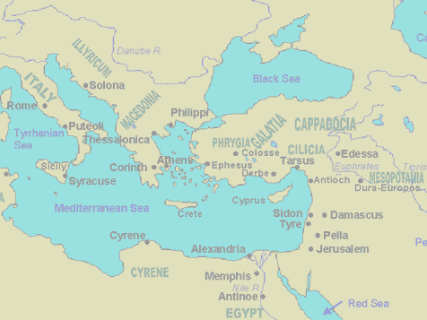
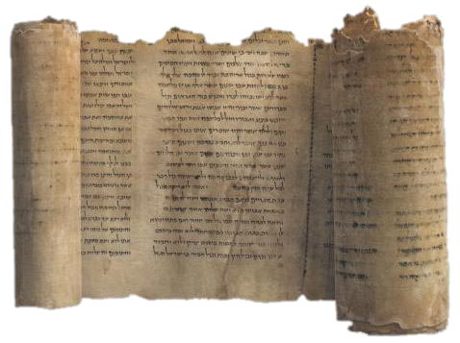

James’ Letter to the Scattered 12 Tribes

Slide 2
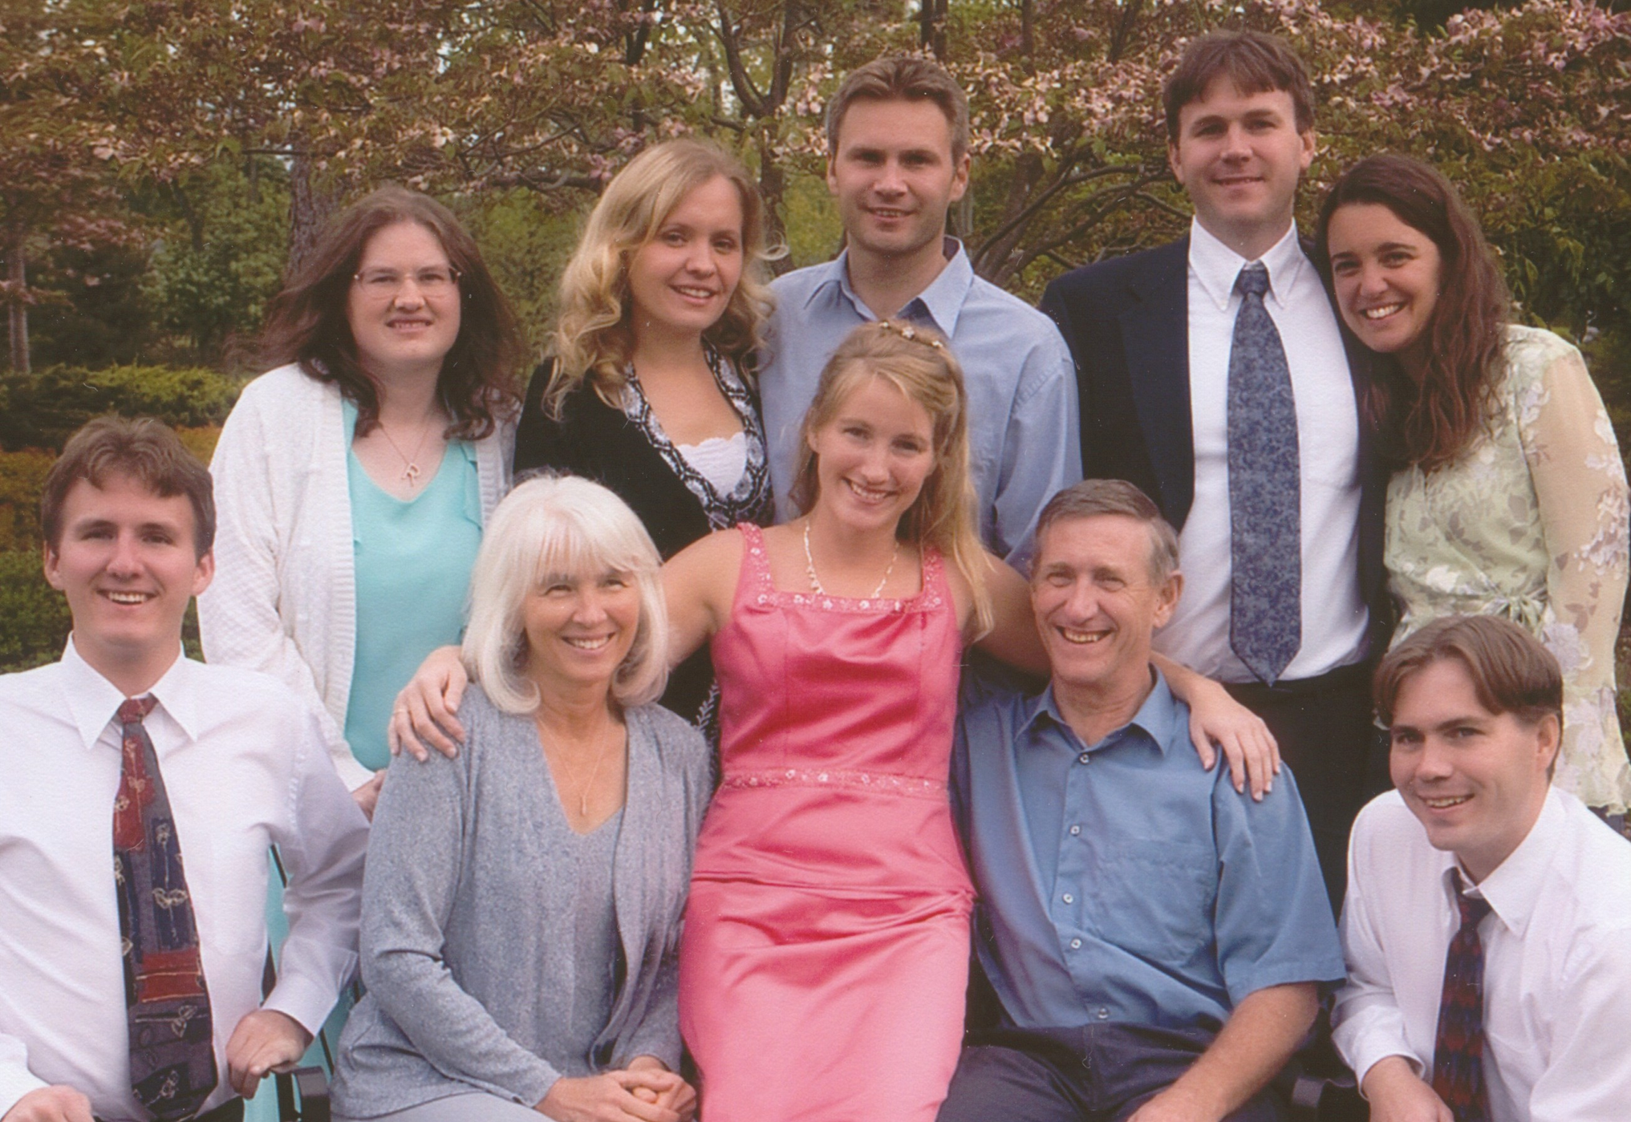

Slide 3
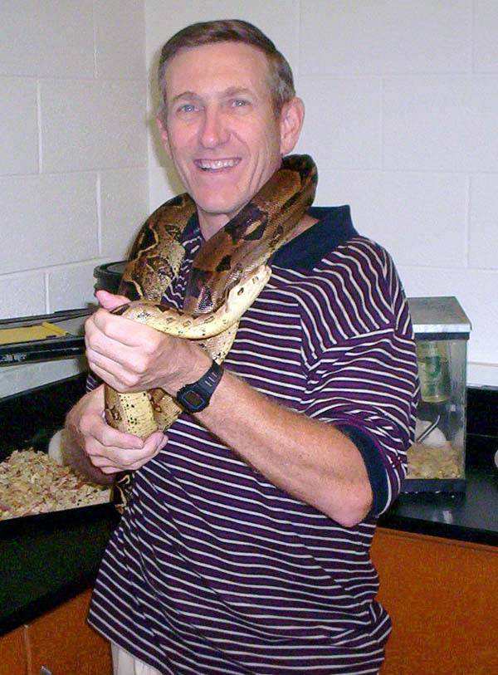
I taught High School biology and AP biology
Explains my 8th grade vocabulary

Slide 4
Jews scattered from Jerusalem
Acts 8:1 Now Saul was consenting to his death. At that time a great persecution arose against the church which was at Jerusalem; and they were all scattered throughout the regions of Judea and Samaria, except the apostles.
Acts 11:19 Now those who were scattered after the persecution that arose over Stephen traveled as far as Phoenicia, Cyprus, and Antioch, preaching the word to no one but the Jews only.
Was God Involved?
The Jews that had left Jerusalem and Israel years ago were considered worldly & ungodly, but they became prosperous & rich in other areas. Now more Jews were scattered from the land and these poor were persecuted by the rich Jews who had left earlier.

Slide 5
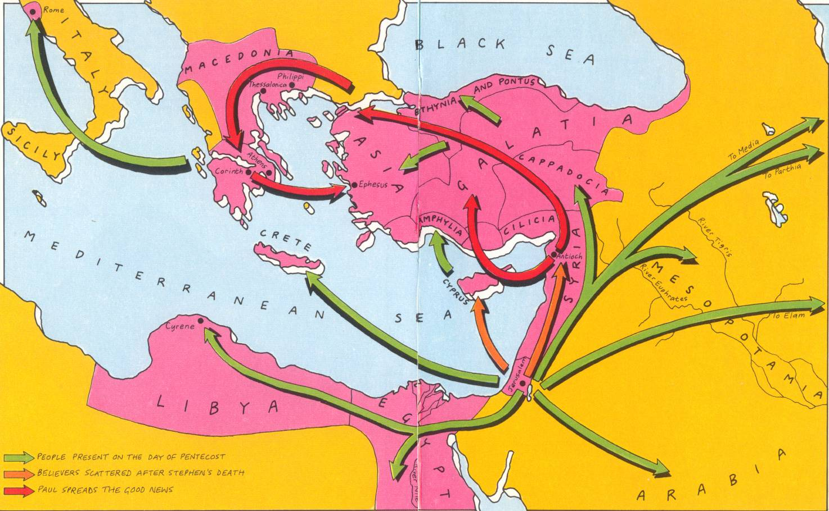
Gospel Expands

Slide 6
Which James was he?
Son of Zebedee (and brother of John)
  Killed in Acts 12
Son of Alphaeus (and brother of Matthew?)
Son of Cleopus & Mary (“the little”)
  Brother of Joses
  May be same as son of Alphaeus above
Half-brother of Jesus
  Had the respect of Jerusalem ecclesia (Acts15)
  Many word parallels in letter of Acts 15
  Many connections to words of Jesus
Matt 13:55 "Is this not the carpenter's son? Is not his mother called Mary? And his brothers James, Joses, Simon, and Judas?

Slide 7
James Grew up with Jesus
Reflected on the teachings of Jesus – many phrases in this letter also occur in the gospels
Well versed in the Law & Prophets
Jesus challenged him to be a doer, not just a hearer
First hand experience of prejudice against Jesus and dependence on legalism
Personally called by Jesus after his resurrection (1Cor 15:7)
v.1 James humbly introduces himself as “James, a servant of God and of the Lord Jesus Christ”

Slide 8
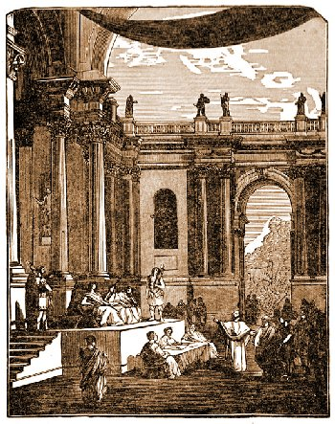
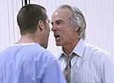
Reason for the Letter
They were facing persecution and trouble from rich, established Jews
Too many Jewish believers had a belief system that was not mani- fested in their way of life
  Our faith must show itself in our works
Riches & covetousness were affecting some
  Many were prejudiced against the poor
Verbal wars were being fought in the ecclesia

Slide 9
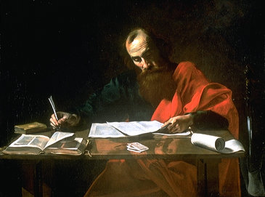
When was the Letter Written?
About 45-46 AD (before Paul’s 1st journey)
Persecution by rich Jews, not Gentiles
No mention of any Gentile problems
Late enough for James’ authority to be established (Acts 12:17)
Early enough that the inclusion of Gentiles was not a major issue yet (before Acts 15)
  No mention of Gentiles at all

Slide 10
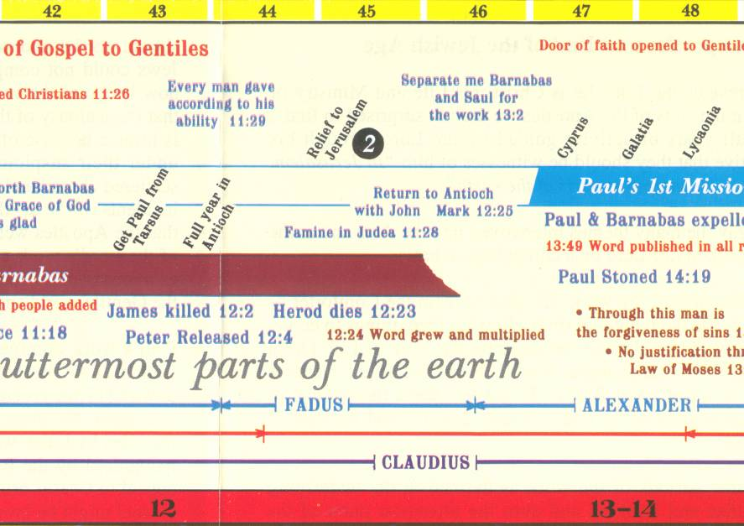

Slide 11
James balances Galatians
Hearers only: Christ did it all by Grace! I don’t need to do anything or change
Judaisers: I must work to earn my salvation
James corrects this (45 AD)
Galatians corrects this (49 AD)
Faith working through Love (Gal 5:6)
God has forgiven us in Christ. We follow Christ’s example & live for God and his family because of our love for them.

Slide 12
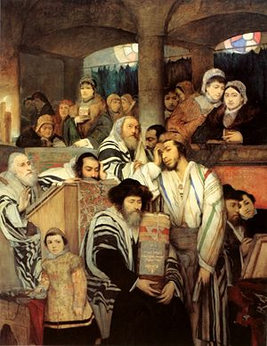
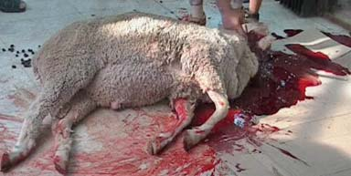
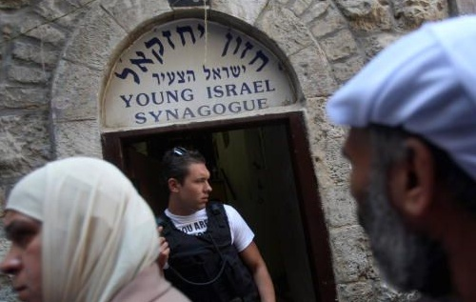
This was a transition period
Many believing Jews still attended synagogues (2:2) and visited the temple
The Jewish community still had an impact on the believers
Many Jewish believers still kept the Law

Slide 13
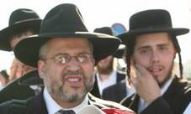
Problems with Jewish background
Some depended on their Jewish heritage
  Thought they were the chosen people
  They believed this gave them access to the grace of God
  God will save them because they are Jews, without Christ having any impact on their behavior (hearers only group)

Slide 14
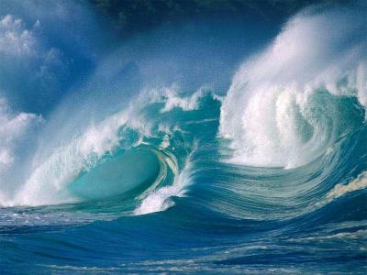
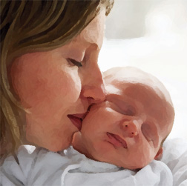
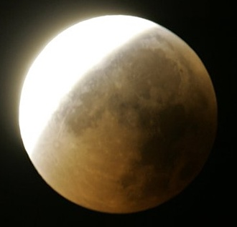
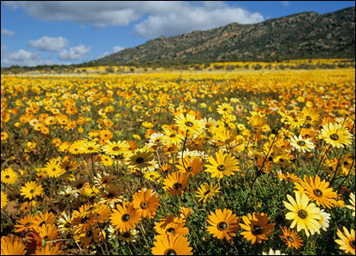
Watch for the allusions to nature
Waves of the sea (1:6)
Flower of the field withers (1:10-11)
Human life cycle (1:15)
Shadow of turning (1:17)
Brought forth as 1st fruits (1:18)
More later!

Slide 15
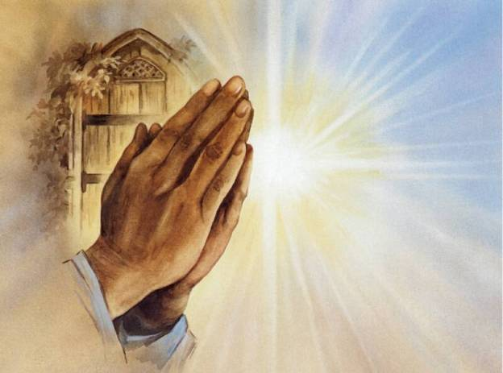
Verses 2-11
God will help us understand our Trials if we believe & trust Him – He knows what He’s doing!

Slide 16
What about Ecc 9:11?
But time and chance happen to them all
Check out the context of Ecc 8 and 9
Look at how the Hebrew word is used in 1 Kings 5:4
But now the Lord my God has given me rest on every side; there is neither adversary nor evil occurrence.

Slide 17
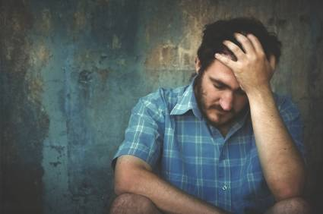
Verses 12-18
God uses trials to develop us into His children. Not to destroy us!

Slide 18

Basic intent of James’ Letter
If we trust God’s involvement in our life, we will have a spiritual mind that allows us to live as members of God’s family both now and forever.

Slide 19
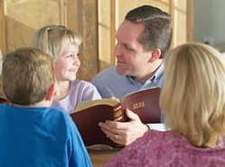
Verses 19-27
Godly characteristics we need, to endure our trials

Slide 20
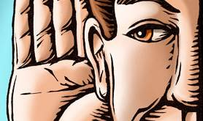


The Lesson for Us
Be swift to hear
Slow to speak
Slow to wrath

Slide 21
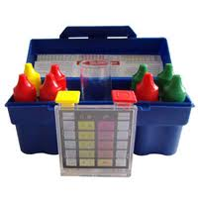
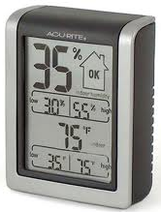

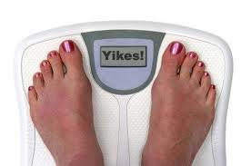
James give us specifics (tools) to measure how our Faith is affecting our life

Slide 22

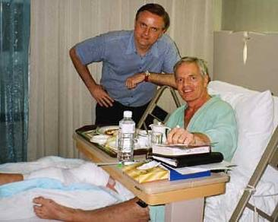
The wrath of man
Does not produce the righteousness of God

Slide 23
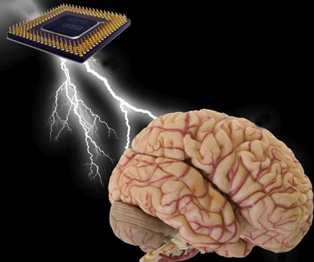
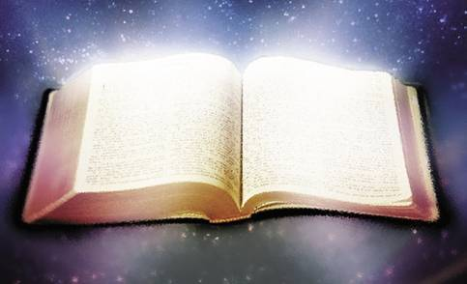
Receive with meekness the implanted word
It can save your soul!

Slide 24
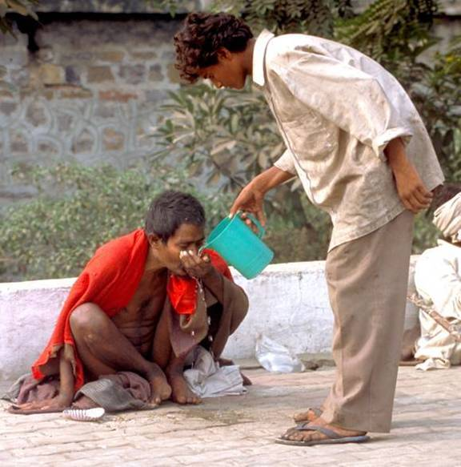
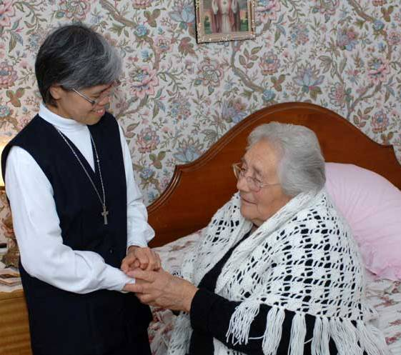
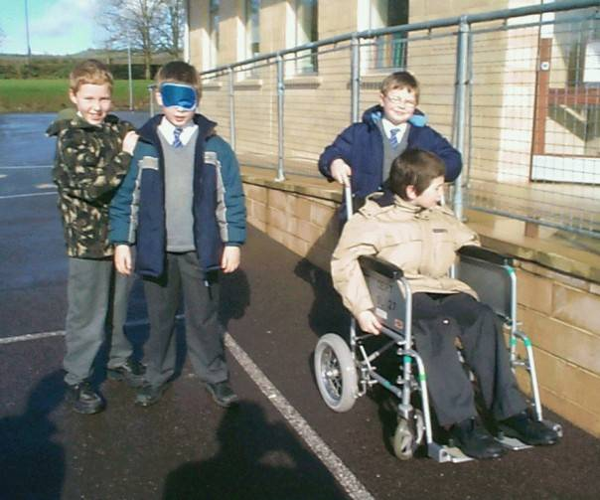

Become a Doer of the Word

Slide 25
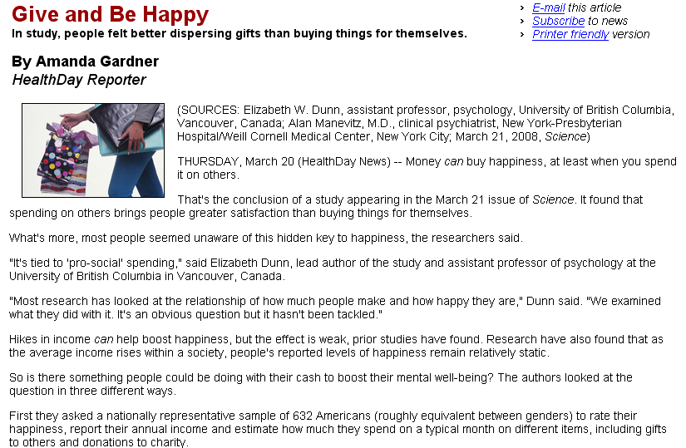
Science, March 21, 2008

Slide 26
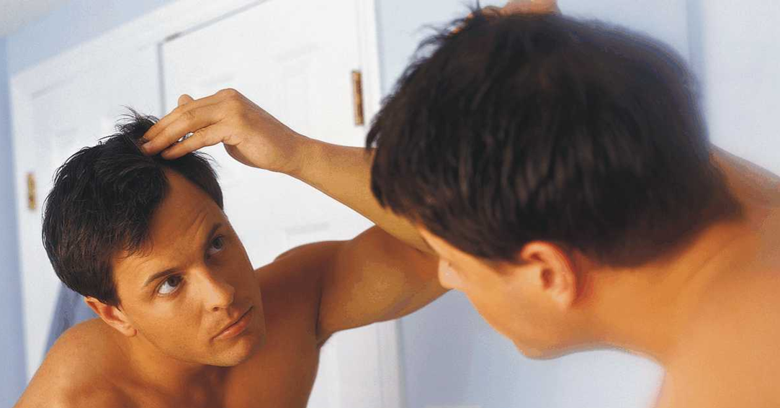
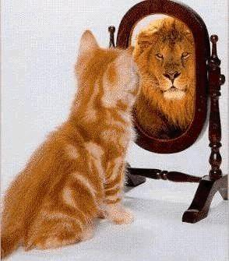
The Mirror Test
Hearers only of the word: Just look and then walk away and forget – no change!

Slide 27

What are we going to do different when we get home?
How can I help out in my ecclesia?
We should decide this week!

Slide 28
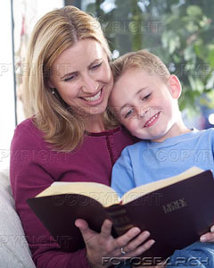
Looking into the Law of Liberty
Reading the Bible should change our life! Christ becomes our example. We become Doers of the Word.
This one will be blessed in what he does

Slide 29
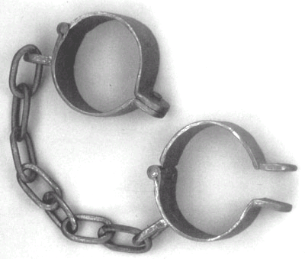
Law of Liberty sets us free!
1Cor 10:29 Paul’s liberty to eat (2Cor 3:17 – “unveiled face”)
James 1:25 perfect law of liberty (2:12)
1 Pet 2:16 don’t misuse liberty (2Pt 2:19)
John 8:32-36 Truth will make you free
Gal 5:1, 13 For freedom Christ has set you free!
Rom 8:2 free from the law of sin & death (6:7, 18, 22) [Law of Spirit of life = perfect Law of Liberty]
Free to serve one another through love (Gal 5:13)

Slide 30

Don’t be deceived
(3 times!)
We must understand good gifts are from our heavenly Father (16-18) [not just the result of our great work!]
We must be a doer of the word (v.22) [not just a hearer!]
We must bridle our tongues (v.26) [our speech reveals our true heart!]

Slide 31
Pure & Undefiled Religion before God (not man)
Visit orphans & widows in their troubles
  Help those who cannot help themselves or reward you now
Keep yourself unspotted from the world
  Don’t let the behavior of worldly people influence you to act like them
This is the way members of God’s family live!

Slide 32
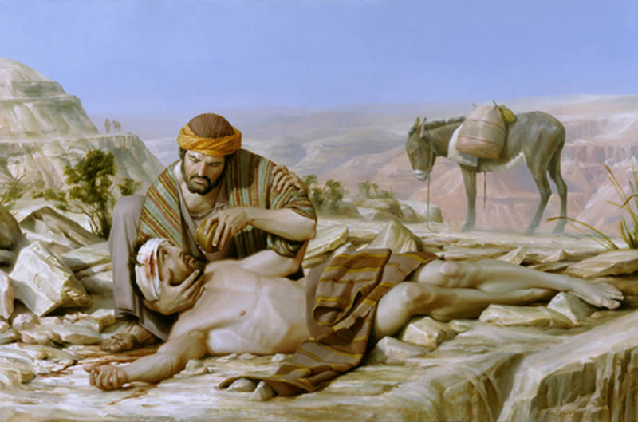
What kind of Religion do we have?
One that looks good from the outside or one that teaches us to live as children of God?

Slide 33
Next Class
Look at some specifics that help us understand the kind of religion we live

