Slide 1

Biblical Examples of Solving Ecclesial Problems
Examples of how people in the Bible handled their ecclesial and family problems & how God used these situations to allow them to practice living by faith

Slide 2


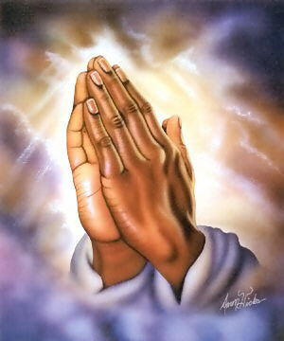
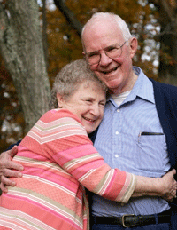

Useful resources!
Daily Bible Readings
Wisdom of experience

Slide 3
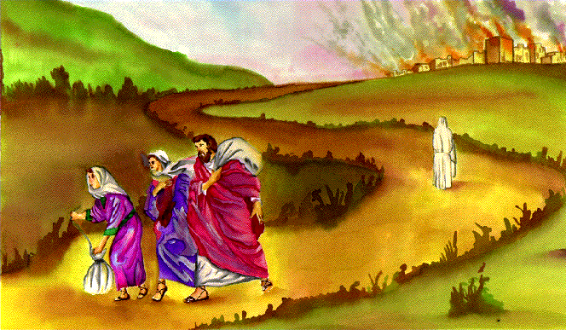
God is more concerned with how we go about it, than the end result – He’s very patient!
He killed Nabal after David waited (1 Sam 25), would have helped Asa beat Baasha (2 Chr 14-16), could have wiped out Jericho the 1st day (Josh 6)
He can bring about the result He wants for a specific problem any time – He’s in control!
These problems give us an opportunity to practice living by faith
Clearly the ends does not justify the means!

Slide 4
Solving Ecclesial Problems
Gen 4: Cain and Abel (20)
Lev 10: Aaron’s sons burned the goat (10)
Num 27, 36 Daughters of Zelophehad (12 & 13)
Joshua 9: covenant with the Gibeonites (6)
Joshua 22: 2.5 tribes build an altar (5)
Judges 19-21: Levite and his concubine (11)
Jonathan’s dilemma with Saul & David (21)
1 Sam 14: Jonathan eats some honey (9)
1 Sam 25: Abigail counsels David (17)
1 Kings 12: Rehoboam’s tough stand (19)
Ezra 9-10: Foreign wives (18)
John 8: woman taken in adultery (16)
Acts 15: Jerusalem conference (7)
1 Cor 1-3: factions in Corinth (22)
1 Cor 5: man living with his father’s wife (14)
2 Cor 2: repentant man comes back (15)

Slide 5
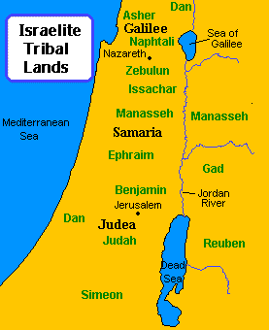
Solving Ecclesial Problems:
Joshua 22
Problem: The eastern 2.5 tribes built an altar on the west side of the Jordan.
Reaction: Lots of assumptions about motives are made by the other tribes, who then gather the troops to attack!
Solution: Good leadership encourages communication! Talk to each other and try to understand why people do what they do. If possible, look for a solution that satisfies the needs of everyone.

Slide 6
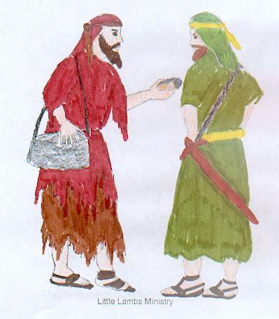
Solving Ecclesial Problems:
Joshua 9
Problem: The leaders made a covenant with the Gibeonites without consulting God. Now they had conflicting principles: Kill Gibeonites or honor covenant?
Reaction: All the congregation complained against the leaders. Many wanted to kill the Gibeonites because they had deceived Joshua so they could live.
Solution: They compromised, allowing the Gibeonites to live but making them permanent slaves in Israel. The people accepted the decision of the leaders, even though it was not perfect!
Note: God honored the agreement (10:8). David later honored this agreement too (2 Sam 21) while Saul tried to wipe them out! In Neh 3:26 some descendants still involved in service!

Slide 7
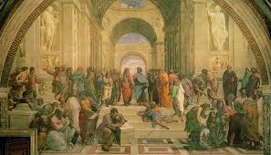
Solving Ecclesial Problems:
Acts 15
Problem: Uncircumcised Gentiles were joining the community. They ate food offered to pagan gods and did not follow Jewish customs or keep the Law of Moses.
Reaction: Many believing Jews did not want to accept these Gentiles as legitimate members. They wanted to make the Gentiles get circumcised and keep the Jewish practices.
Solution: A big conference was held in Jerusalem to discuss the problem and seek solutions. The group consulted the Bible and the work of the Lord in their lives. They came up with a compromise that involved concessions for the sake of others, but did not compromise essential principles – salvation by grace.
more

Slide 8

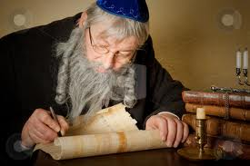
Compromise of Acts 15
"but that we write to them to…..
abstain from things polluted by idols
from sexual immorality
from things strangled
and from blood.

Slide 9

Solving Ecclesial Problems:
1 Samuel 14
Problem: Saul made his men take an oath that they would not eat any food until he had beaten the Philistines that day. Jonathan left the group and God used him to defeat a garrison of Philistines. While traveling through a forest, Jonathan ate some honey.
Reaction: When Saul found out, he thought Jonathan should die (v.44).
Solution: Saul’s men realized this would be a worse mistake than the oath, so they rescued Jonathan from Saul “for he has worked with God this day”. Sometimes ecclesias need to rescue members from mistakes of elders and cannot just let elders make bad decisions that may destroy one of God’s flock.

Slide 10
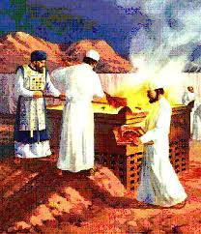
Solving Ecclesial Problems:
Leviticus 10
Problem: Aaron and his sons burned the goat for the sin offering, when they should have eaten it and ritually born the guilt of the people.
Reaction: Moses was angry with Eleazar and Ithamar.
Solution: Aaron talked to Moses and explained why it would have been inappropriate to eat the goat that day. Moses listened, learned, and was then content. Circumstances required a modification of the Law.

Slide 11
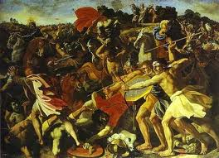
Solving Ecclesial Problems:
Judges 19-20
Problem: Some men of Gibeah ravished and killed a Levite’s concubine. The people of Benjamin defended the men of Gibeah.
Reaction: The people of Israel wanted to kill the men of Gibeah. The battle got out of control and they almost killed every man of Benjamin! Then they took an oath not to give their daughters as wives to Benjamin. Nearly wiped out a tribe!
Bad Solution: One bad decision led to another! The Israelites told the Benjaminites to kill the people of Jabesh Gilead and take their women. Then they told them to “steal” more women from Shiloh.
“Everyone did what was right in his own eyes”

Slide 12
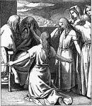
Solving Ecclesial Problems:
Numbers 27
Problem: Zelophehad died and had no sons, but did have 5 daughters. There was no provision in the Law for an inheritance to pass on to daughters, but these daughters did not want to lose their inheritance.
Reaction: Moses did not know what to do, so he asked God what to do.
Solution: God modified the Law to explain what to do if a man had no sons, but did have daughters. He also further extended the principle to handle other similar situations that might arise, so the inheritance would stay in the family.
Rules can’t anticipate every situation!

Slide 13
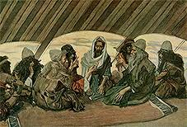
Solving Ecclesial Problems:
Numbers 36
Problem: The tribe (Manesseh) of the daughters of Zelophehad was concerned that these women might marry out of the tribe and the tribe would loose part of their land.
Reaction: Moses accepted this as a legitimate concern and asked God what to do.
Solution: God modified the Law again and put restrictions on the daughters who got their father’s inheritance, that they must marry someone from their own tribe. A compromise solution that met everyone’s needs.
Some rules need to be modified for special situations

Slide 14

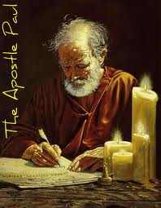
Solving Ecclesial Problems:
1 Corinthians 5
Problem: A man was living with his Father’s wife (man’s step-mom) and he justified it as acceptable.
Reaction: The Corinthians were so accepting of diverse behaviors that they did not intervene to stop this immorality, in fact, they boasted about how good they were at tolerating sinners!
Solution: Paul writes to them and demands that they take a clear stand on immoral issues like this one because these behaviors will prevent us from being accepted into God’s kingdom and they can corrupt other believers too! These people must be “delivered to Satan” that they might be saved.
Note: God has never tolerated these behaviors!

Slide 15
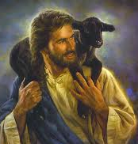
Solving Ecclesial Problems:
2 Corinthians 2
Problem: The immoral man of 1 Cor 5 who was rebuked and disfellowshipped, changed his ways, repented, and wanted to be received back.
Reaction: Some members did not want to receive this repentant sinner back into fellowship. They probably didn’t think he had really changed, or they wanted to make an example of him, or they thought he would continue to be a bad influence in the ecclesia.
Solution: Paul says to forgive and comfort this man, lest he be overwhelmed by excessive sorrow. “Reaffirm your love for him”. People trying to return to the ecclesia need our love and support more than those who never left! This is a real challenge to our faith and our ability to extend the mercy we hope to receive from God.
Welcoming back can be more difficult!

Slide 16
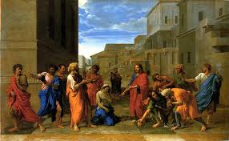
Solving Ecclesial Problems:
John 8
Problem: A woman was caught in the act of adultery.
Reaction: The people wanted her stoned. They said Moses commanded in the Law that she should be stoned (Lev 10:20; Deut 22:22; Ezek 16:38-40).
Solution: Jesus challenged each potential stone thrower to think about their own sins and failings first, then see if they were willing to throw a stone. We must find out if a sinner is sorry and repentant, or boldly defiant of God. Jesus counsels us to think about God’s mercy towards ourselves, before we pronounce a death-blow judgment against a repentant child of God.
Note: if a sinner is sorry, then “mercy triumphs over judgment” (James 2:13) [Like David]

Slide 17
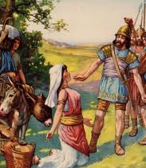
Solving Ecclesial Problems:
1 Samuel 25
Problem: David’s men had protected Nabal’s flocks and men for many months. Nabal refused to provide food for David’s men, even when he planned a feast and had plenty of food to share.
Reaction: David decided to kill Nabal’s men and take his possessions because Nabal was so selfish, unkind and unthankful. (David wanted to handle Nabal like Saul was handling David!)
Solution: Abigail knew this would be a major mistake that David would regret one day. She went to David and appealed to him about his relationship with God and his own spiritual values. With good spiritual reasoning and wisdom, she quietly convinced David not to attack, and she provided all his men with food. She prayed and waited for God to solve her personal problem.

Slide 18
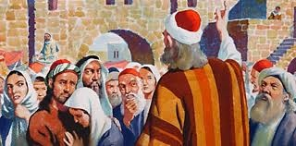
Solving Ecclesial Problems:
Ezra 9-10
Problem: Some Jewish men had married Gentile women and mixed with the nations. This had been part of the reason for their exile!
Reaction: Initially, this practice crept in and was accepted, until Ezra took up the challenge to deal with the issue.
Solution: Pray, meet together to discuss possible solutions, then choose one and move ahead asking for God’s help. They decided to put away their foreign wives, but spent 3 months individually investigating each case (probably to determine if the foreign wives had converted!). Only 113 cases required divorce. No over-reaction here!

Slide 19
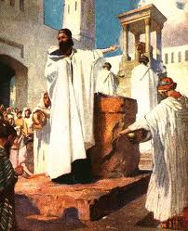
Solving Ecclesial Problems:
1 Kings 12
Problem: Men of Israel had worked hard for Solomon in completing his building projects (temple, own house, etc). Now Rehoboam had to decide whether to lighten the work load, keep it the same, or make it harder.
Reaction: Rehoboam lacked faith to trust God to hold the kingdom together, so he decided to try to maintain control through showing himself “tougher” than his Dad.
Solution: Rehoboam should have trusted God to hold the kingdom together. He needed to treat others the way he would have liked to be treated. Kindness, mercy and love are not signs of weakness!
Note: Don’t require of others what we are not willing or able to do ourselves! Matt 23:4; Acts 15:10

Slide 20
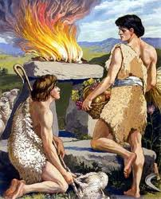
Solving Ecclesial Problems:
Genesis 4
Problem: Cain became jealous of Abel because his own works were evil and Abel’s were righteous (1 John 3:12). Rather than working it out and changing his life, Cain let this jealousy boil within him and turn to hatred.
Reaction: Eventually the opportunity arose when Cain’s jealousy drove him to kill Abel.
Solution: Cain should have asked God to help him grow spiritually, deal with his jealousy, and learn to value Abel’s righteousness and love his brother.
“We know that we have passed from death to life, because we love the brethren. He who does not love his brother abides in death. Whoever hates his brother is a murderer, and you know that no murderer has eternal life abiding in him. By this we know love, because He laid down His life for us. And we also ought to lay down our lives for the brethren.” (I Jn 3:14-16)

Slide 21
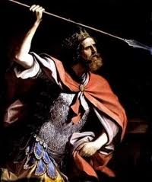
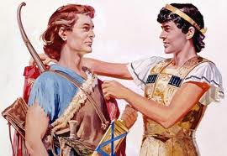
Solving Ecclesial Problems:
Jonathan’s dilemma with Saul & David
Problem: Saul is Jonathan’s dad and the anointed king of Israel. David is Jonathan’s trusted spiritual friend and anointed to be the next king of Israel. Saul is hunting David to kill him.
Reaction: Part of Jonathan longs for David. Part of Jonathan feels responsible to help and serve Saul. The human tendency is to choose sides and only support one side. Jonathan chooses a tough road!
Solution: Jonathan stays with Saul to help out in the kingdom, while supporting and encouraging David, waiting for God to remove Saul and establish David as king in the land.

Slide 22
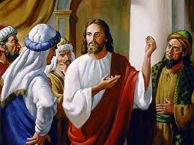
Solving Ecclesial Problems:
1 Corinthians 1-3
Problem: Believers in Corinth had split up into groups, along party lines. Each group thought they alone had preserved the important aspects of the Truth.
Reaction: Each group thought they were better than the others. People in one group, did not think they should associate with people in another group. There was arguing and boasting, jealousy and strife. The body of Christ was severely divided.
Solution: Paul appeals to look at the big picture and remember the little humble part we play. Wisdom is from God. The ecclesia is God’s field and God’s temple, and it was bought with the blood of Jesus Christ. Remember…it’s not my ecclesia!

Slide 23
Lesson From Bible Examples
We must make the effort to communicate!
Pray to God and ask for help to find solutions
Don’t always assume the worst!
Use our Bibles for guidance
Treat others the way we would like to be treated
It’s OK to compromise on non-essential issues
Be willing to extend God’s mercy to others
Be careful we don’t overreact to others’ mistakes and make worse mistakes ourselves!
Be willing to listen to brothers and sisters who try to seek Godly solutions
Accept decision of elders (unless it may destroy one of God’s flock)
☺ Be sure to thank God when it works! ☺

Slide 24
