Slide 1


Slide 2
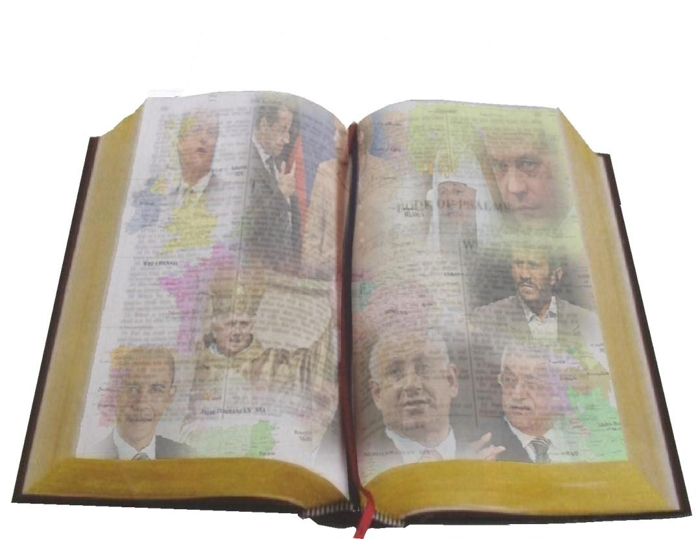
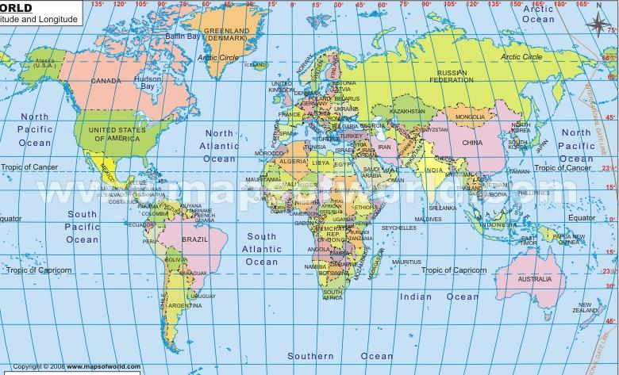
Milestones Update
Brief up-date
Germany, the Vatican and the euro crisis
The Beast and its Rider and the euro crisis
S W Wales Prophecy Day, 5th Nov 2011
Notes:
What an incredible year! So much has been happening. In the Financial world, political world, natural world even ecclesial world. Bewildering number of items to look at. 6 significant areas @ in a brief update. Then spend most of our time looking at @ or in the terms of Rev 17 @. How can we keep up-to-date?@>

Slide 3
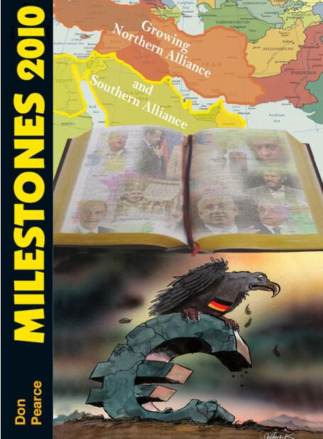
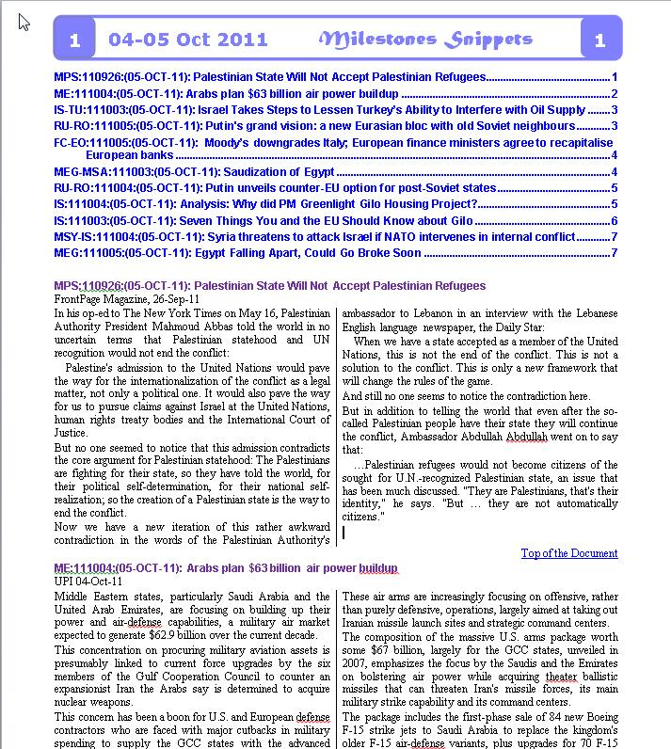
Notes:
There is the yearly Milestones – looking back at the previous yr, Next there is the BM @ strongly advocate a subscription to this lively mag. Every quarter Milestones updates, Then there are the Snippets @– leave details up on our final screen. 3 times a week emailing of current items which have taken my eye. Won’t find many on Fox, CNN, BBC or even the Daily Telegraph. So 6 important items. @>

Slide 4
UK leaving EU
Arab “Spring”
Putin to run again
Gulf Council
Brief up-date
Nord Stream
(Israel an increasingly desirable spoil)
PLO bid for statehood
Notes:
So 6 items @ @ @ Bro Simon has dealt with this @ @ @. The financial turmoil we will be looking at in our 2nd half. So Arab Spring. @>

Slide 5
Arab “Spring”
Notes:
@>

Slide 6
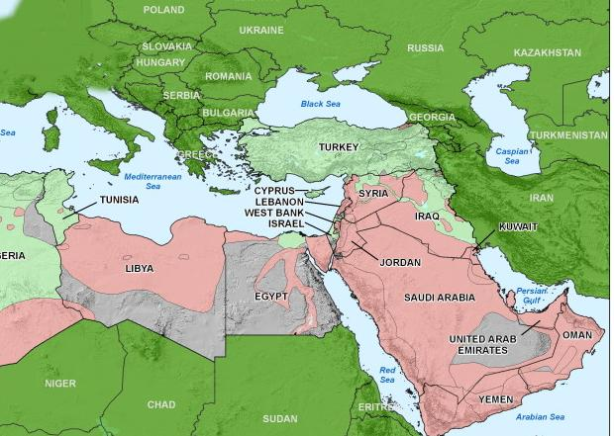
Arab Spring
Just had elections.
the Islamist Ennahda party has emerged as the main winner
Notes:
Tunisia @ @>

Slide 7
Over 6,700 candidates and 47 political parties registered for Egypt’s first elections since the toppling of the former President Hosni Mubarak
Arab Spring
Parliamentary elections are scheduled to begin on November 28, and will take place in several phases, with upper house elections ending on March 24, 2012.
Notes:
Egypt @ @>

Slide 8
Arab Spring
Planning to set up a new government based on the strict interpretation of Sharia law
Notes:
Libya @>

Slide 9
Arab Spring
‘000’s killed and imprisoned
Notes:
Syria @>

Slide 10
Arab Spring
Just signed cease-fire with main rebel leader.
Notes:
Yemen @>

Slide 11
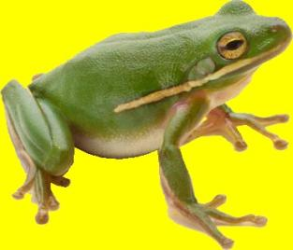
Arab “Spring” is part of the 200 yr movement of the frog spirits.
Pharaoh promised freedom, but didn’t give it (Exodus ch 8)
Notes:
@ @ @>

Slide 12
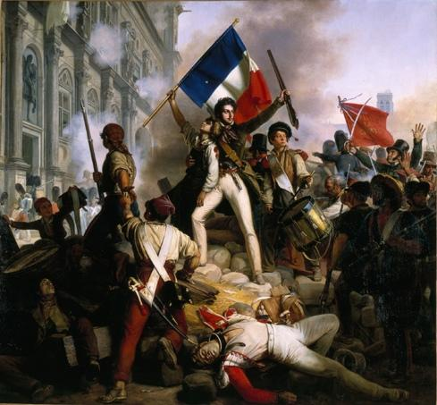
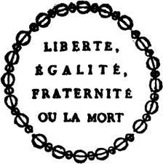
Notes:
@ Don’t think many French though they had much freedom afterwards.@>

Slide 13
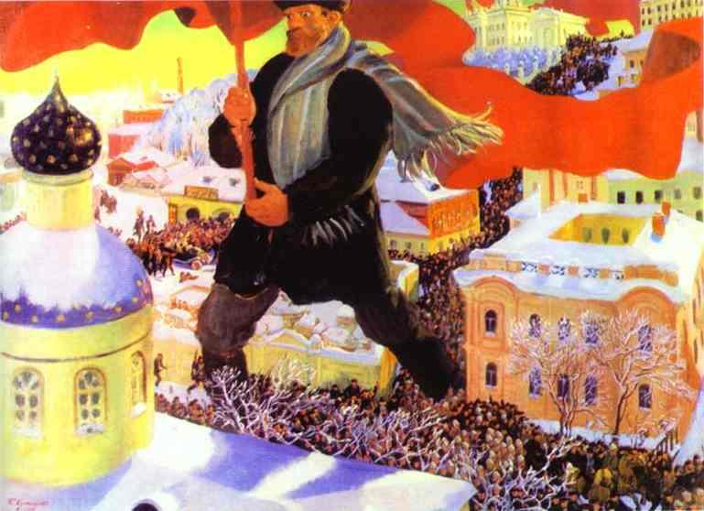
Notes:
Not sure if Russian’s thought they had the freedom promised them when under Stalin! @>

Slide 14
Arab Spring
They promise freedom!
BUT!!
One “unintended” consequence is that Saudi Arabia is emerging as the strongest moderate Muslim power.
Notes:
Unintended @ Saudi. Takes us to the Gulf Council @>

Slide 15
Gulf Council

Slide 16
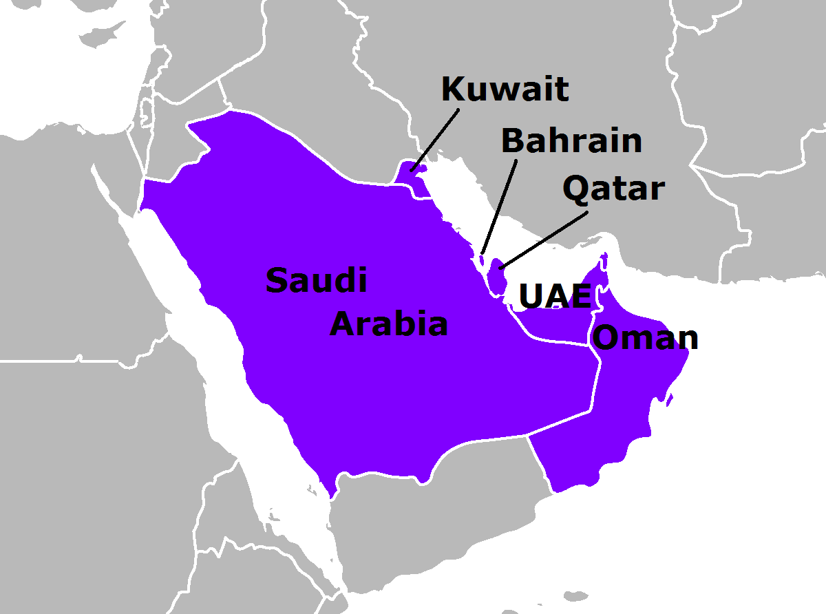
Members of the Gulf Cooperation Council
Jordan joined Sept
Morocco
ditto
Set up in 1981
Expanding to counter Iranian threat
Notes:
Originally members who border the Gulf. 1981 @. Now expanding it’s joint army @ in effort to counter Iranian threat. @ @ @>

Slide 17
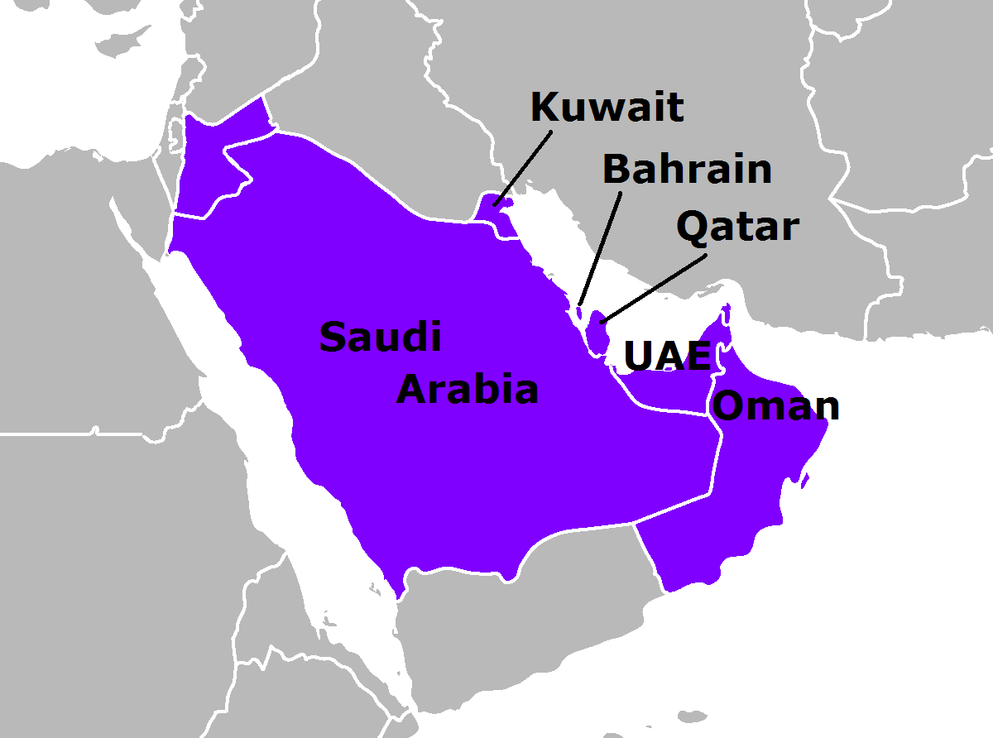
Members of the Gulf Cooperation Council
Set up in 1981
Egypt invited
Expanding to counter Iranian threat
Notes:
Now discussions with Egypt@ Keen for her to join. Makes good sense. If she joins map changes @>

Slide 18
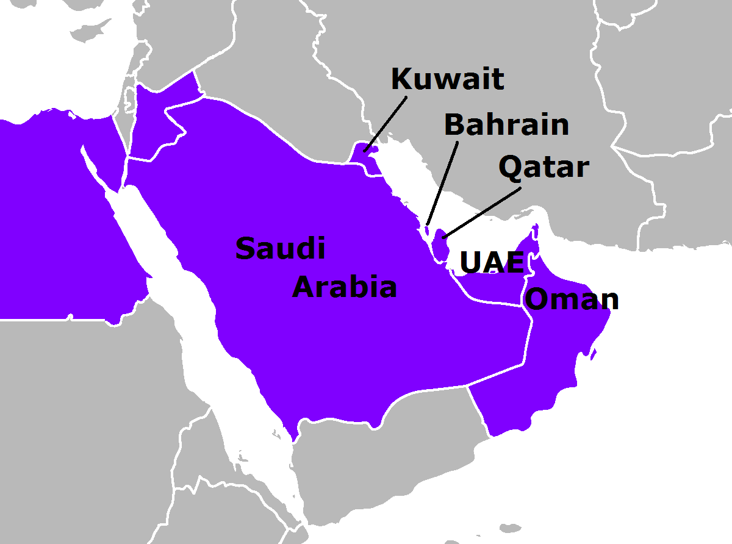
Members of the Gulf Cooperation Council
Set up in 1981
Egypt invited
Yemen due 2016
Expanding to counter Iranian threat
Notes:
Yemen @ Again from scripture we can be certain that this will happen, after all this is the heart of the Sheba Dedan area of Ez 38:13 @>

Slide 19
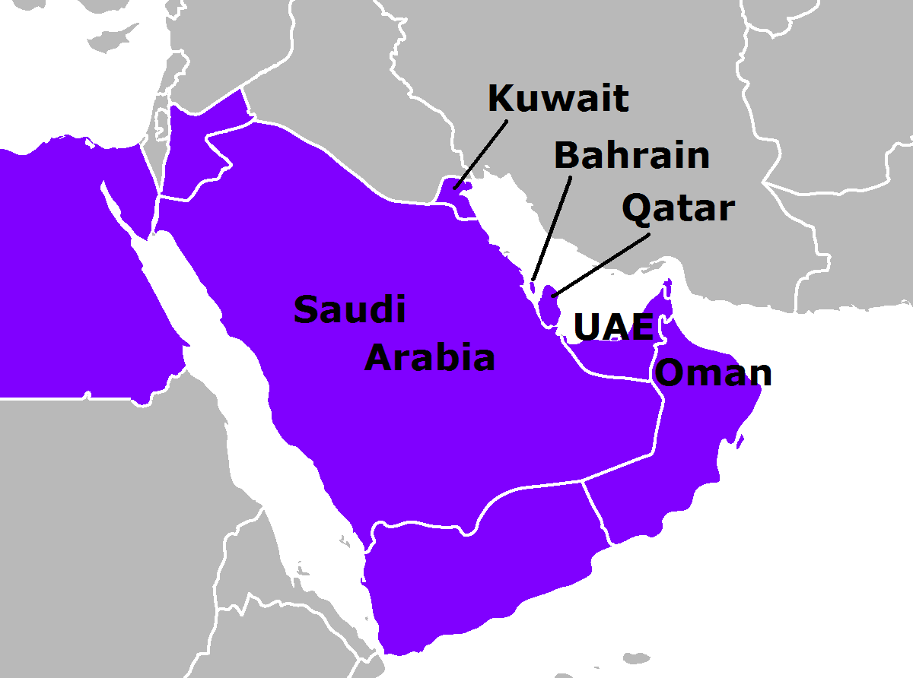
Members of the Gulf Cooperation Council
Set up in 1981
Egypt invited
Yemen due 2016
Expanding to counter Iranian threat
Notes:
See growing southern alliance in Sheba Dedan area. According to Debka, quietly working with Israel @>

Slide 20

Members of the Gulf Cooperation Council
Set up in 1981
Netanyahu's Secret Weapon. An Israeli-Saudi Strategic Understanding
Debka 27-May-11
Egypt invited
Yemen due 2016
Expanding to counter Iranian threat
Notes:
Sharing @ intelligence. Remember this is all to counter Iran @>

Slide 21
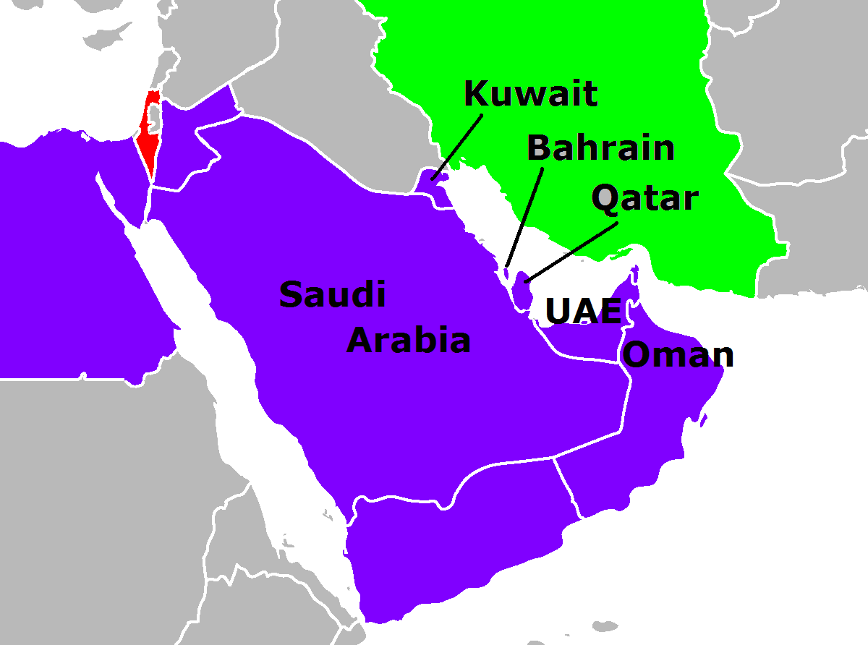
Members of the Gulf Cooperation Council
Set up in 1981
Egypt invited
Yemen due 2016
Expanding to counter Iranian threat
Notes:
What is so thrilling to see as another layer to the growing coming together of the GCC is America’s declaration regarding Iraq.

Slide 22
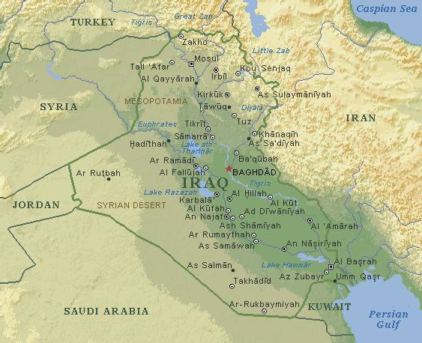
Notes:
America had hoped to be able to leave a 20,000 troops in Iraq, but Iraq has refused. So the US has decided to increase troop levels in the Gulf region. Subject to agreement these extra will be placed in Kuwait @. Also working with the GCC@>

Slide 23
U.S. Is Planning Build-up in Gulf After Iraq Exit
The US administration has proposed establishing a stronger, multilateral security alliance with the six nations and the United States. The proposal still requires the approval of the council, whose leaders will meet again in December in the Saudi capital, Riyadh.
“It’s not going to be a NATO tomorrow but the idea is to move to a more integrated effort.”
New York Times 29-Oct-11
Notes:
@ This is exactly what we have been looking for the southern Arab nations working with the West and Israel. Turn to @>

Slide 24
PLO bid for statehood
Notes:
Just over a month ago @>

Slide 25
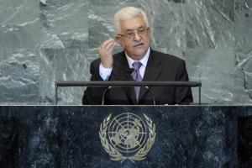
Palestinian’s claim to Statehood
UN General Assembly Sept. 23rd
Mahmoud Abbas
Notes:
In Sept we saw Abbas requesting the UN Gen Ass in New York that they recognise their claim to a State. Matter is currently under discussion. What we need to understand is their ultimate goal is the elimination of the State of Israel. The same day one of his senior ministers was being interviewed. @>

Slide 26
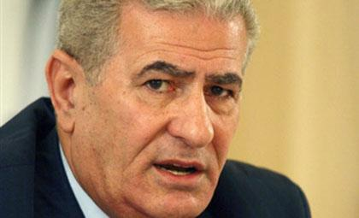
Palestinian’s claim to Statehood
“When we say that the settlement should be based upon these [1967] borders, President (Abbas) understands, we understand, and everybody knows that the greater goal cannot be accomplished in one go.”
Al Jazeera TV 23-Sep-11
Abbas Zaki
Senior Fatah member
Notes:
Read. End. He went on to say @>

Slide 27
Palestinian’s claim to Statehood
“If we say that we want to wipe Israel out… C’mon, it’s too difficult. It’s not [acceptable] policy to say so. Don’t say these things to the world. Keep it to yourself.”
Al Jazeera TV 23-Sep-11
Abbas Zaki
Senior Fatah member
Notes:
Read. End. Abbas made it quite clear last year @>

Slide 28
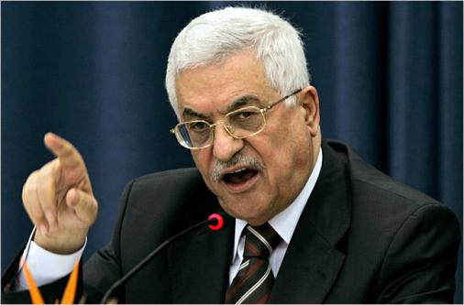
“I would not agree to having Jews among the NATO forces, or that there will live among us even a single Israeli on Palestinian land.”
28-Jul-10
Mahmoud Abbas
“I've said it before, and I'll say it again: I will never recognize the Jewishness of the state, or a 'Jewish state.‘”
23-Oct-11
Notes:
Read. @>

Slide 29
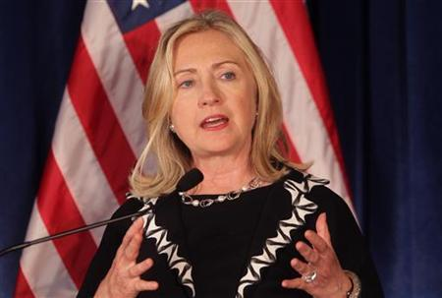
"It's not going anywhere for the foreseeable future, and even if it were, you are not going to get a state through the U.N. It's not going to happen."
Clinton told Reuters many nations were making the case to the Palestinians that their formal letter delivered on September 23 seeking U.N. membership would not give them a state and that the only viable path was direct negotiations with Israel.
Notes:
Clinton told them it would be a vain attempt. Then on Mon@>

Slide 30

Working towards “a new humanism for the 21st century”
United Nations Educational, Scientific and
Cultural Organization
Notes:
On Monday Palestine was voted in as a member of UNESCO, subject to her signing up to the NESC charter. Unesco aim is @. On Mon 107 states voted, although when matter put to vote again on Wed only 51 states voted for Palestine being a member – not that there is a state of Palestine!. The US immediately stopped all UNESCO funding. Although an insignificant step to a recognised statehood, there is the fear for Israel that the PLO could use it to claim UNESCO Heritage for various site in Jerusalem. When Israel tried to register in order to get grants Tomb of the Patriarchs, Hebron and Rachel's Tomb, Bethlehem UNESCO said they were part of the Palestinian Territories, and not part of Israel’s heritage. Watch this space. Will a Palestinian State be established. Wouldn’t appear so @>

Slide 31
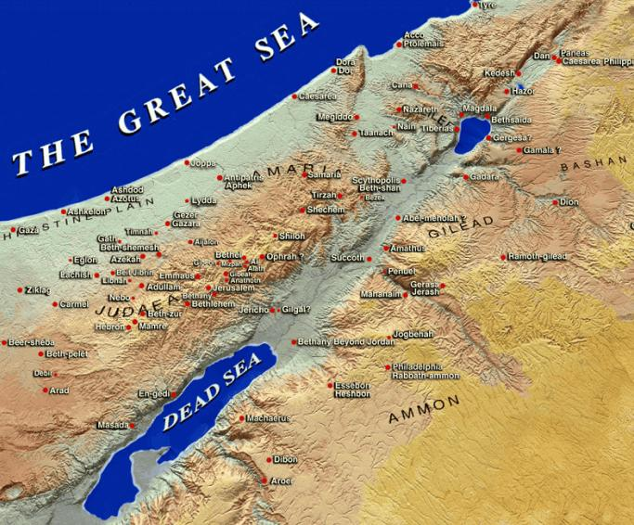
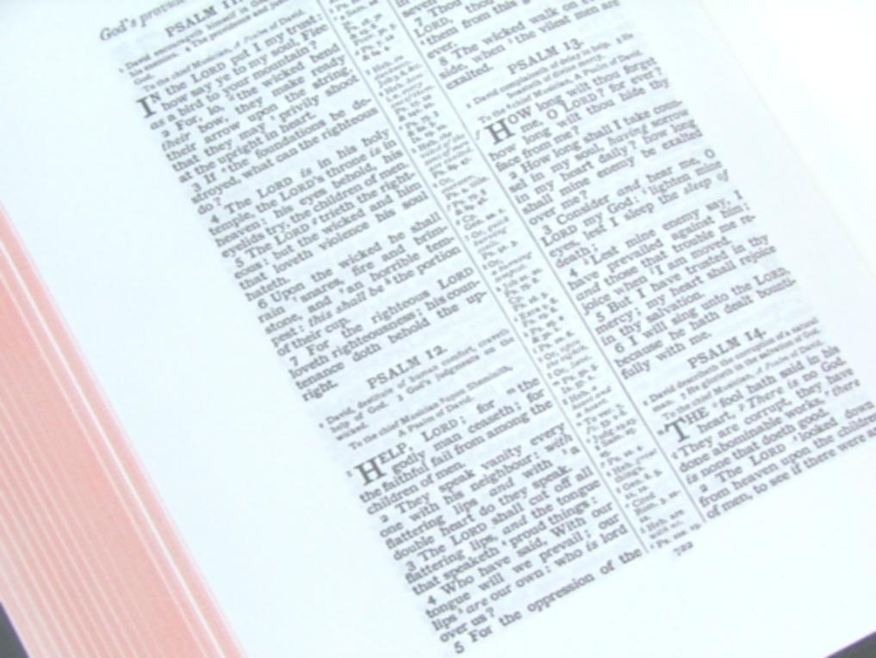
mountains of Israel
midst of the land
[Gog comes] against the mountains of Israel … upon the people that are gathered out of the nations, which have gotten cattle and goods, that dwell in the midst of the land.
Ezek 38:8,12
Notes:
…. Here is a different map @>

Slide 32
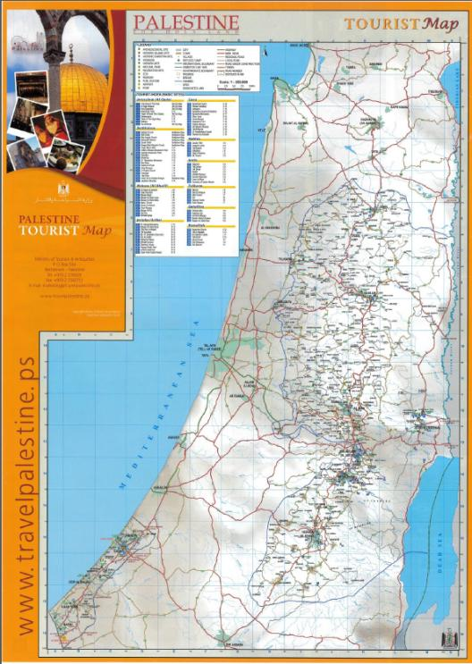
No mention of Israel!
Israeli towns given Arab names!
Official Palestinian tourist map
Notes:
It is a Palestinian tourist map. Israel wiped out! So not difficult to see then when the Bible talks of the nations coming against Israel – this is so credible. Nord Stream @>

Slide 33
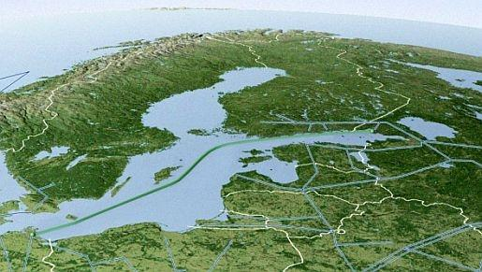
Nord Stream
Nord Stream
Notes:
Or North Stream is a pipeline @ that runs from Russia to Germany @>

Slide 34
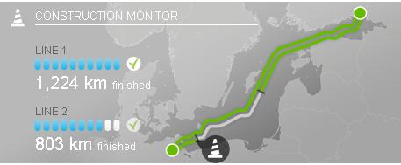
Nord Stream
North Stream undoubtedly uplifts the overall Russian-German strategic ties to a qualitatively new level of partnership. Asia Times 11-May-11
55 bn cm³/yr
Nov 8th
Notes:
Due to start supplying gas @ Tue Nov 8 when Medvedev is in Germany for the official opening 450 guests. Marks a big step for both countries @. When 2nd pipe completed at end of next yr able to supply @ (About 60% of Germany's total gas consumption. Our next brief look is at @>

Slide 35
Putin to run again
Notes:
Now there’s a surprise! Who would have guessed it! @>

Slide 36
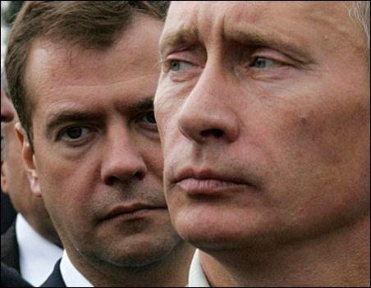
The return of the man who never left
Economist 24-Sep-11
No. 2 most powerful man
Forbes 03-Nov-11
Putin's presidential ambitions signal a return to autocracy
The Observer 25-Sep-11
Notes:
Putin will run for President and Medvedev will go back to Prime minister. @. No 2 (up from No 4). autocracy @ . @>

Slide 37
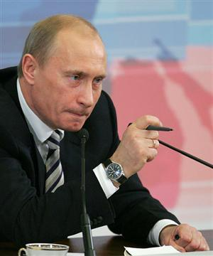
2 x 6 yr terms
Autocratic
- ruthless
A latter-day Assyrian
Mic 5:5
Notes:
@ He can now serve 2 6 year terms. He is an autocrat @ Ideal candidate for @ @>

Slide 38
And this man [Messiah] shall be the peace, when the Assyrian shall come into our land: and when he shall tread in our palaces, then shall we raise against him seven shepherds, and eight principal [or princes of] men.
Micah 5:5
Notes:
Read. The Assyrian will come to take a spoil & a Prey - to control Israel’s new found gas & oil wealth, as well as their high-tech products. They will meet their match in Messiah and his saints. Let’s turn to last Snippet @>

Slide 39
UK leaving EU
Notes:
Being constantly talked about. Reaching breaking point. @>

Slide 40
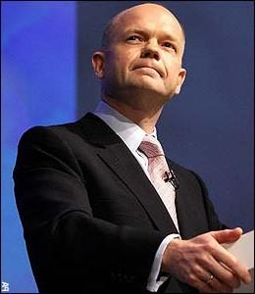
The mood of the nation is more hostile to Europe than at any point since 1971.
“excessive regulation” “unnecessary interference in daily life”
Daily Telegraph 17-Oct-11
William Hague
The think-tank Civitas calls on Britain to plan an “exit strategy from a failing EU” Daily Telegraph17-Oct-11
Notes:
Hague . Civitas @ Last week quite a rebellion of Conservative MP’s over not being allowed to vote for a referendum on the EU@>

Slide 41
Half of Conservative MPs 'want to pull out of the EU'
Twice as many Tory MPs want Britain to pull out of the European Union as voted for a referendum last week, one of the leading rebel MPs has claimed.
Daily Telegraph 01-Nov-11
Notes:
Even more than shown at the time. Opinion polls @>

Slide 42
ICM/Guardian poll 21-23 October 2011 – 70% Want a Referendum; 49% would Pull Out
Conservative Home September Poll of Conservative members - 60% want to leave the EU:
Notes:
One doesn’t have to be a member of the EU to trade with EU. Britain can come out and have the best of both worlds. The prospect of Britain leaving is now moving to not IF but WHEN? And soon. @>

Slide 43
... the question may be on the table sooner rather than later despite Cameron’s efforts, as Germany and others make a strong case for re-opening the treaty to tighten up economic governance rules.
EUObserver 22-Oct-11
Notes:
Cameron has promised to hold ref if Lisbon Treaty is amended – Merkel is saying we need to amend it! Surely the Commonwealth heads last week encouraged Cameron to increase commonwealth links. It is clear @>

Slide 44
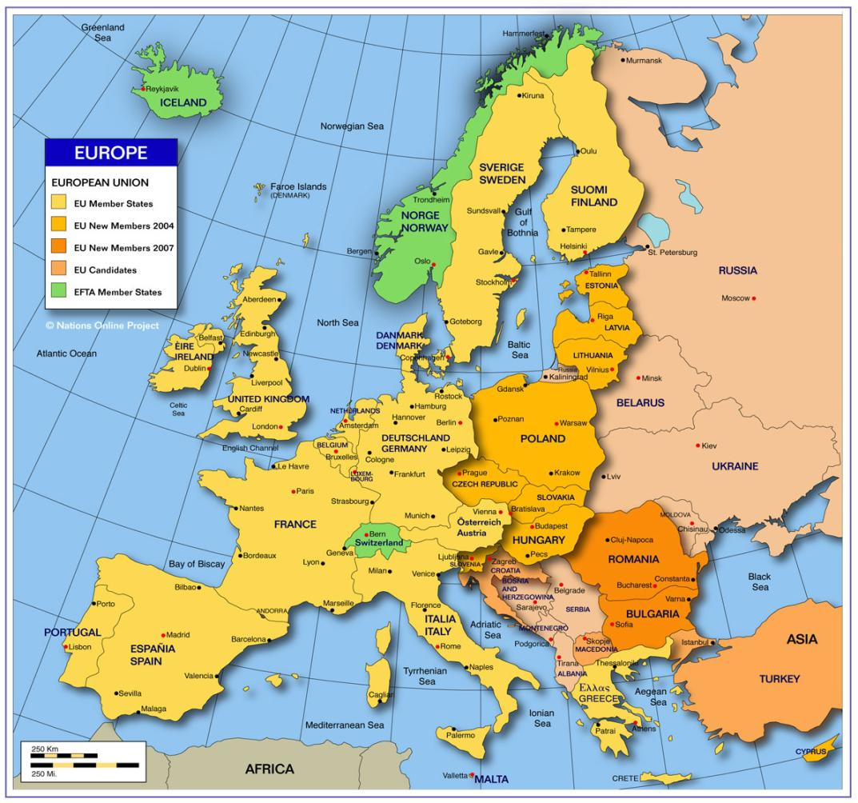
However else the outcome of the European Union and euro-area summits are judged in the coming weeks, one conclusion seems clear: the countries at the eurozone core of the EU are now determined to take a major step – not only to economic and fiscal integration but also to de facto political union.
Guardian 27-Oct-11
Notes:
A step by far too far for Britain. So our main topic@>

Slide 45
Germany, the Vatican and the euro crisis
The Beast and its Rider and the euro crisis
Also gives background as to why Israel is so hated
Notes:
Or in terms of rev 17 At the same time – running as a background theme we shall see why Israel is so hated by the nations of the world @. @>

Slide 46
The Beast and its Rider and the euro crisis
Subprime mortgage crisis
Euro imbalance
"We are sick of you criticising us and telling us what to do. You say you hate the euro and now you want to interfere in our meetings.“ Sarkozy to Cameron on Sunday 23rd Oct
“The euro crisis is becoming surreal in that everything that possibly could go wrong is now doing so, all at once.”
UPI 24-Oct-11
Why are we interested?
Notes:
Background. Two centres for financial crisis @ @ Linked but have different problems @ @. Rousing passions@ @. Very critical times, world staring on edge of a bottomless pit; Why are we interested @? It is that it is bringing Germany to greater power. Why are we interested in that? Because it is shaping Germany’s future role! @>

Slide 47
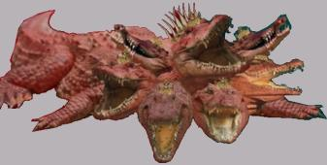
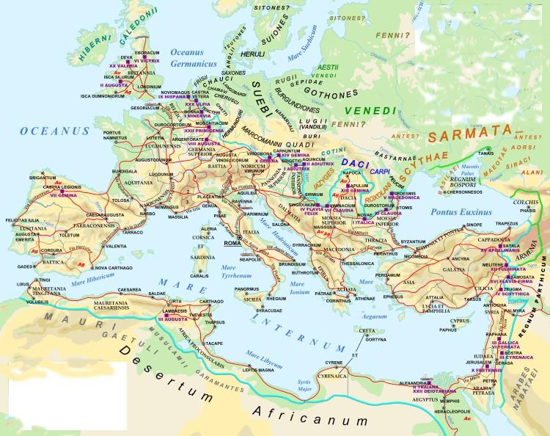
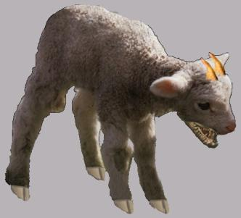
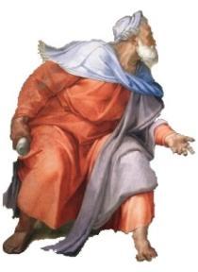
Rev 16
Dragon
Beast
False
Prophet
Notes:
Rev 16, deals with the vials, and we are living under the 6th vial period. It has a beast @ a Dragon @; & False Prophet @. This is the time of today. Their policies are causing the nations to want to eliminate Israel. What is critical is the different picture in ch 17@> .

Slide 48
Rev 17
Dragon
Beast
False
Prophet
Notes:
No mention of the Dragon in Ch 17 @. And the false prophet and the beast are replaced @ @ by a new phase – a woman riding the Beast.@> .

Slide 49
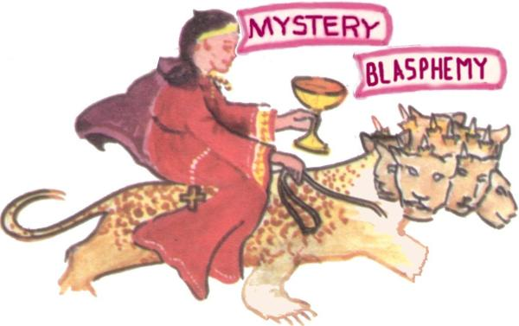

Rev 17
Woman riding the Beast
Looking for a recreation of the former Beast of the Sea/Earth – the Holy Roman Empire i.e. a Europe, led by Germany, carrying (17:7) the Papacy
Notes:
Ch 17 is about this beast/rider making war with Christ & saints. So evidently a stage beyond Armageddon of ch 16, the Dragon power has been broken on the mountains of Israel, Christ is king in Jerusalem @. The everlasting Gospel has gone forth from Zion. Just as the Jews rejected Christ at his 1st coming, so Christendom will reject him at his 2nd coming. So await this final step @ of the Papacy being carried by the European Beast – seeing it developing but not there yet. Christ will have returned. We won’t see completion this side of the Judgement Seat. @> .

Slide 50
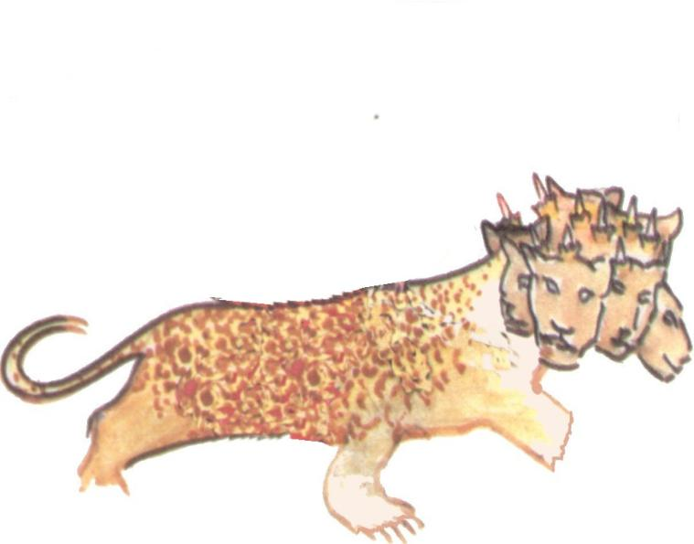
1st reich
800/962 - 1806
the Beast
2nd reich
1871 - 1918
3rd reich
1933 - 1945
4th reich
201? - ?
Germany
Notes:
So looking at a revived Germany. Go through. Watching the incredible growth of the 4th German reich. @>

Slide 51
A remarkable turn-around!
1st reich smashed
2nd reich smashed
3rd reich smashed
1800-
1900-
2000-
Notes:
1806 @, 1918 @; 1945 @ Here we are today @ with Germany top dog in Europe!

Slide 52
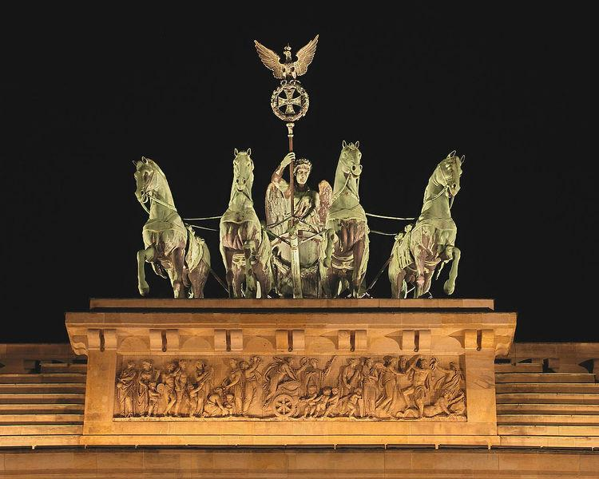
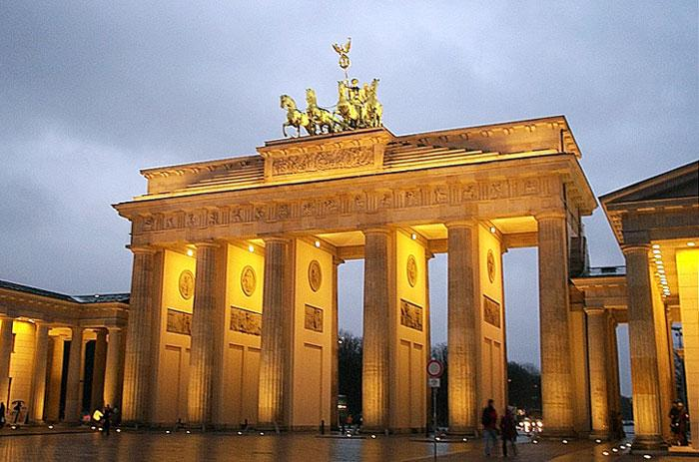
Germany at the heart of Europe!
Notes:
following reunification of Germany in 1991 the German parliament voted to move from Bonn back to Berlin its former seat of gov. @. which took place in 1999. Much more central to their vision of an enlarged Germany but full of imperial significance. Brandenburg Gate @ @. There is talk of reviving the monarchy amongst rt wing Catholics! So we find Germany today at Europe’s heart @>

Slide 53
Germany 81.7m
Population
France 64.7m
UK 62m
US $14,624bn
China $5,745bn
Japan $5,390bn
GDP
Gross Domestic Product
Germany $3,305bn
France $2,555bn
UK $2,258bn
Notes:
Unashamedly at the heart of the EU is @ Germany. Since reunification of Germany 21 yrs ago has become the biggest country by population in EU @. Look at @GDP – value of goods and services generated by a country per year. And now the most powerful in Europe. @>

Slide 54
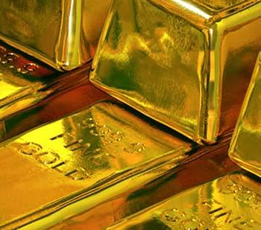
Gold reserves
USA 8,133 tonnes
Germany 3,401
£118 bn
€136 bn
IMF 2,867
(7) Switzerland
1,104
Notes:
Gold reserves So No 2. Quite int. When European Monetary Institute was replaced by the European Central Bank in 1998, ready for launch of euro, its gold reserves inexplicably dropped by $20 bn. Yet oddly –I can’t think there was a connection – surely not – Germany’s own reserves increased by $20bn!! Was this the secret price that Germany demanded for giving up her Deutschmark? It is a wonderful fall back position. Enough gold that if Germany decided to abandon the euro and restore the deutschmark, she could give it gold-backed status! At today’s prices worth a cool @. This would drive the last nail in the US currency’s coffin @>

Slide 55
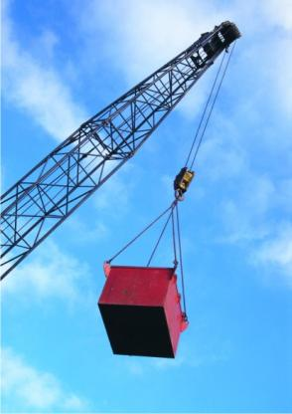
Exports
China $1,506 bn
Germany $1,337 bn
US $1,270 bn
Notes:
Exports . So No 2.! So how did Germany get to this position? Sheer hard work, belt tightening for years. @>

Slide 56
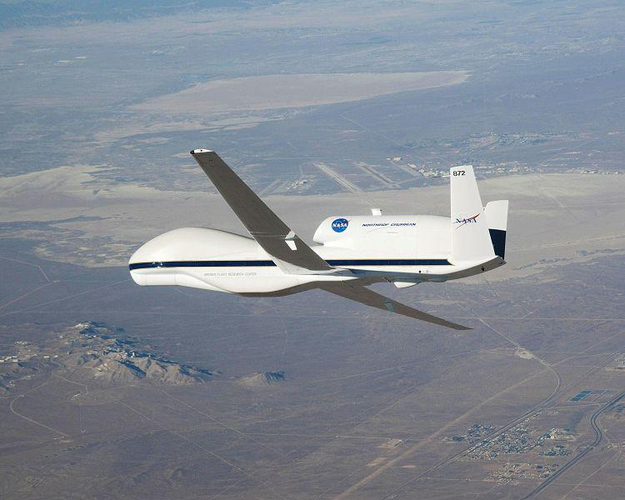
Military
US
China
UK
India
Germany
Notes:
Very different results according to criteria, but found 2 sites that put Germany as No 5 in world. In spy equipment – a world leader. Just last month taken delivery of the 1st of a series of world’s biggest drone @. Built in US but with German equipment it is miles ahead of anything else in Europe! Why is Germany so anxious to build her military. Let’s just say – so did Hitler! @>

Slide 57
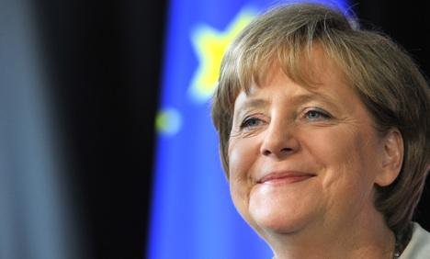
Forbes magazine has named German Chancellor Angela Merkel the world's most powerful woman, calling her the "undisputed" leader of the European Union and head of its only "real global economy."
The Local [Germany] 25-Aug-11
Notes:
Powerful leader! Who has led the way to Germany power. @>

Slide 58
Leadership of one state over another
Europe, the German Way
Following the German victory at the Euro Crisis Summit, Berlin has been preparing the next steps for expanding its unabashed hegemony* over Europe. An option, permitting direct intervention into the national budgets of indebted countries, is to be inscribed as soon as possible in EU treaties.
German-Foreign-Policy.com 01-Nov-11
Notes:
Hegemony @. Through thick and thin, the Germans have been working to achieve this dominant role. @>

Slide 59
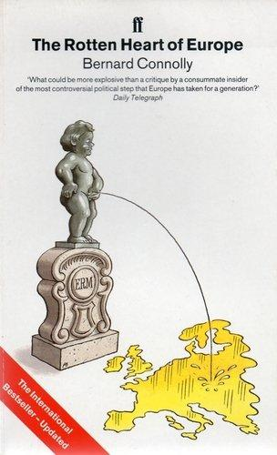
The Frankish-German desire to use the European unification process to “recreate the empire of Charlemagne”
The Rotten Heart of Europe
Bernard Connolly
Not possible without the support of the Vatican
Notes:
Needed @ Vatican support. Where was the original treaty of Rome signed - Rome@>

Slide 60
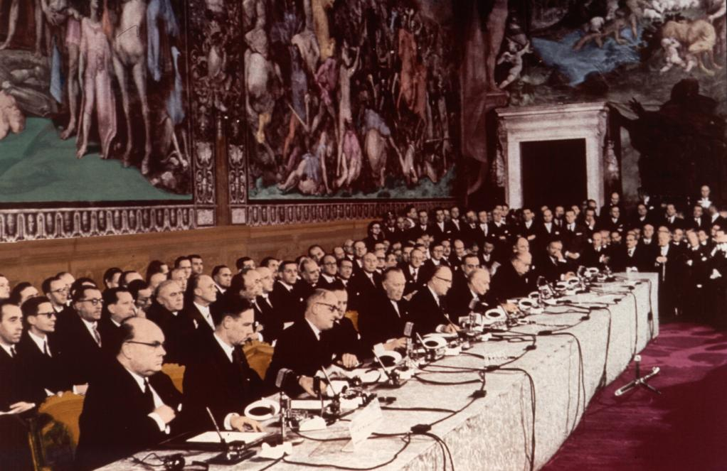
Signing Treaty of Rome 25-Mar-1957
Notes:
It was in 1957 that they met here. That dark figure @ at the end is @>.

Slide 61
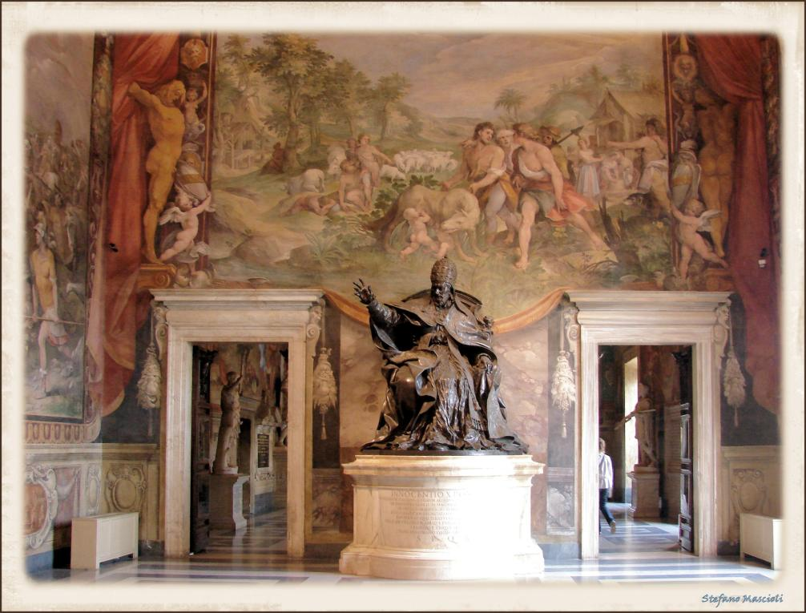
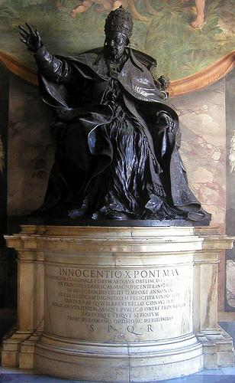
Trained as a lawyer, Innocent X succeeded Pope Urban VIII (1623–44) on 15 September 1644, as one of the most politically shrewd pontiffs of the era, who much increased the temporal power of the Holy See. Wikipedia
Notes:
@ @ @ Incidentally @>

Slide 62
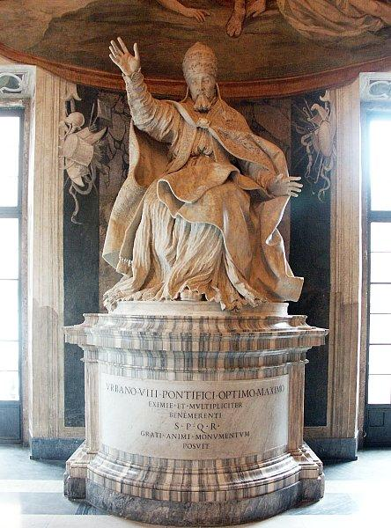
Urbane VII “He was the last pope to expand the papal territory by force of arms” Wikipedia
Notes:
His predecessor Urban 8th is at other end of room. Wiki says of him @ “He was the last pope to expand the papal territory by force of arms,” How deliciously appropriate, for the Vatican is gaining great power through the EU. They trotted off to get the Pope’s blessing. @>

Slide 63

As Europe recovered, Pius XII had encouraged European unification attempts and the foundation of the EU. He addressed the heads of State and governments from Italy, France, Germany, and the Benelux countries at this historic occasion. [Signing Treaty of Rome 25-03-57.] On June 13, 1957 he demanded a united Europe, aware of its foundations, with common institutions, a common foreign policy, and a strong European parliament to control the institutions and the council of ministers. Wikipedia
Notes:
Read. End. Where was the European Constitution signed the precursor of the Lisbon Treaty? @>

Slide 64
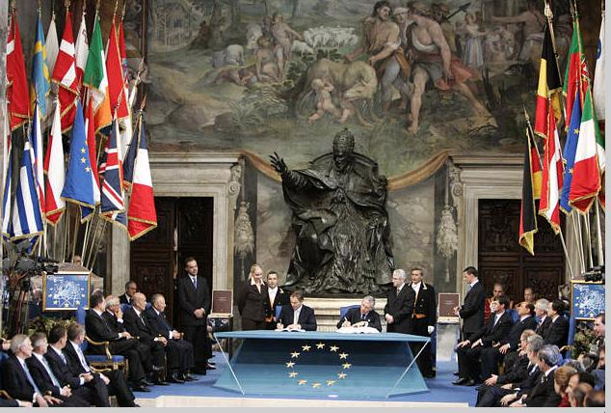
EU Constitution 29-Oct 2004
Notes:
Same room. Pope Innocent X came out of the shadows. Turned it round and had each individual leader sign. This is Tony Blair. @>

Slide 65
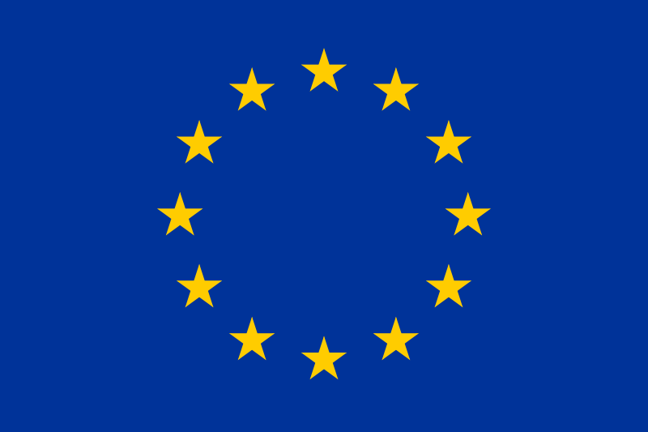
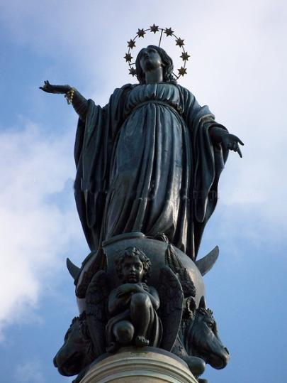
Notes:
EU flag, openly based upon the 12 stars of Mary @– the Queen of Europe As well as German resurgence we see Vatican resurgence. @>

Slide 66
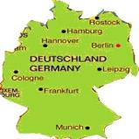
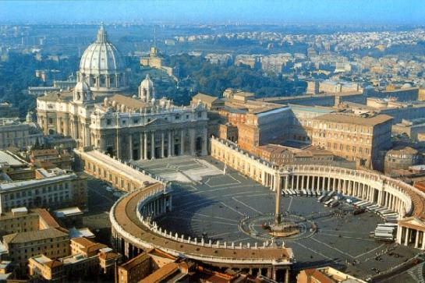
Vatican guiding Europe!
Vatican lobbied hard to get the Lisbon Treaty to reflect her planned role.
Notes:
The Vatican’s hand behind was behind the drafting of the Lisbon Treaty. They celebrated the Lisbon Treaty with a call to arms to seize the opportunity! Benedict heavily involved, most of his trips have been centred on Europe. @>

Slide 67

1,500,000 young people from around the world assembled to listen to the Pope in Spain
World Youth Day celebrations have now drawn more than 15 million participants, making WYD the “largest regularly held international religious event on the planet.”
Notes:
We saw in Aug the Pope’s visit to Spain. @. Sept he visited Germany @>

Slide 68

Pope & Chan. Merkel, Germany Sept 11
Notes:
The German press is rather hostile to the papacy, but they seemed to be won over by his visit. His aim was to strengthen the right wing elites, who wield the power in Germany and who have been advancing the EU dream of political unity, and church & state working together. @>

Slide 69

The real movers and shakers have been the influential Catholic elites who have provided the vision for Germany’s return to imperial power. Benedict does not need the German press on his side. He already has under his wing those who have the influence to break dissent, and he will use it when the moment is ripe.
The Trumpet 22-Sep-11
Notes:
Read end. He visited parliament @>

Slide 70

The invitation to give this address was extended to me as Pope, as the Bishop of Rome, who bears the highest responsibility for Catholic Christianity. In issuing this invitation you are acknowledging the role that the Holy See plays as a partner within the community of peoples and states. Setting out from this international responsibility that I hold, I should like to propose to you some thoughts on the foundations of a free state of law.
Law should be based on religion
Notes:
The Budestag. He is on a battle to re –evangelize Europe @ Read End. This theme @. @>

Slide 71
What Benedict is doing with his priestly troops is akin to the process that Karl-Theodor zu Guttenberg began with Germany’s military forces when he was minister for defense. He’s simply preparing for war—in his terms, a “new evangelization”—a crusading war, by stripping out the dead wood and scaling down to a leaner, meaner hard core of loyalists willing and prepared for the sacrificial effort of crusading for Europe to return to its Catholic, its “holy Roman,” roots.
The Trumpet 22-Sep-11
Oct 2012 commences “A Year of Faith”
Notes:
The Budestag. He is on a battle to re –evangelize Europe @ Read end. Look for a strong battle within Europe to bring people back to the church. Last month he declared @. We remind ourselves of this section @>

Slide 72
The Beast and its Rider and the euro crisis
Subprime mortgage crisis
Euro imbalance
Why are we interested?
Also gives background as to why Israel is so hated
Notes:
Let’s see Germany’s role in the euro crisis! Remind ourselves of the sub-plot @ @>

Slide 73


From the 13th C expulsion of England’s Jews to the 19th C Russian pogroms to the Nazi Holocaust, sour economic conditions have historically formed the backdrop of rising anti-Semitism.
Israel Today 16-Oct-11
Vatican calls for global authority on economy
Reuters 24-Oct-11
It’s just like pre-World War II Nazi Germany. You think blood libels can’t happen in America? ibid
“Who holds the wealth and power in this (US) country? The Judo-Capitalists … the No 1 enemy … should be run out of this country” ibid
Notes:
Int comment last month from Israel on the “Occupy Wall St “ protests around the world. A minority are openly blaming the Jews. Read. End. Went on @ @ Blame the bankers – blame the Jews. Even Pope calls for a new world bank, and it wouldn’t be controlled by Jews! @>

Slide 74


Is it likely that the old Catholic anti-Semitism can again take root under Benedict?
German Foreign Policy 21-Sep-11
YES!
David Berger
His support for anti-Semitic Passion plays
What he said when visited Auschwitz
His re-instatement of the Bro’s of Pius
His choice of hard-line cardinals
Re-introduction of old liturgy which ascribes an inferior status to Judaism
Notes:
Europe and Russia has a long history of anti-Semitism. Growing again. David Berger a German Theologian. Yes@; Reasons @. Richard Williamson One of the re-instated bishops is a holocaust denier. Recent headline @>

Slide 75

Italy against the Jews
Murky wave of anti-Israel zeal, demonization of Jews growing at alarming rate in Italy
Israel Today 13-Jun-11
Notes:
So look at the euro crisis @>

Slide 76


Eurozone member
To join in future
Opt out
Opt out but referendum
Notes:
Blue are the 17 eurozone members. Economically the euro zone consists of 2 halves. A southern & northern. @. Poorer countries, richer countries. How could it be conceived that these disparate countries could be locked into one currency? In normal terms it is was madness. Yet as a plan to put Germany in control it was masterful! Not too difficult in seeing Greece being kicked out @>

Slide 77

Notes:
Italy even bigger mess @>

Slide 78

Notes:
Spain not much better @>

Slide 79

Notes:
Portugal would prob follow Spain @>

Slide 80

Notes:
As well could Ireland @>

Slide 81

Poland
Czech Rep
Notes:
Ireland. Leave inner core . This is Poland @; Czech Rep @; They might be dragged into the inner core. Rest in an outer core, but Britain I would see breaking free with ass membership. So how did this all come about? @>

Slide 82
What role did Germany play in causing this crisis?
What if, instead of the euro being designed to further contain the Germans, the Germans crafted the euro to rewire the European Union for their own purposes?
Stratfor 16-Mar-10
Notes:
As Stratfor remarked last year. In other words all this being done to achieve a hidden agenda. Political integration! This cartoon points the way! @>

Slide 83

Economist
30-Jul-11
Notes:
@ @ @>

Slide 84
Economist
30-Jul-11
Notes:
Enlarge @ So let’s look at some recent articles. @>

Slide 85
The Greek crisis brings us even closer to the long-planned European empire
Daily Telegraph 23-Jun-11
The euro crisis will give Germany the empire it’s always dreamed of
Daily Telegraph 22-Jul-11
Berlin has been preparing the next steps for expanding its unabashed hegemony over Europe
German Foreign Policy 01-Nov-11
Notes:
@ @ Let’s fill these headlines out. @>

Slide 86
That would be to misunderstand the grand strategy being pursued in Brussels. It is designed to achieve, without recourse to war, the realization of a dream unfulfilled since the fall of Rome, the first pan-European Empire. Spain, France and Austro Hungary failed in their attempts to build such an Empire and after yet another destructive European war, the founding fathers of the EU swore to achieve through politics what warfare had failed to deliver.
Daily Telegraph Blog 23-Jun-11
Notes:
Read. Cont. @>

Slide 87
The creation of a common, or to be correct, sole currency, the euro, was not an end in itself, but a weapon to achieve by economic means, a European government. It was about politics, not economics.
Daily Telegraph Blog 23-Jun-11
Notes:
Read End.

Slide 88

Germany is busy turning into one of the most dynamic and productive economies in the world. Despite the grumbling, for the Germans, the bail-outs are worth every penny, because they guarantee a cheap outlet for their manufactured goods. Germany has come very close to realising Bismarck’s dream of an economic empire stretching from central Europe to the Eastern Mediterranean.
Daily Telegraph 22-Jul-11
Notes:
Read End. Witness her invasion of Greece. Not with Jackboots as under Hitler, but businessmen with brief cases buying up Greek companies at knock-down prices!@>

Slide 89
Bargain Hunting in Greece
Deutsche Telekom, Others Look to Grab State-Owned Assets at Fire-Sale Prices
German companies are hunting for bargains in Greece as the debt-stricken government moves to sell state-owned assets to stabilize the country's finances. Germans have substantial experience with fire sales of state-owned assets in the former East Germany after reunification in 1991.
Wall Street Journal 07-Jun-11
Notes:
Read End. So we see Germany & the Vatican growing in power. That’s bad news for Israel. The nations are being prepared to come into Israel to destroy her. We know that that is not the end, but marks a new beginning for Israel under her Messiah. So we come to the end of our review. @>

Slide 90

God’s 7,000 year plan
 |  |  |  |  |  | Kingdom
4,000 BC
2,000 BC
0
2,000 AD
Notes:
We are so blessed to live in this critical period @ when the Kingdoms of this world become the Kingdom of our Lord. The greatest political earthquake is about to break. The political world, the social world the natural world are all teetering on the edge, about to crash before the little stone power cut out of the mountain without hand.
We are labouring to be accounted worthy of being part of that stone power. Of working with the Lord Jesus and then with saved Israel to put to an end man’s misrule, and to show to man life as God intended. A life that recognises God as the Creator. Jesus as His son. The Word of God as a record of truth, and to bring the remnants of the nations into the millennial age. When the law shall proceed from Zion @>

Slide 91




Thus shall [Israel] know that I the LORD their God am with them, and that they, even the house of Israel, are my people, saith the Lord GOD.
And ye my flock, the flock of my pasture, are men, and I am your God, saith the Lord GOD. Eze 34:30,31
Notes:
Shall reign victorious. @ from the new Jerusalem. Then God will been seen to be right to choose the Jewish nation, for in this day @ @. What a glorious end In God’s Mercy may we be there. I leave my final slide – @>

Slide 92
Keep up-to-date
Hyperlink headings
Cumulative index 3mthly
Milestones Snippets
Keyed indexing
About 8 pages 2-3 x’s a week
To request, email me at snippets@milestonesuk.org
Notes:
If you want to keep up to date with world events send me an email to receive Milestones Snippets

