Slide 1
FORGIVENESS
Forgiveness and Sin

Slide 2
A Broad Subject
Forgiveness relates to:
The atonement
Sin & its punishment death
God’s character
Sacrifice & the Law of Moses
Fellowship
Salvation by grace
Faith, Hope & Love

Slide 3
Sin Defined
What is sin?
Whosoever committeth sin transgresseth also the law: for sin is the transgression of the law.
I John 3:4
What is the law?
And this is his commandment, That we should believe on the name of his Son Jesus Christ, and love one another, as he gave us commandment.
I John 3:23

Slide 4
Sin defined by what it isn’t
Sin is not Righteousness
All unrighteousness is sin: and there is a sin not unto death.
I John 5:17
Sin is not Faith
And he that doubteth is damned if he eat, because he eateth not of faith: for whatsoever is not of faith is sin.
Romans 14:23

Slide 5
SIN IS:
Failing to believe (I Jn 3:4 & 23)
Failing to love as Christ loved (I Jn 3:4 & 23)
Anything that is not Godly (I Jn 5:17)
Anything that contradicts our faith (Rom 14:23)
Not just actions, also thoughts (I Jn 3:15)
Not just what we do, also what we don’t do (Jas 4:17)

Slide 6
Degrees of sin?
Now the works of the flesh are manifest, which are these; Adultery, fornication, uncleanness, lasciviousness, idolatry, witchcraft, hatred, variance, emulations, wrath, strife, seditions, heresies, envyings, murders, drunkenness, revellings, and such like: of the which I tell you before, as I have also told you in time past, that they which do such things shall not inherit the kingdom of God.
Galatians 5:19-21

Slide 7
Degrees of sin?
For he that said, Do not commit adultery, said also, Do not kill. Now if thou commit no adultery, yet if thou kill, thou art become a transgressor of the law.
James 2:11

Slide 8
The effects of sin
Death (Rom 6:23)
Rupturing of relationship with God (Isa 59:2)
Rupturing of relationships with others (Matt 5:23-24)
Reinforcement of sinful behaviour (I Jn 2:11)

Slide 9
God’s view of sin
It is by definition the opposite of God (Matt 19:17)
His punishment for it is everlasting death (Rom 6:23)
Its emphasis in the Law of Moses
The images used to symbolise sin in scripture

Slide 10
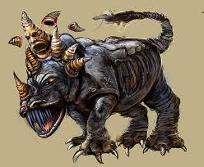
Images of sin - Daniel

Slide 11
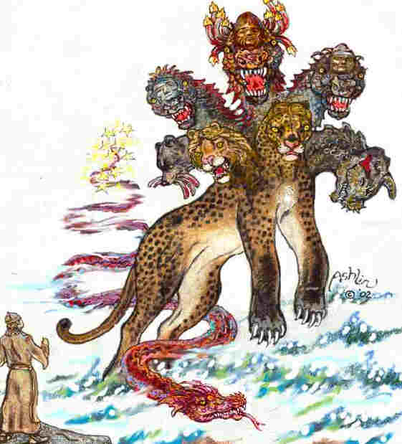
Images of sin - revelation

Slide 12
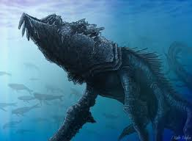
Images of sin – Leviathan & Behemoth

Slide 13
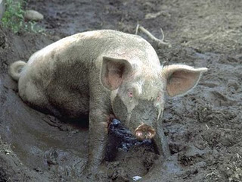
Images of Sin – PIG mire

Slide 14
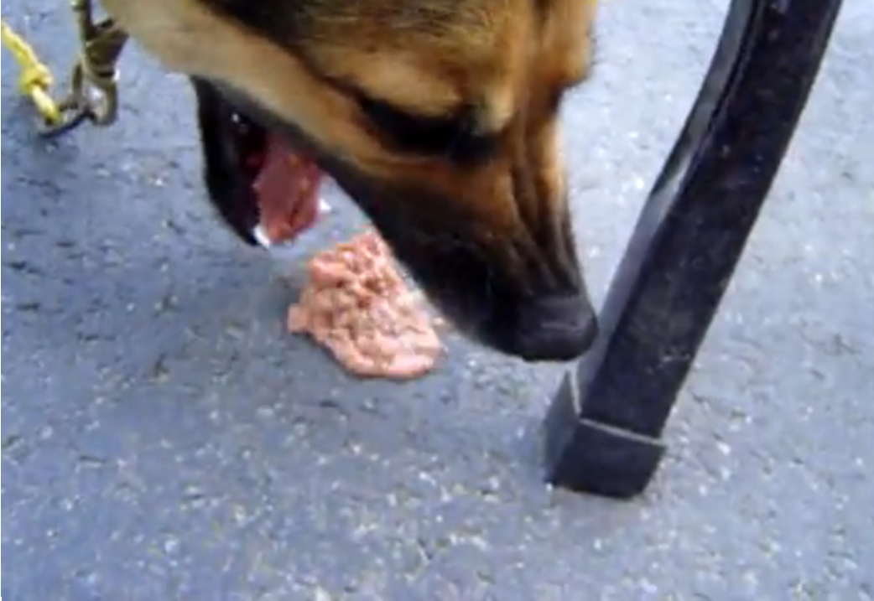
Images of sin – dog vomit

Slide 15
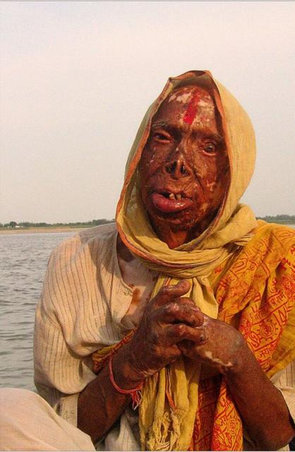
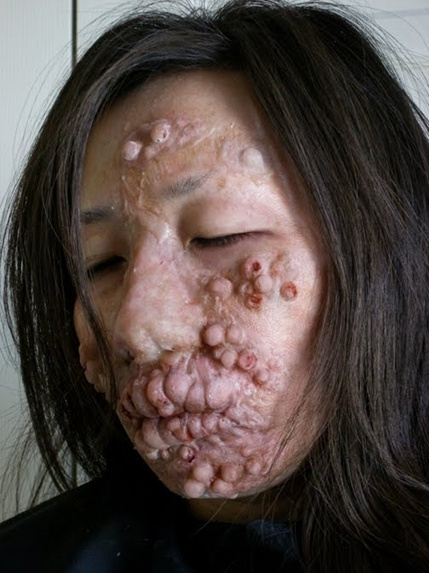
Images of sin - leprosy

Slide 16
TERMS DEFINED
Sin = transgression, iniquity, unrighteousness
Mortality = subject to death, and inclined toward sin
Faith = belief
Justification = imputed righteousness, made righteous, forgiven

Slide 17
God is forgiveness
Exodus 34:6-6: Yahweh, Yahweh, El, merciful and gracious, long suffering and abundant in goodness and truth, keeping mercy for thousands, forgiving iniquity and transgression and sin
Numbers 14:18 Yahweh is long suffering and of great mercy, forgiving iniquity and transgression
Deuteronomy 4:31 For Yahweh thy God is a merciful God
Psalm 108:3 Yahweh is merciful and gracious, slow to anger, and plenteous in mercy
Ephesians 2:4 God who is rich in mercy, for his great love wherewith he loved us
I Peter 1:3 Blessed be the God and father of our Lord Jesus Christ, which according to his abundant mercy hath begotten us again

Slide 18
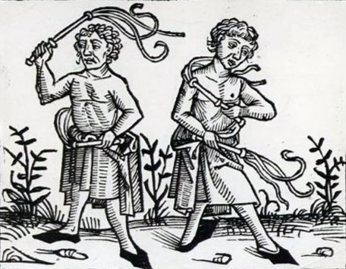
‘earning’ forgiveness

Slide 19
‘unconditional’ forgiveness
Grace means there is nothing we can do to make God love us more … And grace means there is nothing we can do to make God love us less – no amount of racism or pride or pornography or adultery, or even murder
What’s so Amazing About Grace? p70

Slide 20
Unconditional forgiveness?
With some people it is fashionable to say that pardon is full and free and unconditional. It is full and free but there are conditions.
Dennis Gillett
Genius of Discipleship p27

Slide 21
3 principles of forgiveness
Faith
  we must believe that God has forgiven us
  Even as Abraham believed God, and it was accounted to him for righteousness Galatians 3:6
Repentance
  we have to change (but what do we have to change?)
  Repent, and be baptized every one of you in the name of Jesus Christ for the remission of sins Acts 2:38
Forgiving Attitude
  we have to forgive others
  But if ye do not forgive, neither will your Father which is in heaven forgive your trespasses Mark 11:26

