Slide 1
FORGIVENESS
Principles of Forgiveness

Slide 2
Unconditional forgiveness?
With some people it is fashionable to say that pardon is full and free and unconditional. It is full and free but there are conditions.
Dennis Gillett
Genius of Discipleship p27

Slide 3
3 principles of forgiveness
Faith
  We must believe that God has forgiven us
  Even as Abraham believed God, and it was accounted to him for righteousness Galatians 3:6
Repentance
  We have to change
  Repent, and be baptized every one of you in the name of Jesus Christ for the remission of sins Acts 2:38
Forgiving Attitude
  We have to forgive others
  But if ye do not forgive, neither will your Father which is in heaven forgive your trespasses Mark 11:26

Slide 4
faith
It is easy to say God is merciful
It much harder to say God is merciful to ME
It is easy to believe Christ died for the sins of the world
It is much harder to believe Christ died for MY sin
We all believe that God forgives transgression and sin
We need to believe that God has forgiven MY sin

Slide 5
Forgiveness & faith
We need to believe that God forgives my sin (Heb 11:6)
Believing in God’s forgiveness will lift the burden of guilt and shame (Heb 4:12-16)
Abraham was forgiven on the basis of his faith (Gal 3:5-6)
We inherit the promises to Abraham every time our sis are forgiven (Gal 3:7-9)
Faith is the prime principle of forgiveness because the other principles develop from faith

Slide 6
PROCESS OF REPENTANCE
Recognise Sin
  I Cor 2:14, Heb 4:12, Jas 1:23-25
Only through God’s word
Confess Sin
  Lev 5:5-6, I Jn 1:9
  Confession needs to be specific
Change
  Ezek 18:30, Act 2:38
  Repentance is a change of thinking

Slide 7
REPENT
Strongs:
G3340
μετανοέω
metanoeō
met-an-o-eh'-o
From G3326 and G3539; to think differently or afterwards, that is, reconsider (morally to feel compunction): - repent.
From ‘meta’ = to transfer (metamorphosis) + ‘noieo’ = the mind (nous)
Repentance is to change – not our ways, but our thinking

Slide 8
Change Thinking
Every deliberate act is the outcome of deliberate thought, and it therefore follows that control of thought must lie at the root of all reform
Islip Collyer, Conviction & Conduct p 159

Slide 9
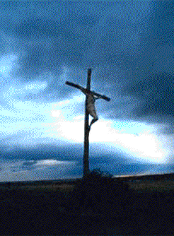
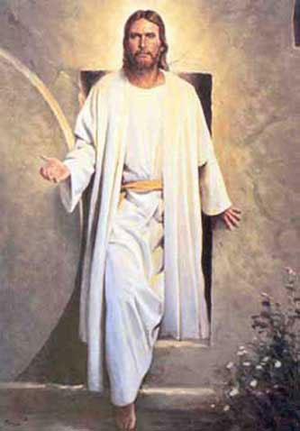
Repentance – Romans 6
Crucify the old man
Walk in newness of life

Slide 10
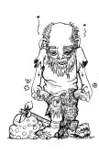

Repentance – Colossians 3
Put off the old
Put on the new

Slide 11
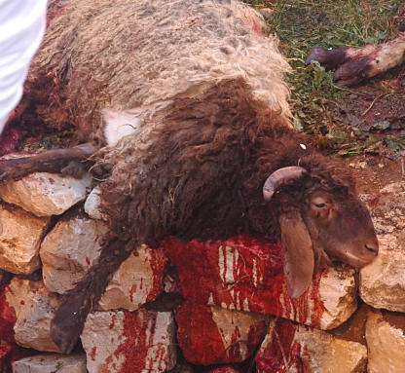
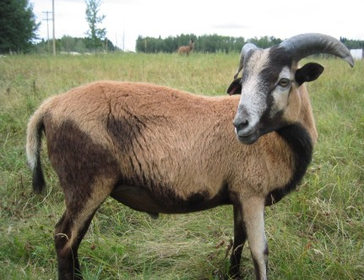
Repentance – Romans 12
A sacrifice
That lives

Slide 12
3 principles of forgiveness
Faith
  We must believe that God has forgiven us
  Even as Abraham believed God, and it was accounted to him for righteousness Galatians 3:6
Repentance
  We have to change
  Repent, and be baptized every one of you in the name of Jesus Christ for the remission of sins Acts 2:38
Forgiving Attitude
  We have to forgive others
  But if ye do not forgive, neither will your Father which is in heaven forgive your trespasses Mark 11:26

Slide 13
Hebrews 9
THE OLD
THE NEW
First testament
Moses, the Law
Tabernacle& Vessels
Holy places made with hands
Patterns (of heavenly), figures (of true)
Blood of calves & goats
New testament
Christ
Heavenly things themselves
Better sacrifices
Heaven itself
Sacrifice of himself

Slide 14
Literal blood?
Literally, the blood of Christ which was shed on Calvary would be of no use to them. It trickled down his side; it oozed from his hands and feet; it gushed from the spear gash; and fell on the ground and dried away like any other blood, and nobody could find it if they tried, and if they could, it would not be of any spiritual value. … In a literal sense, the blood of Christ was the same as our own. … It is not the blood as literal blood that is precious or efficacious, but its relation to something of which the blood shedding is expressive
Robert Roberts, The Blood of Christ pp 5 & 6

Slide 15
Blood = life
For the life of the flesh is in the blood: and I have given it to you upon the altar to make an atonement for your souls: for it is the blood that maketh an atonement for the soul.
Leviticus 17:11

Slide 16
BLOOD = LIFE
The blood of Christ can only take away our sins if we follow his example and dedicate our own lives to developing God’s character at the expense of our own character
The blood of Christ can only take away our sins if we repent

Slide 17
Fig leaves
Created by Adam & Eve
Salvation based on human principles
Salvation earned by human endeavour
Principle behind ‘blood shed’ not revealed

Slide 18
Coats of skins
The lamb had to die
Adam & Eve identify with lamb – they ‘die’
Adam & Eve remain alive – they are ‘resurrected’
Dressed in skins, Adam & Eve look like sacrificed lambs
God did all the work

Slide 19
GENESIS 3 – sin & forgiveness
Sin brings guilt (vv 7, 8 & 10)
Sin ruptures our relationship with God (v8) & with others (v12)
The word of God identifies sin (vv8-11)
We cannot manufacture our own covering for sin (v7)
Sin reinforces sinful inclinations (v18)
Forgiveness does not mean we escape the consequences of sin (vv16-19)
God’s principles of forgiveness are the same from Genesis to Revelation (the slain lamb) (v21)
Forgiveness is based on repentance (v21)

Slide 20
FORGIVENESS
Principles of Forgiveness

