Slide 1
FORGIVENESS
Forgiving One Another

Slide 2
The LORD’S PRAYER
After this manner therefore pray ye:
Our Father which art in heaven, Hallowed be thy name. Thy kingdom come. Thy will be done in earth, as it is in heaven. Give us this day our daily bread. And forgive us our debts, as we forgive our debtors. And lead us not into temptation, but deliver us from evil: For thine is the kingdom, and the power, and the glory, for ever. Amen.
Mat 6:9-13
For if ye forgive men their trespasses, your heavenly Father will also forgive you: But if ye forgive not men their trespasses, neither will your Father forgive your trespasses.
Mat 6:14-15

Slide 3
Why Forgive?
It is part of God’s character - Exo 34:6-7
And the LORD passed by before him, and proclaimed, The LORD, The LORD God, merciful and gracious, longsuffering, and abundant in goodness and truth, keeping mercy for thousands, forgiving iniquity and transgression and sin
Our aim to show Agapae love - Jn 13:34
A new commandment I give unto you, That ye love one another; as I have loved you, that ye also love one another.
Christ’s example – I Pet 2:23
Who, when he was reviled, reviled not again; when he suffered he threatened not

Slide 4
WHY FORGIVE?
It is a condition of God forgiving us - Mat 6:14-15
For if ye forgive men their trespasses, your heavenly Father will also forgive you: But if ye forgive not men their trespasses, neither will your Father forgive your trespasses.
We are also sinners - Jn 8:7
So when they continued asking him, he lifted up himself, and said unto them, He that is without sin among you, let him first cast a stone at her.
Given our flawed judgement, better to err on the side of mercy - Rom 14:4
Who art thou that judgest another man's servant? to his own master he standeth or falleth. Yea, he shall be holden up: for God is able to make him stand.

Slide 5
Why forgive?
Because of what God has done for them - Rom 8:32-34
He that spared not his own Son, but delivered him up for us all, how shall he not with him also freely give us all things? Who shall lay any thing to the charge of God's elect? It is God that justifieth. Who is he that condemneth? It is Christ that died, yea rather, that is risen again, who is even at the right hand of God, who also maketh intercession for us.
Do unto others as you would have done unto you - Jas 2:8
If ye fulfil the royal law according to the scripture, Thou shalt love thy neighbour as thyself, ye do well:

Slide 6
Why Forgive?
Only possible response to God’s forgiveness - Col 3:12-15
Put on therefore, as the elect of God, holy and beloved, bowels of mercies, kindness, humbleness of mind, meekness, longsuffering; forbearing one another, and forgiving one another, if any man have a quarrel against any: even as Christ forgave you, so also do ye. And above all these things put on charity, which is the bond of perfectness. And let the peace of God rule in your hearts, to the which also ye are called in one body; and be ye thankful

Slide 7
Why Forgive?
Gods judgement of us will reflect our judgement of others - Mat 7:2
For with what judgment ye judge, ye shall be judged: and with what measure ye mete, it shall be measured to you again.
Our relationship with brothers & sisters reflects our relationship with God - I Jn 4:19-21
We love him, because he first loved us. If a man say, I love God, and hateth his brother, he is a liar: for he that loveth not his brother whom he hath seen, how can he love God whom he hath not seen? And this commandment have we from him, That he who loveth God love his brother also.

Slide 8
Forgiveness - Human v divine
DIVINE FORGIVENESS | HUMAN FORGIVENESS
Imputes righteousness to the forgiven | No Moral impact on the forgiven
Is only ever one way | Works both ways
Conditions (3 Principles) | No conditions
Freely given, ungrudging | Should be free, ungrudging
Immediate | Should be immediate
Unlimited | Should be unlimited

Slide 9
Seven times a day!
Take heed to yourselves: If thy brother trespass against thee, rebuke him; and if he repent, forgive him. And if he trespass against thee seven times in a day, and seven times in a day turn again to thee, saying, I repent; thou shalt forgive him.
Luke 17:3-4

Slide 10
LUKE 6:32-38
But love ye your enemies, and do good, and lend, hoping for nothing again
Luke 6:35
Forgive without:
DEMANDING recompense
or even EXPECTING recompense
or even HOPING FOR recompense

Slide 11
I CORINTHIANS 6:5-7
I speak to your shame. Is it so, that there is not a wise man among you? no, not one that shall be able to judge between his brethren? But brother goeth to law with brother, and that before the unbelievers. Now therefore there is utterly a fault among you, because ye go to law one with another. Why do ye not rather take wrong? why do ye not rather suffer yourselves to be defrauded?

Slide 12
Why is forgiveness difficult?
We’re hurting
  Solution: time?
  Solution: Suffer ourselves to be emotionally defrauded
Our own faults are hardest to forgive in others
  Solution: remember God has forgiven us this fault
We enjoy the power of withholding
  Solution: get over yourself
Forgiveness makes us vulnerable
  Solution: this is a solution!
We become willing prisoners of our feelings

Slide 13
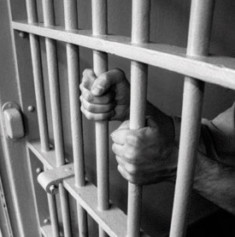
WHO is the Prisoner?
To forgive is to set a prisoner free and discover the prisoner was you
Colin Attridge
The Fruit of the Spirit p105

Slide 14
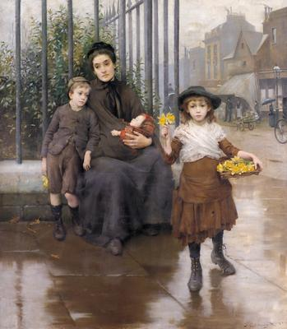
The deserving poor?
Who art thou that judgest another man's servant? (Rom 14:4)

Slide 15
STaGES OF FORGIVENESS
Forgive without discussion
  Minor offence
  Offender may be unaware, offence unintentional
  Offence had limited consequences
Forgive with bilateral conversation (Matt 18:15)
  Offence is serious
  Offender in danger of sinning through ignorance
  Offender is in danger of repeating offence
  Offence affects our faith / faith of others
Forgive with witnesses (Matt 18:16)
  Offender does not respond to v15
  AIM (ALWAYS): TO WIN OUR BROTHER

Slide 16
The ultimate example
And when they were come to the place, which is called Calvary, there they crucified him, and the malefactors, one on the right hand, and the other on the left. Then said Jesus, Father, forgive them; for they know not what they do. And they parted his raiment, and cast lots.
Luke 23:33-34

Slide 17
FORGIVENESS
Forgiving One Another

