Slide 1
Discipleship in the Last Days

Slide 2
Outline
Problem – 2 Timothy 3: 1-9
  What is the issue? What are the indicators?
Solution Strategy – 2 Tim 3: 10-17
  What are the guiding principles for approaching issue?
Implementation – 2 Tim 4:1-5
  What is the exhortation as it applies to us?
Find the Facts, establish the Principles, apply the Exhortation

Slide 3
Problem (2 Tim 3:1-9)
“Lovers of their own selves”: Selfish, intent on own interests
“Covetous”: Lover of money (Lk 16:14 – Pharisees)
“Boasters”: Empty pretender (from vagrancy = directionless)
“Proud”: pre-eminence over others
“Blasphemers”: False words concerning God
“Disobedient to parents”
“Unthankful”
“Unholy”: Wicked
“Without natural affection”: Inhuman, no love for fellow man
“Trucebreakers”: Unforgiving
“False Accusers”: Diabolos… slander

Slide 4
Problem (2 Tim 3:1-9)
“Incontinent”: No self control
“Fierce”: Savage
“Despisers of those that are good”
“Traitors”: betray friends (used of Judas)
“Heady”: Reckless, rash
“Highminded”: Blinded by conceit
“Lovers of pleasures more than lovers of God”:
“Having a form of Godliness”: Outward appearance is good
“But denying the power thereof”: Never changes their life
“Ever learning”: always gaining more knowledge
“Never able… knowledge of truth”: never translates to understanding

Slide 5
In the Ecclesia? (2 Tim 3:1-9)
“Lovers of their own selves”: Selfish, intent on own interests
“Covetous”: Lover of money (Lk 16:14 – Pharisees)
“Boasters”: Empty pretender (from vagrancy = directionless)
“Proud”: pre-eminence over others
“Unthankful”
“Lovers of pleasures more than lovers of God”:
“Having a form of Godliness”: Outward appearance is good
“But denying the power thereof”: Never changes their life
“Ever learning”: always gaining more knowledge
“Never able… knowledge of truth”: never translates to understanding
If we see these within ourselves, what do we do about it?

Slide 6
Solution Strategy (2 Tim 3:10-16)
“Thou hast fully known” – Carefully followed
  Doctrine: Teaching
  Manner of life: Conduct
  Purpose: Goal in life
  Faith: Conviction
  Longsuffering: Patience
  Love: Agape – Self-sacrificing love
  Patience: Endurance
  Persecutions: Suffering for truth sake
  Afflictions: Trials
“Continue thou in those things”
“Walk in the spirit and ye shall not fulfill the lust of the flesh” Gal 5:16

Slide 7

Solution
(goal)
Deliverance
Endure trials & afflictions
Patient, self
-
sacrificing love
Goal and Conviction
Teaching and Conduct
Strategy: Develop a Goal and a Conviction that enables a Patient, Self-sacrificing love that will Endure Trials & Afflictions in order to achieve that Goal.

Slide 8
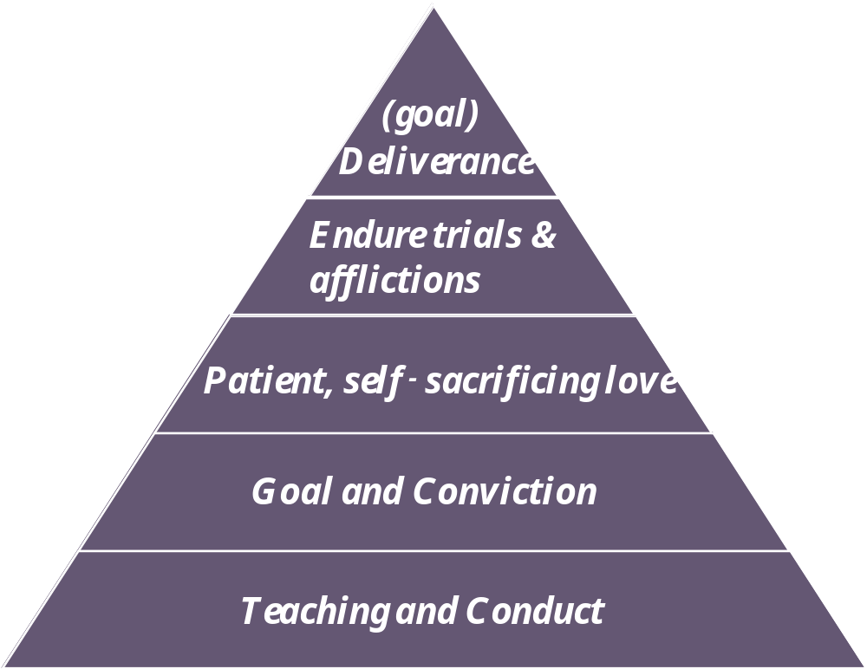
Solution Strategy (2 Tim 3:10-16)
Scriptures enable adherence to plan
  Inspired: God-breathed – they are alive!
  Doctrine: For teaching
  Reproof: For proving what’s true
  Correction: For correcting what’s wrong
  Instruction: For training in what’s right

Slide 9
Implementation (2 Tim 4:1-5)
Preach the word!
  When it’s convenient and when it’s not convenient
  Reprove: Bring error to light
  Rebuke: Strong stand against wrong
  Exhort w/ longsuffering and doctrine: uplift/encourage
But people won’t want to hear
Preaching is to those outside ecclesia and inside
- But not ‘one size fits all’!

Slide 10
Summary (2 Tim 4:1-5)
Problem – people will be totally opposed to God
Solution – Walk in the Spirit!
  Pick an example to follow
  Gain a solid foundation in the Word
  Apply the Word by making a goal, committing to goal, and enduring whatever necessary to achieve
  Don’t focus on negative inputs, God will take care of!
  Make Word of God enabler for achieving goal
Implementation – Preach!
  Inside the ecclesia and out – always be ready
  People won’t want to listen
  But don’t be dissuaded… be fully persuaded!

Slide 11
Deliverance
(goal)
Endure trials & afflictions
Patient, self-sacrificing love
Goal and Conviction
Teaching and Conduct

