Slide 1

INSPIRATIONAL
READING
Nehemiah 8

Slide 2

Scriptural Pattern
Learn to fear
Keep the words
Do them
Heart not lifted up
Turn not to right or left
Prolong his days
Deut. 17:18-20
Hear
Learn
Fear
Observe
Deut. 31:11-13

Slide 3
Scriptural Pattern
II Kings 22:8-11
II Kings 23:1-3
Josiah rediscovers book (Ezra 7:10)
King reads before all people (Neh.8)
‘Stood to covenant’ (Neh.10)
Custom of reading (Neh.8:1)
Eyes fastened on him (Neh.8:3,5-6)
Expounds meaning (Neh.8:7-8)
Lu.4:16-22

Slide 4
Scriptural Pattern
Reading was customary
Paul attends reading
Lack exposition
Col.4:16, I Thess.5:27
Acts 15:21
Acts 13:14-15,27
Give Attendance
I Tim.4:13
Gr. ‘to hold the mind towards,
pay att’n to, be cautious about,
apply oneself to’
Be Changed
II Cor.3:15
Gr. lit. ‘are being changed’
‘transfigured’ – Mt.17:2

Slide 5
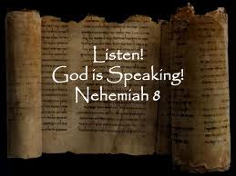
Nehemiah 8:1-13
Verse 1
‘gathered themselves’
Voluntarily!!
‘as one man’
Unity of mind!!
Ex.24:3,7 – ‘one voice’
Acts 1:14 – Gr. ‘homothumadon’ – ‘one mind’
Theme – Acts 2:46,4:24,5:12,8:6,15:25
Phil.2:2,Rom.12:16,15:6
Gal.5:10 – ‘be none otherwise minded’
Psalm 133:1,3

Slide 6
Nehemiah 8:1-13
Verse 1-2
Two Titles
of Ezra
Ezra ‘The Scribe’ – Ezra 7:6,10 – Preparation!!
Ezra ‘The Priest’ – Mal.2:7 - ‘seek the law at his mouth’
‘The congregation’
LXX – ‘ecclesia’
‘all that could hear with understanding’
Deut.31:10-13 - Composition – ‘men,women,children,stranger’
Isaiah 28:9-10 - Principle of Learning
Goal in Reading
Repeated Reinforcement
Natural progression in understanding

Slide 7
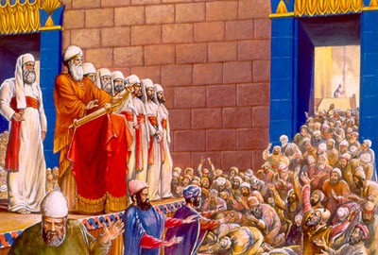
Nehemiah 8:1-13
Verse 3
Tower of Hananel
Tower of Meah
‘street’
Fish Gate
Sheep Gate
Heb. ‘an open square’
Old Gate
Ephraim Gate
Prison Gate
East Gate
Horse Gate
Ophel
Tower
Water Gate
Valley Gate
Fountain Gate
Dung Gate

Slide 8


Nehemiah 8:1-13
Verse 3
‘from the morning until midday’
Heb. (mgn) ‘light’ – A 3-6 hour study!
‘the ears of all the people were attentive’
How you hear – Lu.8:18
What you hear – Mk. 4:24
Refusal – Heb. 2:1-3
Exhort – Concentration, diligence, focused
engrossed, vigilance, ‘in the zone’.
Lu.19:48
Acts 17:11
Goal in Reading
Read in such a way as to command
peoples attention and demand their focus.

Slide 9

Nehemiah 8:1-13
Verse 5
‘all the people stood up’
Same Rx @ dedication in I Kings 8:14
Demonstrated
Reverence
Humility
Respect
Fear
Emotion
MENTAL PREPARATION
RECEPTIVE FRAME OF MIND
Goal in Reading
Capture and express the emotion of the Word so
that those who have prepared themselves will
be moved by it.

Slide 10


Nehemiah 8:1-13
Verse 6
‘Ezra blessed the LORD’
Heb. ‘barak’ – ‘to bend the knees, to kneel down’
Ps.95:6 – ‘let us kneel before the Lord’
II Chron.6:13 – Solomon’s example
‘Amen, Amen’
Heb. ‘so be it’ – see Jer. 11:5
Understanding precedes ‘Amen’ – I Cor. 14:16
‘lifting up their hands’
Perhaps like ascending incense – Ps.141:2, Rev.5:8,8:3,4
‘faces to the ground’
Complete submission to the will/mercy of another – Christ – Mt.26:39

Slide 11

Nehemiah 8:1-13
Verse 6 (cont)
Goal in Reading
Reading always preceded by prayer
Reading itself is a form of worship
Be able to say ‘Amen’
Position ourselves reverently

Slide 12
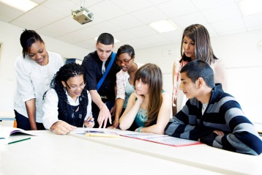
Nehemiah 8:1-13
Verse 7-9
‘distinctly’
RSV – ‘clearly’
‘gave the sense’
RSV – ‘with interpretation’ – ‘insight’
‘caused the people to understand’
Note: The people stood in their place.
Levites moved amongst the people 1:1 and in small groups
expounding the Word
Jehoshaphat set the pattern – II Chron.17:7-9
Necessarily leads to response – v.12
Goal in Reading
Capture the emotion & understanding and impart it to audience –
then reinforce it with exposition.

Slide 13
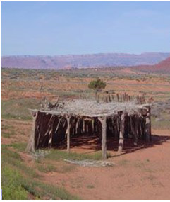
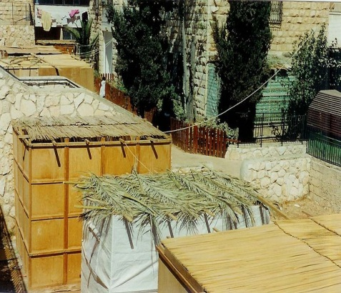
Nehemiah 8:1-13
Verse 13
‘chief fathers, priests, Levites gather before Ezra…
even to understand the words of the law’
Note mgn. Rendering ---------- ‘Train the Trainer’
Verse 14-18
Experiential Learning – The Feast of Tabernacles
Accompanies the reading of the law – Deut.31:9-13
Reminder that we are simple sojourners
‘THE JOY OF THE LORD IS YOUR STRENGTH’ v.10
Goal – Reinforce the reading in a practical way.

Slide 14

Goal in Reading
Capture and express the emotion of the Word so
that those who have prepared themselves will be moved by it.
Goal in Reading
Repeated Reinforcement
Natural progression in understanding
How do
we read
like Ezra?
Goal in Reading
Reading always preceded by prayer
Reading itself is a form of worship
Be able to say ‘Amen’
Position ourselves reverently
Goal in Reading
Approach the Word with proper reverence
Mental preparation for instruction
Goal in Reading
Capture the emotion & understanding and impart it to audience –
then reinforce it with exposition.
Goal – Reinforce the reading in a practical way.

Slide 15

How Readest Thou?
Slooooooow Down
- we should never be in a hurry to read the Word
Preparation
- read the passage ahead of time
- feel the emotion ahead of time so that you can impart the
same emotion to others you are reading to
- review the difficult words
- practice out loud
Emphasize Sentiments and Emotion
Can be accomplished by:
- pausing
- speeding up/slowing down
- raising and lowering the voice
Use Punctuation to your Advantage
- Hesitate at a comma
- Pause at a semi-colon
- Full stop at a colon/period

Slide 16
5. Posture
- Stand erect
- Open your airway
- Project your vioce
LET ‘S GIVE IT A TRY !!
ACTS 7:51-60

Slide 17



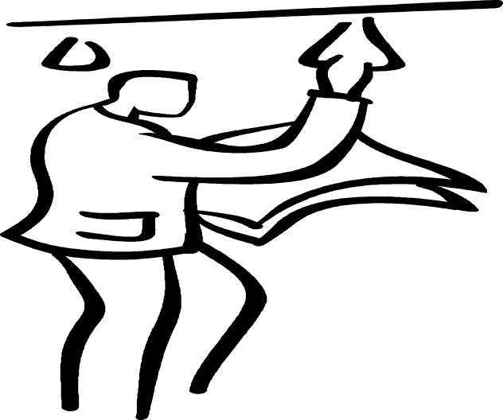


Slide 18
