Slide 1
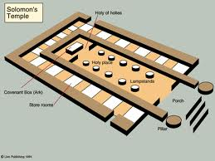
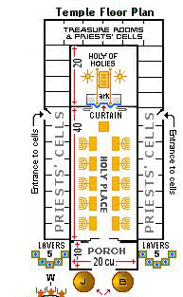
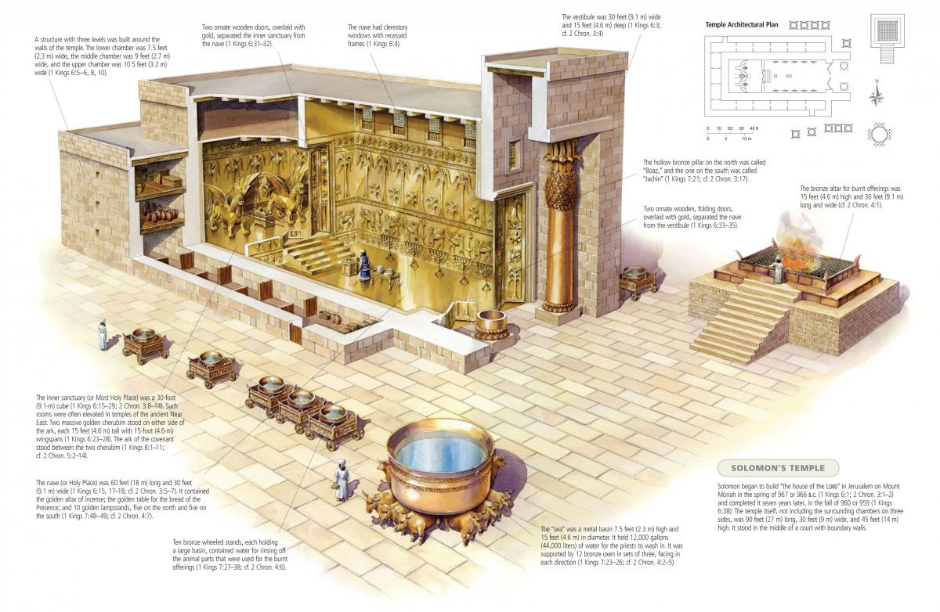

Slide 2

REPEATED REFORM
A CHAMBER FOR SIN
NEHEMIAH 13

Slide 3
Nehemiah 13
Outline
v.1-3 Re-Reading the Word
v.4-14 Re-Establishing the Temple Integrity
v.15-22 Re-Establishing the Sanctity of the Sabbath
v.23-31 Re-Establishing Purity in Relationships
Remember me, O my God…….
v.14 ….for the good deeds that I have done for the house
of my God, and for the offices thereof.
v.22 …and spare me according to the greatness of thy mercy
v.31…for good.

Slide 4

Nehemiah 13
Re-Reading
The Word
Verse 1
‘On that day they read’
Heb. ‘to call out, recite, read aloud’
‘in the audience’
Heb. ‘the ear, to place in anyone’s ear’
Is.22:14 – ‘it was revealed in mine ears’
Ex.17:14 – ‘rehearse it in the ears of Joshua’

Slide 5

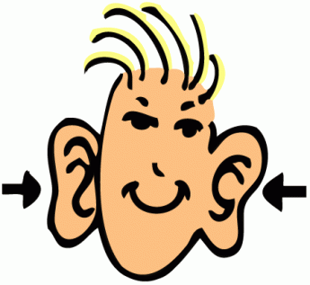
Nehemiah 13
Re-Reading
The Word
THE LISTENER
‘The hearing ear, and the seeing eye,
The LORD hath made even both of them’
Proverbs 20:12

Slide 6
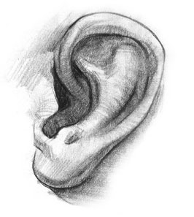
Nehemiah 13
Re-Reading
The Word
Prov.4:20 – ‘incline your ear unto my sayings’
Prov.22:17 – ‘bow down thine ear’
Prov.18:15 – ‘ear of the wise seeketh knowledge’
DIRECTION
Prov.15:31 – ‘ear that heareth…wise’
Prov.25:12 – ‘obedient ear’
OPEN
Zech.7:11 – ‘pulled away the shoulder
stopped their ears,
that they should not hear’
Prov.28:9 – ‘turneth away his ear’
STOPPED

Slide 7
Nehemiah 13
Re-Reading
The Word
Verse 2-3
Ezra 9:1-9, 10:11,16-17
Neh.9:2, 10:18-19
The Principle of Separation
‘separated’ – Heb. ‘exclude, cut off’
‘mixed multitude’
Came with them from Egypt – Ex.12:38
Caused them to stray in the wilderness – Num.11:4
II Cor. 6:14-17

Slide 8
Nehemiah 13
Re-Establishing
Temple Integrity
Verse 4
‘Eliashib’
Character
High priest – seems diligent – 3:1
Perhaps didn’t complete his task – 3:28 v.20-21
Perhaps among nobles praising Tobiah – 6:17-19
Grandson married Sanballat’s daughter – 13:28
‘having the oversight of the chamber’
mgn – ‘being set over’
cp 12:44

Slide 9
Nehemiah 13
Re-Establishing
Temple Integrity
‘allied unto Tobiah’
Heb. ‘near (place,kindred,time)’
Ges. ‘an intimate acquaintance’
Num.27:11 – ‘kinsmen that is next to him’
Lev.21:2 – ‘kin that is near’
Job 19:14 – ‘kinsfolk’
Verse 5
‘chamber’ – Heb. ‘a room in a building’
same word used 10:37-39
see also I Chron.9:26-34

Slide 10
Nehemiah 13
Re-Establishing
Temple Integrity
DO WE HAVE A CHAMBER
FOR TOBIAH?

Slide 11
Nehemiah 13
Re-Establishing
Temple Integrity
Verse 6
‘all this time was not I at Jerusalem’
remained in Jerusalem as governor for 12 yrs – 5:14
returned to Babylon at some point to fulfil 2:6
Pattern in Absence of Sound Spiritual Leadership
Ex.32:1
Judges 2:7-13
II Chron.24:15-18
Mt.13:24-30
ARE WE ANY DIFFERENT?

Slide 12
Nehemiah 13
Re-Establishing
Temple Integrity
Pattern for Cleansing
Lev.14:33-57 – Cleansing the Leprous House
Empty the house – v.36
Inspected by priest and cleansed – v.37-48
Atonement – bl. of bird – v.49-53
‘…to teach when it is unclean and when it is clean’ v.57
Verse 8
‘it grieved me sore’
Heb. ‘raging, of evil disposition’
A Christ-like response
Mt.21:12-13
Mk.11:15-17
Jn.2:13-17

Slide 13
Nehemiah 13
Re-Establishing
Temple Integrity
EXHORT
Nehemiah was angry. He showed it. He was right to be angry. Critics of
Nehemiah forget that deep rooted wrongs are seldom corrected except
by people who have first become sufficiently angry. The cool, the complacent,
the compromisers don’t change anything. We can be wrong if we do nothing
more than act angry. Righteous anger, the kind God approves of, always acts
to right the injustice. Wrong anger is probably not the major problem in
ecclesias today ---- bigger problems are compromise and complacency.
‘Those that would expel sin out of their hearts, those living temples, must
throw out its household stuff and all the provisions made for it and take
away all those things that are the food and fuel of lust; this is in effect to
mortify it.’ (MH)

Slide 14
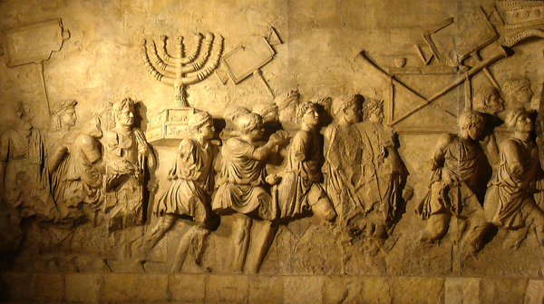
Nehemiah 13
Re-Establishing
Temple Integrity
Verse 9
‘cleansed the chambers’
Lev.14:37-48 – Step 2
Cp Hezekiah – II Chron.29:5,15-16,18
‘brought again the vessels of the house of God’
II Tim.2:19-21
Which vessel are we?

Slide 15
Nehemiah 13
Re-Establishing
Temple Integrity
Verse 11
‘contended’
Heb. ‘grapple, to wrangle, hold a controversy’
Ges. ‘to seize one another by the hair – to contend
with the hand and with blows’
BDB – ‘quarrel noisily, shouting, clamour’
Exhort
Prov.28:4
‘set them in their place’
Lit.Heb. ‘stand in a fixed spot’

Slide 16
Nehemiah 13
Re-Establishing
Temple Integrity
Verse 13
Building
Wall
Sealed
Cov’t
Read
Law
Shelemiah Priest 3:30?
‘thank offering’
Zadok Scribe 3:29 10:21
‘just’
Pedaiah Levite 3:25 8:4 (stood with Ezra)
‘Yah has ransomed’
Hanan Levite 10:22 8:7 (teacher)
‘favour’
‘counted faithful’
I Tim.3:13, Ecc.7:1, Acts 6:3

Slide 17
Nehemiah 13
Re-Establishing
Temple Integrity
When we allow a ‘chamber for sin’ …..
Lose charitableness.
Lose interest in the sabbath.
Lose our families.

Slide 18
Nehemiah 13
Re-Establishing
Temple Integrity
1. Lose Charitableness
Verse 10
‘portion’ Heb. ‘an allotment’ – from rt. ‘to weigh out’
rt. wd. = Heb. ‘manna’ – Ex.16:15 (mgn)
Exhort – II Cor.8:13-15, 9:6-10
Harvest Principle
Free Will Principle
Grace Principle
Thanksgiving Principle

Slide 19
Nehemiah 13
Re-Establishing
The Sabbath
2. Lose Interest in the Sabbath
Verse 15-22
Rest
Holy
Perpetual Covenant
Ex.31:12-18
Jer.17:19-27 – Specific Warning
Amos 8:5 – Attitude against Sabbath
‘not neglecting - as some habitually do - to meet together’
‘And let us not hold aloof from our church meetings, as some do’
Heb.10:25 (Wey,Philips)

Slide 20
Nehemiah 13
Re-Establishing
The Family
3. Lose Our Families
Verse 23-31
Addressed previously in Ezra 9-10
Meshezabeel
Neh.10:21
Arah
Ezra 2:5
Neh.7:10
Neh.3:4
Berechiah
Pethahiah
Neh.11:24
Shechaniah
Neh.12:25,33
Meshullam
Daughter
Tobiah
Johanan
Daughter
son
Neh.6:18
13:28
Eliashib
Joiada
Son
Daughter
Sanballat

Slide 21
Nehemiah 13
Re-Establishing
The Family
3. Lose Our Families
Verse 24
Exhort – Deut. 7:3-4
Chances are pull of unbeliever will win!
Exhort – What language do our children speak?
Can they talk ‘the Truth’?
Is their first language that of Ashdod?
James 3:10-13
…it all starts with a
chamber for sin!!

Slide 22
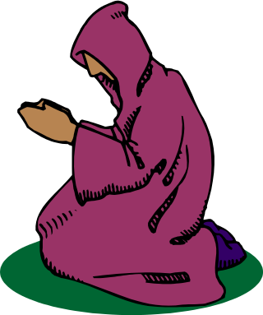
NEHEMIAH
Living IN PRAYER
Nehemiah 1

Slide 23
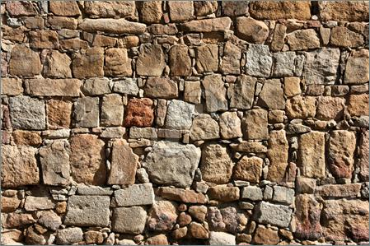
BUILDING WALLS
Nehemiah 3
‘Hewers of the
stone of the wall’

Slide 24

NEHEMIAH
SPIRITUAL LEADERSHIP
Strategist/Visionary
Motivator
Positive Communication Patterns
Confrontation – Anger Management
Managing Opposition

Slide 25

INSPIRATIONAL
READING
Nehemiah 8

Slide 26
REPEATED REFORM
A CHAMBER FOR SIN
NEHEMIAH 13

