Slide 1
Zephaniah
Study 1 – “The great day of Yahweh is near and hasteth greatly”

Slide 2
The times of Zephaniah
…

Slide 3
Analysis of Zephaniah
The prophecy summarised:
1:1-2:3 Hastening judgements upon Judah
2:4-15 Judgement on the nations
3:1-7 The sins of Judah and Jerusalem
3:8-20 A remnant restored and redeemed
Purpose of the prophecy – To encourage a faithful remnant in the face of rapidly approaching Divine judgement.
Roots of the prophecy – Genesis 1 to 35

Slide 4
Zephaniah the Prophet
A descendant of Hezekiah – of the house of David – with access!
Prophesied between 630 and 621 BC during the early years of Josiah’s reign.
Contemporary with Jeremiah who began prophesying in Josiah’s 13th year.
Seemingly responsible for Josiah’s early reforms.

Slide 5
Character of the Ecclesia
Judah steeped in Babylonian idolatry and worldly practice.
Insensitive after nearly 60 years of apostasy.
Under irrevocable sentence of Divine judgement.
Only a small remnant surrounding Josiah remained faithful.
Attitude to reform lukewarm and hypocritical – Jer. 3:10.

Slide 6
Zephaniah
“Whom Yah hid”
Son of Cushi – “A Cushite”. ???????
Gedaliah – “Whom Yah has made great”.
Amariah – “Whom Yah promised”.
Hizkiah (Hezekiah) – “Strengthened of Yah”.
Underlying theme of prophecy:
The salvation of a remnant whom God hid among the Cushites and made great through the one He promised (to Abraham) and strengthened for Himself.

Slide 7
Babylonian Apostasy
2 Kings 21:2 – Restored religion of the Canaanites – Descendants of Ham.
2 Kings 21:3 – Baal and Asherah (Astarte) – Phoenician gods of the sun and moon – Origins in ancient Babylon.
“host of heaven” – Astral worship of the Chaldeans – Worshipped sun, moon and stars (signs of the Zodiac) – 2 Kings 23:5.
2 Kings 23:11 – Horses and chariots of the sun borrowed from Assyria and Babylon.

Slide 8
Cush – Father of Nimrod
History records that Cush – also called Kish and Bel – settled in Babylon first.
Cush was the great original prophet of the Babylonian mysteries.
Bel = “the confounder” - of languages and of religion – Isa. 46:1; Jer. 50:2; 51:44. Chaldean – “to break in pieces, scatter abroad.”
Bel was later called Baal and Jannus.
Cush began the form of false religion that spread throughout Mesopotamia and Canaan.
Formula – Mic. 6:16 – “For the statutes of Omri are kept, and all the works of the house of Ahab”.

Slide 9
The table of Nations….from Shem, Ham and Japheth
Cush
“…of them was the whole earth overspread.”

Slide 10
“Cush begat Nimrod”
Gen. 10:8
“Nimrod ben Cush” – Has a numerical value of 666
Nimrod
N = 50
M = 40
R = 200
D = 4
Ben
B = 2
N = 50
Cush
K = 20
SH = 300
294
52
320
= 666

Slide 11
Roots of the Prophecy
Zeph. 1:2-3 – Cp. Gen. 6:7 – Gen. 1 order of creation reversed – 1st clue – reversal!
Zeph. 2:3 - Cp. Flood – All consumed but a remnant ‘hid’.
Zeph. 1:1; 2:12; 3:10 – Cushi = Babylon.
Zeph. 2:13 - Assyria/Ninevah.
Zeph. 1:16; 3:6 – Towers – Cp. Gen. 11:1-4; and cities – Cp. Gen. 10:10-11.
Zeph. 3:9 – “pure language” – Gen. 11:1.
Zeph. 3:9-20 – Abraham and Jacob.

Slide 12
Zephaniah – Giant stepping stone between Genesis and Revelation
Daniel
Genesis
Zephaniah
Isaiah
Jeremiah
Apocalypse

Slide 13
The theme of Zephaniah
“The great day of the LORD is near”
To warn of inevitable and hastening judgement on Judah, Jerusalem, and all nations.
To herald salvation for a faithful remnant and ultimate redemption for Israel and the nations.

Slide 14
6 victims of Divine judgement
V.4 - The idols of Baal in Judah.
V.4 - Idolatrous priests and corrupt Levitical priests.
V.5 - Star worshippers on housetops.
V.5 - Those with divided allegiance – Yahweh and Molech.
V.6 - Those turned back from their God.
V.6 - The irreligious who sought not Israel’s God.

Slide 15
Seven – The Covenant number in Zephaniah
“The day of Yahweh” – 7 times.
“nations” – goh’y – 7 occurrences.
“people” – am – 7 occurrences.
“I” – The Divine guarantee – 7 times – Zeph. 3:19-20.

Slide 16
The Day of Yahweh
627/626
587/586
Jehoia-
kim
Nebuchadnezzar’s
Captivity
Manasseh Josiah Zedekiah
40 years
“forty years of judgement are consumed in preparing the Millennial reign of peace and righteousness” – Eureka Vol. 5 pg. 39 (Logos Edition)
Armageddon
Christ’s universal rule
The march of the Rainbowed Angel

Slide 17
Events of the Jubilee Period
50 years
Marriage
of Lamb
Yahweh Sabaoth manifested in power
for 40 years but unseen by the world
Elijah’s mission to scattered Jewry
THE SECOND EXODUS OF ISRAEL
Return of Christ - Resurrection
Judgement Seat
Arabs subdued
The smiting and healing of Egypt
Christ’s universal rule over all nations
Judah saved and settled in Land
10 years
Gog buried – Land cleansed & divided
40 years
ARMAGEDDON
Rome destroyed
Mid-heaven
Proclamation
10 years
Marriage
Supper
Catholic Europe destroyed – 30 years
Britain submits
All nations submit to Christ
Temple built

Slide 18
Twin evils of apostasy and prosperity targeted
V.8 – “strange apparel – nokriy malbush – foreign clothing (of false religion V.4).
V.9 - “fill their masters’ houses” – i.e. temples of false gods via robbery.
V.10 – “the second” – Lower part of the city where markets located.
V.11 – “Maktesh” – “depression”; i.e. Lower city (Roth.) = marketplace.
V.12 – “settled on their lees” – Cp. Jer. 48:11 – stagnation of long prosperity.

Slide 19
Prosperity when we go!
Luke 17:26-30
Eating and drinking – gluttony and excessive drinking – culture of enjoyment and revelry.
Marrying and being given in marriage – implies multiple marriages – culture of pleasure.
Buying and selling – pre-occupation with acquisition – never satisfied = materialism.
Planting – business pursuits - culture of increase and gain.
Building – continual upgrading to improve status – culture of luxury and comfort.
Zeph. 1:18 – Roth. - Neither their silver nor yet their gold, shall be able to deliver them, in the day of the indignation of Yahweh, but, in the fire of his jealousy, shall the whole earth be consumed; For, a destruction, surely a terrible one, will he make, with all them who dwell in the earth.

Slide 20
Remember Lot’s wife
The struggle between the “housetop” and the “stuff in the house”.
The housetop in Israel was designed for prayer and meditation.
“stuff” – skelios – implement, equipment, apparatus.
Lot’s wife tried to secure the present and lost the future.

Slide 21
The Judgement Seat reveals
Luke 17:34-37
“that night” - Allusion to Gen.19:1 – “evening”.
“two men in one bed” - i.e. a husband and wife (allusion to Lot and his wife).
“two women grinding together” - i.e. two labouring to feed others in the Truth.
“the one shall be taken” - paralambano - to receive near; i.e. associate with oneself (speaks of an intimate relationship); used of taking a wife to oneself - Matt.1:20,24.
“left” – aphiemi – to dismiss from a marriage – 1 Cor. 7:10-11.
A remnant hidden in the day of Yahweh’s anger

Slide 22
Zephaniah
Study 2 (God willing) –
“When the Most High divided to the nations their inheritance”

Slide 23
Timeline of Depressions
World War 2
1929
10 years
1939
War
Times of prosperity become times of poverty and unemployment
1930
201?
10 years
Oil crisis
will bite
by 2012
Times of prosperity become….
A time of trouble such as never was – Dan. 12:1-2
Armageddon

Slide 24
The day of Yahweh is near
Revival of Russian military and political power.
Growing unity in Europe through influence of Catholicism.
Increasing isolation of Britain in Europe.
Israel defiantly prospers in the Arab Spring era.
Men’s hearts failing for fear of looming problems too big for man to handle.
Living costs and fuel prices soar.
World on verge of huge economic collapse.
Unprecedented immorality and corruption.
Abandonment of God’s principles in church and state.

Slide 25
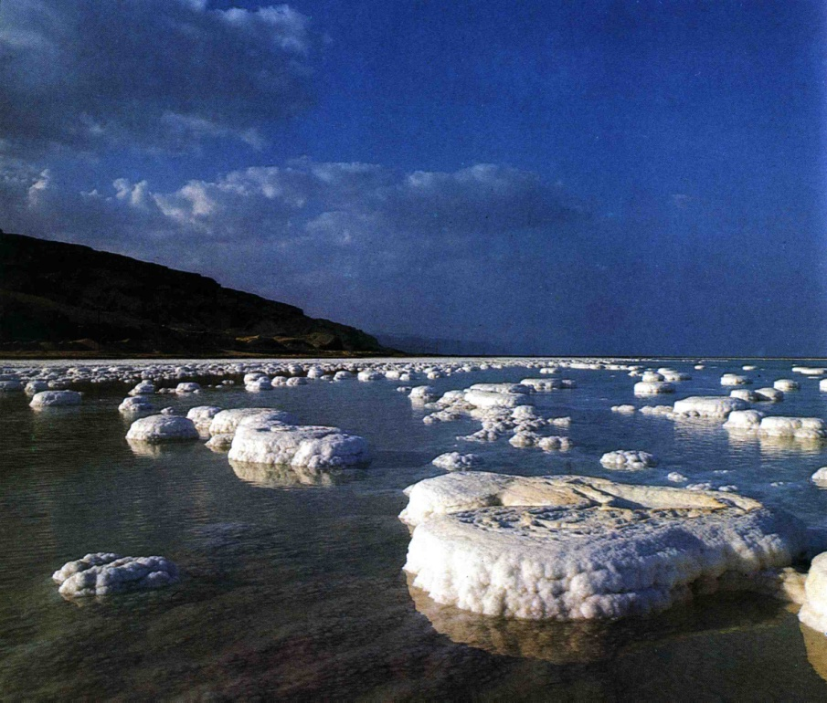
Luke 17:34-37
“the other shall be left” - aphiemi - to send forth, to leave, depart from, abandon (used of separation in marriage - 1 Cor. 7:11,12,13).
“Where, Lord?” - i.e. where will they be left. Answer - like Lot's wife; in the place they preferred to be.
But his wife looked back from behind him, and she became a pillar of salt. – Gen. 19:26

