Slide 1
Zephaniah
Study 2 – “When the Most High divided to the nations their inheritance”

Slide 2
Nimrod in Zephaniah
Nimrod is not named but is omnipresent.
The word “Cush” occurs 3 times – The presence of Babylon – Gen. 2:13.
Towers/cities (3:6) – “high towers” (1:16).
“nations” – goyim – used 7 times.
“I rise up to the prey” (3:8) - Allusion.
“language” - saphah - (3:9) – Gen. 11:1.
Ninevah/Assyria (2:13) – Military phase of the Kingdom of men.

Slide 3
Deut. 32:8-9
“When the most High divided to the nations their inheritance, when he separated the sons of Adam, he set the bounds of the people according to the number of the children of Israel.
For the LORD’S portion is his people; Jacob is the lot of his inheritance.”
El Elyon – Gen. 14:19 – “possessor of heaven and earth”.
Commentary on events of Gen. 10 and 11.

Slide 4
Separation of the sons of Adam
The nations’ inheritance divided “according to the number of the children of Israel.”
12 sons – Gen. 35:22 = Israel (Gen. 49:28).
70 children of Jacob’s house at removal into Egypt – Gen. 46:27; Deut. 10:22 = The Gentile nations.

Slide 5
The Kingdom of Men
“First, the Lion of Babylon, or the golden section of the image; then, the Bear of Medo-Persia, or the silver; third, the Leopard of Grecia, or the brazen; and fourth, the Dragon of Rome, or the iron. These are the four general phases of “the kingdom of men,” from the time of Nimrod to the future coming of the Ancient of Days to supersede it by “the Kingdom of God.”
Eureka Vol. 4 pg. 225 (Logos Edition)

Slide 6
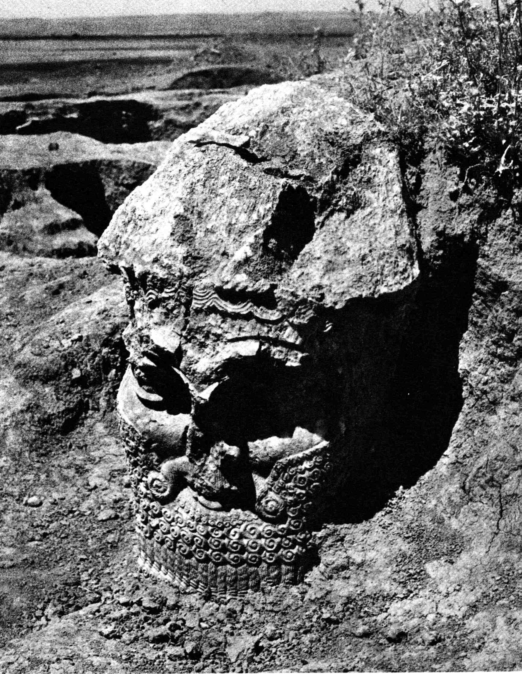
Nimrod – 13th Generation from Adam
Adam
Cain
Enoch (1st city named)
Irad
Mehujael
Methusael
Lamech (7th - Jude 14)
3 to the flood - Noah
Ham
Cush
Nimrod (13th = rebellion)
His name means - “The Rebel” or “We will rebel”.

Slide 7
Nimrod
“The rebel” (We will rebel)
13th generation from Adam – 13 is the number of rebellion – note Gen. 14:4; 17:25.
The first God-King or “god of the earth” – Rev. 11:4 – Type of the Papacy.
Founded the first kingdom on earth – The kingdom of men.
Mighty hunter – gibbor tsayid – Roth. - “A hero of the chase”.
Usurped God’s dominion over the carnal creation – Gen. 9:2.
Established a ‘name of blasphemy’.

Slide 8
“Before Yahweh” – Gen. 10:9
“before” – paneh - in front of, before, to the front of, in the presence of, in the face of, at the face or front of.
“In the face of YHWH can only mean 'in defiance of YHWH' as Josephus and the Targums understand it.”
Keil and Delitzsch

Slide 9
Nimrod
“From the foundation of the world none was ever found like Nimrod, powerful in hunting, and in rebellions against the Lord.”
The Targum of Jonathan

Slide 10
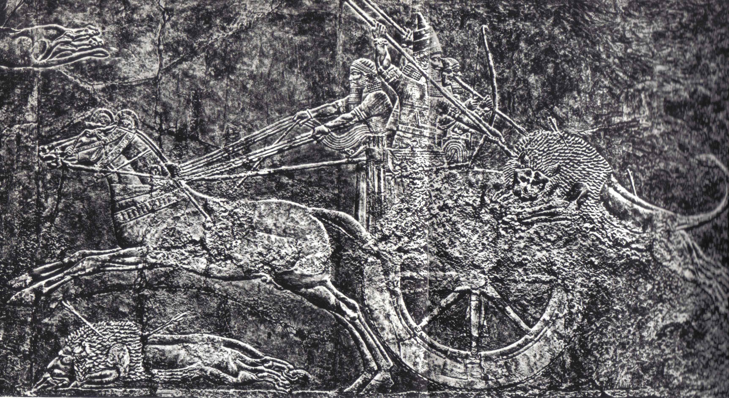
Assyrian tradition – Mighty hunters
Ashurbanipal (669-627 BC) lion hunting in a chariot

Slide 11
Nimrod’s Power
“The way, too, in which Ninus (the legendary first Assyrian king) gained his power is the very way in which Nimrod erected his. There can be no doubt that it was by inuring his followers to the toils and dangers of the chase that he gradually formed them to the use of arms, and so prepared them for aiding him in establishing his dominions.”
Alexander Hislop, “The Two Babylons” pg. 23

Slide 12
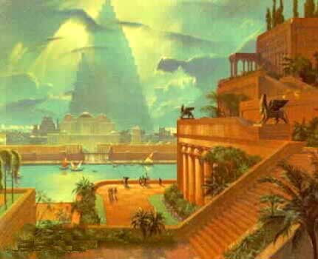
The Land of Shinar
Heading
The rebellion of Nimrod – The tower of Babel
“And the beginning of his kingdom was Babel, and Erech, and Accad, and Calneh, in the land of Shinar.” – Gen. 10:10

Slide 13
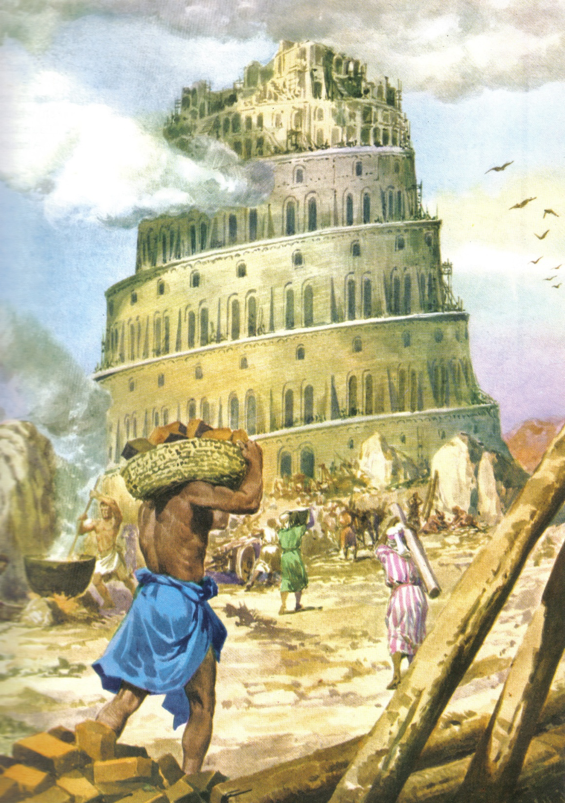
Gen. 11:4
And they said, Go to, let us build us a city and a tower, whose top may reach unto heaven; and let us make us a name, lest we be scattered abroad upon the face of the whole earth.

Slide 14
“Let us make us a name” – Gen. 11:4
“Name” is shem – name, renown.
Possible deliberate play on the name Shem - installed as God’s priest in Salem – Gen. 14.
Bro. Thomas, Elpis Israel
“It is probable that Shem was the personage to whom Abraham paid tithes on his return from the slaughter of the kings.”
The rebellion sought to promote a counterfeit religion – the ancient Anti-christ (i.e. in place of Christ).

Slide 15
God’s answer to Nimrod’s rebellion
In the beginning Elohim had said:
Gen. 1:26 – “Let us make man in our image, after our likeness”.
But now man defies that objective:
Gen. 11:3 – “Go to, let us make brick…”
Gen. 11:4 - “Go to, let us build us a city and a tower…”
Gen. 11:4 – “…let us make us a name”.
God’s response is:
Gen. 11:7 - “Go to, let us go down, and there confound their language…”

Slide 16
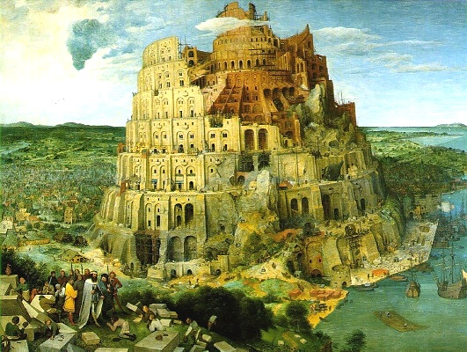
“So the LORD scattered them abroad from thence upon the face of all the earth: and they left off to build the city.”
Heading
Gen. 11:8

Slide 17
The table of Nations….
From Shem, Ham and Japheth
Within 100 years of the Flood, Nimrod’s rebellion resulted in 70 different languages and 70 nations.
“…of them was the whole earth overspread.”

Slide 18
Genesis 10
70 nations from Shem, Ham and Japheth
Vv.2-5 14 nations from Japheth
Vv.6-20 30 nations from Ham
Vv.21-32 26 nations from Shem
Total 70
(Key - Count names only once and omit Noah, Shem, Ham and Japheth, and the names of cities)

Slide 19
Shem – Gen. 10:21
Why “the father of all the children of Eber”?
Eber is number 11 in the list of progeny!
Eber – from the root eber – across, on the opposite side.
The primary root abar – to cross over (used widely of any transition) - occurs 29 times Josh. 1-4 of Israel “passing over” Jordan.
Gen. 14:13 – “Abram the Hebrew” - an Eberite (that is, Hebrew) or descendant of Eber.

Slide 20
Eber and Hebrew
Muslim historian of the 13th century, Abu al-Fida relates the story that the patriarch Eber (an ancestor of Abraham) was allowed to keep the original tongue, Hebrew in this case, because he would not partake in the building (i.e. of the tower of Babel).

Slide 21
After the Flood – Patriarchal Line
Noah - 950
Died 35 yrs after Abraham
Shem - 600
Arphaxad - 438
Salah - 433
Eber - 464
The Deluge
Peleg - 239
Reu - 239
Eber over-lived Abram by 4 years
Serug - 230
100
Nahor - 148
Nimrod’s rebellion
Terah - 205
Abram - 175

Slide 22
Peleg – Gen. 10:25
Peleg – “division”. Strong suggests the division of an earthquake. Root – channel, canal.
Names occurs 7 times O.T. (only) = Related to Covenant.
“in his days was the earth divided” – badal – sig. to divide by distinguishing, making a distinction. Used – Gen. 1:4,6,7; Lev. 20:24,25; Isa. 56:3; 59:2.
The separation of the nations happened when he was born – he was named after the dramatic event!

Slide 23
“In his days was the earth divided”
Gen. 10:22-25
Noah
Gen. 10:6-8
Shem
Elam, Asshur, Arphaxad, Lud, Aram
Ham
Cush, Mizraim, Phut, Canaan
Uz, Hul, Gether, Mash
Seba, Havilah, Sabtah, Raamah, Sabtechah,
Nimrod (12)
Salah
Eber (11)
Sheba, Dedan
Peleg, Joktan
(12)
Division

Slide 24
Joktan – Representative of rebels
Joktan is the 13th descendant of Shem listed.
He was born after the division of the nations.
His name means “He will be made little”.
Its numerical value is 169 = 13 x 13.
He had 13 sons - Numerical value of sons names is 2756 = 212 x 13.
13 is the Biblical number of rebellion - Gen. 14:4; Mark 7:21-22.
Nimrod was the 13th generation from Adam – his name means “We will rebel”.

Slide 25
“According to the number…..”
Now counting from Shem
Shem
Elam
Asshur
Arphaxad
Lud
Aram
Uz
Hul
Gether
Mash
Salah (“sprout”)
Eber (father of Hebrews)
Shem
Arphaxad
Salah
Eber
Peleg
Reu
Serug
Nahor
Terah
Abram
Isaac
Jacob
Gen. 10:22-25
The generations of Shem
Gen. 11:10-32

Slide 26
Israel and the Nations
The Jew first
12 = Israel
Ex.15:27 – Elim
12 wells of water
Luke 9:1
12 disciples sent to preach
Rev. 7:4-8
Perfect Israel - The Redeemed
Then the Gentiles
70 = Gentiles
70 palm trees
Luke 10:1
70 disciples sent to preach
Rev. 7:9
Redeemed out of all nations

Slide 27
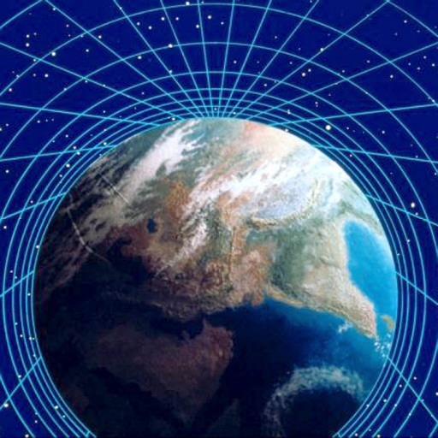
Heading
As a result of the Flood, there are 12 tectonic plates on the earth’s crust!
Israel and the nations

Slide 28
Israel the only ‘immortal’ nation
Jer. 30:11 – “…though I make a full end of all nations whither I have scattered thee, yet will I not make a full end of thee (Israel)….”
Jer. 46:28 – “Fear thou not, O Jacob my servant, saith the LORD: for I am with thee; for I will make a full end of all the nations whither I have driven thee: but I will not make a full end of thee, but correct thee in measure; yet will I not leave thee wholly unpunished.”

Slide 29
The Feast of Tabernacles - The ingathering of all nations
Seven days - 15th to 21st day of Tishri (7th month)
Day 1 - (Num. 29:13) 13 bullocks offered
Day 2 - (v.17) 12
Day 3 - (v.20) 11
Day 4 - (v.23) 10
Day 5 - (v.26) 9
Day 6 - (v.29) 8
Day 7 - (v.32) 7 = Total 70 (The Nations)
8th Day - One bullock offered (Num.29:35-36) – “That great day of the feast” – John 7:37.
Begins with 13 – No. of rebellion
Ends with 7 – Covenant & Sabbath rest

Slide 30
Zephaniah
Study 3 (God willing) –
“He will famish all the gods of the earth”

