Slide 1
Zephaniah
Study 3 – “He will famish all the gods of the earth”

Slide 2
Analysis of Zephaniah
The prophecy summarised:
1:1-2:3 Hastening judgements upon Judah
2:4-15 Judgement on the nations
3:1-7 The sins of Judah and Jerusalem
3:8-20 A remnant restored and redeemed
Purpose of the prophecy – To encourage a faithful remnant facing rapidly approaching Divine judgement that they might be hid in the day of Yahweh’s anger.

Slide 3
Judgement on the Nations
Note play on names in decrees of judgement – as in Mic. 1:10-16.
Gaza = strong.
Ashkelon = Weighing place, i.e. a mart.
Ashdod = a fortified place, a castle.
Ekron = eradication. Root. aqar.
“forsaken” - azab – to loosen; desolated.
“desolation” - shimamah – devastation.
“drive out” - garash – drive out of possession.
“rooted up” - aqar – to pluck up (by the roots); to exterminate.

Slide 4
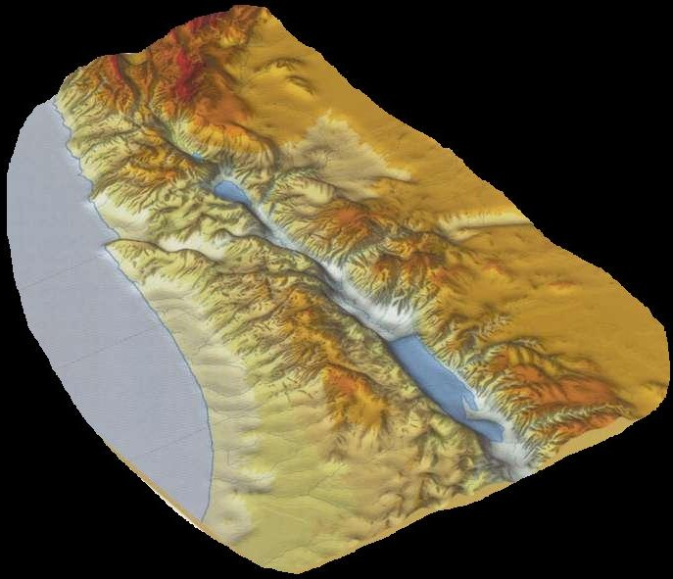
…
Judgement on the surrounding Nations
Ammon
The Philistine
coast
Moab
Zeph. 2:4-10

Slide 5
Zephaniah 2:11
“Terrible will Yahweh be against them, for he hath caused to waste away all the gods of the earth, that men may bow down to him, every one from his place, all the coastlands of the nations.”
Rotherham
A prophecy of the future

Slide 6
Land of Cush - Gen. 2:10-14
And a river went out of Eden to water the garden; and from thence it was parted, and became into four heads.
The name of the first is Pison: that is it which compasseth the whole land of Havilah, where there is gold…
And the name of the second river is Gihon: the same is it that compasseth the whole land of Ethiopia (Cush = black).
And the name of the third river is Hiddekel: that is it which goeth toward the east of Assyria. And the fourth river is Euphrates.

Slide 7
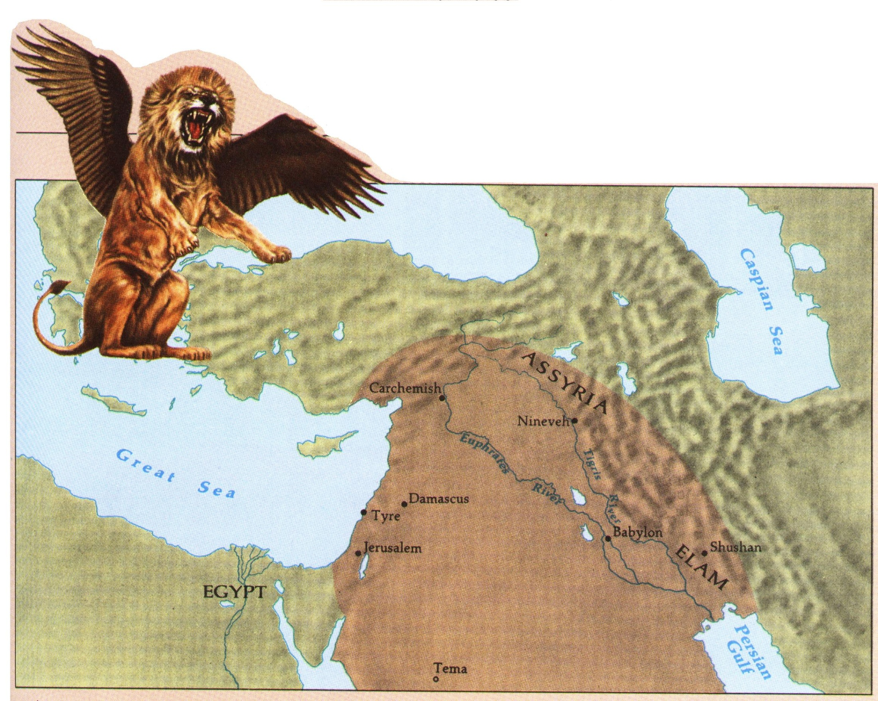
Heading
Assyro-Babylonian Empire – BC (2240) 606 - 539
Nimrod’s
kingdom
Cush (1)
Cush (2)
Cush (3

Slide 8
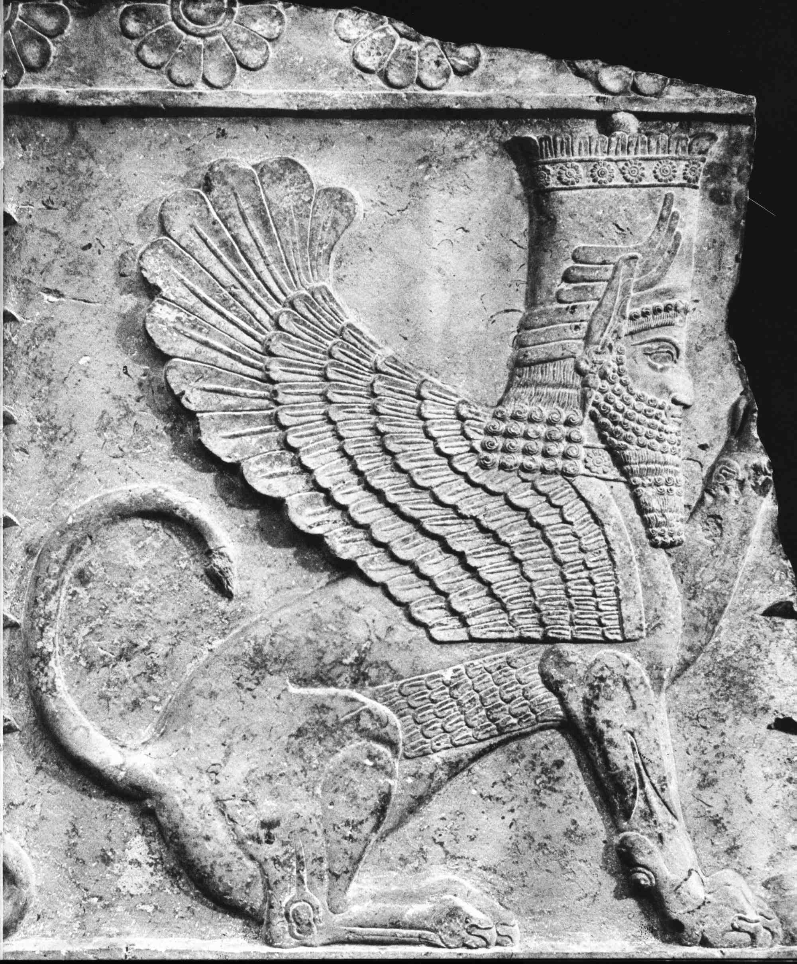
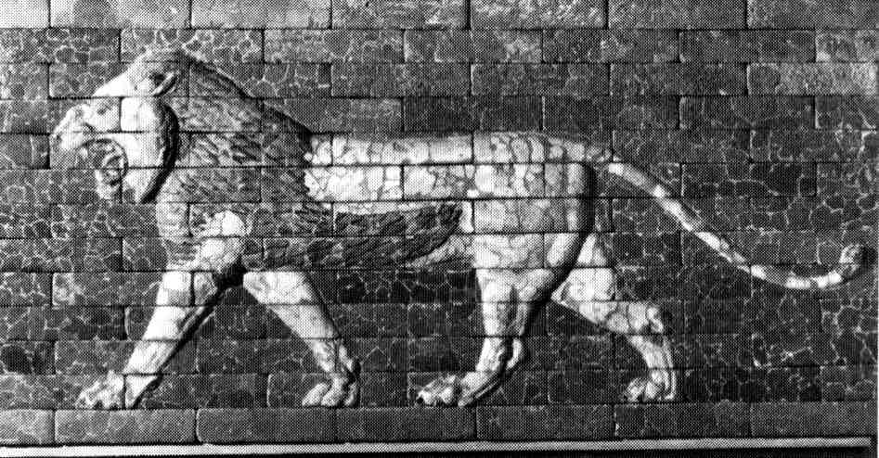
The Assyro-Babylonian Lion – Dan. 7:4
The first was like a lion, and had eagle's wings: I beheld till the wings thereof were plucked, and it was lifted up from the earth, and made stand upon the feet as a man, and a man's heart was given to it.
Lion from the Ishtar Gate

Slide 9
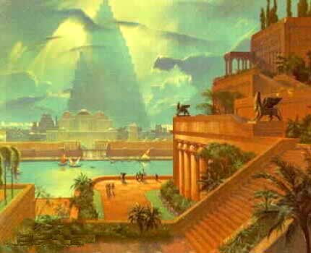
The Tower of Babel
Heading
The beginning of the Kingdom of Men
And the beginning of his kingdom was Babel, and Erech, and Accad, and Calneh, in the land of Shinar. – Gen. 10:10

Slide 10
Mega-cities – Kingdom of Men
Nimrod established two mega-cities:
Babel (Babylon), Erech (Enoch), Accad and Calneh – Gen. 10:10.
Nineveh, Rehoboth, Calah and Resen – Gen. 10:11-12.
The earliest Babylonian kings bore the title “Four races”.
When God called Abram and developed from him Israel, the nation was marked by four – 4 mothers for the 12 tribes; 4 square encampment, 4 standards – see Num. 23:10; 24:6.

Slide 11
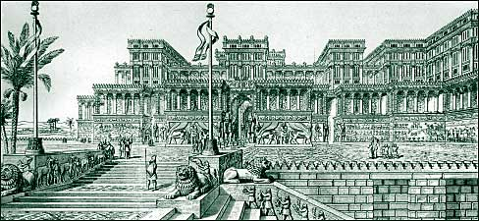
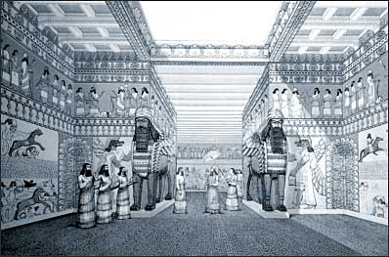
The Glory of Nineveh
Sennacherib’s palace
Tiglath-Pileser’s palace
“This is the rejoicing city that dwelt carelessly, that said in her heart, I am, and there is none beside me.”

Slide 12
Assyria, Babylon and Judah
How Assyria and Babylon came into Judah
Ahaz brought the design of an Assyrian altar to Jerusalem –
2 Kings 16:10-11
…
Assyrian invasion under Sennacherib in reign of Hezekiah
Idolatry
Manasseh introduces Babylonian idolatry and astral worship

Slide 13
Assyria, Babylon and Judah
Wherefore the LORD brought upon them the captains of the host of the king of Assyria, which took Manasseh among the thorns, and bound him with fetters, and carried him to Babylon. - 2 Chron. 33:11
…
Manasseh (“causing to forget”) taken to Babylon as forerunner of Judah who he was responsible for corrupting with Babylonian idolatry.

Slide 14
Isaiah and “The Assyrian”
Isaiah prophesied in the days of Uzziah, Jotham, Ahaz and Hezekiah.
Witnessed the invasion of Sennacherib and the apostasy of both Ahaz and Manasseh.
Title of the latter day Gogian host -
Isaiah 10:5,24; 14:25; 30:31; 31:8 - Cp. Mic. 5:5,6.

Slide 15
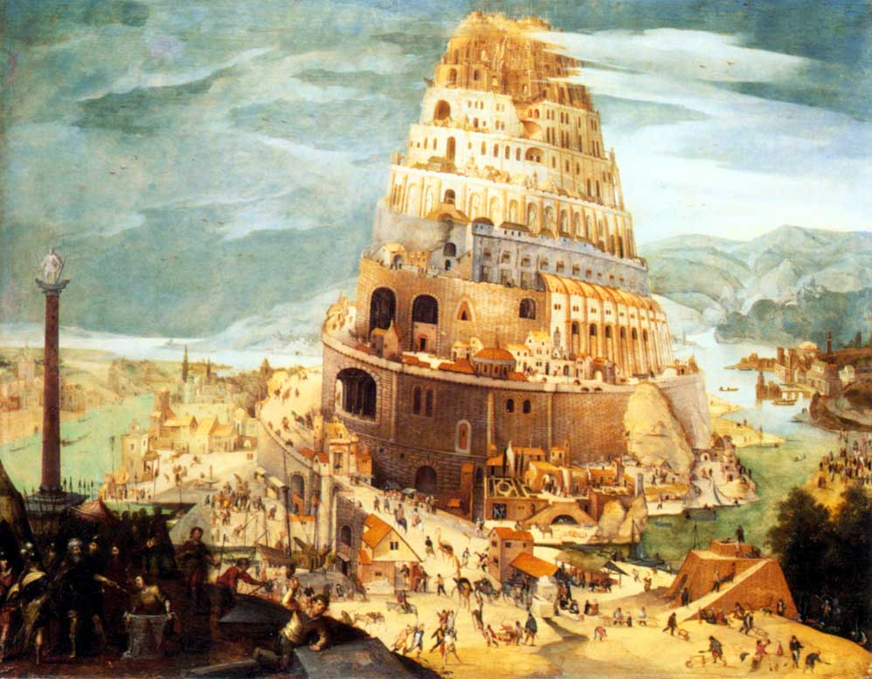
Nimrod in Isaiah 33
“king” – Vv.17, 22 (Gen. 10:10).
“towers” – migdal – V.18 (Gen. 11:4).
“speech” – saphah – V.19 (Gen. 11:1).
“shall…ever be removed” – naca – V.20 – translated “journeyed” Gen. 11:2.

Slide 16
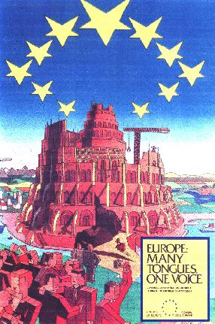
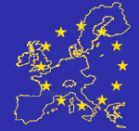
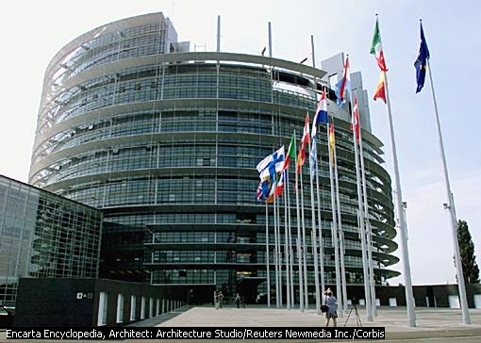
Europe is rebuilding the Tower of Babel
The new European Parliament in Strasbourg, France

Slide 17
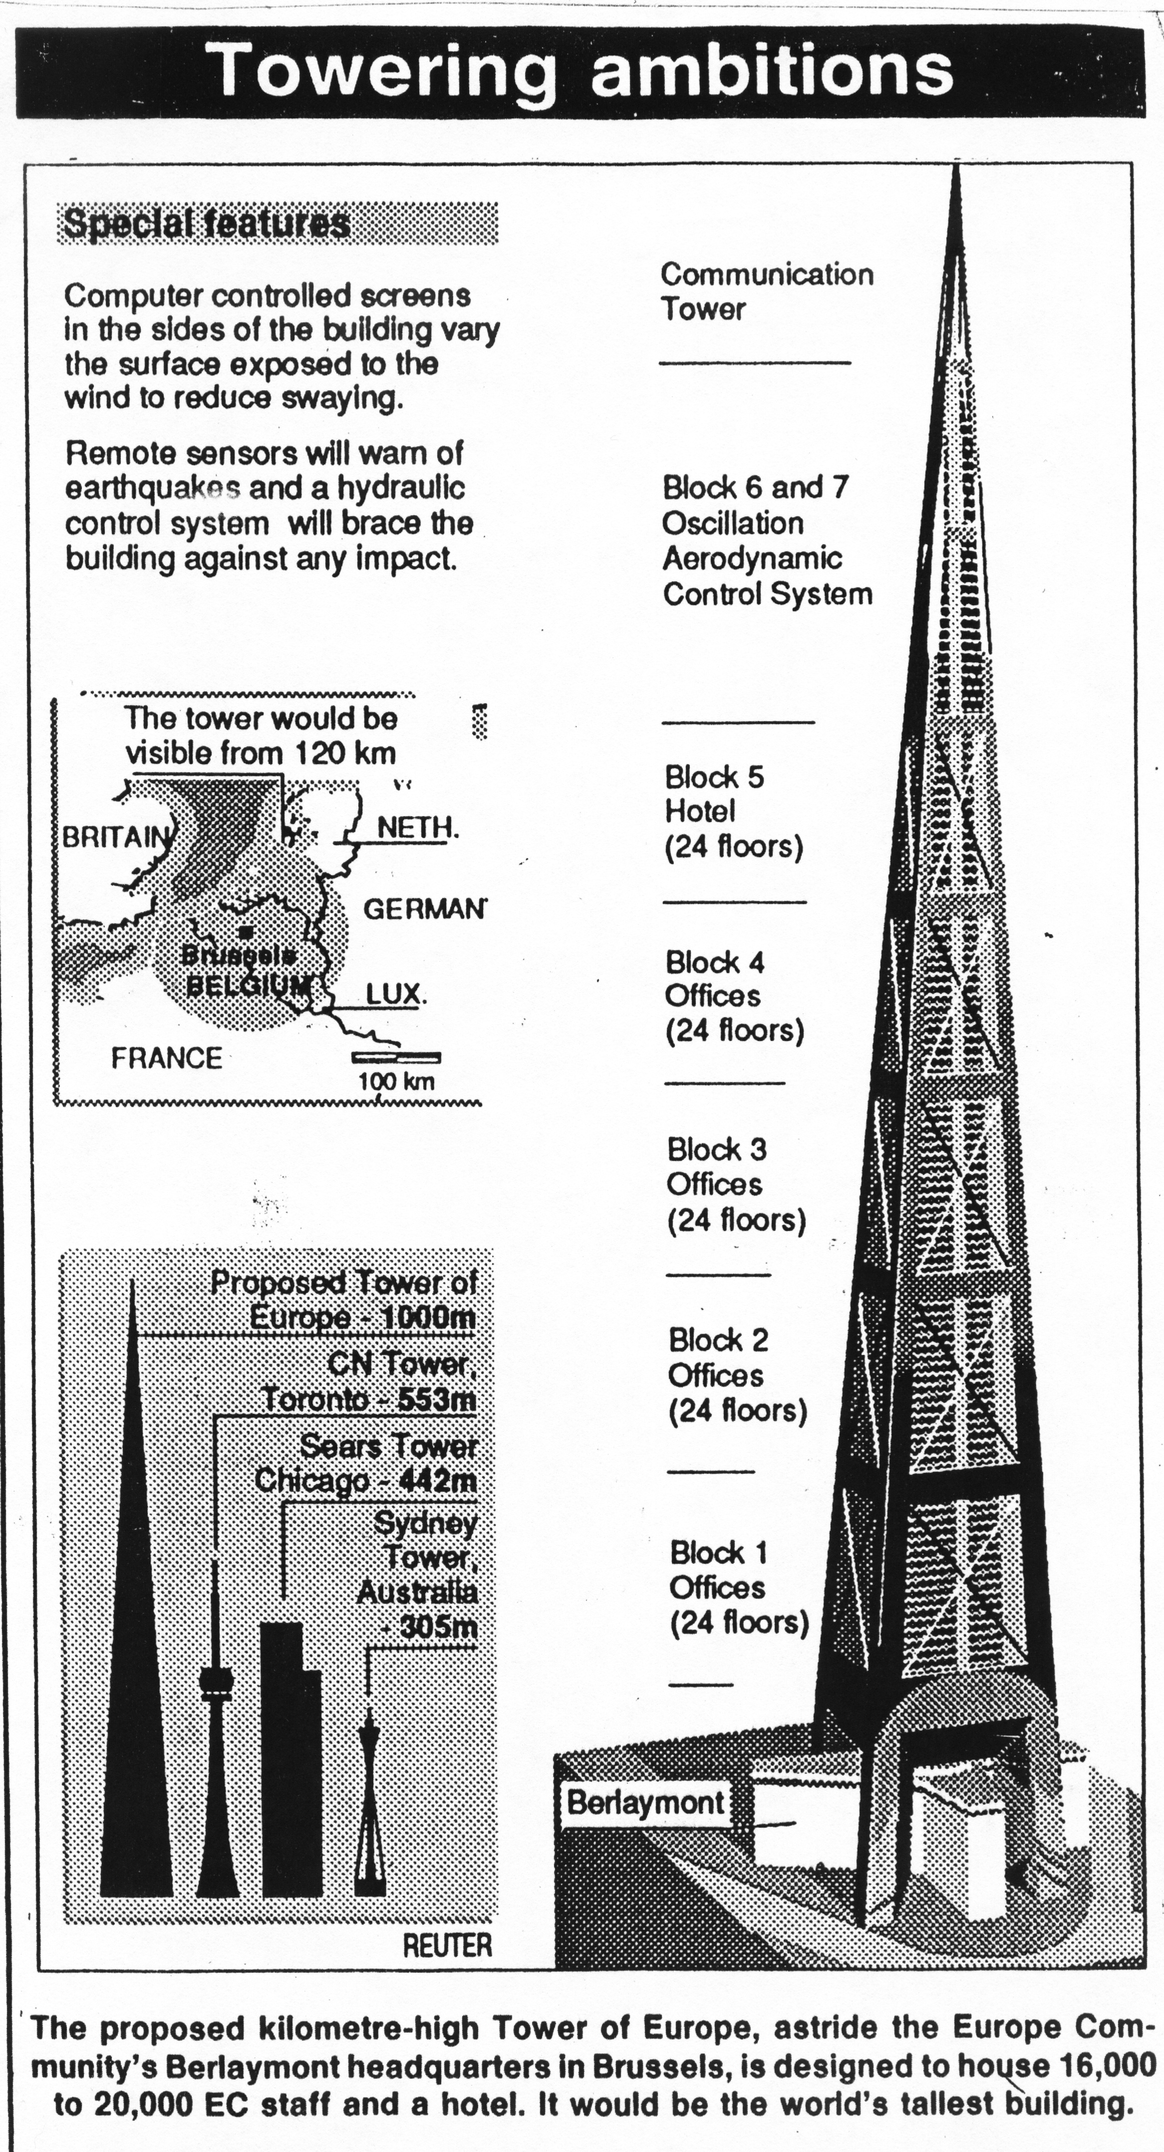
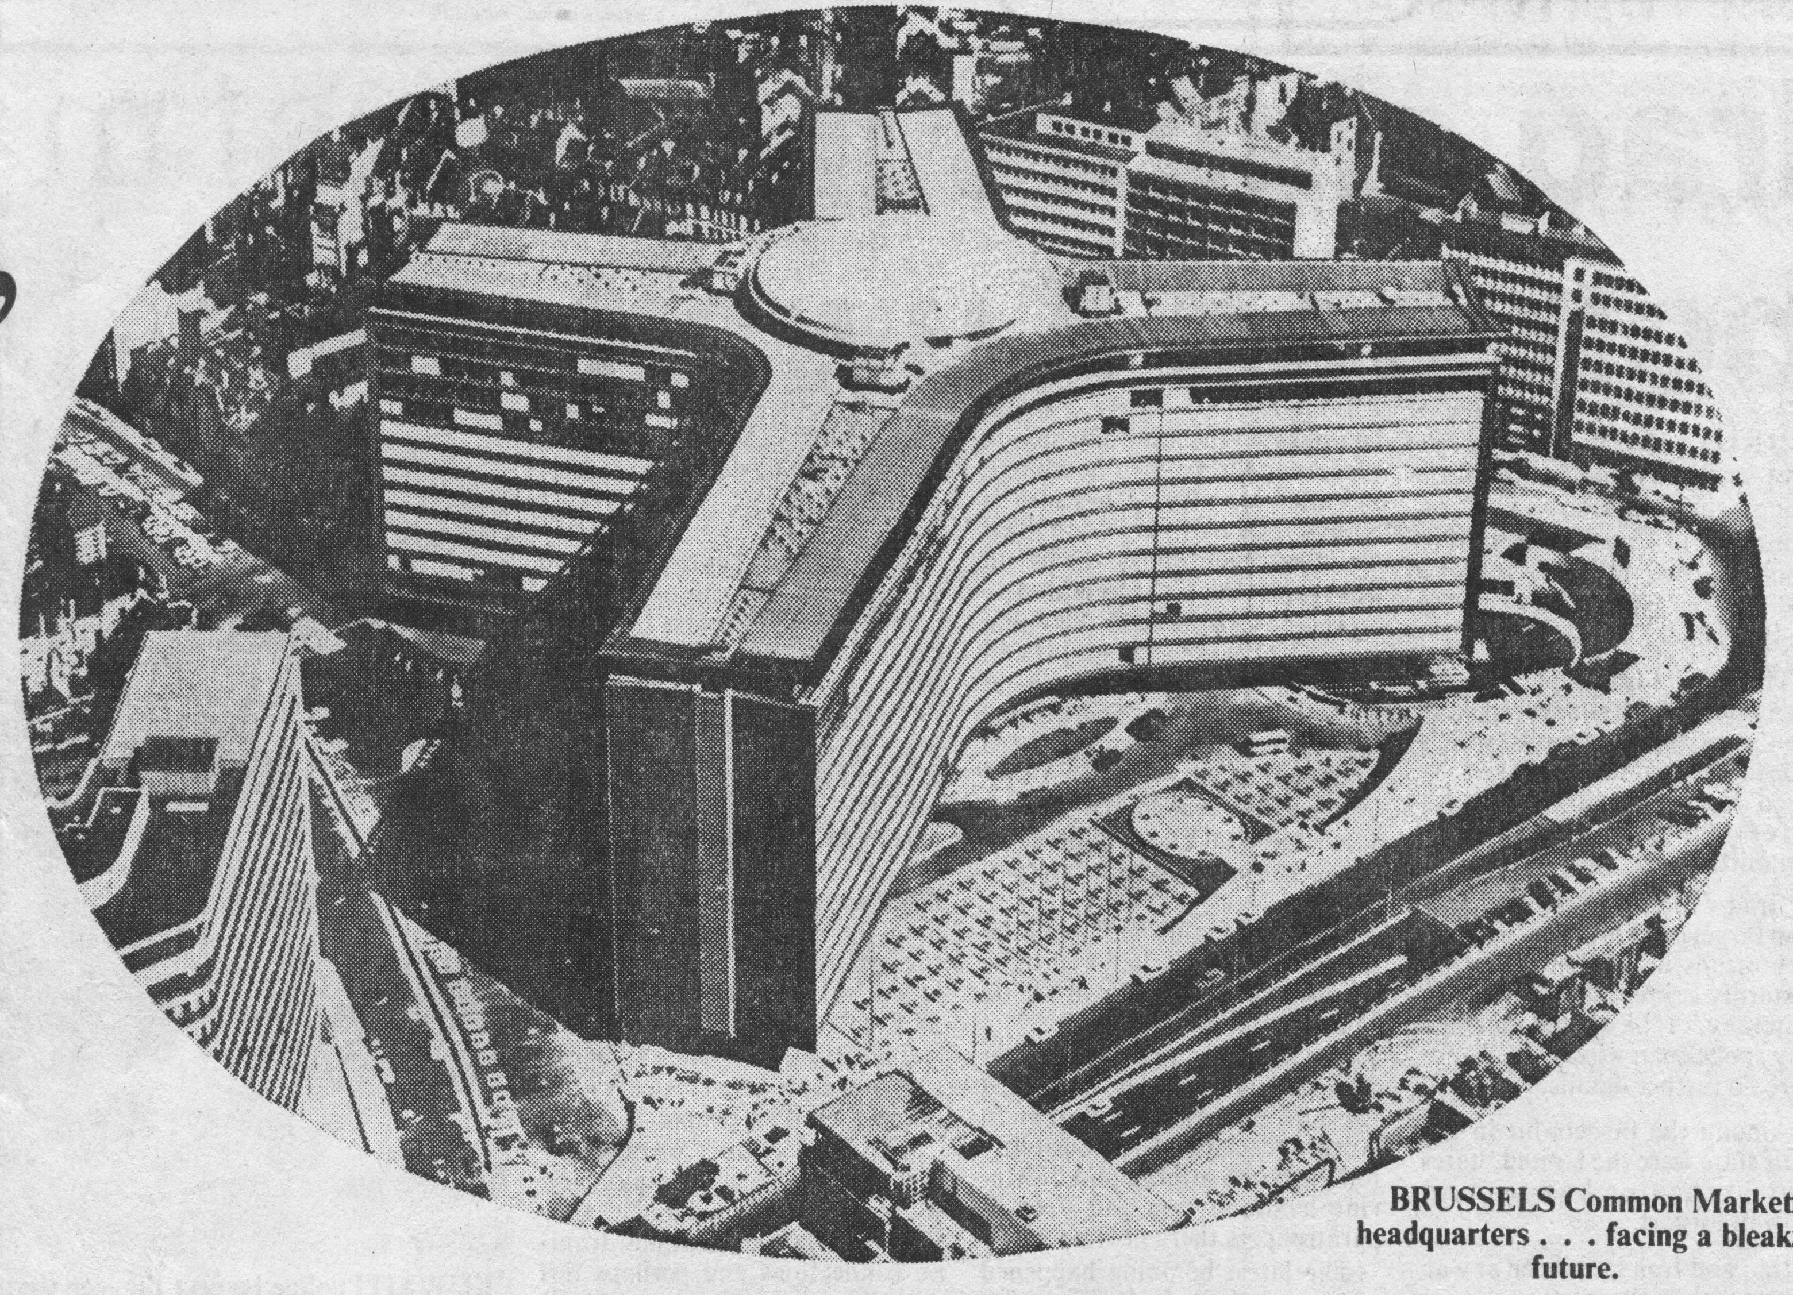
Modern Tower of Babel
Superseded 1990’s plan to build world’s tallest building!
Berlaymont building in Brussels – EU headquarters.

Slide 18
Edom in Isaiah 34
Bro. C. C. Walker in “The Ministry of the Prophets” page 498 writes concerning Isa. 34:
“The opening of this chapter is an emphatic challenge of wide-reaching application, that at once tells us that we must not limit the matter to the times of Isaiah, or a century or two later, nor to a few hundred square miles of territory that properly belong to Edom in his day…”

Slide 19
Edom “the people of my curse”
Isa. 34:5
"curse" - cherem - doomed, devoted to destruction. (The word is next to Hormah in the Dictionary of Biblical Hebrew words).
The word is used of Jericho as a “devoted” city.
Occs. Zech.14:11 – “no more utter destruction”.
It is the last word of the O.T. in the Hebrew.
Used in the context of the Amalekites - 1 Sam.15:21 where “things which should have been utterly destroyed” is all one Hebrew word.
Its root charam occurs 7 times in 1 Sam.15 as “utterly destroy/ed”.

Slide 20
Edom and Bozrah – Typical names
Edom means “red” and is identified with Adam = the flesh in political and religious manifestation.
Bozrah can signify “fortification”, “sheepfold” or “vintage”.
These two names taken together in the appellative sense denote the “blood of the sheepfold” or “vintage”.
The land of Israel is to be a sheepfold for the slaughter of Gog, and thereafter Europe will become a winepress for the destruction of antitypical Edom.

Slide 21
Identification of Latter Day Edom
Isa. 34:9-10
And the streams thereof shall be turned into pitch, and the dust thereof into brimstone, and the land thereof shall become burning pitch.
It shall not be quenched night nor day; the smoke thereof shall go up for ever: from generation to generation it shall lie waste; none shall pass through it for ever and ever.
Rev. 14:10-11
…and he shall be tormented with fire and brimstone in the presence of the holy angels, and in the presence of the Lamb:
And the smoke of their torment ascendeth up for ever and ever: and they have no rest day nor night, who worship the beast and his image, and whosoever receiveth the mark of his name.

Slide 22
Bozrah, Babylon and Rome
Etymologically linked – Bozrah means “sheepfold” or “fortress” – Babylon was in the plain of Dura = “wall”, “rampart” or “dwelling” – Rome in Hebrew (Romiith – has N.V. of 666) = “fortification”.
Bozrah was the capital of Edom just as ‘Babylon the Great’ or Rome is the capital of all nations who oppose Christ – Rev. 14:8; 18:2 (cp. Isa. 34:11).
Thus Edom symbolises all anti-Semitic nations led by Catholicism in the last days.

Slide 23
The Birds and Beasts of Isa. 34
Symbol of nations – Dan. 4:20-22.
Vv.11-15 – Unclean birds and beasts because they represent the Gentiles.
Released from Babylonian control when Rome finally destroyed – V.10.
V.17 – They possess “the land of Idumea” for the ad olahm – the duration of the Millennium.
They are the “them” of Isa. 35:1 for whom the once desolate wilderness of “the land of Idumea” will flourish in the Kingdom.

Slide 24
Genesis in Reverse!
Isa. 34:11-15 – Babylon/Nineveh empty except for wild beasts and unclean birds – no longer ‘hunted’.
Isa. 34:15-17 – The Flood revisited – Every animal with its mate.
Isa. 35:1-7 – The curse of Eden lifted.
Isa. 35:9 – Savagery of the Assyro-Babylonian lion removed.
Isa. 35:10 – A remnant redeemed.

Slide 25
Who among us? – Isa. 33:13-14
Hear, ye that are far off, what I have done; and, ye that are near, acknowledge my might.
The sinners in Zion are afraid; fearfulness hath surprised the hypocrites. Who among us shall dwell with the devouring fire? who among us shall dwell with everlasting burnings?
V.17 – “Thine eyes shall see the king in his beauty: They shall see a land that stretcheth afar.”

Slide 26
Zephaniah
Study 4 (God willing) –
“I will turn to the peoples a pure language”

