Slide 1
Zephaniah
Study 4 – “I will turn to the peoples a pure language”

Slide 2
Analysis of Zephaniah
The prophecy summarised:
1:1-2:3 Hastening judgements upon Judah
2:4-15 Judgement on the nations
3:1-7 The sins of Judah and Jerusalem
3:8-20 A remnant restored and redeemed
Purpose of the prophecy – To encourage a faithful remnant facing rapidly approaching Divine judgement that they might be hid in the day of Yahweh’s anger.

Slide 3
The sins of Judah and Jerusalem
V.2 – 4 elements essential to salvation lacking:
Hearkening to the Word - Motivation
Acceptance of correction - Humility
Trusting in Yahweh - Dependence
Drawing near to God - Relationship
V.3-4 – 4 leadership culprits – princes, judges, prophets and priests.
V.5 – 4 responses of the Divine character.
V.6 – 4 remedies – Eradicate Nimrod!

Slide 4
Summary – Zephaniah 3:8-10
Theme – Israel’s God rises to the prey to reverse Nimrod’s rebellion
V.8 – Nations assembled for Armageddon and subsequent judgements.
V.9 – Nations given a pure religion.
V.10 – Scattered Israel recovered from dispersion.

Slide 5
Contrasts
Nimrod
(Papacy)
Gen. 10:8,9
Gen. 10:10
Gen. 10:9
Gen. 11:4
Gen. 11:9
“confusion”
Gibbor
King
Hunter
Name
Language
Yahweh
(Christ)
Zeph. 3:17
Zeph. 3:15
Zeph. 3:8
Zeph. 3:12,19,20
Zeph. 3:9
“pure”
Latter days

Slide 6
Zephaniah 3:8-9
Therefore, wait for Me - an affirmation of the LORD, For the day of My rising for prey, For My judgment is to gather nations, To assemble kingdoms, To pour out on them Mine indignation, All the heat of Mine anger, For by the fire of My jealousy consumed is all the earth.
For then do I turn unto peoples a pure lip, To call all of them by the name of the LORD, To serve Him with one shoulder.
Young’s Literal (modified)

Slide 7
Zephaniah 3:8
The verse contains every letter of the Hebrew alphabet (22) including the 5 ‘final’ letters.
These 27 letters of the alphabet are used at least once in the verse.
27 = 3 x 9 – or put scripturally – 999.
27 = 10 (“all”) + 17 (10 + 7 = absolute completeness).
Total fullness and finality

Slide 8
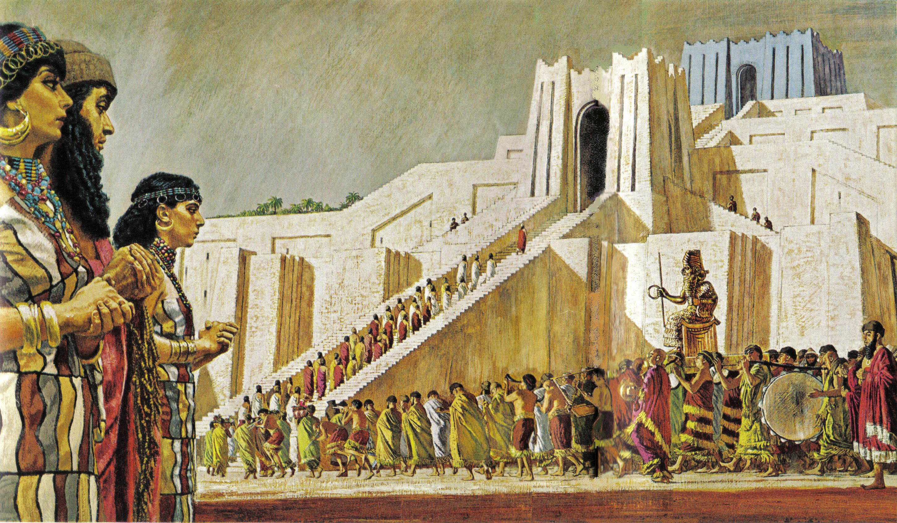
“Your fathers dwelt on the other side of the flood in old time……and they served other gods.” – Josh. 24:2
The ziggurat at Ur – a smaller version of the tower of Babel
So when God called Abram from the heart of Nimrudian apostasy, He began the 5 millennium process of reversing Nimrod’s work.

Slide 9
God’s Purpose with Abraham
“Look unto Abraham your father, and unto Sarah that bare you: for I called him alone, and blessed him, and increased him.” – Isa. 51:2
“And in thy seed shall all the nations of the earth be blessed” – Gen. 22:18

Slide 10
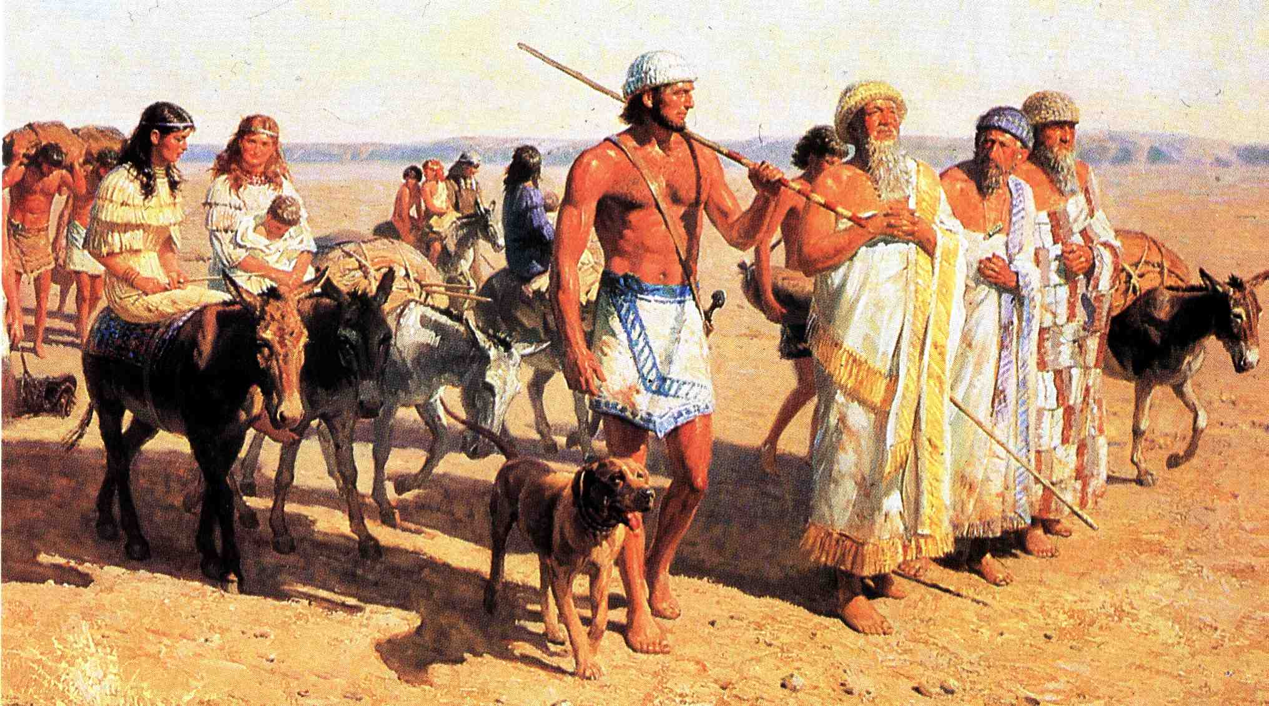
Abram leaves Ur of the Chaldees for Haran and 5 years later, for the Land of Promise – Heb. 11:8

Slide 11
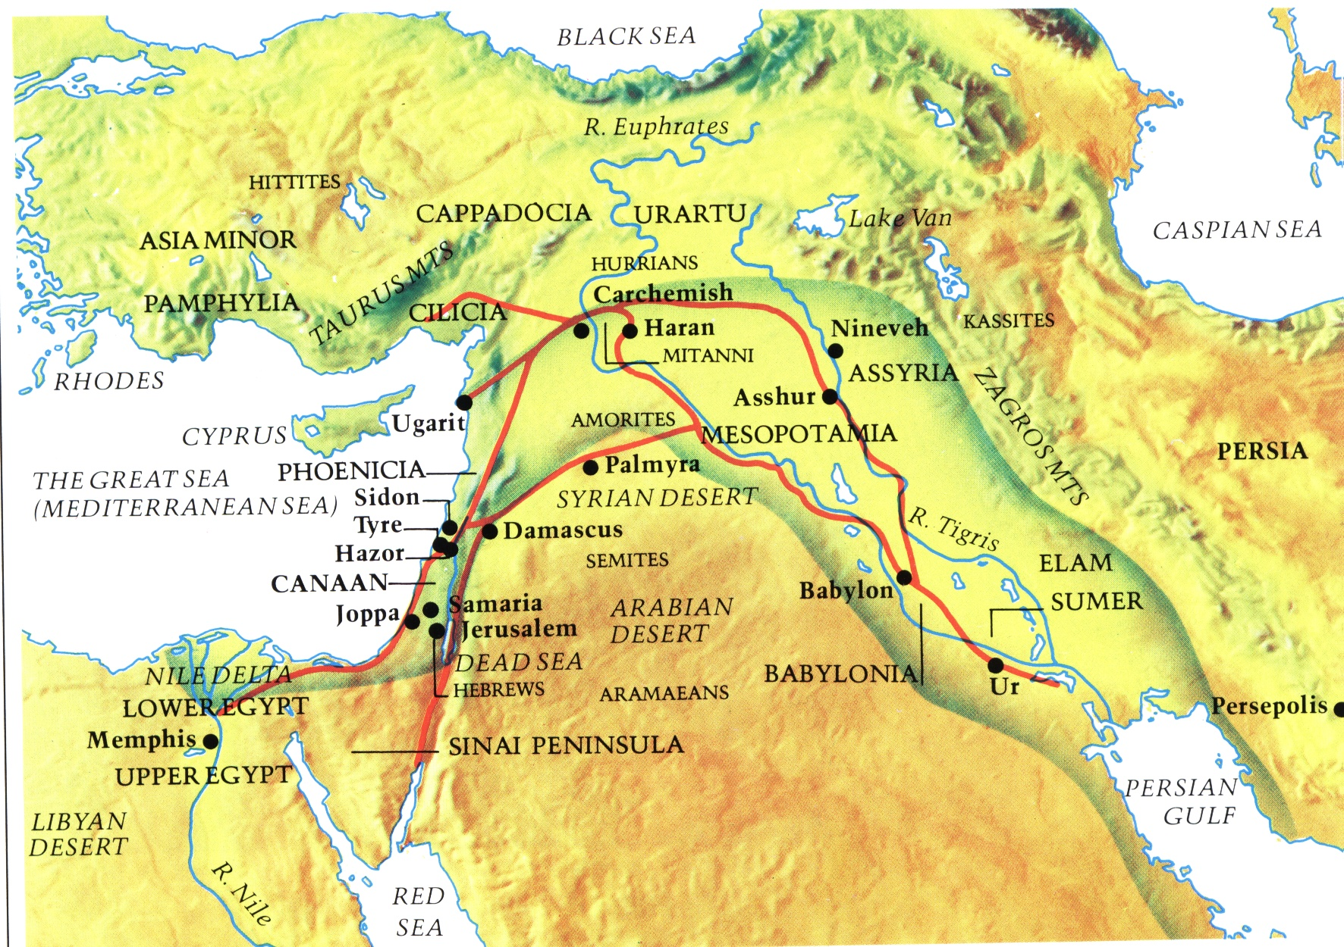
“Get thee out of thy country…”
Abraham brought from beyond the rivers of Cush

Slide 12
God’s Purpose with Israel
“You only have I known of all the families of the earth” – Amos 3:2
“…the people shall dwell alone, and shall not be reckoned among the nations” – Num. 23:9
“And he shall reign over the house of Jacob for ever; and of his kingdom there shall be no end” – Luke 1:33 (Cp. Isa. 9:7 – “increase of his government and peace”)

Slide 13
The 12/70 Principle - Ps. 59:13
“Consume them in wrath, consume them, that they may not be: and let them know that God ruleth in Jacob unto the ends of the earth.”
“And he shall reign over the house of Jacob for ever; and of his kingdom there shall be no end” – Luke 1:33 (Cp. Isa. 9:7) i.e. territorially.

Slide 14
“From beyond the rivers of Cush”
…
The 40 year mission of Elijah
The
Second Exodus
of Israel
Cush
Gen. 2:13-14

Slide 15
The Second Exodus of Israel
40 years under Elijah’s leadership
“the land of the north” (Jer. 3:18)
Elijah’s mission
30 years conflict
Wilderness of the Peoples
(Rev. 17:3)
Baptism
(Isa.
11:11-16)
Rebels purged out
Bonds of the Covenant
Roth. – “and will contend (shaphat – to judge) with you there face to face” – Ezek. 20:35
Ezek. 20:37

Slide 16
The First Promise to Abraham
Gen. 12:1-3
Get thee out of thy country, and from thy kindred, and from thy father's house, unto a land that I will shew thee:
And I will make of thee a great nation, and I will bless thee, and make thy name great; and thou shalt be a blessing:
And I will bless them that bless thee, and curse him that curseth thee: and in thee shall all families of the earth be blessed.
1
2
3
3 primary conditions to be met
1
2
3
4
7 clauses
5
6
7

Slide 17
A Great Nation
“nation/s” – goy / goyim - nation, people (noun masculine).
First occs. Gen. 10:5 - “Gentiles” and “nations”.
Next 4 occs. rendered “nations” – Gen. 10:20, 31, 32 (twice).
The 7th occ. is in Gen. 12:2 – “I will make of thee a great nation.”
This is the first of 7 clauses in the first of 7 promises made to Abraham.
The word “great” is gadol – this is also the 7th occ. in the O.T.

Slide 18
Families
“families” - mishpachah - clan, family, tribe, kind; hence people or nation.
First occ. – Gen. 8:19 – “kinds”.
Next 5 occs. rendered “families” – Gen. 10:5,18,20,31,32.
7th occ. – Gen. 12:3 – “…in thee shall all families of the earth be blessed.”
This is the 7th clause of this first of 7 promises made to Abraham (with 7 clauses).
“blessed” – barak – The 7th occ. in O.T. is Gen. 12:2 – “I will bless thee” – The 10th (= all) is…

Slide 19
Culmination of the 3 Great Covenants
Rev. 20 – Final fulfilment of Gen. 3:15
The Old Serpent bound and finally destroyed
Sin and rebellion eradicated - death abolished
Rev. 21 – Abrahamic Covenant fulfilled
The Holy City (Abrahamic) completed
One nation – Israel – embraces all
Eternal inheritance experienced by all
Rev. 22 – The Promises to David fulfilled
Divine authority over all the earth
David’s throne established forever
The spiritual house of David complete

Slide 20
The Millennium – The Serpent bound
The Jubilee Period
Flesh eradicated
The
Little
Season
1000 year reign of Christ
50 yrs
Flesh bound
Rev.
20:3
Flesh subdued
Flesh unleashed
Mortality abolished from the earth at the end of Millennium

Slide 21
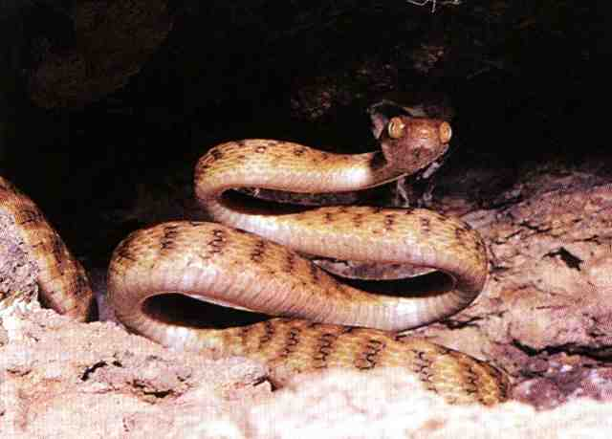
The old Serpent destroyed - Genesis 3:15 fulfilled
“And the earth rested from war”

Slide 22
Israel the only ‘immortal’ nation
Jer. 30:11; 46:28 – “…though I make a full end of all nations whither I have scattered thee, yet will I not make a full end of thee (Israel)….”
Prefigured by the Feast of Tabernacles
Over 7 days 70 bullocks were sacrificed;
Day 1 (13); Day 2 (12) >>>>Day 7 (7) = 70;
Number of the nations in Scripture is 70;
The nations will keep feast of Tabernacles in the Millennium (7th Day) – Zech. 14:16;
On the 8th day just one bullock was offered – represents only one nation after Millennium.

Slide 23
No more sea – Rev. 21:1-8
Rev. 21:1-8 – The time beyond the Millennium.
Hence, “new” heavens and earth (1st past) – V.1.
No “sea” = no more nations (only one).
City adorned as bride – final phase of Ecclesia.
City gates identified with Israel – V.12.
The city is dominated by 12 – 12 gates, 12 foundations, 12 apostles, 12 stones.
The number 12 occurs 12 times (if 144 = 12 x 12 is counted as 2 – V.17).
This city is a corporation of immortal people – the Israel of God in its final manifestation.

Slide 24
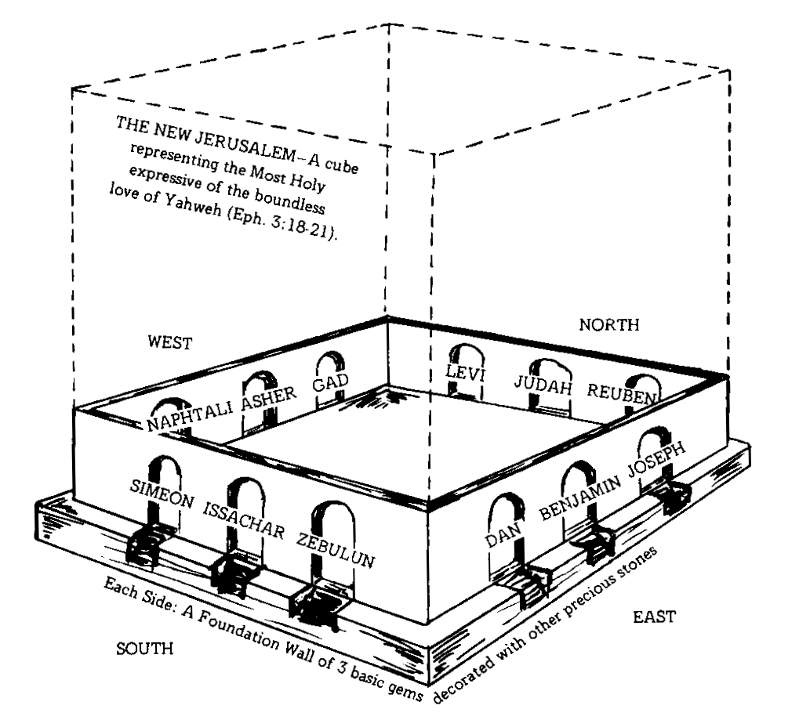
The Holy City – New Jerusalem
12,000 furlongs = 2,400 kms
12 = Israel; 1,000 = family, hence the whole family of Israel
A perfect cube – the Most Holy = all immortal because of the love of God – Eph. 3:18-21
Eph. 3:19 - May be able to comprehend with all saints what is the breadth, and length, and depth, and height;
And to know the love of Christ, which passeth knowledge, that ye might be filled with all the fulness of God.

Slide 25
The Holy City a Great Nation
“city” occurs 12 times in Rev. 21 & 22.
This is the Abrahamic “city” – Heb. 11:10,16; 12:22-23.
The “holy city”is styled by Bro. Thomas, “The New Jerusalem body politic” and “the holy Jerusalem association of saints”.
“It is the Yahweh-Elohistic municipality, symbolized by one hundred and forty-four cubits, each cubit representing one thousand of the numerical symbol of this “Holy Nation,” the Israel of the Deity.”
Eureka Vol. 1 pg. 115
“City” and “nation” are equivalent terms – a corporation of people

Slide 26
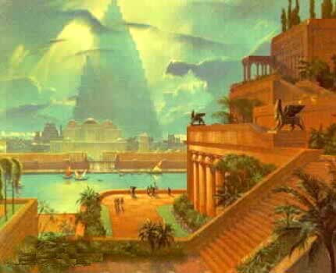
A tale of two Cities
Enoch (Cain)
Erech (Nimrod)
Babylon (Nimrod)
“God is not ashamed to be called their God: for he hath prepared for them a city.” – Heb. 11:16

Slide 27
The rebellion of Nimrod reversed
“One language” (saphah – 1st occ. Gen. 11:1 = religion) – Restored - Zeph. 3:9.
All nations (70) incorporated into one – Israel.
All families of the earth blessed in Abraham and his seed.
One city (a great nation) remains in which all are immortal – the perfected Bride of Christ.
Sin and death abolished – God dwells with men – Rev. 21:3.
“We will rebel” never heard on earth again.

Slide 28
Zephaniah
Study 5 (God willing) –
“I will save her that halteth”

