Slide 1
Zephaniah
Study 5 – “I will save her that halteth”

Slide 2
Analysis of Zephaniah
The prophecy summarised:
1:1-2:3 Hastening judgements upon Judah
2:4-15 Judgement on the nations
3:1-7 The sins of Judah and Jerusalem
3:8-20 A remnant restored and redeemed
Purpose of the prophecy – To encourage a faithful remnant facing rapidly approaching Divine judgement that they might be hid in the day of Yahweh’s anger.
Based on the call of Abram and his arrival in the Land – Gen. 12:6-8

Slide 3
Summary – Zephaniah 3:8-20
Theme – A Remnant Restored and Redeemed
V.8 – Nations assembled for Armageddon and subsequent judgements.
V.9 – Nations given a pure religion.
V.10 – Scattered Israel recovered from dispersion.
V.11-13 – Ungodliness removed from Jacob – A remnant redeemed.
V.14-17 – Israel saved by a rejoicing warrior-king.
V.18-20 – Limping Israel redeemed and made the head and praise of all nations.

Slide 4
The Deliverance of Jacob
There are two stages to the deliverance of Jacob:
Christ will “save the tents of Judah” first immediately after Armageddon – Zech. 12.
Elijah will lead the Second Exodus for 40 years to recover all Jews outside the Land – Ezek. 20.
Stage 1
Judah saved
Armageddon
Stage 2
The Second Exodus of Israel
40 years

Slide 6
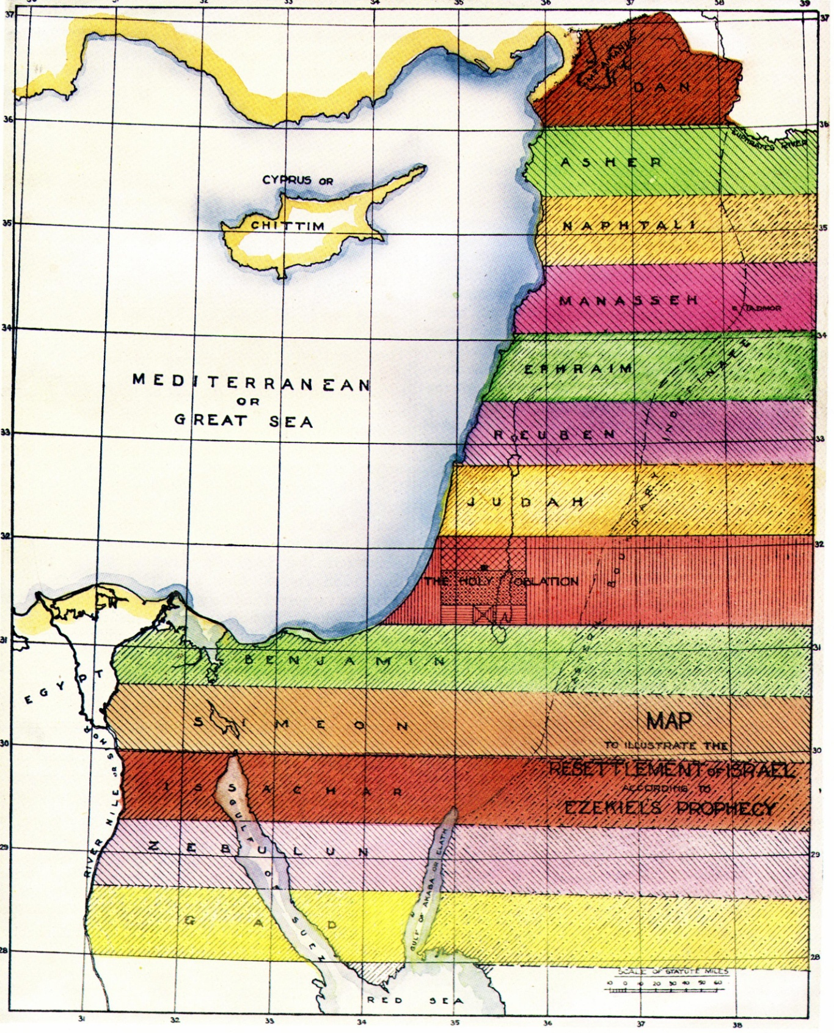
The Second Exodus of Israel
Across 'the River'
Elijah returns with the purified remnant of scattered Jewry
All nations submit to Christ’s rule
All nations submit
to Christ’s rule
15
14
Across tongue of the Egyptian Sea
“He shall have dominion also from
sea to sea, and from the river unto
the ends of the earth.” Ps.72:8

Slide 7
Contrasts
Nimrod
(Papacy)
Gen. 10:8,9
Gen. 10:10
Gen. 10:9
Gen. 11:4
Gen. 11:9
“confusion”
Gibbor
King
Hunter
Name
Language
Yahweh
(Christ)
Zeph. 3:17
Zeph. 3:15
Zeph. 3:8
Zeph. 3:12,19,20
Zeph. 3:9
“pure”

Slide 8
A Name
The Hebrew word shem occurs 5 times in book – 1:4; 3:9,12,19,20.
Nimrod’s rebellion began with the words, “let us make us a name (shem)”.
When God has reversed Nimrod’s rebellion:
V.9 – All peoples will call on His name (shem).
V.12 – The remnant of Israel will trust in His name.
V.19-20 – Israel will be given a name among all nations.

Slide 9
“In the midst of thee”
Prominent theme – Vv. 11,12,15,17.
The Song of Israel’s Redeemed Remnant – Isa. 12:5-6
“Sing unto the LORD; for he hath done excellent things: this is known in all the earth.
Cry out and shout, thou inhabitant of Zion: for great is the Holy One of Israel in the midst of thee.”

Slide 10
Silent in His love – Zeph. 3:17
“mighty” – gibbor – powerful warrior. 1st occ. is Gen. 6:4; 2nd of Nimrod Gen. 10:8.
Nimrod hunted and killed – Israel’s God calls and saves!
“rejoice” – sus – a cheerful, enthusiastic full joy.
“rest” – charash – to be silent.
Roth. – “Yahweh, thy God, in the midst of thee, as a mighty one, will save,—will be glad over thee with rejoicing, will be silent in his love, will exult over thee with shouts of triumph.”

Slide 11
The time of Jacob’s trouble
Jer. 30:1-11 – God’s promise to redeem Jacob from all his enemies and give him peace in the Land of promise.
Gen. 32:13-32 – The longest night of Jacob’s life – meticulous preparation to meet Esau – but God intervened to teach Jacob the greatest lesson of his life.
“For the LORD hath redeemed Jacob, and ransomed him from the hand of him that was stronger than he.” – Jer. 31:11

Slide 12
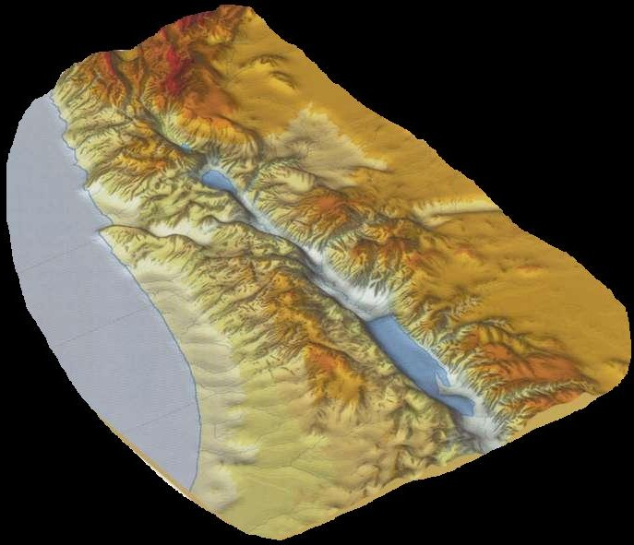
… ….
Jacob Returns to the Land – Basis of Jeremiah’s dream
Jacob journeys in haste from Haran
An angel wrestles with him at Jabbok
Confrontation with Laban at Galeed
Jacob halts upon his thigh unable to save himself from Esau
Esau comes from Edom with 400 men

Slide 13
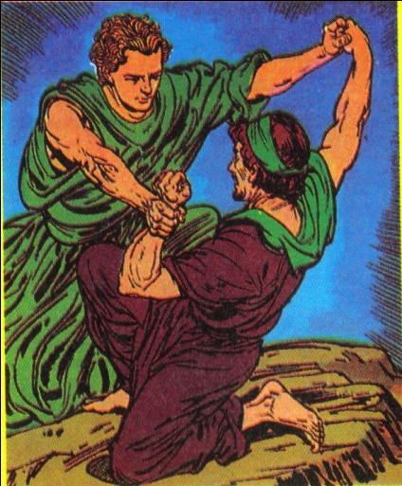
God’s Method – Gen. 32:24-32
“left alone” – This is when our relationship with God is tested – Jacob sought the angels (V.1).
“there wrestled a man with him” – This was an angel (Hos. 12:4). God initiated the struggle. His method is to use the circumstances of human life to test and purge His servants.
Why “a man” and not “an angel”?

Slide 14
God’s Method – Gen. 32:24-32
“thigh…out of joint” – Strongest part of body dislocated – Lesson - no confidence in flesh – hence V. 32.
Named changed to Israel, but not until Gen. 35:21 after Rachel (the Syrian) had died.
Peniel (“I have seen God”) – 1st person singular – Jacob’s lesson.
Penuel (“they have seen God”) – 3rd person plural – Lesson for all.

Slide 15
The sinew that shrank Gen. 32:32
“sinew” – The sinew or tendon which holds the hip bone in its socket.
Thigh is strongest part of body = The strength of man.
Lesson – Israel’s ‘family builders’ do not put any trust in human strength.

Slide 16
“He halted upon his thigh”
Gen. 32:25 – “out of joint” – yaqa – dislocated.
“The sciatic nerve, the longest in the human body, runs from the lower back through the pelvic region and down the
back of the leg. To relieve the pain, sufferers often walk by bending the affected leg at the knee and rotating it outwards.” (Encarta)

Slide 17
“I will save her that halteth” Mic. 4:6-7; Zeph. 3:19
“Sciatica sometimes occurs during pregnancy when the sciatic nerve is pinched between the head of the foetus and the pelvic wall.” (Encarta)
Sciatic pain is the closest thing a man can experience to the pain of childbirth – Jer. 30:6-7.
“Ask ye now, and see whether a man doth travail with child?

Slide 18
Jacob Redeemed - Ezek. 39:25-28
Therefore thus saith the Lord GOD; Now will I bring again the captivity of Jacob, and have mercy upon the whole house of Israel, and will be jealous for my holy name;
After that they have borne their shame, and all their trespasses whereby they have trespassed against me, when they dwelt safely in their land, and none made them afraid.

Slide 19
Israel – Their own Messiah
“Not until they came to perceive, beginning in the 1860's, that they would have to act as their own Messiah did the return to Israel actually become realizable...” – ‘Bible and Sword’ - Barbara Tuchman.
“The Jewish people must be their own Messiah”, wrote the historian Heinrich Graetz in 1864.
Asked if the Jews still awaited Messiah, Rabbi Abrahams said in Jerusalem in the early 1970s; “We are the Messiah”.
Like Uzziah their highly successful and blessed king who grasped the dual role of king-priest thinking he was Messiah – hence Zech. 14:5; 12:12-14; 13:1

Slide 20
Jacob Redeemed – Ezek. 39:25-28
When I have brought them again from the people, and gathered them out of their enemies’ lands, and am sanctified in them in the sight of many nations;
Then shall they know that I am the LORD their God, which caused them to be led into captivity among the heathen: but I have gathered them unto their own land, and have left none of them any more there.

Slide 21
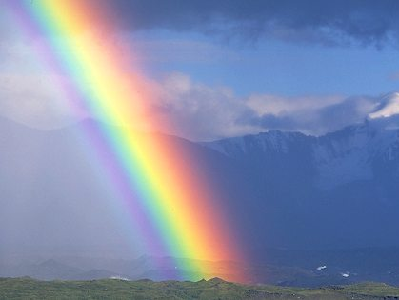
The Great Day is Near
To completely reverse the effects of Nimrod’s rebellion
“Even so, come, Lord Jesus.”

