Slide 1
The sure mercies of David
Study 1 – “A man after God’s own heart”

Slide 2
The purpose of this study
The three covenants of promise are fundamental to our faith – make us unique and very blessed!
Gen. 3:15 – Promise of redemption
Gen. 12-22 – Promise of inheritance
2 Sam. 7 – Promise of authority
The 3 great covenants are intertwined and inter-dependent – revealed by stages.
The last 3 chapters of Scripture reveal the final and ultimate fulfilment of each.

Slide 3
The Kingdom of God in the past
Proclaimed by God at Mt. Sinai - Ex. 19:5-6.
God himself was Israel’s king - 1 Sam. 8:6-7.
Israel were the subjects of the Kingdom - Deut. 7:1,6.
The Land of Canaan was the territory of the Kingdom - Ex. 3:17; Lev. 25:23.
Anointed kings sat on God’s throne - 1 Chron. 28:5; 29:23.
Through disobedience the throne of David was overturned - Ezek. 21:25-27.

Slide 4
So why did God give the promise to David?
1 Sam. 13:14 – On the rejection of Saul:
“But now thy kingdom shall not continue: the LORD hath sought him a man after his own heart, and the LORD hath commanded him to be captain over his people, because thou hast not kept that which the LORD commanded thee.”
Paul’s commentary – Acts 13:20-23.

Slide 5
A man after God’s own heart
In Acts 13:22 Paul cites not only 1 Sam. 13:14 but Ps. 89:20.
In V.34 he cites Isa. 55:3.
Ps. 89 is a Maschil (to give instruction) of Ethan (“permanent”) the Ezrahite (noted for wisdom – 1 Kings 4:31) - brother of Heman (1 Chron. 2:6).
Set over the singing in the Tabernacle of David – 1 Chron. 6:31-32,44.
Isa. 55 is a call to all to become children of Zion.

Slide 6
Psalm 89
V.1-2 are elaborated in V.5-18.
V.3-4 are elaborated in V.19-37.
Translation by Bro. Thomas of V.2-4:
“A Hidden Period of mercy shall be builded; thy faithfulness in them, the heavens, thou wilt establish. I have devised a covenant for my chosen one; I have sworn to David my servant, saying, during a hidden period I will establish thy seed; and I will build thy throne for a generation of the race.”
Eureka vol. 2 pg. 29

Slide 7
The honour of kings
Ps. 89:5-7 – The incomparable power and wisdom of Yahweh is revealed in part by His covenant to a certain class.
Ps. 25:14 – “The secret of the LORD is with them that fear him; and he will shew them his covenant.”
V.7 – “assembly” – sod – a circle of friends (gathering in secret to share secrets); counsel, assembly.
“saints” – qadosh – sacred, holy.
“about” – sabiyb – circle, round about.

Slide 8
David found among holy ones
Ps. 89:19 – “holy one” – chasiyd - kind, faithful, godly, holy one, saint, pious.
Roth. – “Then spakest thou in vision of thy men of lovingkindness.”
V.20 – Cited Acts 13:22.
V.20-29 – David is presented as type and forerunner of Christ – God’s firstborn.
Davidic Covenant language dominates the context to V.37.
V.27 – “higher” – elyon – Divine title first used Gen. 14:18 – Bro. Thomas – “the most high to the kings of the earth.”

Slide 9
Summary of Ps. 89
Summation – Ps. 89 is about the certainty of the fulfilment of the covenant made to David which relies on resurrection from the dead, hence
The sure mercies of David
Isa. 55:3

Slide 10
The sure mercies of David
Acts 13:34 - And as concerning that he raised him up from the dead, now no more to return to corruption, he said on this wise, I will give you the sure mercies of David.
Paul cites Isa. 55:3 at Antioch to prove Christ was raised from the dead and immortalised.
The Servant Prophecies revolve around the Abrahamic Covenant – Isa. 51:1-3.
Isa. 55 refers to the Davidic and Edenic.

Slide 11
The Servant Prophecies
Isa. 53 – Yahweh’s suffering servant redeems a seed.
Isa. 54 – Zion’s numerous children all taught of God.
Isa. 55 – The call of the Gospel to Jew and Gentile.
V.1-5 – The invitation of the Gospel.
V.6-7 – A second call to the lawless.
V.8-11 – The transcendence and power of the Word.

Slide 12
The Servant Prophecies
Isa. 55 - V.12-13 - The ultimate product of the Word.
Isa.56 - The response of Jew and Gentile.
Isa. 53:11 is the last of 20 occurrences of “servant” in the singular from chap. 40. From Isa. 54 to 66 the remaining 11 occurrences are in the plural – “servants”.

Slide 13
“A Nation” - Isa.55:5
Context – Inclusion of Gentiles
Isa. 54:1-5 – “God of the whole earth”;
Isa. 55:1 – “every one”; V.4 – “peoples”; Isa. 56:3-8 – “stranger”, “all peoples”, “others”.
Isa. 65:1-2 - Paul cites verse 1a in Rom. 10:20 in reference to the Gentiles, and verse 2a in Rom. 10:21 in reference to the Jews. The balance of verse 1 confirms that the phrase “a nation” refers to the Gentiles.

Slide 14
Matt. 21:43
Isa. 65:2-7 – The nation of Israel under law but apostate.
Isa. 65:8-10 – A remnant and Redeemer out of Israel.
Isa. 65:11-16 – Israel punished and the true ecclesia (Jew and Gentile) formed.
“The kingdom of God shall be taken from you (the Jews) and given to a nation (the true ecclesia, including the Gentiles) bringing forth the fruits thereof.”

Slide 15
Hearing Intelligently – Isa. 55:1-3
“no money (silver)” = No ‘redemption’.
“buy” – shabar – buy, purchase grain (parent noun is sheber – grain). Roth. – “buy grain”.
Cost is self-sacrifice, not cash!
“hearken diligently” – shama shama. Heb. shama – to hear intelligently (duplicated for emphasis).
Deut. 6:4 – “Hear (shama), O Israel”.

Slide 16
Hearing Intelligently – Isa. 55:1-3
Hebrew structure - Infinitive after finite verb – Hence; Roth. – “…keep on hearkening. And, so eat that which is good, and let your soul take exquisite delight in fatness”.
Roth. – “Incline your ear, and come unto me, Hearken, That your soul, may live”.
Connection between grain and hearing - Mark 4:23-29.

Slide 17
Christ a witness to Gentiles Isa. 55:4-5
Lo! As a witness to the peoples, have I given him, — As a leader and commander to the peoples:
Lo! A nation thou shalt not know, shalt thou call, And, a nation which hath not known thee, unto thee, shall run,—For the sake of Yahweh thy God, And for the Holy One of Israel, because he hath adorned thee.
Rotherham

Slide 18
Second call to the lawless Isa. 55:6-7
V.6 – Roth. (Mgn.) - “…while he letteth himself be found”.
V.7 – “wicked” – rasha – morally wrong. Roth. “lawless”.
“unrighteous” – aven – to exert oneself in vain; to come to nought, nothingness.
“let him return” – shub – to turn back. Suggests a former servant.
“thoughts” – machashabah - thought, plan, intention. Occurs 5 times in chap. (grace).
“abundantly” – rabah – increase, multiply.

Slide 19
Thoughts and Ways Isa. 55:8-11
RAIN
Cause
Thoughts
Motivation
Given by God
Returns fulfilled
BREAD
Effect
Ways
Product
Seed – continuation (others)
Bread – sustenance (self)

Slide 20
The Edenic curse lifted Isa. 55:12-13
The Ultimate Product of the Word
Gen. 3:18 – “Thorns also and thistles shall it bring forth to thee; and thou shalt eat the herb of the field”.

Slide 21
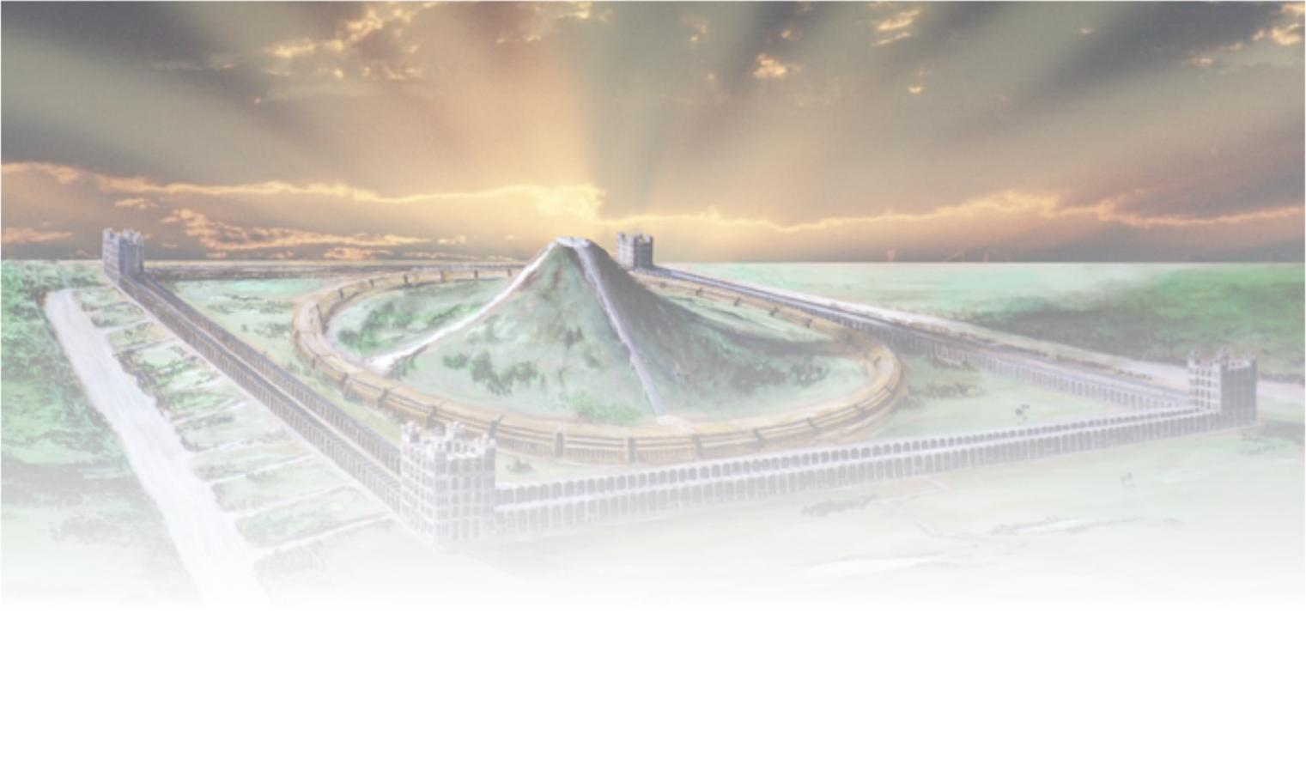
The sure mercies of David
Next study –
“Bringing the Ark to Zion”

Slide 22
...

