Slide 1
The sure mercies of David
Study 2 – “Bringing the Ark to Zion”

Slide 2
Why did David bring the Ark to Zion?
Why did David place the Ark in a separate tent to the Tabernacle of Moses?
The Mosaic Tabernacle was at Gibeon in the days of David - 1 Chron. 16:39; 21:29.
The Altar of Sacrifice was at Gibeon - 1 Kings 3:4.
David set up his own tent in Jerusalem to house the Ark - 2 Sam. 6:17; 1 Chron. 15:1-3; 16:1.

Slide 3
David by-passes Gibeon
2 Chron. 1:3-4 – The Tabernacle of Moses was at Gibeon.
2 Sam. 6:10-12,17 – The Ark brought from Kirjath-jearim to Jerusalem.
Gibeon

Slide 4
David’s audacious actions
David acted as a priest when the Ark came to Jerusalem - 2 Sam. 6:14,18-19; 1 Chron. 16:2-3.
Like Melchizedek, David distributed bread and wine to the people when the Ark was brought into his tent - 2 Sam. 6:19; 1 Chron. 16:3.
David appointed Levites to minister in the worship conducted at his Tabernacle - 1 Chron. 16:4-6.

Slide 5
David knew the place of sacrifice
David offered sacrifices before the tent he had set up for the Ark – 2 Sam. 6:18; 1 Chron. 16:2.
The Reasons
David knew the centre of divine government, and universal worship in the future would be in Jerusalem.
David emulated the Melchizedek King-Priesthood which preceded and was superior to the Mosaic Order.
Hence the 6 steps of 2 Sam. 6:13

Slide 6
The Tabernacle of David
David knew that the redemptive work of God's son for all men would be accomplished at Jerusalem.
David was determined to include all believing Gentiles who might have been excluded by the Mosaic system (e.g. uncircumcised Philistines - 2 Sam. 15:18-22 (cp. 18:1-2 & Zeph. 2:5).
He knew this in part from his study of Gen. 14 & 22. See 1 Sam. 17:54; Ps. 8; Ps. 132:6.

Slide 7
Genesis 14
The first cameo of the Kingdom
V.1 A northern confederacy forms – “In the days of these kings” - Dan. 2:44.
V.2-7 Northern confederacy invades the Land - Gog foreshadowed.
V.8-12 Southern confederacy defeated - Lot and family taken captive.
V.13-16 Abraham united with Jew and Gentile defeats invader - Rescues Lot.
V.17-20 Abraham meets Melchizedek king of Salem – Fellowship.
V.21-24 Abraham repudiates the king of Sodom’s offer of wealth.

Slide 8
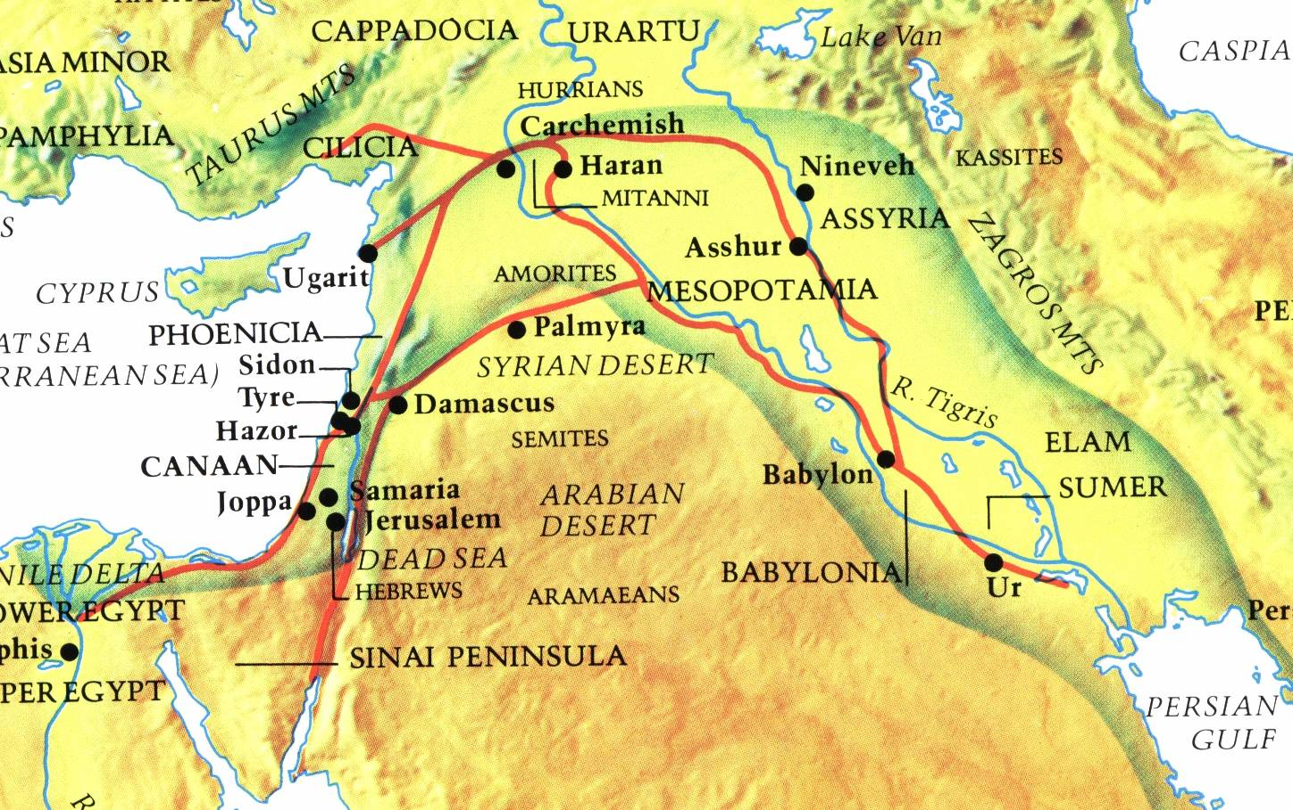
The Northern Confederacy
This is the territory of the Biblical “king of the north” – Dan.11:40

Slide 9
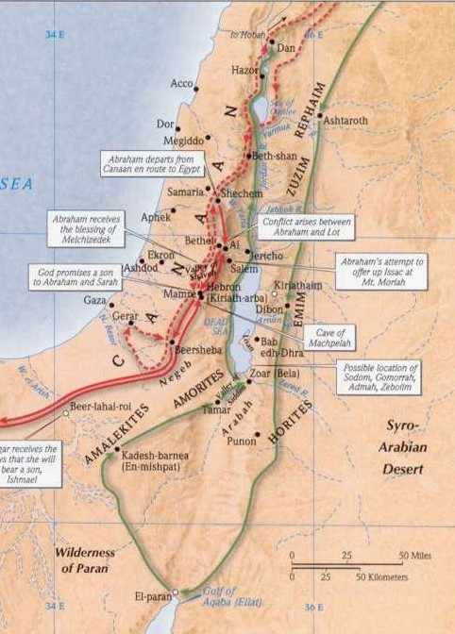
The battle of the kings
Gen. 14
Invasion by a northern confederacy on a southern confederacy. There are 4 ‘kings’ in the northern confederacy.
The sure mercies of David

Slide 10
The Main Characters as Types
Chedorlaomer and kings – Gog and confederates.
Lot (“veiled”) and family – Israel after the flesh in blindness.
King of Sodom – Corrupt, effete and prosperous anti-Gog powers.
Abram and servants – Christ and saints in warlike manifestation.
Melchizedek – Christ as King Priest in the Kingdom Age.
The sure mercies of David

Slide 11
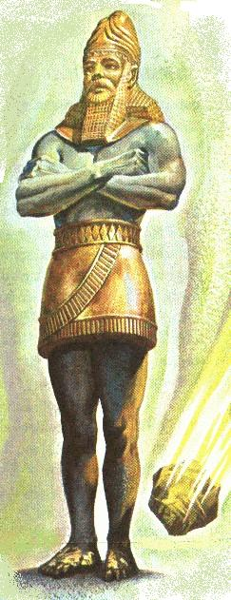
Nebuchadnezzar’s Image
Amraphel king of Shinar
Babylonian Empire
BC 606-539
Gold
Medo-Persian Empire
BC 539-334
Silver
4 empires of the kingdom of men
Grecian Empire
BC 334-67
Brass
Roman Empire
BC 67-AD 476
Iron
Dan. 2:44 - “And in the days of these kings...”
Iron & clay
Modern
Europe
The sure mercies of David

Slide 12
Armageddon Foreshadowed
A northern confederacy led by Chedorlaomer = “a handful of sheaves”, associated with Amraphel (“Powerful people”) the king of Babylon, invades the Land and takes Abraham’s brethren captive.
Armageddon = “a heap of sheaves in a valley for judgement” precipitated by Gog, leader of a confederacy of nations, in alliance with Babylon the Great (Rome), coming down upon the mountains of Israel.
Like Chedorlaomer, Gog is victorious and carries away many of the Jews into captivity along with the spoils of war.
The sure mercies of David

Slide 13
Abraham’s Army
V.13 - Gentiles in covenant with Abraham
- Mamre – “strength” or “fatness”
- Eshcol – “cluster of grapes”
- Aner – “waterfall”
- Lit. “brother Eshcol and brother Aner”.
- “confederate” – baalim berith – owners of a covenant.
V.14 – 318 - “trained servants, born..own house”
“trained” – chaniyk – initiated, i.e. practised.
Ges. – skilled, of tried fidelity. The root chanak – to narrow; to initiate or discipline.
Typify Jew and Gentile in Christ’s immortal army.
The sure mercies of David

Slide 14
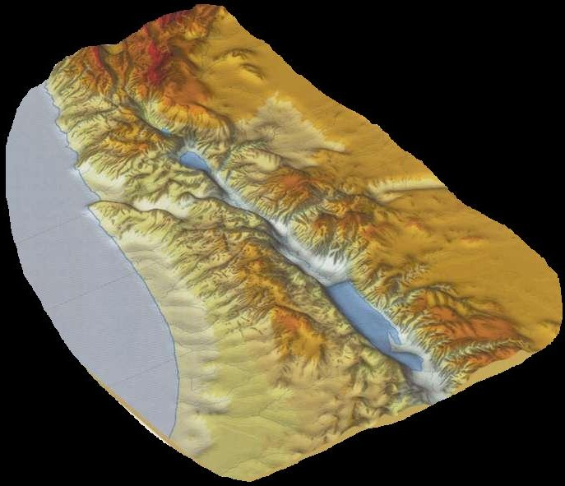
Abram defeats a northern confederacy
Genesis 14
Dan =
Judgement
Dan
Abraham meets Melchizedek – King-priest of Salem – Ps. 76:2
Valleys
Salem
Hebron
Armageddon precedes the setting up
of the Kingdom of God
Chedorlaomer = “A handful of sheaves”
Northern confederacy takes Lot and his family into captivity – Zech. 14:2

Slide 15
Stephen’s revelation of David’s mission – Acts 7:44-46
V.44 – The Tabernacle of Moses made for Israel.
V.45 – Tabernacle of Moses brought into “the possession of the Gentiles” by Joshua.
Gentiles driven out by God for 500 years.
“unto the days of David” – What changed?
David converted Gentiles instead of killing them!
Why did David find favour with God?
Because of “the tabernacle of David”

Slide 16
The Jerusalem Conference
Acts 15:12-19
The term “Gentiles” occurs 7 times in context.
James’ astonishing citation of Amos 9:11-15 – context of the Kingdom.
Amos 9:7 – Yahweh had brought Philistines into the Land at the same time as Israel – could He not also save them?
The Tabernacle of David ends all debate about “uncircumcised” Gentiles - cp. Philistines converted by David.
“Known unto God are all his works from the beginning of the age.”

Slide 17
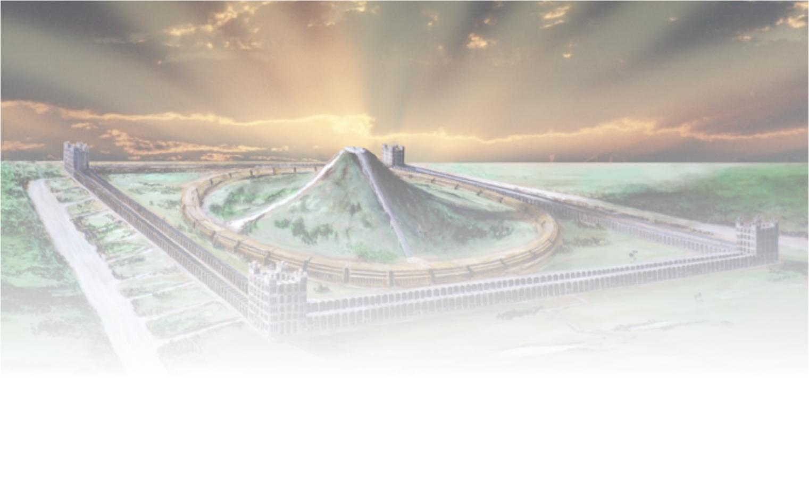
The future Tabernacle of David
Isaiah 16:5
A house of prayer for all nations – Isa. 56:7; Mark 11:17
“And in mercy shall the throne be established: and he shall sit upon it in truth in the tabernacle of David, judging, and seeking judgment, and hasting righteousness.”

Slide 18
The sure mercies of David
Next study –
“Yahweh will make thee an house”

Slide 19
...

