Slide 1
The sure mercies of David
Study 3 – “Yahweh will make thee an house”

Slide 2
The Promise in Scripture
BC 1000 Made to David - 2 Sam. 7:10-16.
BC 970 Passed to Solomon - 1 Chron. 28:5-8.
BC 930 Offered to Jeroboam - 1 Kings 11:31-38.
BC 750 Fulfilment prophesied - Amos 9:11.
BC 720 Sure – Isa. 9:6-7; 11:1-5; 16:5; 22:22; 55:3.

Slide 3
The Promise in Scripture
BC 600 Confirmed for future - Jer. 23:5-6; 33:15-26.
BC 590 Lost by Zedekiah - Ezek. 21:25-27.
BC 4 Birth of David's son (Gabriel) - Luke 1:31-35.
AD 96 Seen fulfilled - Rev. 4:2; 22:1,16.
All that is now required is for him to appear again “whose right it is” to sit on David’s throne

Slide 4
David forbidden to build temple
2 Sam. 7:1 – “sat in his house” – David saw the incongruity of his comfortable circumstances in contrast to the Ark.
“rest” – nuach – to rest, settle down.
V.2 – “Nathan” – “given”. Plays a major role in the delivery of the promises – V.3,4,17, and in exposing David’s sin – 2 Sam. 12 where his name occurs 7 times.
V.5-7 – Yahweh expresses satisfaction with ‘curtains’ (V.2). David’s tent found favour with Him - Acts 7:46.

Slide 5
David exalted – Israel saved
2 Sam. 7:8 – “sheepcote” – naveh – abode, habitation (of shepherds) – see final occ. Zeph. 2:6.
V.9 – “I was with thee” – The reason for David’s exaltation.
“great name” – See 2 Sam. 5:10.
V.10 – “a place for my people” – The promises begin with a permanent inheritance for Israel – Ezek. 37:25-26.
“move no more” – Indicates a fulfilment in the Kingdom Age.

Slide 6
Yahweh builds David a house
2 Sam. 7:10-11 - Roth. – “...neither shall the sons of perversity again humiliate them, as at first; even from the day when I put judges in charge over my people Israel, thus will I give thee rest from all thine enemies. And Yahweh must tell thee that, a house, will Yahweh make for thee.”
David forbidden to build the temple because he shed much blood – 1 Chron. 22:8. But a ‘house’ is promised to him.

Slide 7
‘House’ is bayith
bayith in 2 Sam. 7
Occurs 15 times in chapter.
First 5 occs. of a literal building - V.1,2,5, 6,7.
Last 10 occs. are of a family or spiritual house - V.11,13,16,18,19,25,26,27,29 (2).
The only exception is that V.13 may have a dual meaning.
David understood his house to be an enlarged immortal family - V.16,19,25,29.

Slide 8
The promises to David
Eureka Vol. 2, pg. 28-29 (Abridged):
1. A dynastic house was guaranteed to David.
2. The kingdom and throne of this dynasty would be established during a future period.
2 Sam. 7:12 – “And when thy days be fulfilled, and thou shalt sleep with thy fathers, I will set up thy seed after thee, which shall proceed out of thy bowels, and I will establish his kingdom.”

Slide 9
The promises to David
Eureka Vol. 2, pg. 28-29 (Abridged):
3. The commencement and duration of that period were hidden from David.
4. The kingdom and throne would be established by Yahweh.
5. The occupant of the throne would be a resurrected seed of David and Son of God.
2 Sam. 7:13 – “…and I will stablish the throne of his kingdom for ever.”

Slide 10
The promises to David
Eureka Vol. 2, pg. 28-29 (Abridged):
6. This seed should come to his death by the violence of his enemies; and be pierced with a spear.
7. The establishment of the kingdom and throne would be after David's death, and subsequent to his resurrection, so that it might be “before his face”.
2 Sam. 7:16 – “And thine house and thy kingdom shall be established for ever before thee: thy throne shall be established for ever.”

Slide 11
The promises to David
Eureka Vol.2, pg.28-29 (Abridged):
8. The Covenant of the Hidden Period contained all that constituted the salvation looked for by David.
9. He who should be both seed of David and Son of God would be ruler over mankind in righteousness and glory, occupying David's throne.
10. This ruler would utterly destroy the power of the wicked.

Slide 12
“If he commit iniquity”
2 Samuel 7:14
Hebrew - be ha awatho.
From ‘awah, signifying in the Niphil (Passive Voice); something done to one, cause to bow down, to suffer iniquity.
Lit. – “In his subverting”, i.e. in his deprivation of justice, or in the perverting of his right. Similar usages occur Ps. 38:6; Job 33:27; 34:12; Ps. 119:78; Lam. 3:36,59.
No conditional sense exists in the Heb.

Slide 13
Similar forms of awah
Ps. 38:6 – “I am troubled; I am bowed down greatly.”
Job 33:27 – “I have sinned and perverted that which was right.”
Job 34:12 – “...neither will the Almighty pervert judgment.”
Ps. 119:78 – “...they dealt perversely with me without a cause.”
Lam. 3:36 – “To subvert a man in his cause, the Lord approveth not.”

Slide 14
Other translations
Similar forms of awah
Lam. 3:59 – “O Yahweh, thou hast seen my wrong, judge thou my cause.”
Bro. Thomas – “Whom in his being caused to bow down I will....”.
Adam Clarke – “Even in his suffering for iniquity I will....”.

Slide 15
David – Type of Christ
2 Sam. 7:19 – “And is this the manner of man, O Lord GOD?”
“manner” is towrah - law, custom, mode or manner (Ges.) The idea is of a type or pattern.
Lit. - “This is the type of the Adam” (i.e. the second Adam = Christ).
David is astonished and humbled that he was chosen to be both a type and forefather of the son of God.

Slide 16
David – Type of Christ
1 Chron.17:17 – “and hast regarded me according to the estate of a man of high degree”.
“estate” is towr - a manner, mode.
Interlinear Bible translates “as a type of the man who is on high”.
Youngs. Lit. – “..and hast seen me as a type of the man who is on high.”
LITV – “...and have looked upon me as a type of the Man who is on high.”

Slide 17
David’s House – 2 Sam. 7:25-29
V.25 – “concerning his house” – This ‘house’ looms large in David’s mind.
“establish it for ever” – Indicates that final fulfilment is in the Kingdom Age.
V.26 – “name be magnified....let the house” – David aligns Yahweh’s future glory with his eternal house – Rom. 8:30.
V.27 – “I will build thee an house” – The most important element to David.
“house...may continue for ever” – Twice mentioned in verse; i.e. an eternal house.

Slide 18
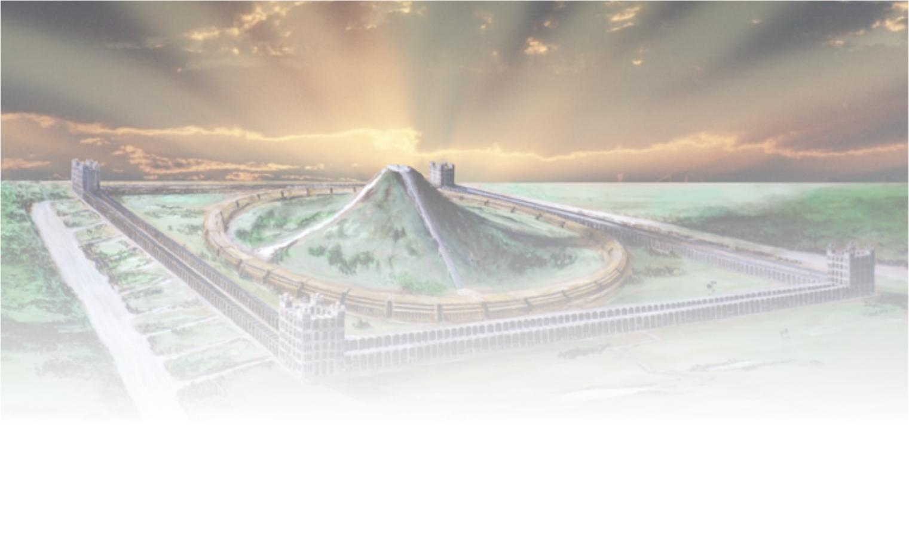
The sure mercies of David
Next study –
“Building again the Tabernacle of David”

Slide 19
...

