Slide 1
The sure mercies of David
Study 4 – “Building again the Tabernacle of David”

Slide 2
David called Gentiles – Rom. 15:8-9
Mic. 7:20 – “Thou wilt perform the truth to Jacob, and the mercy to Abraham, which thou hast sworn unto our fathers from the days of old.”
Ps. 18:49 – David (Christ) subdues Gentiles – “the strangers shall submit themselves unto me” (v.44).
Deut. 32:43 – Gentile conversion.
Ps. 117:1 – Centre of Bible – cp. chesed and emeth (v.2).
Isa. 11:10 – Ultimate conversion of nations.

Slide 3
The numbering of Israel – 1 Chron. 21 - Mistake or otherwise?
Suggested that David did not err in numbering Israel, for he sought only to collect money for the building of the Temple.
Suggested Israel were punished by Yahweh for their apathy and disinterest in the project.
It is postulated that David was correct and Joab wrong in opposing the numbering.
Is this right?

Slide 4
Summary of David’s Life
- 1 Kings 15:5
Because David did that which was right in the eyes of the LORD, and turned not aside from any thing that he commanded him all the days of his life, save only in the matter of Uriah the Hittite.
“…by this deed thou hast given great occasion to the enemies of Yahweh to blaspheme” – 2 Sam.12:14

Slide 5
Who sinned? David or Israel
1 Chron. 21:1 - And Satan stood up against Israel, and provoked David to number Israel.
2 Sam. 24:1 - And again the anger of the LORD was kindled against Israel, and he moved David against them to say, Go, number Israel and Judah.
Israel was deserving of punishment, but was David free of error in numbering them?

Slide 6
1 Chron. 27:23-24
²³ But David took not the number of them from twenty years old and under: because the LORD had said he would increase Israel like to the stars of the heavens.
²⁴ Joab the son of Zeruiah began to number, but he finished not, because there fell wrath for it against Israel; neither was the number put in the account of the chronicles of king David.

Slide 7
David acknowledged his mistake
1 Chron. 21:17 - And David said unto God, Is it not I that commanded the people to be numbered? even I it is that have sinned and done evil indeed; but as for these sheep, what have they done?
2 Sam. 24:10 - And David's heart smote him after that he had numbered the people. And David said unto the LORD, I have sinned greatly in that I have done: and now, I beseech thee, O LORD, take away the iniquity of thy servant; for I have done very foolishly.

Slide 8
The Real Mistake
Numbering Israel just to know their number was forbidden – Ex. 30:12-14. The half shekel was required to impress need for redemption.
Numbering the tribes of Israel and omitting the Gentile converts in the Land was David’s greatest mistake.
Hence, the punishment was the loss of 70,000 Israelites (1 Chron. 21:14) – 70 is the number of the Gentiles (nations) – Deut. 32:8; Gen. 10; Gen. 46:27. A thousand represents a family – Jud. 6:15. 70,000 = The family of the Gentiles.

Slide 9
A lesson in Ornan’s threshing floor
Ornan signifies “strong” (Strong’s) or “light was perpetuated” (BDB). The name occurs 12 times in Scripture = Israel (11 in 1 Chron. 21).
His other name Araunah signifies “joyful shouting of Yah” (BDB). The name occurs 9 times in 2 Sam. 24.
Jebusite = “trodden down” (threshing floor) – represents judgement (cp. v.20).
Had 4 sons – number of new creation developed in righteousness. Total 5 = grace.
Divine judgement stops at the threshing floor of a faithful Gentile family.

Slide 10
David taught what he already knew!
Commanded to build altar in Ornan’s threshing floor on Mt. Moriah – 2 Chron. 3:1.
Then Solomon began to build the house of the LORD at Jerusalem in mount Moriah, where the LORD appeared unto David his father, in the place that David had prepared in the threshingfloor of Ornan the Jebusite.
David tried to go to Gibeon – 1 Chron. 21:29-30.
David knew where Christ would be sacrificed – 1 Sam. 17:54 (Gen. 22:2 – cp. Gentiles – Gen. 21).
David sacrificed on Moriah – 1 Chron. 21:28, and gathered Gentiles – 1 Chron. 22:1-2.

Slide 11
Yahweh seen by David on Moriah
2 Chron. 3:1 - Then Solomon began to build the house of the LORD at Jerusalem in mount Moriah, where the LORD appeared unto David his father, in the place that David had prepared in the threshingfloor of Ornan the Jebusite.
Margin – “which was seen of David his father”
David reminded of Gen. 21 and 22
Moriah – “Seen of Yah”

Slide 12
Context of Abraham’s Covenant with Gentiles - Gen. 21:22-34
Ishmael and Hagar banished – Represents setting aside of Mosaic order (Gal. 4).
Abraham makes a covenant with Abimelech king of the Philistines.
Abraham offers up Isaac as a type of God and Christ in the act of sacrifice.
The covenant made unconditional – “In thy seed shall all the nations be blessed”.
Abraham receives news of his family in Gentile lands.
1 Chron. 21:2 – “number Israel from Beersheba to Dan” – At Beersheba Abraham made a covenant with Philistines – Left out of David’s numbering, the project ends in judgement (Dan)

Slide 13
Yahweh seen on Moriah
Gen. 22
V.1 – Abraham tested
V.2 – From Beersheba
V.4 – 3 days to Moriah
V.12 – Hand stayed
V.2 – Moriah – “Seen of Yah”
V.13-14 – Abraham sees Yah
V.2 – Burnt offering
V.15 – Angel from heaven
V.18 – All nations blessed
V.19 – Returns to Beersheba
1 Chron. 21
V.1 – David tested
V.2 – Beersheba to Dan
V.12-15 – 3 days to Moriah
V.15 – Stay now thine hand
V.15 – Ornan seen of Yah
V.16,28 – David saw Yah
V.26 – Burnt offering
V.26 – Answer from heaven
22:2 – Gathered strangers
David returns to Gentiles

Slide 14
Ornan a King – 2 Sam. 24:23
Young’s Literal – “…the whole hath Araunah given, as a king to a king…”
Possible descendant of Melchizedek – cp. Adoni-zedek king of Jerusalem – Josh. 10:1.
Had 4 sons = True spiritual Israel.
Gen. 22
1 Chron. 21
Matt. 3:17
Abraham
and
Isaac
Angel
and
Ornan
Yahweh
and
Christ

Slide 15
“But Solomon built him an house”
2 Chron. 2:17-18 – Solomon involved Gentiles in building the Temple – 70,000 (family of nations).
(See – RSV – different perspective on v.17.)
Acts 7:45-48
(David) desired to find a tabernacle for the God of Jacob.
But Solomon built him an house.
Howbeit the most High dwelleth not in temples made with hands.
Solomon’s temple restored Mosaic system.
Elyon

Slide 16
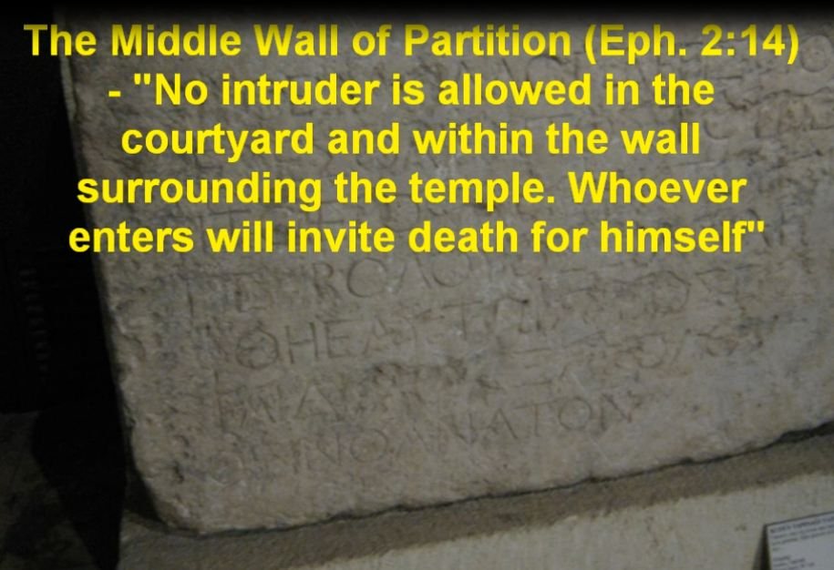
Now in the Museum in Istanbul – The inscription from the Temple in Christ’s time

Slide 17
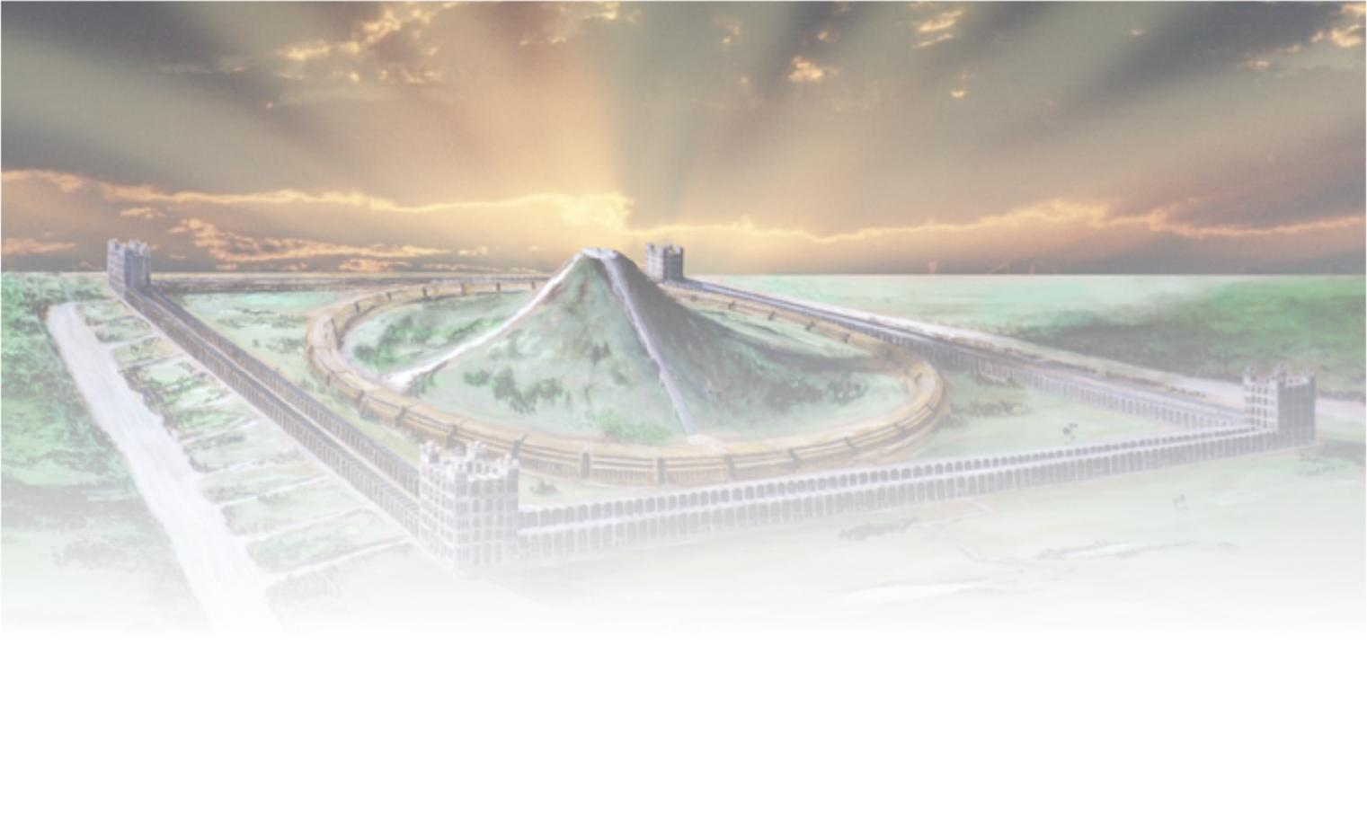
The sure mercies of David
Next study - “An everlasting covenant,
ordered in all things and sure"

Slide 18
...

