Slide 1
The sure mercies of David
Study 5 – “An everlasting covenant, ordered in all things and sure”

Slide 2
Structure of final chapters of 2 Samuel
Not in chronological order.
Structured to form a picture of the final fulfilment of the promises to David.
List of mighty men from earliest days – placed near the end to typify immortals.
2 Sam. 23:1,7 – David heads the list as a type of Christ – then gradations of saints.

Slide 3
David’s psalm of thanksgiving
2 Sam. 22 – Celebrates David’s triumphs over all his enemies – V.1.
Deep roots in Gen. 14 and Deut. 32 – Melchizedek, Armageddon, El Elyon.
Theme of producing ‘children’ from Jew and Gentile – Deut. 32:5-6,18 (Tzur).
Rock/stones and children – Isa. 51:1-2; Dan. 2:34,45; Luke 3:8; 1 Pet. 2:3-5.
Prophetic of Christ’s final triumph over all flesh – note V.44-51 (cannot be David).

Slide 4
2 Samuel 23:1-7
Translation by Bro. Thomas:
“Now these words of David, the last, are an oracle of David, son of Jesse; even an oracle of the mighty man enthroned, concerning an Anointed One of the Elohim of Jacob; and the pleasant theme of Israel’s songs.
Yahweh’s spirit spake by me, and His word was upon my tongue; Elohim of Israel spake to me, and the Rock of Israel discoursed, saying, There shall be a ruler over mankind, ruling in the righteous precepts of Elohim.

Slide 5
2 Samuel 23:1-7
And as brightness of morning, He shall rise the Sun of an unclouded dawn, shining forth after rain upon tender grass out of the earth.
Though my house is not so with Ail, yet He hath appointed for me the Covenant of the Olahm, ordered in everything and sure: truly this is all my salvation, and all my delight, though he cause it not to spring forth.
But the wicked shall be all of them as a thorn-bush to be thrust away; yet without hand shall they be taken;

Slide 6
2 Samuel 23:1-7
...nevertheless a Man shall smite them. He shall be filled with iron and the shaft of a spear; but with fire to burn up while standing, they shall be consumed.”
Eureka Vol. 2 pg. 28
David’s last words reveal his absolute conviction in the promises of God – he expresses his confidence in “the sure mercies of David”.

Slide 7
2 Samuel 23:1-7
THE LAST WORDS OF DAVID - FAITH IN THE PROMISES OF GOD
V.1 – “the last words of David” – Therefore words of vital importance. Placed before list of mighty men because subject is the victory of Multitudinous Christ in Kingdom of whom they are a type.
“David the son of Jesse” – “The Beloved” son of “Extant” is a type of Christ and saw himself as such - 2 Sam.7:19.

Slide 8
David’s authority – V.1
“said” – na'am - to speak with assurance and authority (occurs twice in verse). Is used nearly 300 times in this peculiar form of God's utterances, but only in 3 places of human speech - here and in Num. 24:3,4,15, 16, and Prov.30:1 - all claim special inspiration (see V.2).
“the man” – geber - valiant man, warrior. A man of experience in warfare.
“high” – al – on top.

Slide 9
David’s theme – V.1
“the anointed” – mashiyach - anointed (Messiah). The word ol occurs before this word - so it should be rendered – “concerning an Anointed One”.
“of the God of Jacob” – Elohim - the mighty ones of Jacob = Yahweh who will be finally manifested in redeemed saints.
“and the sweet psalmist of Israel” – na'iym - delightful. Bro. Thomas translates “even the pleasant (theme) of Israel's songs”, i.e. Messiah is the theme of the Psalms.

Slide 10
2 Sam. 23:3
V.3 – “The God” - Elohim. Theme of ‘Mighty Ones’ permeates the discourse.
“He that ruleth over men must be just” – Roth. – “One ruling over men, a righteous one...” Bro. Thomas – “There shall be a ruler over mankind, a just one”. The ‘He’ here is the Multitudinous Christ, the future ruling body upon earth (Eureka vol.1 pg. 349).

Slide 11
The Multitudinous Christ 2 Sam.23:3-4
“This Eternal Spirit in his multi-tudinous manifestation is the Sun, belonging to the morning of that great day in which the world shall be ruled in righteousness; and Yahweh’s glory shall cover the earth as the waters cover the sea. The Spirit in David contemplating this ek pollon eis, and vice versa, the One-in-Many, the future ruling body upon earth, says...

Slide 12
The Multitudinous Christ 2 Sam.23:3-4
......“There shall be a Ruler over mankind, a Just One, ruling in the righteous precepts of Elohim. And as brightness of morning, He shall rise the Sun of an unclouded dawn shining forth after rain upon tender grass out of the earth.”
Eureka vol. 1 pg. 349

Slide 13
The sun of righteousness
“ruling in the fear of God” - Bro. Thomas – “ruling in the righteous precepts of Elohim”. This is the quality of the rule of Christ and the saints.
V.4 – “as the light of the morning” - Bro. Thomas – “as brightness of morning”. Speaks of the new Millennial Day which introduces the Kingdom Age.
“the sun riseth” - Analogous to Christ and his brethren as the government of the Age to come - Mal. 4:2; Matt. 13:43; Rev. 21:23; 22:16; Dan. 12:3; SS 6:10.

Slide 14
A morning without clouds
“a morning without clouds” - There will be no obscuring of Christ's rule. Note the language of the earlier stage - Ezek. 1:26-28.
“as the tender grass” - Grass = flesh (Isa. 40:5-8). The regrowth after the scything judgements of God - Ps. 72:6.
“clear shining” - Uninterrupted light of Divine government - Rev. 22:5.
“after rain” - Lifted from Deut. 32:1 = doctrine, teaching of Christ and saints after judgements.

Slide 15
David looks to the future
V.5 – “Although my house be not so with God” - The translations differ: Roth. - “When not so was my house with God, then he..”. RSV – “Yea does not my house stand so with God, for he has..”. Interlinear Bible – “For is not so my house with God? For he has..”. Companion Bible – “For is not my house thus through God? For he..”.
“hath made with me” - Roth. – “hath appointed me”.

Slide 16
Covenant of Olahm
“an everlasting covenant” - Bro. Thomas - “the Covenant of the Olahm” (the Hidden Period or Millennium).
“desire” - chephets - pleasure, desire. See use Ps. 1:2; 16:3; Isa. 58:3,13.
“grow” - tsamach - sprout. Used Ps. 132:17 (‘bud’); Jer. 33:15; Ezek. 29:21; Isa. 55:10.
V.6 – “Belial” - without profit, worthless-ness. Interlinear Bible – “But the wicked”. Roth. – “the abandoned”.

Slide 17
The wicked destroyed
“all of them” - Implies total and final destruction of all the wicked in the earth. Cp. Rev. 21:8.
“as thorns” - kohtz. 2nd use in O.T. First occ. of the word is in Gen. 3:18. The curse of mortality through sin.
“thrust away” - nadad - to drive away.
“because they cannot be taken with hands” - Bro. Thomas – “though not with hand shall they be taken”; i.e. they shall be taken ‘without hand’ as in Dan. 8:25; 2:34-35 - without human agency.

Slide 18
Triumph through crucifixion
V.7 – “the man” - ish - great man = Christ.
“shall touch them” - naga - to touch; lay the hand upon, hence to strike. Bro. Thomas – “But the Man shall smite upon them”. Christ will destroy the wicked by Divine power - Ps. 110:6.
“fenced” - Mgn. “filled” is correct.
“with iron and the staff of a spear” - The Roman spear which pierced Christ’s side - John 19:34.

Slide 19
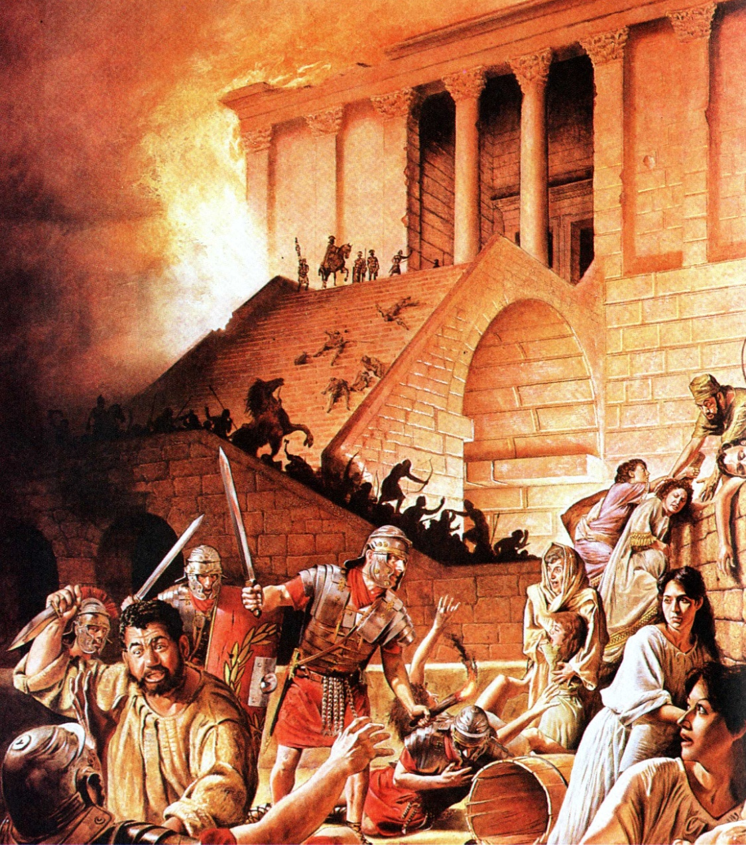
Divine judgement to come
“burned” - saraph - to be on fire. Root of Seraphim (= Saints).
“with fire” - See the fate of Gog and Magog at Armaged-don (Ezek. 38:22; 39:6) and at end of Millennium (Rev. 20:8-9).

Slide 20
Yahweh’s furnace in Zion
“in the same place” - shebeth - from root sig. both locality and a state of confidence. Bro. Thomas – “in standing”, i.e. while in position standing to arms as in Zech. 14:12. A.V. is also acceptable = destruction of the wicked in the very place where Christ was crucified to destroy sin - see Ezek. 38 & 39; Zech. 12 to 14.
The final destruction of the wicked is at Jerusalem - Rev. 20:8-9.

Slide 21
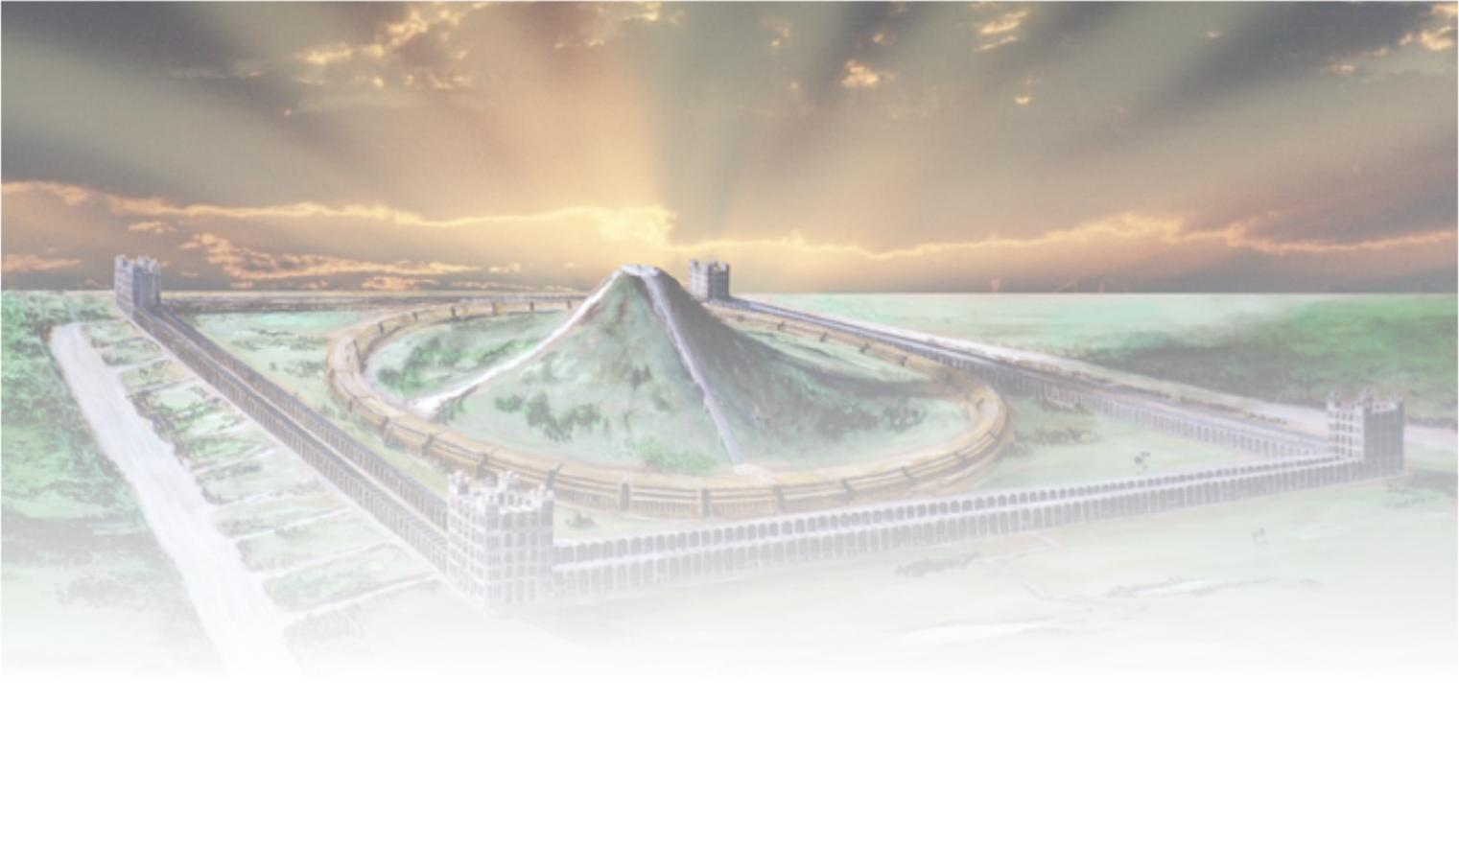
The sure mercies of David
Next study –
“The root and offspring of David”

Slide 22
...

