Slide 1
The sure mercies of David
Study 6 – “The root and offspring of David”

Slide 2
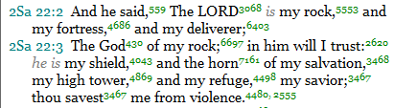
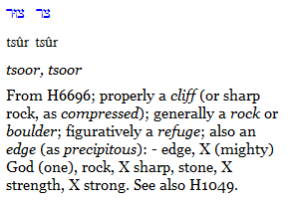
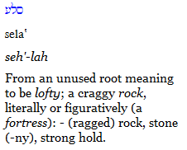
Tzur and Selah in 2 Sam. 22
6697
5553
4 occs. in 2 Sam. 22
Only once in 2 Sam. 22

Slide 3

Tzur in 2 Sam. 22
6697

Slide 4

Tzur in 2 Sam. 22
6697

Slide 6
The Millennium
The Jubilee Period
Flesh eradicated
The
Little
Season
1000 year reign of Christ
50 yrs
Flesh bound
Rev.
20:3
Flesh subdued
Flesh unleashed
The sure mercies of David

Slide 7
The End - 1 Cor. 15:24-28
Then cometh the end, when he shall have delivered up the kingdom to God, even the Father; when he shall have put down all rule and all authority and power.
For he must reign, till he hath put all enemies under his feet.
The last enemy that shall be destroyed is death.
For he hath put all things under his feet. But when he saith all things are put under him, it is manifest that he is excepted, which did put all things under him.
And when all things shall be subdued unto him, then shall the Son also himself be subject unto him that put all things under him, that God may be all in all.
The Greek word pas occurs 10 times in this bracket of verses.
The sure mercies of David

Slide 8
God “All in All”
The Greek word pas (all) is used 10 times in 1 Cor. 15:24-28 (a context of its own).
10 is the number for “all”.
The Greek word hupo (“under”) occurs 8 times in the passage – twice by itself and 6 times as part of the word hupotasso.
8 is the number of a new beginning and immortality.
Hence, all on earth will be immortal.
The sure mercies of David

Slide 9
Culmination of the 3 Great Covenants
Rev. 20 – Final fulfilment of Gen. 3:15
The Old Serpent bound and finally destroyed
Sin and rebellion eradicated - death abolished
Rev. 21 – Abrahamic Covenant fulfilled
The Holy City (Abrahamic) completed
One nation – Israel – embraces all
Eternal inheritance experienced by all
Rev. 22 – The Promises to David fulfilled
Divine authority over all the earth
David’s throne established forever
The spiritual house of David complete
The sure mercies of David

Slide 10
Joshua 3 &4
Israel crosses Jordan - Baptism of the Spirit
The saints cross Jordan into their inheritance led by the Lord Jesus Christ. In John 3:5 Christ taught that a birth of water and of Spirit is necessary for entrance to the Kingdom. Israel were baptized in the Red Sea (1 Cor. 10:1-2). This second ‘baptism’ prefigures the acquisition of Spirit nature and entrance into the Land of Promise. Israel crossed 2,000 cubits down-stream from where the Ark (carried by priests) stood in the Jordan (Josh. 3:3-4). Its water flowing from the sea of life (Galilee) down the serpentine course of Jordan (“the descender”) to the sea of death (Dead Sea) went back through Adam (Josh. 3:14-17) – a type of the effect of Christ’s work reversing the effects in himself of Adam’s transgression 2,000 years before the ‘Israel of God’ cross into the Land as immortals because of his work.

Slide 11
Joshua 5
Circumcision reinstituted in Israel
The reproach of Egypt is “rolled away” (Gilgal) when Israel was circumcised the second time. Baptism is called ‘circumcision’ in Col. 2:11-12. The second circumcision of Israel with ‘sharp knives’ (Josh. 5:2) prefigures a birth of the Spirit - The saints enter into immortality and the reproach of Egypt is finally rolled away - Manna (the Word in probation – Ex. 16) not required in immortality ceases at Passover time (Josh. 5:10-12) – the time of eternal redemption through Christ our Passover (1 Cor. 5:7) - Joshua's encounter with the captain of the host (Michael the Archangel) prefigures Christ's role as "Michael your prince" – Dan. 12:1-2 – a work of redemption and judgement.

Slide 12
Joshua 6
Jericho overthrown - Armageddon
A chapter of sevens – Jericho is mentioned for the 21st time in the O.T. in v.1. ‘Shophar’ occurs 14 times; ‘seven’ occurs 14 times; ‘compassed’ occurs 7 times, and there are 7 priests, 7 trumpets, 7 days, 7 times in the overthrow of the city which match the 7 seals (priests unseal the Word – Isa. 29:11; Mal. 2:7) - 7 trumpets, 7 vials (time cycles of Divine wrath since 1789), 7 thunders of the Apocalypse which are triggered by Armageddon (the gathering to which is the final event of the 6th Vial (Rev. 16:16) – Armageddon (commencing with the pouring out of the 7th Vial) is prefigured - Gog is overthrown but Babylonian elements (Catholic resistance to Christ) survive as they will for 40 years beyond Armageddon. The 4 metals of Nebuchadnezzar’s image occur in Josh. 6:19 & 24. A total of 7 things (complete judgement) were destroyed in the overthrow (v.21) and the household of faith is revealed to the world (v.22) as it will be at Armageddon.

Slide 13
Josh. 7
The house of Judah cleansed
The sin of Achan revealed – Achan was of the tribe of Judah – the prophetic name of Jews in the Land at Christ’s return (Zech. 12:7). Armageddon will see two thirds of the people in the Land destroyed (Zech. 13:8). The remnant will be purged and converted (Zech. 12:9-14; 13:1). Prefigures Jews in the Land humbled by defeat in war (as they were at Ai) and the holocaust of Armageddon - The house of Judah will be cleansed and caused to mourn. The valley of Achor (Josh. 7:26) becomes a memorial and a sign of Divine mercy for the remainder of ‘Israel’ (Jews outside the Land) – Hos. 2:15.

Slide 14
Joshua 8
Ai defeated – Bonds of Covenant
The defeat of the kings of Ai and surrounding cities prefigures Israel’s victories over local nations (Zech. 14:14; 9:13-17) – The fate of Ai (Josh. 8:28) prefigures the destruction of Rome 10 years after Armageddon (Rev. 14:8). After the victory Joshua marched the whole nation to Shechem and set half on Mt Ebal (mount of cursing) and half on Mt Gerizim (mount of blessing) where the whole nation entered into a covenant to keep Yahweh’s Law. Prefigures scattered Israel (‘Joseph’ or Ephraim – Ezek. 37:15-28) being brought into the Land to join their brethren (Judah) and entering into a new covenant as a result of the Second Exodus – Ezek. 20:33-38.

Slide 15
Joshua 9
Deception of the Gibeonites
After the fall of Ai 6 nations assemble to oppose Israel with ‘one mouth’ (v.2) – Prefigures the rebellion of the Catholic nations of Europe post-Armageddon and even post-destruction of Rome (Ps. 2; Rev. 17:12-14) – However, like the Gibeon-ites the Tarshish powers will submit to Christ after Armageddon, but feignedly out of fear (Ps. 66:3; 18:44 – the word “submit” means to yield feigned obedience – Heb. to lie) – Also like the Gibeonites, the nations who willingly submit to Christ are preserved but compelled to labour in the Temple as servants to Israel. The submissive nations will bring their wealth and service to the building of the House of Prayer for all nations – Zech. 14:14; Isa. 60:5-6,9-17. This was to happen in the place God chose (Josh. 9:27).

Slide 16
Joshua 10
Adoni-zedek’s confederacy defeated
Adoni-zedek means “Lord of righteousness” (a religious power). He probably claimed descent from Melchizedek (“king of righteousness”) the first king of Jerusalem (Gen. 14:18). One of the titles of the Pope is “King of Jerusalem” adopted during the Crusades, and the Papacy claims to be a ‘descendant’ of Christ as his ‘Vicar on earth’. This confederacy includes 5 kings (5 is the number of Divine grace – it is a ‘religious’ confederacy) Gibeon is called a ‘royal city’ = Britain (Tarshish) a monarchy with ‘young lions’ (Ezekiel 38:13 – the lion a symbol of royalty) - Catholicism unites the nations against Christ citing the false ‘Antichrist’ doctrine (Ps. 2) and will doubtless threaten those nations who have submitted to Christ’s rule.

Slide 17
Joshua 10 (cont.)
Adoni-zedek’s confederacy defeated
But the confederacy is defeated over an extended "day" of judgement (40 years – Zech. 14:3 – a reference to this extended day in Josh. 10 – Zech. 12-14 is about an extended ‘day’ of Divine judge-ment) – The defeat is initially via hailstones which selectively kill only Canaanites – Prefigures the work of the saints as ‘hailstones’ of a talent (around 114 pounds – the weight of an immortal who has lost unnecessary ‘vital’ organs and blood at immortalization – Rev. 16:17-21) Like the 5 kings the papacy and its supporters will be cast into the ‘abyss’ (Rev. 18:21; 19:20) after the elders of Israel (the saints) place their feet on the necks of ‘Satan’ (Rom. 16:20; Rev. 20:1-3).

Slide 18
Joshua 10 (cont.)
Seven Canaanite cities overthrown
A list of 7 cities captured by Joshua and Israel concludes the chapter, but these are not strictly chronological with the events of Adoni-zedek’s overthrow. Prefigures the seven campaigns of Christ to subdue the nations (7 thunder judgements of Rev. 10:3-4) – Joshua took all these at ‘one time’ – prefiguring the 40 years of conquest required to establish the Kingdom. Then a lull in fighting sees Joshua return to base camp (Josh. 10:43) - The Millennial period of rest from war is prefigured.

Slide 19
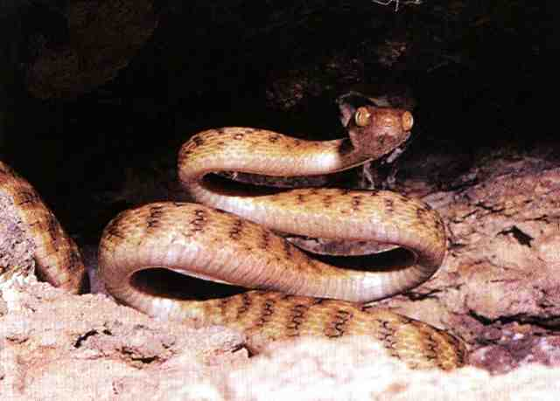
The old serpent destroyed
- Genesis 3:15 fulfilled
Prefigured in the type of Josh. 11
“And the earth rested from war”

Slide 20
Jabin King of Canaan
His name means “intelligent” or “wise” – the characteristic of the serpent – Gen. 3:1.
Jabin is a dynastic name – there were two who ruled from Hazor (“village”) – Cp. Josh. 11:1.
In both contexts – Josh. 11 and Jud. 4 Jabin is a type of the serpent in political manifestation (cp. Rev. 20).
“Canaan” = “humiliated”. Monarch of humiliation – Phil. 3:21 (“body of humiliation”).
Judges 4 is an enacted parable of the overthrow of the serpent power by Christ.
The sure mercies of David

Slide 21
Jabin represents the Serpent
Joshua 11 | Revelation 20
V.1 – Jabin – “Intelligent”, “wise” | V.2 – The old serpent – “more subtle” Gen. 3:1
V.2-3 – from north, south, east, west | V.8 – gather from four quarters of the earth
V.4 – even as the sand on the sea shore | V.8 – as the sand of the sea
V.5 – met together, pitched together | V.9 – went upon the breadth of the earth
V.5 – Merom – “height” or “elevation” | V.9 – the beloved city – Zion (elevation - Ps.48:2)
V.6 – burned chariots with fire | V.9 – fire from God out of heaven
The sure mercies of David

Slide 22
Jabin represents the Serpent – cont.
Joshua 11 | Revelation 20
V.8 – Mishrephoth-maim – “burnings of waters” | V.10 – cast into the lake of fire and brimstone
V.8 – left none remaining | V.14 – the second death – mortality abolished
V.11 – left none to breathe | V.15 – no mortals remain
V.23 – the land rested from war | The serpent destroyed – no sin and death – Gen. 3:15
Joshua 11 is the basis for Revelation 20 – it foreshadows the final conflict between Christ and the serpent in political manifestation.
The sure mercies of David

Slide 23
The Apocalypse in Joshua
Josh. 12 – 31 kings subdued and their land given to Israel – Prefigures the destruction of all opposition to divine rule and the dissolution of all nations –
Only Israel remains.
The sure mercies of David

Slide 24
Abraham promised a Great Nation
Gen. 12:2-3
And I will make of thee a great nation¹/, and I will bless thee²/, and make thy name great³/; and thou shalt be a blessing⁴/:
And I will bless them that bless thee⁵/, and curse him that curseth thee⁶/: and in thee shall all families of the earth be blessed⁷/.
The first of seven promises to Abraham has seven clauses – the first points to the culmination of God’s purpose.

Slide 25
No more Sea – Rev. 21:1-8
Rev. 21:1-8 – The time beyond the Millennium.
Hence, “new” heavens and earth (1st past) – V.1.
No “sea” = no more nations (only one).
City adorned as bride – final phase of Ecclesia.
City gates identified with Israel – V.12.
The city is dominated by 12 – 12 gates, 12 foundations, 12 apostles, 12 stones.
The number 12 occurs 12 times (if 144 = 12 x 12 is counted as 2 – V.17).
This city is a corporation of immortal people – the Israel of God in its final manifestation.
The sure mercies of David

Slide 26
Israel the only ‘immortal’ nation
Jer. 30:11; 46:28 – “…though I make a full end of all nations whither I have scattered thee, yet will I not make a full end of thee (Israel)….”
Prefigured by the Feast of Tabernacles
  Over 7 days 70 bullocks were sacrificed;
  Day 1 (13); Day 2 (12) >>>>Day 7 (7) = 70;
  The number of the nations in Scripture is 70;
  The nations will keep the feast of Tabernacles in the Millennium (7th Day) – Zech. 14:16;
  On the 8th day just one bullock was offered – represents only one nation after Millennium.
The sure mercies of David

Slide 27
The Holy City a Great Nation
“city” occurs 12 times in Rev. 21 & 22.
This is the Abrahamic “city” – Heb. 11:10,16; 12:22-23.
The “holy city”is styled by Bro. Thomas, “The New Jerusalem body politic” and “the holy Jerusalem association of saints”.
“It is the Yahweh-Elohistic municipality, symbolized by one hundred and forty-four cubits, each cubit representing one thousand of the numerical symbol of this “Holy Nation,” the Israel of the Deity.”
  Eureka Vol. 1 pg. 115
“City” and “nation” are equivalent terms – a corporation of people

Slide 28
The Throne of David
“throne” occs. 5 times (grace) - Rev. 20-22.
Rev. 22:1,3 – this is the throne of David – cp. Rev. 5:5-7 – Lion of Judah = root of David.
In the vision of Rev. 4 the Greek for “throne” occs. 14 times = certainty of covenant.
2 Sam. 7:16 – “And thine house and thy kingdom shall be established for ever before thee: thy throne shall be established for ever.”
Rev. 22:16 – “I am the root and the offspring of David.”
The sure mercies of David

Slide 29
David’s House a Spiritual Family
“House” - bayith in 2 Sam. 7 (Occs. 15 times in chapter)
First 5 occs. of a literal building – Vv. 1,2,5,6,7.
Last 10 occs. are of a family or spiritual house – Vv. 11,13,16,18,19,25,26,27,29 (2). The only exception is that V.13 may have a dual meaning.
David understood his house to be an enlarged immortal family – Vv. 16,19,25,29.
The sure mercies of David

Slide 30
The Spirit is the Root of David
“It is the Eternal Spirit, then, who, through Jesus, says in Apoc. 22:16, “I am the Root and the Offspring of David, the bright and Morning Star.” The Spirit, apart from Jesus, could not say this. The Spirit is the Root of David, because David and all mankind sprung from the Spirit who created them.”
  Eureka Vol.1 pg. 350
Proof – Isa. 11:1-3
The sure mercies of David

Slide 31
The Spirit is the Root of David
“Spirit” in Isa. 11:2-3
Heb. ruach – wind; breath, i.e. a sensible exhalation. See use Ps. 33:6.
In Isa. 11:2 the 4 occs. have vav for vowel sounding. But in v.3 ruach occurs with yod for the vowel sounding. This changes the meaning from exhalation to inhalation – note the margin, “Heb. scent, or smell” (to smell requires inhalation).
In v.2 it is Yahweh who ‘breathes out’ the Spirit, while in v.3 it is Christ who ‘breathes in’ the Spirit exhaled by his Father.
The sure mercies of David

Slide 32
The Spirit and the Bride say, Come!
Rev. 22:16-17
“the root” equates with “the Spirit”
“right to the tree of life” (v.14)
“enter … the gates into the city”
“the offspring” with “the bride”
The sure mercies of David

Slide 33
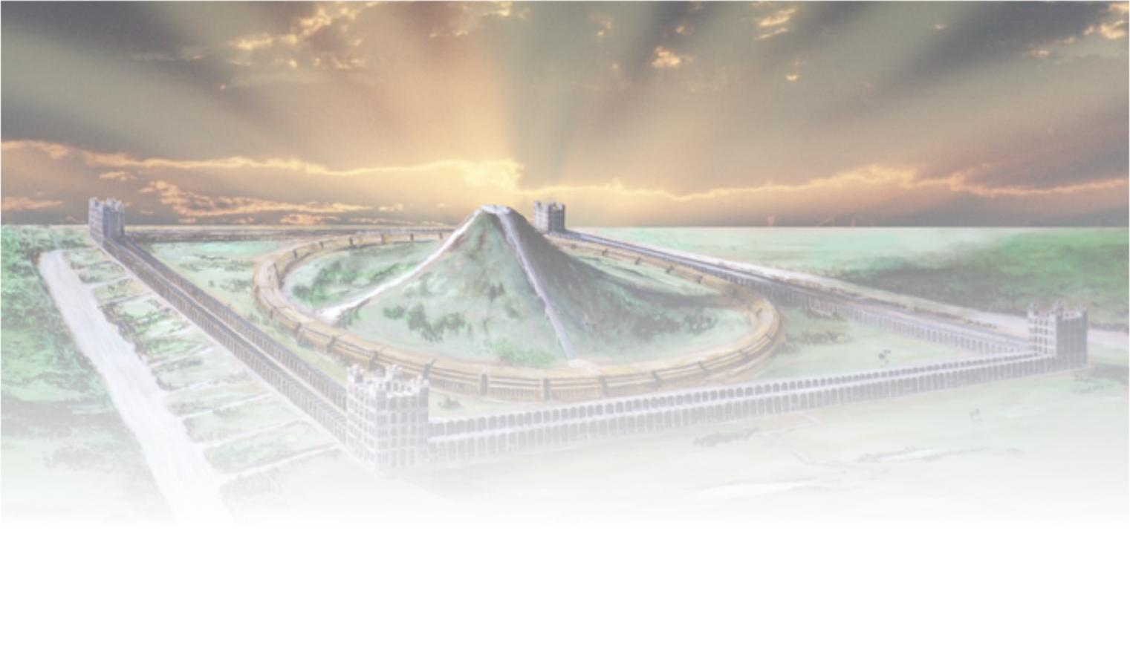
The future Tabernacle of David
Isaiah 16:5
The sure mercies of David
“And in mercy shall the throne be established: and he shall sit upon it in truth in the tabernacle of David, judging, and seeking judgment, and hasting righteousness.”

Slide 34

“Even so, come, Lord Jesus.”
“…the path of the just is as the shining light, that shineth more and more unto the perfect day.” – Prov. 4:18

Slide 35
...

Slide 36
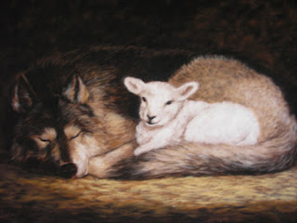
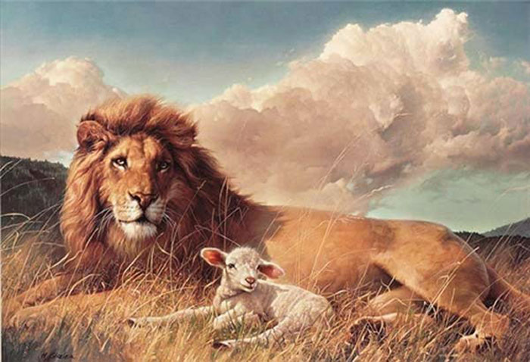
The vision of Isaiah 11
The sure mercies of David

Slide 37
A little child shall lead them
Redeemed Israel is represented by a range of clean and sacrificial animals – lamb, kid, calf, fatling, heifer, ox.
The nations are represented by wild carnivorous beasts – wolf, leopard, young lion, bear, lion.
The flesh is represented by serpents.
The ‘little child’ is Christ – Isa. 9:6-7.
The ‘sucking child’ = Judah/Israel reborn.
The ‘weaned child’ = saints – they will suppress the flesh (serpent).

