Slide 1

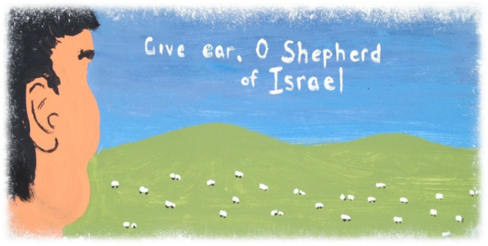



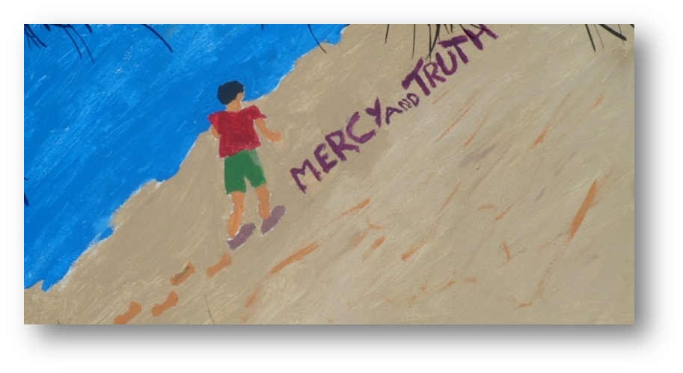
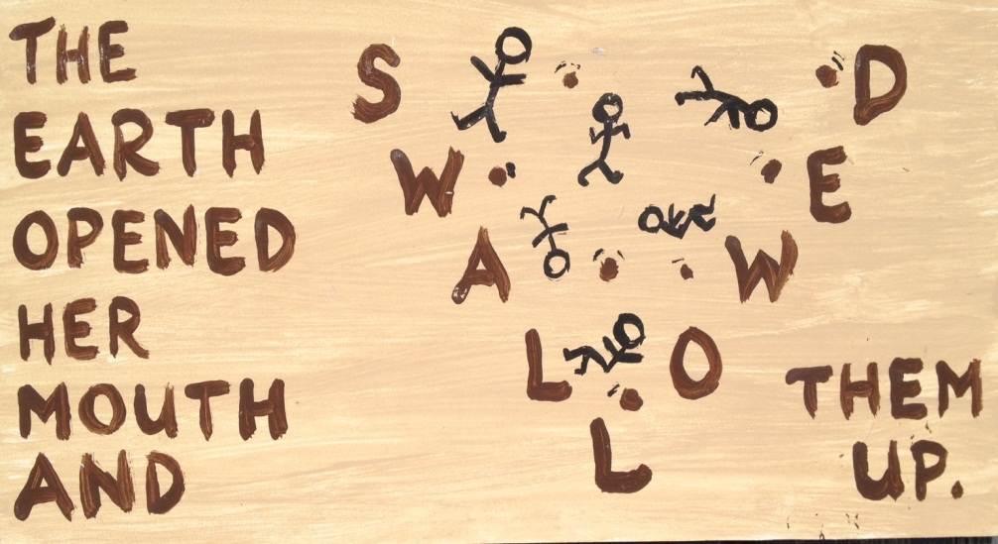

Slide 2
“As Moses was to Aaron, so he was to all Israel, “In the place of God.” He gave them the bread of heaven to eat, and water out of the flinty rock to drink, and clad them with raiment that waxed not old upon them. What a perfect king was this! Truly the father of his people, who sustained them in life with food and raiment, and taught them wisdom from above. What nation ever had such a king as Moses? and what were David and Solomon to Israel after him? As the servant of Yahweh, he gave the nation an existence, ushering it into being amid storm and fury, and the ruin of a mighty host from the depths of the sea; he sustained it from the storms of heaven for forty years; beat down their enemies, and trampled them as the mire of the streets; gave them a holy, just, and good, but inexorable law; and brought them to the verge of Canaan’s land, a well-trained and disciplined nation, fit and prepared to take possession of it under the conduct of a successor worthy of himself. He was Yahweh’s servant “faithful in all his house for a testimony,” or representation “of those things which were to be spoken after.” He was the greatest character the world has known with one exception. The world’s great ones are not to be named in the same breath! Moses! What meekness, disinterestedness, faithfulness, self-denial, wisdom, knowledge, power, honour, glory, exaltation, doth that name represent!”
Bro. Thomas in the article “Moses and the Prophet like unto him”

