Slide 1
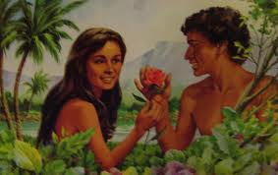

Family Life Lessons in Genesis
Class 1:
Adam to Noah
Trust in the Lord with all your heart, and lean not on your own understanding; In all your ways acknowledge Him, and He shall direct your paths. (Proverbs 3:5-6)

Slide 2

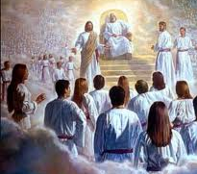
God chose to Use Families
He could have chosen another way - communes, polygamy, divorce….
Gen 2:18 not good for man to be alone
Gen 18:19 I have known Abraham…that he might command his children
Eph 3:14-21 the Father of the Lord Jesus Christ…from whom the whole family in heaven and in earth is named
God allows us to experience His divine family and character through our families

Slide 3

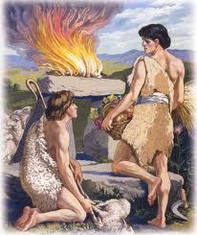
Genesis Contains:
1) Most fundamental doctrines
2) Counsel on most fundamental family (and ecclesial) issues
3) History of good & bad choices – written for our learning
Now all these things happened to them as examples, and they were written for our admonition, on whom the ends of the ages have come. Therefore let him who thinks he stands take heed lest he fall. (1 Cor 10:11-12)

Slide 4
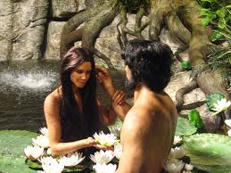
Genesis 2:18 (Marriage)
And the LORD God said, "It is not good for the man to be alone; I will make him a helper suitable to him.“ (NASB)
God didn’t intend us to be alone – like isolationists – He expects us to work with others.
In families, we help others and ourselves at the same time
Helper “comparable to him” (NKJ) or “suitable for him” (NASB) → we must look for spouses who will help our spiritual life!
Animals were formed from the ground, Eve was formed out of Adam.

Slide 5
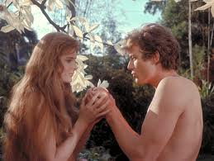
1 Timothy 2:11-15 (RSV)
11 Let a woman learn in silence with all submissiveness.
12 I permit no woman to teach or to have authority over men; she is to keep silent.
13 For Adam was formed first, then Eve;
14 and Adam was not deceived, but the woman was deceived and became a transgressor.
15 Yet woman will be saved through bearing children, if she continues in faith and love and holiness, with modesty.
Paul draws general conclusions from Adam & Eve
This is not cultural – it’s God’s view of how He wants His family to operate in the ecclesia – He knows best!
Not about who is greater or more important
Roles for men & women were established by God for our good, so we can be members of His family

Slide 6


Today’s society is confused
Some claim boys & girls are equal & demand the same roles
  Biology doesn’t support this
  Creates confused, over-worked & over-stressed people
Some women seem to be better leaders than their spouses
  “better” is not the issue
  God doesn’t need the “best”
    High priests, kings, etc show that!

Slide 7

The Bible is Clear:
Men are responsible to lead, provide, save, teach and give their lives for their spouses – show the life of Christ!
  Many families struggle when men do not come through
  Men must read, study, pray & be involved in their families – all aspects!
Look to Christ for the ultimate example!

Slide 8
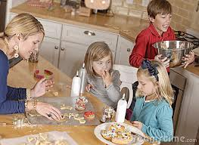

1 Timothy 5:14
Therefore I desire that the younger widows marry, bear children, manage the house, give no opportunity to the adversary to speak reproachfully.
“rule (oikodespoteo) the household” (RSV)
God wants a house that runs in peace, where everyone helps and encourages one another

Slide 9

1 Corinthians 11:7-11
7 For a man indeed ought not to cover his head, since he is the image and glory of God; but woman is the glory of man.
8 For man is not from woman, but woman from man.
9 Nor was man created for the woman, but woman for the man.
10 For this reason the woman ought to have a symbol of authority on her head, because of the angels.
11 Nevertheless, neither is man independent of woman, nor woman independent of man, in the Lord.
12 For as woman came from man, even so man also comes through woman; but all things are from God.
The relationship of men and women, and their respective roles before God, were designed by God & His angels from the beginning of creation – for the spiritual development of His family

Slide 10

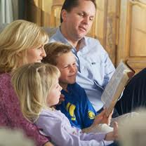
Marriage was designed by God
Mark 10:6-9
6 "But from the beginning of the creation, God 'made them male and female.'
7 'For this reason a man shall leave his father and mother and be joined to his wife,
8 'and the two shall become one flesh'; so then they are no longer two, but one flesh.
9 "Therefore what God has joined together, let not man separate.“
Malachi 2:15
And did not he make one? Yet had he the residue of the spirit. And wherefore one? That he might seek a godly seed. Therefore take heed to your spirit, and let none deal treacherously against the wife of his youth. [many people were breaking their covenants]
God designed marriage to be a one man - one woman relationship because He knows this is the best way to develop godly children!

Slide 11

Raising Godly Children is the Goal
We need someone at home instructing our children
The focus is on our children! When we get this right, many other problems dissolve.
What we do with our children is very similar to what the angels do with us – This is our practice time! We are learning to be angels in the kingdom

Slide 12

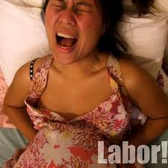
16 to the woman He said: "I will greatly multiply your sorrow and your conception; in pain you shall bring forth children; your desire shall be for your husband, and he shall rule over you.“
17 Then to Adam He said, "Because you have heeded the voice of your wife, and have eaten from the tree of which I commanded you, saying, 'You shall not eat of it': "Cursed is the ground for your sake; in toil you shall eat of it all the days of your life.
Genesis 3:16-17
The Hebrew word for “pain” is the same word translated “toil” in v. 17
Just as men struggle all their lives with bringing food out of the ground, so women struggle in bringing forth children fruitful to God
1 Tim 2:15 Yet woman will be saved through bearing children, if she continues in faith and love and holiness, with modesty. (RSV)

Slide 13

Genesis 3:16
“your desire shall be for your husband, and he shall rule over you”
Husbands should direct their families towards God – this is the responsibility of every husband!
Wives should be able to look to their husbands for spiritual direction – and follow it. This way our children learn how to submit, so they will one day submit to God.
This is how God and His angels designed the family to work
This does fail sometimes [Abigail & Nabal] and we must make the most of a bad situation – praying God will bring good out of the bad

Slide 14
Ephesians 5:30-32
30 For we are members of His body, of His flesh and of His bones.
31 "For this reason a man shall leave his father and mother and be joined to his wife, and the two shall become one flesh."
32 This is a great mystery, but I speak concerning Christ and the church.
Everything God did in Gen 1-3 was about redeeming His family through His son. Our families today are designed to clearly teach us about redemption in Christ Jesus.

Slide 15

Lessons from Adam & Eve
God uses families to develop His family
Not good to be alone – don’t be isolated from God’s family
Look for spouse who is a “helper fit” for you
Our goal: help save our spouse
Marriage is for life! Not ours to break.
Parents: Focus on developing Godly children
  Dads: Be a spiritual leader for spouse and children
  Moms: Be available, be home for your kids
Men & women have different God-given strengths & weaknesses: therefore, different roles – appreciate each other!

Slide 16

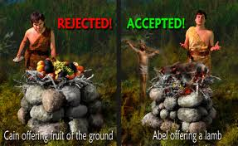
Cain & Abel
(Siblings & Brothers & Sisters in Ecclesial life)
Genesis 4:3-5
3 And in the process of time it came to pass that Cain brought an offering of the fruit of the ground to the LORD.
4 Abel also brought of the firstborn of his flock and of their fat [shows rules for offerings were already established). And the LORD respected Abel and his offering,
5 but He did not respect Cain and his offering. And Cain was very angry, and his countenance fell.

Slide 17
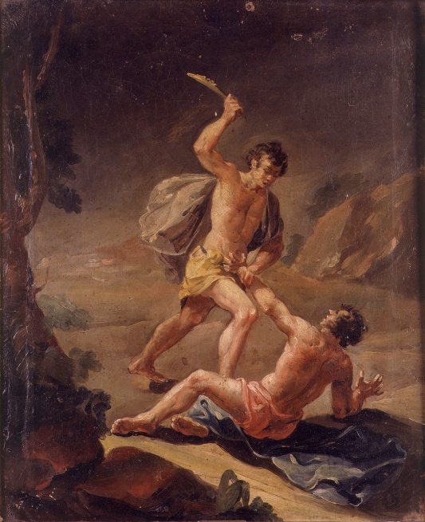

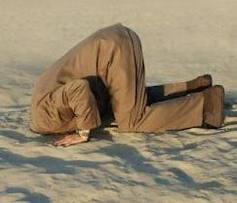
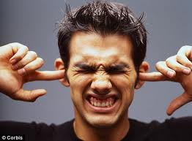
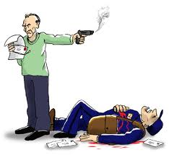
This incident deals with the root cause of many family problems
What will we do when we make mistakes?
Admit our mistake, learn a lesson, and get right with God
OR
Blame others, refuse to grow, get angry with God and others, become an unhappy person
It’s hard to grow spiritually when we get angry at the people who help us understand our weaknesses and mistakes
Don’t shoot the messenger!

Slide 18
Proverbs 9:8
Do not correct a scoffer, lest he hate you; Rebuke a wise man, and he will love you.
Proverbs 17:10
Rebuke is more effective for a wise man than a hundred blows on a fool.
How do you respond when rebuked?

Slide 19
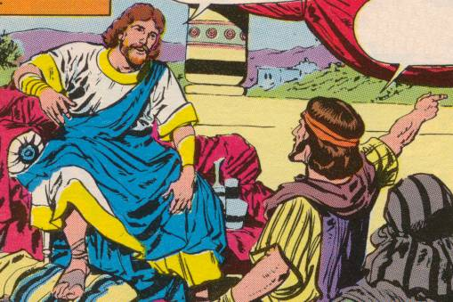
Hanani’s Rebuke of Asa
2 Chronicles 16
Hanani is the father of the prophet Jehu (1 Kgs 16:1)
Mistake
Asa’s Mistake: relied on king of Syria (v.7)
Past Lessons: Defeat of Zerah should have convinced Asa to rely on God (v.8)
Consequence: King of Syria escaped and will cause trouble in future. More wars to come (v.9)
Future Decisions: God’s angels are available to help those who trust in God (v.9)
Asa’s Challenge: After this mistake and his public rebuke, how will Asa respond?

Slide 20
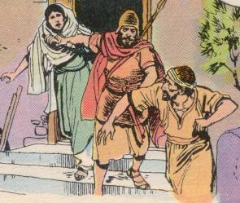
Asa turns to Evil
Anger drove him to imprison Hanani (10)
Did not accept God’s rebuke – blamed Hanani
Oppressed other people
Could not accept rebuke for his mistakes
God understands that “we all make many mistakes” (James 3:2 RSV), but He expects us to learn from them, repent of our sin, and treat others kindly.

Slide 21
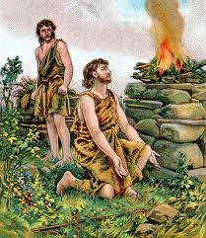
How could Abel “fix” the problem?
He probably couldn’t
Same problem Joseph later ran into with his brothers
Continue to be kind, gracious, helpful and keep the door open!
This was Cain’s problem – not Abel’s!
Pray for one another
Don’t let issues like this ruin your effectiveness in family & ecclesial life. Let God work in the situation!

Slide 22


Choices for us:
Which one will we make when things go wrong?
1) Get angry and be unkind. Get jealous of others who make good choices. Decide “it’s not fair”.
2) Admit mistakes. Look for God’s influence and respond with kindness. Look for the lesson God wants us to learn. Appreciate the good in one another that God develops.
But the fruit of the Spirit is love, joy, peace, longsuffering, kindness, goodness, faithfulness, gentleness, self-control. Against such there is no law. (Gal 5:22-23)

Slide 23
Genesis 4:6-7
God tried to work with Cain!
6 So the LORD said to Cain, "Why are you angry? And why has your countenance fallen?
7 "If you do well, will you not be accepted? And if you do not do well, sin lies at the door. And its desire is for you, but you should rule over it.” (the war with sin!)
God wanted to extend mercy to Cain, but Cain failed to join God in the war against Sin

Slide 24
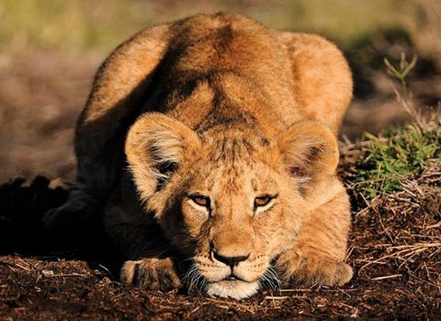
Sin is couching at the door.
It’s desire is for you!
But you must master it!
This is the 1st personification of “Sin”

Slide 25

We tend to pick the easy battles
Genesis 3:16
Your desire shall be for your husband, and he shall rule over you.
Genesis 4:7
And if you do not do well, sin lies at the door. And its desire is for you, but you should rule over it.
Many men like to quote “he shall rule over you” to their wives, but fail to rise to God’s challenge that “its (Sin’s) desire is for you, but you should rule over it.“ [you must master it (NASB)]

Slide 26
Romans 6:12-14
12 Therefore do not let sin reign in your mortal body, that you should obey it in its lusts.
13 And do not present your members as instruments of unrighteousness to sin, but present yourselves to God as being alive from the dead, and your members as instruments of righteousness to God.
14 For sin shall not have dominion over you, for you are not under law but under grace.
If husbands (boys) spent more time fighting this war, their relationships with wives (girls) would bond and strengthen as God’s power changes their lives

Slide 27
1 John 3:10-12
10 In this the children of God and the children of the devil are manifest: Whoever does not practice righteousness is not of God, nor is he who does not love his brother.
11 For this is the message that you heard from the beginning, that we should love one another,
12 not as Cain who was of the wicked one and murdered his brother. And why did he murder him? Because his works were evil and his brother's righteous.
We must “practice righteousness” every day. This means loving God’s family, laying down our lives for them, and forgiving their mistakes against us.

Slide 28
Lessons from Cain & Abel
Faith demands we live God’s way
Sin would like to devour us – We must use God’s power to rule it
Make good choices that will help us to grow
Our attitude towards others must be one of love & forgiveness
Holding on to hatred & envy will ruin our lives and can lead to major sins

Slide 29
Genesis 6:5-6
Noah: Saved his Household
5 Then the LORD saw that the wickedness of man was great in the earth, and that every intent of the thoughts of his heart was only evil continually.
6 And the LORD was sorry that He had made man on the earth, and He was grieved in His heart.
7 So the LORD said, "I will destroy man whom I have created from the face of the earth, both man and beast, creeping thing and birds of the air, for I am sorry that I have made them."
8 But Noah found grace in the eyes of the LORD.
Noah found grace because he loved God’s ways

Slide 30
Luke 17:26-30
26 And as it was in the days of Noah, so it will be also in the days of the Son of Man:
27 They ate, they drank, they married wives, they were given in marriage, until the day that Noah entered the ark, and the flood came and destroyed them all.
28 Likewise as it was also in the days of Lot: They ate, they drank, they bought, they sold, they planted, they built;
29 but on the day that Lot went out of Sodom it rained fire and brimstone from heaven and destroyed them all.
30 Even so will it be in the day when the Son of Man is revealed.
People were too busy for God

Slide 31
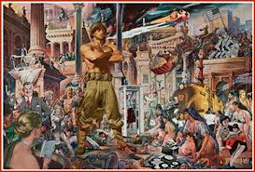
What was it like?
Immoral (6:1, 11-12)
Violence (6:11; 9:6)
Extremely corrupt – like today!
Too busy for God (Luke 17)
Ezekiel 14:14 Even if these three men, Noah, Daniel, and Job, were in it, they would deliver only themselves by their righteousness, says the Lord GOD.
So how did God bring a faithful family through all this corruption?

Slide 32
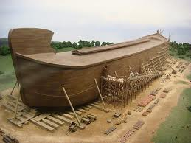
A Family Witness Project
Genesis 6:13-14
13 And God said to Noah, "The end of all flesh has come before Me, for the earth is filled with violence through them; and behold, I will destroy them with the earth.
14 "Make yourself an ark of gopherwood; make rooms in the ark, and cover it inside and outside with pitch.
Noah didn’t make any new converts, but his obedience did save his household. Don’t judge your witnessing projects by the number of converts from the world!

Slide 33

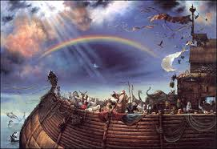


Projects must start with committed Parents
Noah had a living faith – drove him to be involved. Led by example.
“only Noah and those who were with him” (7:23)
God saved 4 human couples (even the animals came 2 by 2)
God saves families for the sake of committed parents
Parents must lead by example – Bible readings, building up your ecclesia, witnessing, visiting sick, doing for others, acknowledging the work of God in your lives!

Slide 34
Lessons from Noah
Continue strong in faith, even in the midst of a corrupt generation
Get the family involved in ecclesial projects – Lot could have learned a bunch from Noah!
Make time for God! Don’t let this world eat up all your time.
The son of man is coming at an hour you do not expect, so be ready at all times!
Get in the ark before the door closes!

Slide 35
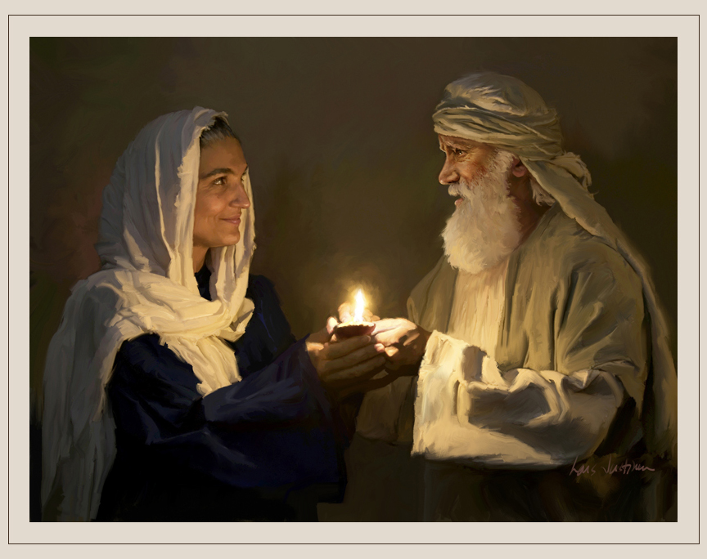
Next Class
We’ll look at lessons from Abraham & Sarah – the parents of the faithful

